Slide 1
Introduction to the LHCb detector
Paula Collins,
CERN

Slide 2
Brief tour of the LHCb experiment
Focus on
  RICH system
  Silicon Vertex Detector
LHCb upgrade in preparation
Talk partly stolen from Vladimir Gligorov, Monica Pepe-Altarelli, Guy Wilkinson,

Slide 3
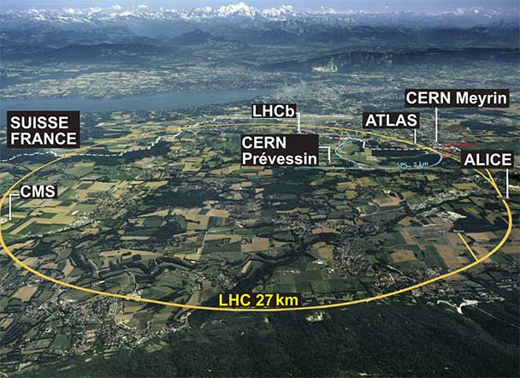
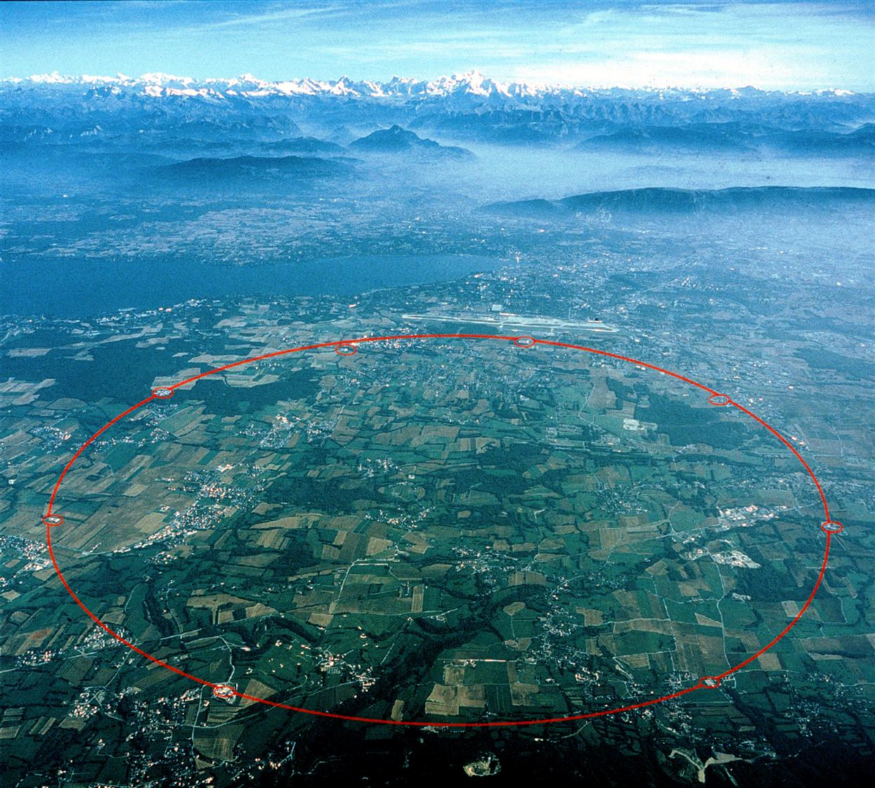
L’expérience LHCb

Slide 4
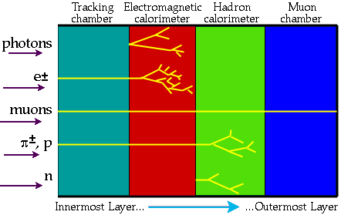
How to measure and identify particles?
Ideally we would like to measure the position, charge, speed, mass and energy of all particles produced in the collisions.
The particle detector is made up of several layers which all play a role in particle detection
Notes:
There is not enough visible mass in rotating spiral galaxies to hold them together
4

Slide 5
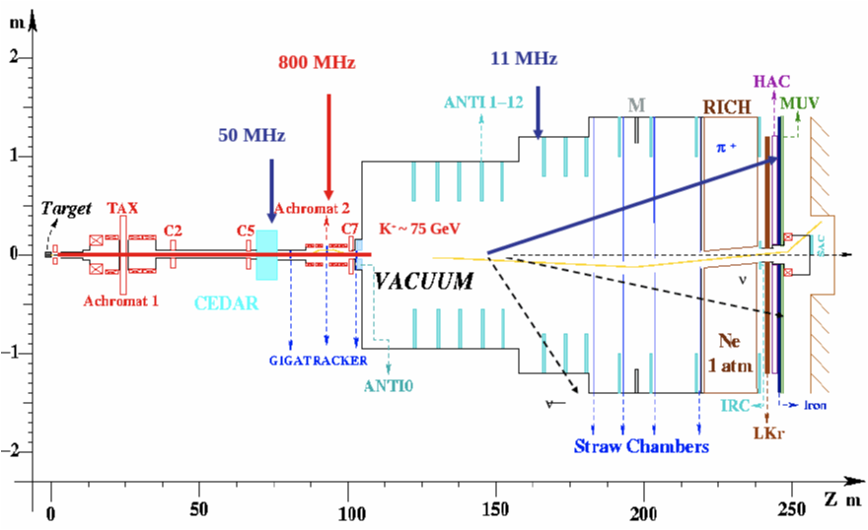
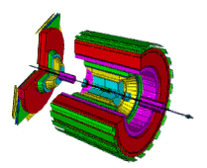

Traditionally colliding beam
experiments have this kind of layout
while fixed target experiments have
a forward geometry
Particle production roughly constant in units of rapidity

Slide 6
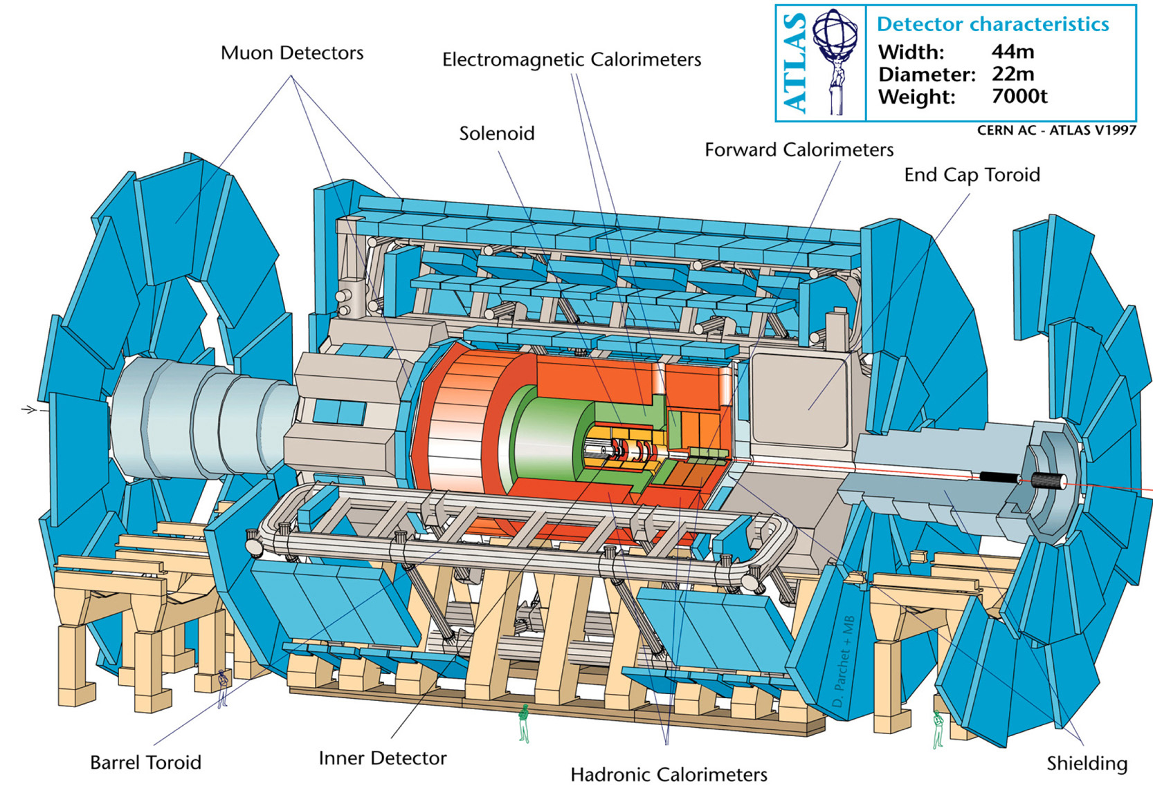

Slide 7
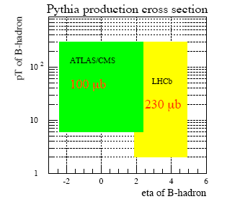
Angular distribution of b and b quarks
forward (backward) and correlated

Slide 8
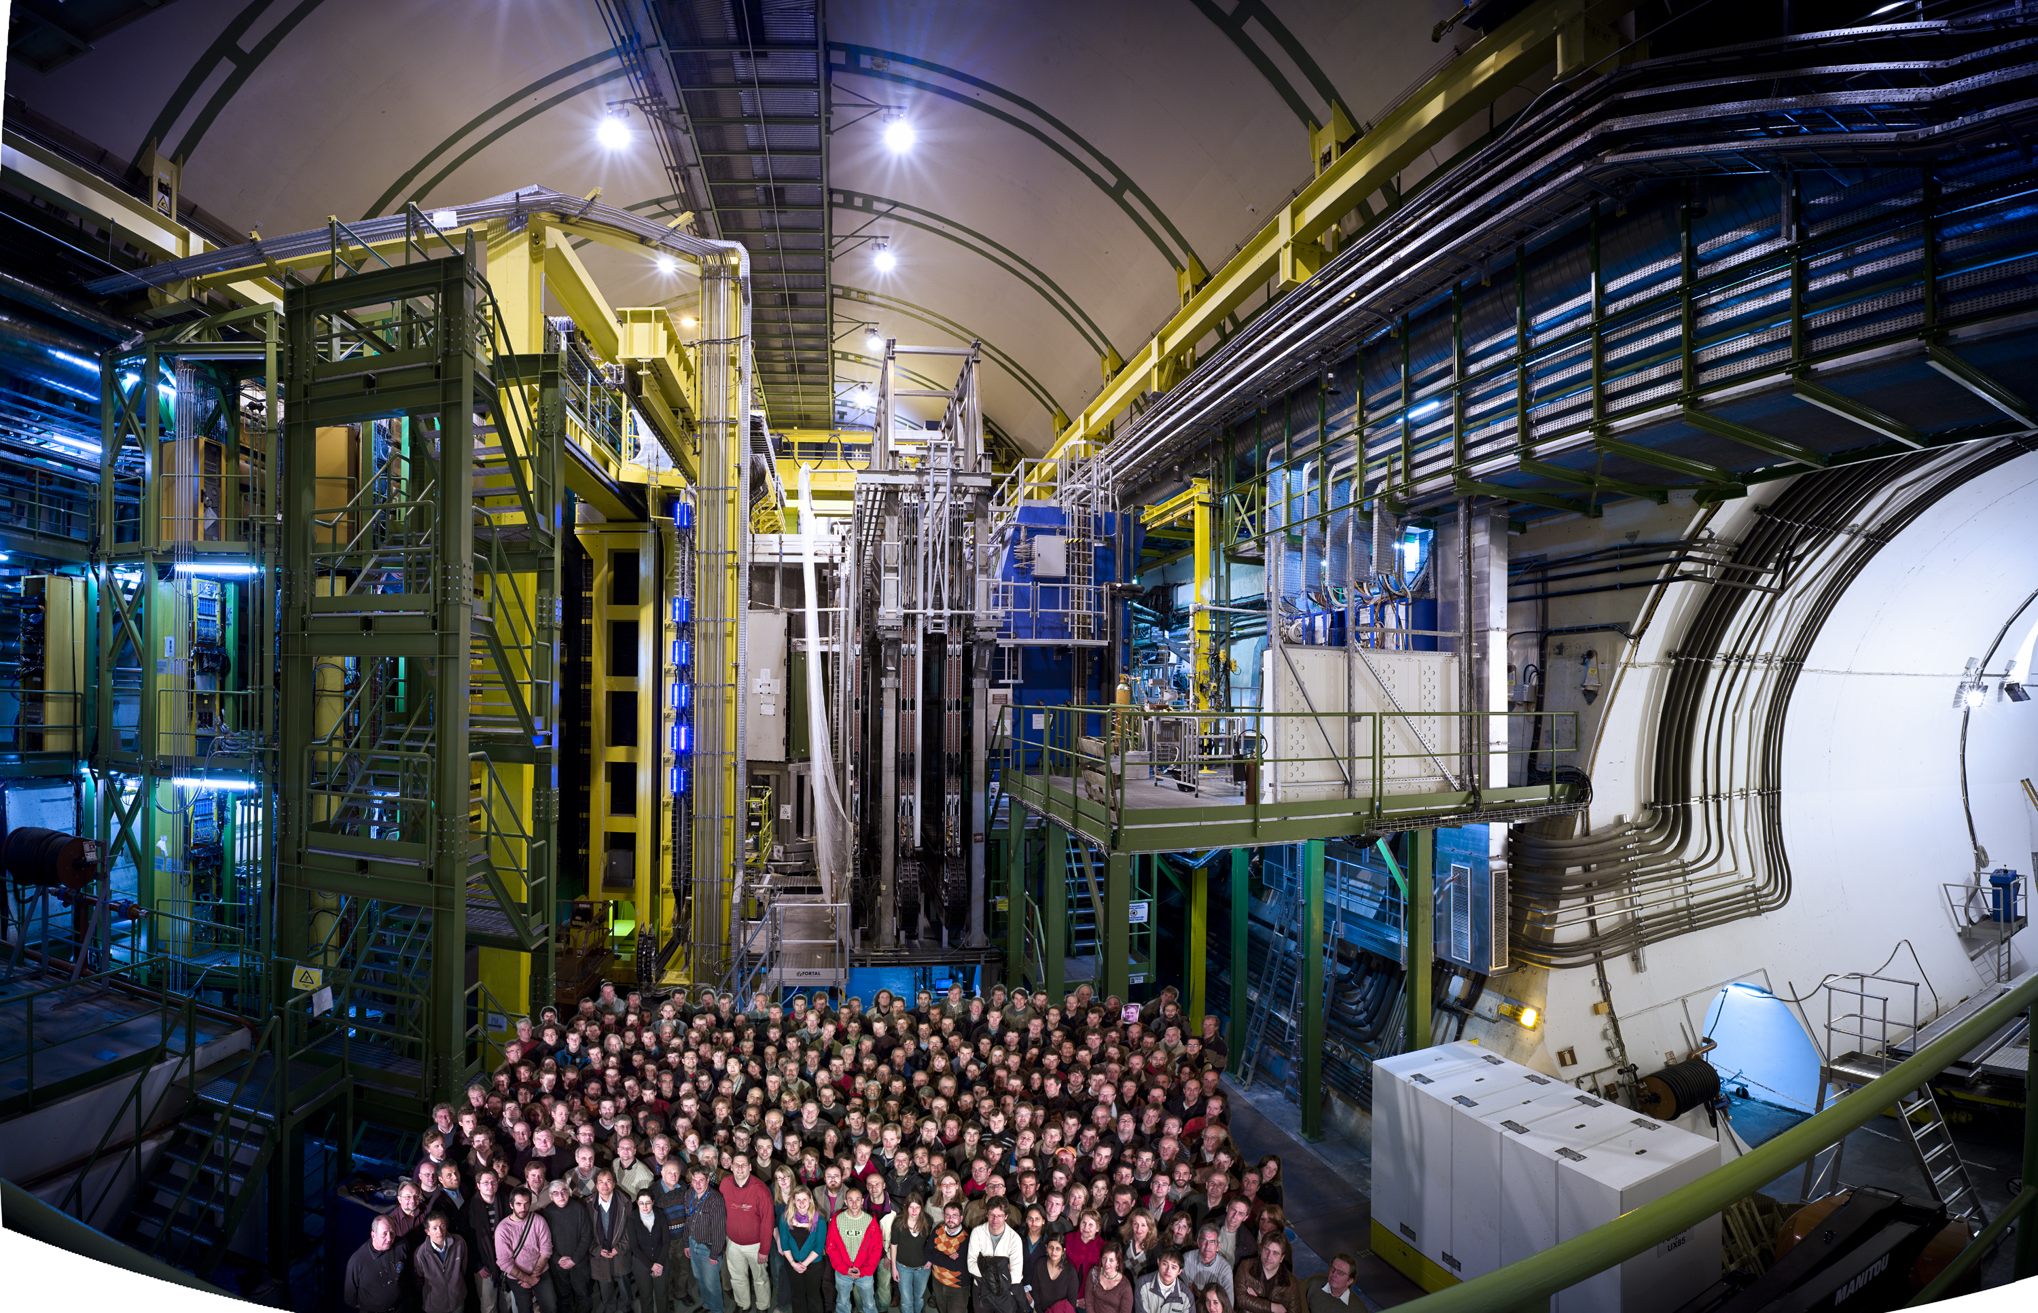
LHCb
700 members
52 institutes
15 countries
1100 members
52 institutes
15 countries
Notes:
Fundamental research (pursuit of knowledge, not making money)
Pooling resources (money and intellectual)
training

Slide 9
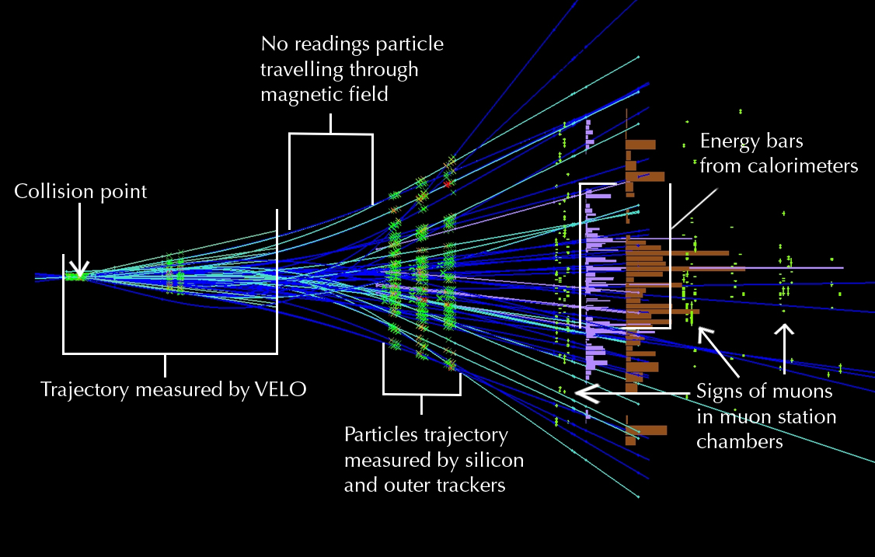
How to measure and identify particles?
Pour chaque collision, l’objectif du physicien est de caractériser toutes les différentes particules produites.
La trace laissée par la particule fournit de nombreuses informations utiles, surtout si le détecteur est placé dans un champ magnétique : la charge de la particule, par exemple, est clairement détectable, puisque les particules à charge électrique positive sont déviées dans un certain sens et celles à charge négative dans le sens opposé.
De même, il est possible de déterminer l’impulsion de la particule (la « quantité de mouvement » égale au produit de la masse par la vitesse) : les particules à impulsion élevée se propagent en ligne presque droite, tandis que les particules à faible impulsion décrivent des spirales serrées.
Notes:
There is not enough visible mass in rotating spiral galaxies to hold them together
9

Slide 10
Detector Requirements
Key features:
  Highly efficient trigger for both hadronic and leptonic final states to enable high statistics data collection
  Vertexing for secondary vertex identification
  Mass resolution to reduce background
  Particle identification
Example: B_{s} → D_{s} K
K⁺
Mass + pointing constraints to
reduce background
K⁺
B_{s}
K⁻
D_{s}
Good K/π separation
Primary vertex
π⁻
b^{t}
Good primary + secondary vertexing to measure proper time
Flavour Tagging

Slide 11
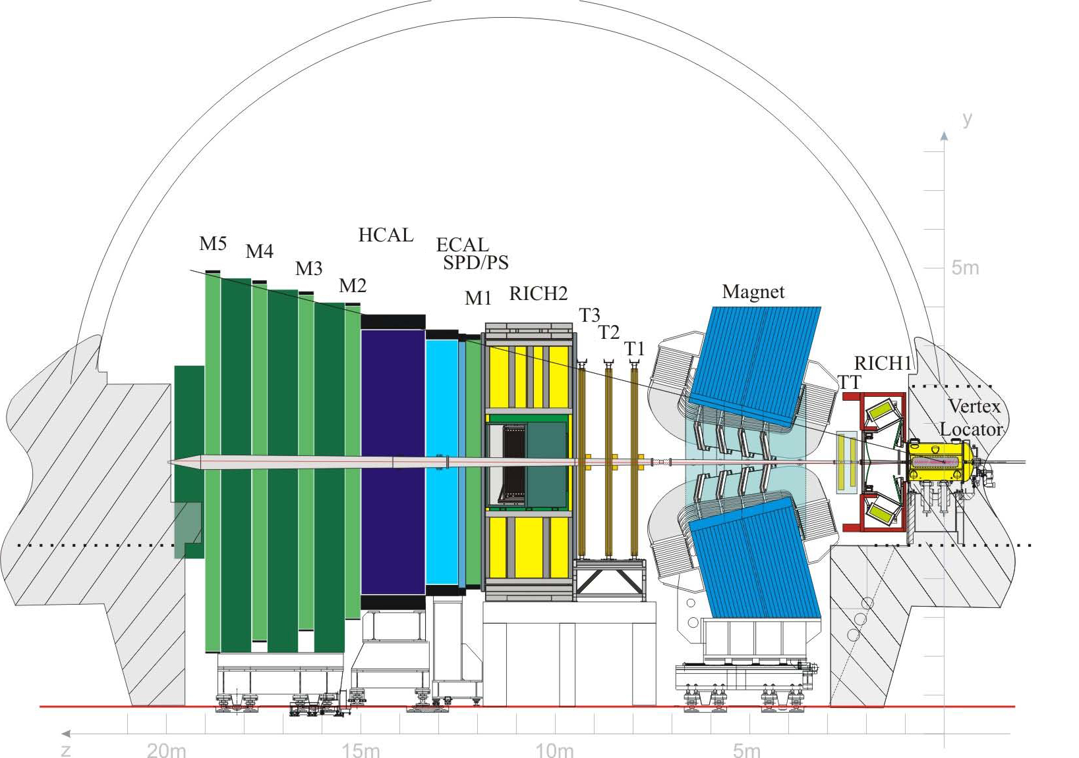
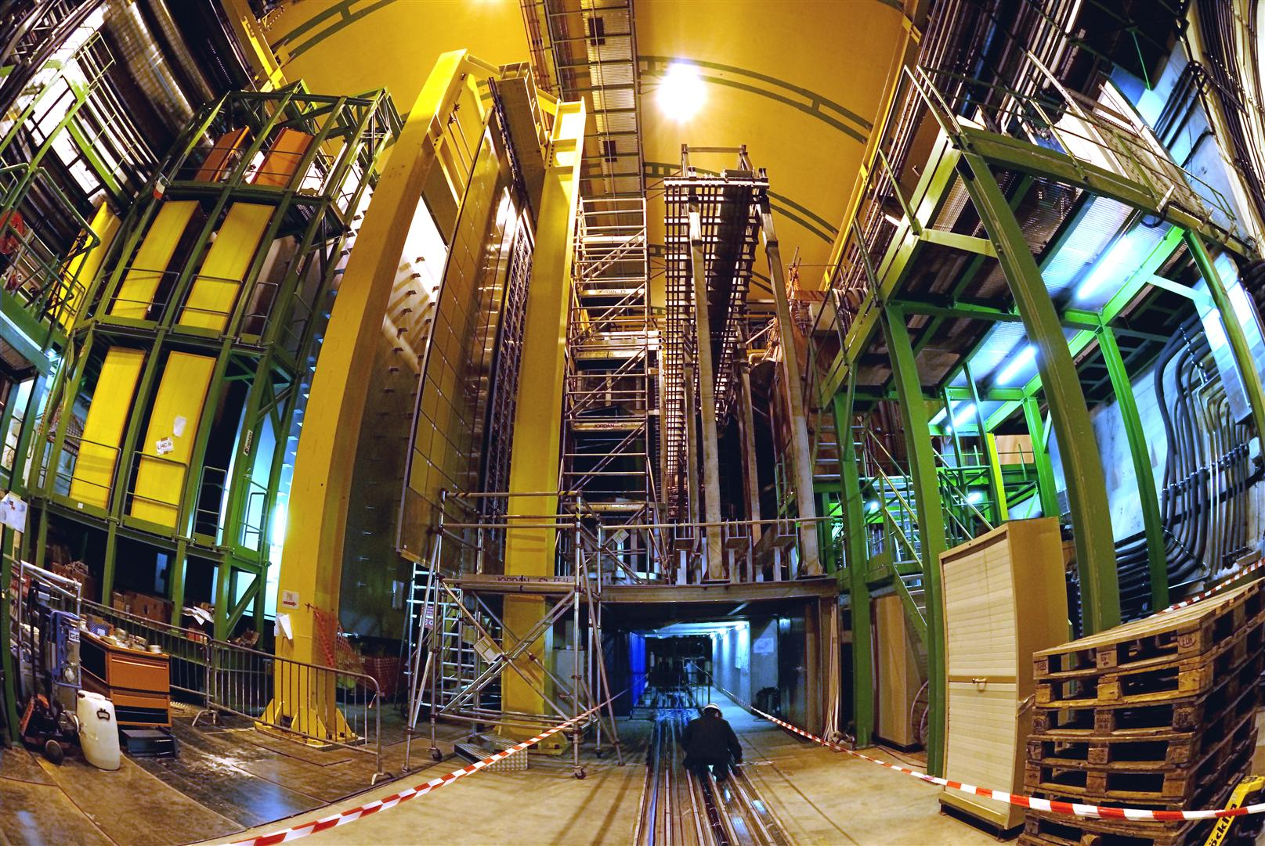
Notes:
11

Slide 12

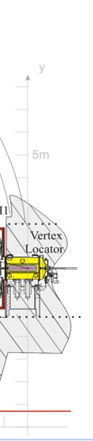
VErtex LOcator
Notes:
12

Slide 13
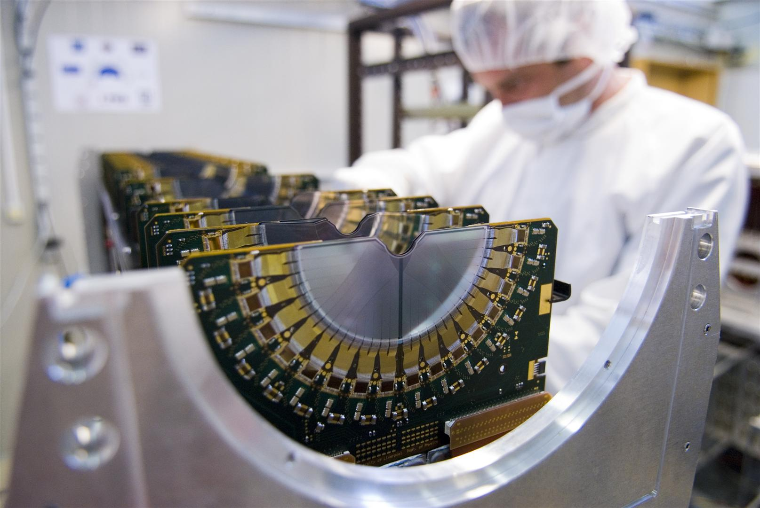
Notes:
13

Slide 14
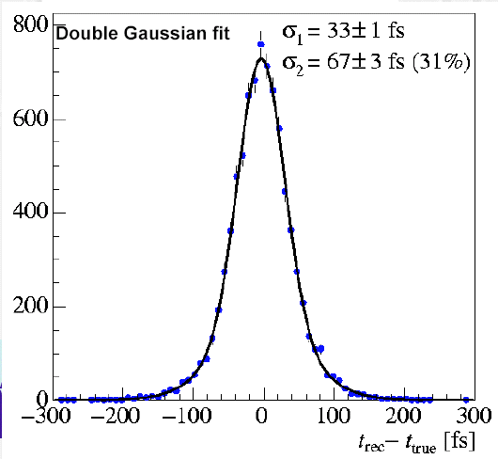
Vertex Locator (Velo)
21 stations of silicon strip detectors (r-φ)
~ 4 μm hit resolution
Trigger on large IP tracks
Measurement of decay distance (time)
Example: B_{s} → D_{s} K
σ(t) ~40 fs
47 μm
144 μm
K⁺
B_{s}
K⁺
D_{s}
K⁻
Primary vertex
π⁻
d~1cm
440 μm
Notes:
14

Slide 15


Cherenkov Detectors
Notes:
15

Slide 16
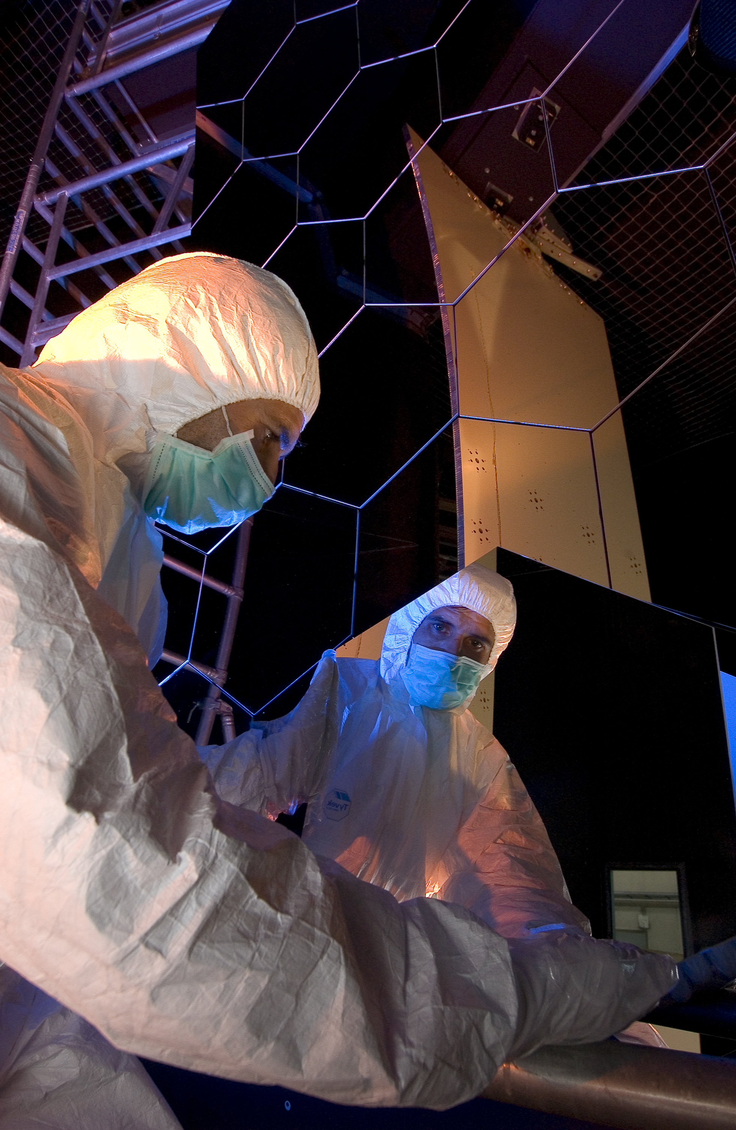
Cherenkov Detectors
Notes:
16

Slide 17
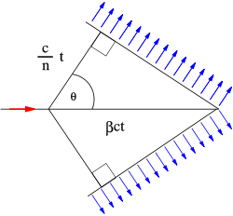
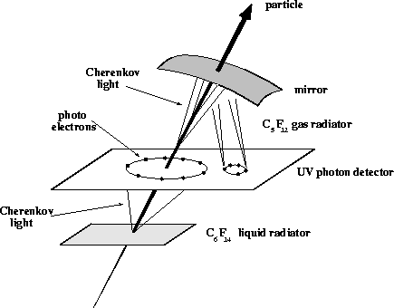
Cherenkov light
    Radiation produced when a charged particle travels faster than the speed of light in the medium it is passing through (βc >c/n, with n=refractive index)
    Light produced in a cone with cosθ_{c}=1/βn can be detected as a ring image
    By measuring θ_{c} (∝ radius of ring)
    the velocity β of the particle is found
    Then with knowledge of its momentum
    the mass of the particle can be found

Slide 18
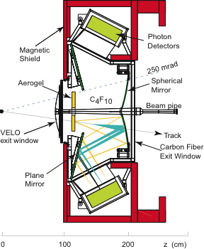
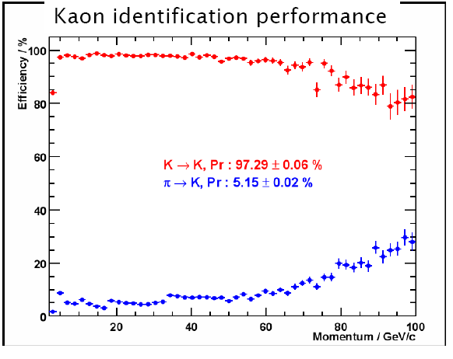
Cherenkov Detectors
B_{s} → D_{s} K
π⁺,K⁺
B_{s}
K⁺
D_{s}
K⁻
K→K : 96.77 ± 0.06%
π→K : 3.94 ± 0.02%
π⁻
Primary vertex
b^{tag}

Notes:
18

Slide 19

Tracking detectors
Notes:
19

Slide 20
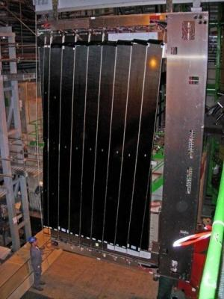
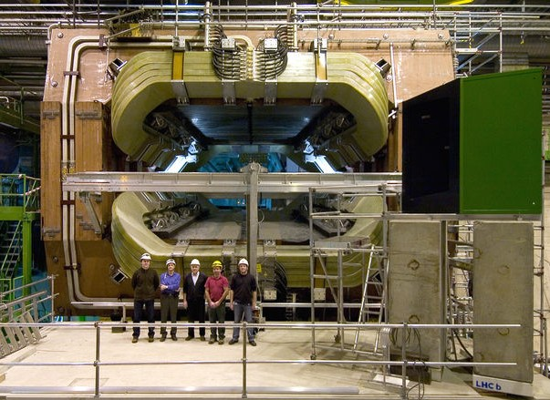
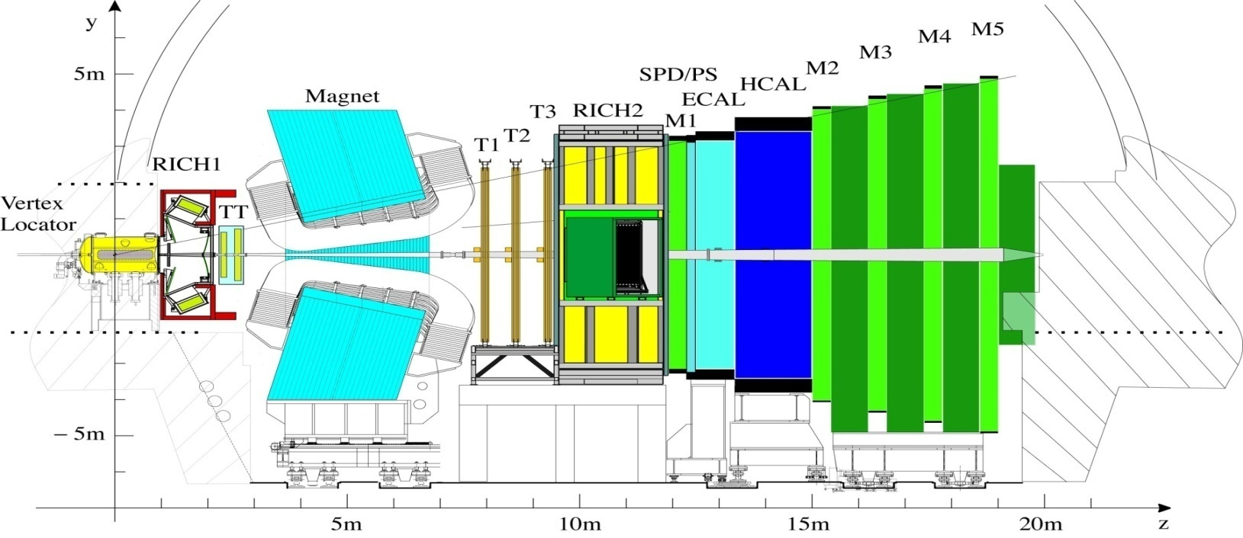
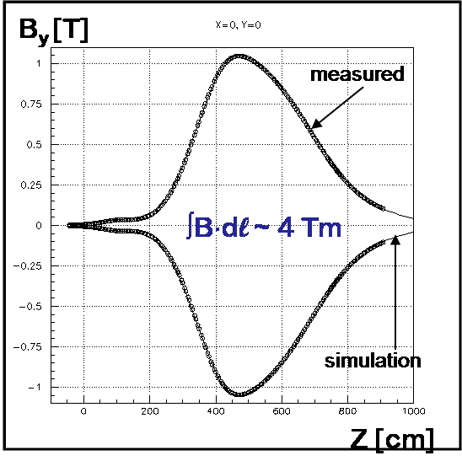
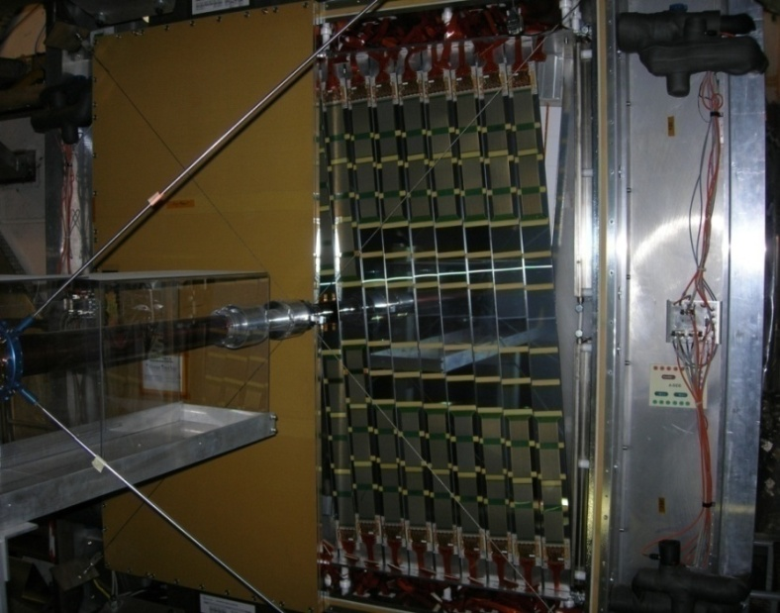
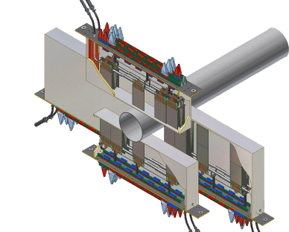
Momentum measurement
Outer
Tracker
24 layer
Straws
σ_{hit}~200μm
σ_{p}/p~0.5%
Trigger
Tracker
Inner
Tracker
4 layers Si:
~200 μm pitch
Notes:
20

Slide 21
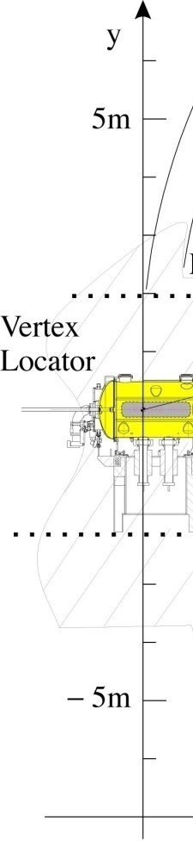
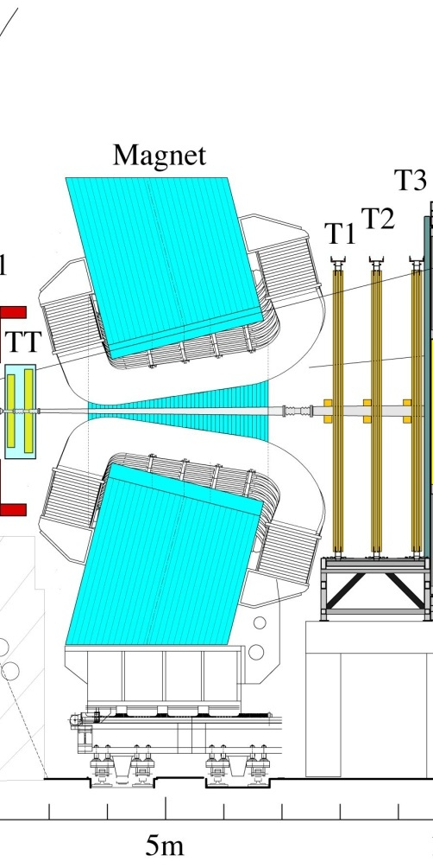
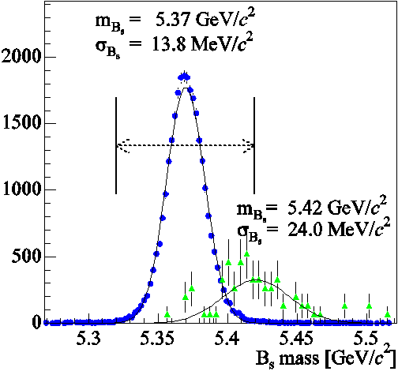
Momentum measurement
Outer
Tracker
24 layer
Straws
σ_{hit}~200μm
σ_{p}/p~0.5%
Mass resolution
σ ~14 MeV
Bs→ Ds K
Bs →Ds π
π⁺, K⁺
B_{s}
K⁺
D_{s}
K⁻
π⁻
Primary vertex
b^{tag}
Trigger
Tracker

Inner
Tracker
4 layers Si:
~200 μm pitch
Notes:
21

Slide 22

Calorimeters
Notes:
22

Slide 23

Muon Detectors
Notes:
23

Slide 24
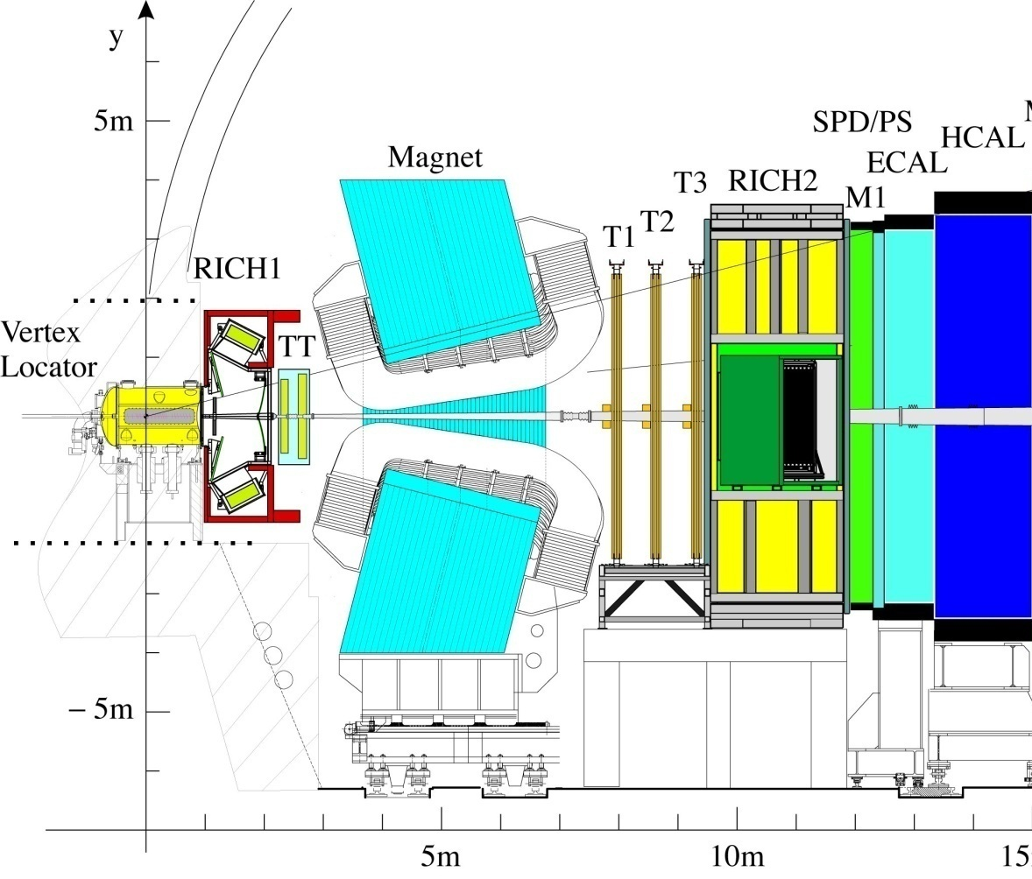
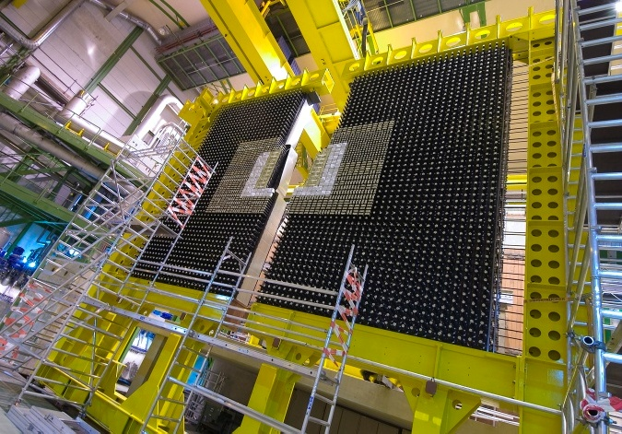

Particle identification and L0 trigger
e
h
ECAL (inner modules): σ(E)/E ~ 8.2% /√E + 0.9%
Calorimeter system :
Level 0 trigger: high E_{T} electron and hadron
Identify electrons, hadrons, π⁰ ,γ
K⁺
B_{s}
K⁺
D_{s}
K⁻
Primary vertex
b^{tag}
π⁻

Slide 25
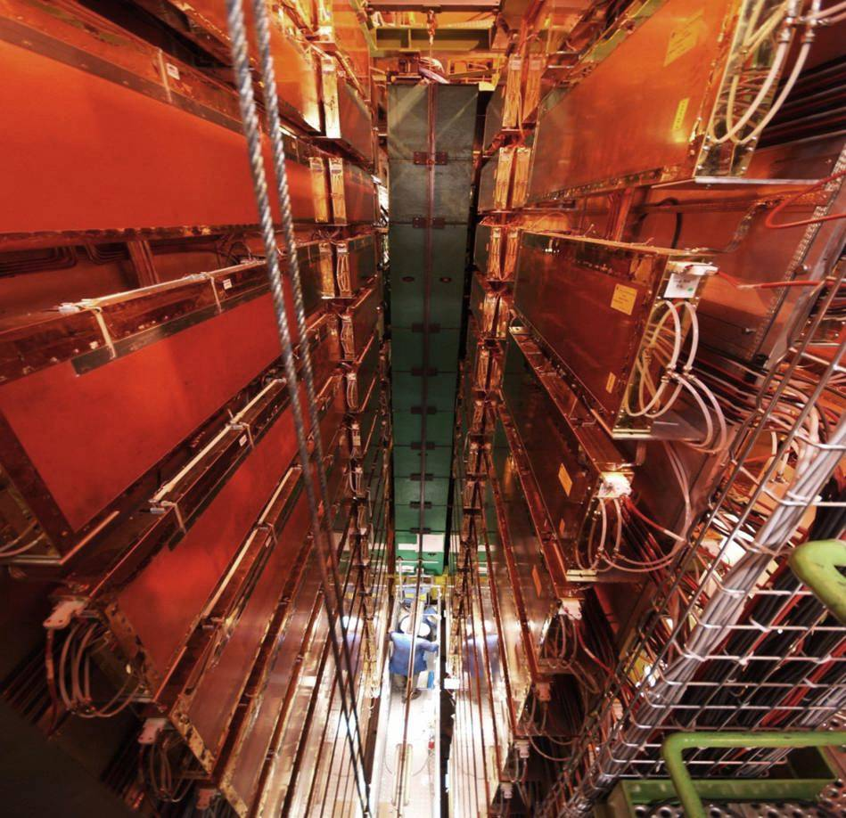
Particle identification and L0 trigger
Multi Wire Proportional Chambers (MWPC)
μ
Muon system:
Level 0 trigger: High P_{t} muons
Identify muon (also important for flavour tagging)
K⁺
B_{s}
K⁺
D_{s}
K⁻
Primary vertex
b^{tag}
π⁻

Slide 26
LHCb Trigger
Trigger is crucial as σ_{bb} is less than 1% of total inelastic cross section and B decays of interest typically have BR < 10⁻⁵
b hadrons are long-lived →
  well separated primary and secondary vertices
have a ~large mass→
  decay products with large p_{T}
Notes:
Check trigger efficiencies

Slide 27
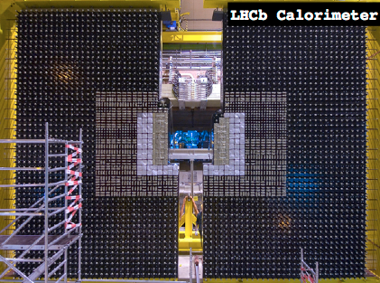
LHCb trigger
The tracking and particle ID systems of the detector can only be read out at
1 MHz : must therefore start with Calorimeter/Muon based hardware trigger

Slide 28
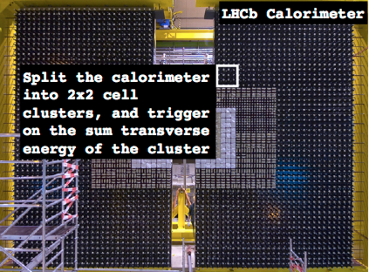
LHCb trigger
The tracking and particle ID systems of the detector can only be read out at
1 MHz : must therefore start with Calorimeter/Muon based hardware trigger

Slide 29
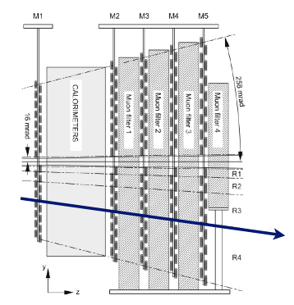
LHCb trigger
The tracking and particle ID systems of the detector can only be read out at
1 MHz : must therefore start with Calorimeter/Muon based hardware trigger
For muons search for a track in all 5 muon system stations
(also momentum estimate from first two stations)
Trigger limitation comes from ability of front-end boards to collect and process information in time

Slide 30
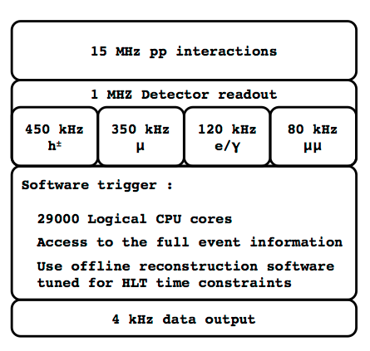
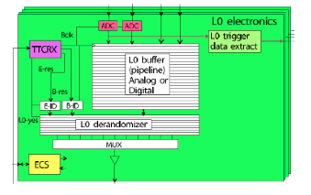
Trigger Latency
Maximum latency of L0 trigger is 4 μs
Half of this is time for particles to travel to the detector, and their signals to travel throught the cables in the readout system – the other half the time needed to make a decision
Need to be able to process 80 events in parallel
  Muon(s) with high transverse momentum
  Hadrons with high transverse energy etc..
20-30 ms

Slide 31
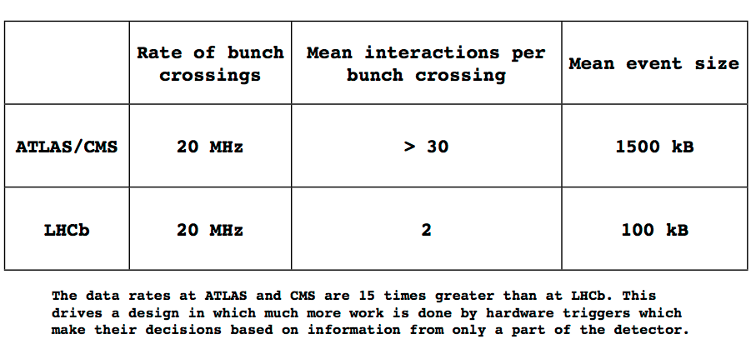
ATLAS/CMS triggers vs LHCb

Slide 32
Focus on RICH

Slide 33


Cherenkov Radiation in a Nutshell
Fundamental Cherenkov relation:
Both a threshold
and thereafter, an
angular dependence
up to saturation (cosθ=1)
Frank-Tamm relation:
So number of photons will also increase with velocity (up to saturation)
Notes:
when the speed is above threshold emits photons at a characteristic angle which changes with beta

Slide 34
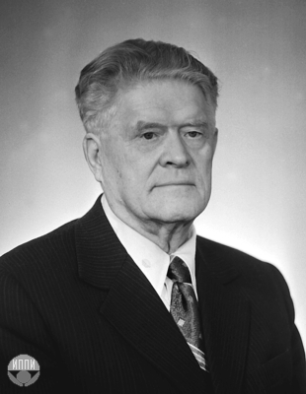
History of Cherenkov Radiation
Prediction of Cherenkov radiation: Heaviside 1888
Discovery (by accident) : Pavel Cherenkov 1936
Radiation seen when uranyl salts
exposed to radium source.
Sergey Vavilov was Cherenkov’s
supervisor, and hence Russians
refer to Vavilov-Cherenkov radiation
Explanation: Tamm and Frank 1937
Experimental exploitation in HEP
pioneered by Cherenkov himself
Cherenkov: 1905-1990
(Cherenkov, Tamm, Frank: Nobel Prize 1958)

Slide 35
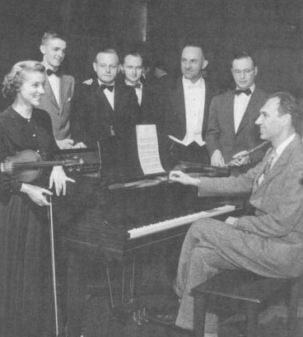
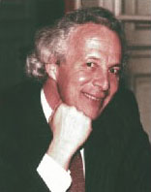
Fathers of the RICH
Cherenkov :
1936 – discovery
Arthur Roberts: 1960 - first
to propose exploiting ☺_{c}
Tom Ypsilantis: 1977- driving
force behind practical RICH
1905-1990
1912-1994
1928-2000

Slide 36
What is a RICH ?
Measurement of cosθ from RICH, together
with p, from tracking system, allow
mass, and hence PID to be determined.
This is an excellent way of separating cosθ from kaons and protons
The simplest way to exploit Cherenkov radiation is to choose n such
that heavy particles do not emit light. This works OK if p range narrow.
→Cherenkov counter (not a RICH!)
But if we want to do better, or if momentum is far from monochromatic,
then we need to measure cosθ_{C} . We have to image the ring. This is a RICH!

Slide 37
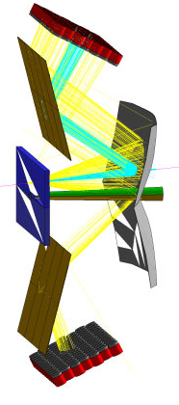
LHCb RICH 1: a two-in-one detector
Spherical Mirror, tilted at 0.3
rad to keep photodetectors
outside acceptance
Aerogel
Gas volume
Flat Mirror
Photodetectors, enclosed
in magnetic shielding box
(not shown) to protect vs
fringe field of dipole magnet

Slide 38
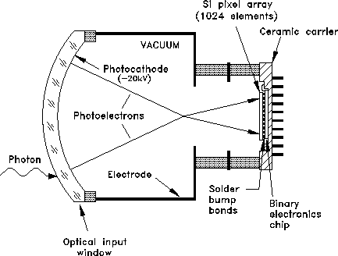
Hybrid Photo-Diodes (HPDs)
What kind of photodetector do
we need for high performance
PID at the LHCb? Requirements:
Solution – the HPD:
Good single photon
efficiency
Sensitivity in visible
Capacity to cover large
area (several m²)
Good spatial resolution
(order mm²)
High rate capabilities

Slide 39
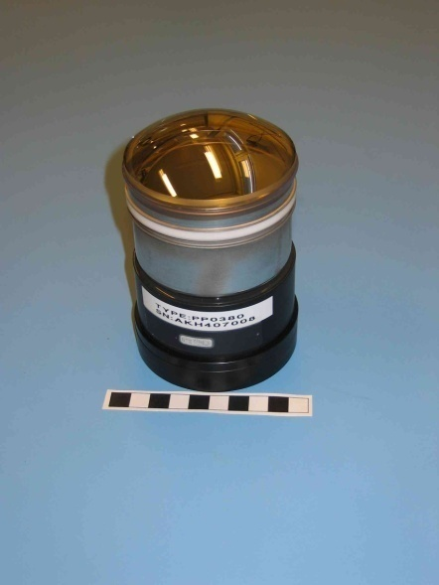
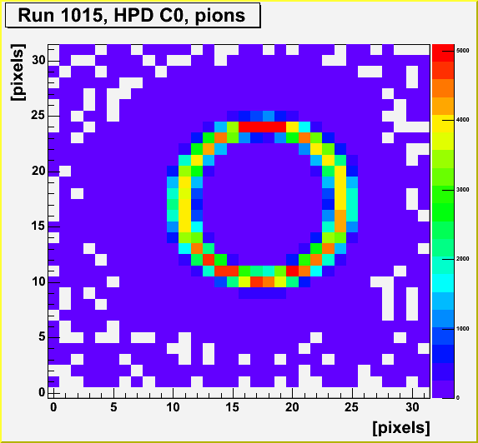
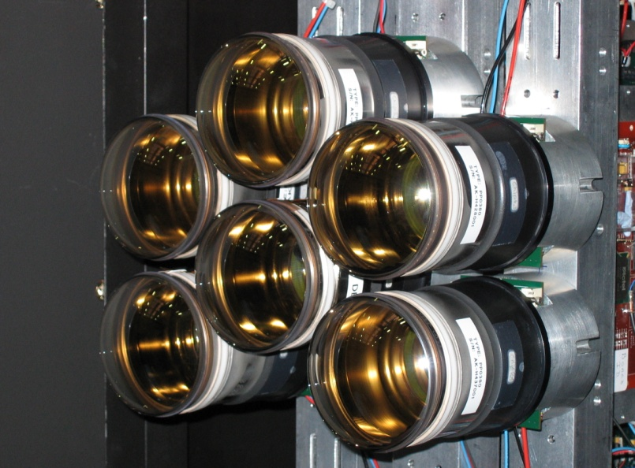
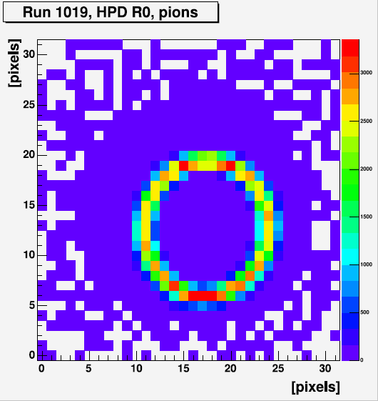
HPDs and Testbeam Results

Slide 40
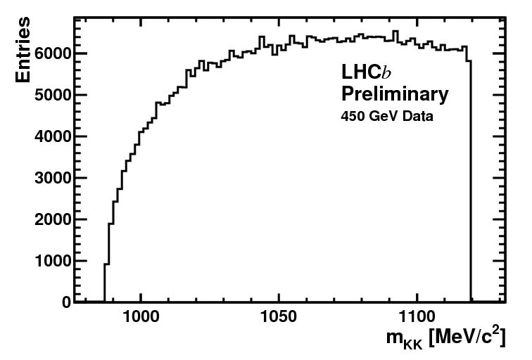
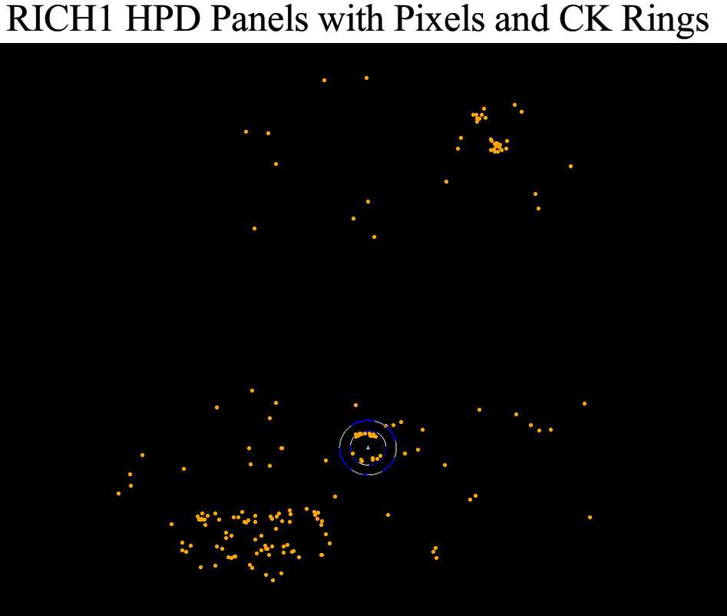
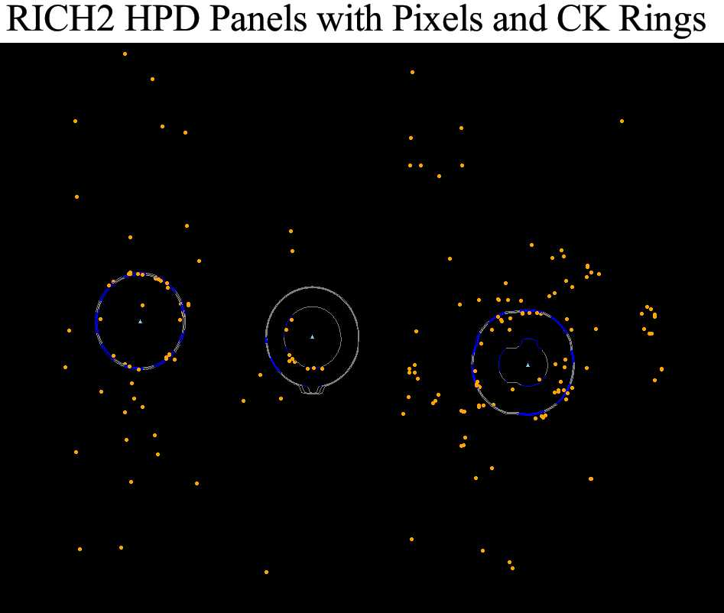
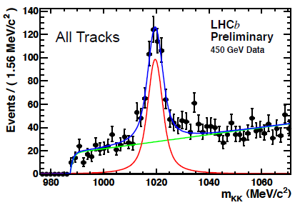

LHCb RICH already performed well
with very first (2009) collision data
LHCb data
(preliminary)
RICH 1
Kaon ring
Φ → KK ?
No PID
LHCb data
(preliminary)
RICH 2
with PID
Kaon ring
Φ → KK !

Slide 41

Reconstructed Cherenkov angle vs momentum

Slide 42

A performance plot

Slide 43






LHCb RICH: performance on ‘B→hh’
Two-body charmless B decays are central goal of LHCb physics. Significant
contribution of Penguin diagrams provides entry point for New Physics
RICH needed to dig out contributing modes !
LHCb preliminary
B⁰→Kπ
Inclusive spectrum,
ππ hypothesis
Deploy
RICH to
isolate
each
mode !
B⁰→ππ
Λ_{b}→pπ
Λ_{b}→pK
B_{s}→KK
+
-

Slide 44
Focus on VELO

Slide 45



VELO: Current Design
2 retractable detector halves:
  7 (37) mm from beam when closed (open)
21 stations per half with an R and φ sensor
Operated in secondary vacuum
300μm Al foil separates detector from beam vacuum
Bi-phase CO₂ cooling system
Cooling manifold
Base
21 +2 modules
Kapton cables
RF foil
45
45
Notes:
45

Slide 46


VELO sensors
silicon edge just 7 mm from beam!
300 μm n in n strip sensors (Micron Semiconductor)
Double metal layer for signal routing
512
strips
512
strips
1385 outer
strips
683 inner
strips
512
strips
512
strips
Ф measuring sensors:
2 regions
Short/long strips
Pitch=36-97μm
Stereo angle.
R measuring sensors:
45º quadrants
Pitch=40-102μm
46
46
Notes:
46

Slide 47

Silicon very popular in HEP

Slide 48






Large Systems
DELPHI 1990
DELPHI 1994
DELPHI 1996
CMS 2007
÷ 2 !
CDF 2001

Slide 49
Silicon sensors for HEP
amplifier
Start with high resistivity silicon
More elaborate ideas:
n+ side strips – 2d readout
Integrate routing lines on detector
Floating strips for precision
make radiation hard
Al strip
p⁺
+
+
SiO₂/Si₃N₄
-
-
+
+
n bulk
n⁺
-
+ Vbias
Hybrid Pixel sensors
Chip (low resistivity silicon)
bump bonded to sensor
Floating pixels for precision
chip
chip
n⁺
p
n⁺
chip
DEPFET:
Fully depleted sensor
with integrated preamp
chip
CCD: charge collected in thin layer
and transferred through silicon
MAPS: standard CMOS wafer
Integrates all functions

Slide 50

Basic Principles (1)
The probability of an electron jumping from the valence band to the conduction band is proportional to
-E_{g}
e
kT
where E_{g,} the band gap energy is about 1.1 eV and kT=1/40 eV at room temperature
Next step is to dope the silicon with impurities
Phosphorus doping: electrons are majority carriers
Boron doping: holes are majority carriers
Some numbers:
Intrinsic carriers: 10¹⁰cm⁻³
Doping concentration: 10¹²cm⁻³
Silicon Density: 5 x 10²³cm⁻³

Slide 51


Basic Principles (2)
Now we can construct a p-n junction
p
–
⊕
+
⊕
–
⊕
n
+
+
+
+
+
+
–
–
–
+
⊕
⊕
+
+
+
+
+
+
+
–
–
–
+
–

Slide 52

Basic Principles (3)
Now for the magic part!
p
n
–
⊕
⊕
–
⊕
⊕
+
+
+
+
+
+
–
–
–
+
⊕
+
⊕
⊕
–
+
+
+
+
+
+
–
–
–
When brought together to form a junction, the majority diffuse carriers across the junction. The migration leaves a region of net charge of opposite sign on each side, called the space-charge region or depletion region. The electric field set up in the region prevents further migration of carriers.
Dopant
concentration
Space charge
density
Carrier
density
Electric
field
Electric
potential

Slide 53


Basic Principles (4)
The depleted part is very nice, but very small
Apply a reverse bias to extend it
Electron-hole pairs created by the traversing particles drift in the electric field
V_{d} = d² / (2ερμ)

Slide 54
Basic Principles (5)
By segmenting the implant we can reconstruct the position of the traversing particle in one dimension
p side
implants
+
x
+
-
Typical values used are
pitch : 20 μm – 150 μm
bulk thickness: 150 μm – 500 μm
+
-
-

Slide 55

Double Metal Technology

Slide 56

Challenging, but elegant

Slide 57
Irradiation –
LHCb VELO most irradiated silicon so far at LHC
Good testing ground for future upgrades
Change of depletion/operation voltage
  Due to defect levels that are charged in the depleted region -> time and temperature dependent, and very problematic!
Increase of leakage current
  Bulk current due to generation/recombination levels
Damage induced trapping centers
  Decrease in collected signal charge

Slide 58



Irradiation: strips for LHCb
High and strongly non uniform irradiation
We expect the classic bulk damage effects
LHCb vertex detector
Increased Leakage Current
  Noise
  Hard to bias
10¹⁴
Depletion voltage [V]
Effective Doping Changes
  Depletion growing from n⁺ side
n_{eq}/cm² per year
10¹³
Fluence
Annealing effects
  Buildup of negative space charge worsening in time
  Strongly temperature dependent
radius [cm]

Slide 59

Changes in depletion voltage

Slide 60

LHCb textbook

Slide 61





LHCb – new textbook
R sensors are showing inefficiencies at the outer parts which are inversely dependent on HV
Landau shapes of R sensors are deteriorating
φ
R
LHCb VELO Preliminary
LHCb VELO Preliminary
LHCb VELO Preliminary
LHCb VELO Preliminary
LHCb VELO Preliminary
Before irradiation
After irradiation

Slide 62

LHCb and VELO Upgrade
Current detector

Slide 63
Upgrade overview
All sub-detectors read out at
40 MHz for software trigger
Current detector → upgraded detector
SciFi
Pixel
VELO
UT

Slide 64
Upgrade overview
All sub-detectors read out at
40 MHz for software trigger
Current detector → upgraded detector
SciFi
Pixel
VELO
UT
Replacement of
full tracking system

Slide 65
Upgrade overview
All sub-detectors read out at
40 MHz for software trigger
Current detector → upgraded detector
RICH 1 redesigned; new photodetectors
installed for RICH 1 and RICH 2
SciFi
Pixel
VELO
UT
Replacement of
full tracking system

Slide 66
Upgrade overview
All sub-detectors read out at
40 MHz for software trigger
Current detector → upgraded detector
RICH 1 redesigned; new photodetectors
installed for RICH 1 and RICH 2
SciFi
Pixel
VELO
UT
Replacement of
full tracking system
Calorimetery and muons:
Redundant components of system removed;
new electronics added; more shielding included

Slide 67


Challenges for VELO Upgrade
40 MHz readout (electronics)
Pattern recognition and trigger capabilities
Radiation hardness (and cooling)
How do I cope with having 10 quadrillion particles thrown at me?*
*10¹⁶ fluence / cm² at 4cm SLHC

Slide 68



VELO Upgrade
52 modules
Module pitch:
N*25 mm
VELO halves closed
front view
projected view of sensors

Slide 69

Hybrid Pixels

Slide 70


Hybrid Pixels

Slide 71


Intelligent Pixels 4 LHCb
Timepix design requestedand funded by EUDET collaboration
Conventional Medipix2 counting mode remains.
sensor
Threshold
Addition of a clock up to 100MHz allows two new modes.
Time over Threshold
Time of Arrival
Threshold
Analogue amplification
Digital processing
Pixels can be individually programmed into one of these three modes
Time of Arrival counts to the end of the Shutter
Time Over Threshold counts to the falling edge of the pulse
Chip read-out

Slide 72


Or As Results…
Time of Arrival
Strontium Source
Time over Threshold
Ion Beams at HIMAC
Charge deposition studies with various Isotopes
Space Dosimetry
Courtesy L. Pinsky, Univ. Houston

Slide 73
Summary
LHCb is a very innovative, and so far very successful experiment with an exciting future
I hope that in the future you may join us!
ברוכים הבאים!
ביקור נעים!

