Slide 1
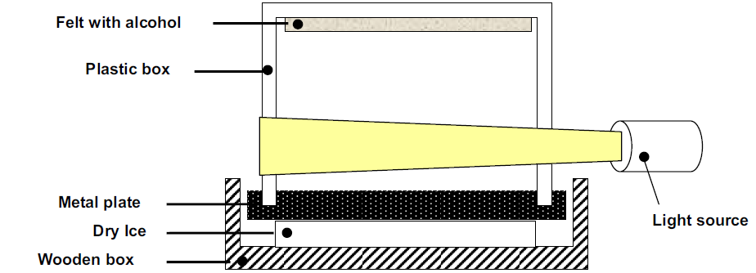
~20 °C
Evaporation
Supercooled vapor
-78 °C

Slide 2
Charles Thomson Rees Wilson (1869 - 1959)
  Modelling the cloud formation with expansion cloud chambers (1911)
  Ionization
  (shared) Nobel-prize in 1927 (Arthur Compton)
Alexander Langsdorf
  Diffusion cloud chamber (exactly the same on the table!)
  Continuous operation
Rochester and Butler
  Kaon (from cosmic rays) 1947
Donald A. Glaser (1926 - )
  Bubble chamber 1952
  Liquid hidrogen
  Big chambers (Gargamelle, BEBC)
  Nobel-prize in 1960

Slide 3
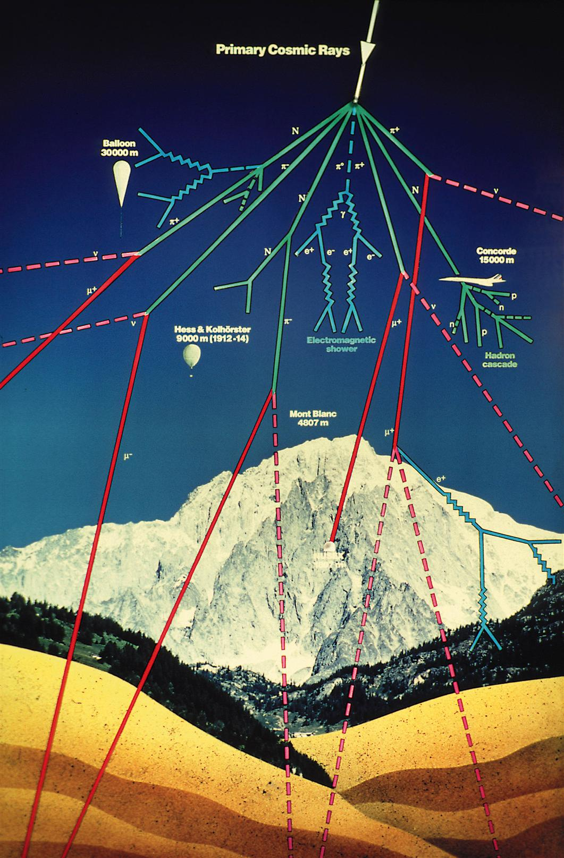
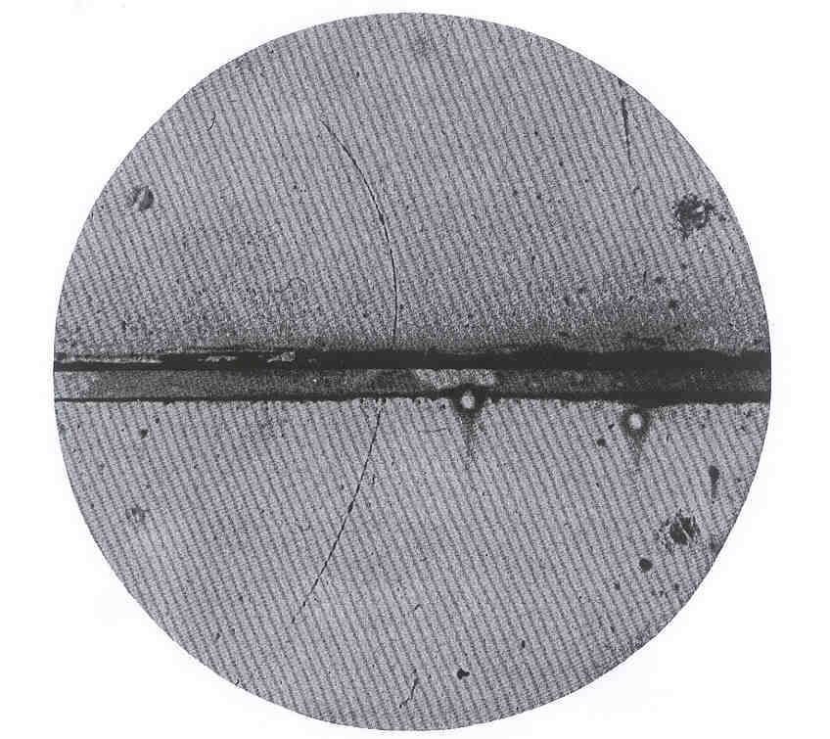
father Theodor Wulf, 1910
  Top of the Eiffel-tower
Victor Hess
  1911-12 ballon up to 5000 m
  Radiation increases rapidly over 1000 m
  Nobel-prize in 1926
Carl Anderson
  1932 (August 2) positron in the cosmic rays
  Nobel-prize in 1936

