Slide 1

Última Hora

Slide 2
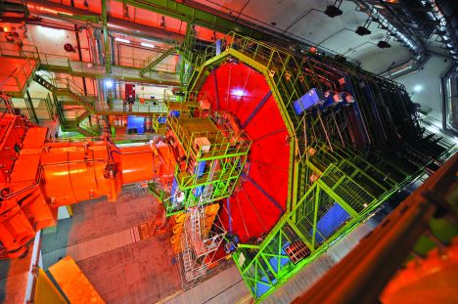
Caverna de CMS está aberta para visitas.

Slide 3
Esta tarde não há água em CMS.
Portanto
Vão à casa de banho antes de apanhar o autocarro ou passem no banheiro antes de pegar o ônibus.

Slide 4



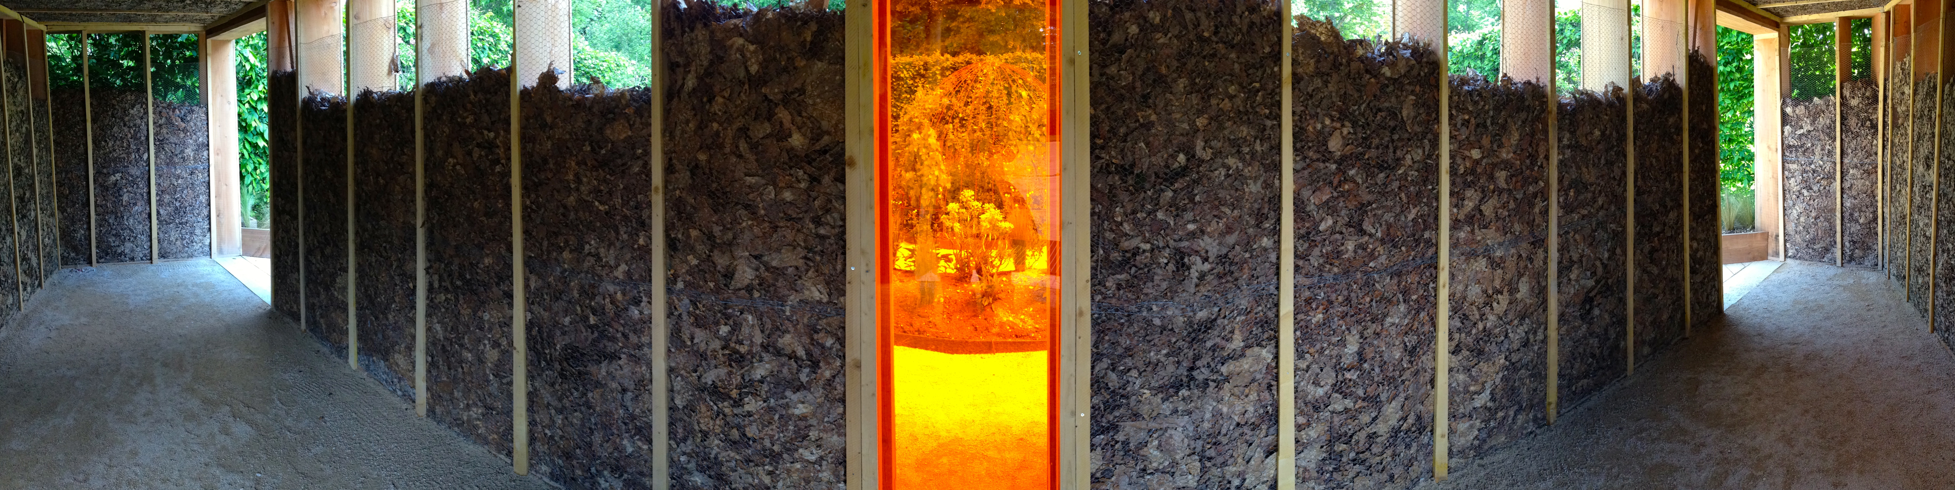

CMS Physics:
FundamentalS of science &
Fundamental SCience
André David (CERN)

Slide 5

Things you can’t “unsee”
[ http://cern.ch/go/Dxh7 ]

Slide 6

Things you can’t “unsee”
[ http://cern.ch/go/Dxh7 ]

Slide 7
Things you can’t “unsee”
[ http://cern.ch/go/Dxh7 ]

Slide 8
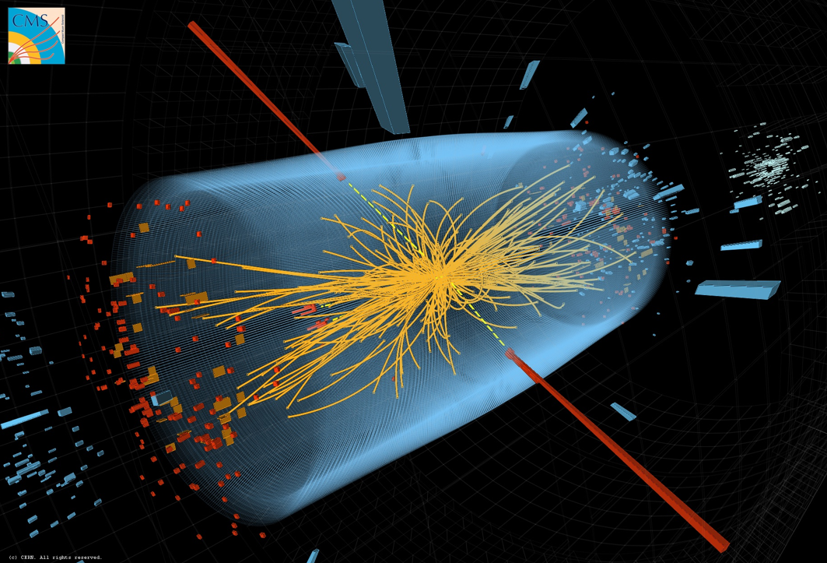

Final Run 1 H→γγ analysis

Slide 9
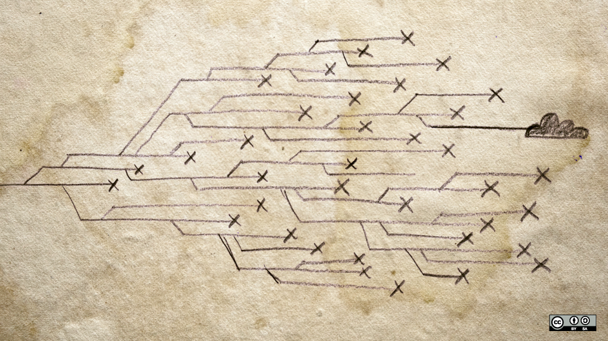
The experimental method falsifying theories since the dawn of reason
[ opensource.com ]
Crosses: experimental results pushing humans to track back and rethink their models.

Slide 10
Respeitar a incerteza

Slide 11
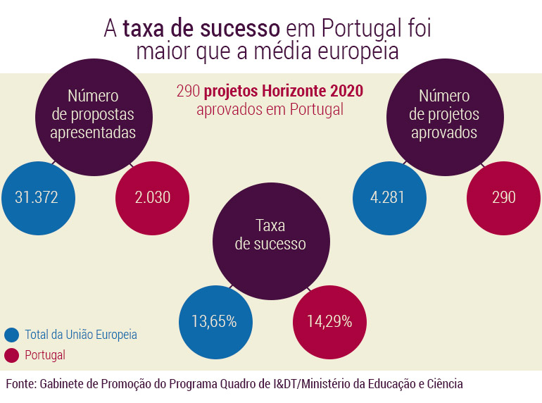
A importância da incerteza
[ http://observador.pt/especiais/transplante-de-medula-ossea-um-novo-e-grande-incentivo/ ]

Slide 12
A importância da incerteza
[ http://observador.pt/especiais/transplante-de-medula-ossea-um-novo-e-grande-incentivo/ ]
E os algarismos significativos ?

Slide 13
A importância da incerteza
[ http://observador.pt/especiais/transplante-de-medula-ossea-um-novo-e-grande-incentivo/ ]
290/2030 > 4281/31372 ?

Slide 14
A importância da incerteza
[ http://observador.pt/especiais/transplante-de-medula-ossea-um-novo-e-grande-incentivo/ ]
290/2030 > 4281/31372 ?
Ou seja, 1.047 > 1 ?

Slide 15
A importância da incerteza
[ http://observador.pt/especiais/transplante-de-medula-ossea-um-novo-e-grande-incentivo/ ]
$ R
R version 3.2.2 (2015-08-14) -- "Fire Safety"
Copyright (C) 2015 The R Foundation for Statistical Computing
Platform: x86_64-apple-darwin14.5.0 (64-bit)
> library("rateratio.test")
> rateratio.test(c(290,4281),c(2030,31372),conf.level=0.90,alternative="greater")
Exact Rate Ratio Test, assuming Poisson counts
data: c(290, 4281) with time of c(2030, 31372), null rate ratio 1
p-value = 0.2331
alternative hypothesis: true rate ratio is greater than 1
90 percent confidence interval:
0.9664013 Inf
sample estimates:
Rate Ratio Rate 1 Rate 2
1.0468849 0.1428571 0.1364593

Slide 16
A importância da incerteza
[ http://observador.pt/especiais/transplante-de-medula-ossea-um-novo-e-grande-incentivo/ ]
basicamente a mesma

Slide 17
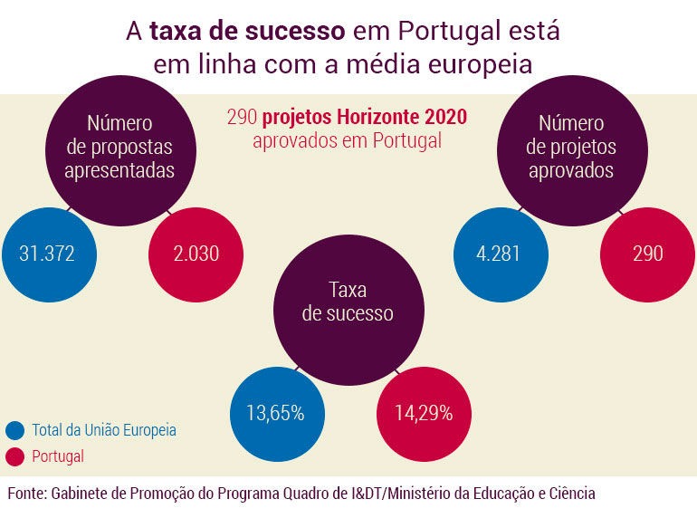
Um final feliz: artigo actualizado
[ http://observador.pt/especiais/transplante-de-medula-ossea-um-novo-e-grande-incentivo/ ]

Slide 18
Exactidão e precisão

Slide 19
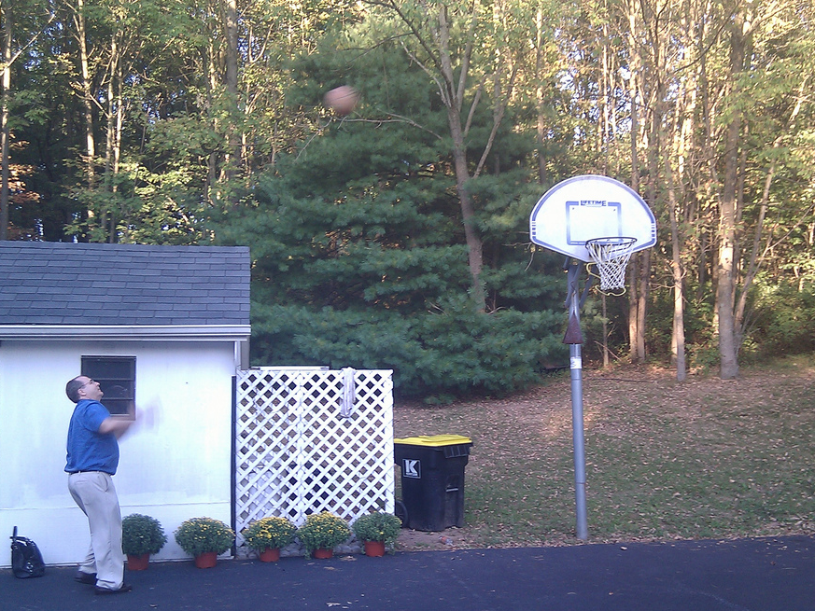
Two words on accuracy and precision

Slide 20
Imprecise
Inaccurate

Slide 21
Imprecise
Imprecise
Accurate
Inaccurate

Slide 22
Accurate
Precise
Imprecise
Imprecise
Accurate
Inaccurate

Slide 23
Accurate
Inaccurate
Precise
Imprecise
Precise
Imprecise
Accurate
Inaccurate

Slide 24
Erros não são incertezas

Slide 25

Two words on error and uncertainty
Error: the result of a bias or mistake.
Uncertainty: the degree to which some thing is not known.
It’s a mistake to call errors uncertainties.
E.g., experimentalists correct for systematic effects (biases).
  Corrections come with added uncertainty.

Slide 26
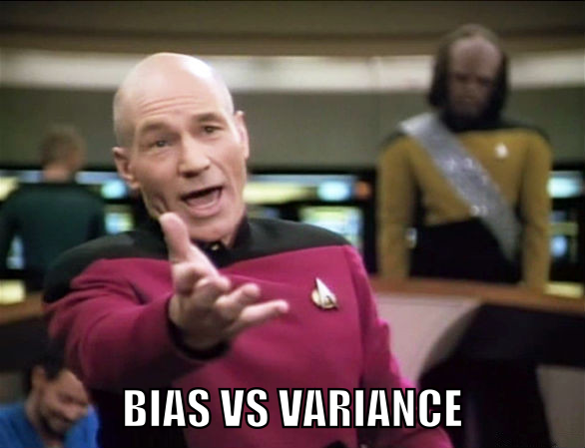
Inaccurate
Precise
Correct bias
Decrease precision
Imprecise
Accurate

Slide 27
“Água mole em pedra dura…”
Ou o preço de pesquisar coisas novas.

Slide 28
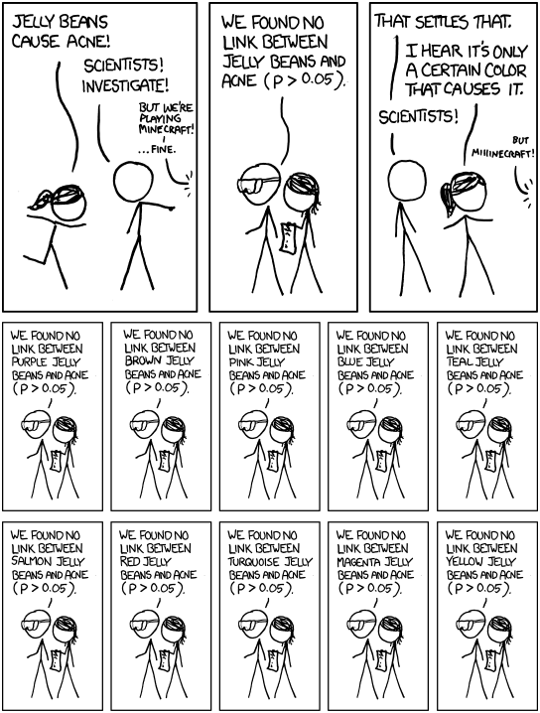
Significant – xkcd.com/882

Slide 29
Significant – xkcd.com/882

Slide 30
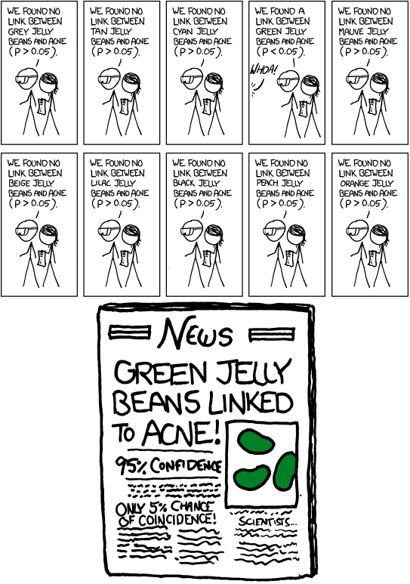
Significant – xkcd.com/882

Slide 31
Significant – xkcd.com/882

Slide 32
About the role of experimentalists

Slide 33
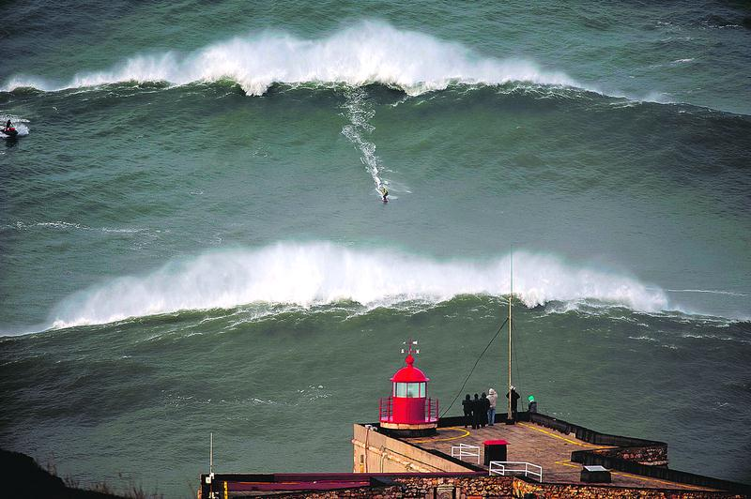

Slide 34
Nature

Slide 35
Experimentalists
Nature
Theory

Slide 36
Experimentalists
Nature
Theory
Theorists (inside)

Slide 37
Experimentalists
Nature
Theory
Phenomenologists
Theorists (inside)

Slide 38
Nature
Nature
Theory
Phenomenologists
Theorists (inside)

Slide 39
Nature
Experimentalists
Nature
Theory
Phenomenologists
Theorists (inside)

Slide 40
Nature
Experienced experimentalists
Experimentalists
Nature
Theory
Phenomenologists
Theorists (inside)

Slide 41
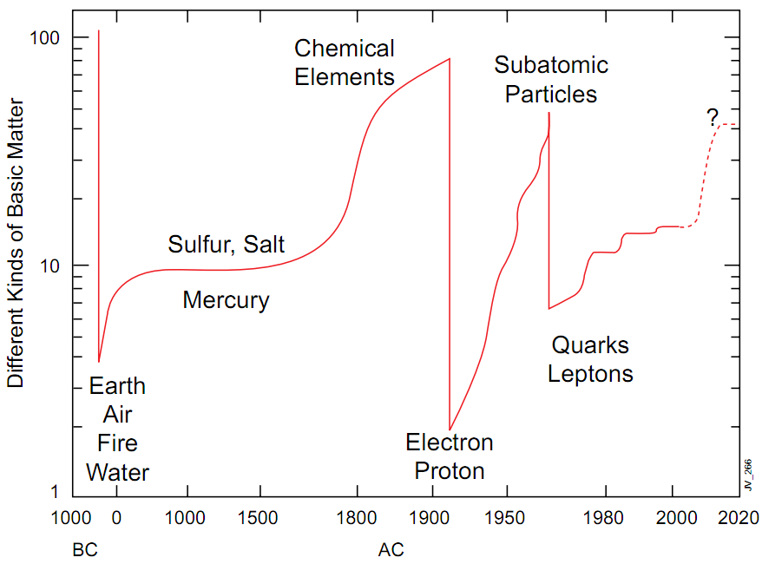
Evolutions & revolutions of the elements
[ Plot courtesy of Jim Virdee ]

Slide 42
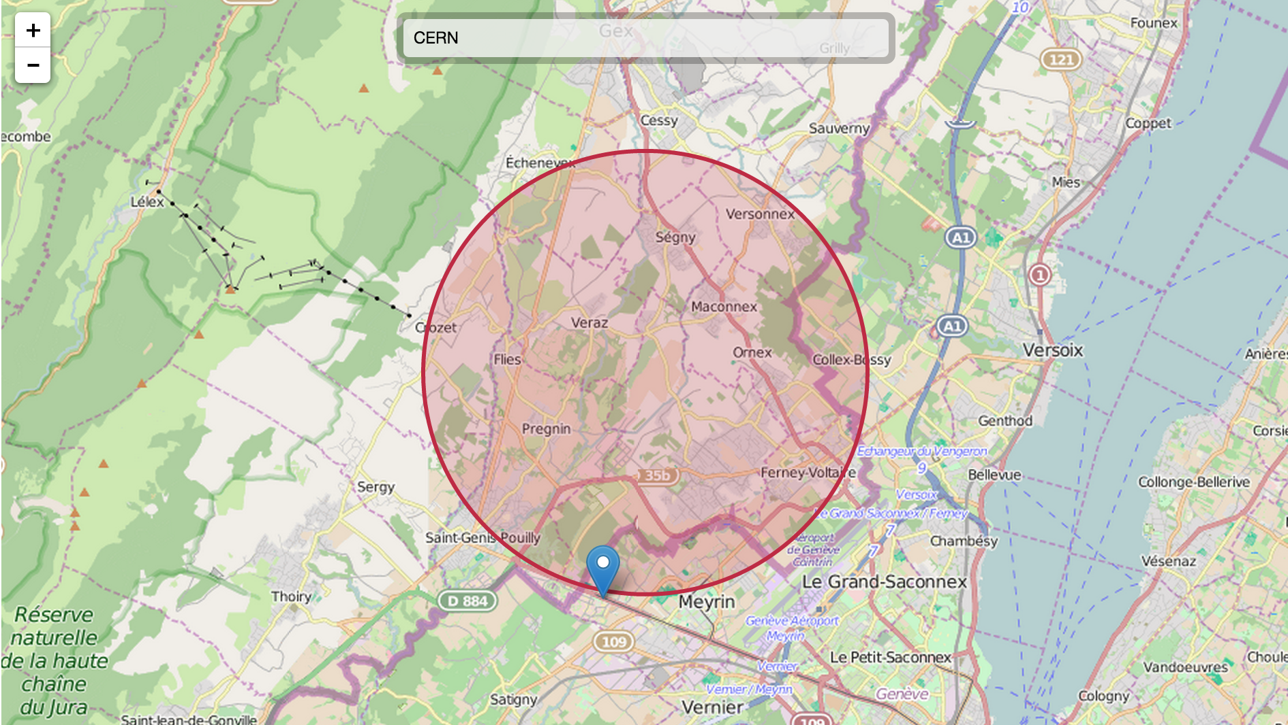

LHC – the lord of the rings
[ http://natronics.github.io/science-hack-day-2014/lhc-map/ ]

Slide 43
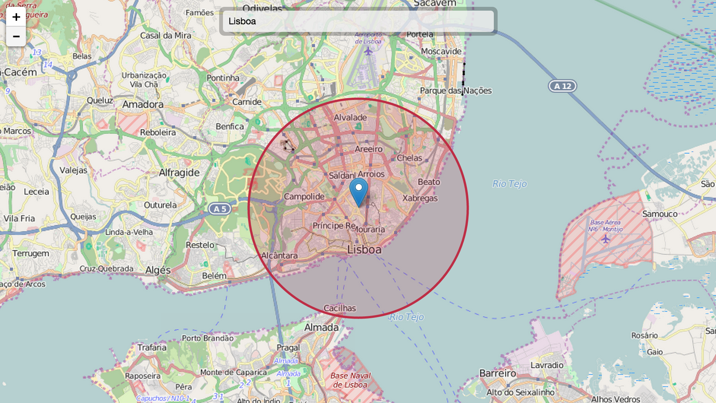
LHC – the lord of the rings
[ http://natronics.github.io/science-hack-day-2014/lhc-map/ ]

Slide 44
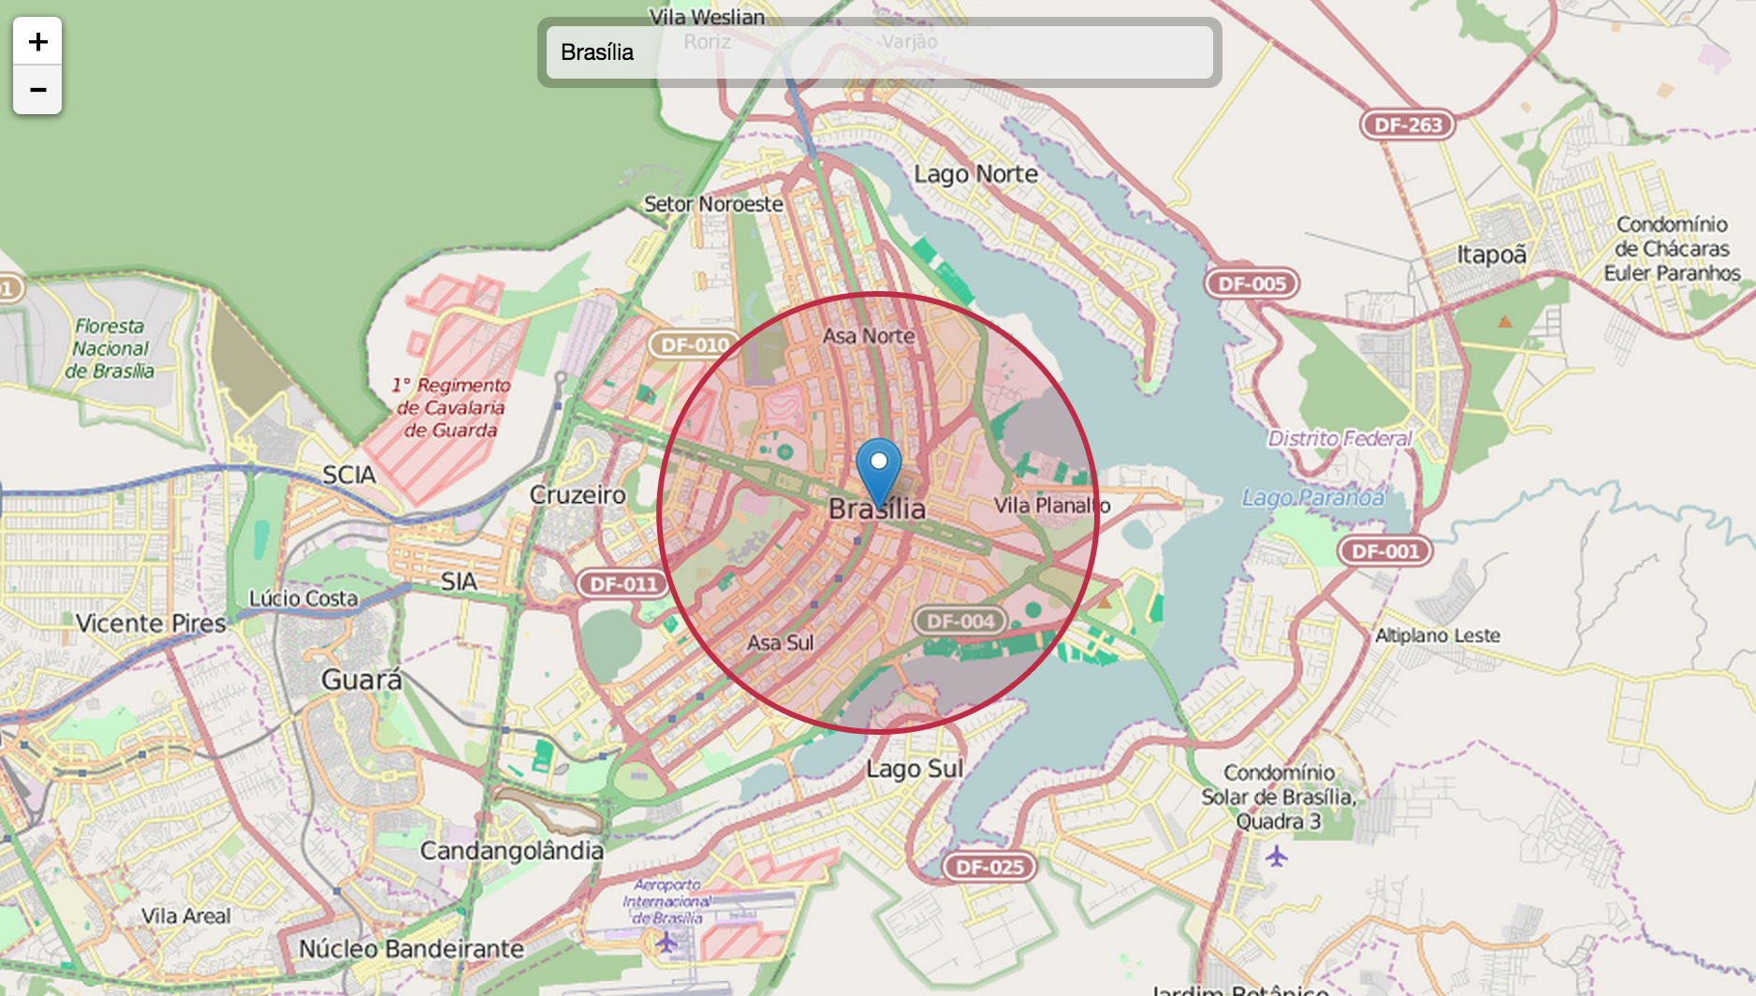
LHC – the lord of the rings
[ http://natronics.github.io/science-hack-day-2014/lhc-map/ ]

Slide 45
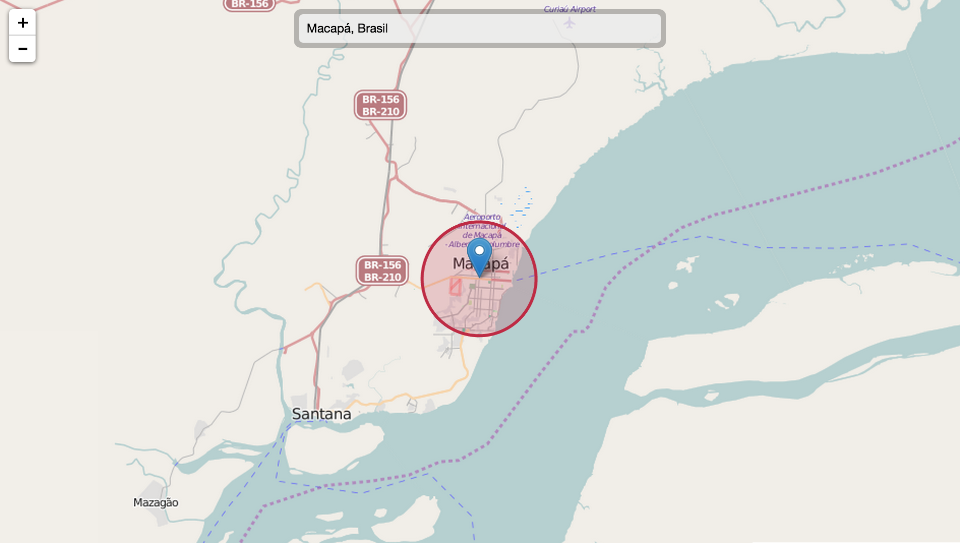
LHC – the lord of the rings
[ http://natronics.github.io/science-hack-day-2014/lhc-map/ ]

Slide 46
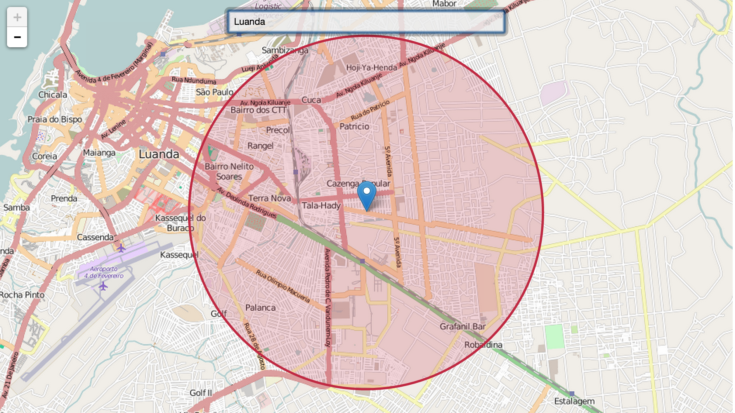
LHC – the lord of the rings
[ http://natronics.github.io/science-hack-day-2014/lhc-map/ ]

Slide 47
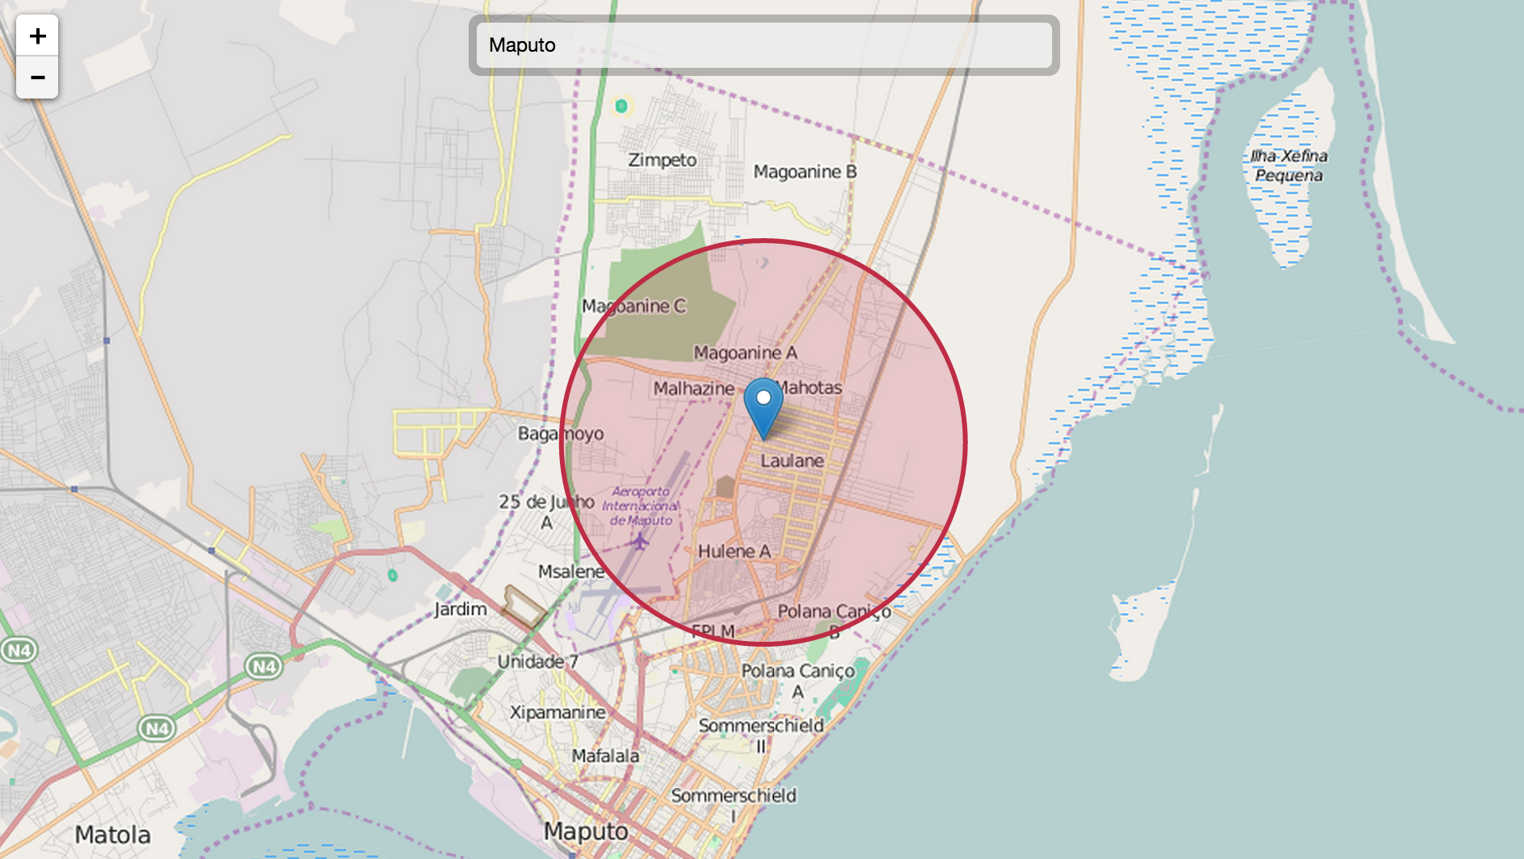
LHC – the lord of the rings
[ http://natronics.github.io/science-hack-day-2014/lhc-map/ ]

Slide 48
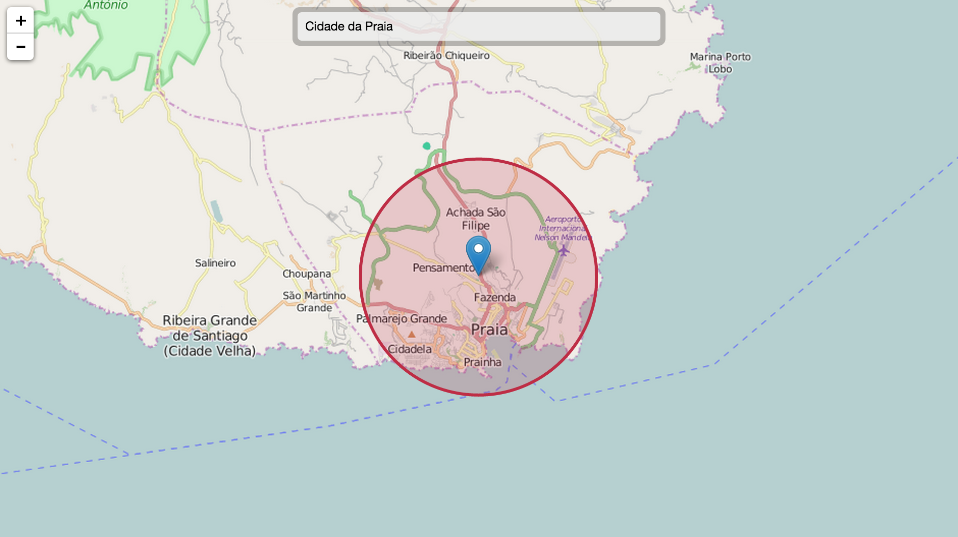
LHC – the lord of the rings
[ http://natronics.github.io/science-hack-day-2014/lhc-map/ ]

Slide 49
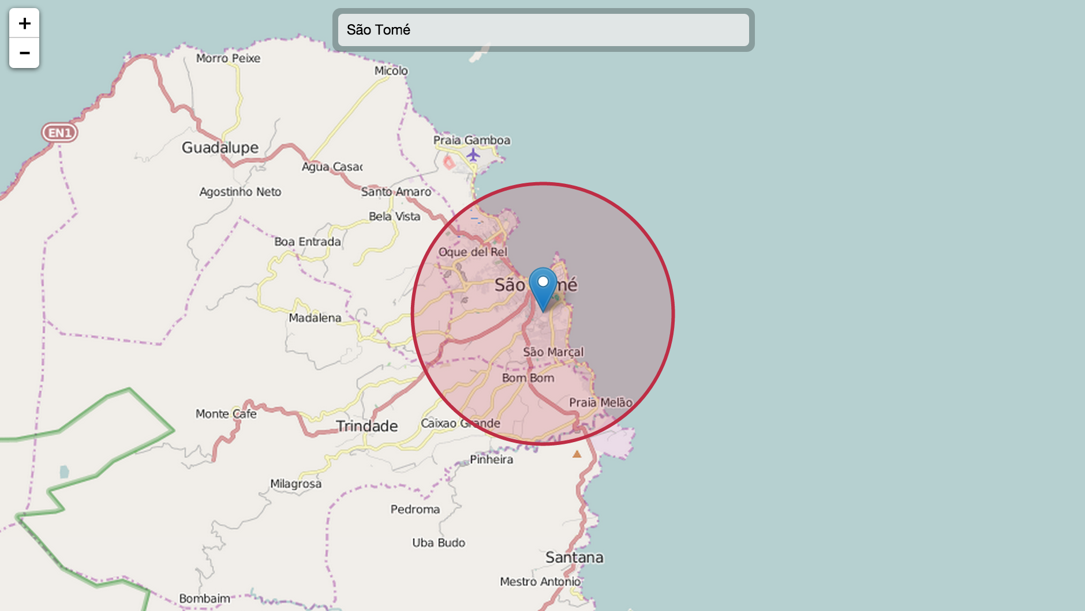
LHC – the lord of the rings
[ http://natronics.github.io/science-hack-day-2014/lhc-map/ ]

Slide 50
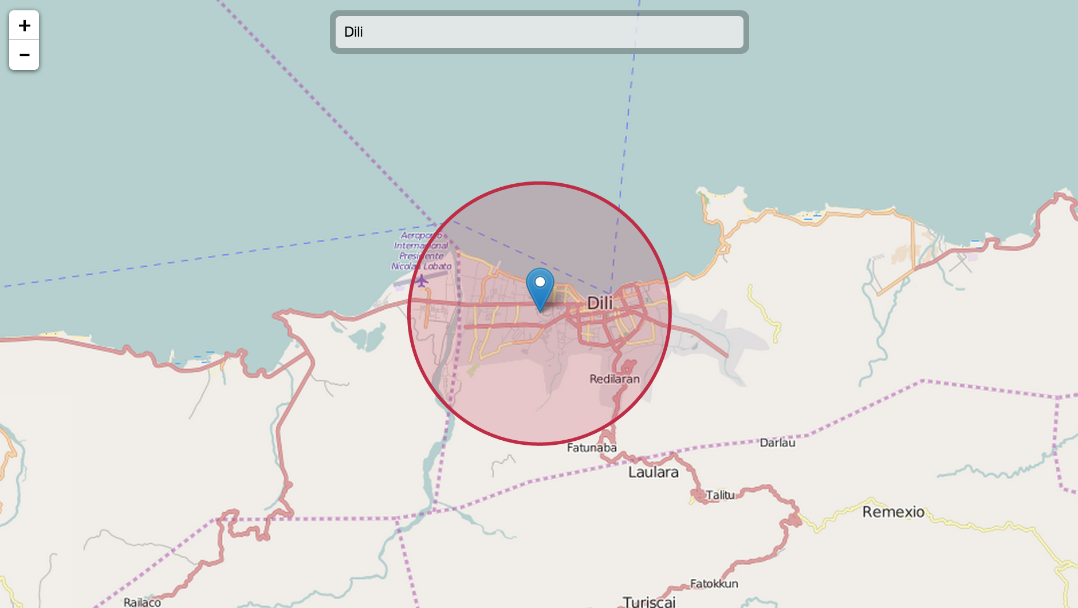
LHC – the lord of the rings
[ http://natronics.github.io/science-hack-day-2014/lhc-map/ ]

Slide 51
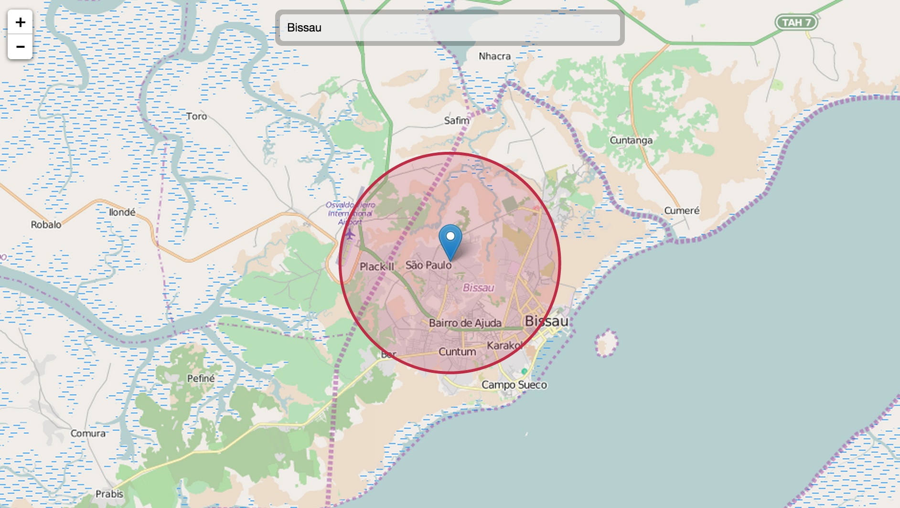
LHC – the lord of the rings
[ http://natronics.github.io/science-hack-day-2014/lhc-map/ ]

Slide 52
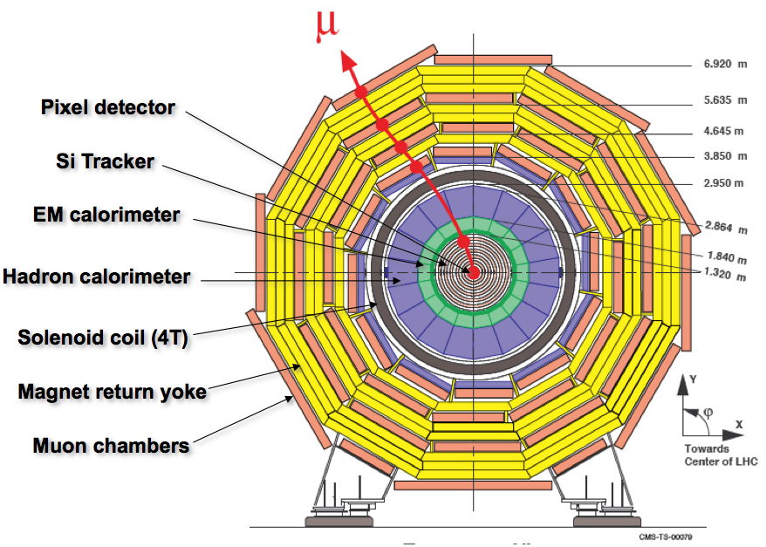
Particle detectors in CMS

Slide 53
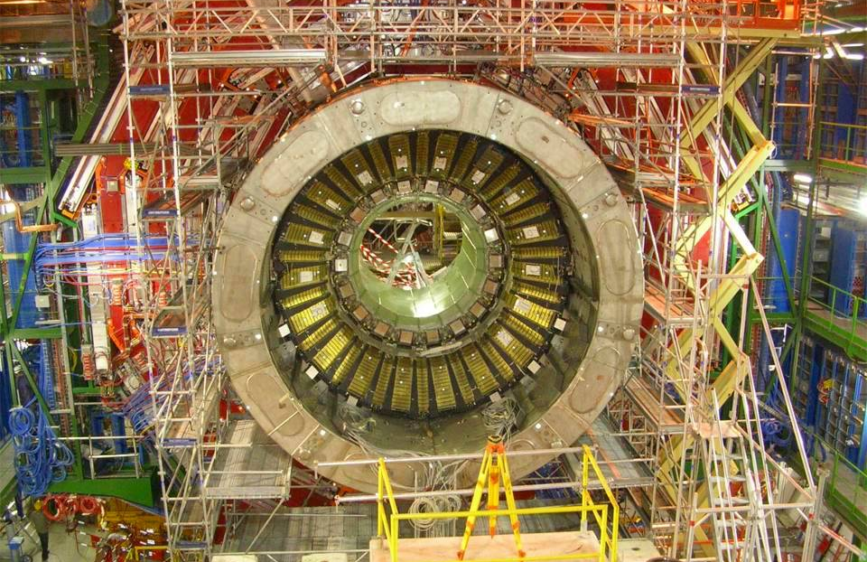
2007: ECAL barrel installed

Slide 54
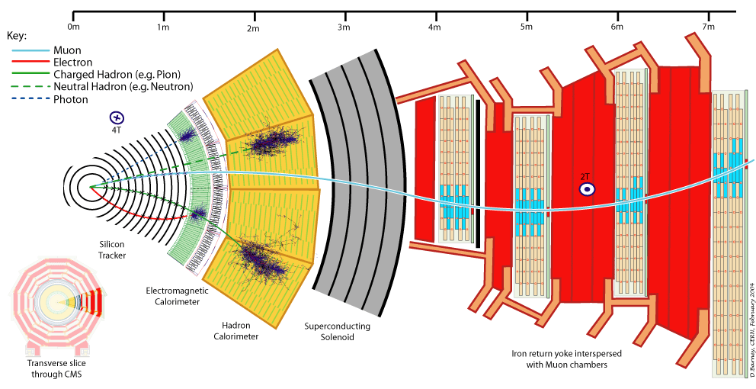
Detecting particles in CMS

Slide 55

Detecting particles in CMS

Slide 56
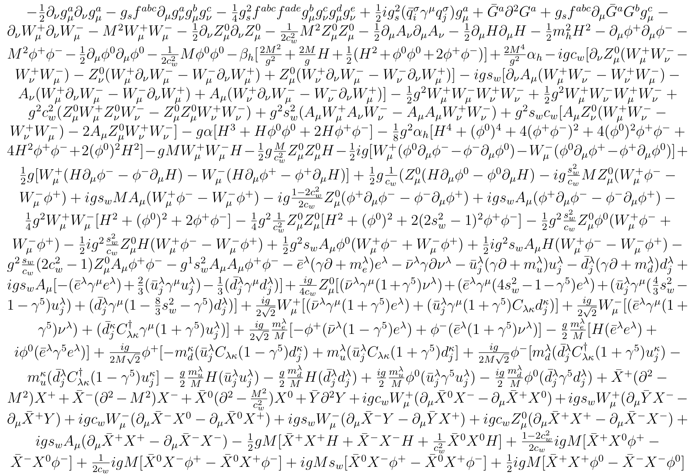
The Standard Model of Particle Physics
[ http://cern.ch/go/dW6z ]

Slide 57
The Standard Model of Particle Physics
[ http://cern.ch/go/dW6z ]

Slide 58
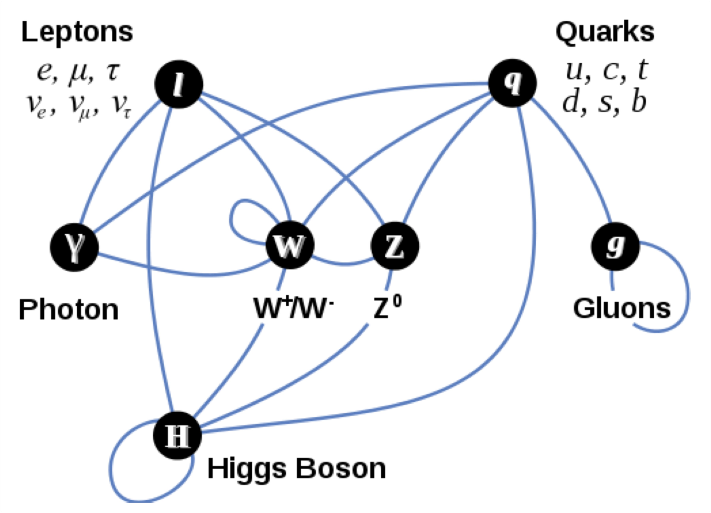
The Standard Model of Particle Physics
Electromagnetic force – light
Weak force – star combustion
Strong force – protons and neutrons

Slide 59
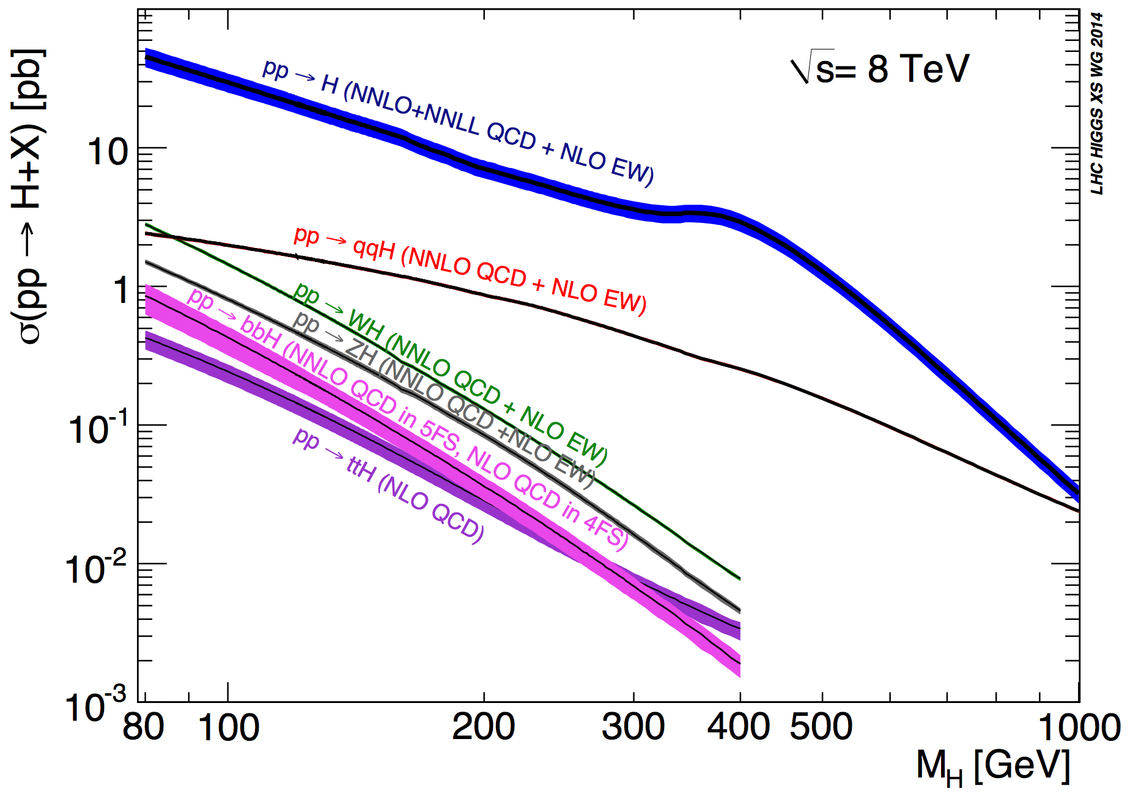
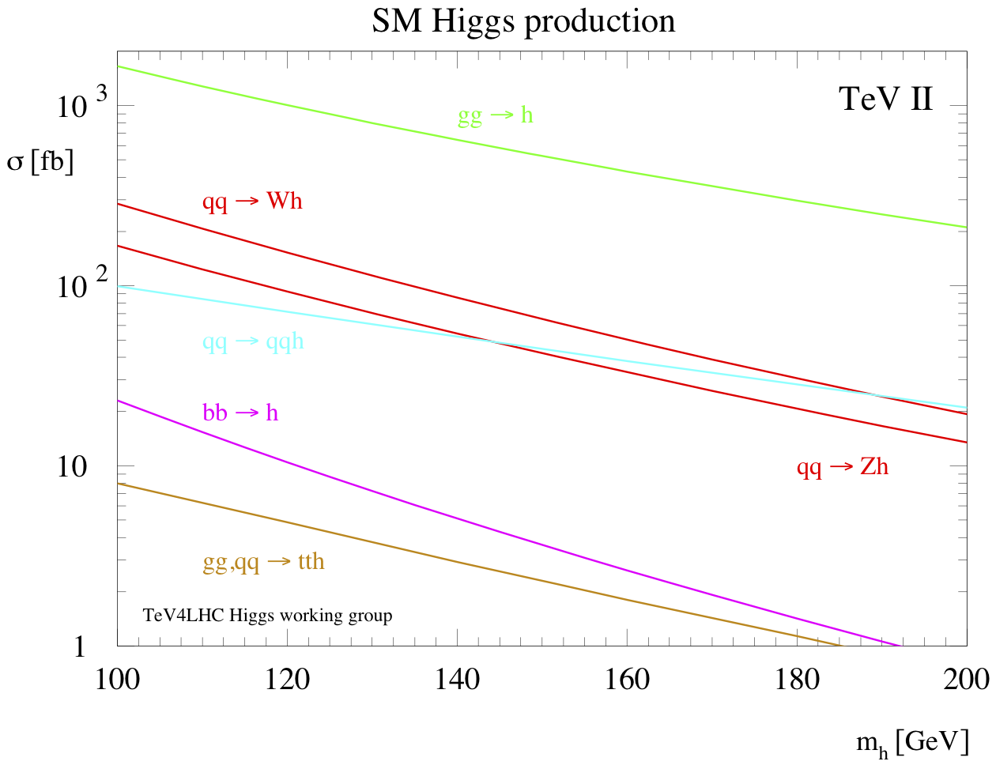
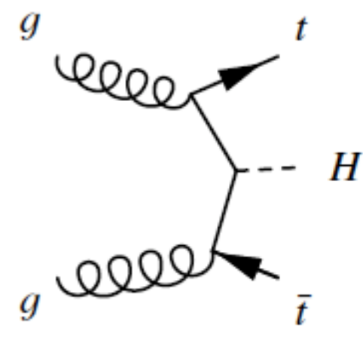
How SM Higgses are born
[ http://cern.ch/go/cWH8 ][ http://cern.ch/go/SnJ8 ]
Gluon fusion
VBF
WH, ZH
bbH, ttH
LHC
Tevatron

Slide 60
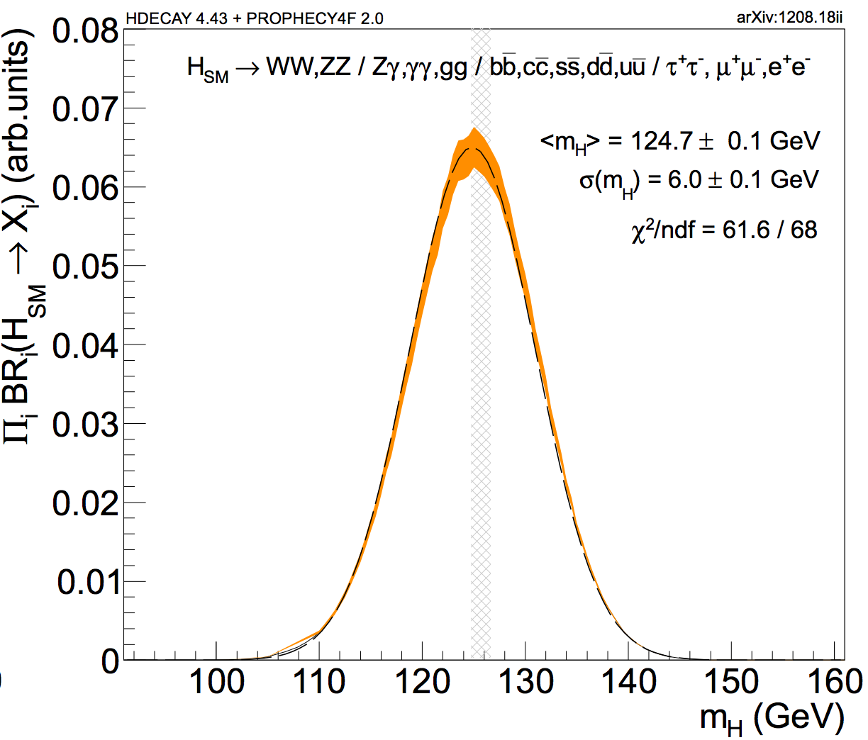
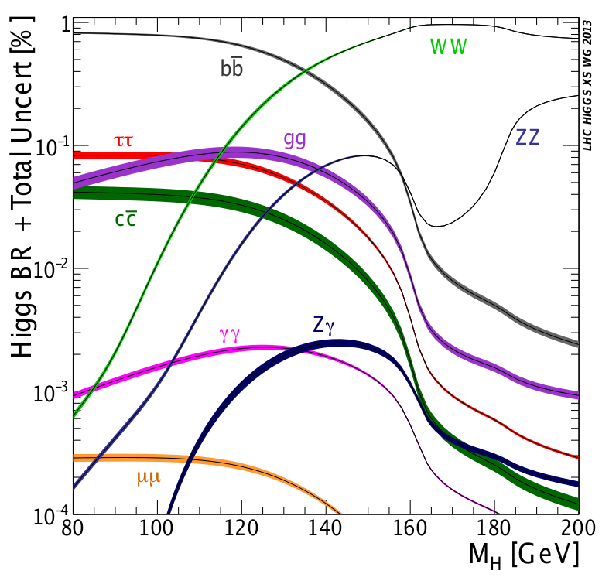
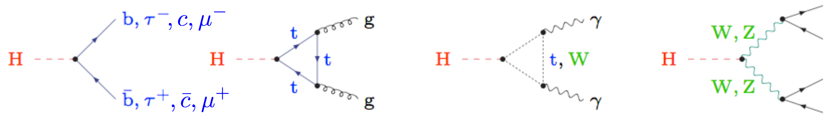
How SM Higgses die
[ http://cern.ch/go/qkh6 ][ arXiv:1208.1993 ][ arXiv:1408.0827 ]
Couplings and kinematics drive BR (bb̅, WW, ττ, ZZ).
  Decays with photons (γγ, Zγ) through loops.
Near to maximal ΠBR_{i} ⟶

Slide 61
Putting it all together
?

Slide 62

2011: nothing else in the horizon
[“Lawrence of Arabia” idea from C. Grojean]
We first saw that we could not exclude a narrow range.

Slide 63
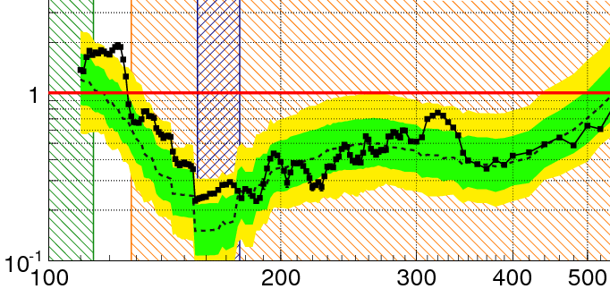
2011: nothing else in the horizon
[“Lawrence of Arabia” idea from C. Grojean]
We first saw that we could not exclude a narrow range.
Z⁰

Slide 64
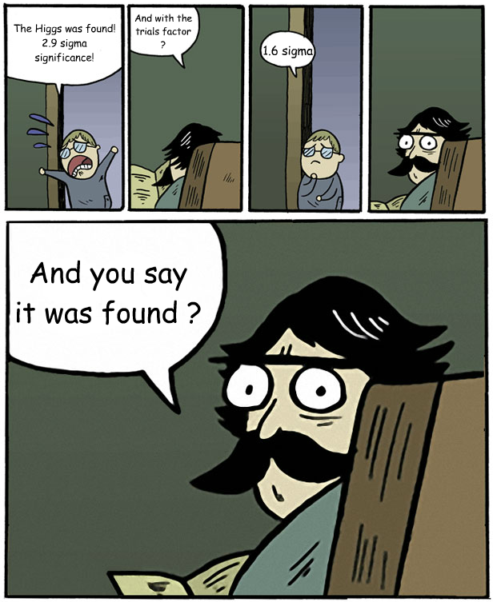
Some theorists…

Slide 65

2012: a rider!
[“Lawrence of Arabia” idea from C. Grojean]
We discovered a peak rising from the background.

Slide 66
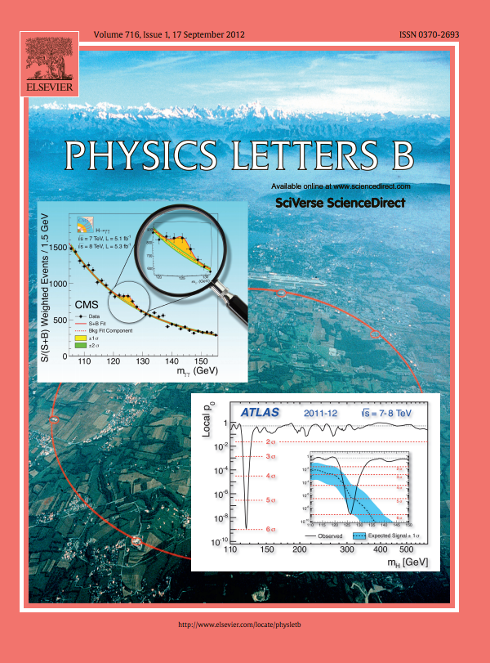
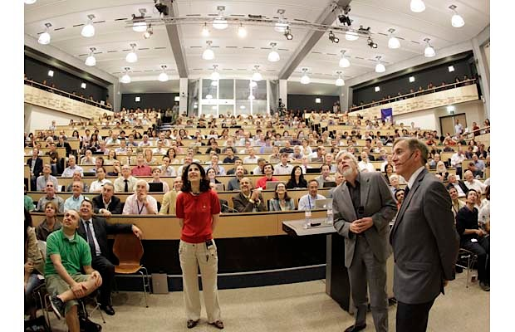
July 4, 2012
Looking up to a new boson
[ http://cern.ch/go/q8jx ]

Slide 67

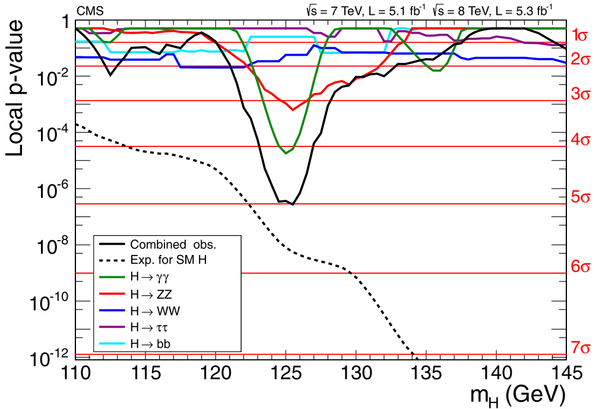
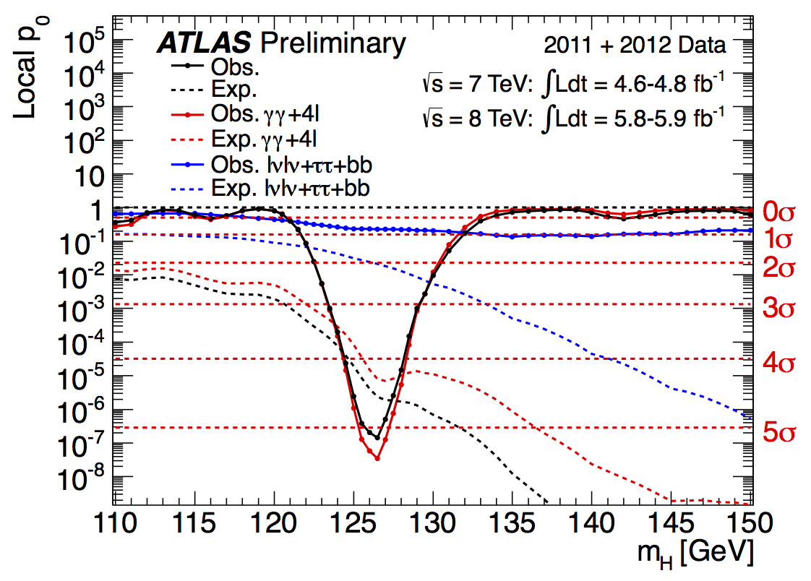
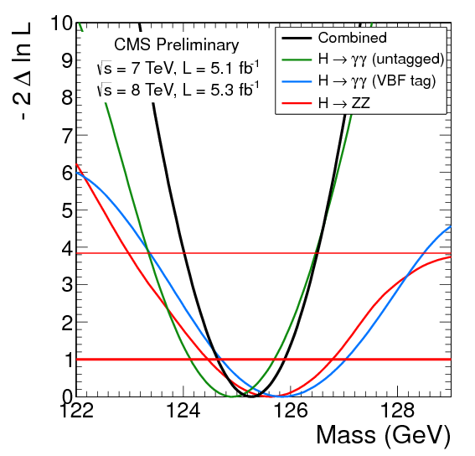
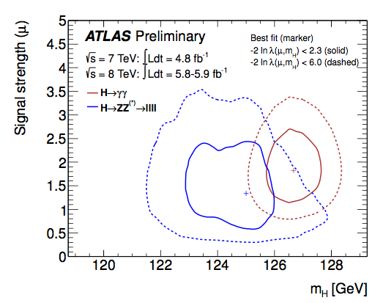
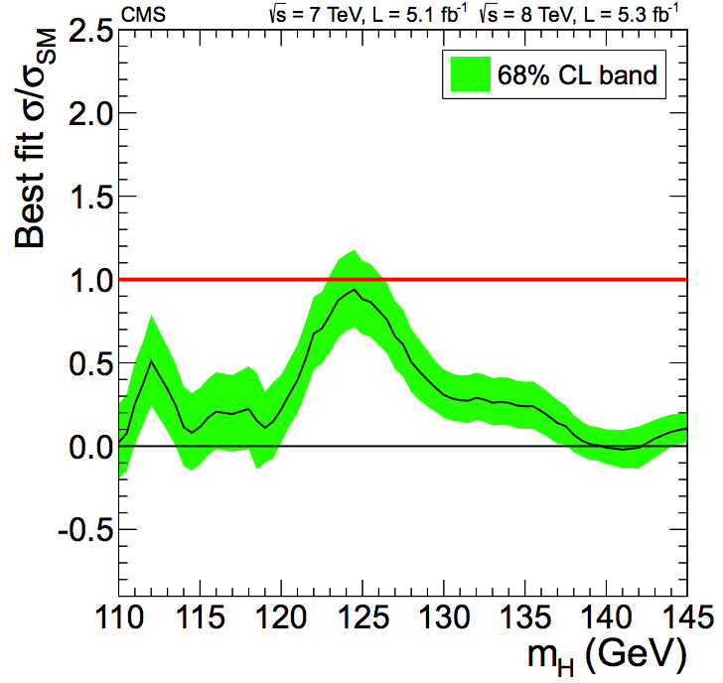
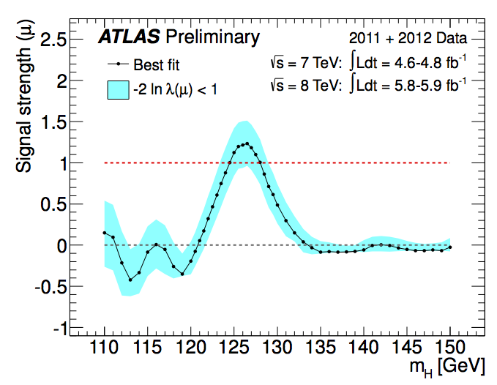
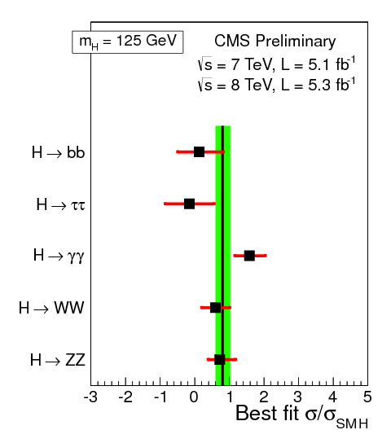
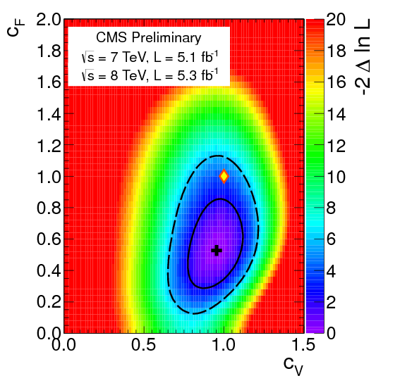
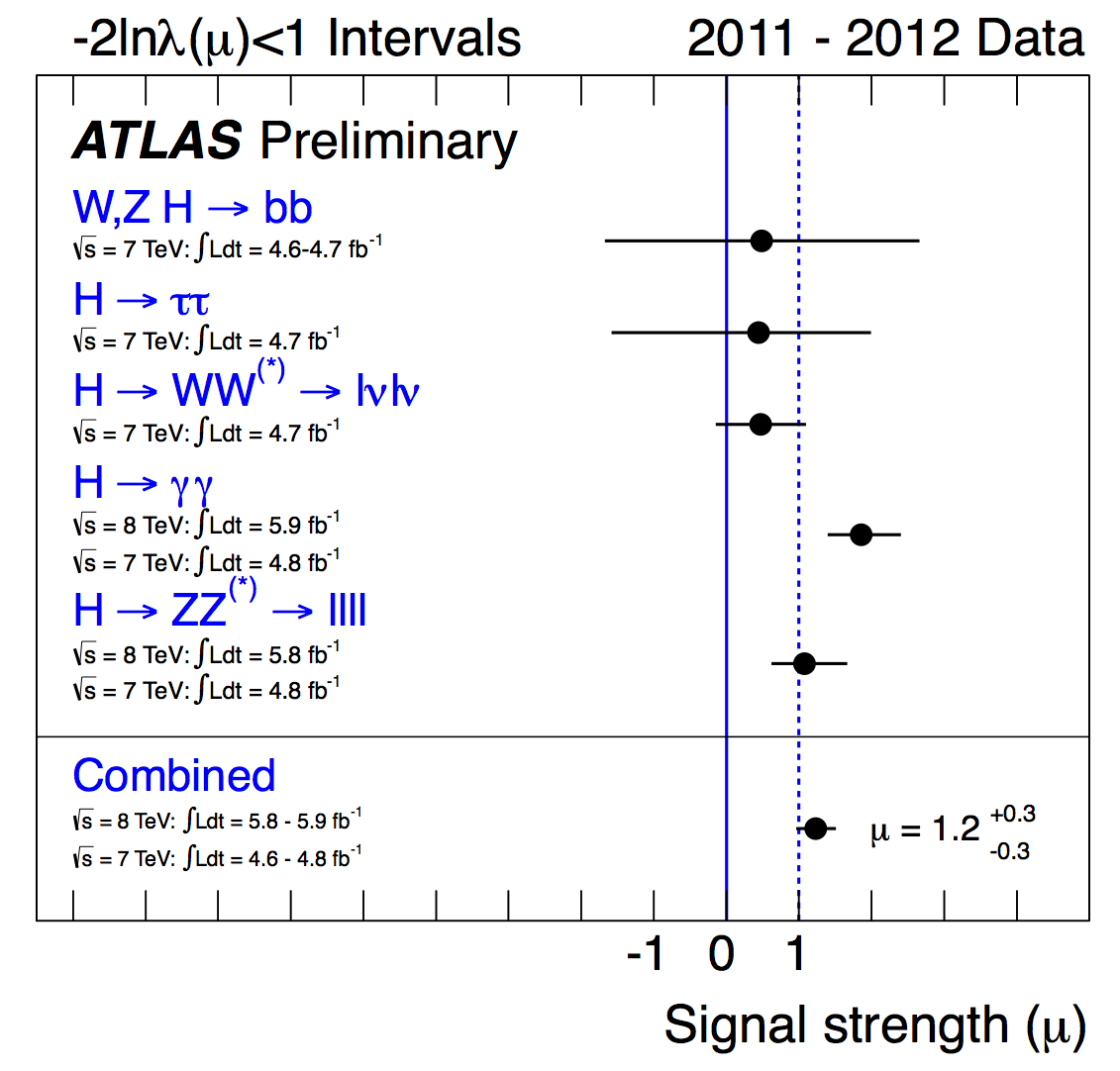
Higgsdependence day recap
[ http://cern.ch/go/q8jx ]
Both experiments at 5.0σ.
  One above SM expectations…
  σ_{ATLAS}/σ_{SM} = 1.2 ±0.3 (at 126.5 GeV).
  …the other one below.
  σ_{CMS}/σ_{SM} = 0.80 ±0.20 (at 125 GeV).
Mass
  ATLAS: min. p-value at 126.5 GeV.
  CMS: m_{X} = 125.3 ±0.6 GeV.
“Proto-couplings” compatible with SM.
“More data needed…”

Slide 68
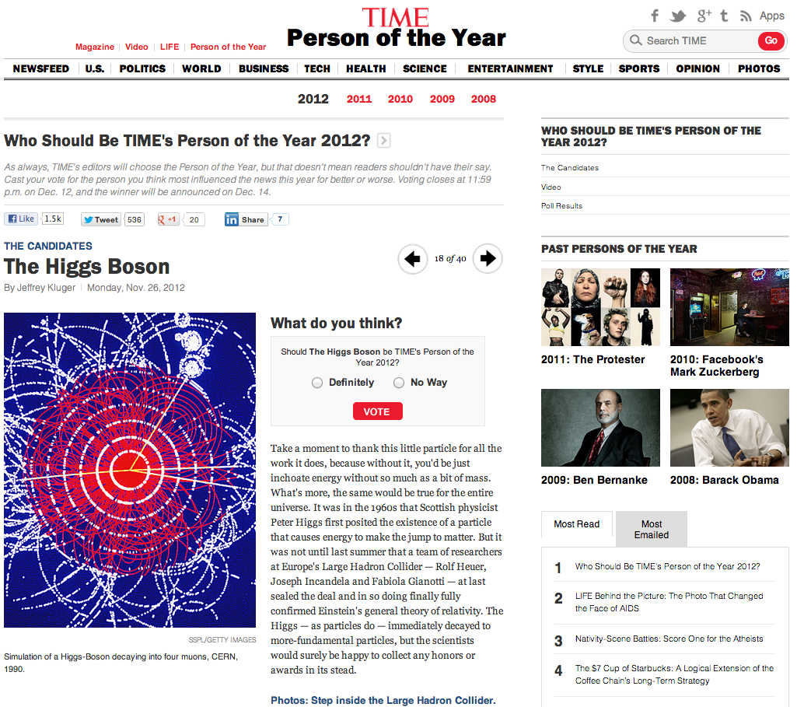

Slide 69
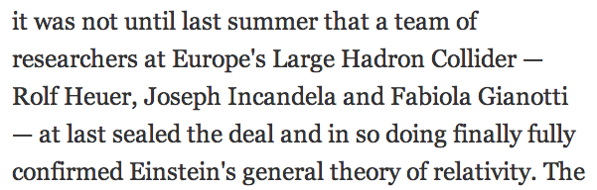

Slide 70
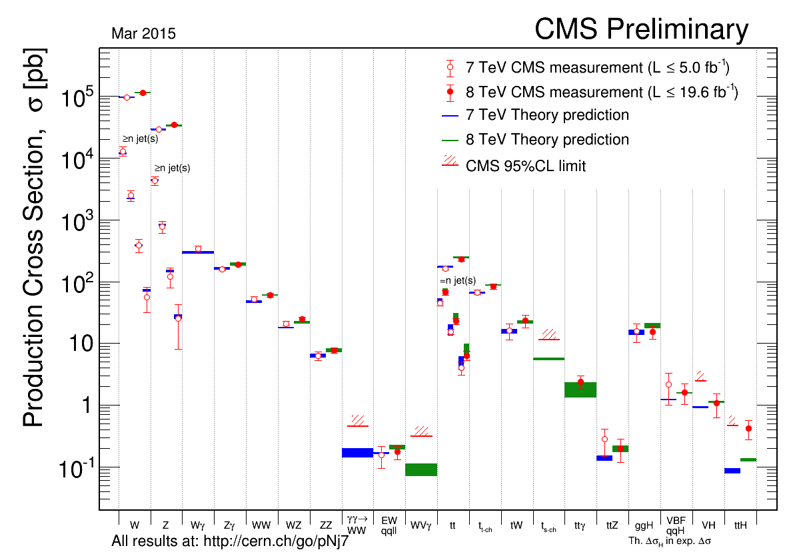
On the shoulders of giants detector makers & theory calculators
“Yesterday’s discovery is today’s calibration, and tomorrow’s background.” – V. L. Telegdi [ http://cern.ch/go/lf9C ][ http://cern.ch/go/KD8D ]
Inelastic collisions: ~7×10¹⁰
Six orders of magnitude of EWK, top, and Higgs Physics
Top quarks
Higgs
W and Z bosons
Notes:
http://www.wolframalpha.com/input/?i=2e5+pbarn+∗+%28+average+earth-sun+distance+%29+%2F+%2873.5+mbarn%29

Slide 71

2013: a rider with a gun
[“Lawrence of Arabia” idea from C. Grojean]
By early 2013 a clear Higgs-like picture emerged.

Slide 72

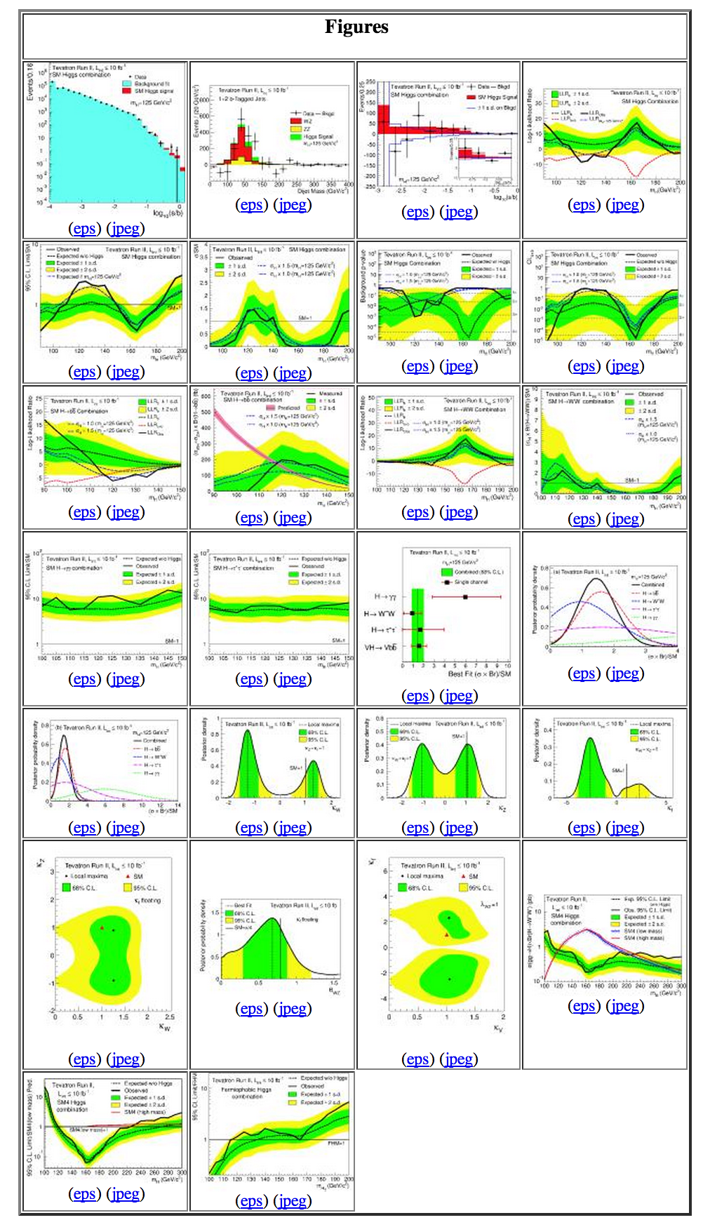



(self-inflicted) Mission: impossible
Present a coherent view of (some) present-day Higgs coupling results from LHC (and Tevatron) experiments.
  Any mistake is the speaker’s fault (send email).

Slide 73
Oversimplified big picture
T – Tevatron; A – ATLAS; C – CMS; combination drivers in red.
★ “seen” ☆ “tried” - “impossible” | H⟶bb̅ |  |  | H⟶ττ |  |  | H⟶WW |  |  | H⟶ZZ |  |  | H⟶γγ |  |  | H⟶Zγ |  |  | H⟶inv. |  |  | H⟶μμ |  |  | H⟶cc̅ H⟶HH
 | T | A | C | T | A | C | T | A | C | T | A | C | T | A | C | T | A | C | T | A | C | T | A | C | T | A | C
ggH | - | - | - | ☆ | ★ | ★ | ☆ | ★ | ★ | ☆ | ★ | ★ | ☆ | ★ | ★ | - | ☆ | ☆ |  |  |  | - | ☆ | ☆ | -
VBF |  |  | ☆ | ☆ | ★ | ★ |  | ★ | ★ |  | ★ | ☆ |  | ★ | ☆ | - |  | ☆ |  |  | ☆ | - |  | ☆ | -
VH | ★ | ☆ | ★ | ☆ |  | ☆ | ☆ | ☆ | ☆ |  | ☆ | ☆ |  | ☆ | ☆ | - |  |  |  | ☆ | ☆ | - |  |  | -
ttH |  | ☆ | ☆ | ☆ |  | ☆ | ☆ |  |  |  |  |  |  | ☆ | ☆ | - |  |  |  |  |  | - |  |  | -
Still much to explore on the rarer ends.
(to the right and to the bottom) (and outside this picture ䷲)

Slide 74


H→γγ vignettes
[ EPJC 74 (2014) 3076 ]
5.7σ (5.2σ exp.)
m_{H}= 124.70 ±0.31 (stat.) ±0.15 (syst.) GeV
σ/σ_{SM} = 1.14 ±0.21 (stat.) ±0.11 (theo.) ±0.07 (syst.)
H→γγ
EPJC 74 (2014) 3076

Slide 75



Relative signal strengths
[ arXiv:1303.6346 ][ ATLAS-CONF-2015-007 ][ arXiv:1412.8662 ]
 | Tevatron | ATLAS | CMS
m_{H} | 125 GeV | 125.4 GeV | 125.0 GeV
μ = σ/σ_{SM} | 1.44 ^{+0.59}_{-0.56} | 1.18 ±0.15 | 1.00 ±0.14
Naïve LHC average: 1.1 ±0.1

Slide 76




Weak bosons and fermions
[ arXiv:1303.6346 ][ ATLAS-CONF-2015-007 ][ arXiv:1412.8662 ]
 | Tevatron | ATLAS | CMS
p(SM) | - | 41% | < 1σ

Slide 77


The deviations that we do not (yet) see
[ ATLAS-CONF-2015-007 ][ arXiv:1412.8662 ]

Slide 78

Nobel prizes…

Slide 79
What is the Higgs boson mass?
Something that the SM does not predict.
Something we can measure!

Slide 80


Mass peaks: mass measurements

Slide 81


Mass peaks: mass measurements

Slide 82

Combined LHC mass measurement
[ arXiv:1503.07589 ]

Slide 83

Combined LHC mass measurement
[ arXiv:1503.07589 ]
Stat. uncertainty dominates overall.
Energy scale syst. can be improved.
Run 2 will reduce uncertainty !

Slide 84

For the record
~5150 authors.
Found that there are two:
  Archana Sharma
  (both CMS)
  Andrea Bocci
  Muhammad Ahmad
  F. M. Giorgi
  (one CMS, one ATLAS)

Slide 85
Standard Model of Particle Physics
[ http://cern.ch/go/dW6z ]

Slide 86
Standard Theory of Particle Physics
[ http://cern.ch/go/dW6z ]
SM with H = Standard Theory

Slide 87
Standard Theory of Particle Physics
[ http://cern.ch/go/dW6z ]
Valid up to ~Planck scale ?

Slide 88

The fate/character of the Universe
[ JHEP 08 (2012) 098 ]
Hic sunt leones
Hic est taedet
The SM vacuum stability depends crucially on the masses of the top quark and Higgs boson.

Slide 89
Standard Theory of Particle Physics
[ http://cern.ch/go/dW6z ]
Valid up to ~Planck scale ?

Slide 90
Standard Theory of Particle Physics
[ http://cern.ch/go/dW6z ]
Valid up to ~Planck scale ?
But: dark matter, matter-antimatter, etc.

Slide 91
The Next Standard Model
[ http://cern.ch/go/dW6z ]
Standard Theory

Slide 92
The Next Standard Model
[ http://cern.ch/go/dW6z ]
Standard Theory
Something else

Slide 93

So small that you need a pipette

Slide 94

The future
[“Lawrence of Arabia” idea from C. Grojean]
We must examine this Higgs to the fullest extent !
  It may be the only clue to leave the SM oasis and cross the desert.

Slide 95




The future is in precision and accuracy
Present
Accelerator physicists
More collisions
Experimentalists
Better detectors & analyses
Theorists
Better predictions
Still SM ?
Future
Beyond SM ?

Slide 96

Back to the #13TeV future

Slide 97

The future is luminous

Slide 98


Back to the #13TeV future

Slide 99

The beautiful boring Universe today
[ arXiv:1303.5062 ][ ATLAS-CONF-NOTE-2015-007 ][ arXiv:1412.8662 ]
Up above: “Simple six-parameter ΛCDM”.
Down below: (Not-as-simple) ~20-parameter Standard Model of Particle Physics.
Looking forward to LHC combination and surprises at higher energy: PeV neutrinos, LHC 13 TeV, …

Slide 100
“…and references therein.”
Experiments’ pages on Higgs results:
  ATLAS: http://cern.ch/go/7lDT
  CMS: http://cern.ch/go/6qmZ
  Tevatron: http://cern.ch/go/h9jX
    CDF: http://cern.ch/go/q8NV
    D0: http://cern.ch/go/9Djq
Partial list of conferences and workshops:
  Higgs Days 2013: http://cern.ch/go/6zBp
  ECFA HL-LHC workshop: http://cern.ch/go/SFW6
  Higgs EFT 2013: http://cern.ch/go/bR7w
  Higgs Couplings 2013: http://cern.ch/go/THp9
  Moriond 2014: http://cern.ch/go/k8FP
  Bernasque 2014: http://cern.ch/go/Pz7l
  ICHEP 2014: http://cern.ch/go/8Btf
  Rencontres du Vietnam 2014: http://cern.ch/go/9ZJJ
  Zuoz Summer School 2014: http://cern.ch/go/9SHw
  Higgs Days 2014: http://cern.ch/go/lfP6
  Higgs Couplings 2014: http://cern.ch/go/HMm6

