Slide 1


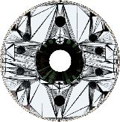
LHC Upgrade
Lucio Rossi – CERN
HL-LHC project leader
talk to 9th CERN-KEK committee
21 November 2014 @ KEK

Slide 2
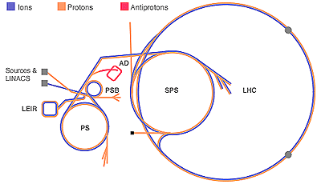
LS 1 from 16th Feb. 2013 to Dec. 2014
2013
2014
17th Nov.
2015
F
M
A
M
J
J
A
S
O
N
D
J
F
M
A
M
J
J
A
S
O
N
D
J
F
M
A
LHC
SPS
PS
PS Booster
beam to beam
available for works
Physics
Beam commissioning
Shutdown
Powering tests

Slide 3
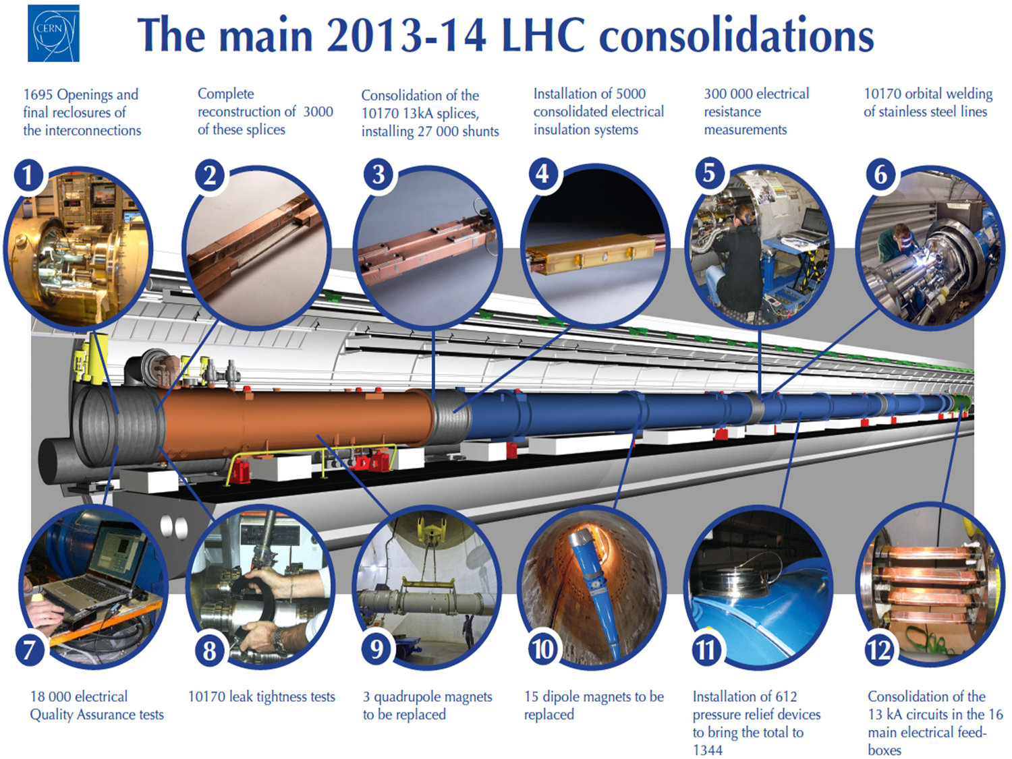

Slide 4
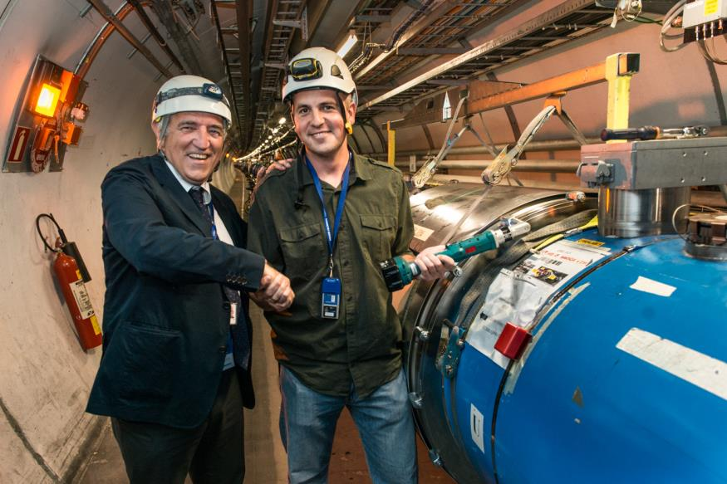
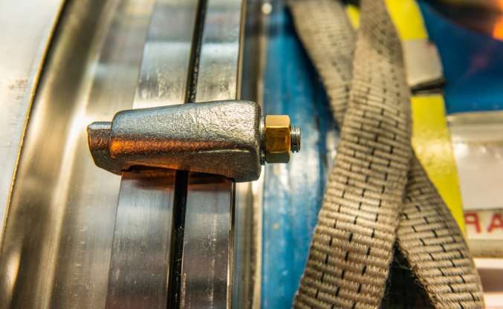
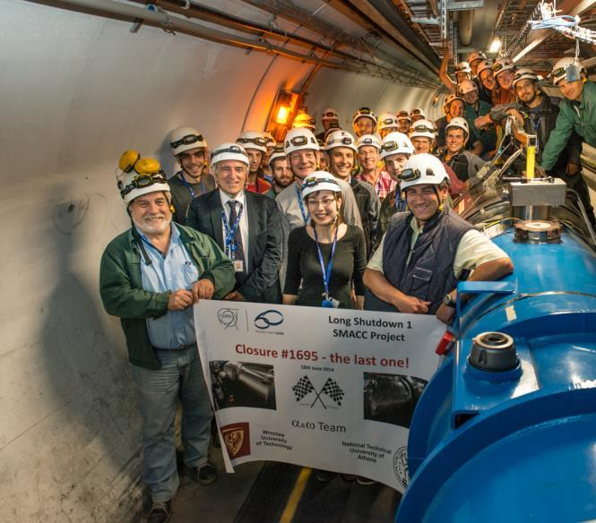
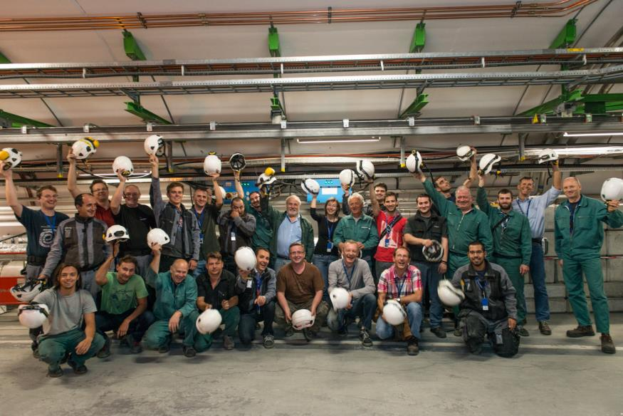
Closure Nb1695
the last one!
18th June 2014
NTUA (GR), HNINP, WUT (PL), JINR (Dubna)

Slide 5
Cool-down of LHC sectors
Slow-down during weekends
CSCM
ITR8 intervention
Courtesy of Laurent Tavian

Slide 6
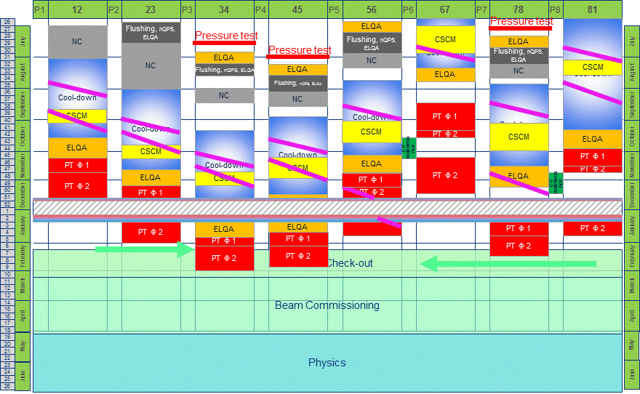
  Safety First,
  Quality Second,
  Schedule Third
LHC schedule V4.1
1st beam (March 2015)
Courtesy of Katy Foraz

Slide 7
Maximum beam energy : 13 TeV c.m. in 2015
Decision to run at a maximum energy of 6.5 TeV per beam during the powering tests and during 2015.
(10 to 15 training quenches per sector are expected to be needed to reach that energy).
“We accept the risk that results from late quench tests could force to run at lower energy”
Emilio Meschi – LHC physics coordinator
NO change of beam energy in 2015.
A decision regarding the possibility of increasing the energy will be taken later in 2015, based on the experience gained in all eight sectors at 6.5 TeV per beam during powering tests and operation with beams.

Slide 8
LHC goal for 2015 and for Run 2 and 3
Priorities for the 2015 run :
Establish proton-proton collision at 13 TeV with 25ns and low β* to prepare production run in 2016.
Optimisation of physics-to-physics duration
Later in 2015: decision on special runs “when and duration” (90m optics): not in the 1st part of the year. Waiting LHCC recommendation
Pb-Pb run: one month at the end of 2015
The goal for Run 2 luminosity is 1.3 x 10³⁴ cm⁻² s⁻¹ and operation with 25 ns bunch spacing (2800 bunches), giving an estimated pile-up of 40 events per bunch crossing.
“A maximum pileup of ~50 is considered to be acceptable for ATLAS and CMS”

Slide 9
Run III
Run I
Run II
0.75 10³⁴ cm⁻²s⁻¹
50 ns bunch
high pile up ∼40
1.7 10³⁴ cm⁻²s⁻¹
25 ns bunch
pile up ∼45
1.7-2.2 10³⁴ cm⁻²s⁻¹
25 ns bunch
pile up ∼60
Lumi saturation &
Technical bottlenecks:
50 ⇒ 25 ns
Plan approved by CERN management upon preparation in HL-LHC Coord Group and RLIUP
See deliverable D1.7 Common LHC time plan

Slide 10
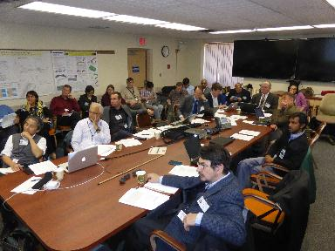
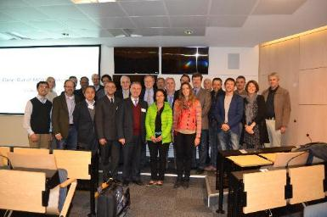
Two important International Reviews
(May 2013 : Collimation Review)
International Review of the Crab Cavity (BNL, 5-6 May 2014): Downselection & Prioritization. SPS TEST!
International Review of the MQXF SC Cable (CERN 5-6 November 2014): more margin, finalize optimization & need more Industrialization especially with EU Nb₃Sn.

Slide 11

HL-LHC Baseline Parameters
WP2 charge – PLC webpage
Parameter | Nominal LHC​ (design report) | HL-LHC 25ns (standard)​ | HL-LHC 25 ns (BCMS) | HL-LHC 50ns
Beam energy in collision [TeV] | 7 | 7 | 7 | 7
N_{b} | 1.15E+11 | ​2.2E+11 | 2.2E11 | ​3.5E+11
n_{b} | ​2808 | ​2748¹ | 2604 | ​1404
Number of collisions at IP1 and IP5 | 2808 | 2736 | 2592 | 1404
N_{tot} | 3.2E+14 | 6.0E+14 | 5.7E+14 | 4.9E+14
beam current [A] | ​0.58 | 1.09 | 1.03 | 0.89
x-ing angle [μrad]​ | 285 | 590 | 590 | 590
beam separation [σ] | 9.4 | 12.5 | 12.5 | 11.4
β* [m] | 0.55 | ​0.15 | 0.15 | ​0.15
ε_{n} [μm]​ | 3.75 | ​2.50 | 2.50 | 3
ε_{L} [eVs]​ | 2.50 | ​2.50 | 2.50 | ​2.50
r.m.s. bunch length [m] | ​7.55E-02 | ​7.55E-02 | ​7.55E-02 | ​7.55E-02
Piwinski angle | ​0.65 | 3.14 | 3.14 | 2.87
Geometric loss factor R0 without crab-cavity | ​0.836 | 0.305 | 0.305 | 0.331
Geometric loss factor R1 with crab-cavity | (0.981) | 0.829 | 0.829 | 0.838
beam-beam / IP without Crab Cavity | 3.1E-03 | ​3.3E-03 | ​3.3E-03 | 4.7E-03
beam-beam / IP with Crab cavity | 3.8E-03 | 1.1E-02 | 1.1E-02 | 1.4E-02
Peak Luminosity without crab-cavity [cm⁻² s⁻¹] | 1.00E+34 | 7.18E+34 | 6.80E+34 | 8.44E+34
Virtual Luminosity with crab-cavity: Lpeak*R1/R0 [cm⁻² s⁻¹] | (1.18E+34) | 19.54E+34 | 18.52E+34 | 21.38E+34
Events / crossing without levelling w/o crab-cavity | ​27 | 198 | 198 | 454
Levelled Luminosity [cm⁻² s⁻¹] | - | ​5.00E+34 | 5.00E34 | 2.50E+34
Events / crossing (with levelling and crab-cavities for HL-LHC) | 27 | 138 | 146 | 135
Peak line density of pile up event [evt/mm] (max over stable beam) | 0.21 | 1.25 | 1.31 | 1.20
Levelling time [h] (assuming no emittance growth) | - | 8.3 | 7.6 | 18.0
LIU required
Collision values
Impedance, efficiency etc.
New IT Quads & ATS
This makes 250 fb⁻¹/y a solid goal
Crab Cavity required
Levelling required
Efficiency requires long fill times (ca. 10h)!

Slide 12
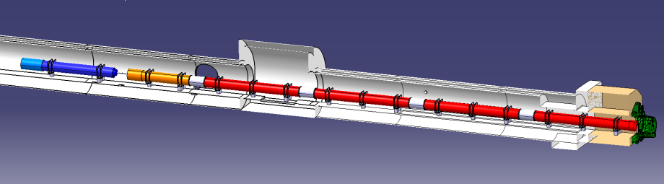





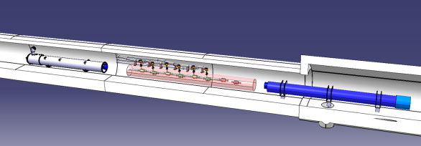


In-kind contribution and Collaboration for HW design and prototypes
ATLAS
CMS
Q1-Q3 : R&D, Design, Prototypes and in-kind USA
D1 : R&D, Design, Prototypes and in-kind JP
MCBX : Design and Prototype ES
HO Correctors: Design and Prototypes IT
Q4 : Design and Prototype FR
CC : R&D, Design and in-kind USA
CC : R&D and Design UK

Slide 13
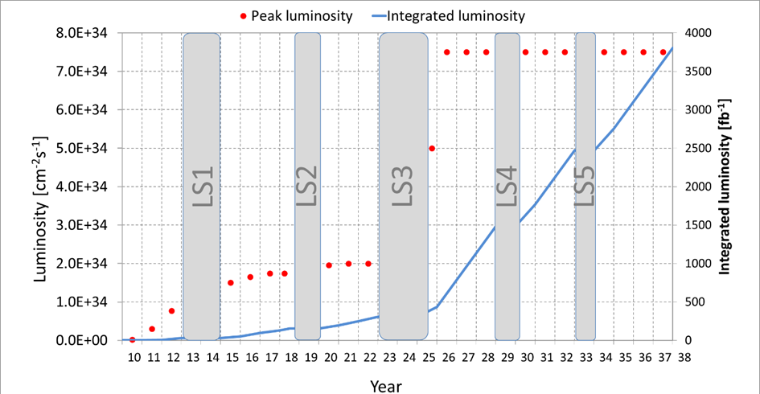
Only with 350 fb⁻¹/y (L_{lev}=7.5 10³⁴ and some optimism) the goal is reachable
L_{lev}=7.5 10³⁴
(or lower if T_{proton} 160 → 200 days/y
Int.L ∼ 4000 fb-1
Mike Lamont

Slide 14
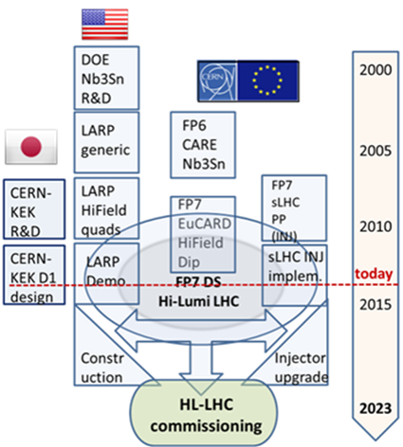
Collaborations
In addition to the FP7-HiLumi LHC (CERN contracts):
CEA (FR) for Q4 Design & proto (also completion Fresca2 technological demo)
INFN-Milano (IT): HO Corrector magnets Design and Prototypes
INFN-Genova (IT): D2 Design
CIEMAT (ES): IT Orbit corrector magnet (nested) desing and prototype
UniMan (UK) for collimators
UniGE (CH), Uni. Bratislava (SK), Twente Univ. (NL) for Nb3Sn
South Hampton U. (UK) under way for SC links

Slide 15
We need more collaborations
Russia
China (proposal made but …)
India (proposal starting: TAXS/TAXN?)
Brazil? Mexico?
Georgia? (R. Veness)
More initiative welcome also from Member States Institutions:
frame: 50%-50% subdivision of the cost.
Time to think beyond FP7 Hilumi governance.

Slide 16
Status of approval and Budget
(May 2013 Brussel : approval by Council as EU)
(June 2013: first construction money for HL-LHC in the CERN MTP)
In 2014 HiLumi LHC established as 1st US priority by P5, process under way
June 2014: approval of MTP 2014-2018 with HL-LHC as main CERN project for the next decade.
Council has approved MTP 2015-2019 including Design and initial Construction cost and took note favorably of the total CtC to 2025 (with a cut proposed by CERN management of about 10%). This inclede approc^xiamtely 740 MCHF.
We are missing about 20% (only!) for the total project wrt to the budgetary evaluation of 2011 (which did not included WP14 and SM18 infrastructure)
This is a challenge, not a nuisance!

Slide 17
HiLumi Book : a collection of papers in scientific style
20 papers, 300 pages
(sorry for the 10 months delay!)

Slide 18
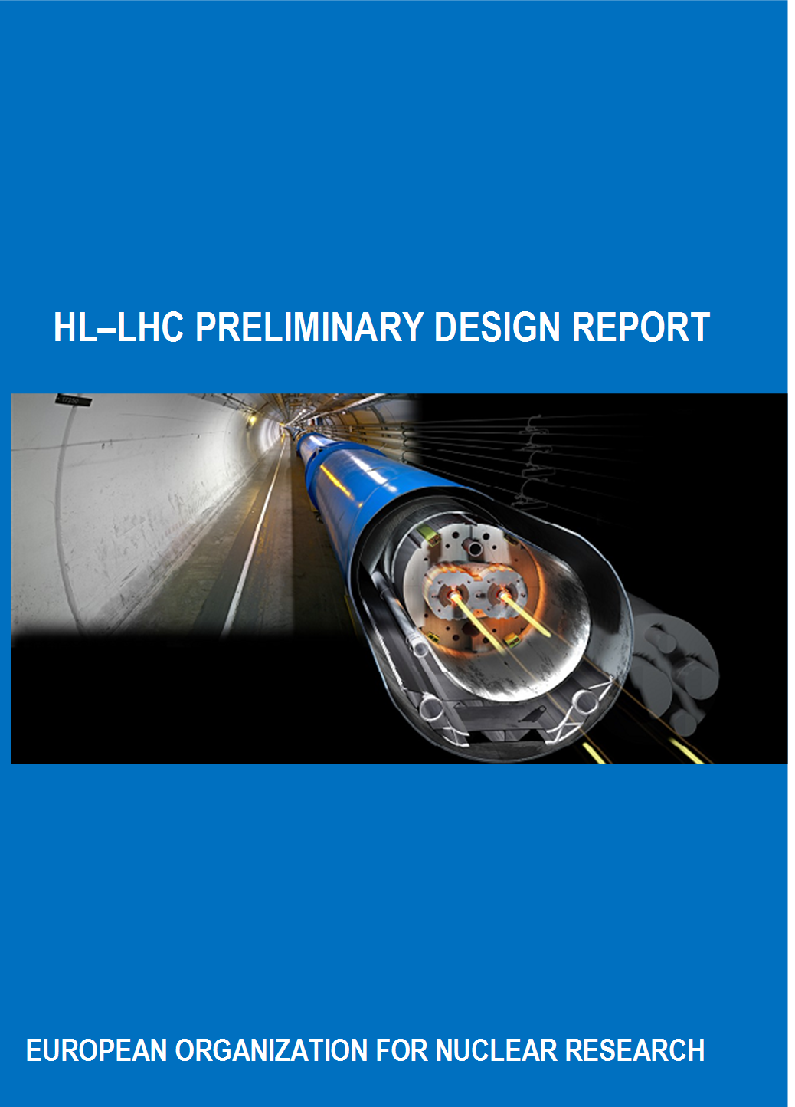
Preliminary
Design Report
PDR
V0 end Nov. For EU
V1 January ’15 after CERN ED approval
V2 March 2015 as CERN yellow report

Slide 19
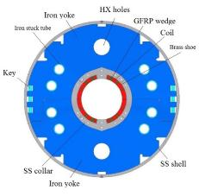
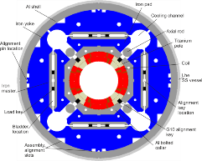
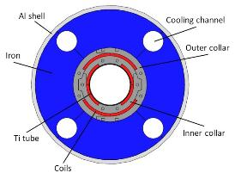
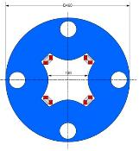
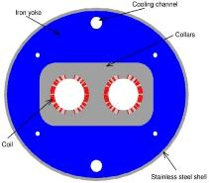
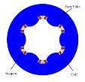
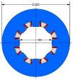
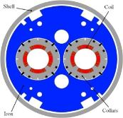
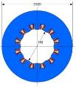
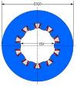

WP3 the magent zoo in the IR
Ezio Todesco
Triplet QXF (LARP and CERN)
Orbit corrector (CIEMAT)
Separation dipole D1 (KEK)
Skew corrector (INFN)
Corrector sextupole (INFN)
Corrector octupole (INFN)
Recombination dipole D2
(INFN design)
Q4 (CEA)
Cross-sections in scale
Corrector dodecapole (INFN)
Corrector decapole (INFN)

Slide 20

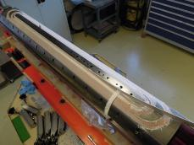

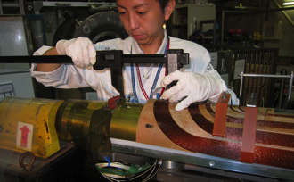
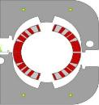

TRIPLET AND DIPOLES
Triplet
  First dummy and Nb₃Sn coils manufactured in US and at CERN
  Cable review done, design in December 2014
  First quadrupole test in 2015
Separation dipole D1
  First Nb-Ti coils being manufactured
  First test in 2015
Recombination dipole D2
  Cross-section defined
  Mechanical structure in progress
QXF coil wound in US
[G.Ambrosio et al., ASC 2014]
D2 collaring [P. Fabbricatore, S: Farinon]
D1 winding at KEK [T. Nakamoto, et al., ASC 2014]

Slide 21
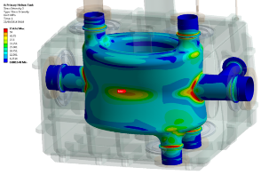
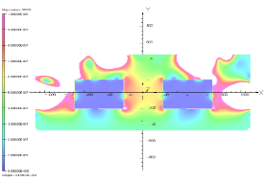
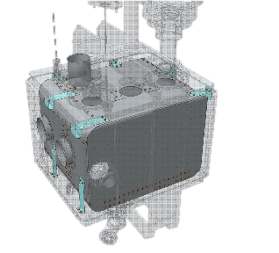
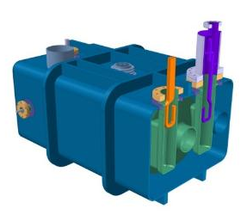
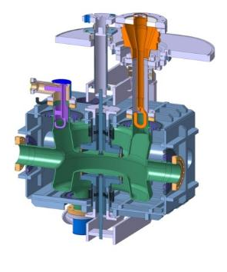
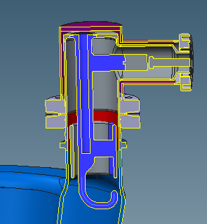
WP 4 : Dressed Crab Cavities
R. Calaga
Dressed cavity designs are almost complete.
This includes the cavity, tuner, couplers, magnetic shielding and the LHe vessel.

Slide 22
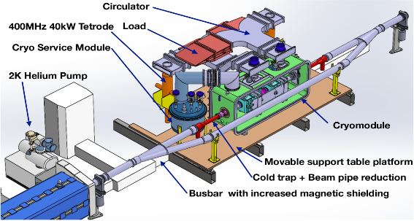
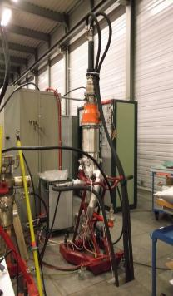
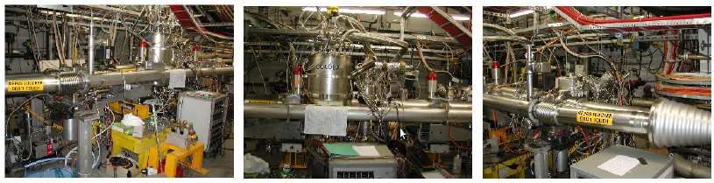
CC SPS tests
On schedule for install the first cryomodule at the end of 2016 and test in in SPS in 2017 and 2018.

Slide 23
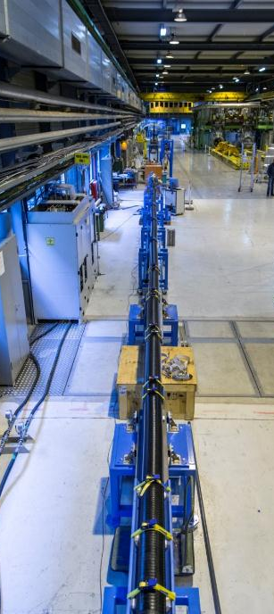
L = 20 m
Φext = 163 mm
Record in MgB₂ SC Line
Φ=19.5 mm
A. Ballarino
Ltot=2×20 m
I= 20 kA @ 24 K
Bp=1 T
Forced flow of He gas
Demonstration of possibility of transferring
high-current in MgB2 cables from round wire

Slide 24
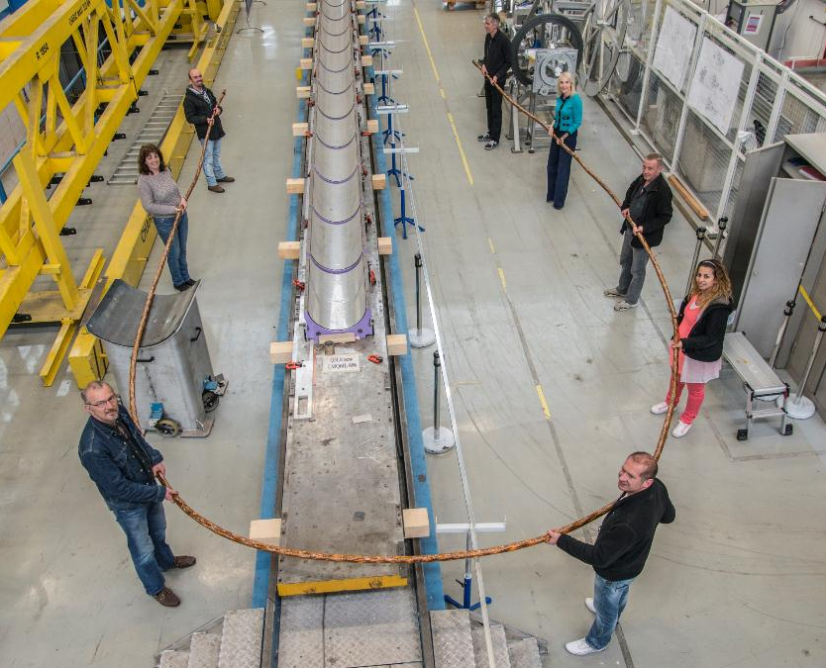
SC Link
for LHC P7
L = 20 m
(25×2) 1 kA @ 25 K, LHC Link P7

Slide 25
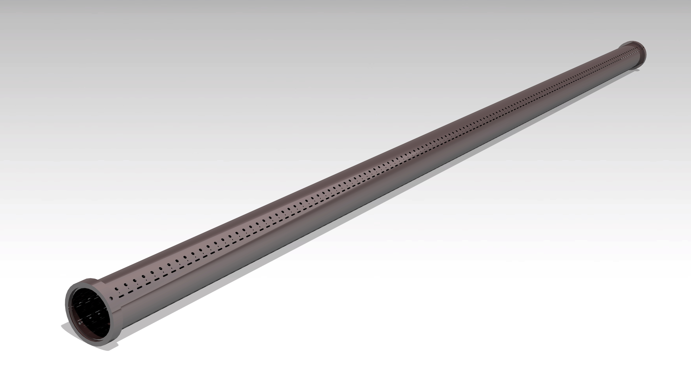
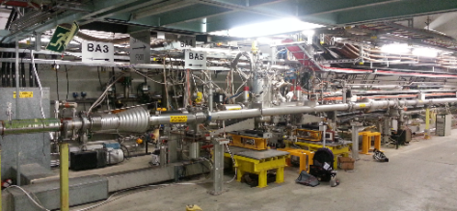
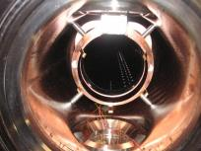
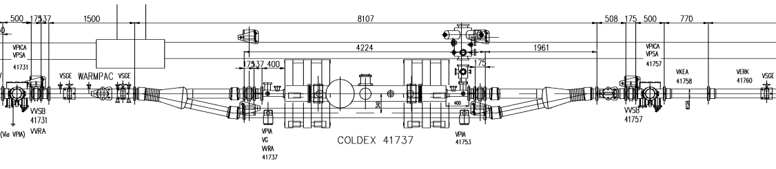
Performance of a-C coated Beam Screen
Photon stimulated desorption at RT of a-C coating at KEK Photon Factory (E_{c} = 4 keV)
COLDEX equipped with a-C coated beam screen held at 50 K
Tests with LHC type beams in SPS (3-9/11/2014):
    Heat load < 1 W/m
    Pressure rise < 10⁻⁸ mbar (mainly H₂)
2015: continue characterisation at cryogenic temperature of a-C coating in the laboratory and with COLDEX
~2.2 m, ID 67 beam screen
Internally coated with amorphous carbon

Slide 26
Cost & Schedule Review - Scope
HL-LHC and LIU projects
taking into consideration how these are linked to the consolidation project and the operation of the CERN accelerator complex
Assess the status of the project development taking into account the technical developments that are still ongoing
Assess the project baseline (not technical – RLIUP),i.e.
    Project Scope
    Schedule
    Cost
    And
    Project Management Methods
    Risks

