Slide 1
Linear Collider R&D Status in cooperation with CERN and KEK focusing on the ILC
Akira Yamamoto (KEK-CERN)
CERN-KEK Committee held at KEK,
21 November, 2014

Slide 2

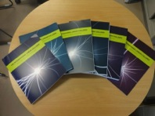
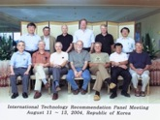
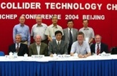
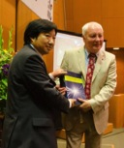
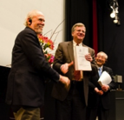
ILC “Design to Realization”
1980’ ~ Basic Study
2005
2006
2007
2008
2009
2010
2011
2012
2013
2014
2004
ILC-GDE
LCC
Ref. Design (RDR)
TDR
Tech. Design：TDP1
TDP 2
TDR completion
LHC
Higgs
discovered
Selection of SC Technology
2013.6.12
126 GeV
2012.12.15

Slide 3
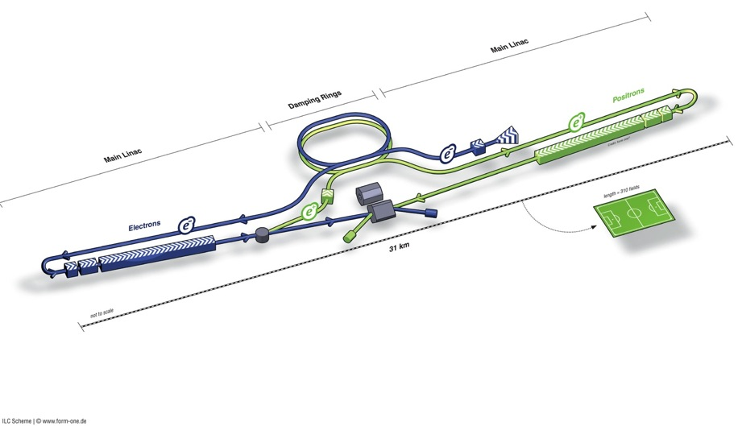
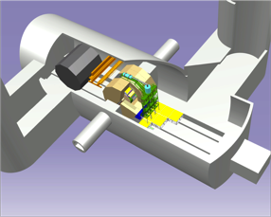
ILC TDR Layout
Damping Rings
Polarised electron source
Ring to Main Linac (RTML)
(including
bunch compressors)
e+ Main Linac
e- Main Linac
Parameters | Value
C.M. Energy | 500 GeV
Peak luminosity | 1.8 x10³⁴ cm⁻²s⁻¹
Beam Rep. rate | 5 Hz
Pulse duration | 0.73 ms
Average current | 5.8 mA (in pulse)
E gradient in SCRF acc. cavity | 31.5 MV/m +/-20% Q₀ = 1E10
E+ source

Slide 4
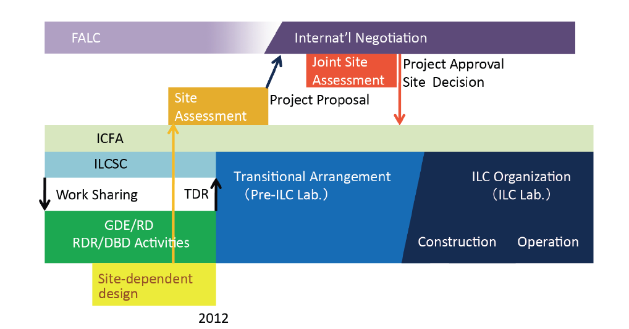
ILC Time Line: Progress and Prospect
Preparation Phase
Expecting ~ (2+ 4) year
Being re-studied
We are here, 2014

Slide 5
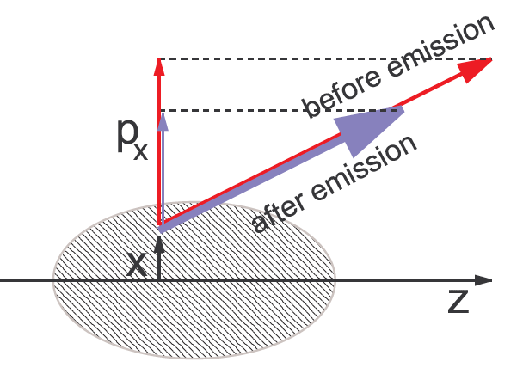
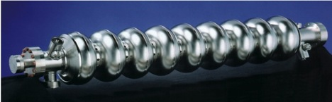
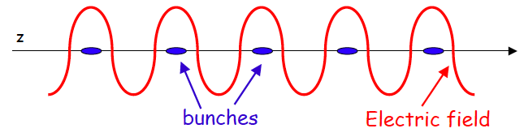
ILC Accelerator Concept
Nano-beam Technology
SRF Technology
Electron and Positron Sources (e-, e+) :
Damping Ring (DR):
Ring to ML beam transport (RTML）:
Main Linac (ML）：SCRF Technology
Beam Delivery System (BDS）
Notes:
5

Slide 6
Remaining Works in Preparation Phase
Key Examples
Accelerator Design and Integration with EDMS:
CFS: Site specific work including Central Campus design and others,
Positron Source: vacuum sealing technology for rotating target,
Damping Ring: Ultra low emittance, Undulators, 650 MHz SCRF,
RTML: residual magnetic field effect in long beam transport-line,
ML: Cavity, CM, Cryogenics integration, to be best cost-effective,
BDS: Final focusing w/ nano-beam, and beam optics update

Slide 7
ILC in Linear Collider Collaboration
To prepare for the ILC project realization
・Detailed design study
・Cost-effective project realization
ICFA
Chair: TBD
FALC
Chair: Y. Okada
Program Adv. Committee
PAC – Chair: N. Holtkamp
Linear Collider Board
LCB – Chair: S. Komamiya
Regional Directors
B. Foster (EU)
H. Weerts (AMs)
A. Yamamoto (AS)
Linear Collider Collab. LCC Directorate
- Director: L. Evans
Deputy (Physics)
– H. Murayama
KEK
KEK
LC Project
Office
Tech.
Board
ILC
– M. Harrison
- (Deputy) H. Hayano
CLIC
– S. Stapnes
Physics & Detectors
– H. Yamamoto
Acc.
Tech. S.
Acc. Design & Integration (ADI)
Technical Support
Phys. & Detector
To be linked to LCC-Phys

Slide 8
LCC-ILC Accelerator Organization
LCC-ILC Director: M. Harrison, Deputies: N. Walker and H. Hayano *KEK LC Project Office Head: A. Yamamoto
Sub-Group | Global Leader Deputy/Contact p. | KEK-Leader* Deputy | Sub-Group | Global Leader Deputy/Contact P. | KEK-Leader* Deputy
Acc. Design Integr. | N. Walker (DESY) K. Yokoya(KEK) | K. Yokoya | SRF | H. Hayano (KEK) C. Ginsburg (Fermi), E. Montesinos (CERN) | H. Hayano Y. Yamamoto
Sources (e-, e+) | W. Gai (ANL) M. Kuriki (Hiroshima U.) | J. Urakawa T. Omori | RF Power & Cntl | S. Michizono (KEK) TBD (AMs , EU) | Michizono T. Matsumoto
Damping Ring | D. Rubin (Cornell) N. Terunuma(KEK) | N. Terunuma | Cryogenics (incl. HP gas issues) | H. Nakai: KEK T. Peterson (Fermi), D. Delikaris (CERN) | H. Nakai Cryog. Center
RTML | S. Kuroda (KEK) A. Latina (CERN) | S. Kuroda | CFS | V. Kuchler (Fnal) A. Enomoto (KEK), J. Osborne (CERN), | M. Miyahara T. Sanuki
Main Linac (incl. B. Compr. & B. Dynamics) | N. Solyak (Fermi) K. Kubo (KEK) | K. Kubo | Radiation Safety | T. Sanami (KEK) S. Roasler (CERN, tbc ) TBD (AMs,) | T. Sanami T. Sanuki
BDS | G. White (SLAC), R. Tomas (CERN) T. Okugi(KEK) | T. Okugi | Electrical Support (Power Supply etc.) | TBD | TBD
MDI | K. Buesser (DESY) T. Tauchi (KEK) | T. Tauchi | Mechanical S. (Vac. & others) | TBD | TBD
 |  |  | Domestic Program, Hub Lab. Facilities | TBD | H. Hayano T. Saeki

Slide 9
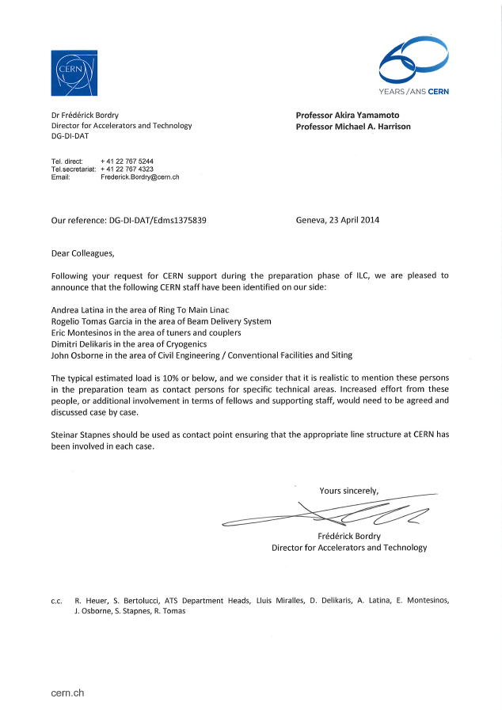
LCC-ILC Accelerator Organization
LCC-ILC Director: M. Harrison, Deputies: N. Walker and H. Hayano *KEK LC Project Office Head: A. Yamamoto
Sub-Group | Global Leader Deputy/Contact p. | KEK-Leader* Deputy | Sub-Group | Global Leader Deputy/Contact P. | KEK-Leader* Deputy
Acc. Design Integr. | N. Walker (DESY) K. Yokoya(KEK) | K. Yokoya | SRF | H. Hayano (KEK) C. Ginsburg (Fermi), E. Montesinos (CERN) | H. Hayano Y. Yamamoto
Sources (e-, e+) | W. Gai (ANL) M. Kuriki (Hiroshima U.) | J. Urakawa T. Omori | RF Power & Cntl | S. Michizono (KEK) TBD (AMs , EU) | Michizono T. Matsumoto
Damping Ring | D. Rubin (Cornell) N. Terunuma(KEK) | N. Terunuma | Cryogenics (incl. HP gas issues) | H. Nakai: KEK T. Peterson (Fermi), D. Delikaris (CERN) | H. Nakai Cryog. Center
RTML | S. Kuroda (KEK) A. Latina (CERN) | S. Kuroda | CFS | V. Kuchler (Fnal) A. Enomoto (KEK), J. Osborne (CERN), | M. Miyahara T. Sanuki
Main Linac (incl. B. Compr. & B. Dynamics) | N. Solyak (Fermi) K. Kubo (KEK) | K. Kubo | Radiation Safety | T. Sanami (KEK) S. Roasler (CERN, tbc ) TBD (AMs,) | T. Sanami T. Sanuki
BDS | G. White (SLAC), R. Tomas (CERN) T. Okugi(KEK) | T. Okugi | Electrical Support (Power Supply etc.) | TBD | TBD
MDI | K. Buesser (DESY) T. Tauchi (KEK) | T. Tauchi | Mechanical S. (Vac. & others) | TBD | TBD
 |  |  | Domestic Program, Hub Lab. Facilities | TBD | H. Hayano T. Saeki
Authorized by
CERN Acc. Director, F. Bordry

Slide 10
LCC-ILC Accelerator Organization
LCC-ILC Director: M. Harrison, Deputies: N. Walker and H. Hayano *KEK LC Project Office Head: A. Yamamoto
Sub-Group | Global Leader Deputy/Contact p. | KEK-Leader* Deputy | Sub-Group | Global Leader Deputy/Contact P. | KEK-Leader* Deputy
Acc. Design Integr. | N. Walker (DESY) K. Yokoya(KEK) | K. Yokoya | SRF | H. Hayano (KEK) C. Ginsburg (Fermi), E. Montesinos (CERN) | H. Hayano Y. Yamamoto
Sources (e-, e+) | W. Gai (ANL) M. Kuriki (Hiroshima U.) | J. Urakawa T. Omori | RF Power & Cntl | S. Michizono (KEK) TBD (AMs , EU) | Michizono T. Matsumoto
Damping Ring | D. Rubin (Cornell) N. Terunuma(KEK) | N. Terunuma | Cryogenics (incl. HP gas issues) | H. Nakai: KEK T. Peterson (Fermi), D. Delikaris (CERN) | H. Nakai Cryog. Center
RTML | S. Kuroda (KEK) A. Latina (CERN) | S. Kuroda | CFS | V. Kuchler (Fnal) A. Enomoto (KEK), J. Osborne (CERN), | M. Miyahara T. Sanuki
Main Linac (incl. B. Compr. & B. Dynamics) | N. Solyak (Fermi) K. Kubo (KEK) | K. Kubo | Radiation Safety | T. Sanami (KEK) S. Roasler (CERN, tbc ) TBD (AMs,) | T. Sanami T. Sanuki
BDS | G. White (SLAC), R. Tomas (CERN) T. Okugi(KEK) | T. Okugi | Electrical Support (Power Supply etc.) | TBD | TBD
MDI | K. Buesser (DESY) T. Tauchi (KEK) | T. Tauchi | Mechanical S. (Vac. & others) | TBD | TBD
 |  |  | Domestic Program, Hub Lab. Facilities | TBD | H. Hayano T. Saeki
Authorized by
CERN Acc. Director, F. Bordry

Slide 11
Further Global Cooperation to be emphasized
Category | Work-base | Specific subject | Global Collaboration w/
Positron Source |  | Positron source | PosiPol Collaboration
Nano Beam | ATF | 37 nm beam 2 nm stability | ATF collaboration with CERN
SCRF Cavity Integration | STF | Power Input Coupler Tuner He-Vessel | CERN-DESY-KEK CEA-Fermi/SLAC-KEK DESY-KEK (WS at CERN, 5 Sept. 2014)
CM integration | STF, ILC | Conduction-cooled SC Quadrupole | Fermilab-KEK
Cryogenics | ILC | Cryog. Underground He inventry High p. Gas Safety | CERN-Fermilab-KEK (WS at CERN, 18 June, 2014)
CFS | ILC | CFS design prep. | CERN-Fermilab-KEK
Radiation Safety | ILC | ML radiation shield | SLAC-DESY-CERN-KEK

Slide 12
Cooperation with CERN and KEK
Nano-beam handling technology >> to be reported by R. Tomas
  Nano-beam and the stability as a common subject for both ILC and CLIC, through ATF collaboration
  Final focusing including magnet and the mechanical stability, as well as commissioning technology, still to be investigated
SCRF cavity integration technology,
  Specially on input-power couplers and tuners, as a common subject for both ILC and SPL for LHC injector upgrade,
Cryogenic engineering
  Specially on handling of large amount of helium inventory, as a specially crucial issue in mountain region,
Civil engineering study
  specially for the detector-hall design,
Radiation Safety
  Radiation safety design and optimization

Slide 13
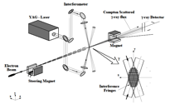
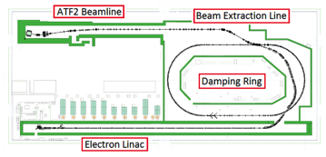

IPAC2014, K. Kubo
ICHEp2014, S. Kuroda
Progress in Beam Size at ATF2
To be reported by G. Tomas
Beam Size 44 nm observed,
(Goal : 37 nm
corresponding to 6 nm at ILC)

Slide 14
Extension of the FY2014 Operation to be realized w/ specially contribution by CERN
In addition to the operation in October and November, the operation can be extended in December,
  10/20-10/31 Beam Operation
  11/3-11/7 Maintenance
  11/10-11/21 Beam Operation
  11/24-11/28 Maintenance
  12/1-12/19 Beam Operation Extension
Special thanks for the CERN’s cooperation!

Slide 15
Cooperation with CERN and KEK
Nano-beam handling technology >> to be reported by G. Thomas
  Nano-beam and the stability as a common subject for both ILC and CLIC, through ATF collaboration
  Final focusing including magnet and the mechanical stability, as well as commissioning technology, still to be investigated
SCRF cavity integration technology,
  Specially on input-power couplers and tuners, as a common subject for both ILC and SPL for LHC injector upgrade,
Cryogenic engineering
  Specially on handling of large amount of helium inventory, as a specially crucial issue in mountain region,
Civil engineering study
  specially for the detector-hall design,
Radiation Safety
  Radiation safety design and optimization

Slide 16
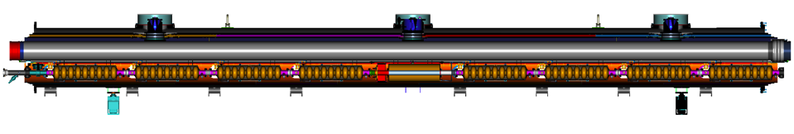
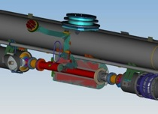
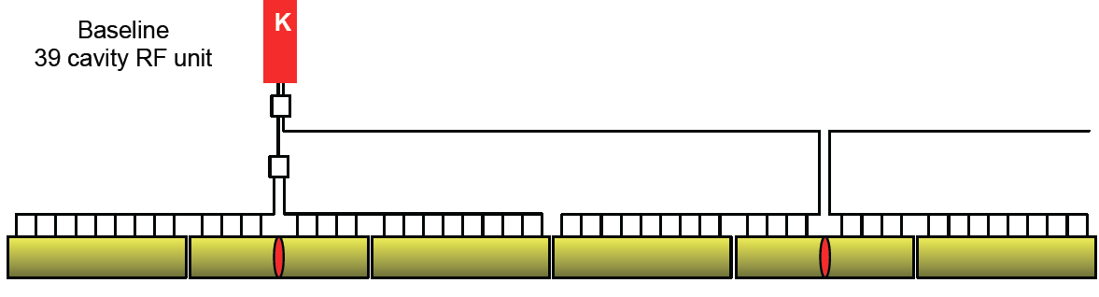
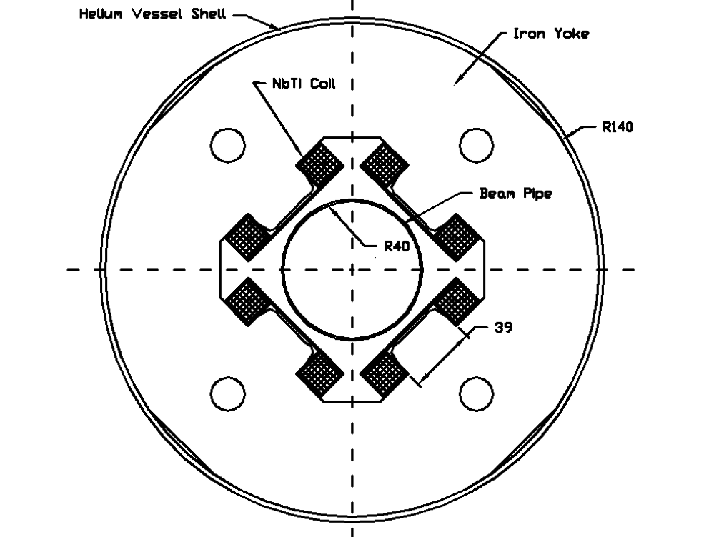
ILC CM Assembly
Type-B module
Type-A has 9 cavities and no quadrupole
cavities (8)
SC quad package
12.652 m (slot length)

Slide 17
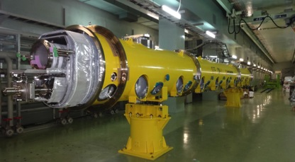
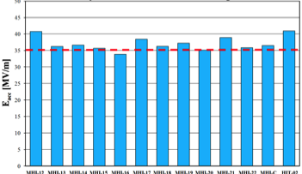
STF2; SCRF Accelerator Plan at KEK
■ Objective
• High Gradient (31.5 MV/m)
＝＞Demonstration of full cryomodule
・Pulse and CW operation (for effectuve
• Training for next generation s
Plan:
Multiple CM for system study
In-house Cavity to be installed
in cooperation with industry
Wide range application including
Photon Science
Electron Gun
Full Cryomodule s
Undulators
Detector
CM0
BC
SC RF-Gun
CM1
CM2a+2b
CM3a +3b,
Beam Dump
Gradient achieved at KEK-STF: > ~ 35 MV/m
Progress: > 90 %, at individual vertical test
Beam Acceleration to be in 2015

Slide 18
H.Hayano
S1-Global Cavity Packages
TESLA-ILC cavity
TESLA-XFEL cavity
Blade tuner
Lever-arm tuner
FNAL cavity
DESY cavity
TTF-III coupler
TTF-III coupler
TESLA-like KEK cavity
TESLA-like KEK cavity
Slide-jack tuner (center)
Slide-jack tuner (end)
KEK-type1 cavity
KEK-type2 cavity
STF-2 coupler
STF-2 coupler

Slide 19

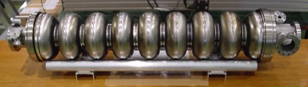
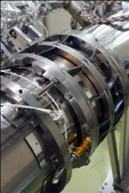
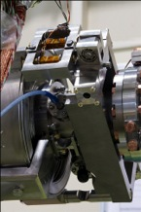
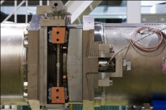
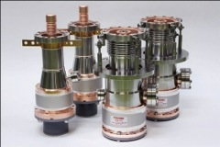
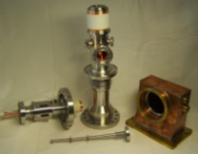
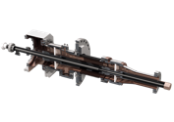
Cavities, Tuners, Couplers in S1-G Cryomodule
TESLA Cavity (DESY/FNAL)
Tesla-like Cavity (KEK)
Slide-Jack Tuner (KEK)
Blade Tuner (INFN/FNAL)
Saclay Tuner
(DESY)
TTF-III Coupler
(DESY/FNAL/SLAC)
STF-II Coupler (KEK)

Slide 20
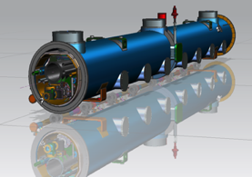
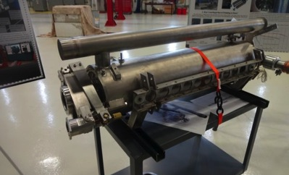
LCLS-II Cavity: a Tuner Design Option to be investigated
LCLS Tuner design covering the beam
Pipe flanges, overcoming a constraint
with a shorter beam pipe
T. Peterson, C. Grimm, et al.,
EXFEL, Tesla type tunder assembly
PHoto, at Fermilab

Slide 21
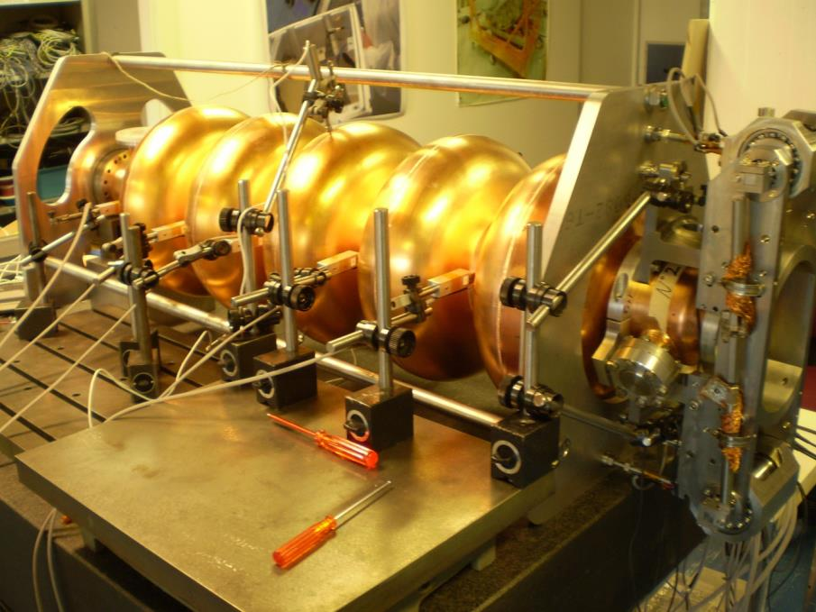
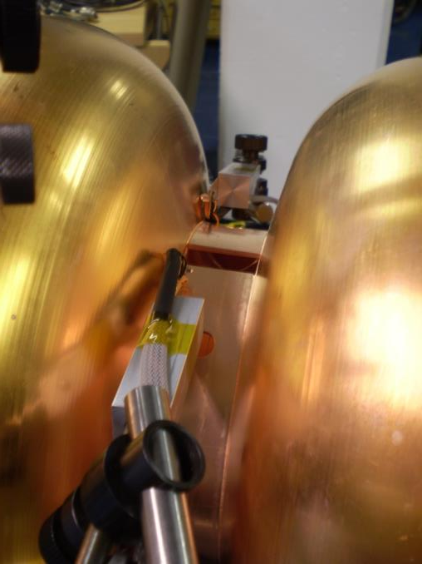
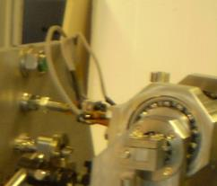
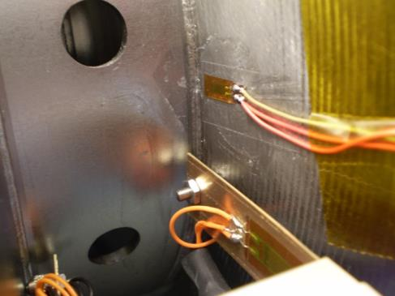
Courtesy M. Guinchard
5 LVDT’s HBM® – WI +/- 2.5mm
5 Displacement sensors based on bending stress measurements
Custom force sensors on rods
HBM® load cells
DAQ QuantumX from HBM ® – Fs 50 Hz

Slide 22
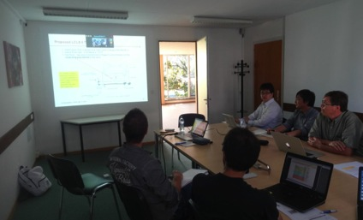
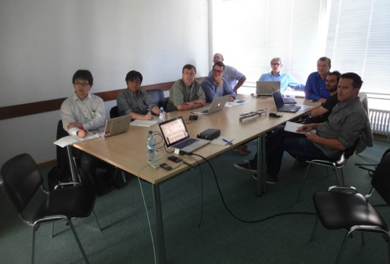
SRF Tuner Workshop at CERN,
5 Sept. 2014

Slide 23
H.Hayano
S1-Global Cavity Packages
TESLA-ILC cavity
TESLA-XFEL cavity
Blade tuner
Lever-arm tuner
FNAL cavity
DESY cavity
TTF-III coupler
TTF-III coupler
TESLA-like KEK cavity
TESLA-like KEK cavity
Slide-jack tuner (center)
Slide-jack tuner (end)
KEK-type1 cavity
KEK-type2 cavity
STF-2 coupler
STF-2 coupler

Slide 24
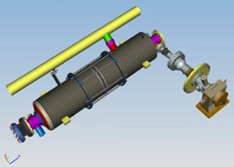
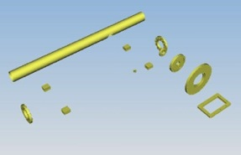
Plug-compatible Conditions
Item | Variation | TDR Baseline
Cavity shape | TESLA / LL | TESLA
Length |  | Fixed
Beam pipe flange |  | Fixed
Suspension pitch |  | Fixed
Tuner | Blade/ Slide-Jack | Blade (→ Lever Tuner as alternate)
Coupler flange (cold end) | 40 or 60 | 40 mm
Coupler pitch |  | Fixed
He –in-line joint |  | Fixed
Magnetic shield | Inside/outside | Inside
相対コスト（現状）:
Coupler: STF > TTF-III coupler (XFEL)
Tune/He-V: S-Jack >> Blade >> Lever (XFEL)
Mag. Shield: Inside > Outside (XFEL)

Slide 25
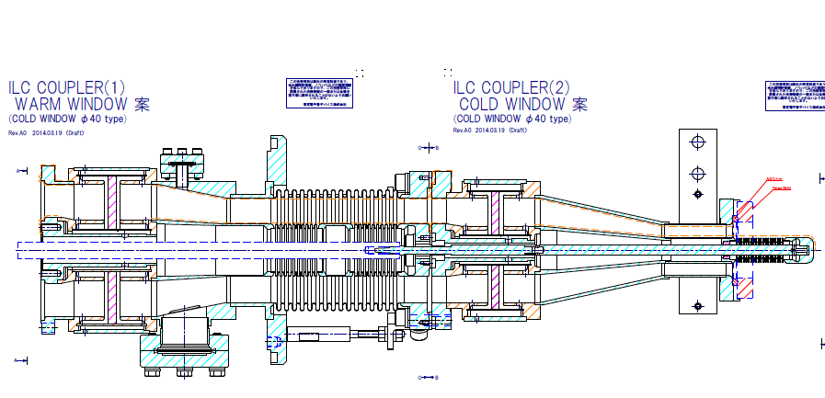
SCRF Power-Input Coupler
Cold-end half/element
Ceramic window

Slide 26
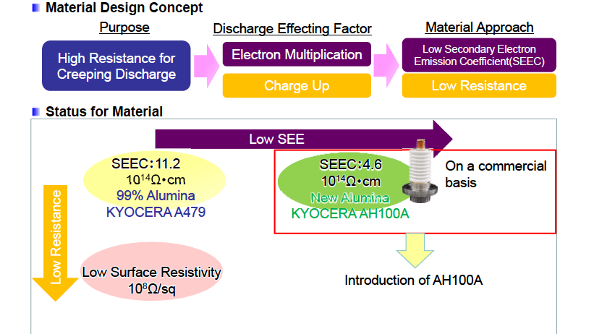
An approach with lower SEE and Lower Resistance Ceramic Window

Slide 27
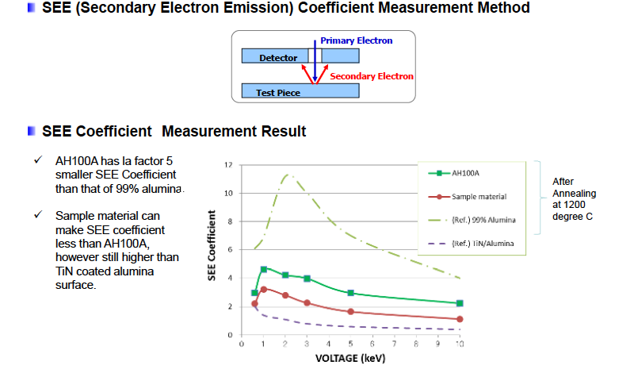
Lower Secondary Electron Emission and lower surface resistance

Slide 28
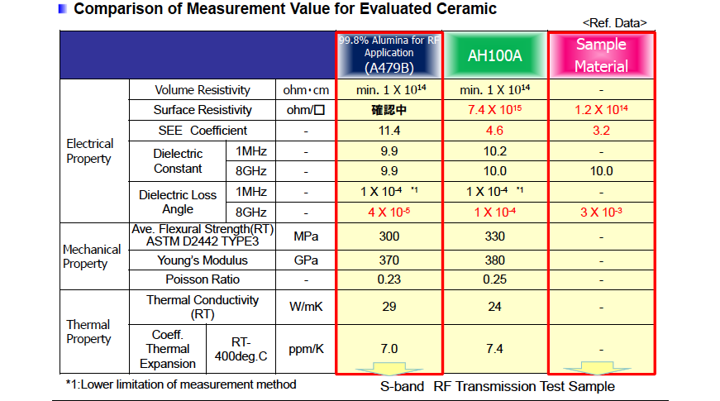
Trial/Sample Ceramic compared with conventional Ceramic

Slide 29
New SCRF Power-Input Coupler under development
Cold-end half/element
Ceramic window
A pair of new coupler using the new ceramic insulator being
developed with CERN’s contribution

Slide 30
Cooperation with CERN and KEK
Nano-beam handling technology >> to be reported by G. Thomas
  Nano-beam and the stability as a common subject for both ILC and CLIC, through ATF collaboration
  Final focusing including magnet and the mechanical stability, as well as commissioning technology, still to be investigated
SCRF cavity integration technology,
  Specially on input-power couplers and tuners, as a common subject for both ILC and SPL for LHC injector upgrade,
Cryogenic engineering
  Specially on handling of large amount of helium inventory, as a specially crucial issue in mountain region,
Civil engineering study
  specially for the detector-hall design,
Radiation Safety
  Radiation safety design and optimization

Slide 31
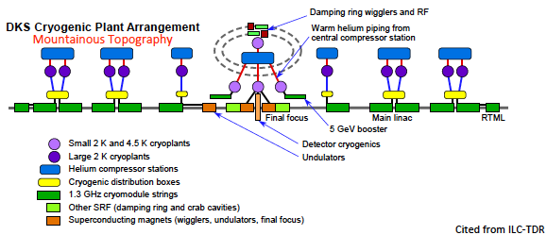
ILC Cryogenics
~ 20 kW at 4.5 K /each
Cryogenis scale is very similar to the LHC Cryogenics

Slide 32
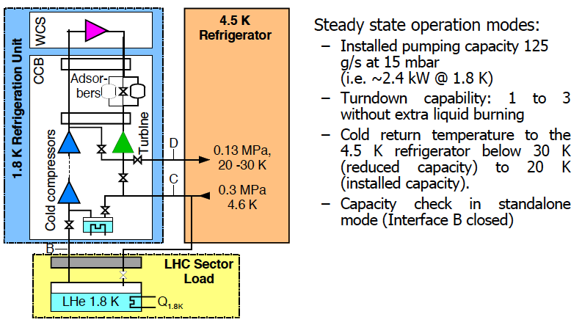
CERN-LHC Cryogenics Diagram

Slide 33
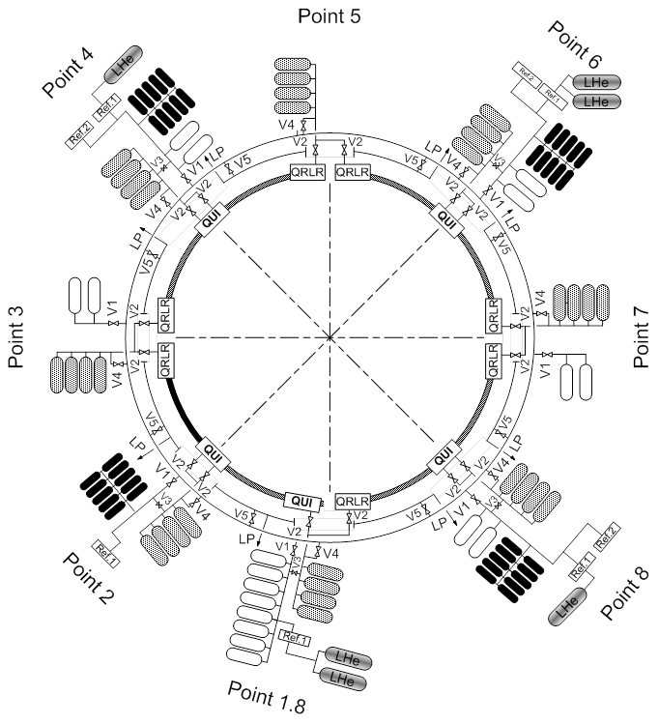



Helium Storage & Distribution
LHC helium storage &
Distribution (high grade helium ring line, 2 MPa, 27 km long, for LHC operation)
[Completing the existing CERN helium recovery system: high grade, 20 MPa, 5 km long and low grade, 3 kPa & 20 MPa, 3 km long each]

Slide 34
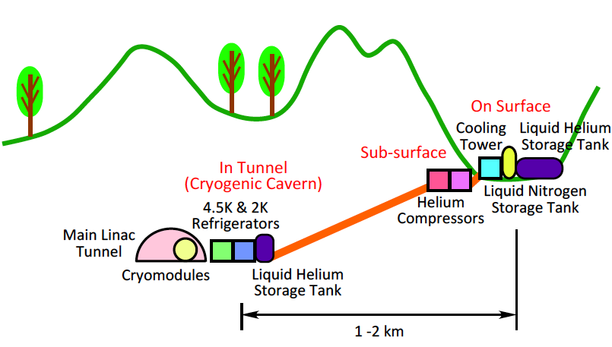
ILC Cryogenics Layout Investigated

Slide 35
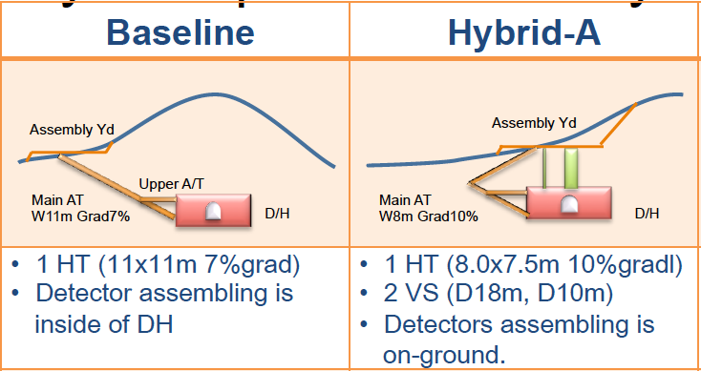
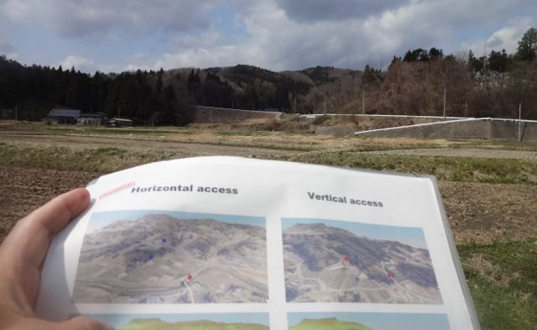
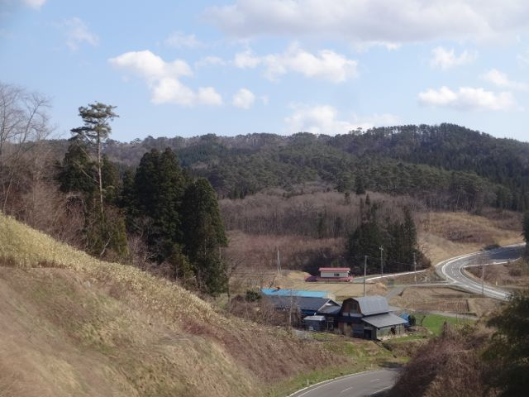
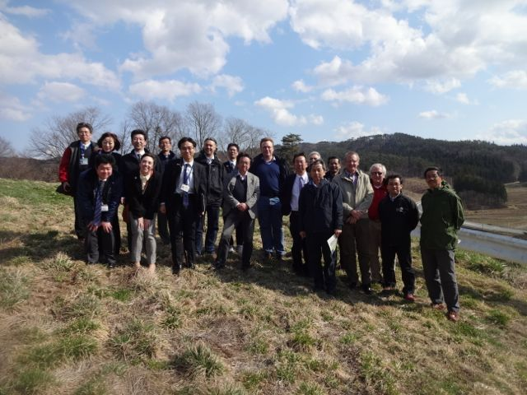
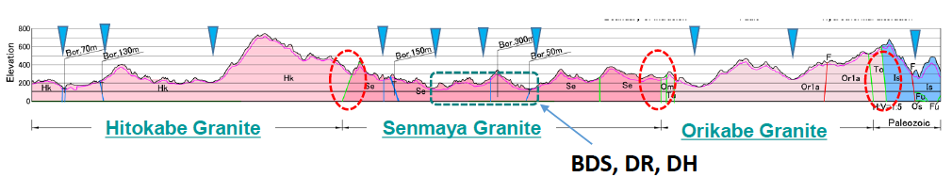
IP Access Design under Re-investigation
TDR IP point

Slide 36
Cooperation with CERN and KEK
Nano-beam handling technology >> to be reported by G. Thomas
  Nano-beam and the stability as a common subject for both ILC and CLIC, through ATF collaboration
  Final focusing including magnet and the mechanical stability, as well as commissioning technology, still to be investigated
SCRF cavity integration technology,
  Specially on input-power couplers and tuners, as a common subject for both ILC and SPL for LHC injector upgrade,
Cryogenic engineering
  Specially on handling of large amount of helium inventory, as a specially crucial issue in mountain region,
Civil engineering study
  specially for the detector-hall design,
Radiation Safety
  Radiation safety design and optimization

Slide 37


ILC Candidate Location: Kitakami Area
High-way
Ofunato
Oshu
Express-
Rail
Kesen-numa
Sendai
Ichinoseki
IP Region

Slide 38


Slide 39

“Kitakami” Landscape, ILC Acc., and CM Models
EDMS work, in cooperation w/ DESY & Fermilab EDMS Team
B. List and H. Lars
A movie separately shown:
http://www.desy.de/~blist/ILC_Movie_AWLC_20141.mp4

Slide 40

Radiation Shield Optimization
Central Radiation Shield
  Wall thickness is being optimized with worldwide discussion
  CERN’s expert advice is being given
Tunnel
RF Distribution
Lattice
Cryomodules

Slide 41
Summary
ILC published Technical Design Report in 2013, and is getting into the “preparation phase”.
The new organization has been established with merging the ILC and the CLIC project under the Director-ship by Dr. L. Evans.
It includes significant CERN’s participations in the world-wide organization, specially for DR, BDS, SRF, Cryogenics, CFS, and Radiation Safety, and further close cooperation is being realized.
We would thank CERN’s cooperation and special support for maximizing the ATF operation in the critical stage approaching a design goal of the R&D in final focusing.

Slide 42
backup

Slide 43
ILC Project Overview
Years | TDR baseline Scenario
1 - 2 | Pre-preparation for 2yrs (for technical effort continuity) 前段階・先端技術開発の継続（２年）
3 - 6 | Preparation (4 yrs) ILC 建設への準備段階（4年）
7 - 15 | Construction (9 yrs) 建設（9年）
(12 -) | (start installation) 組み込みの開始
(13 -) | (start preparation for Commissioning and operation (to be studied) 運転経費（加速器要素・試験設備運転等）の段階的立ち上げ (検討要）
16 - | Beam Commissioning start ビームコミッショニングのスタート
17 – | Operation at 250 ~ 500 GeV (550 GeV) 物理実験 @ 250 ~ 500 GeV (550 GeV)
TBD | Toward 500 GeV HL upgrade ルミノシティーアップグレード(500 GeV)
TBD | Toward 1 TeV upgrade エネルギーアップグレード (1 TeV)

Slide 44
Management of Cryogenic Fluids
Total HELIUM inventory at CERN: 170’000 kg
LHC (accelerator & detectors) helium full inventory: 136’000 kg
Additional strategic permanent storage during operation: 15’000 kg
In situ helium liquefaction for central services (up to 350’000 liter per year)
and distribution by means of mobile containers ranging from 100 to 2’000 liter
(users without dedicated cryogenic plant)

