Slide 1


D1 Development Status
T. Nakamoto
KEK
CERN-KEK Committee
21 November 2014, KEK

Slide 2
Participants & Supports
KEK
T. Nakamoto, M. Sugano, S. Enomoto, H. Kawamata,
Q. Xu (left March 2014), N. Higashi, N. Okada, R. Okada,
Y. Ikemoto, M. Iio, T. Ogitsu, K. Sasaki, N. Kimura, M. Yoshida, A. Yamamoto.
CERN
E. Todesco, A. Musso, G. Kirby, F. Savary, A. Ballarino,
P. Fessia.

Slide 3
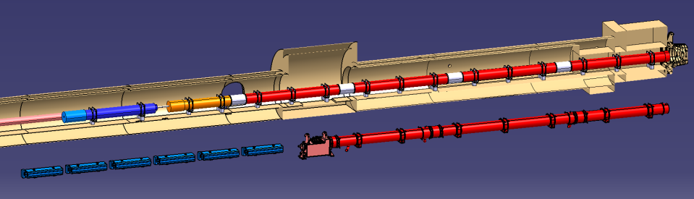





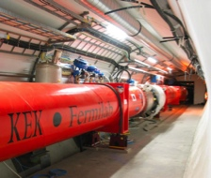

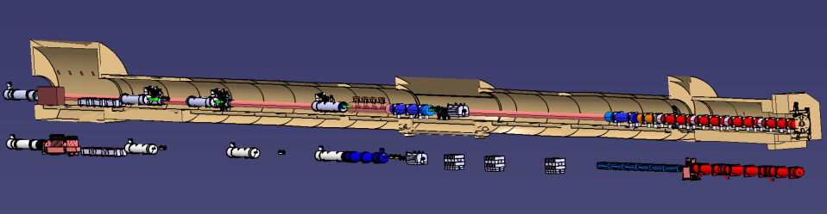

Layout of IR Magnets
IT Quads.& D1
HL-LHC
IT Quads. w/ Nb₃Sn
Q1
Corrector
Package
Q2b
Q2a
Q3
SC D1
Nominal LHC
NC D1
Long Straight Section
HL-LHC
Crab Cavity
Q4
D2
Nominal LHC
Aperture increase in IT Quads:70mm→150mm Large bore also for the new D1
Replacement of current NC D1 by SC D1: Shortening magnet length by 15m
Making room for new crab cavities

Slide 4
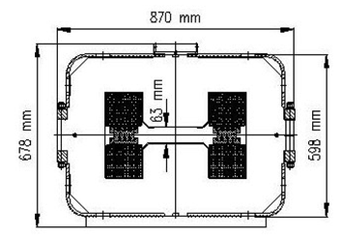
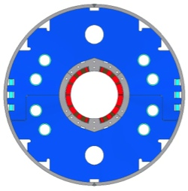
NC vs SC
 | Beam separation dipole, D1
 | LHC | HL-LHC
Aperture | 52mm gap | 150mm
Nominal Field (Peak Field) | 1.4 T | 5.6 T (6.5 T)
Magnetic Length | 3.4 m x 6 ~21m | 6.27 m
Stored Energy | 0.014 MJ/m | 0.34 MJ/m

Slide 5

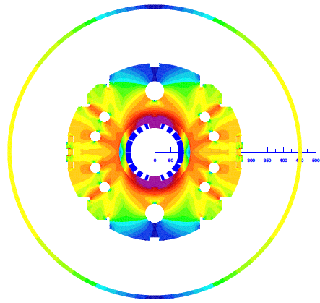
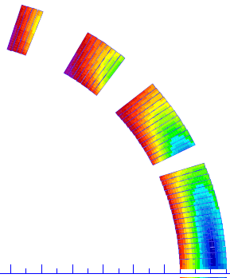
Latest Design Parameters of D1
Coil ID: 150 mm
Integrated field:35 T m (26 Tm at present LHC)
  5.59 T at 12 kA. L_{coil}=6.3 m
T_{op}: 1.9 K by HeII cooling
Op. point (2D coil): 75 %
Coil layout: 1 layer of 15.1 mm cable
  Better cooling. Saving space for iron yoke.
Conductor: Nb-Ti LHC MB outer cable
Structure: Collared yoke structure by keying
  RHIC dipole, LHC MQXA, J-PARC SCFM
  Enhancing iron material for stray field issue
Field quality: < 10⁻⁴ at R_{ref} = 50 mm
Cold mass OD: 550 +10 x 2 = 570 mm
Cryostat OD: 914 mm, same as MB cryostat
Radiation, energy deposition:
4
8
13
135 W in total, 2 mW/cm³ at local peak, Radiation dose >25 MGy
Stress management
High saturation, stray field, flux return cryostat
Radiation resistance, cooling capability
44 turns
5

Slide 6
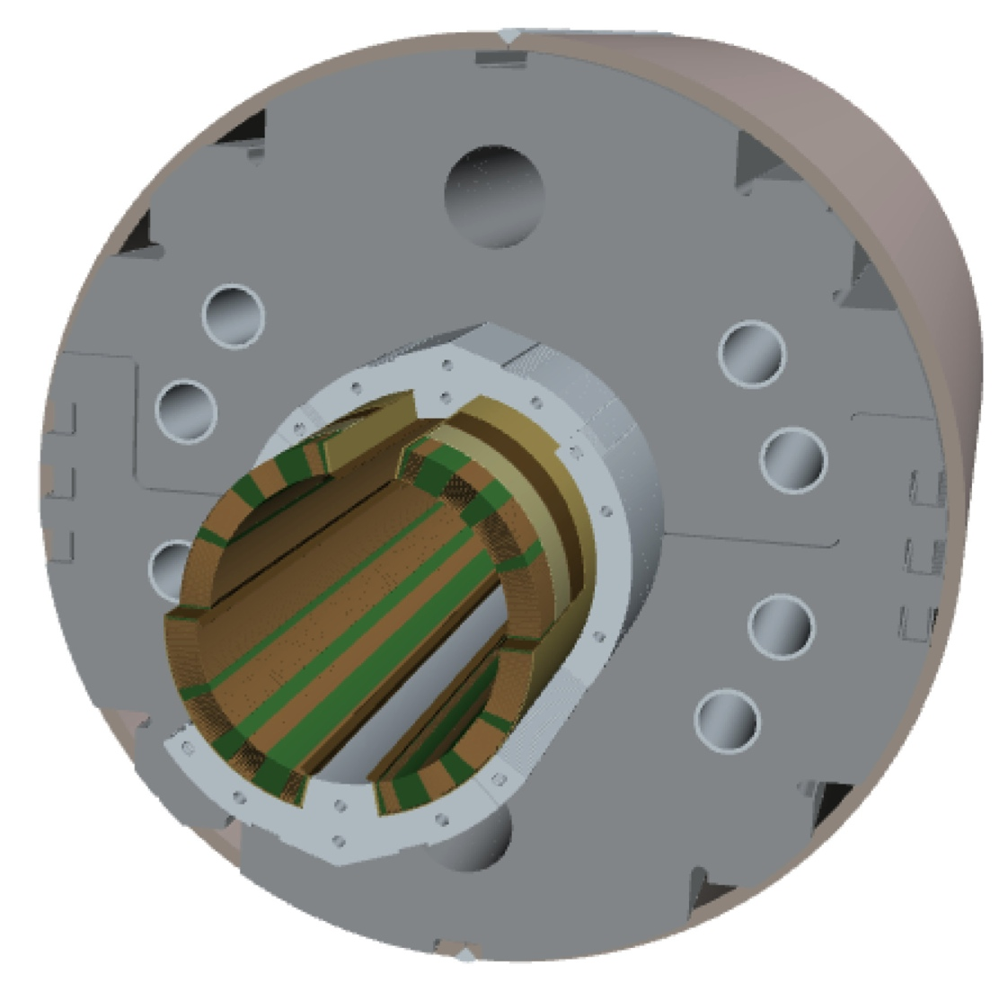
2m-long Model Magnet - Overview
Single-layer coil, 4-split spacer collars, collared yoke by keying
φ60 mm HX hole
Notches and φ 34 mm holes for iron saturation effects
HeII cooling channel
Shell: SUS304L
4 split stainless steel spacer collars: NSSC130S
Same outer-interface for J-PARC SCFM jigs
Brass shoes
Collaring keys
NbTi SC cable (LHC MB outer) + Apical insulation
Radiation resistant GFRP (S2 glass + BT resin) wedges
Horizontal split iron yoke:
low-carbon steel (EFE by JFE steel)

Slide 7
Deliverables
One 2m long model magnet will be built and tested at KEK.
The second model development is also planned.
Design parameters | Production | 2-m model
Field integral | 35 T•m | 10.3 T•m
Magnetic length | 6.27 m | 1.85 m
Coil mechanical length | 6.46 m | 2.00 m
Magnet mechanical length | 6.96 m | 2.50 m
Cold mass weight | 12 tons | 3.8 tons
Cable unit length per coil | 568 m | 175 m

Slide 8
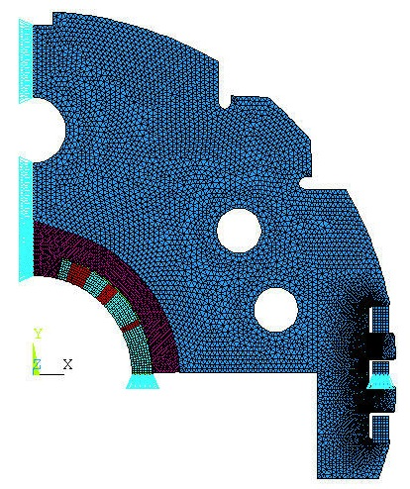
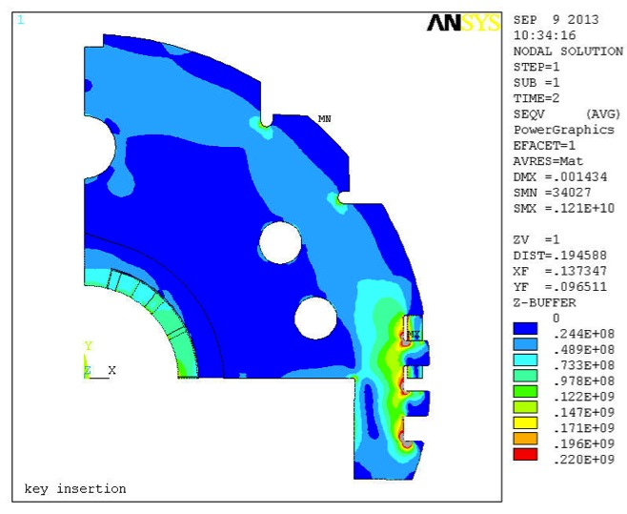
Mechanical Analysis: Yoking
Mechanical analysis during the assembly process, cooling and excitation using ANSYS has been completed
Highest stress arisen at key slots in the yoke < 220 MPa
→ The assembly scheme would be feasible
Key insertion
UX = 0
Yoke
0.5 unit
thickness
Collar
Coil
Stress in the yoke
UY = 0
Remove load from the yoke shoulder and insert the load-key; The gap between top and bottom yokes keep closed at both ends.

Slide 9
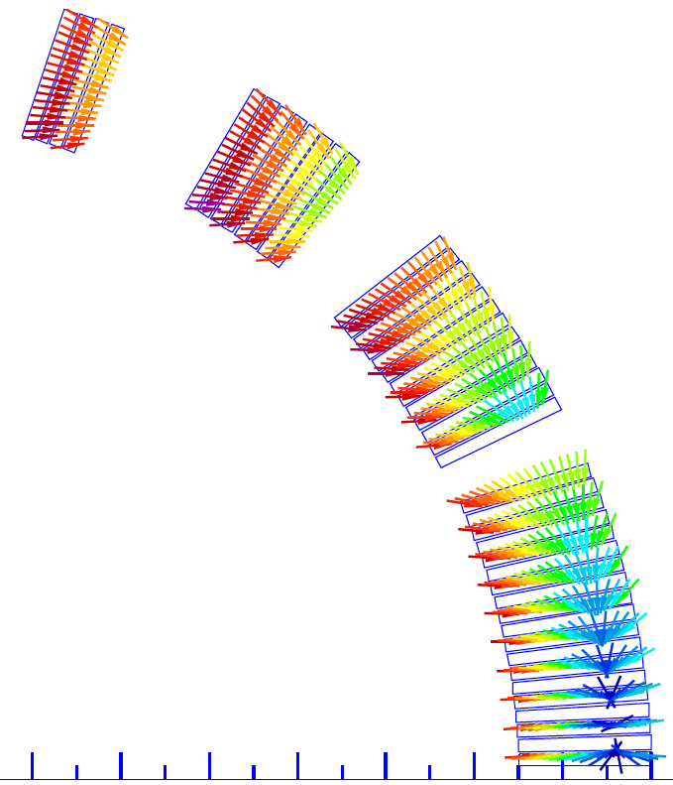
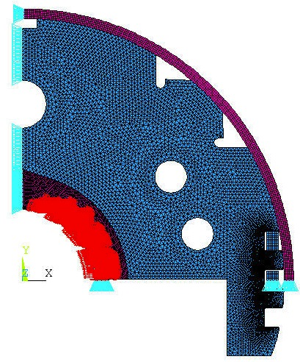


Mechanical Analysis: Coil Stress
Excitation
Pole
UX = 0
Mid-plane
Yoke
Collar
Coil
UY = 0
Coil stress during yoking: 100 MPa

Slide 10
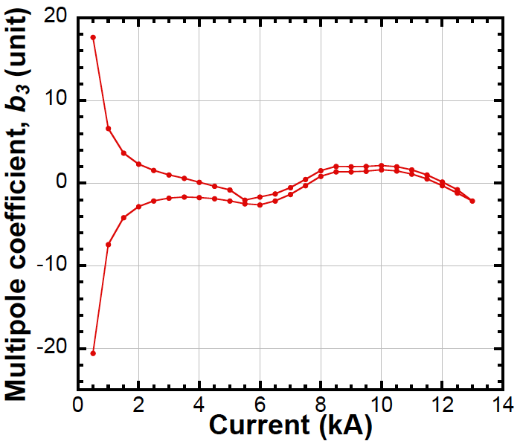
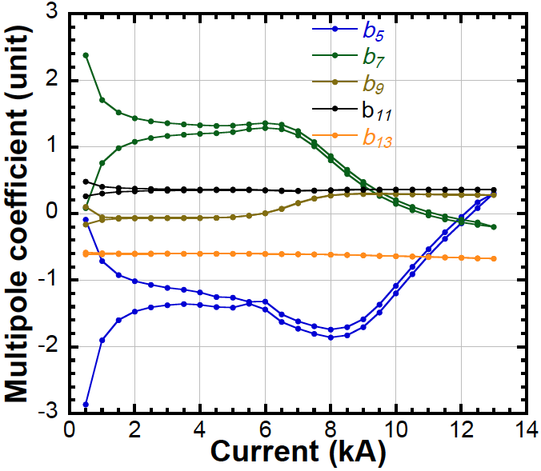
Magnetic Design by ROXIE:
Variation of multipole coefficients
b₃
b₅ ~ b₁₃
Nominal
current
Nominal current
b₃

Slide 11
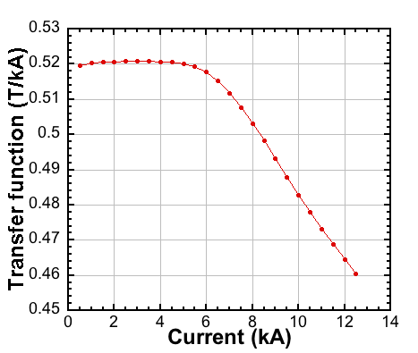
Magnetic Design by ROXIE:
Transfer Function
Nominal current
Transfer function starts to decrease at 6 kA and the value at the nominal
current is lower by 10% than one at low field

Slide 12
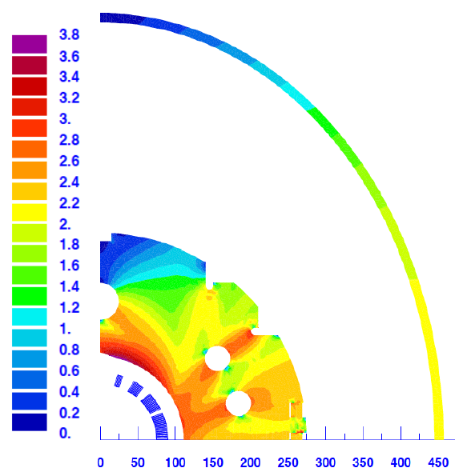
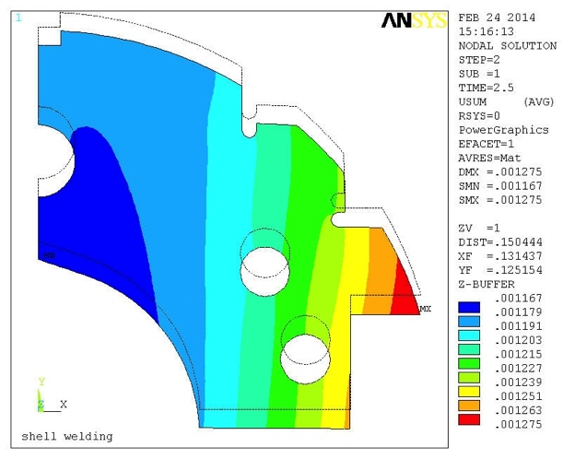
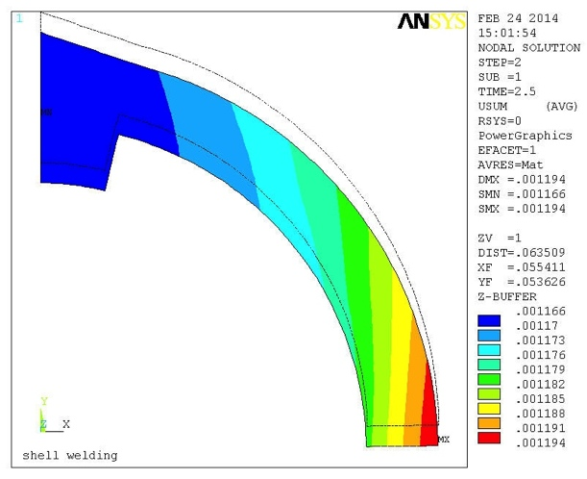
Magnetic Design by ROXIE:
Possible Error Sources
ID890 mm x 1112 mm,
t=12 mm, elliptical
(Change of b₃ by each factor)
Impact of possible design changes
Diameter and position of HX holes (-5.1 units)
Shape of cryostat (Elliptical cryostat option)
(-2 units)
Systematic errors
Packing factor of iron yoke (-1.2 units)
Relative permeability of stainless steel collar (-0.6 units)
Mispositioning of coil blocks during yoking
(-1 unit)
Yoke
Collar
Random geometric error
32μm
33μm
5μm
33μm
9μm
D
C
A
12μm
20μm
Thanks to Susana Izquierdo Bermudez
for her technical support in ROXIE
55μm
B
54μm

Slide 13
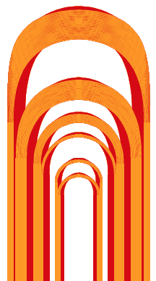
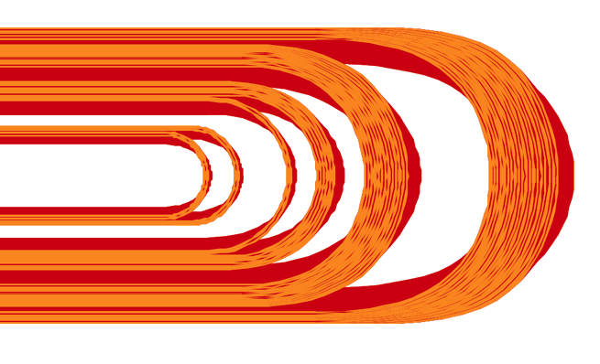
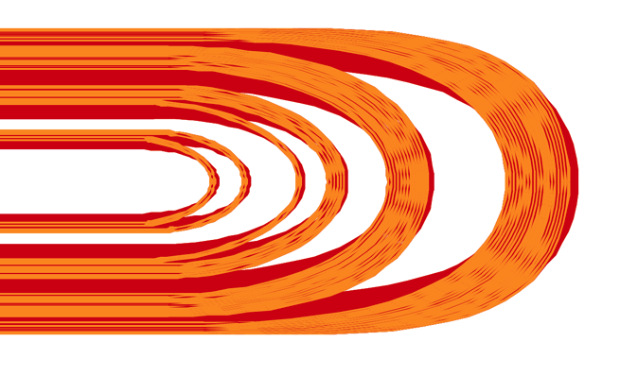

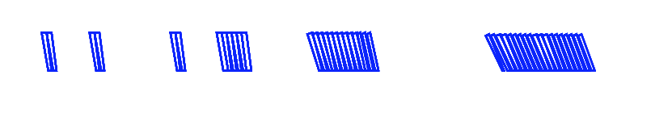

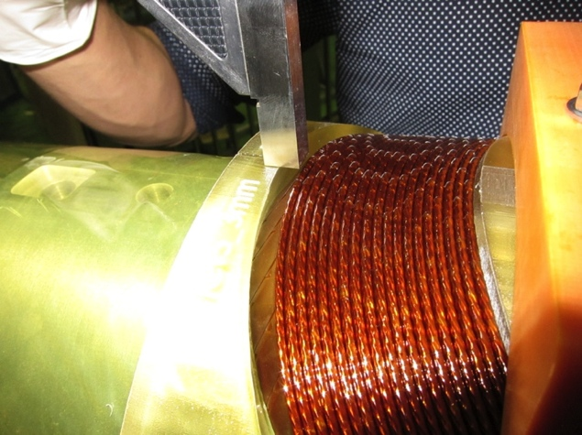
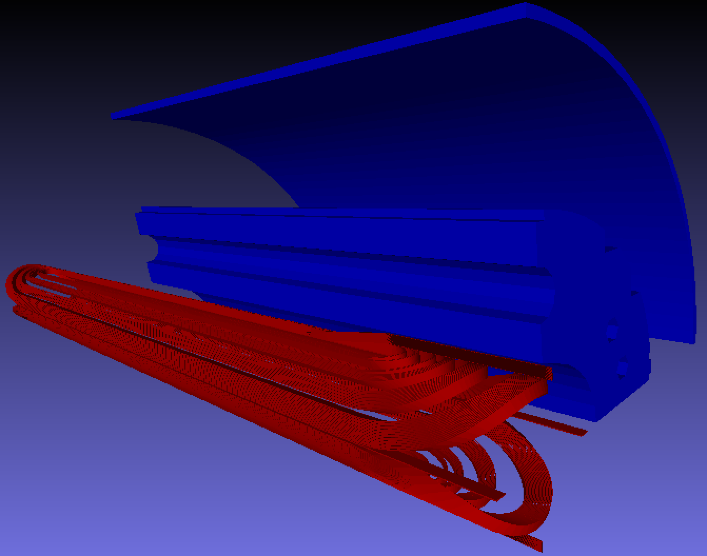
Coil End Design by ROXIE
Coil end found in practice
winding
(2-m test coil)
Old version
Modified design
Due to insufficient length between straight section to end,
cables at the coil end tend to be inclined
to relieve strain energy
→ Difference in height between end spacer and cables
Coil end will be modified to have longer length
End spacer
made using a 3-D
printer
Length of each coil block is being optimized to minimize multipole coefficients

Slide 14
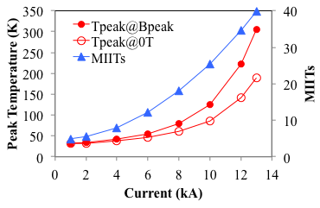
Quench Protection Study with R_{dump}=75 mΩ
Calculation condition
R_{dump}=75 mΩ: Already implemented for the MB circuit in the LHC
Quench detection threshold: 0.1 V, 10 msec
Cable resistance was neglected in calculation of detection time & time constant of
current decay, τ → A conservative scenario
Quench starts around lead out (B ~ 0 T) → Worst case
Peak temperature at B_{peak}
(at I_{max}=13kA) = 305 K
Further study will be made with 3D field map soon.
QPH would not be necessary in the production magnet, but it will be decided after quench test using 2-m model magnet.

Slide 15
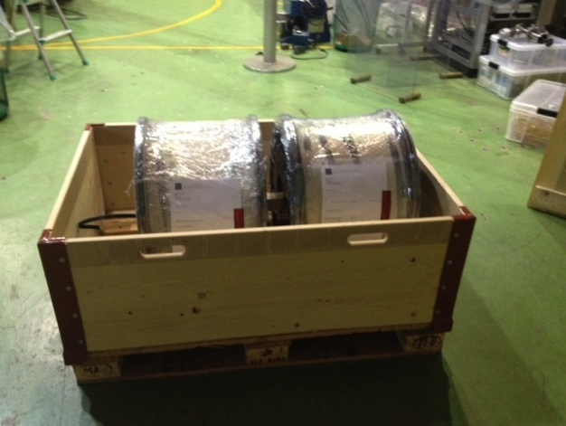
SC Cable Supply & Schedule
NbTi LHC MB outer cable supplied by CERN for the new D1 .
Delivery Date | Objective | Requirement | Remark
Feb. 2013 | 10 stack meas. (a piece length > 0.3 m) | ~50 m w/ MB type insulation | Both MB inner and outer cables w/ MB type insulation
Jan. 2014 May 2014 | 1 practice coil* + 2 real coils for the 1st 2-m long model + 1 spare coil | 220 m** x 4 | LHC MB outer cables w/ MB type Apical insulation
April. 2015 | 2 practice coils + 2 real coils for the 2nd 2-m long model | 220 m x 4 | LHC MB outer cables w/ MB type Apical insulation
JFY2016 (prospect) | 6 or 7 full-scale magnets + 4 practice/spare coils | 600-640 m x 18 | LHC MB outer cables w/ MB type Apical insulation
Done!!
TBD

Slide 16
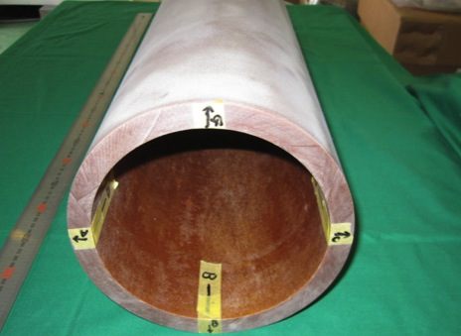
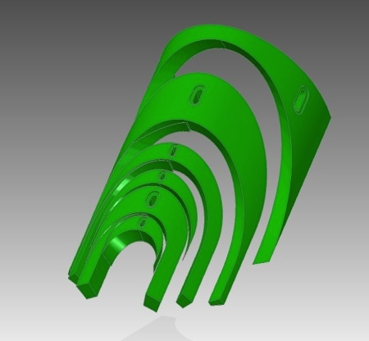
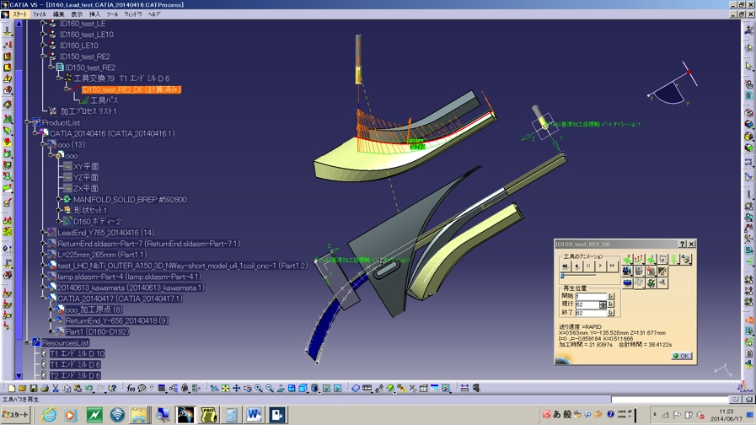
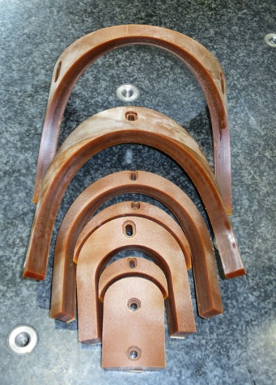
GFRP End Spacers, Wedges
GFRP: MGC BT2160/2170 + S2 glass by ARISAWA
  Radiation resistance beyond 50 MGy
  similar modulus as G10: 29 GPa
  But 30 % higher mechanical strength
End-spacers: manufactured in-house
  Design by ROXIE
  Modeling with NX, Drawing with Solid Edge
  CAD/CAM CATIA V5
Wedges
Adhesion: Cyanate Ester (MGC BT2160RX)

Slide 17
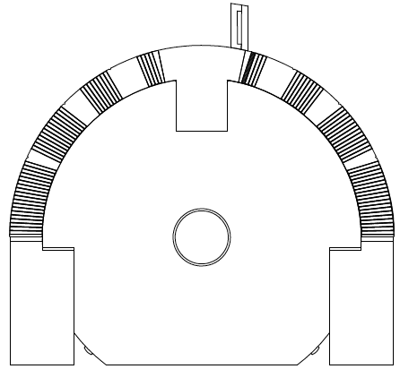
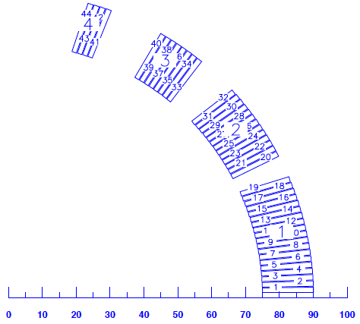
Coil Structure
Cable: NbTi MB cable with APICAL and PIXEO insulation supplied by CERN
Coil configuration:
- Single layer coil
- 44 turns, 4 coil blocks
- Coil length: 2020 mm (between the end saddles)
- 2D cross-section optimized for HX-hole of 50 mm (old version)
Ramp box
Pole shim (GFRP)
Center post
Wedge(GFRP)
Mandrel
MP shim(GFRP)
Pushing bar

Slide 18
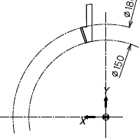
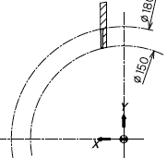
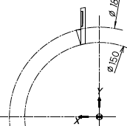
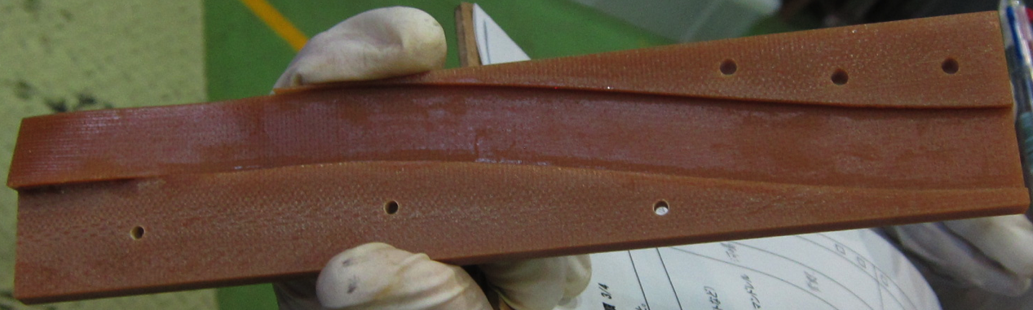
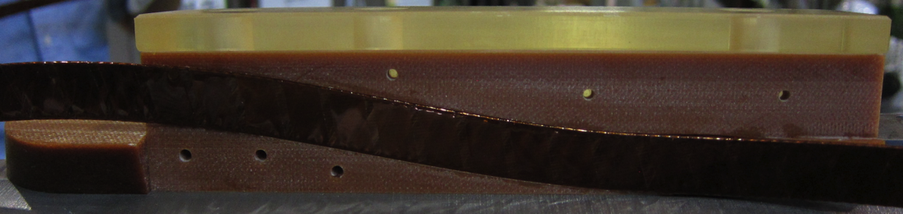
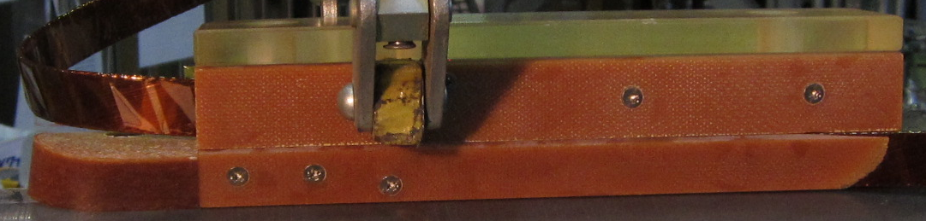
Layer Jump
2D cross-sections of the layer jump
Coil layer at the straight section
Collar layer at the lead end
A
B
C
Pole turn
Ramp box
Ramp box was designed in such a
way that the layer jump turn go out uprightly
C
B
A

Slide 19
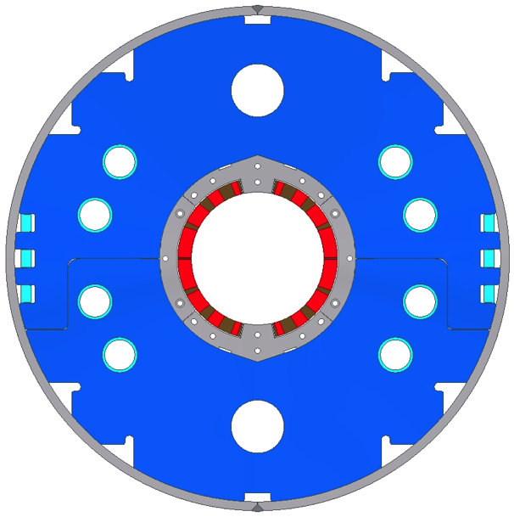
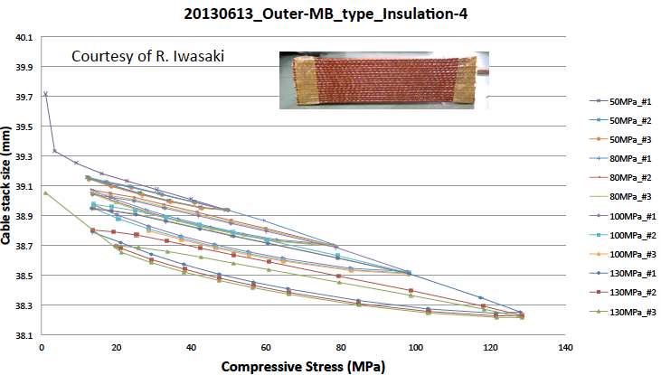
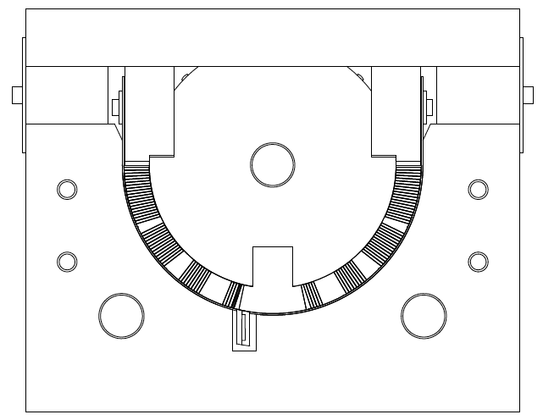
Coil Size Control at Curing
Final size of coil is determined by yoking
Pressure applied to coil
Curing: 50 MPa
Yoking: 100 MPa (max) → 80 MPa
From the results of 10 stack measurement (22 cables),
coil after curing should be larger by 0.9 mm
than the final size
Gap
Curing pressure
Pushing bar
0.9mm-thick shim
Mandrel
0.9 mm-thick shims were inserted
and coil was compressed until the gap
was closed
Forming block

Slide 20
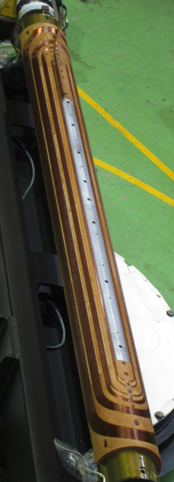
Test Coil Fabrication
Demonstration of coil fabrication with a first 2m (test) coil.

Slide 21
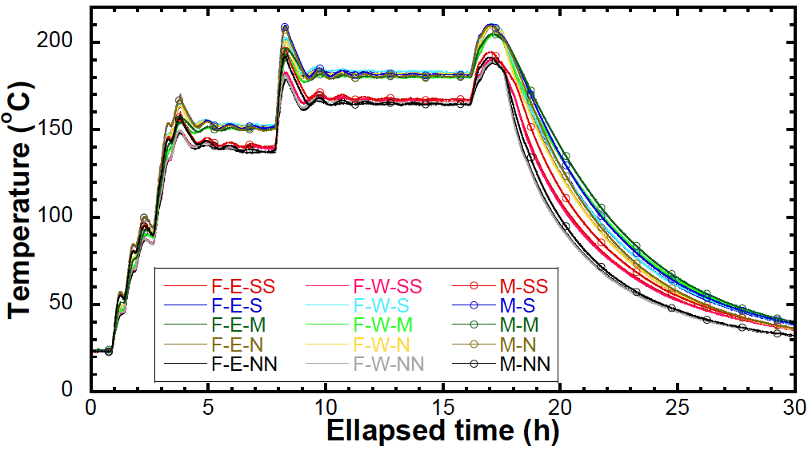
Temperature Trend at Curing
Hardening of cyanate ester
Bonding of polyimide insulation
190ºC
180ºC
150ºC
NN
N
M
S
SS
F-E
M
F-W
Temperature profile to harden cyanate ester (150ºC x 4h + 180ºC x 8h) was obtained
as expected
Max. temperature could be controlled at 190 - 210ºC (< 220ºC)
Expected temperature profile was realized

Slide 22
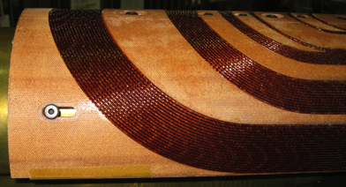
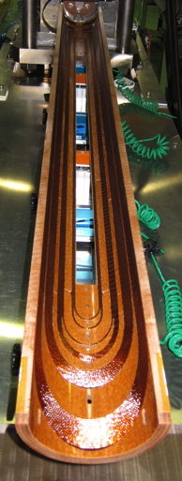
Coil after Curing
The gap between the end saddle and
the cable was closed after curing
→Hard BT resin + S2 glass GFRP can
be accommodated to the cable
Bonding between the cable and
the wedges is sufficiently strong
Effectiveness of heat treatment
profile is verified

Slide 23
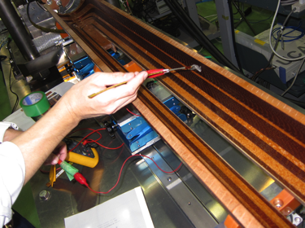
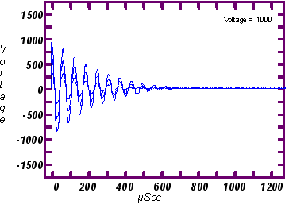
Electrical Tests for QA
No ground fault throughout winding and curing
No change of cable resistance (for 44 turn)
No damage of cable insulation checked
by a bundle of fine Nb-Ti filaments
No turn-turn insulation failure at least
up to 1 kV (Surge test)
Coil inductance: 2.26 mH
(calc. value = 2.28 mH)
After winding | 242.9 mΩ
Under curing pressure, before curing | 242.5 mΩ
After curing | 242.2 mΩ
Surge test
Electrical soundness of the coil
was confirmed

Slide 24
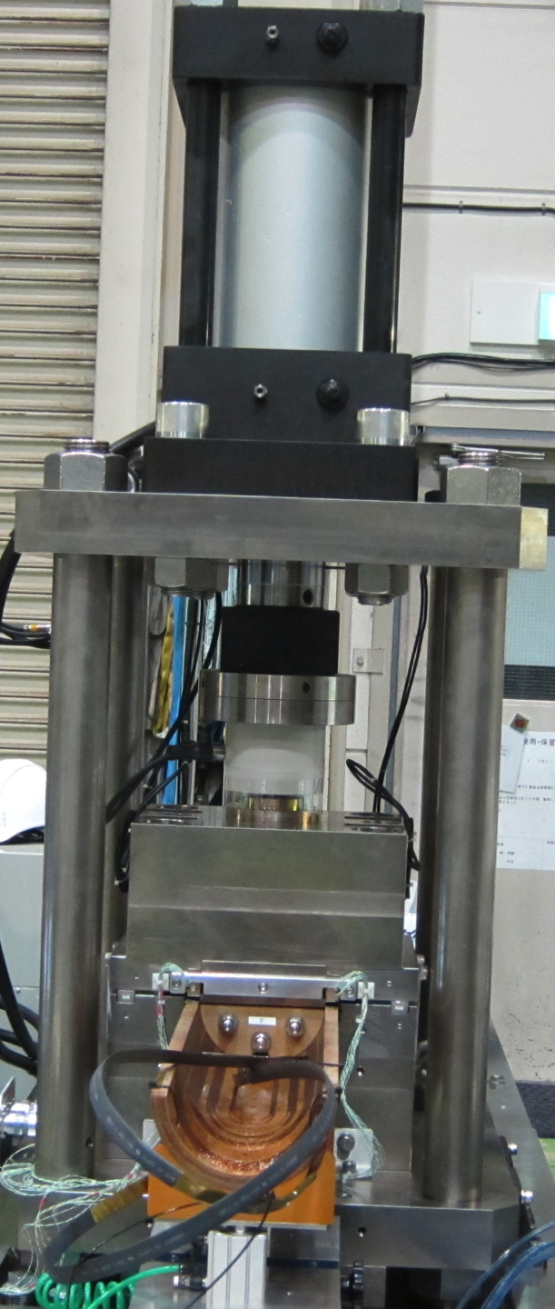
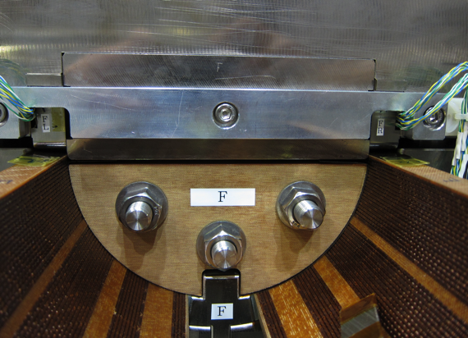
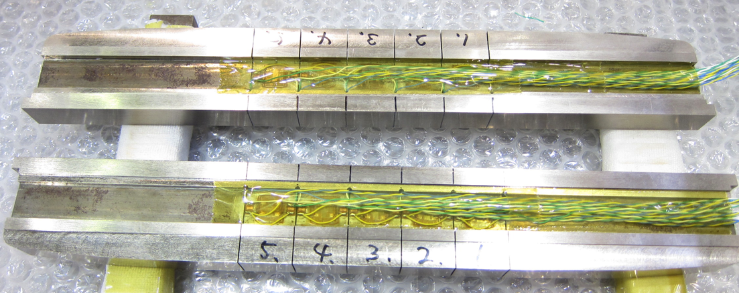
Coil Size Measurement
Similar apparatus as CERN (Thanks to G. Kirby)
50 ton hydraulic press
Coil pressure up to 90 MPa
Continuous measurement using the 5.4 m-long bench
Two pushing bars each having 5 x 20mm-wide fingers
4 x linear gauges to measure coil deformation
L5
L4
L3
L2
L1
R5
R4
R3
R2
R1
Pushing bars with strain gauges
Maximum pressure to compress the coil to the final size was measured

Slide 25




Coil Size Measurement: Results of Test Coil
Coil pressure – deformation
Results for adjacent 5 sections
Coil stress at the final size along the coil length
L
R
R5
R4
R3
R2
R1
1-m Straight section
Dot: Results for each 20 mm
Line: Average for every100 mm
Oversize
Final size
Measured maximum pressure: 80 – 92 MPa
(After correction considering machine
deformation: 90 – 100 MPa)
The size of our test coil is almost
as designed
Preliminary

Slide 26





Ground Insulation
Ground Insulation: same concept as MQXA
  4 layer of 0.125 mm thick Polyimide insulation (Upilex-RN)
  Large shrinkage of the coil during the assembly should be taken into account.
Brass shoes to intervene laminated collar sheets and the insulated coil.
Collaring mandrel ensuring the proper coil form.
Concept and design checked by the practice model.

Slide 27
QPH & Spot Heater
QPH might not be necessary for the D1 because peak temperature is estimated to be 300K by a conservative scenario.
Quench Protection Heater (0.25 mm think) for model magnet R&D
  Still searching for manufacturer in Japan.
  Possibility of supply from CERN
  Necessity??
Spot heaters will be implemented in the model magnet for the quench protection study.
  higher field at the straight section
  lowest field at the coil end (probably at lead-out)
CLIQ might secure the quench protection?
  Experimental study with the 1st model magnet

Slide 28
Requirement for Cooling
New 2 HX holes: φ60 @R=190
Collar lamination w/ 0.2mm gap by emboss
Longitudinal grooves on collar: d2 x w20, both sides of triangle notch.
Yoke packing factor of 98 %
Free area: 153 cm²
Suggestion by Rob:
2 x φ57 HeII HXs
Radial gap of 4 % up to HX holes.
Longitudinal free area >100cm²
Heat Exchanger
Collar 96%
Yoke 98%
Heat Exchanger

Slide 29

Collars
Stainless steel: NSSC 130S (same as YUS130S)
  12 tons of NSSC-130S sheets (2.3mm & 2.6mm thick) delivered. This can cover the model magnet development and >30% of the 7-m long full-scale magnets production.
  Specification, once set for the LHC MB, is fulfilled. Very low permeability of 1.002 confirmed at RT/4.2K.
4-way split collar concept for the dipole coil to avoid the unwanted warp at the fine-blanking process.
  Collars work as spacers between the coil and the yoke.
  A sub-stack of the collars is laminated by the 2.3mm thick “fixing collar” and the 2.6mm thick “spacer collar”. Similar with MQXA.
  Four sub-stacks are connected by lock pins and provide the coil pre-stress below 5 MPa.
  Emboss of 0.2mm
Procurement of fine-blanking dies is on-going.
Radiation resistant GFRP collar at lead end, same design concept as the J-PARC SCFM.
Odd layer
Even layer
e.g.) GFRP collar to clamp the ramp box and the lead-out on the single layer coil for J-PARC SCFM.

Slide 30


Collaring Press and Mandrel
Horizontal collaring press in preparation.
  coil pre-stress below 5MPa.
  coil deformation controlled by the collaring mandrel.
Demonstration of collaring mandrel
  3D rapid prototyping.
  Main mandrel can be removed by using “Flat Roller” after yoking.

Slide 31

Yokes
Low carbon steel: EFE by JFE steel
  15 tons of EFE sheets (5.6mm & 6mm thick) delivered for the model magnet.
  Another 15 tons will be procured within this year.
  Y.S.: > 240 MPa. Magnetic property: OK.
Yoke is locked by 3 keys at each side. The coil pre-stress of 90-100 MPa will be given by the yoking.
Mechanical short model study: Demonstration of mechanical structure
  Concept of 4-way split collars and pre-alignment feature.
  Increase of thickness difference (5.6mm & 6.0mm): help for yoke stacks assembly.
  Coil pre-stress measurement at assembly and cool-down to LN₂ temperature
For model magnet:
  KEK placed an order of fine-blanking dies. Yoke stacks will be delivered by Feb. 2015.
  Holes on the yoke sheet are not finalized and will be machined for the model magnets.
assembly of top and bottom yoke stacks for J-PARC SCFM

Slide 32

Presses, Jigs
3500 tons hydraulic press
Forming block
Yoking jig
(J-PARC SCFM)
3.6 m long hydraulic press for coil curing and yoking is ready.

Slide 33





Preparatory Work for Cold Tests
Modification and procurement of the cryostat for
“12 kA, 150 mm aperture” D1 magnet.
  Old Spec. of 9m-deep vertical cryostat: 7.5kA, 70 mm aperture dedicated for MQXA.
  New header w/ larger warm bore.
New 15 kA CLs to be delivered in March 2015
Upgrade of PC and bus lines. (7.5 kA >> 15 kA).
  New 15kA-DCCT procured by KEK is being calibrated at CERN.
  New dump resistor of 75 mΩ with grounding at the middle.
New DAQ systems
New 15kA bus lines
New 15kA-CLs
New header, cold tube, quench antenna

Slide 34
Deliverables and Near-term Plan
One 2m long model magnet will be built and tested at KEK.
The second model development is also planned.
Up to now, 2m long test coil fabricated. Coil size measurement done.
Dec. 2014 A short mechanical model
April 2015 1st 2m long model
  Field optimization by ROXIE and end spacer design are underway.
  Coil winding would start at Jan. 2015.
June 2015 Commissioning of test stand
  A new header (cryostat flange) for D1. To be inspected by local government.
  A new pair of 15kA CLs
  Upgraded 15kA P/C and buses
Sep. 2015 Cold test of 1st model
Dec. 2015 2nd 2m long model
Feb. 2016 Cold test of 2nd model

Slide 35
Accounting & Budget for D1 model R&D
 |  | JFY2013 Accounting |  | JFY2014 Budget
 |  | Prediction | Inventory on order | Proposal | Min. Req.
Income | Carry over from the last year | 8.40 | - | 0 | 0
 | CERN-KEK Budget | 21.17 | - | 21.10* | 21.10*
 | KEK (ATLAS-J + ? ) | 85.00 | - | 126.00 | 80.00
 | Total | 114.57 | - | 147.10 | 101.10
Expenditure | Conceptual Design | 0.00 + 1 FTE | - | 0.00 + 0.2 FTE | 0.00 + 0.2 FTE
 | Engineering (CAD support) | 7.52 + 1 FTE | - | 7.00 + 1 FTE | 7.00 + 1 FTE
 | Materials for D1 model magnet | 52.81 | 34.60 | 55.00 | 44.50
 | Test stand | 44.97 | 7.50 | 47.00 | 25.00
 | Technical support | 5.41 | 2.21 | 12.00 | 12.00
 | Travel & others | 3.87 | 1.00 | 5.00 | 2.60
 | Carry over to the next year | 0 | 0 | 21.10 | 10.00
 | Total | 114.57 | 45.31 | 147.10 | 101.10
+22.29
82.6
55.00
Unit: MJYen (~10kCHF)
* Assuming 100 JYen=1 CHF

Slide 36
Accounting (Not finished yet)
2013 and 2014
CERN-KEK Budget
KEK (ATLAS-J + ? )
Note:
CERN-KEK Budget for 2015 was transferred Aug. 2014.
No budget remains.

Slide 37
Summary
KEK has been engaged in the FP7 HiLumi-LHC design study. R&D of the beam separation dipole magnet, D1, including the 2-m model is underway.
  Coil ID of 150 mm
  35 Tm w/ nominal field of 5.6 T at 12kA under 2 mW/cm³ (local peak), 25MGy
Conceptual design is mostly completed and the 1st test coil was fabricated at KEK. Coil size measurement results showed that the coil was made as designed.
The 1st 2m model will be fabricated spring 2015 and the cold test is anticipated in September 2015.

