Slide 1
Electronics Requirements for Tracker Upgrades
A.A. Grillo
Santa Cruz Institute for Particle Physics
University of California Santa Cruz
With much information taken from all four experiments
especially from A. Kluge, K. Wyllie and F. Vasey.

Slide 2
Topics to Cover
The topics I will cover are a bit more limited than the title implies.
I will not cover pixel or MAPs detectors as they have already been covered by earlier talks.
I also will not discuss tracking chambers associated with muons as that will be covered in a later talk.
What I will then discuss are the following:
  ALICE: Upgrade electronics for the TPC.
  LHCb: Upgrade electronics for the UT & the SciFi detectors.
  CMS: Electronics for the Silicon Strip Detector.
  ATLAS: Electronics for the Silicon Strip Detector.
Jorgen Christiansen gave a very comprehensive talk on the upgrade electronics for all the silicon detectors at last year’s workshop.
  This talk will complement and update what Jorgen presented for the silicon strip detectors.

Slide 3
ALICE Upgrade Strategy
High precision measurements of rare probes at low p_{t}.
  Cannot be selected with a trigger filter.
  Must have a large sample of events recorded for full analysis.
  Target
    Pb-Pb ➔ ≥ 10 nb-1 => 8 x 10¹⁰ events
    p-p (@5.5 TeV) ➔ ≥ 6 pb-1 => 1.4 x 10¹¹ events
  Increase statistics by a factor of 100.
Strategy to read out all events with online data reduction (no filtering)
  Continuous sampling at 10 MHz for L = 6 x 10 ²⁷ cm⁻¹s⁻¹.
  Reconstruction of clusters and tracks online.
  Improve vertexing and tracking at low p_{t}.
Upgrade includes TPC with new GEMs but without trigger.
  Ion backflow mechanism of GEMs allows continuous readout vs. MWPCs.

Slide 4
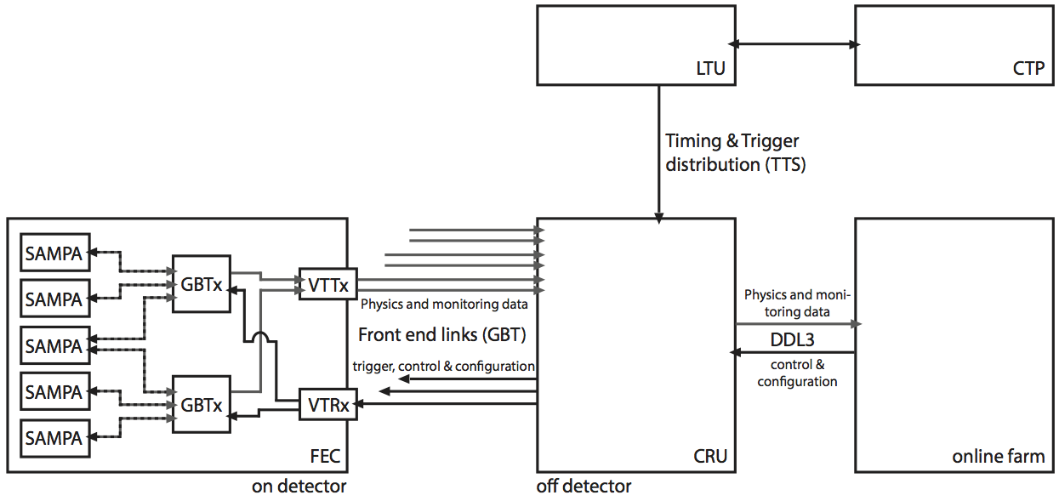
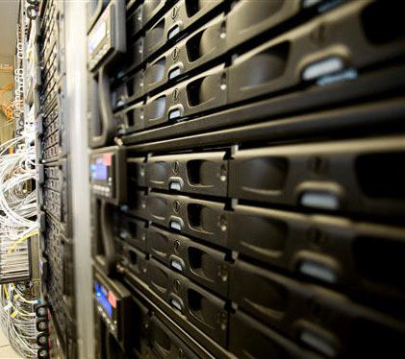
TPC Readout
Front-end card
  ~500k channels
  Continuous or triggered sampling at 10 MHz,
  events at 50 kHz collision rate are
  overlapping in 100 μs drift time.
  3400 front-end cards
  & ~17k SAMPA ASICs.
Use of GBTs & VTTx for data transmission.
Power supplies & Cooling reused from
runs 1 & 2.
TPC Front-end Cards
with SAMPAs & GBT
TPC Readout Architecture

Slide 5
SAMPA ASIC
Used for TPC & muon chambers (MCH)
  32 channel amplifier-shaper-ADC-DSP
  triggerless/continuous & triggered readout
  < 500 e @ 18.5 pF (TPC)
  bi-polarity input
  10 bit ADC – 10/20 Msamples/s
  on ASIC base-line correction and zero suppression
  4 x 320 Mbit/s
  serial outputs
  130 nm
  TSMC CMOS
  technology.

Slide 6
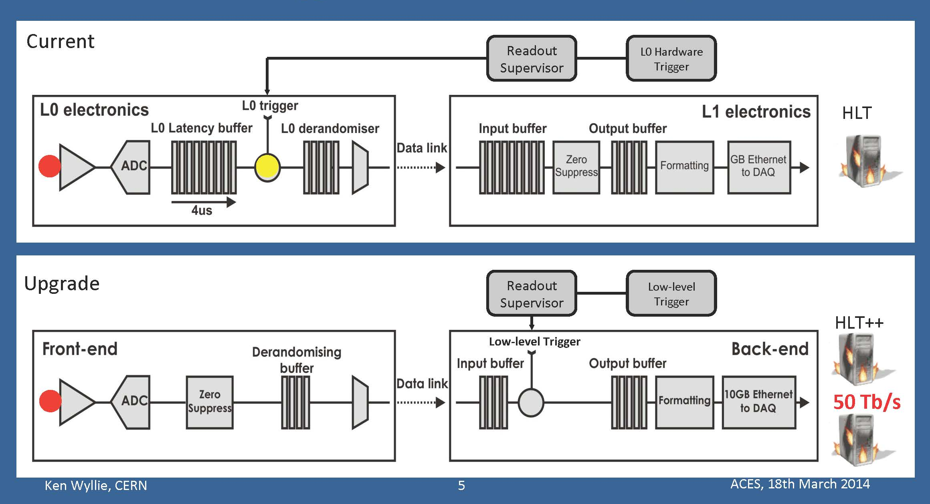
LHCb Upgrade Strategy
The LHCb strategy is captured in this figure from Ken Wyllie.
The entire detector will be readout at the 40 MHz beam crossing rate.
A low level trigger will provide a final filter prior to shipping data to the DAQ system reducing the event rate from 40 MHz to 20 kHz.
  Low level trigger uses calorimeter and muon information.

Slide 7
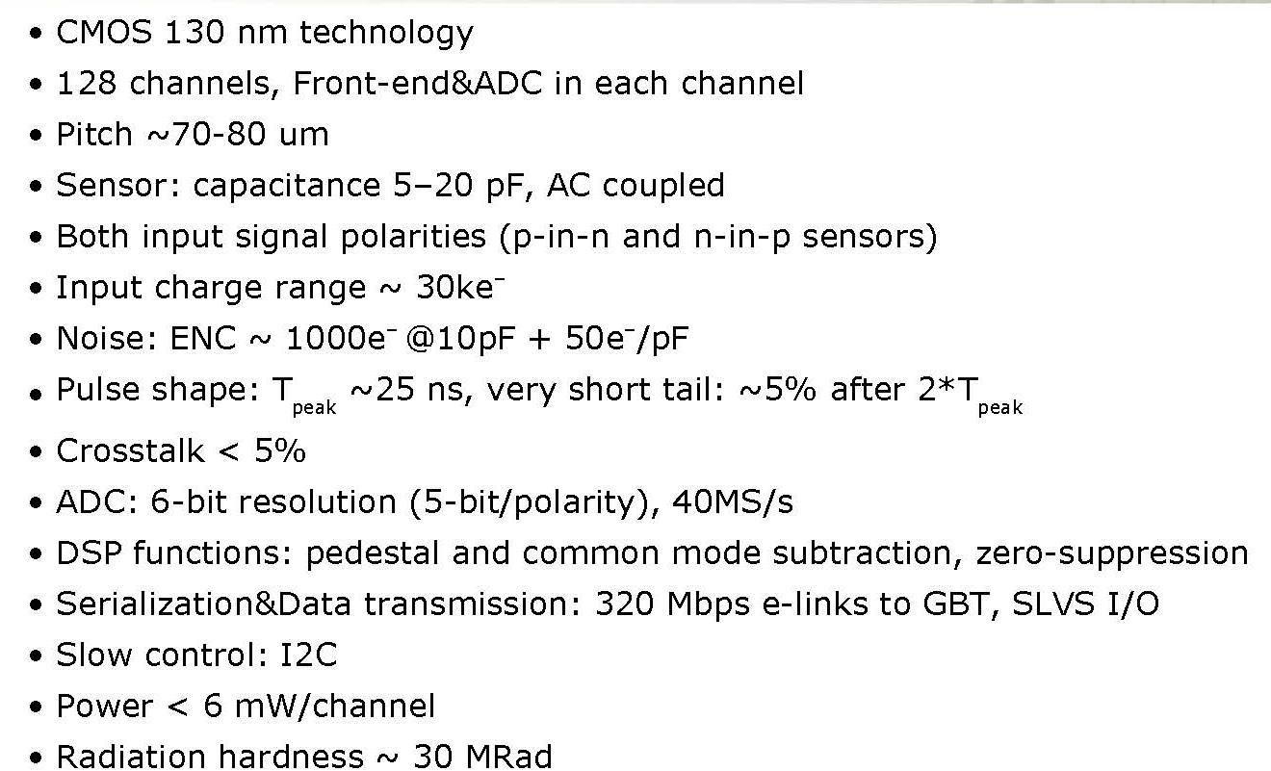
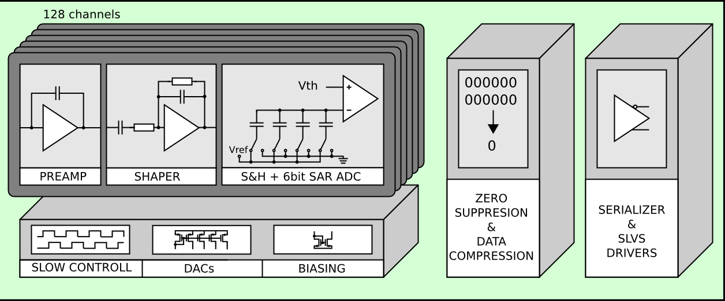
SALT ASIC in Development for the UT
Specifications from M. Idzik’s TWEPP 2014 talk:

Slide 8
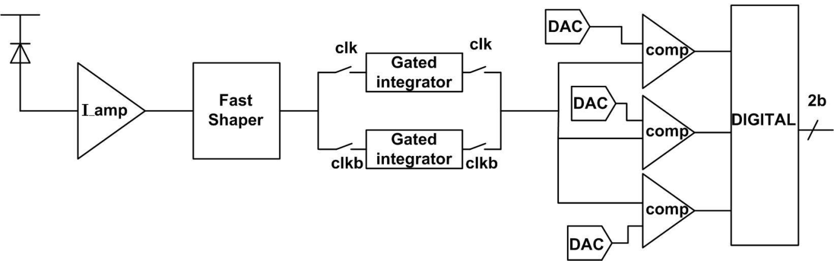
Electronics for Scintillating Fibers
Silicon photo multipliers:
  High photon detection efficiency.
  Low cross-talk.
  Meet the required radiation tolerance.
  Small temperature dependence.
  Small dead region.
  Thin entrance window.
  Presently only two vendors meet requirements: Hamamatsu & Ketek.
PACIFIC readout ASIC:
  Very low input impedance (~ 30 Ω).
  Fast tunable shaper.
  Dual interleaved 25 ns gated integrator.
  2-bit with40 MSamples/s flash non-linear ADC.
  Power consumption < 8 mW/channel at 1.2 V.
  Serialization at 160 MHz.
  Bandgap references and I2C interface based on CERN design.
  64 channels/chip to match pitch of SiPMs.
  130 nm technology.

Slide 9
Remaining System Aspects of LHCb Upgrade
Power for the UT readout will be provided by a new version of the rad-tolerant linear regulator from ST.
The SciFi readout will use the FEAST-MP DC-DC converter developed by CERN.
Both tracker systems will use the GBT and Versatile link for data transmission out of the front-end ASICs to be received by PCIexpress cards with FPGAs to process the data prior to sending it to PC farms.

Slide 10
CMS Outer Tracker
Consists of two different types of modules:
  “2S” modules of two back-to-back strip sensors at the largest radii..
  “PS” modules of one strip sensor back-to-back with a macro pixel sensor at intermediate radii.
Four separate ASICs are required:
  CBC is the front-end for 2S modules (130 nm technology).
  SSA for the strip sensors of PS modules (65 nm technology).
  MPA for pixel sensor of PS modules (65 nm technology).
  CIC concentrator chip for both 2S and PS modules (65 nm technology).
The three front-end chips include an analogue front-end, comparator and digital back-end – but the CBC and MPA also include stub finding logic.
  Track stubs formed by hits in top and bottom sensors are identified and only those with p_{t} above programmable threshold in the 4T field are kept.

Slide 11
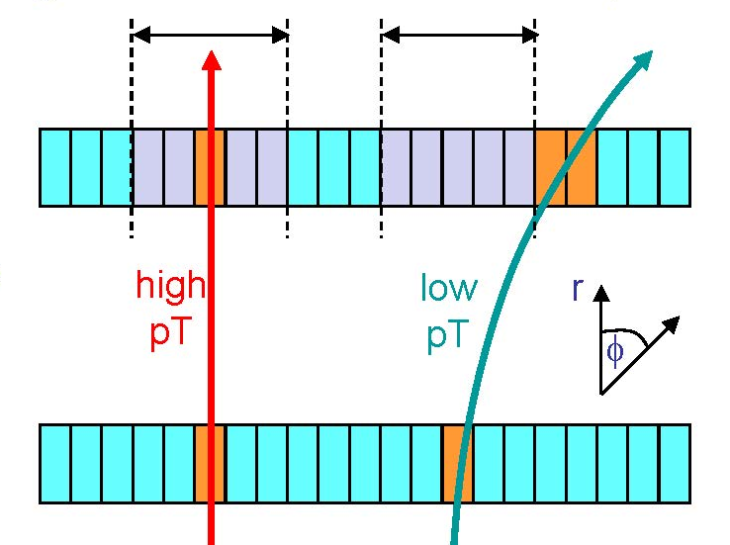
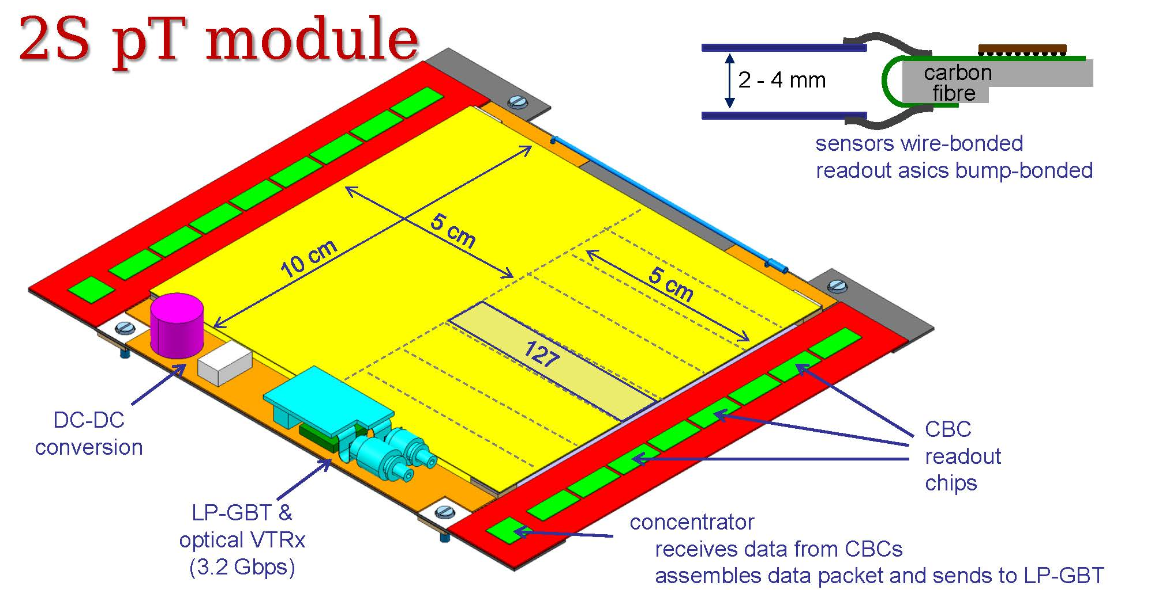
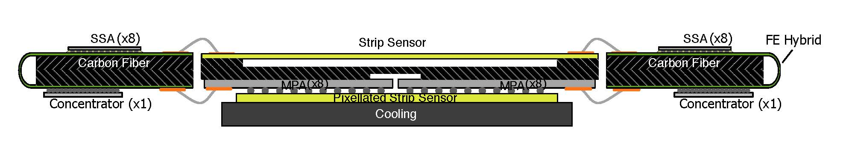
CMS Outer Tracker Modules Forming p_{t} Cut
Programmable Window Width Defines p_{t} Cut
2S Module
PS Module

Slide 12
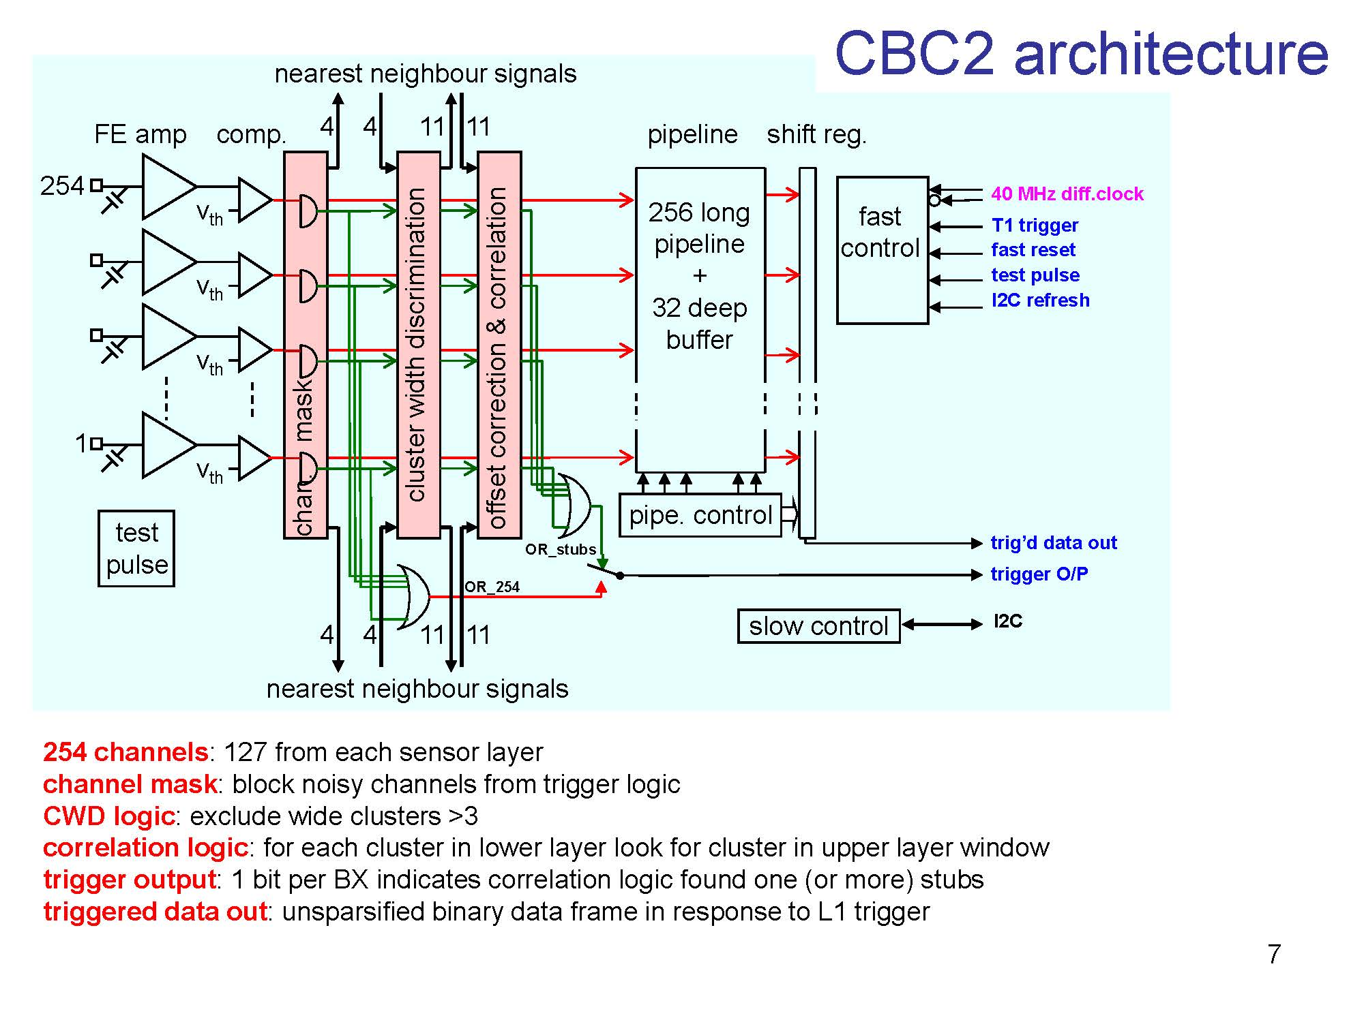
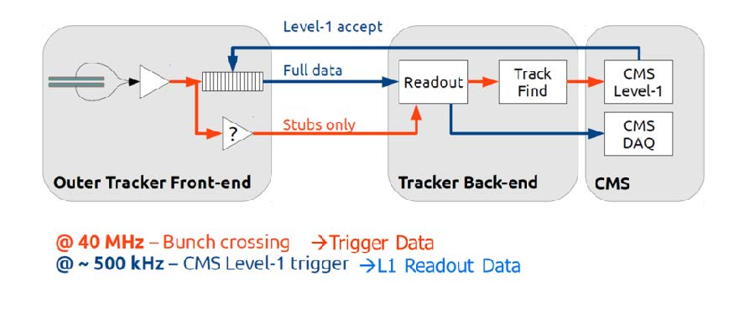
Readout Architecture
Strip signals are amplified and discriminated into hit/no-hit signals.
Then passed to cluster logic.
With one GBT link per module, the lower power option of the future LP-GBT will be required.
Data Flow

Slide 13
ATLAS ITk – Strips Sub-detector
Both barrel and end-cap modules use the same chip set.
  ABC front-end ASIC (130 nm technology).
    10 ABCs per hybrid for barrel, up to 12 for end-cap hybrids.
  HCC: hybrid controller chip (130 nm technology).
Original architecture responded to two types of trigger signals:
  L1: transmit entire event from all modules.
  L0-ROI: temporarily hold data upon receipt of L0.
    Transmit data from specific modules if ROI signal is received.
    ROI limited to 10% of all modules.
Data from ROI modules to be supplied to TDAQ in time for track data to be used in L1 decision.
  Philosophy: track fitting off-detector can make best use of data.
Prototype ABC130 fabricated; HCC in fab now.
  These will be used to build prototype modules, staves & petals.

Slide 14
ATLAS ITk – Strips Sub-detector
With the change in L0 rate to 1 MHz, architecture has changed.
  L0 Mode: transmit data from all modules upon receipt of L0 (≤ 1 MHz).
  L1/L0-ROI Mode: retain original architecture as second option.
Changes include:
  Serial connection of ABCs to HCC replaced by “star” arrangement with separate path from each ABC to its HCC.
  HCC now “event builder” transmitting variable length packet per event.
New specifications are being written.
Redesign work will start shortly.
  Effects on module mechanics & assembly process negligible.
  Using original architecture ASICs to finalize module, stave, petal assembly processes will allow schedule to be maintained.

Slide 15
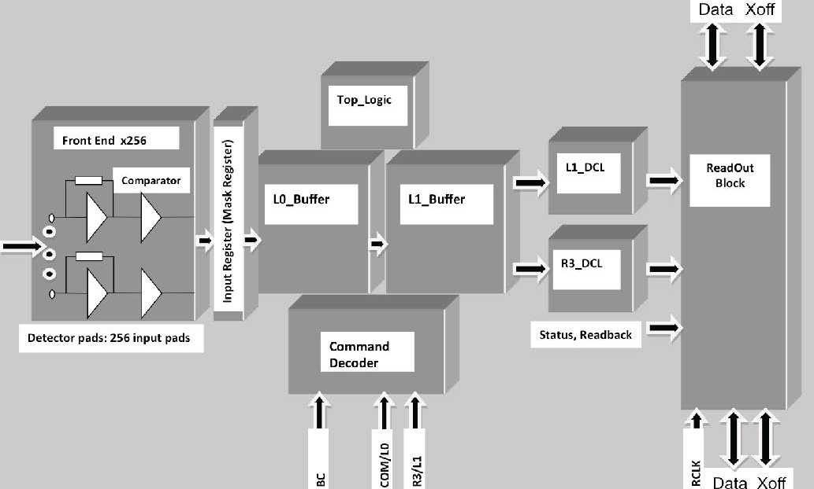
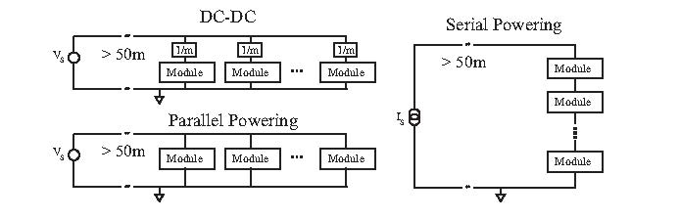
ITk Strips Readout Architecture
DC-DC Converters & Serial Powering both developed to reduce material and power loss the cables.
Block Diagram of Original ABC130 Design.
Continues use of “Binary” hit/no-hit readout
used in present SCT readout.
Extra buffers allow L1/L0-ROI options.
Radiation tolerant HV switches are being evaluated to allow biasing several modules from a single HV cable with the option of turning off individual modules as needed.
Data transmitted off-detector by future LP-GBT & Versatile Link.
Higher bandwidth of future version is required.

Slide 16
ASIC Technologies
As pointed out, ASICs are being designed in 130 nm & 65 nm technologies.
The are two potential vendors for 130 nm, one for 65 nm.
  Old frame contract with IBM for 250 nm & 130 nm
  New frame contract with TSMC for 130 nm & 65 nm.
There has been some uncertainty about the availability of the IBM 130 nm.
  Still a bit uncertain but appears that it will be available through Phase II construction.
TSMC 65 nm & 130 nm will be available.
  Experience with both is new and not as well tested as with IBM.
  Radiation tolerance still needs to be proven, but initial results look promising.
  The qualification of the 65 nm technology is being led by RD53.
  The CERN Microelectronics Groups -- the initial lead with the 130 nm.
    ATLAS will support this effort as a backup.

Slide 17
Technology Table
 | IBM 130 nm | TSMC 130 nm | TSMC 65 nm | Techno de On-Semi 350 nm | Techno de On-Semi 350 nm | ST | Several Promising
ALICE Phase I | GBT | SAMPA
LHCb Phase I | GBT | SALT |  |  |  | Linear Reg
 |  | PACIFIC |  | FEAST-MP DC-DC
CMS Phase II | CBC |  | SSA |  | FEAST2 DC-DC
 |  |  | MPA
 |  |  | CIC
 |  |  | LP-GBT
ATLAS Phase II | ABC |  | LP-GBT |  | FEAST2 DC-DC |  | HV Switch
 | HCC

Slide 18
Radiation Tolerance Requirements
 | ASICS | Total Ionizing Dose | Total Fluence
ALICE Phase I | SAMPA, GBT | ~ 20 Gy | ~ 4 x 10¹¹n_{eq}cm⁻²
LHCb Phase I | SALT, GBT, Linear Reg. | ~ 150 kGy | ~ 2 x 10¹⁴n_{eq}cm⁻²
 | PACIFIC, GBT, DC-DC | ~ 30 Gy | ~ 6 x 10¹¹n_{eq}cm⁻²
CMS Phase II | SSA, MPA, CIC, LP-GBT, DC-DC |  | ~ 1.5 x 10 ¹⁵ n_{eq}cm⁻²
 | CBC, CIC, LP-GBT, DC-DC
ATLAS Phase II | ABC, HCC, LP-GBT, DC-DC, HV Switch | ~ 317 kGy | ~ 8.1 x 10¹⁴n_{eq}cm⁻²
Note that the radiation levels for pixels in LHCb, CDS and ATLAS are significantly higher than these values for their outer trackers.

Slide 19
Summary
There is development work in several different technologies
  Necessitated by the difficult requirements placed on the four experiments.
There are many opportunities for common development, shared work and progressive upgrades to the electronics as needed.
  Frame contracts between CERN and IC foundries.
    Common access to technologies and design tools.
  Common goals of radiation qualification with work shared by CERN Microelectronics Group and the Experiments.
  Important components provided by CERN Microelectronics Group for use by many or all experiments.
    GBT+Versatile Link → LB-GBT+Versatile Link.
    FEAST-MP DC-DC → FEAST2 DC-DC.

