Slide 2
IC Technologies
Michael Campbell
PH Department
CERN

Slide 3
Acknowledgements
J. Alozy
M. Barbero
S. Bonacini
J. Christiansen
F. Faccio
E. Heijne
K. Kloukinas
X. Llopart
A. Marchioro
S. Michelis
W. Snoeys

Slide 4
Disclaimer
This talk is focussed on mainstream microelectronics technologies
It does not address projects with special requirements such as
  DC-DC
  MAPS, HR/HV CMOS
  Bipolar etc

Slide 5
Outline
Introduction
Challenges for microelectronics at HL-LHC
Common Foundry access – status
  IBM
  TSMC
IP block sharing
Interconnect
Future technologies

Slide 6
Introduction
Rad tolerant ASICs are one of the key enabling technologies of the LHC
In particular, ASICs designed for radiation tolerance in 250nm CMOS played a major role

Slide 7
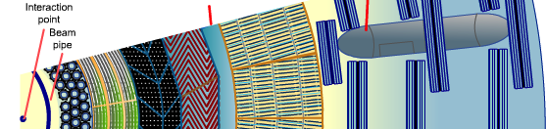
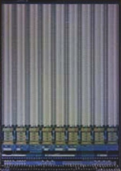


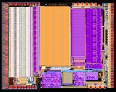
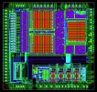
Some of the ASICs in ATLAS
e-CAL
h-CAL
pixel
detector
TRT
beam pipe
Si strip
tracker
muon chambers
ASD muon det
148 000 chips
ASDBLR TRT det
38 000 chips
Chips to scale 1 cm
ABCD Si det
50 000 chips
6 M segments
60 m² Si sensor
Total ATLAS
100 million sensor cells
appr. 800 000 chips
majority ASICs
FE-I3 pix det
28 000 chips
80 M segments
1.7 m² Si sensor
DTMROC TRT det
19 000 chips
E. Heijne

Slide 8
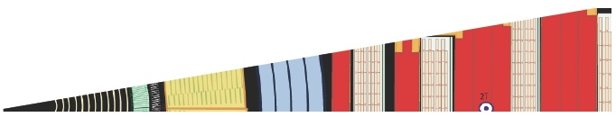
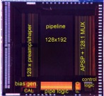


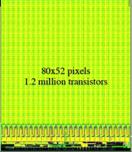
Some of the ASICs in CMS
muon chambers
e-CAL
h-CAL
beam pipe
Si strip tracker
pixel
detector
MAD muon det
181 000 chips
25 000 m² gas-filled
QIE8 calorimeter
220 400 chips
APV25 Si det
110 000 chips
9.3 M segments
198 m² Si sensor
Chips to scale 1 cm
PSI46 pix det
16 800 chips
66 M segments
1 m² Si sensor
Total CMS
appr. 1 million chips
of which 700 000 ASICs
E. Heijne

Slide 9
Introduction
Rad tolerant ASICs are one of the key enabling technologies of the LHC
In particular, rad hard by design deep sub micron 250nm CMOS played a major role
ASICs will continue to be key components for HL-LHC
However, a number of challenges have to be faced when keeping up with the evolution of the technology

Slide 10
Challenges for ASICs for HL-LHC
Higher hit rates
Higher radiation hardness
Higher trigger rate or trigger-free operation
Minimise material/power consumption
High dynamic range design in sub-100nm processes
Dealing with pile up – sub ns time stamping

Slide 11
Moore’s law of pixel readout chips
Clicpix (2013)
Timepix3 (2013)
Medipix3RX (2011)
FEI4
(2011)
Timepix (2006)
Medipix2 (2002)
FEI3
(2006)
Medipix1 (1998)
Alice1LHCb
(2000)
PSI46
(2005)
X. Llopart, W. Snoeys
Unfortunately, the cost of a mask set also increases exponentially
11

Slide 12
Following Moore’s law @ LHC – some practical challenges
Technical:
  Large variety of transistor devices available
  Large choice of metal stacks
  Increased simulation/layout complexity
  Power density challenge
  Design manual scaling
  Wafer diameter increases to 300mm
Organisational:
  Mask set in 65nm costs are Ο(CHF1M)

Slide 13
Some lessons from the first generation of LHC ASICs
The selection of a CMOS process must be based as much on the commercial viability of the foundry/process as on the elegance of the technical solutions it offers. This impacts yield (cost) and long term accessibility.
Collaboration between groups works best if based on a common technology platform
Duplication of design effort - while valuable for training purposes - was probably a little excessive
The choice of readout architecture should allow for short-comings in simulated data.

Slide 14
Outline
Introduction
Challenges for microelectronics at HL-LHC
Common Foundry access – status
  IBM
  TSMC
IP block sharing
Interconnect
Future technologies

Slide 15
CERN Supported Technologies in 2014-2015
Legacy technology: IBM CMOS6SF 250nm
Mainstream technology: IBM CMOS8RF 130nm
Alternate technology: TSMC CMOS 130nm
Advance technology: TSMC CMOS 65nm
S. Bonacini, K. Kloukinas

Slide 16
News on Access to IBM technologies
Commercial contract will be assigned to MOSIS
Favourable pricing conditions (NRE & production runs)
MOSIS guarantees 6 month advance notice in case of a decision to discontinuity the service
Confidential Disclosure Agreements (CDA) remain valid
CERN continues to support the 130nm Mixed Signal Design Kit
Foundry access
  MPWs, Engineering & Production runs via MOSIS
    Design data submitted directly to MOSIS
    Design submission technical support by MOSIS
  Coordination and Purchase orders by CERN
S. Bonacini, K. Kloukinas

Slide 17
Very recent news on IBM foundry
IBM issued a press release on Monday 20th October announcing that Global Foundries will take over their microelectronics business
IBM will pay $1.5bn over 3 years
For the time being the impact (if any) of this acquisition on our agreement with MOSIS to access the IBM process(es) is unknown

Slide 18
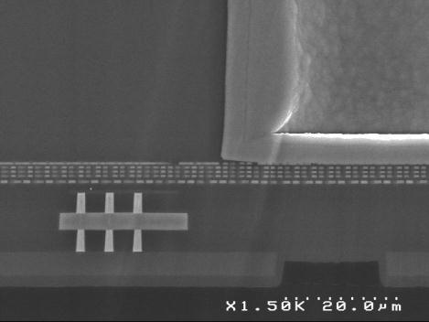
IBM 130nm supported process and metal stacks
MA
passivation
MA
E1
E1
CMOS8RF-DM (3-2-3 BEOL)
95% of designs
MA
mimcap
LY
LY
MQ
MQ
MQ
E1
M4
M4
M4
M3
M3
M3
M3
MQ
CMOS8RF-LM (6-2 BEOL)
Specific mixed signal design kits available for both stacks
More info:
http://support-ictech-mpws.web.cern.ch/support-ictech-mpws/index.htm
M4
M2
M2
M2
M2
M1
M1
M1
M1
M1
M1
M1
W
W
W
W
W
poly
poly
STI
G. Pares. CEA-LETI
S. Bonacini, K. Kloukinas
18

Slide 19
IBM 130nm IP blocks available via CERN
Standard cell library from foundry (173 kgate/mm2)
Standard I/O library from foundry
High-density standard cell library (1.5V and 1.2V, 345 kgate/mm2)
LVDS and SLVS drivers/receivers
SRAM generator (40MHz, dual-port synchronous)
eFuse (1- and 8-bit; 3.3V-10mA-burn in <1ms for 8 bits)
Bandgap (current-mode, output 597 ± 4 mV over p,V,T)
ePLL (40, 80, 160 or 320 MHz input and output, 1.2V or 1.5V supply)
eCDR (as ePLL above, but data input and clock output)
ADC (preliminary. 1 kS/s, 12 bit, 32 channels, 1.5V supply, fees apply)
DAC (8-bit, current output, 40nA LSB)
* Blocks are supplied ‘as is’ for HEP experiments
S. Bonacini, K. Kloukinas

Slide 20
Access to TSMC technologies
Data and technical support
  Institute should contact IMEC to sign an NDA
    IMEC has a list of CERN collaborating institutes
    IMEC will distribute the Mixed Signal design kit and
    provide users with design kit maintenance and technical support
  No access fees. Pay-per-use scheme.
    A 7% fee is applied on the fabrication cost (prototyping, production).
    This fee covers part of the Mixed Signal Design Kit development and maintenance costs
    Projects that make use of the Mixed Signal Design Kit must seek fabrication services
    exclusively via CERN and IMEC service
Foundry services
  Institute should contact CERN to inform about submission plans
  CERN will make an effort to coordinate submissions to share prototyping costs
  CERN will issue the purchase orders to IMEC
  CERN will receive the fabricated chips and distribute them to designers
S. Bonacini, K. Kloukinas

Slide 21
TSMC Non Disclosure Agreement (NDA) and Master Technology Usage Agreement (NDA-MTUA)
3-party NDA: TSMC- IMEC – Institute
  Permitting the distribution of technology information from IMEC to institutes, including layouts of std. cell libraries
  Permitting institutes to exchange technical data and work in collaboration
Covers both 65nm and 130nm processes
Use restrictions:
  automotive applications
  medical applications except for medical imaging systems
  any military applications
  nuclear materials related to defense system or power systems
  aerospace application except fundamental scientific research and dosimetry
Sale of chips is permitted except for banned applications
Export control restrictions
  Comply with all applicable national export control laws, regulations, and rules
  Institutes that will receive silicon from CERN must sign and return to CERN a “Letter of Compliance Concerning Deep-Submicron Technology Circuits”
All NDAs issued by IMEC are identical. Neither IMEC nor the foundry are willing to negotiate 35+ times with all single Institutes
S. Bonacini, K. Kloukinas

Slide 22
TSMC 130nm supported process and metal stacks
Flavour: CM013G
Mixed Signal option
Transistors: Native (zero-vt), high-, low,
std-Vt devices (+ultra-high)
MIM capacitors (1.5 fF/um2)
MOM capacitors
Ultra-thick metal (UTM)
Triple well / deep n-well
8-inch and 12-inch fabs available
8 metals (5-thin, 1-thick, 1-UTM, RDL)
Closest metal stack to legacy 130nm process (DM 3-2-3)
Metal pitch of TSMC process is different from IBM process !
Mixed signal design kit is under development - delivery expected end of 2014
RDL
passivation
RDL
M7
M7
M6
M6
M6
mimcap
M5
M5
M5
M4
M4
M4
M3
M3
M3
M3
M2
M2
M2
M2
M1
M1
M1
M1
M1
M1
W
W
W
W
W
poly
poly
STI
S. Bonacini, K. Kloukinas

Slide 23
TSMC 130nm IP blocks (under development)
Submitted June 2014: (to be tested)
  High-density standard cell library (CERN)
  Bandgap, based on DTNMOS (CERN)
Work in progress:
  SRAM generator (CERN)
  ePLL (40, 80, 160 or 320 MHz input and output, 1.2V supply) to be submitted Dec.2014 (CERN)
  Analog buffer, rail-to-rail (NIKHEF)
  SLVS I/O pads (Univ. Sao Paulo)
S. Bonacini, K. Kloukinas

Slide 24
TSMC 130nm Radiation tolerance measurements
Standard NMOS Vt shift
IBM 130nm
TSMC 130nm
ΔV_{t} (mV)
-160 -120 -80 -40 0
ΔV_{t} (mV)
-80 -60 -40 -20 0
.1 1 10 100
Dose (Mrad)
0.01 0.1 1 10 100 1000
Dose (Mrad)
S. Michelis

Slide 25
TSMC 130nm Radiation tolerance measurements
Standard NMOS Off leakage current
IBM 130nm
TSMC 130nm
I_{leak} (nA)
0.1 1 10 100 1000
I_{leak} (nA)
0.1 1 10 100 1000
0.1 1 10 100
Dose (Mrad)
0.01 1 10 100 1000
Dose (Mrad)
Although leakage current peaks at 2MRad (increase of 4 orders of magnitude) this goes back to the nA level after a few hours of room temperature annealing
S. Michelis

Slide 26
TSMC 130nm Radiation tolerance measurements
Standard PMOS Vt shift
IBM 130nm
TSMC 130nm
ΔV_{t} (mV)
0 20 40 60 80 100
ΔV_{t} (mV)
0 5 10 15 20 25 30 35
0.1 1 10 100
Dose (Mrad)
0.01 0.1 1 10 100 1000
Dose (Mrad)
The Vth shift for Pmos is limited to 5-30mV at 400Mrad. It seems a bit better than IBM
S. Michelis

Slide 27
TSMC 65nm supported process and metal stacks
Two metal stacks
  6+1 metals (“CERN metal stack”)
      4-thin, 1-thick, 1-UTM , RDL
  9+1 metals (compatible with IMEC mini@sic)
      7-thin, 1-thick, 1-UTM , RDL
“Special” metal stacks can be made available
  This will require a one-time-charge of
  15-20KEuro + annual maintenance
  Institutes can always get organized to share
  costs of special PDKs among themselves.
Two standard cell libraries
    9-tracks, standard-Vt
    7-tracks, high-Vt (Low Power)
Mixed-signal design kit is being distributed by IMEC to TSMC-IMEC NDA signatories
RDL
passivation
RDL
M6
M6
M5
M5
M5
mimcap
M4
M4
M4
M3
M3
M3
M3
M2
M2
M2
M2
M1
M1
M1
M1
M1
M1
W
W
W
W
W
poly
poly
STI
S. Bonacini, K. Kloukinas

Slide 28
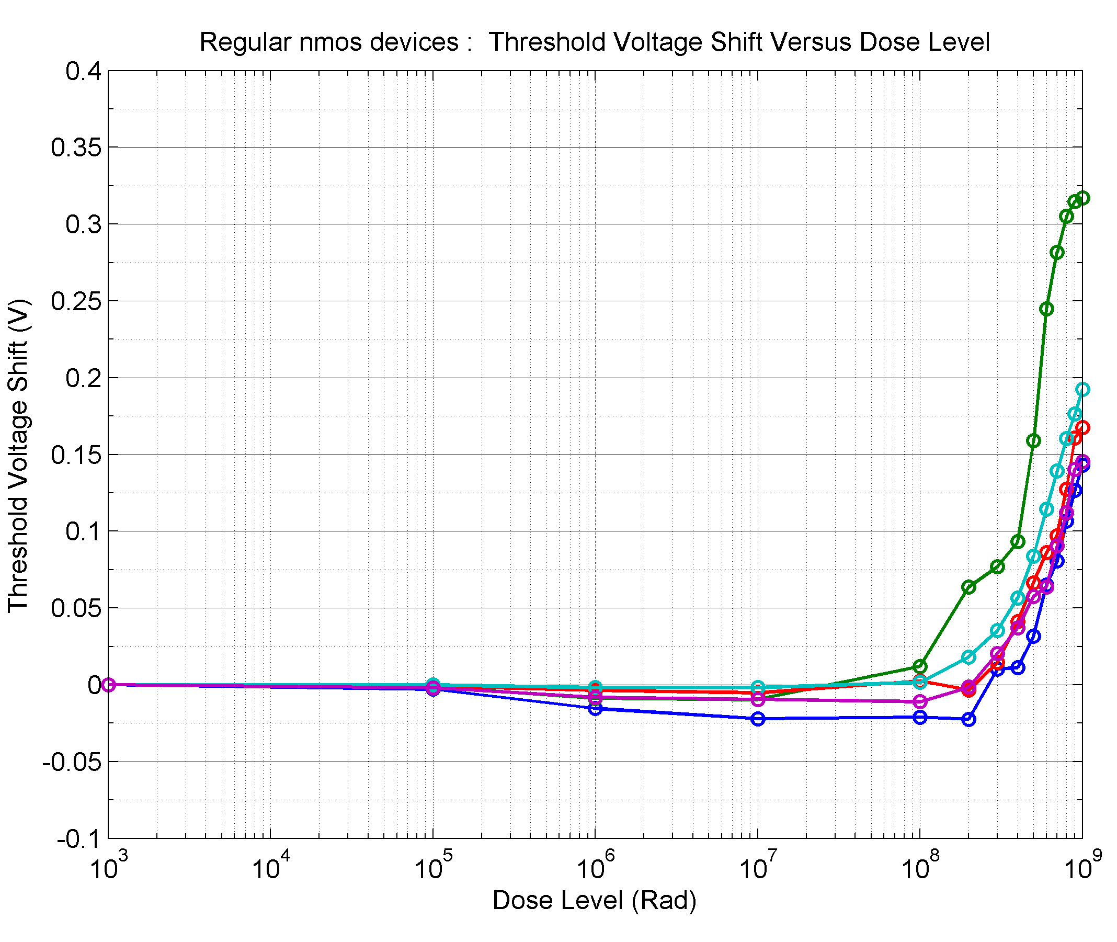
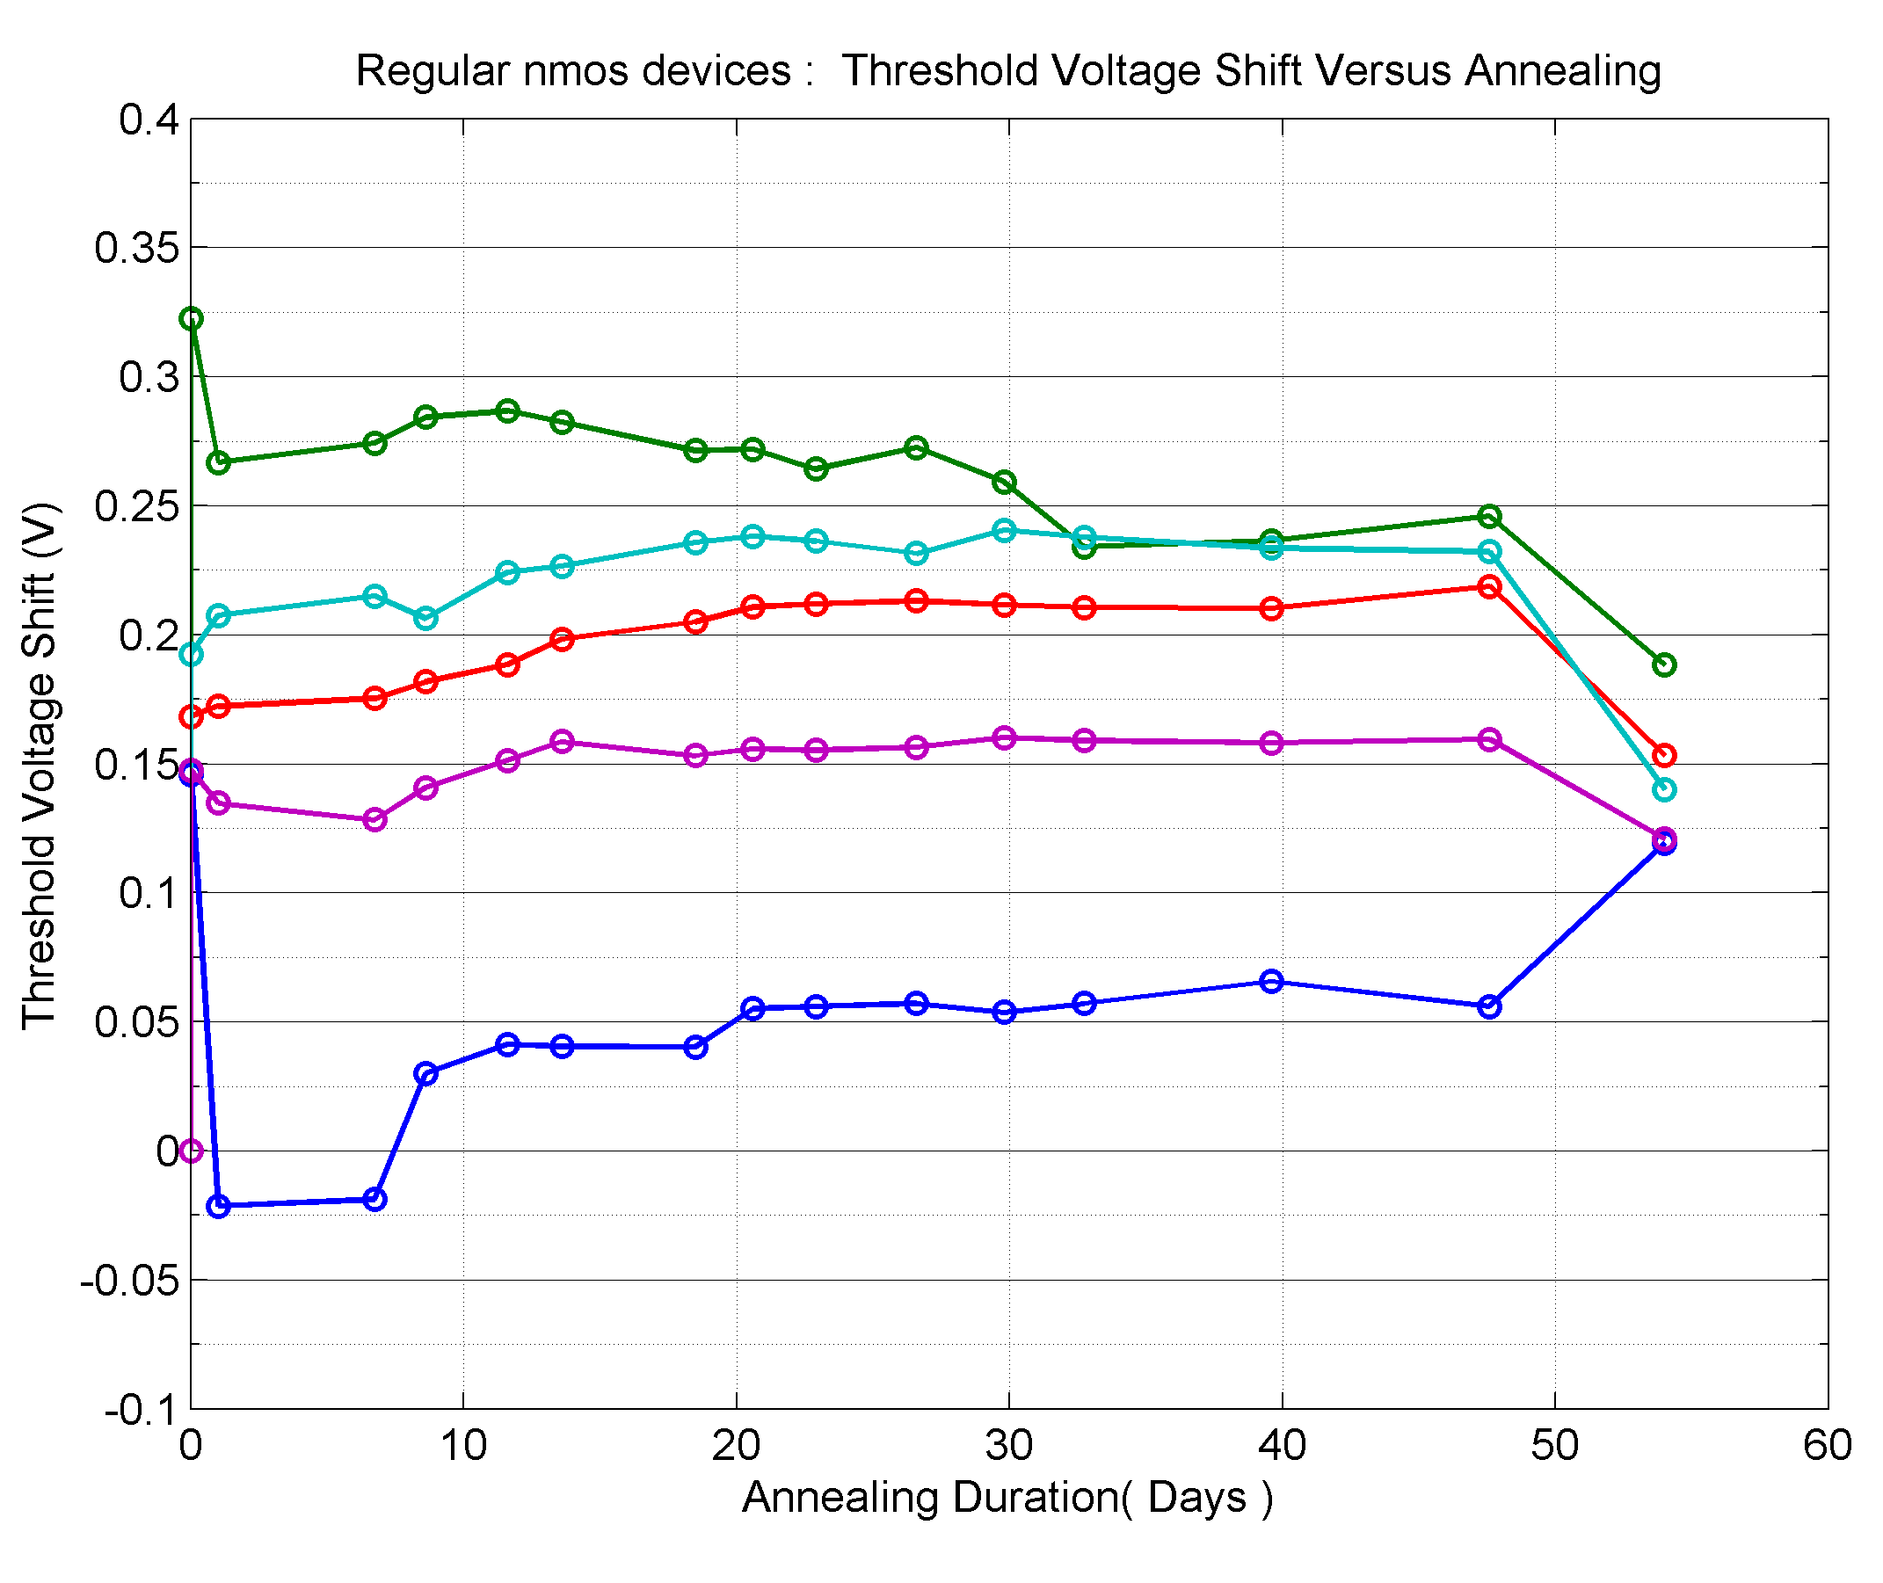
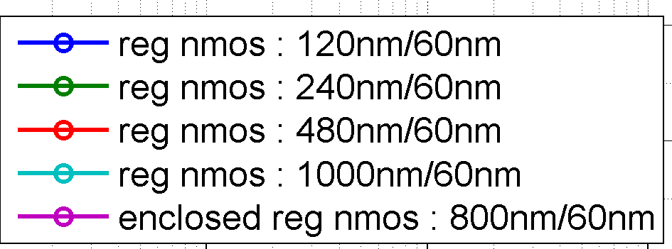
TSMC 65nm Radiation tolerance measurements
Standard NMOS Vt shift
T = -25°C
T = 25°C
T=100°C
ΔV_{t} (mV)
-100 0 100 200 300 400
ΔV_{t} (mV)
-100 0 100 200 300 400
0.01 0.1 1 10 100 1000
Dose (Mrad)
20 30 40 50 60 Annealing (days)
Vth decrease of 20 mV for low dose level (10 Mrad)
Vth increase of 150 mV for 1 Grad
M. Barbero, J. Christiansen

Slide 29
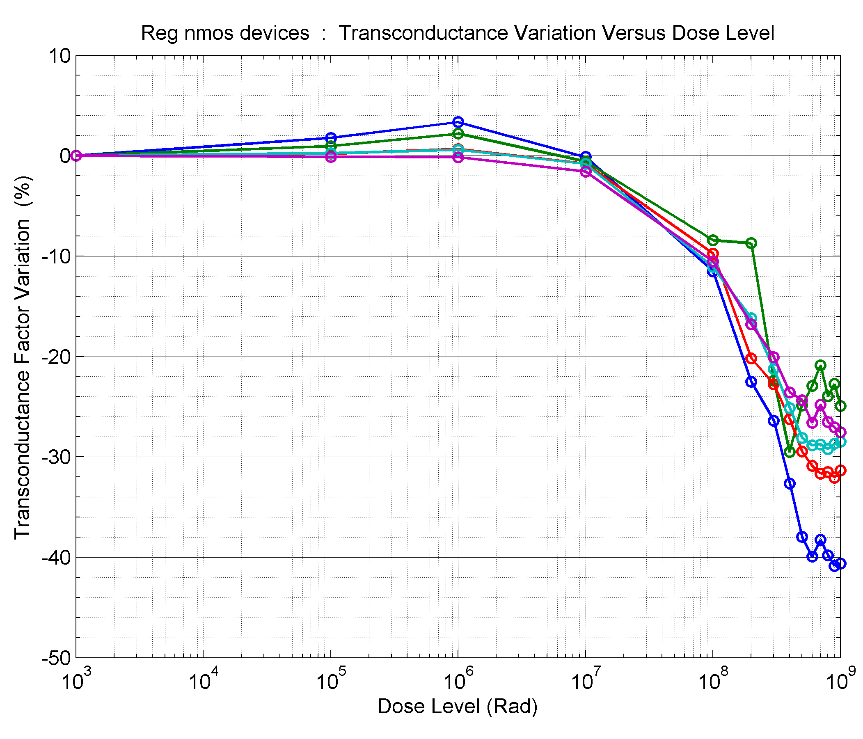
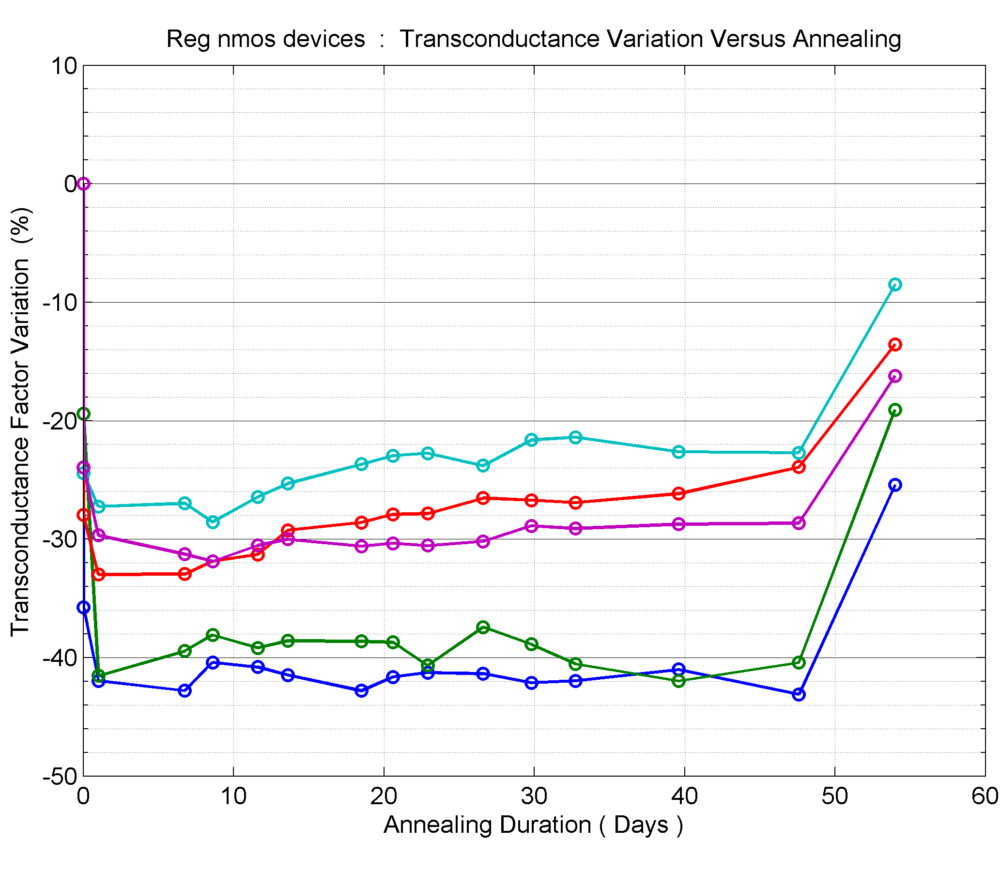
TSMC 65nm Radiation tolerance measurements
Standard NMOS transconductance
T = -25°C
T = 25°C
T=100°C
Δ transconductance (%)
-50 -40 -30 -20 -10 0 10
Δ transconductance (%)
-50 -40 -30 -20 -10 0 10
0.01 0.1 1 10 100 1000
Dose (Mrad)
20 30 40 50 60 Annealing (days)
M. Barbero, J. Christiansen

Slide 30
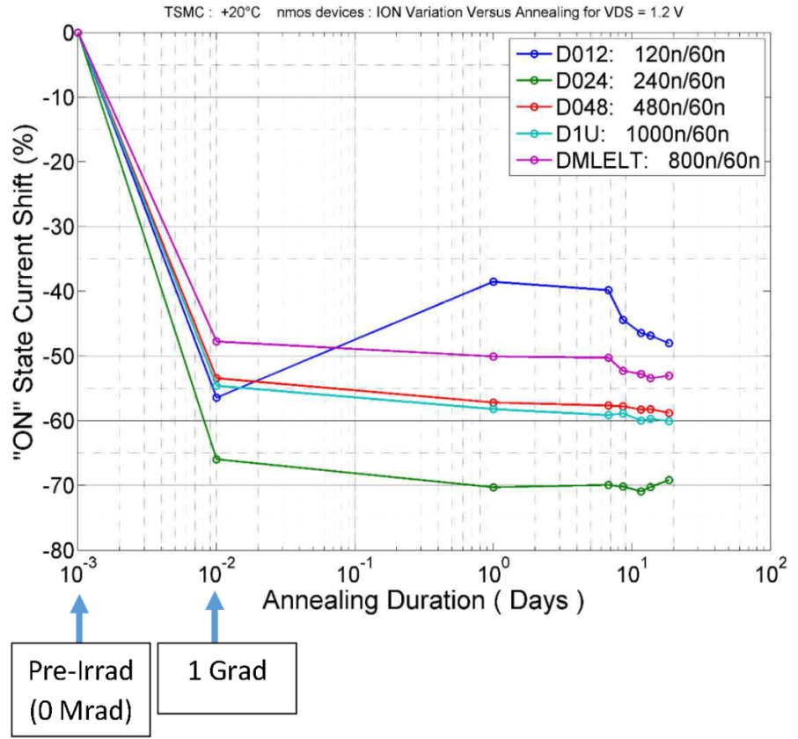
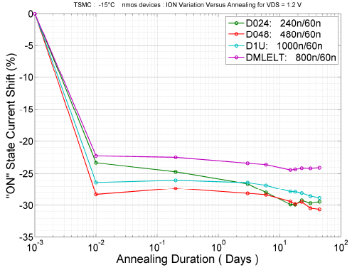
TSMC 65nm Radiation tolerance measurements
Standard NMOS I_{on}
+20°C
-15°C
65% max
<30% max
40 days
30 days
Pre-irrad
(0Mrad)
1Grad
M. Barbero, J. Christiansen

Slide 31
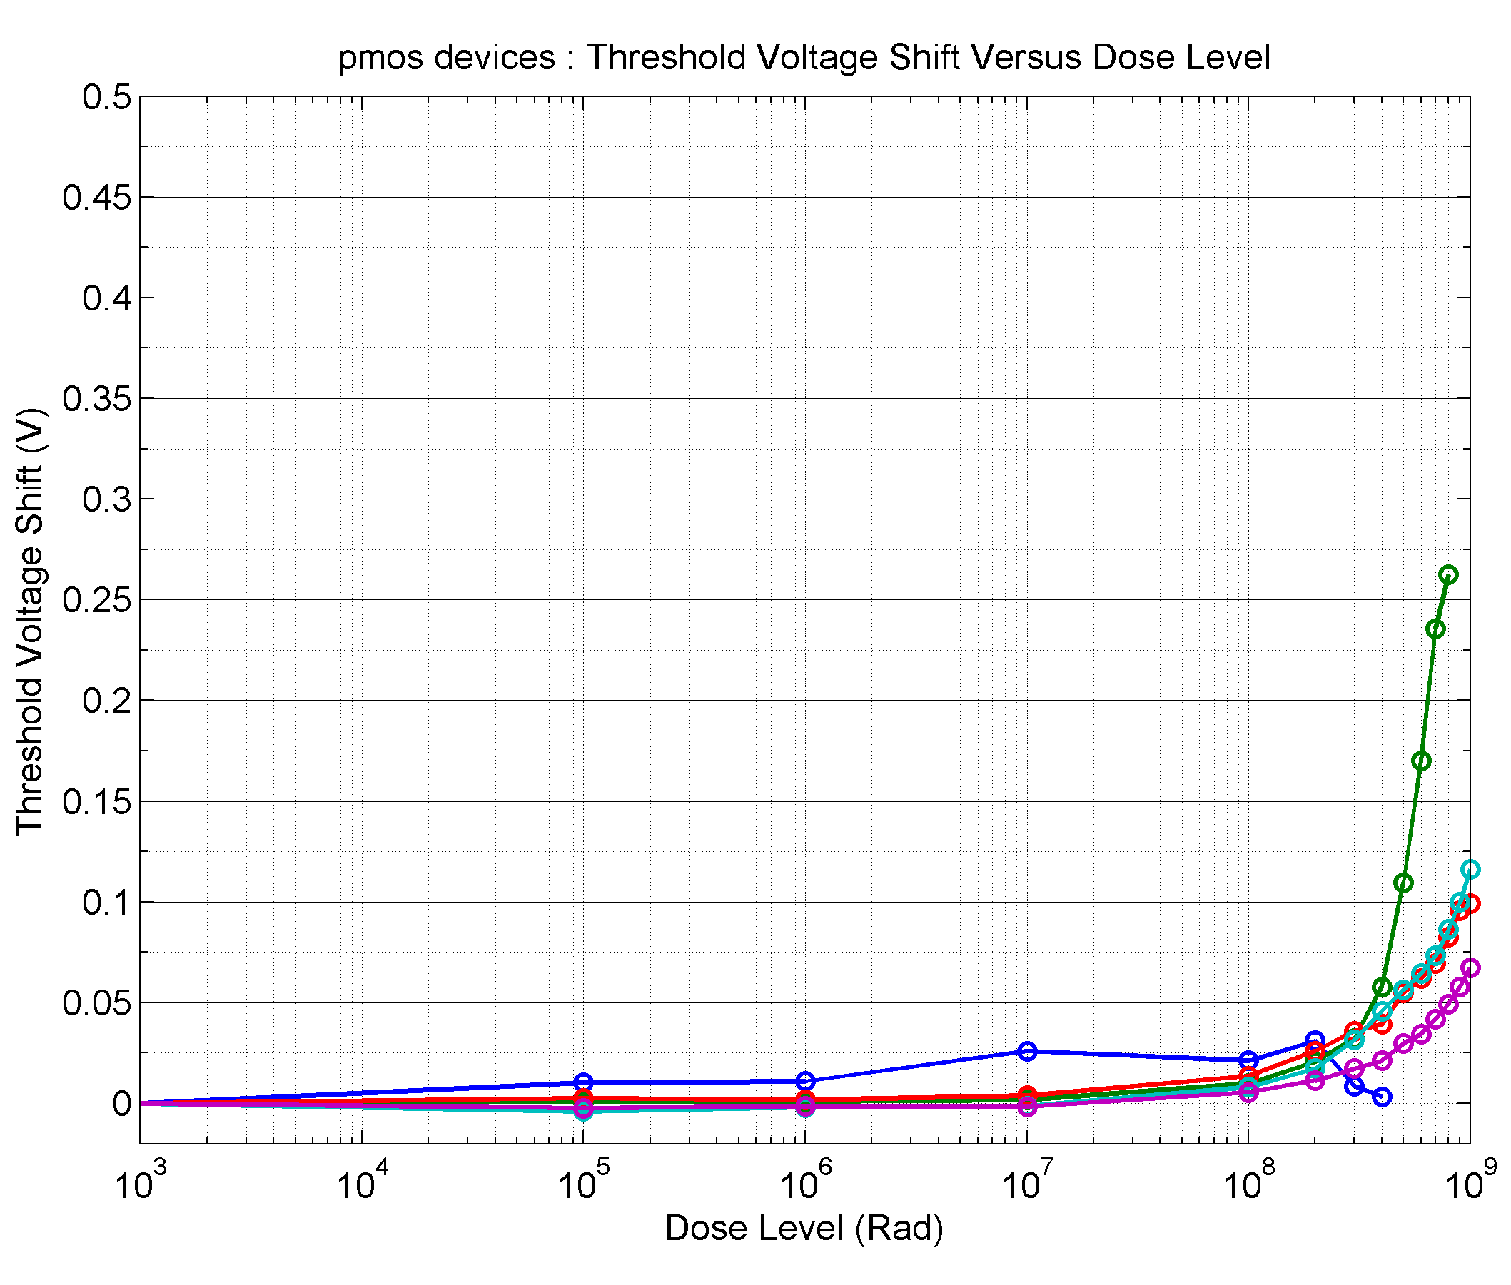
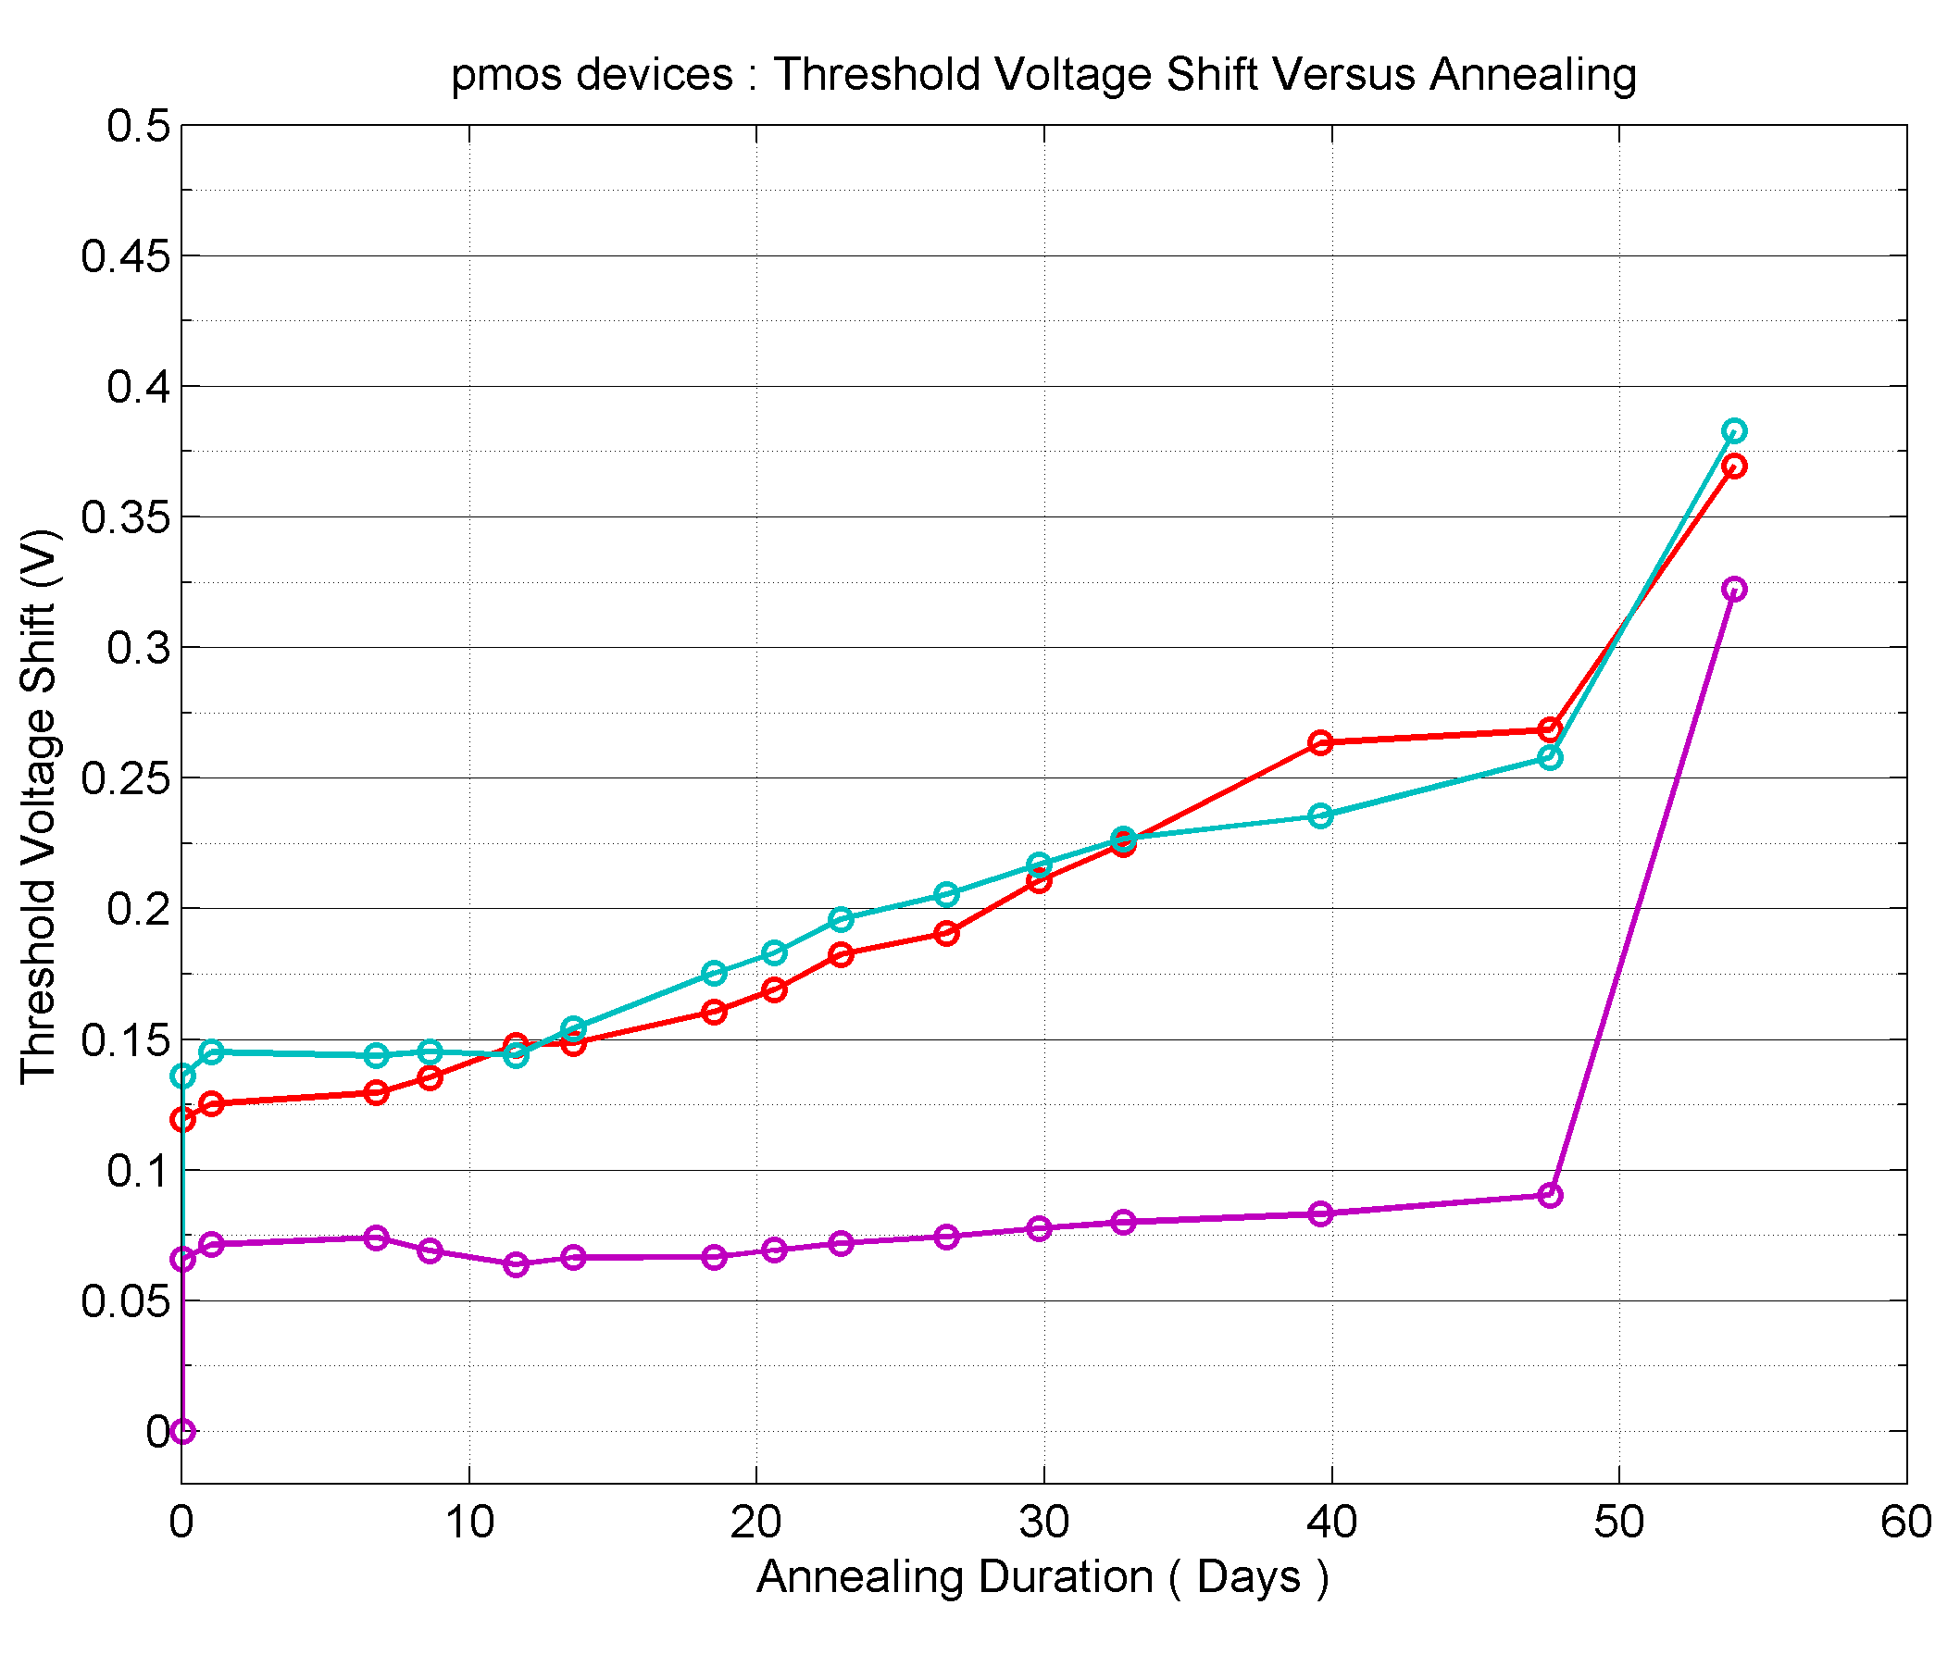
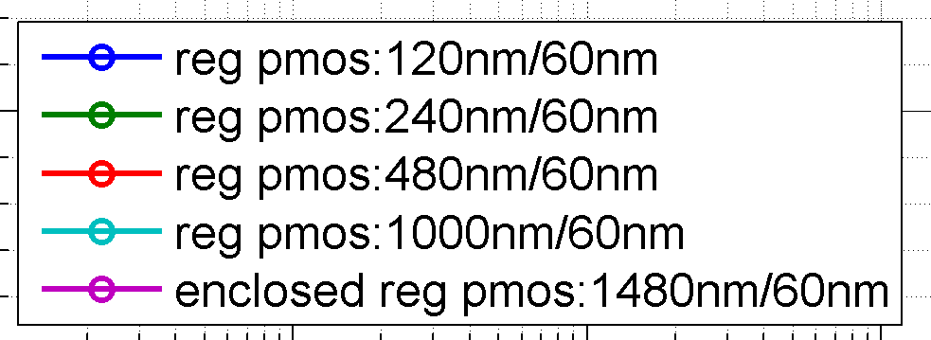
TSMC 65nm Radiation tolerance measurements
Standard PMOS Vt shift
T = -25°C
T = 25°C
T=100°C
ΔV_{t} (mV)
0 100 200 300 400 500
ΔV_{t} (mV)
0 100 200 300 400 500
0.01 0.1 1 10 100 1000
Dose (Mrad)
20 30 40 50 60 Annealing (days)
M. Barbero, J. Christiansen

Slide 32
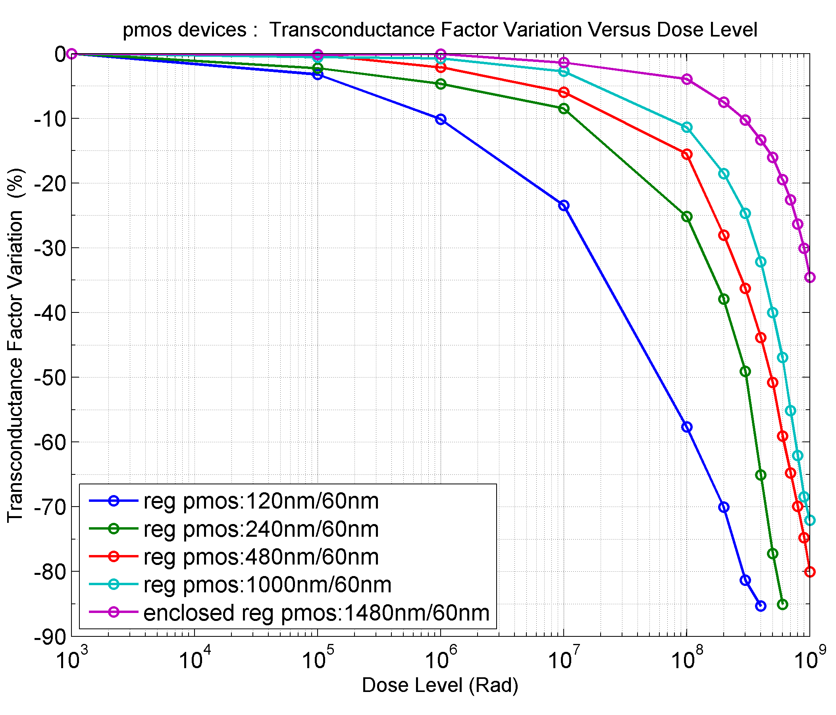
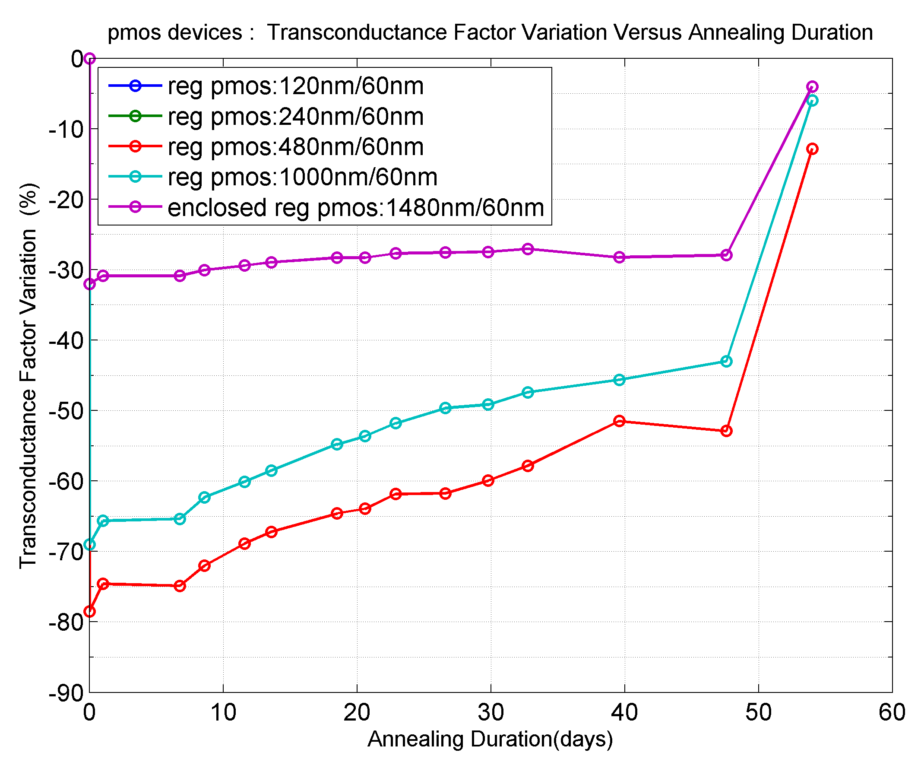
TSMC 65nm Radiation tolerance measurements
Standard PMOS transconductance
Δ transconductance (%)
-80 -60 -40 -20 0
Δ transconductance (%)
-80 -60 -40 -20 0
T = -25°C
T = 25°C
T=100°C
0.01 0.1 1 10 100 1000
Dose (Mrad)
20 30 40 50 60 Annealing (days)
M. Barbero, J. Christiansen

Slide 33
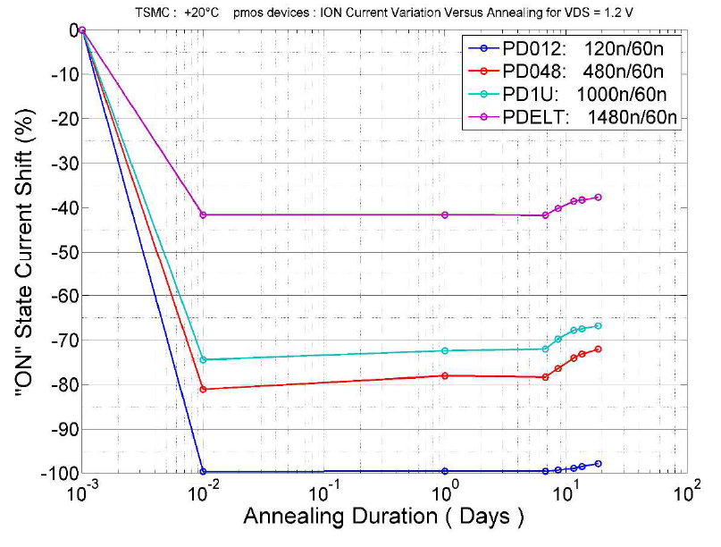
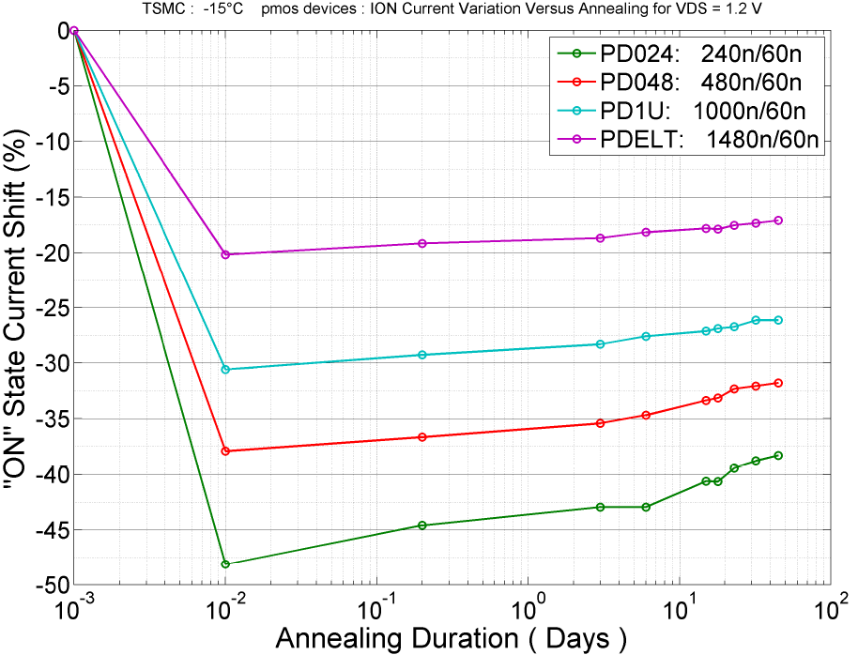
TSMC 65nm Radiation tolerance measurements
Standard PMOS I_{on}
+20°C
-15°C
100% max
<50% max
Pre-irrad
(0Mrad)
1Grad
40 days
M. Barbero, J. Christiansen

Slide 34
IP Block sharing
During LHC-1 sharing of blocks was mostly within sub-detector groups or from CERN to outside institutes.
Licensing was based on ‘gentlemen’s agreements’
Significant duplication of effort
RD-53 have agreement between member institutes but limited to RD-53 efforts
For a more general purpose repository there is a need to solve the ‘engineer at the University of Saint-Genis’ problem

Slide 35
Interconnect technologies
Al wire bonding remains the dominant means of I/O from chips
Flip chip is common on high volume consumer goods
Through Silicon Vias (TSVs)are being used in some special applications (such as smartphone camera assemblies and DRAMs) but such processes are difficult or impossible to access in smaller volumes
TSV-last processing starts to become viable:

Slide 36
Through Silicon Vias
TSV first – VIAs are drilled prior to the fabrication of the CMOS transitors
TSV middle – VIAs are drilled after CMOS definition (Front End Of Line) but prior to metal definition (Back End of Line)
TSV-last – VIA’s are drilled on finished wafers

Slide 37
TSV-last from LETI on Medipix3RX
G. Pares. CEA-LETI

Slide 38
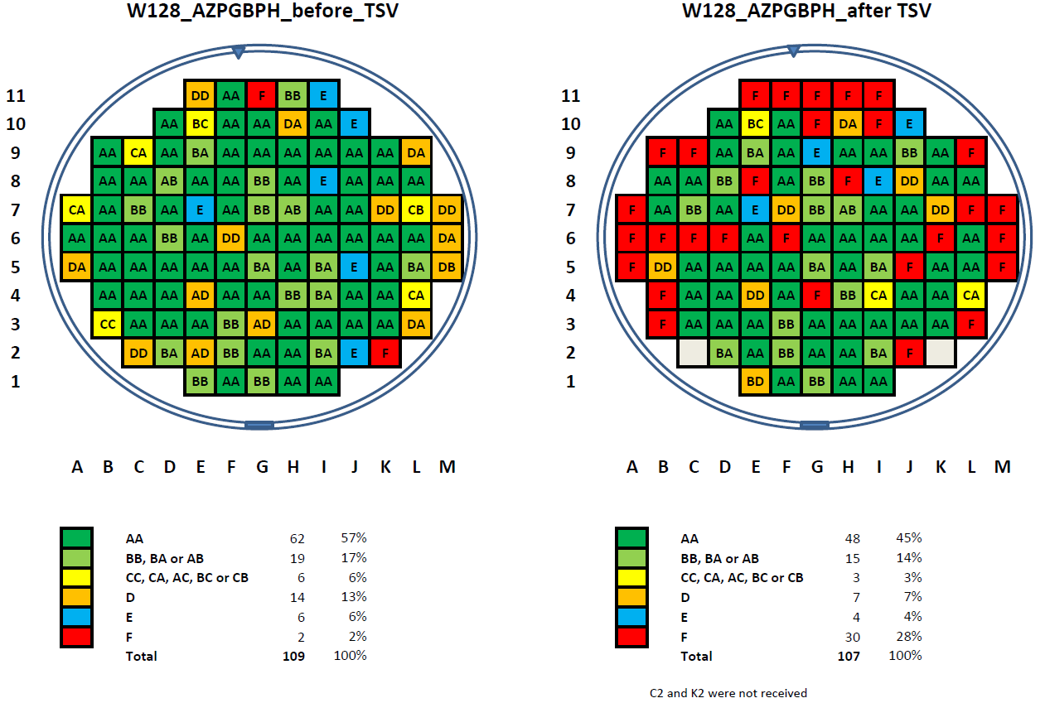
Wafer map before and after TSV processing
J. Alozy

Slide 39
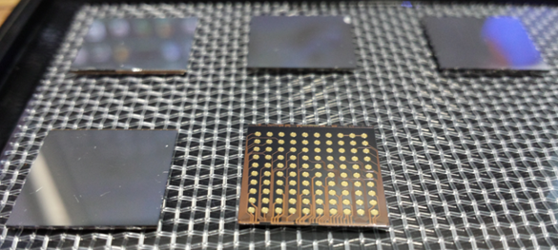
First TSV plus edgeless Si assembly
J. Alozy

Slide 40
Future CMOS technologies
Industry is already in production at 16nm
Some upcoming technical challenges:
  28nm - High K metal gates
  20nm - SiGe strained devices
  16nm – FINFETs
HEP specific challenges
  radiation tolerance
  Front end design density
  Access ($$$)

Slide 41
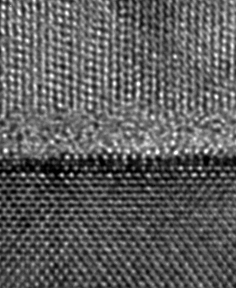
Future CMOS technologies
Industry is already in production at 16nm
Some upcoming technical challenges:
  28nm - High K metal gates
  20nm - SiGe strained devices
  16nm – FINFETs
HEP specific challenges
  radiation tolerance
  Front end design density
  Access ($$$)
Poly Si gate
1.2nm SiO₂
Si substrate
Intel 65nm
Tahir Ghani, Intel

Slide 42
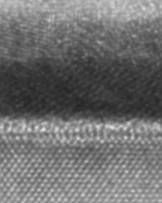
Future CMOS technologies
Industry is already in production at 16nm
Some upcoming technical challenges:
  28nm - High K metal gates
  20nm - SiGe strained devices
  16nm – FINFETs
HEP specific challenges
  radiation tolerance
  Front end design density
  Access ($$$)
Gate electrode
Hi-K dielectric
Si substrate
Tahir Ghani, Intel

Slide 43
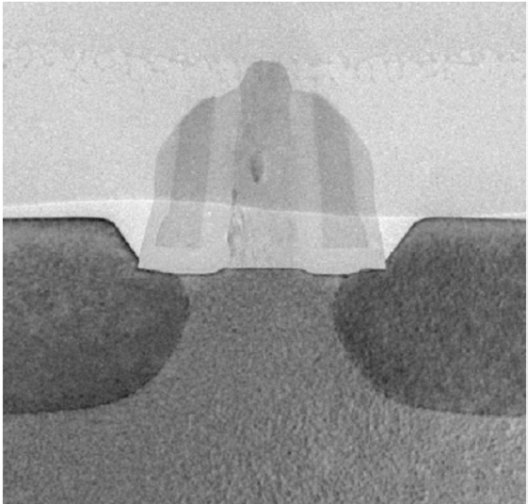
Future CMOS technologies
Industry is already in production at 16nm
Some upcoming technical challenges:
  28nm - High K metal gates
  20nm - SiGe strained devices
  16nm – FINFETs
HEP specific challenges
  radiation tolerance
  Front end design density
  Access ($$$)
Gate
SiGe
SiGe
Source
Drain
Tahir Ghani, Intel

Slide 44

Future CMOS technologies
Industry is already in production at 16nm
Some upcoming technical challenges:
  28nm - High K metal gates
  20nm - SiGe strained devices
  16nm – FINFETs
HEP specific challenges
  radiation tolerance
  Front end design density
  Access ($$$)
Tahir Ghani, Intel

Slide 45
Conclusions
Microelectronics technologies are one of the foundation technologies for present and future HEP experiments
As a community we are best served by using a limited number of common platforms
65nm CMOS is becoming a new ‘hard’ node
We could (and must) get better organised for IP block sharing
New interconnect approaches might provide novel solutions for detector and module design

Slide 46
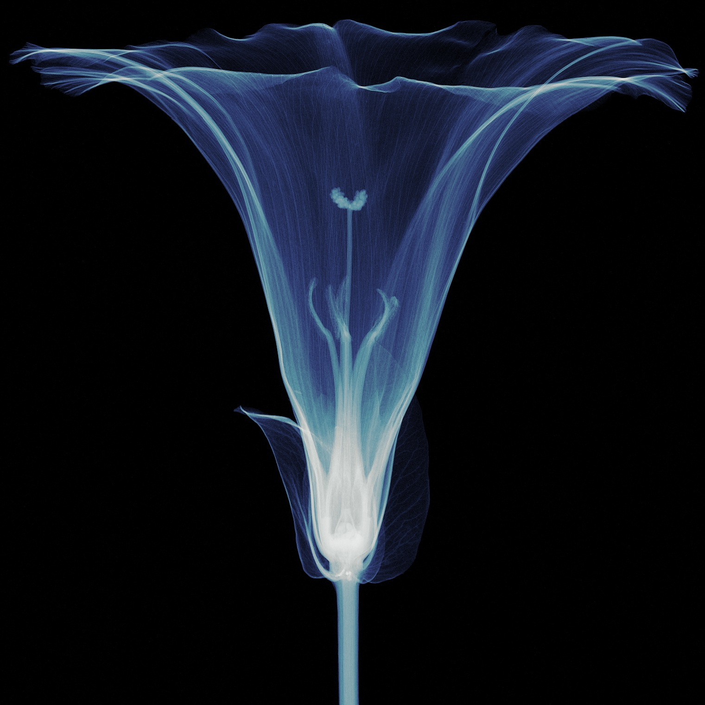
Thanks for your attention!
S. Procz

