Slide 1


Reactive Ion Etching of GEM foils
Avinash Joshi¹, L. M. Pant² & A. K. Mohanty²
¹Alpha Pneumatics, Thane, Maharashtra
²Nuclear Physics Division, Bhabha Atomic Research Centre, Mumbai

Slide 2
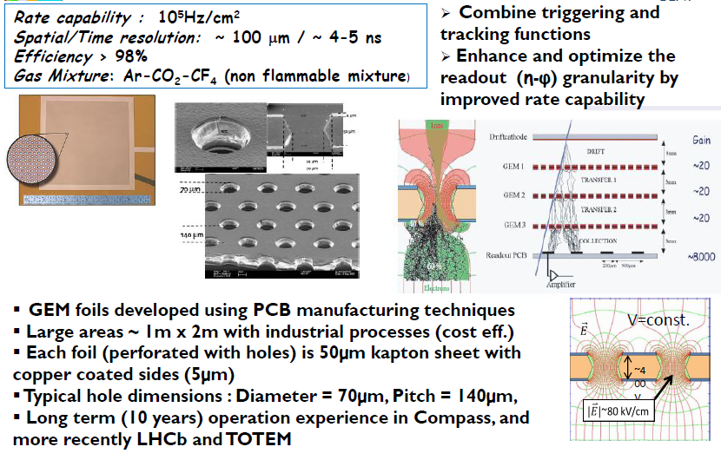
The Triple GEM for the CMS Muon System

Slide 3
Present GEM fabrication process
Present process of GEM foils making involves Photolithography and Chemical / Electrochemical etching of copper and polyamide layers
Uniformity and reproducibility of etching are governed by :
Rate of a chemical reaction : function of ratio of activities (Concentration)
of reactants to products
Transport factor : ratio of partial pressure of a reactant
reaching the surface through boundary layer
to the partial pressure of reactant in gas mix
Activity at reaction surface : function of diffusivity of Reactant Species
(inward) and Products Species (outward)
through the boundary layer
Flow of reactants & products : across boundary layer is controlled by the
thickness of boundary layer.

Slide 4
Disadvantages of Liquid Etching
Reactant and products are in liquid state
Reaction rates are highly sensitive to temperature and concentration of reacting species
Solvent is needed to activate and transport the reacting species
Boundary layer is thick and the layer thickness is few microns
The supply of the reacting species to the reaction surface becomes lesser as the holes become deeper
This problem becomes very prominent when hole diameter is nearer to boundary layer thickness
Inner surface of the etched hole has undercutting, because of isotropicity

Slide 5
Plasma Etching : Advantages over Liquid Etching
Gas Phase reaction - clean and precise
Features having Very Large aspect ratio can be etched
Photo-resist mask can be removed by Ashing under O₂ plasma
Instant Change of etchants by switching gases through MFC control channels
Galvanic protection possible to avoid over-etching of front copper layer.
Etch process can be sequenced and programmed to etch multiple layers, in succession
End point detection by OES (optical emission spectroscopy) is possible
Surface passivation of exposed etched surface by oxygen plasma
Excellent control over Differential etch rate between Copper and Polyimide
DC bias : controlled ion energy for directional etching
Very little undercutting
It is possible to etch copper and Kapton in – situ

Slide 6
Plasma Etching : Process variables
1) RF Power density
2) Gas Mixture component types
3) Gas mixture Ratio
4) Pressure
5) Substrate Temperature
6) Electrode spacing : 19 mm with GEM foil at ground

Slide 7
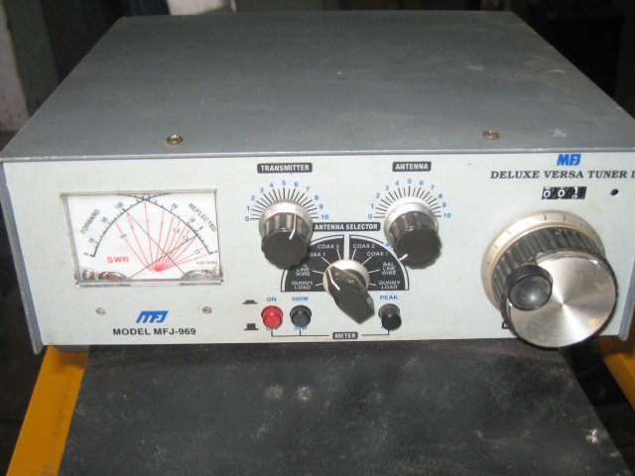
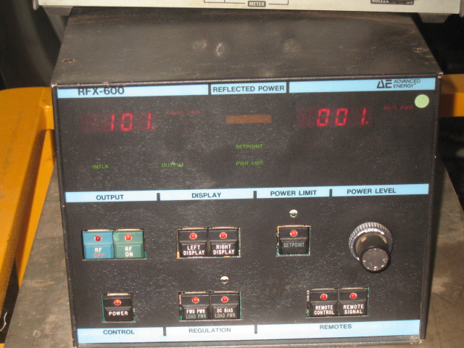
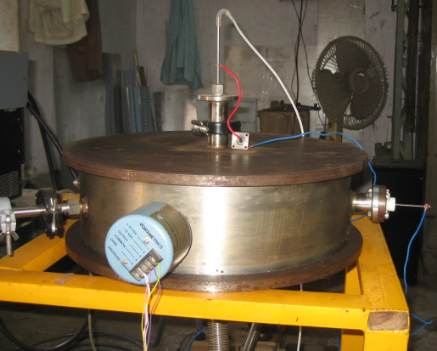
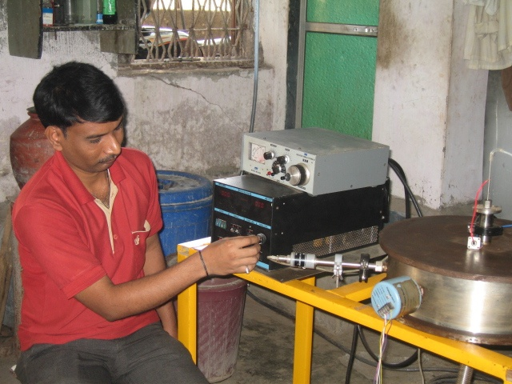
Plasma Etching at Alpha Pneumatics, Thane Factory
Applied
Power (W)
RF matching network
(capacitively coupled plasma)
RF Supply @ 13.56 MHz
Reflected
Power (W)
Process Chamber with
Pirani Gauge & Baratron
Tuning the plasma
457 mm
175 mm

Slide 8
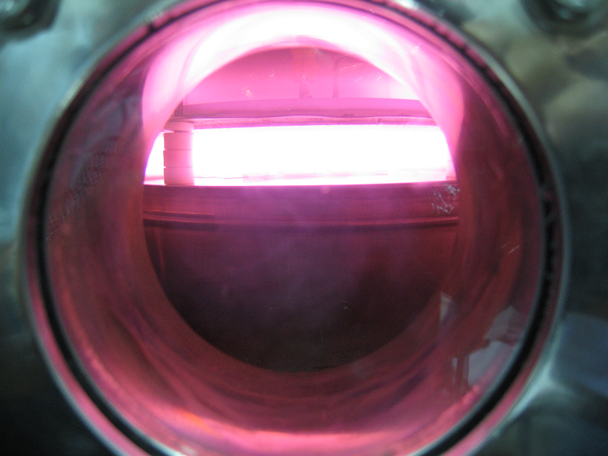
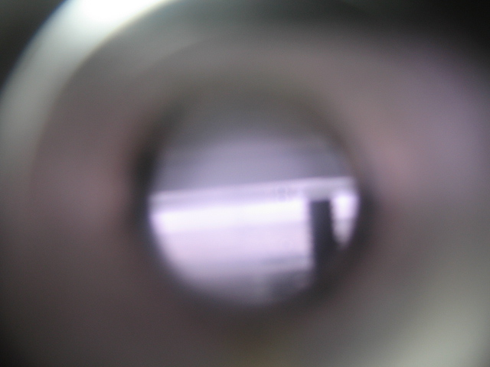
RF Plasma at 0.4 to 1.0 Torr : 19 mm electrode spacing
with O₂ (100%) with SF₆ (100%)

Slide 9
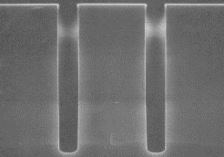
SEM photograph of plasma etched silicon grooves with large aspect ratio (L/a)
L = 90 μm
a = 15 μm

Slide 10
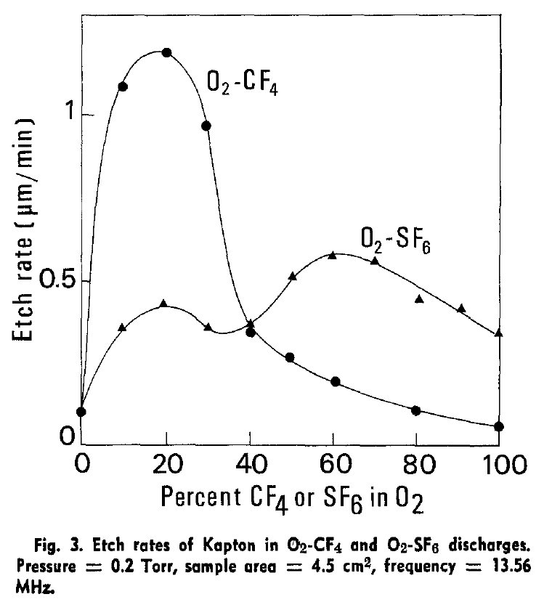
Etch rate of polymide versus SF₆ concentration in O₂
Ref : “Dry Etching of Polyimide in O₂-CF₄ and O₂-SF₆ Plasmas” Guy Turban and Michel Rapeoux , Journal of Electrochem. Soc. Solid State Science and Technology, p 2231-2236, Nov. 1983

Slide 11
Etch rate of polymide versus SF₆ concentration in O₂
Ref : “Dry Etching of Polyimide in O₂-CF₄ and O₂-SF₆ Plasmas” Guy Turban and Michel Rapeoux , Journal of Electrochem. Soc. Solid State Science and Technology, p 2231-2236, Nov. 1983
Etch Rate : μm / min →
percentage of SF₆ in O₂ →

Slide 12
Etching Parameters
Gas Pressure : 0.6 torr
For Polyimide (Kapton)
a) SF₆ : 6.0 SCCM (20%)
b) O₂ : 24.0 SCCM (80%)
c) RF Power Density : 0.6 to 1.2 W/cm²
d) Maximum Etch Rate Achieved : 0.3 μm/min
For Copper
a) SF₆ : 24.0 SCCM (80%)
b) O₂ : 6.0 SCCM (20%)
c) RF Power Density : 0.6 to 2.0 W/cm²
d) Maximum Etch Rate Achieved : 0.05 μm/min
e) Substrate Temp : 25^{O}C/Start, 35^{O}C/End
f) Duration : 10.0 min

Slide 13
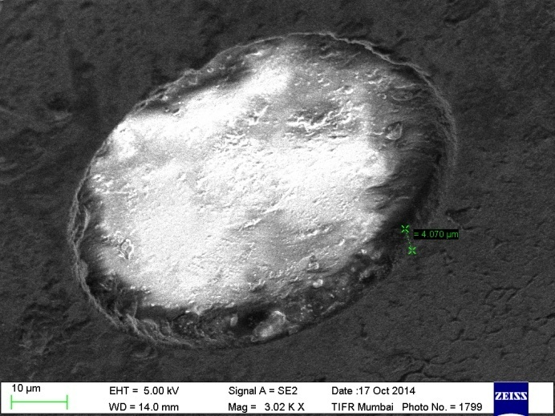
Rejected Polyimide foil from CERN with
Cu already patterned at 70 μm diameter
70 μm
70 μm diameter in Cu
P0
5 μm of Cu
100 nm of Chromium
140 μm
50 μm of polyimide
Courtesy : Shuvendu, ASD-BARC
SEM view

Slide 14
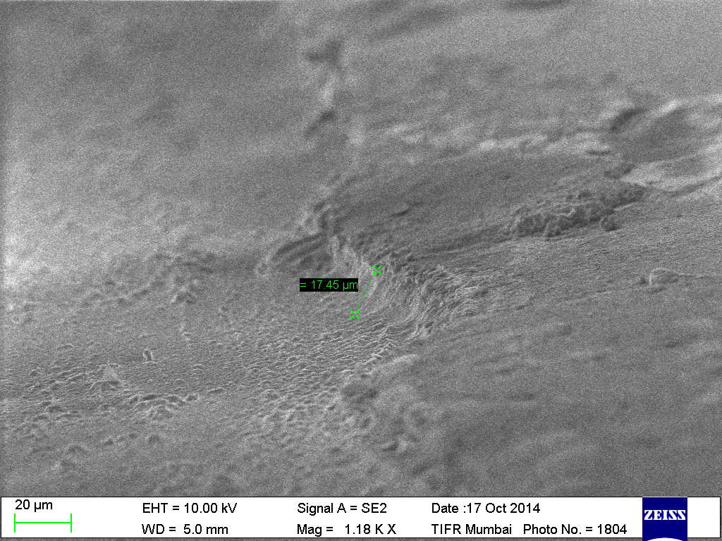
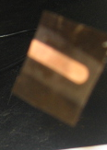
∼ 18 μm deep trench in Polyimide in 48 minutes
under SF₆ (20%) + O₂ plasma
Polymide
Glass
Mask
SEM view

Slide 15
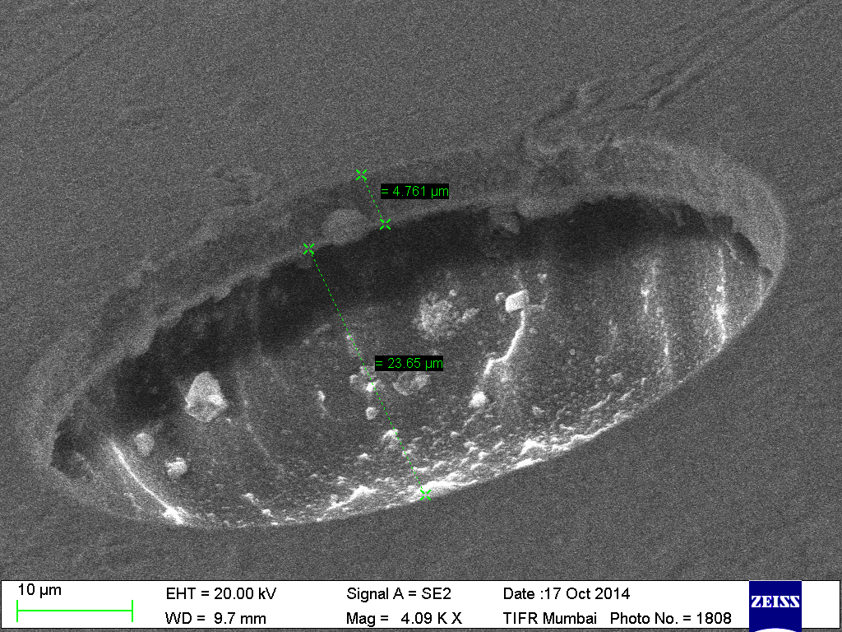
∼ 24 μm deep trench in Polyimide in 60 minutes under SF₆ (20%) + O₂ Note , there is no undercutting
P9
Courtesy : Shuvendu, ASD-BARC
SEM view
70 μm diameter in Cu
5 μm of Cu
24 μm
100 nm of Chromium
50 μm of polyimide

Slide 16
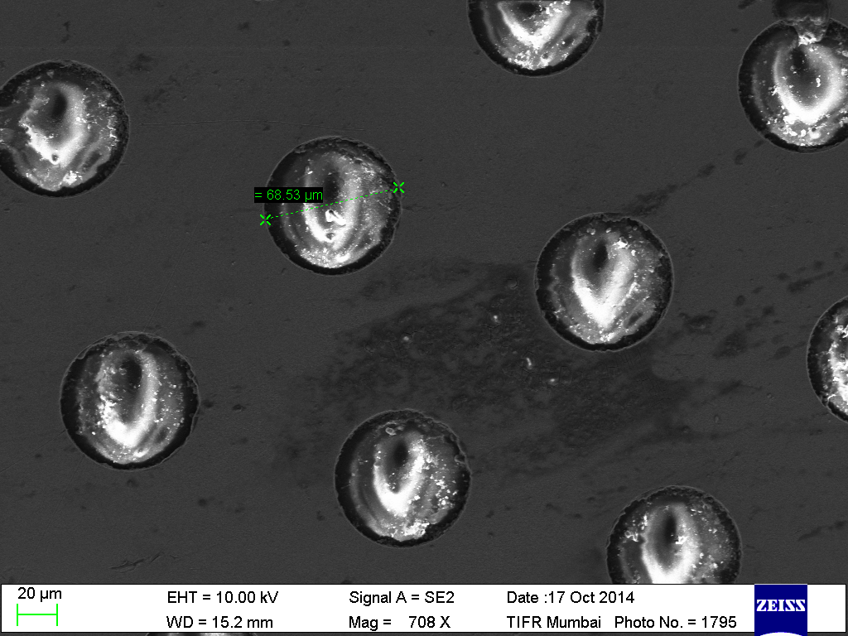
∼ 30 μm deep trench in Polyimide in 60 minutes
under SF₆ (20%) + O₂ plasma
Courtesy : Shuvendu, ASD-BARC
SEM view
70 μm diameter in Cu
5 μm of Cu
30 μm
100 nm of Chromium
50 μm of polyimide

Slide 17
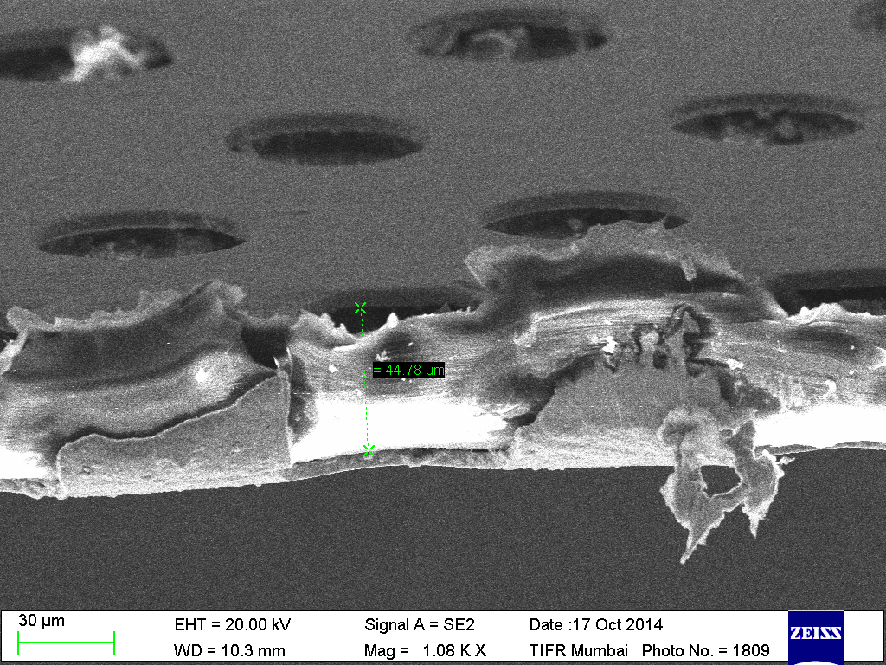
Polyimide etched to a depth of 50 μm in 120 minutes
under SF₆ (20%) + O₂ plasma
45 μm
70 μm diameter in Cu
5 μm of Cu
100 nm of Chromium
50 μm of polyimide

Slide 18
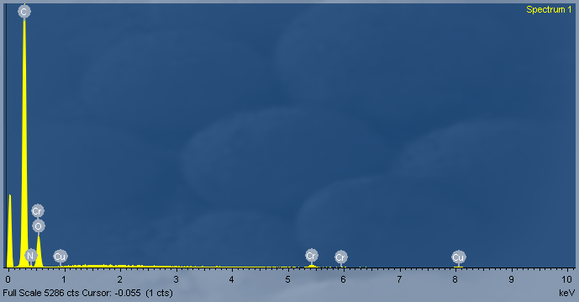
EDAX measurement of surface chemistry showing
presence of Cu and Cr in the bottom layer
70 μm diameter in Cu
5 μm of Cu
100 nm of Chromium
50 μm of polyimide

Slide 19
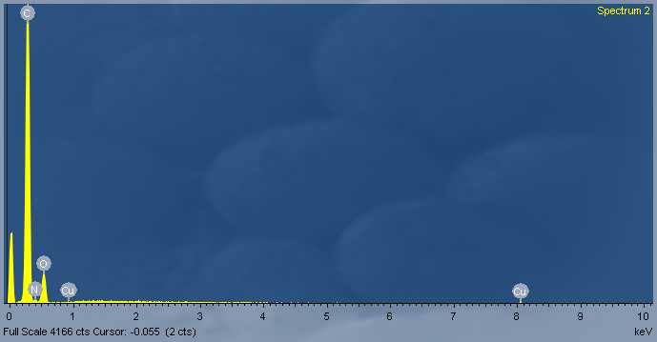
EDAX measurement of surface chemistry showing
absence of Cr in the bottom layer
reverse concentration : SF₆ (80%) + O₂ (20%) flash for a couple of minutes
70 μm diameter in Cu
5 μm of Cu
100 nm of Chromium
50 μm of polyimide

Slide 20
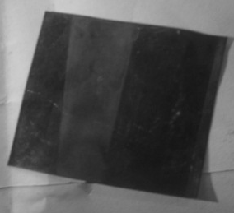
Etching of Copper on Polyimide
SF₆ (90%) + O₂
0.2 μm of Cu
etched from
unmasked surface
Cu intact
due to mask
Cu intact
due to mask

Slide 21
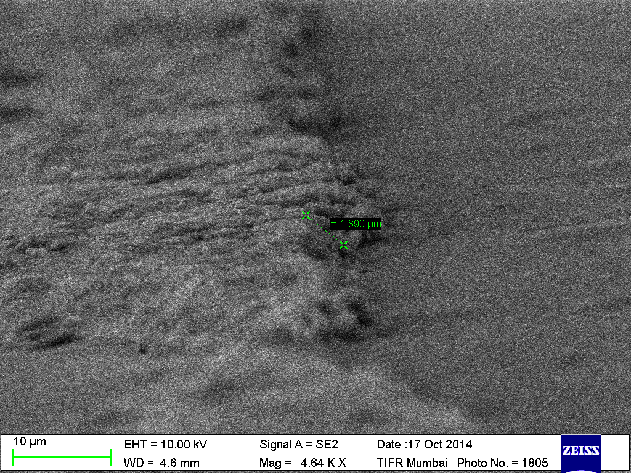
5 μm etching of Copper on Polyimide (5000 X)
SF₆ (90%) + O₂
Cu
Polymide
Glass
Mask
Courtesy : Shuvendu, ASD-BARC
SEM view

Slide 22
Cl₂ as an alternative to SF₆
1) Cl₂ gives better results than SF₆
2) With SF₆ + O₂ mixture, higher surface temperature
(214^{O}C) is required to evaporate the products
3) Etch rates of 0.5 μm/min (x10)have been achieved
under Cl₂ + O₂ plasma and UV irradiation

Slide 23
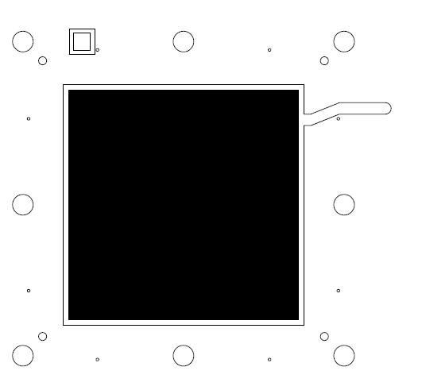
Artwork and Mask making : Image of GEM foil mask

Slide 24
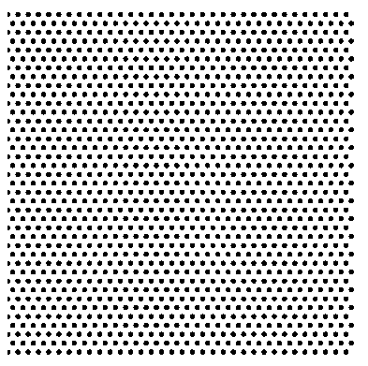
Artwork and Mask making : 1/100th part of artwork
Drawing prepared in Auto Cad 2004 platform
Front and Back side contact /proximity masks
Total 591000 elements per mask
Single reticule of 185 mm x 175 mm size
Present Status :
Artwork prepared by us, which has been okayed by CERN
We are in touch with emulsion mask makers from US and commercial negotiations are going on to prepare emulsion and chrome type contact masks.

Slide 25
Summary and Outlook
An etch rate of 0.5 μm/min for Polymide and 0.05 μm/min for Cu has been demonstrated
Possible modifications / Etchants for future RIE processes for GEM
Gases : SF₆, CF₄ , O2 ,CH₂FCF₃ (R134a) , Cl₂, Argon and Nitrogen, Organometallics
SF₆ and CF₄ more suitable than R134a as Fluorine yield is significantly higher
Cl₂ and O₂ plasma etch copper but does not affect Polymide
SF₆ and O₂ plasma etch PMMA but does not affect copper but etch rate is very poor
Power density of 0.5 Watt/cm² is adequate
CCP or ICP methods can be used for large area
Process of RIE under UV radiation to facilitate CuClx evaporation
We are using CCP technique (@13.56 MHz)

Slide 26
References
1) “Dry Etching of Polyamide in O2-CF4 and O2-SF6 Plasmas”
Guy Turban and Michel Rapeoux , Journal of Electrochem. Soc. Solid State Science and Technology pp2231-2236 Nov. 1983
2) “ Dry Etching of Copper Using Plasma” by Kejun Xia
Semiconductor TCAD Lab. Auburn University, AL,
Oct 19, 2003
3)“Plasma etching of copper films at low temperature”
P.A.Tamirisa et al ,
Microelectronic Engineering, Volume 84, Issue 1, January 2007, Pages 105–108

Slide 27
Acknowledgements
Dr. Padmakar Tillu for providing high purity SF₆ gas
Dr. S.C.Purandare (DCMP – TIFR) for SEM studies
Shivendu (ASD-BARC) for optical images

