Slide 1
Recent results from Test Beam of Hybrid THGEM – Micromegas Photon Detector
Shuddha Shankar Dasgupta
INFN Trieste and Trieste University
On behalf of:
Alessandria, Aveiro, Budapest, Calcutta, Freiburg, Liberec, Prague, Torino, Trieste
collaboration

Slide 2
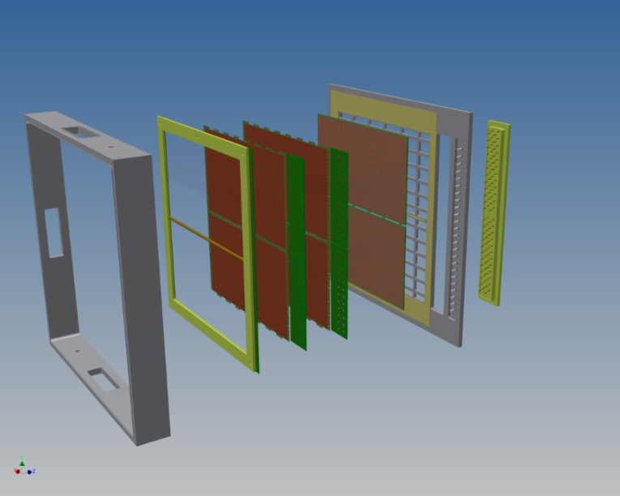
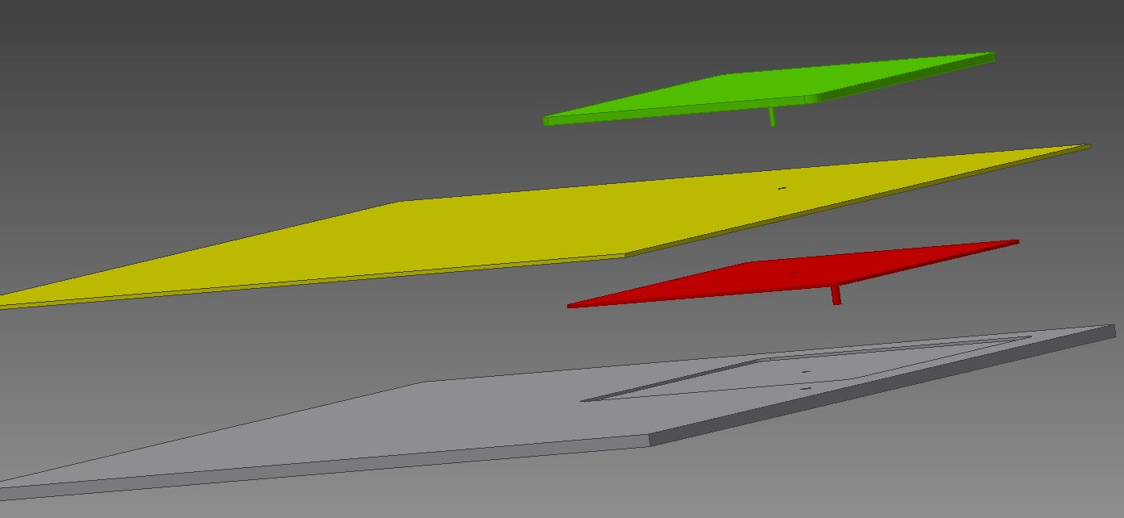
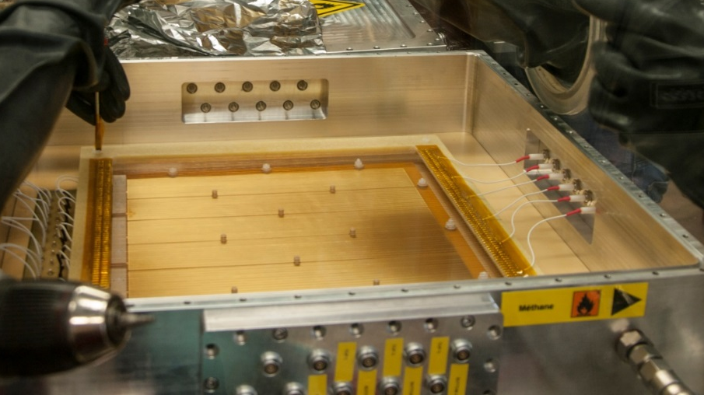
Outline
Hybrid THGEM + MM PD.
The new Hybrid PD equipped with capacitive anode.
Test Beam at CERN PS T10.
Results from analogue readout.
Results from digital readout.
Conclusion

Slide 3
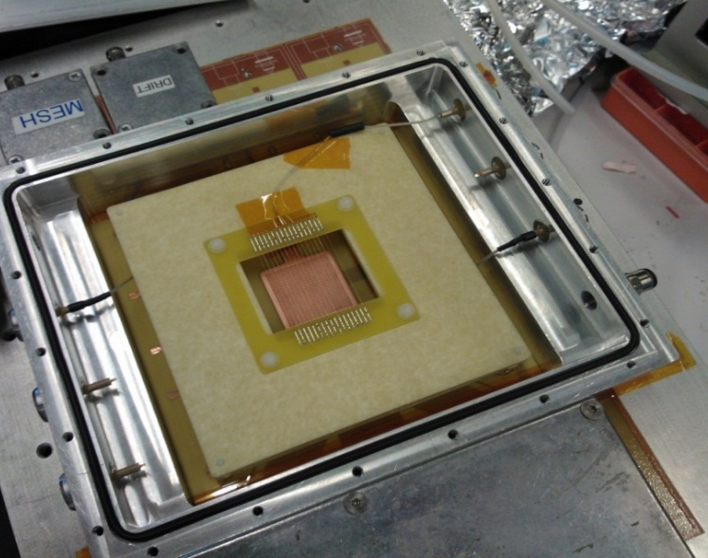

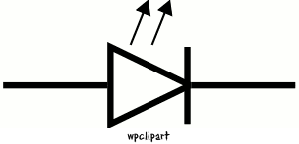
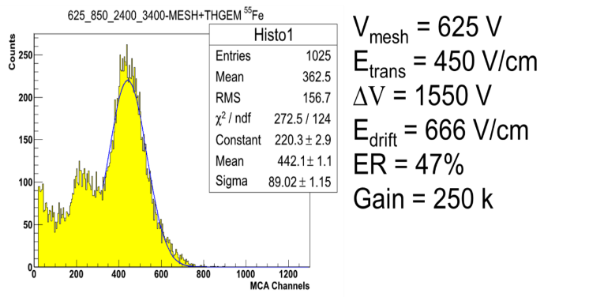
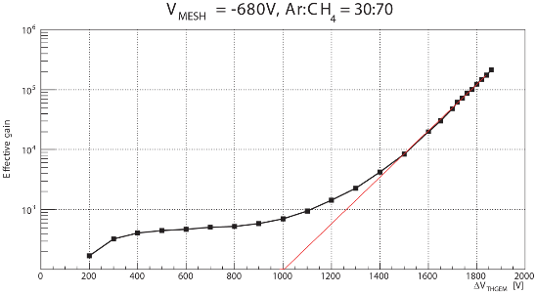
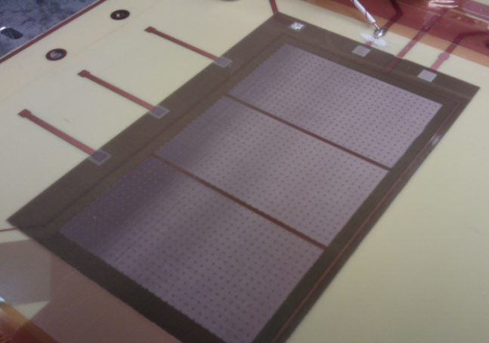
First Hybrid Photon Detector prototype: working principle and results
FIRST SMALL SIZE PROTOTYPE
Preliminary test
⁵⁵Fe source,
Gas used: Ar:CO₂ 70:30.
Double THGEM ∆V scan. Plateau represents the unitary THGEM gain, corresponding MM GAIN ~ 500. Gas: Ar:CH₄ 30:70
Hybrid detector
⁵⁵Fe X–Ray Source.
^{UV LED Source}
Kapton/Fused Silica Window
Drift wires
10⁵
THGEM
15 mm
Micro Mesh
5 mm
Effective GAIN ~ 3E5
128 μm
Anode
Hybrid with double THGEMs and tested with UV LED
CAEN N471A High Voltage PSU
Charge Sensitive Pre amplifier CREMAT CR – 110/111
Normal Readout Chain
Gain ≈ 9.5E5
Bulk Micromegas: courtesy of Saclay COMPASS colleagues
Gas: Ar:CO₂ 70:30

Slide 4
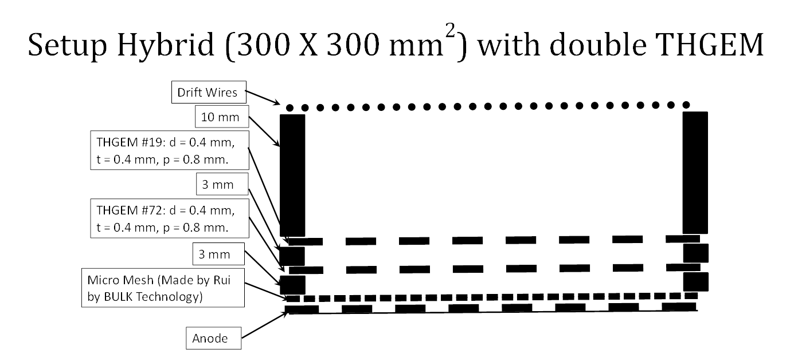
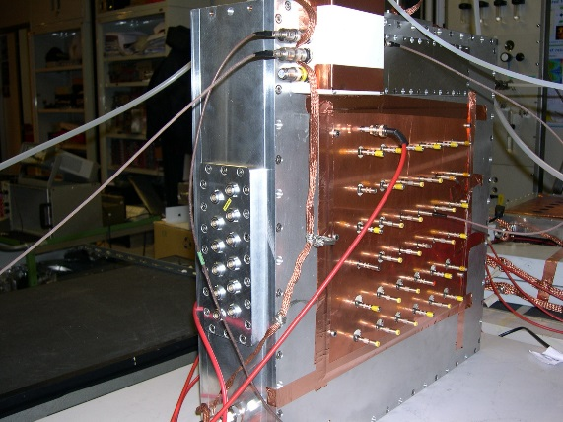
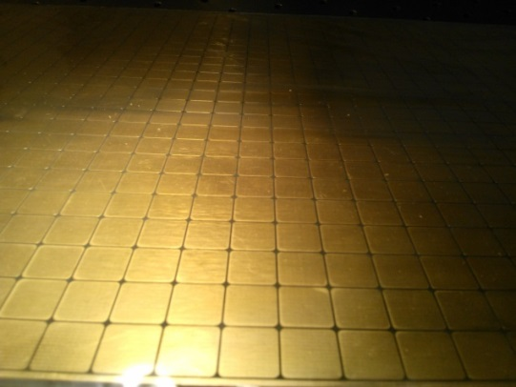
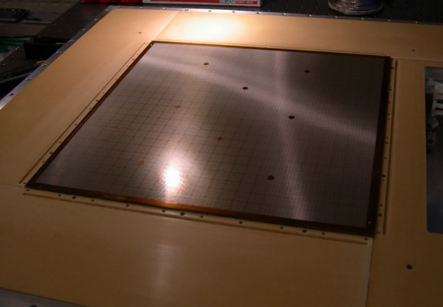
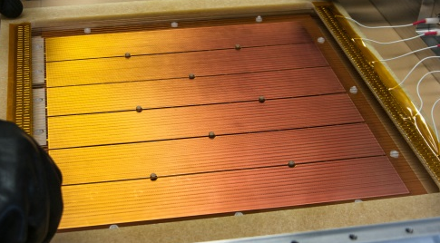

300X300mm² Hybrid prototype with THGEM
Anode Pads (12mm X 12mm)
THGEM with 6 Sectors
Micromegas produced by Rui at CERN by Bulk technology

Slide 5
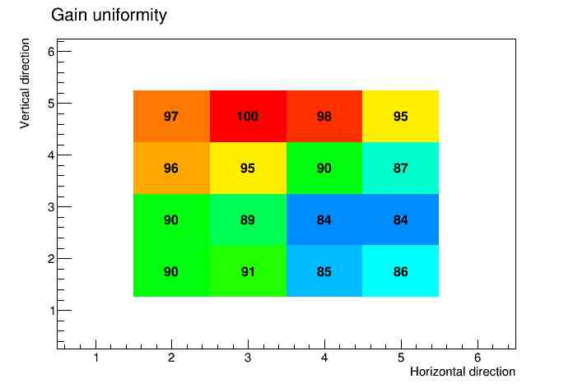
300 X 300 mm² Hybrid prototype:
Micromegas only
300X300 mm² micromesh checked for uniformity with ⁵⁵Fe source
The Micro Mesh was produced by Rui de Olivera in CERN with BULK Technology.
Checked with Ar:CO₂ 70:30, CAEN N471A HV PS, CREMAT CR – 110/111 and Normal Readout chain.
Result obtained: $Uniformity= \frac{\left({GAIN}_{Max}− {GAIN}_{Min}\right)}{{GAIN}_{Max}} ≈14\%$

Slide 6
300 X 300 mm² Hybrid prototype:
Micromegas + THGEM
300 X 300mm² THGEM + Micromegas provide the same response as the 30 X 30 mm² prototype.
All the 6 sectors of the THGEM have been checked with different bias voltages.
Maximum effective gain achieved: 10⁵ or larger with ⁵⁵Fe X – Ray source.
Ar:CH₄ 30:70 is the reference gas mixture for compass THGEM photon detector.
10⁵

Slide 7
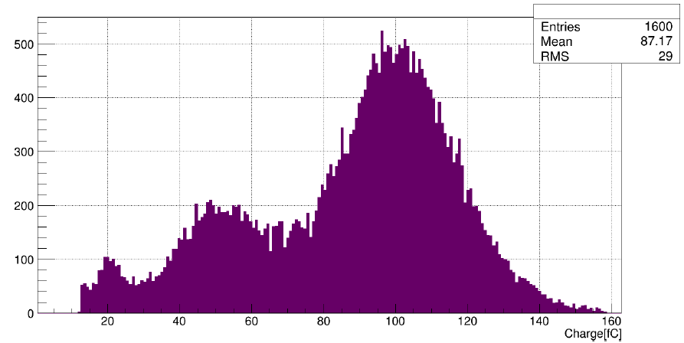
Hybrid Micromegas + THGEM
  ⁵⁵Fe main peak
  → total gain
  ⁵⁵Fe escape peak
  ⁵⁵Fe main peak,
  MICROMEGAS only
  → MICROMEGAS gain

Slide 8

Hybrid with double THGEMs
Staggered configuration
Source used: ⁵⁵Fe, Gas used: Ar:CH₄ 30:70

Slide 9
Improving the detector concept
At the test beam two hybrid detectors have been tested.
The first one has been described so far.
The second is identical but equipped with a capacitive anode architecture.
      Inspired by ATLAS MAMMA principle already presented by J. Wotschack.
      Positive voltage bias on anodic pads via external resistors.
      Mesh at ground (only not segmented electrode).
      Signal readout via capacitively coupled pads.

Slide 10
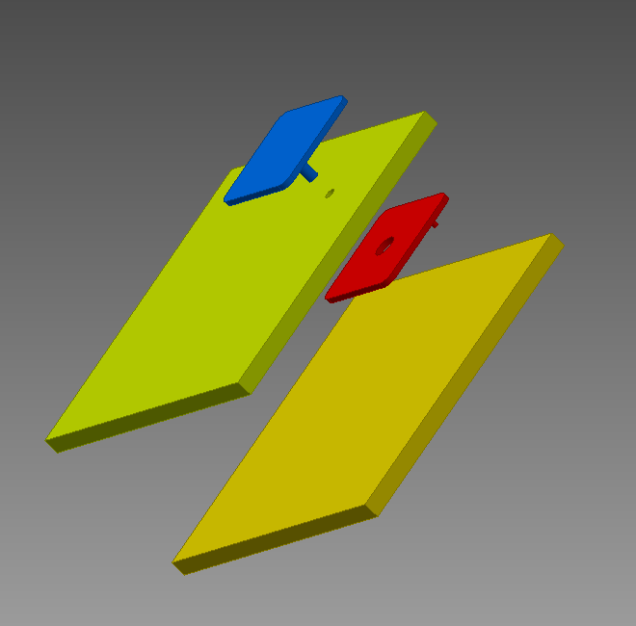
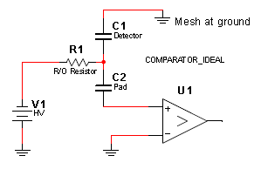
Readout via capacitive anode
Metallic pads
0.10 mm
fiberglass
HV to blue pad through the hole of red pad
Readout Amplifier
PCB
  Scheme (not to scale)
    Only 1 single pad shown
  Principle
    Blue pad at HV via internal connection
    Resistive (individual pad resistor at the PCB rear surface)
    Red pad: signal induced by RC coupling

Slide 11
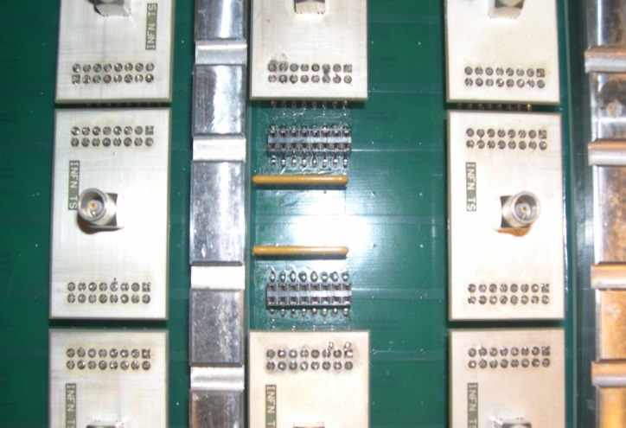
Layout of the capacitive anode PCB
Metallic pads
0.10 mm
fiberglass
Resistor arrays
(from HV line to blue pads)
PCB
HV to blue pad through the hole of red pad
Signal connectors
(from red pads)
We already did extensive study with a small prototype to find out the optimal resistance.
The optimal resistance for <10% signal loss has been found = 1MΩ.
We use a resistor array for each 8 pads.
Section of the back part of the 300 X 300 mm² anode PCB. It has 24 X 24 = 576 (12 X 12mm) pads. For each 16 pads we have this readout board which is used to read all of these 16 pads together through the LEMO female connector.

Slide 12
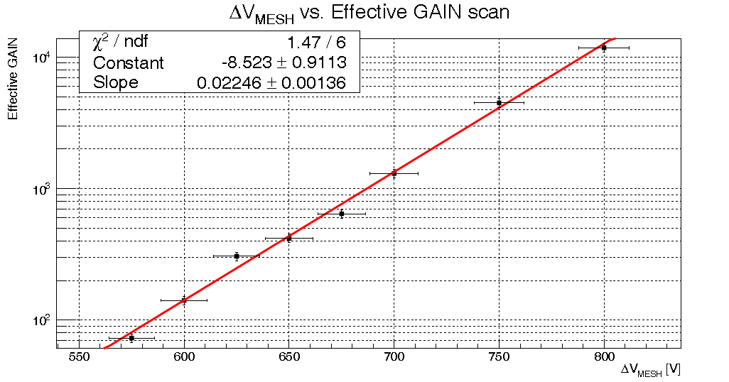
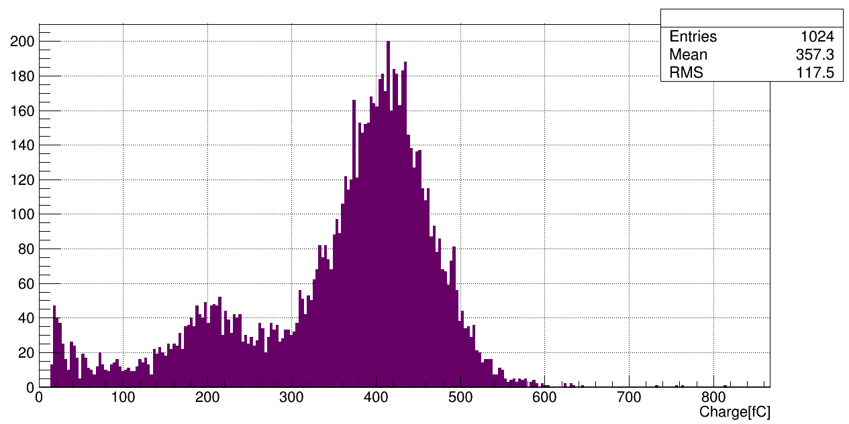
Micromegas with capacitive anode
From now on all results refer to the capacitive Micromegas chamber.

Slide 13
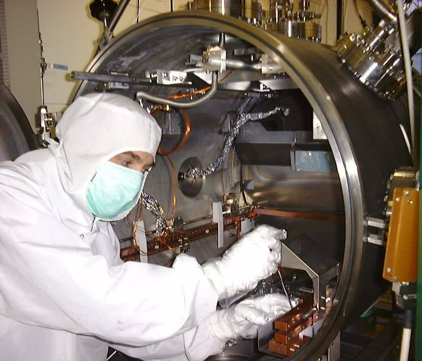
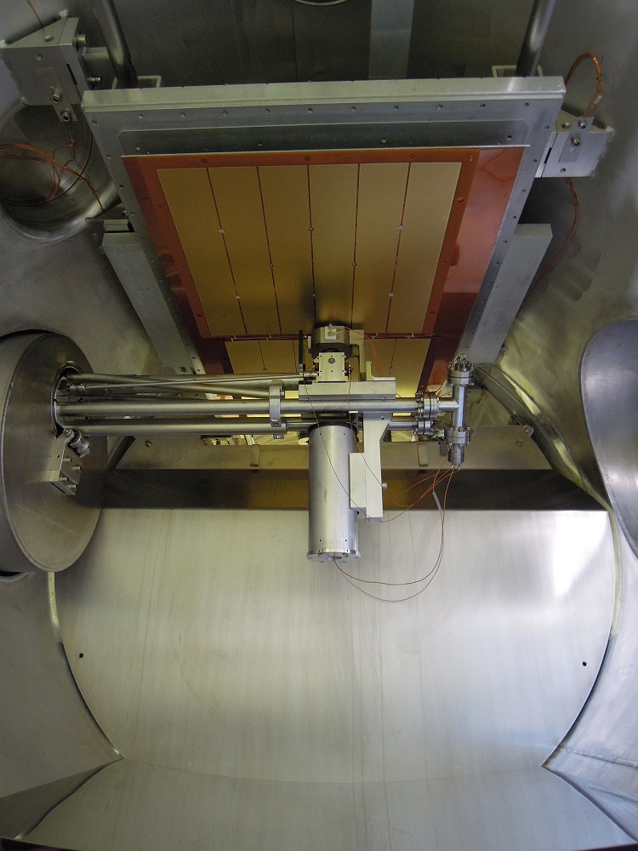
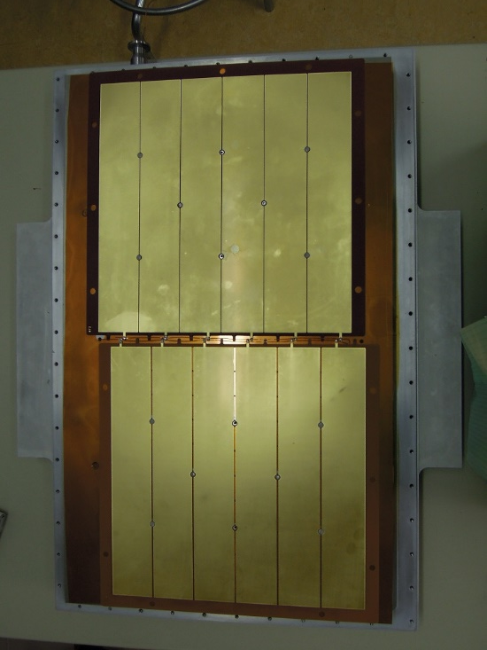
CsI Deposit at CERN
THGEMs to be coated
QE measurement
CsI deposition Plant

Slide 14
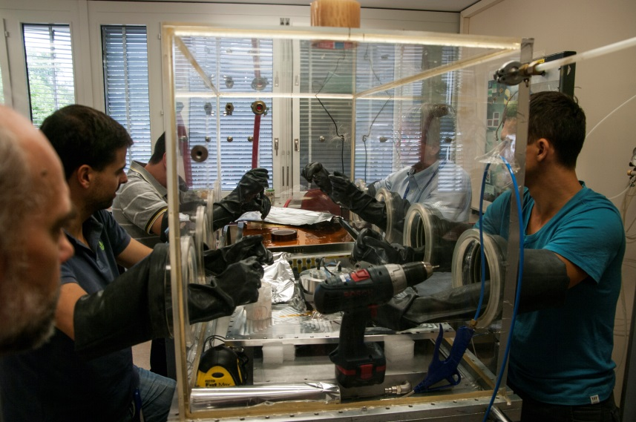
Assembling the Photon Detector
Here this picture shows the delicate operation carried out in CERN in a controlled environment to assembles the CsI coated THGEM to the chamber.

Slide 15
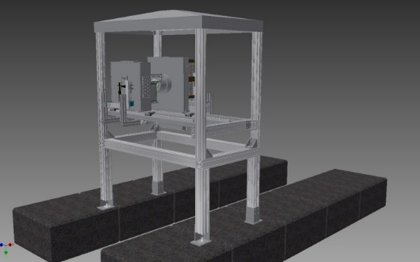
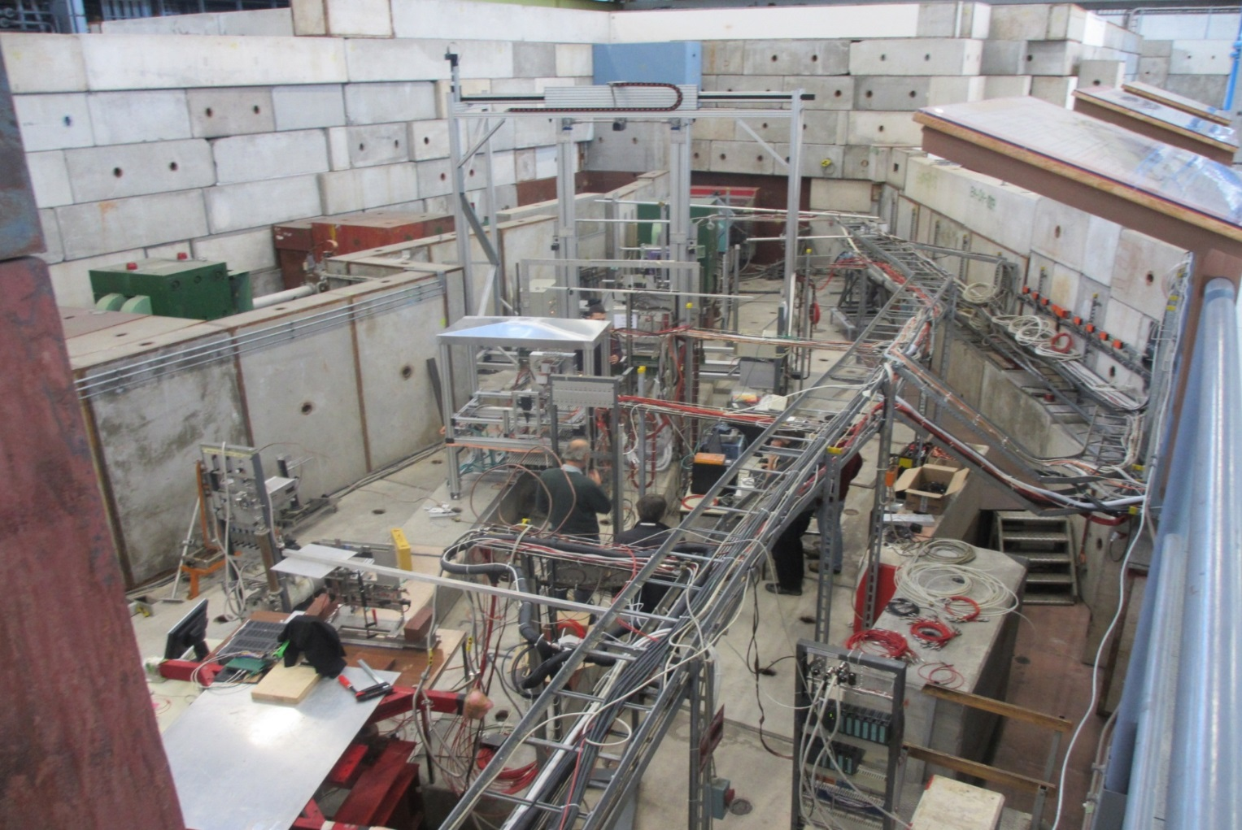
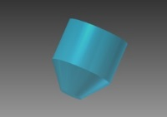
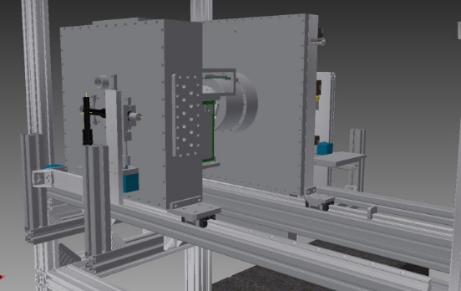
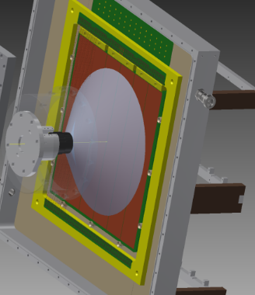
setup for Test Beam
Beam area setup
We set up our prototype in CERN PS T10 beam line.
We used a truncate cone fused silica radiator for Cerenkov photons.
For trigger we use 2 finger cross in front + 2 finger cross in back+ a Paddle.
CERN PS, T10
Trigger = Front Finger cross X Back Finger cross X Paddle.

Slide 16
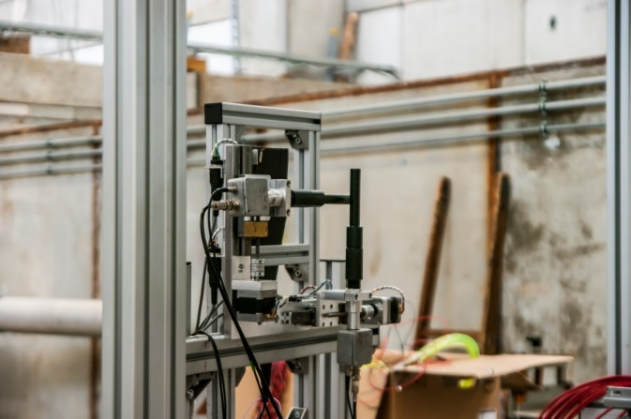
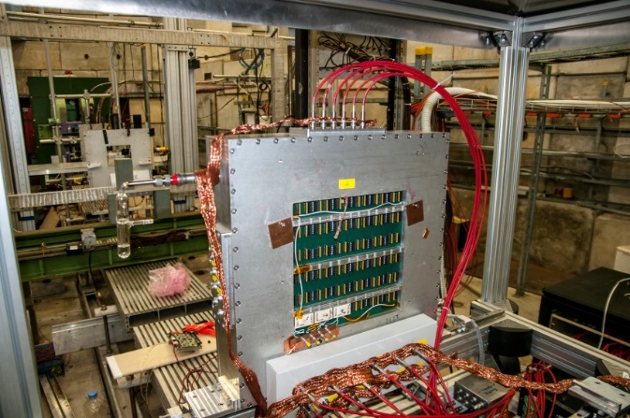
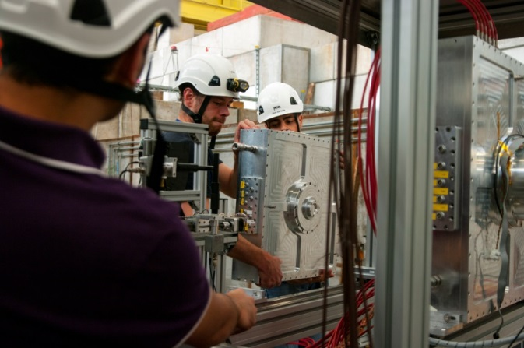
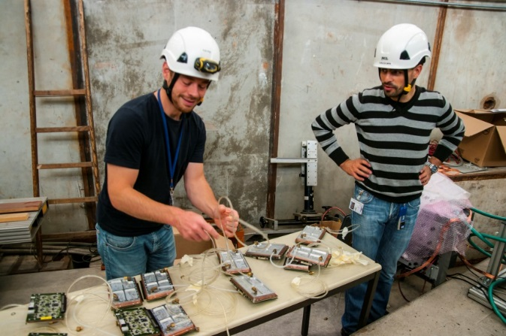
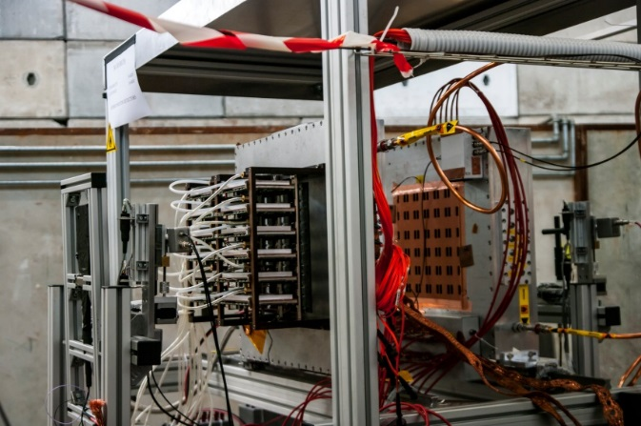
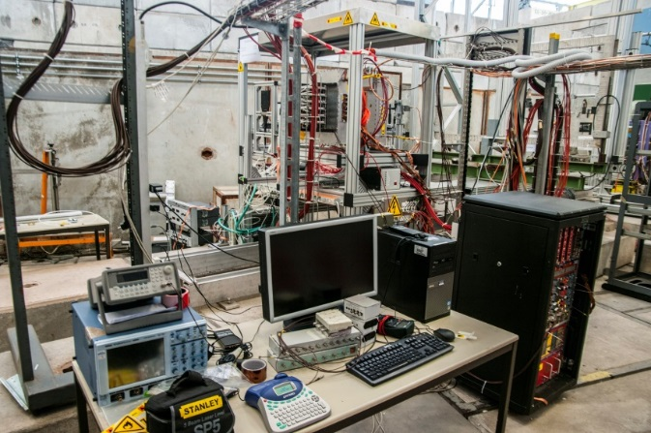
Beam area installation

Slide 17
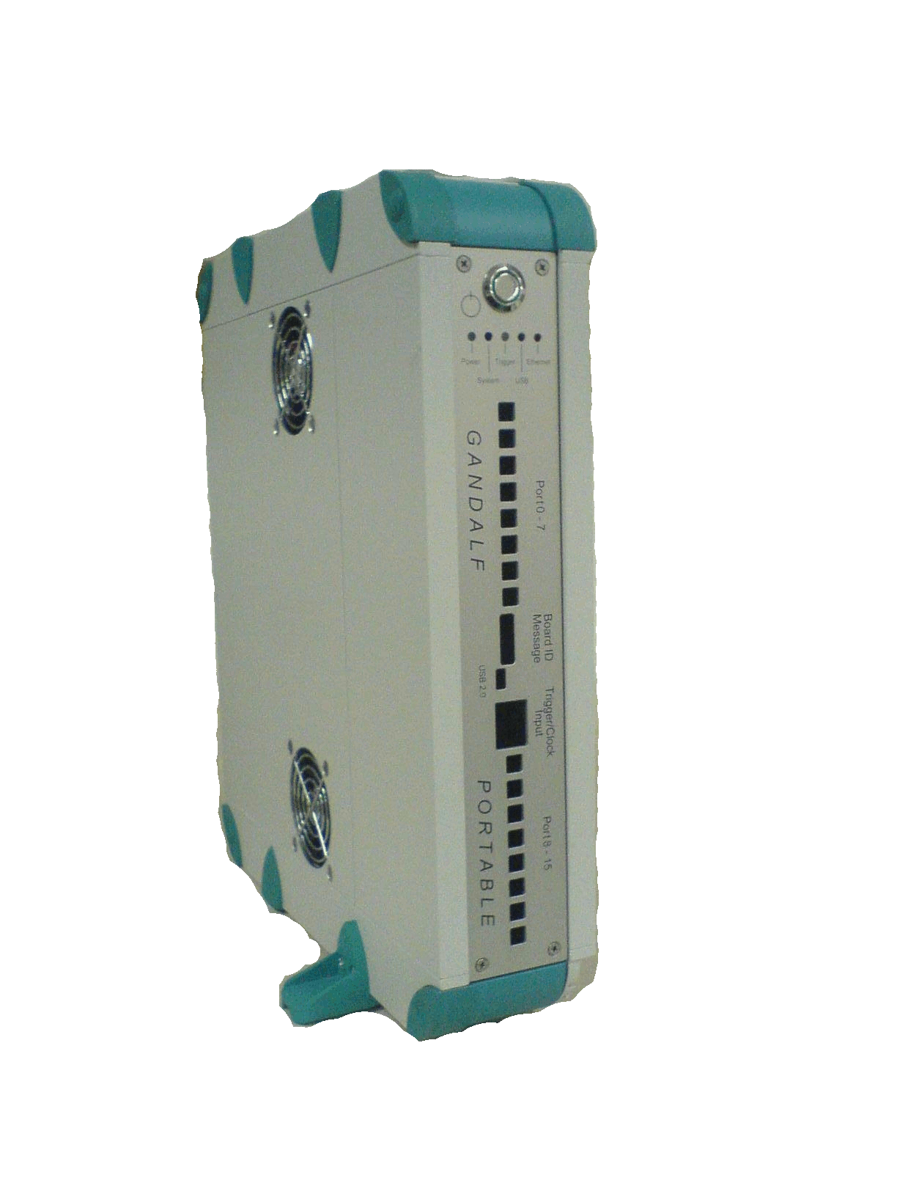

Analog Read – Out
Analogue readout Schematic diagram
Test Input
Output to Amplifier
Detector
Out
Cremat Pre – Amplifier Box
Gandalf
Input
Channels
Amplifier
Out
Pre – Amplifier
(CREMAT CR – 110/CR – 111)
Out
In
Test Input
Input
TRG
Pulser
Physics Trigger
Gandalf
Input
TRG IN

Slide 18
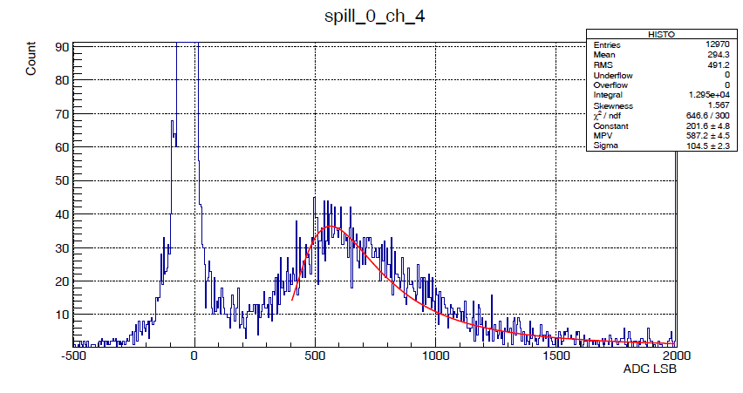
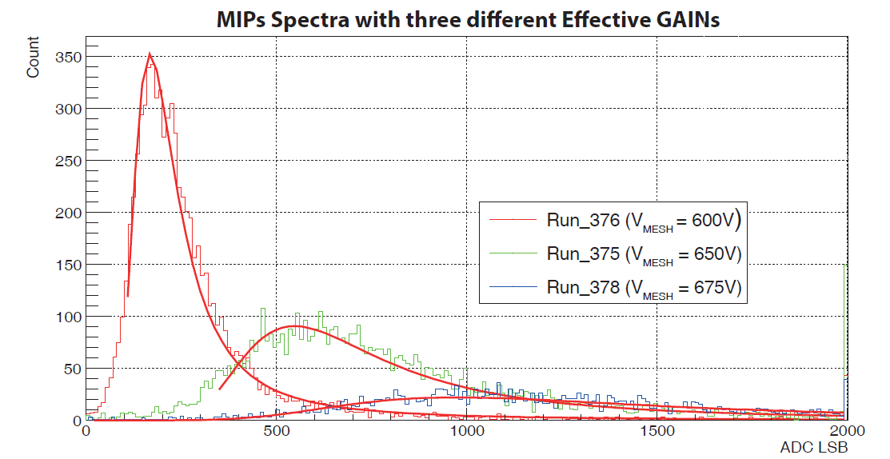
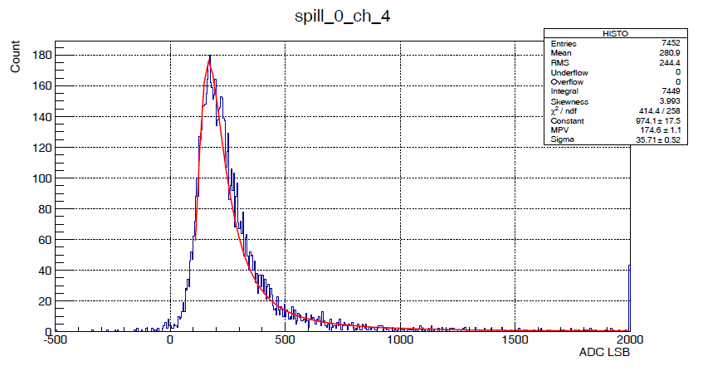
Amplitude distribution of beam particles signals
Gain ~ 12.5K
(16 pad:
the trigger covers a larger area)
Evaluation of the landau due to the charged particles with Mesh voltage
Gain ~ 3.8 K
(32 pad:
trigger fully included →
100% efficiency for MIPs)
MICROMEGAS:
600 V 650 V 675 V

Slide 19
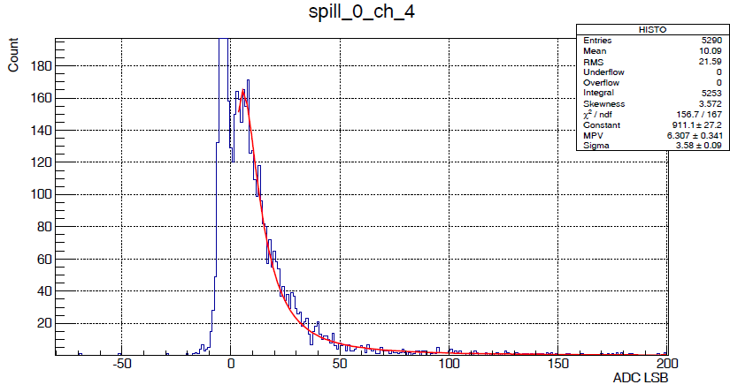
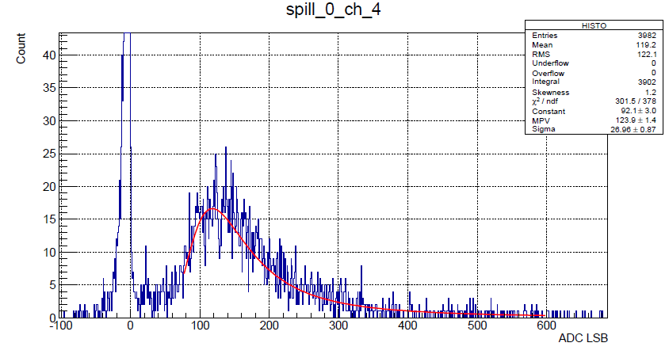
Amplitude distribution of beam particles signals for different Drift field values
E_{Drift} = -100 V/cm
E_{Drift} = +1000 V/cm

Slide 20
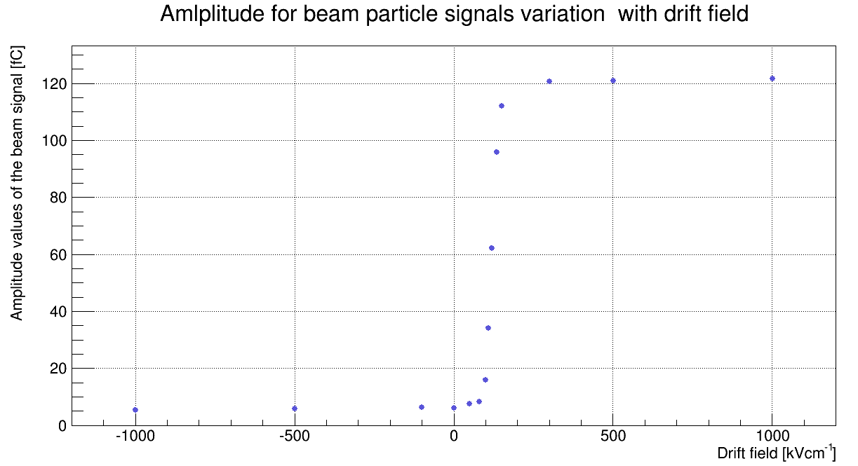
Charged particle signals vs. drift field
100 V/cm

Slide 21
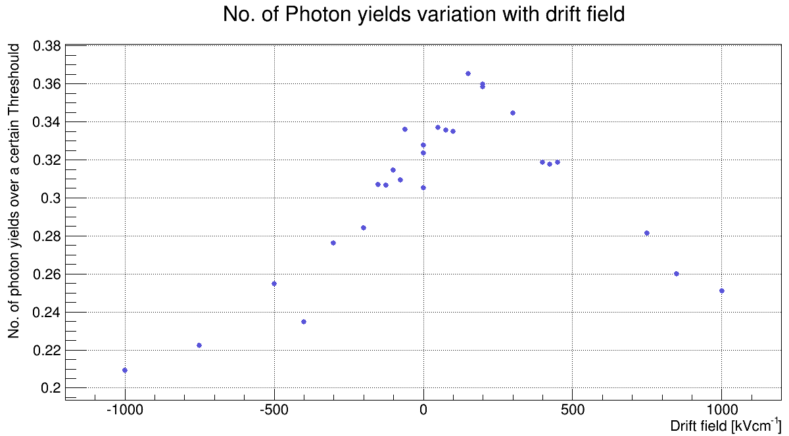
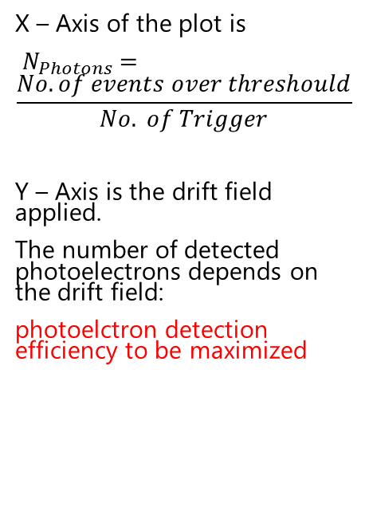
Photon signal vs. drift field
100 V/cm
X – Axis of the plot is
$N_{Photons}=$
$$\frac{No. of events over threshould}{No. of Trigger}$$
Y – Axis is the drift field applied.
The number of detected photoelectrons depends on the drift field:
photoelctron detection efficiency to be maximized

Slide 22
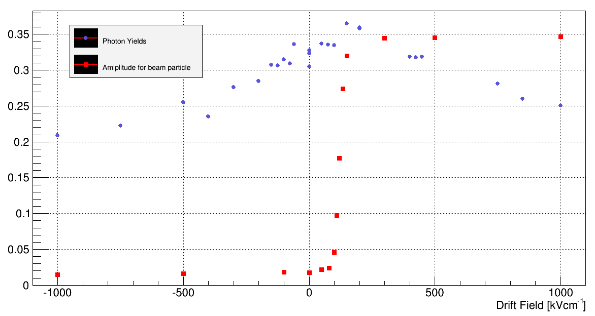
Photon signal and Charged particle signal vs. drift field
50V/cm
Red points are scaled.

Slide 23

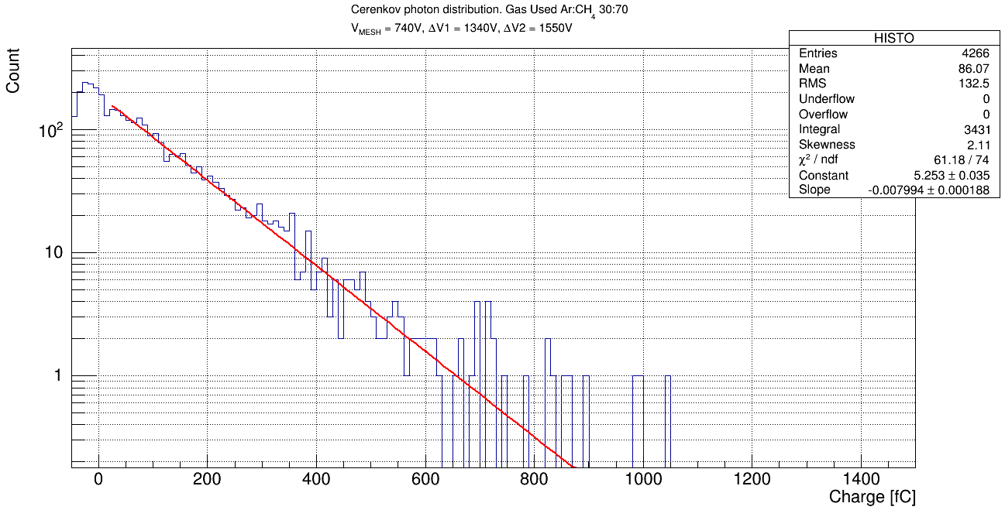
Cerenkov Photon amplitude Distribution
Gain ~ 130K
beam
Č photon
~ 4 times the gain for the same stability condition compared to triple THGEM configuration in 2012

Slide 24
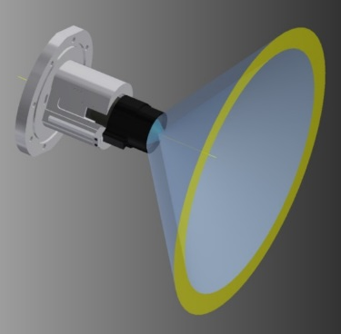
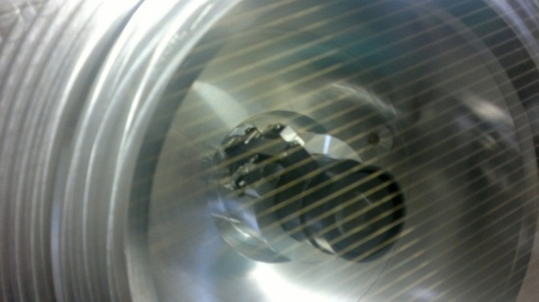

Interceptor position scan
Interceptor Scan
The remotely controlled movable interceptor allows for changing the number of photons in the corona

Slide 25
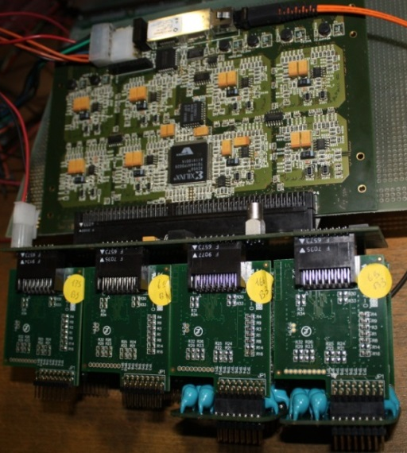
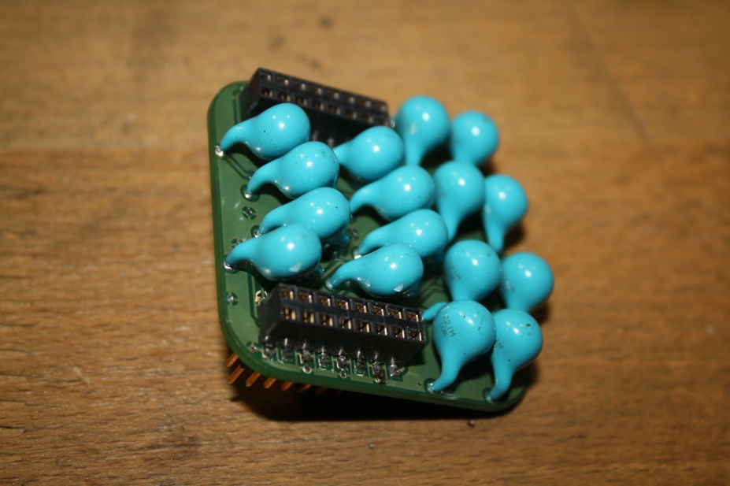

Digital Readout
Digital Readout Setup
Readout chain: same as RICH-1 – MAPMT
  C-MAD
  Roof
  DREISAM card
No need for FE protection boards – 2012:
Fighting against noise during the entire Test
  Impossible to run with all channels together
  Very high thresholds ( from 6 to 15 fC) (~3 fC in 2012 Test Beam)
DREISAM CARD
ROOF Board
CMAD Boards
Protection Boards

Slide 26




Cerenkov Ring Image
2012 for comparison
Log scale
OFF
2012 for comparison
Digital Images

Slide 27



Time response
  For comparison: triple THGEM time spectra from 2012 test beam
The time distribution response is improved and affected by a lower noise level if compared to the 2012 data
  Capacitive/resistive hybrid PD 2014
  2012 lower gain

Slide 28

Digital results
Time Resolution

Slide 29
Conclusion
The hybrid with capacitive anode performed at the Test Beam as they did in the Lab.
The hybrid PD with capacitive micromegash allows to operate the MICROMEGAS at voltage bias which are 100 V larger than for the standard one →
  Larger gain with less THGEM voltage and higher stability
  No other large MPGD has ever been operated with a beam at 10⁵ gain
  Excellent time response
  Nice device suitable for single Cherenkov photon detection
Future GOAL:
  Read-out & noise need to fine tuned
  HV powering system can be upgraded.
  600 X 600mm² prototype is in the preparation to be tested at our INFN Trieste LAB.

Slide 30






Thank you

Slide 31
⁵⁵Fe Spectra for 11780 gain of the capacitive Micromegas

Slide 32




Time response from 2011
Small prototype: time response study (2011)
G = 0.9 * 10⁵
G = 1.1 * 10⁵
G = 1.4 * 10⁵
G = 2.0 * 10⁵

Slide 33

BACK UP
64 channels per card, compact solution
optical data transfer (40 MByte/s)
high rates per channel 10 MHz @ 100 kHz trigger rate
time resolution < 100 ps
based on dead time free F1-TDC
Each CMAD readout board read 8 pads.
Each ROOF board connects 8 CMAD card (means: 64 pads)
Each DREISAM connected to each roof boards (Means each DRIESAM read 64 Pads)
So we need 12 DREISAM boards where 6 of the roofs are half empty.

Slide 34


Progress of 600 X 600mm² prototype
Now the goal is to build a 600X600mm² Prototype to be build and to test it in lab.
The pieces are already produced and ready to be commissioned in our Trieste Lab.

Slide 35




Progress of 600 X 600mm² prototype
  image transfer
  development
Production procedures for 300X600mm² THGEMs
  etching
  stripping dry-film

Slide 36




Progress of 600 X 600mm² prototype
  multi-spindle drilling

Slide 37


Progress of 600 X 600mm² prototype
  connector and anode HV side
  Micromegas side (protected)

Slide 38



Progress of 600 X 600mm² prototype

Slide 39

Progress of 600 X 600mm² prototype

Slide 40

Progress of 600 X 600mm² prototype

Slide 41

Progress of 600 X 600mm² prototype

Slide 42

Progress of 600 X 600mm² prototype

Slide 43

Progress of 600 X 600mm² prototype

Slide 44

Progress of 600 X 600mm² prototype

Slide 45

Progress of 600 X 600mm² prototype

Slide 46

Progress of 600 X 600mm² prototype
lenses and MAPMTs
THGEMs +CsI and Micromegas
PD support frames
field and drift wire frame
large fused silica windows

Slide 47



Progress of 600 X 600mm² prototype
3 m
Al vessel
6 m
MWPC’s + CsI
UV mirror
wall
5 m
PMTs
beam pipe
radiator:
C₄F₁₀
radiator gas: C₄F₁₀

Slide 48
Progress of 600 X 600mm² prototype
3 m
Al vessel
6 m
MWPC’s + CsI
THGEMs + CsI
UV mirror
wall
Foreseen for 2016
5 m
PMTs
beam pipe
radiator:
C₄F₁₀
radiator gas: C₄F₁₀

