Slide 1
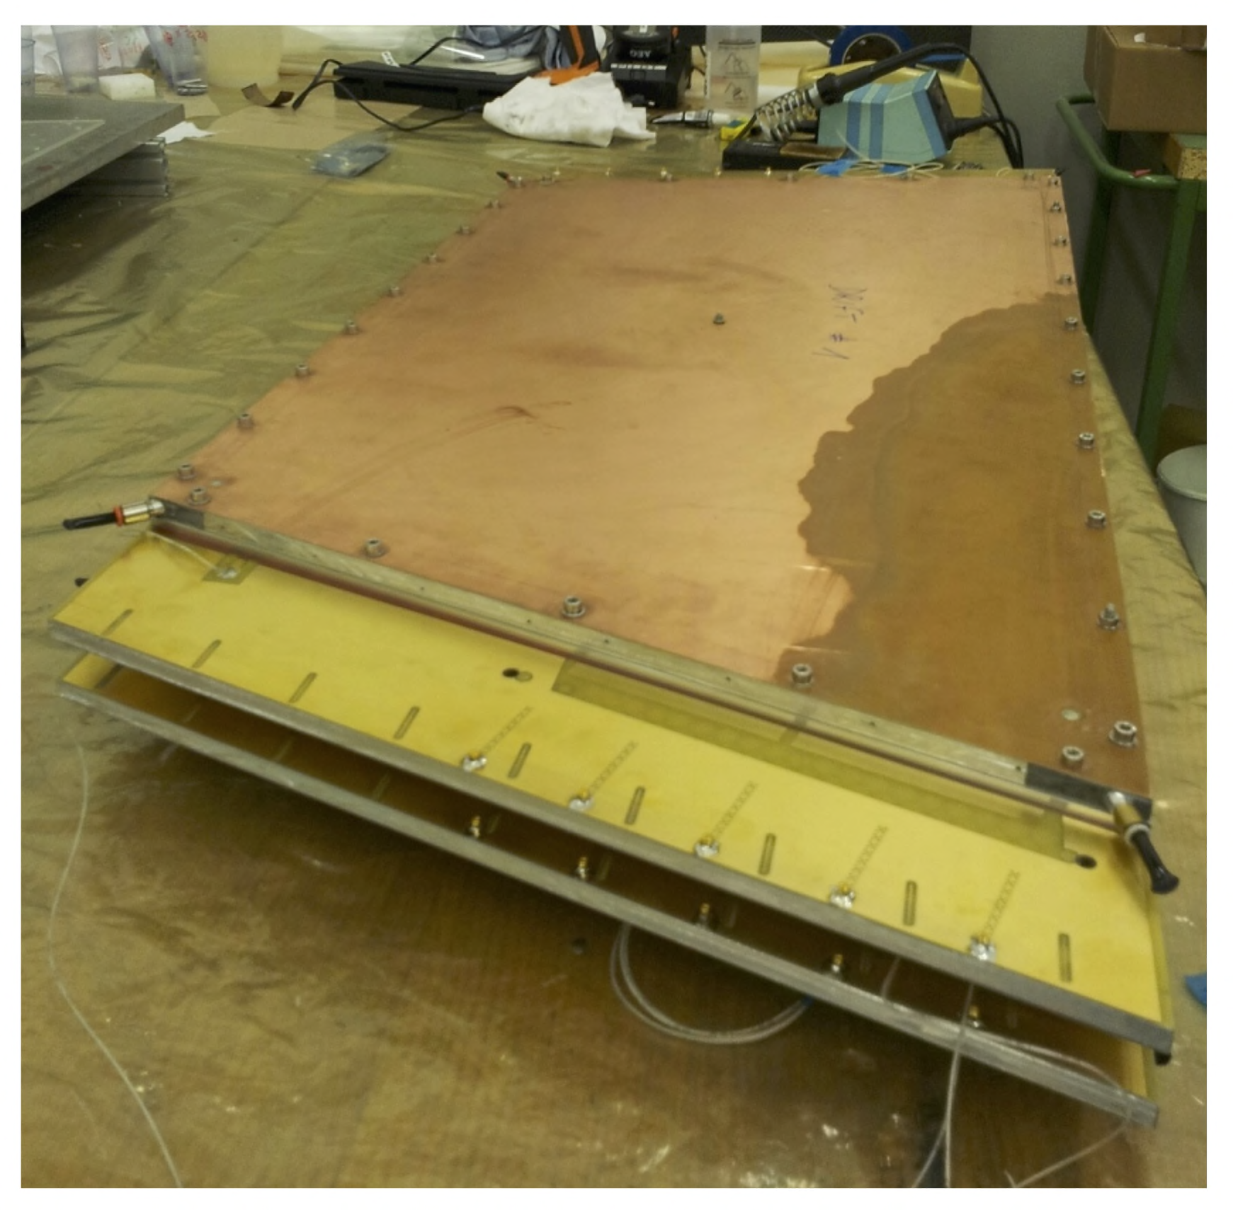
ATLAS Micromegas from MMSW1 to MMSW2

Slide 2
Introduction
The MMSW chambers are pre-series prototypes for the ATLAS NSW micromegas detectors
  Very similar main design features
  Test objects for Module-0s
They correspond to a 50 cm slice of the large-sector NSW MMs at r≈1.5–2 m.
One of the two MMSWs will be installed in the ATLAS cavern next year to be integrated into the ATLAS data stream.
  It will later be installed on one of the existing Small Wheels

Slide 3
The MMSW chambers
1.2 x 0.5 m² x 80 mm
4 detection planes
  2 back-to-back planes for precision coordinate
  2 planes with strips under ±1.5°
  1024 strips/plane
Strip pitch: 415 µm
Drift gap: 5 mm
Mesh: integrated into drift panel & electr. connected to ground
Resistive strips
  split in the centre, 2 HV per plane
  interconnected every 2 cm
  R(strip) ≈ 20 MOhm/cm
  R_{eff}≈2–20 MOhm
MMSW2

Slide 4
MMSW1
In the June RD51 mini week Paolo Iengo reported about the construction of the MMSW1 which, at this, time, was just being completed, see http://indico.cern.ch/event/323839/other-view?view=standard
He described the preparation of the parts, the tools, the panel and detector assembly, and showed first tracks with two out of the four detection planes in operation.
In July the MMSW1 chamber was completed with all four detector planes
In August and October MMSW1 was tested in the T9 and T10 test beams at the PS with 10 GeV hadrons and in the Lab with cosmics

Slide 5
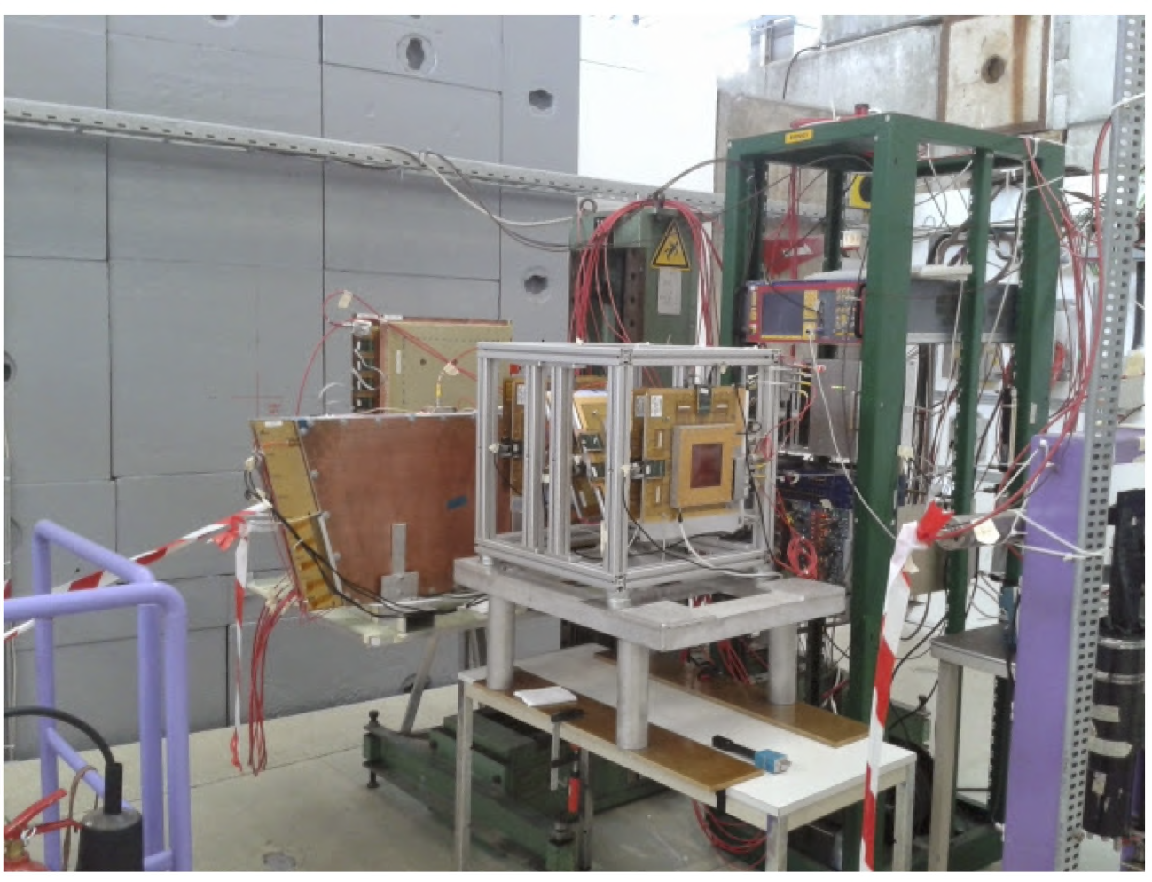
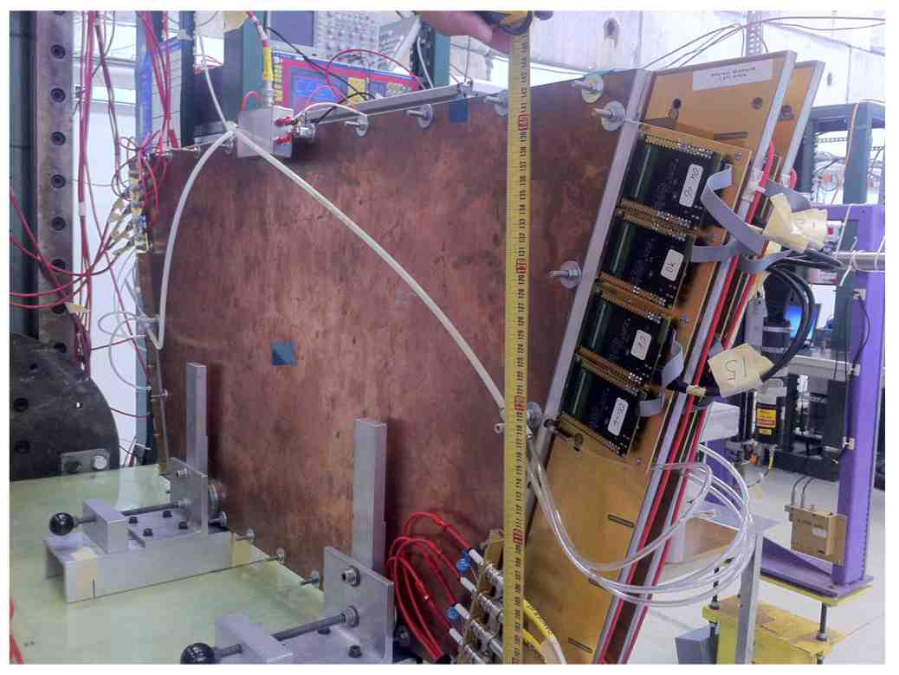
MMSW1: T9 & T10 test beam results
‘online’ plot

Slide 6
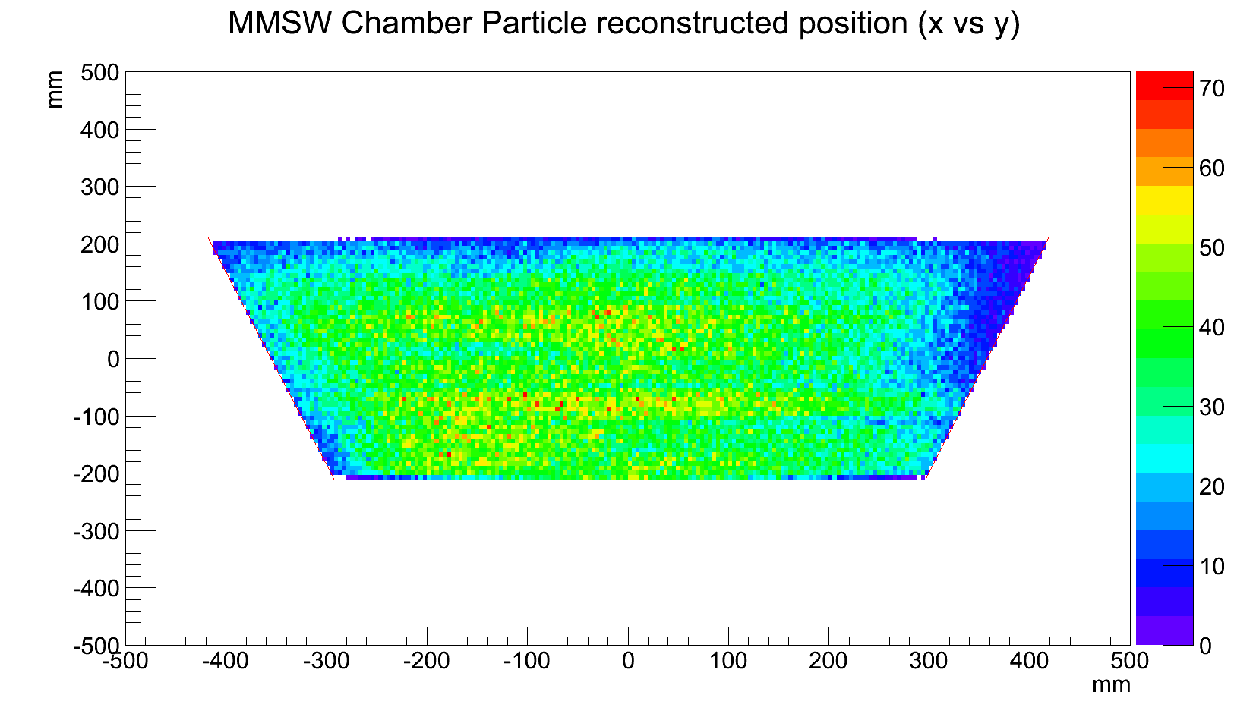
MMSW1: Cosmics
Inadequate trigger
scintillator coverage

Slide 7
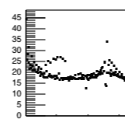
Electrical properties of MMSW1
Strip lengths in MMSW 60–80 cm
Measuring the APV pedestal sample fluctuations gives a good idea about the detector noise
Linear increase of noise between 0.1 and 0.8 m strip length above a base of 11 counts
Fits nicely with results from 10 and 35 cm strips
Extrapolation to 2 m strip length yields a noise ≤30 counts, perfectly acceptable
ExMe
MMSW1
Max strip length in NSW MMs
Tmm
APV25

Slide 8
From MMSW1 to MMSW2
Although MMSW1 performes nicely there are a number of points that we consider(ed) as not optimal
Construction issues
  Vacuum table flatness varied with temperature => panel flatness sufficient but not good enough for full-size panels
  Mesh frame and glueing procedure to complicated and work-intensive, also the result was not perfect (glue into mesh)
  Gas distribution through mesh frame too tight in space and complicated to make; gas tightness not perfect
Assembly and operation
  Relative alignment (pins) of the two readout panels not used
  Relatively high dark currents (although not affecting the detector operation) suggest some pollution (mesh?) - occasionally shorts
Some of those issues are addressed in the following slides

Slide 9
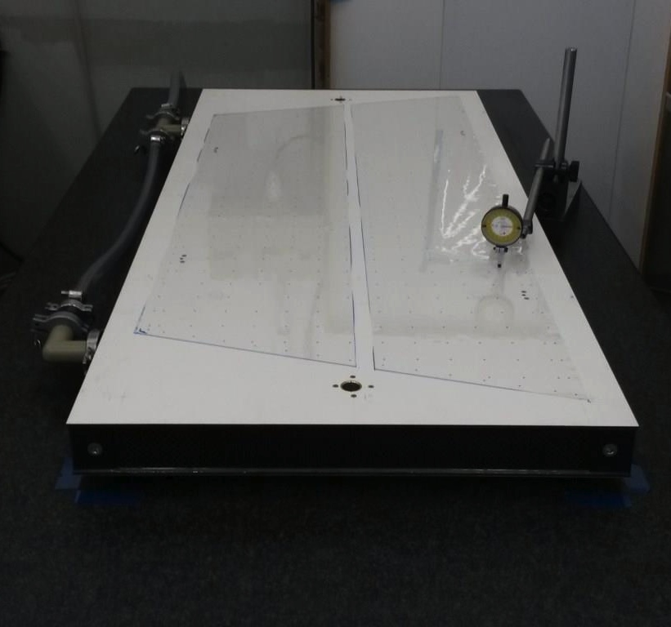
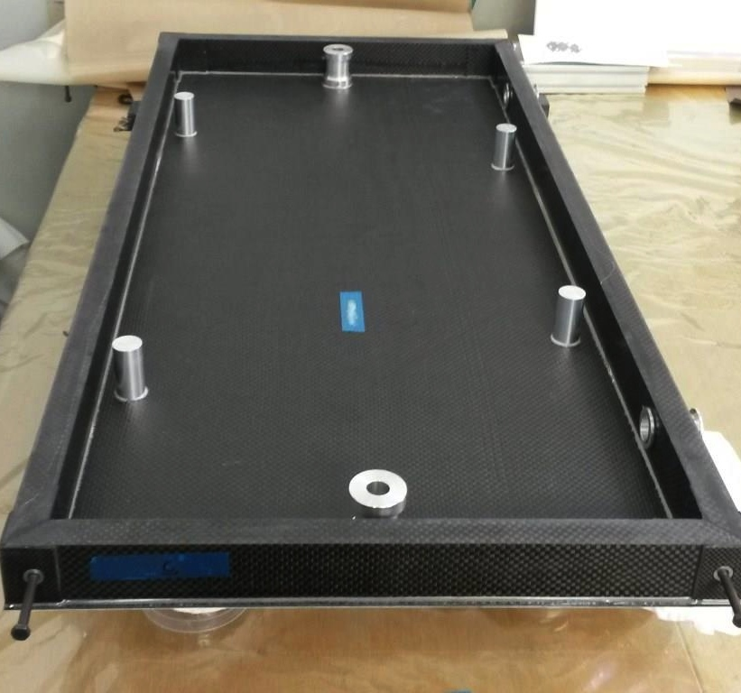
Carbon Fibre vacuum table manufactured at CERN
H. Danielsson (CERN/PH-DT)
Vacuum table QC
Structure under construction

Slide 10
CF vacuum table supported on 3 points (15 points measured) Flatness <10µm
H. Danielsson (CERN/PH-DT)
No temperature effect observed on flatness with ΔT= 7°C!

Slide 11
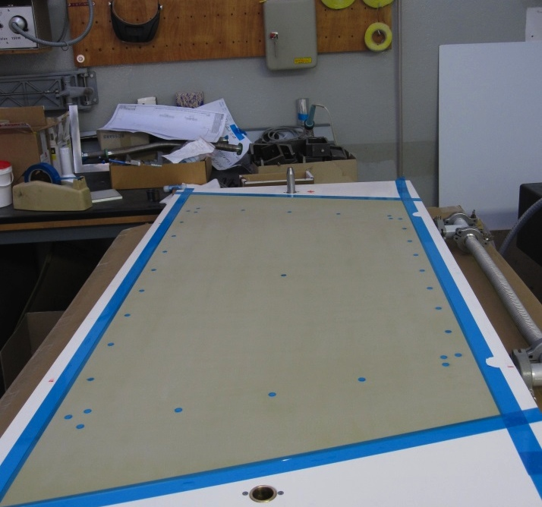
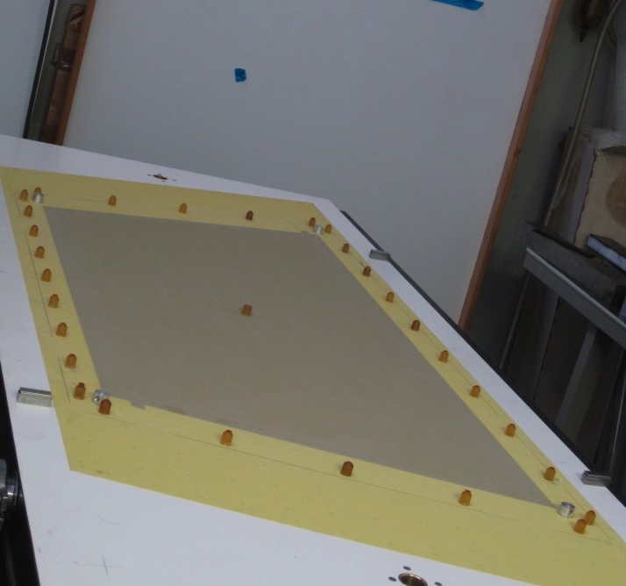
Panel construction
H. Danielsson (CERN/PH-DT)
Top skin (Table #1)
Bottom skin (Table #2)

Slide 12
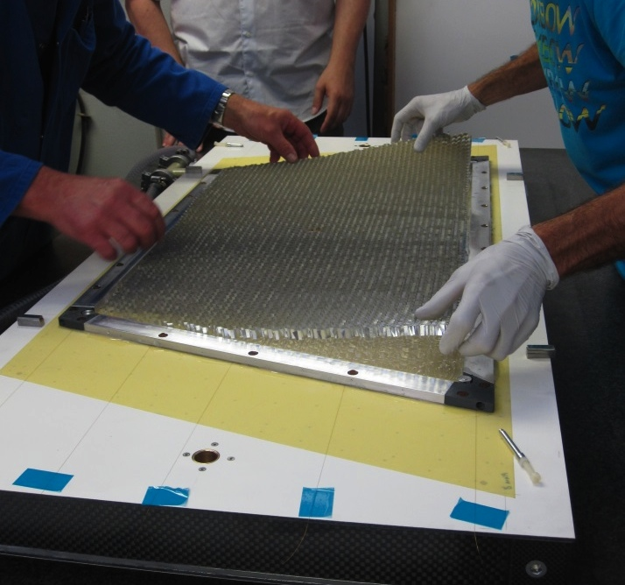
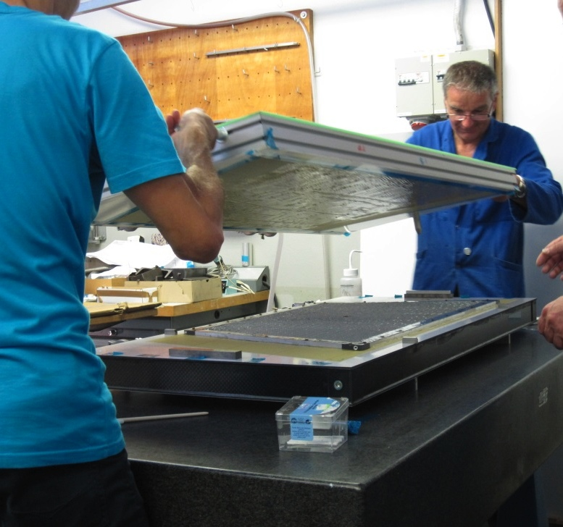
Panel construction
H. Danielsson (CERN/PH-DT)
Frame and honeycomb assembly
Final assembly

Slide 13
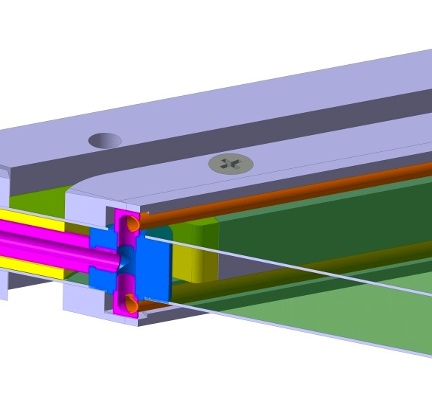
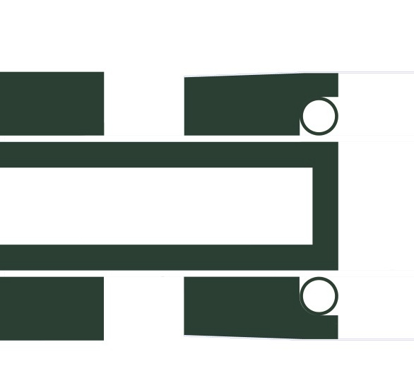
Active gas distribution
H. Danielsson (CERN/PH-DT)
Active gas injection
SS tube Ø3 under mesh support

Slide 14
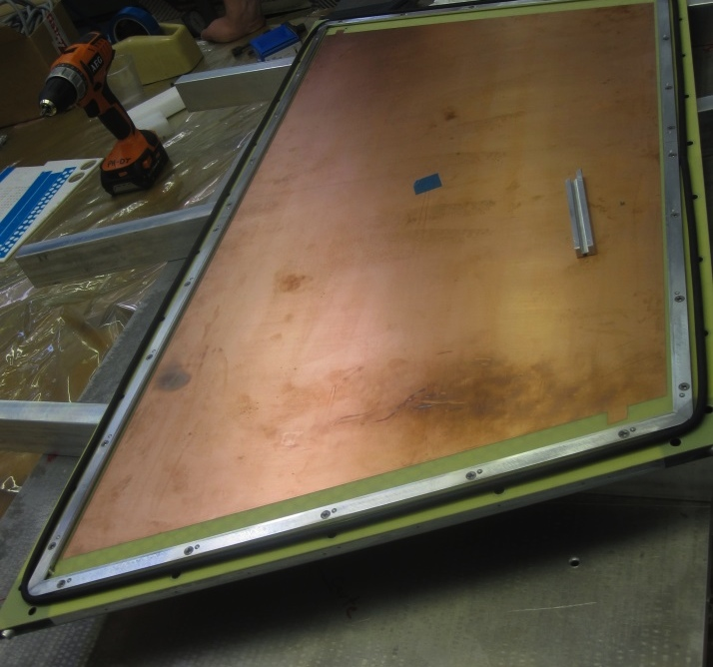
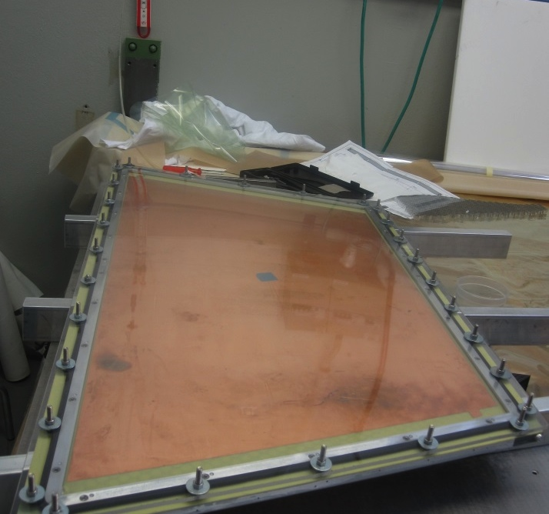
Panel leak test
H. Danielsson (CERN/PH-DT)
Drift panel + EPDM joint
Drift panel under pressure test

Slide 15
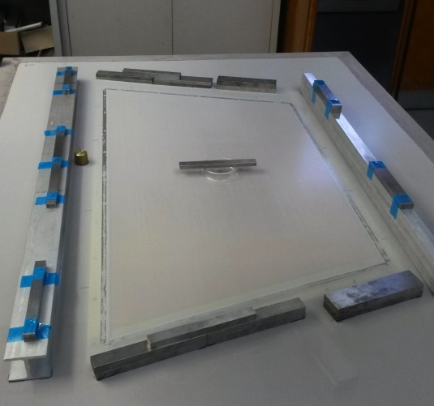
Mesh gluing
H. Danielsson (CERN/PH-DT)
Mesh during polymerisation
Procedure simplified
1 day before / 2 hours now!
Cleaning improved

Slide 16
MMSW2
MMSW2 has been fully assembled and connected to gas and HV 10 days ago
  Under HV for one week, no trip
  Lower currents than MSW1 at higher HV
It has been installed in the H6 test beam Tuesday this week
First data expected last night after the SPS MD

Slide 17
Summary and outlook
The MMSW1 & MMSW2 construction exercises were extremely useful in view of the forthcoming construction of the NSW MM Module-0 construction
The detector performs as expected
For the first time stereo strips were used (by us) giving us a 2nd-coordinate spatial resolution of 2.2 mm, as designed for and perfectly adequate for the NSW
A number of issues that appeared in MMSW1 were successfully cured in MMSW2
A big step in the direction of ATLAS micromegas chamber construction has been done

Slide 18
Acknowledgements
The construction of the MMSW chambers is a collaborative effort between CERN-PH, CERN-DT, and Mainz University
The PCB layout and art work was done by CERN-PH (G. Sekhniaidze)
The PCBs were produced by industry (Eltos, Italy) and completed by CERN-DT (Rui de Oliveira et al.)
The resistive strips were deposited by sputtering in industry in Japan (A. Ochi et al.)
The engineering, tooling, mechanics, and glueing are done by PH-DT (H. Danielsson et al.)
Module assembly and commissioning by CERN-PH
Tests in the beam and data analysis by the full ATLAS MM community (special thanks)

