Slide 1
LIU – PLI “PLanning & Installation” meeting
General information meeting #2

Slide 2
LIU - Planning & Installation Coordination Meeting
Technical coordination
EDMS 1450798
LIU-PSB
Coordination Meeting
LIU-PS
Coordination Meeting
LIU-SPS
Coordination Meeting
LIU-Ions
Coordination Meeting
LIU Project Team
Meeting
Report from the Technical coordinator
LIU-PSB
e-group
LIU-PS
e-group
LIU-SPS
e-group
LIU-IONs
e-group
LIU Project Team
Integration
Meeting
Integration studies
and validation
Studies and decisions on design/work
with a preliminary schedule
LIU-PLI Team
ECR owner
or work responsible
LIU Project Team
Draft Engineering Change Request
Organization of work (i.e. cabling)
presentation
LIU Planning & Installation
Coordination Meeting
Check of the integration in case of modification
Follow-up on the ECR process and comments
Circulation of the ECR to all groups involved
Approval of the ECR
Scheduling
Identification of co-activities between machine
Identification of shared resources
Report from the superintendents
Consolidations
Facilities Coordination
Meeting
Facilities Coordination
Meeting
Linac2
Coordination Meeting
Linac3
Coordination Meeting
Linac4
Coordination Meeting
LEIR
Coordination Meeting
Facilities Coordination
Meeting

Slide 3
LIU - Planning & Installation Coordination Meeting
General information
EDMS 1450798
LIU Project Team
Meeting
LIU-PSB
Coordination Meeting
LIU-PS
Coordination Meeting
LIU-SPS
Coordination Meeting
LIU-Ions
Coordination Meeting
LIU Project Team
LIU-PSB
e-group
LIU-PS
e-group
LIU-SPS
e-group
LIU-IONs
e-group
LIU Planning & Installation
Coordination Meeting
LIU-PLI Team
LIU-PSB
e-group
LIU-PS
e-group
LIU-SPS
e-group
LIU-IONs
e-group
LIU Project Team
report
General information on organization/process
LIU-PLI
EN-MEF-DC
EN-MEF-INT
Safety coordination
EN-EL
DGS-RP
Consolidations
…
15/10
2014
15/10
2014
10/12
2014
28/01
2015
11/03
2015
2015
2015
2015

Slide 4
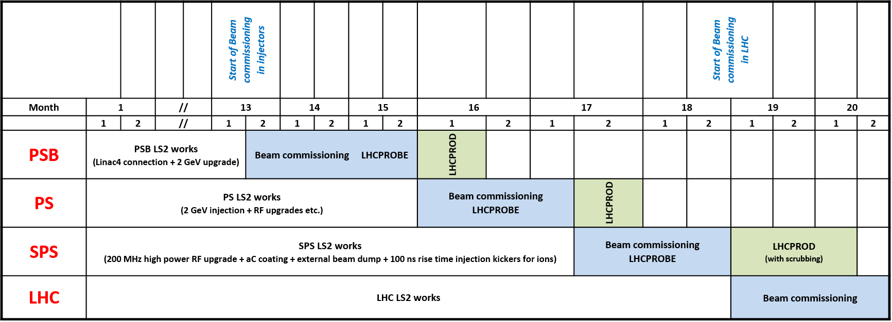
Planning & Installation meeting
Schedule for LS2
This is the baseline given for LIU for LS2. This schedule is the reference and has been published in the TDR and the LIU Roadmap.

Slide 5
Planning & Installation meeting
Schedule for LS2
Schedule presented in Chamonix 2014 taking into account the time estimation for all machine
Schedule taking into account the baseline time window (previous slide)
The optimization has to be done through the YETS and EYETS
2.5 months

