Slide 2
New injection region 1L1
Engineering Change Request
PSB-L-EC-0001 EDMS 1422358
14-01-2015
Wim Weterings
PLI Meeting Wednesday 14th January 2015

Slide 3
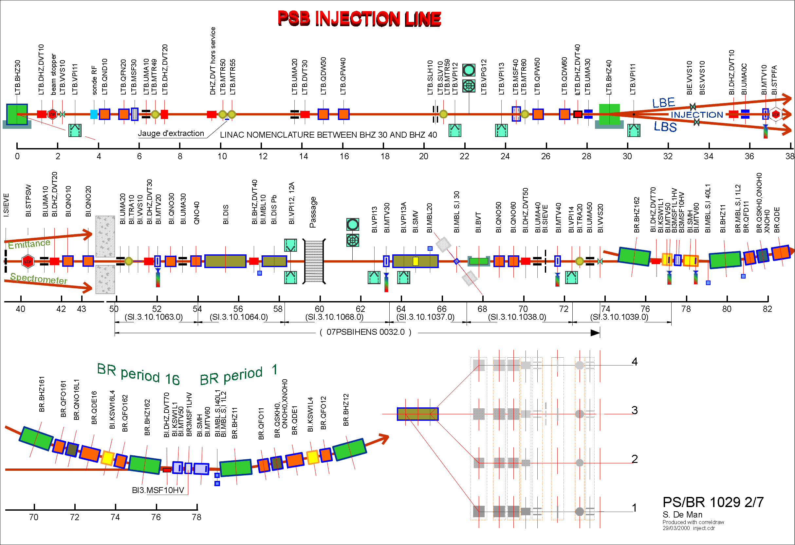
Required Modifications for LINAC 4
Linac4 – PSB Review
15-01-2009
INDICO 46255
Relocate modified KSW1L1 magnet to PSB period 16, build new pulse generator.
Remove obsolete BI.DIS Pb
~0.36 Tm required from BI.BVT for ~175 mrad @ 160 MeV
Modify BI.DIS for
4.3 mrad @ 160 MeV
New BI.SMV,
4 mm thick septum and 70 mm horizontal aperture for
~165 mrad @ 160 MeV with associated new pulse generator.
Rebuild the 2.654 m injection region of each of the 4 PSB rings:
  4 new BS magnets,
  Foil holder and handler,
  Dump for unstripped H⁰/H⁻,
  Beam Instrumentation.
Performance increase of 1.9 in ∫B•dl of
BI.DVT30, BI.QNO30, BI.QNO40, BI.DVT40.
ECR PSB-L-EC-0001
PLI Meeting Wednesday 14th January 2015

Slide 4
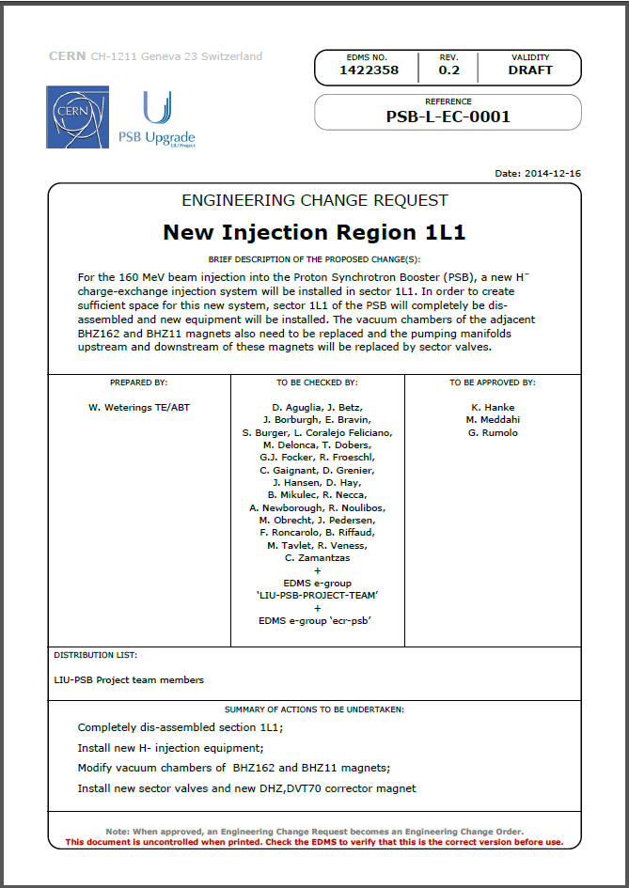
PLI Meeting Wednesday 14th January 2015

Slide 5
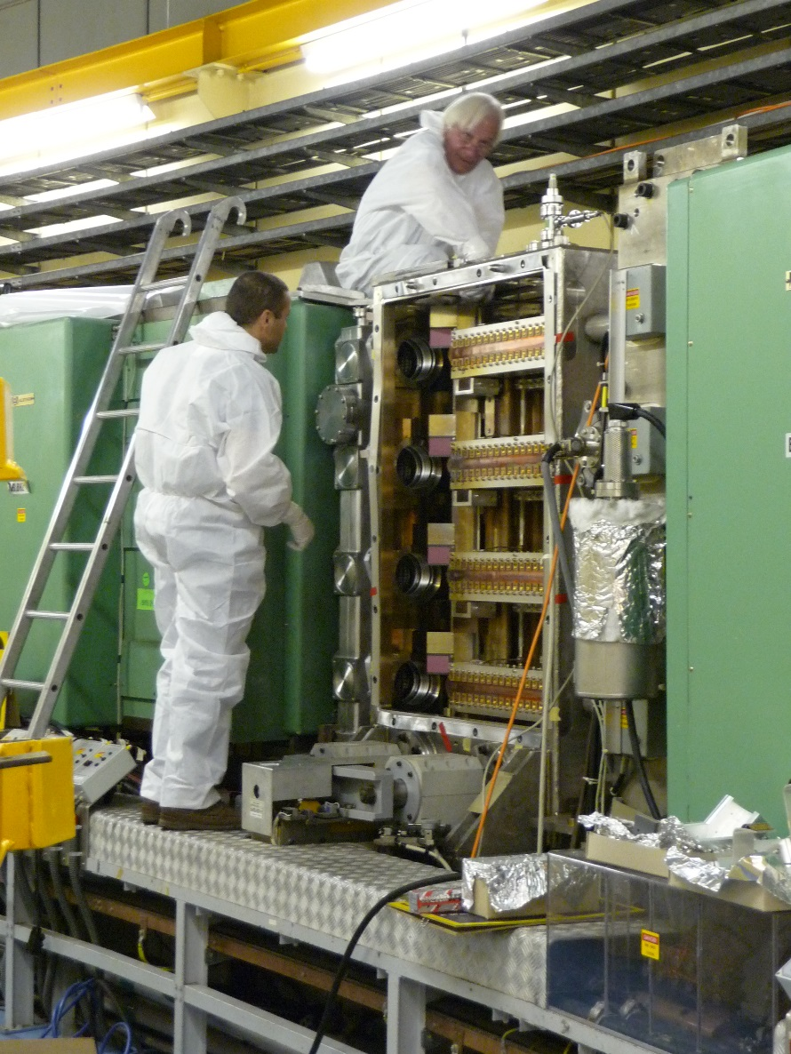
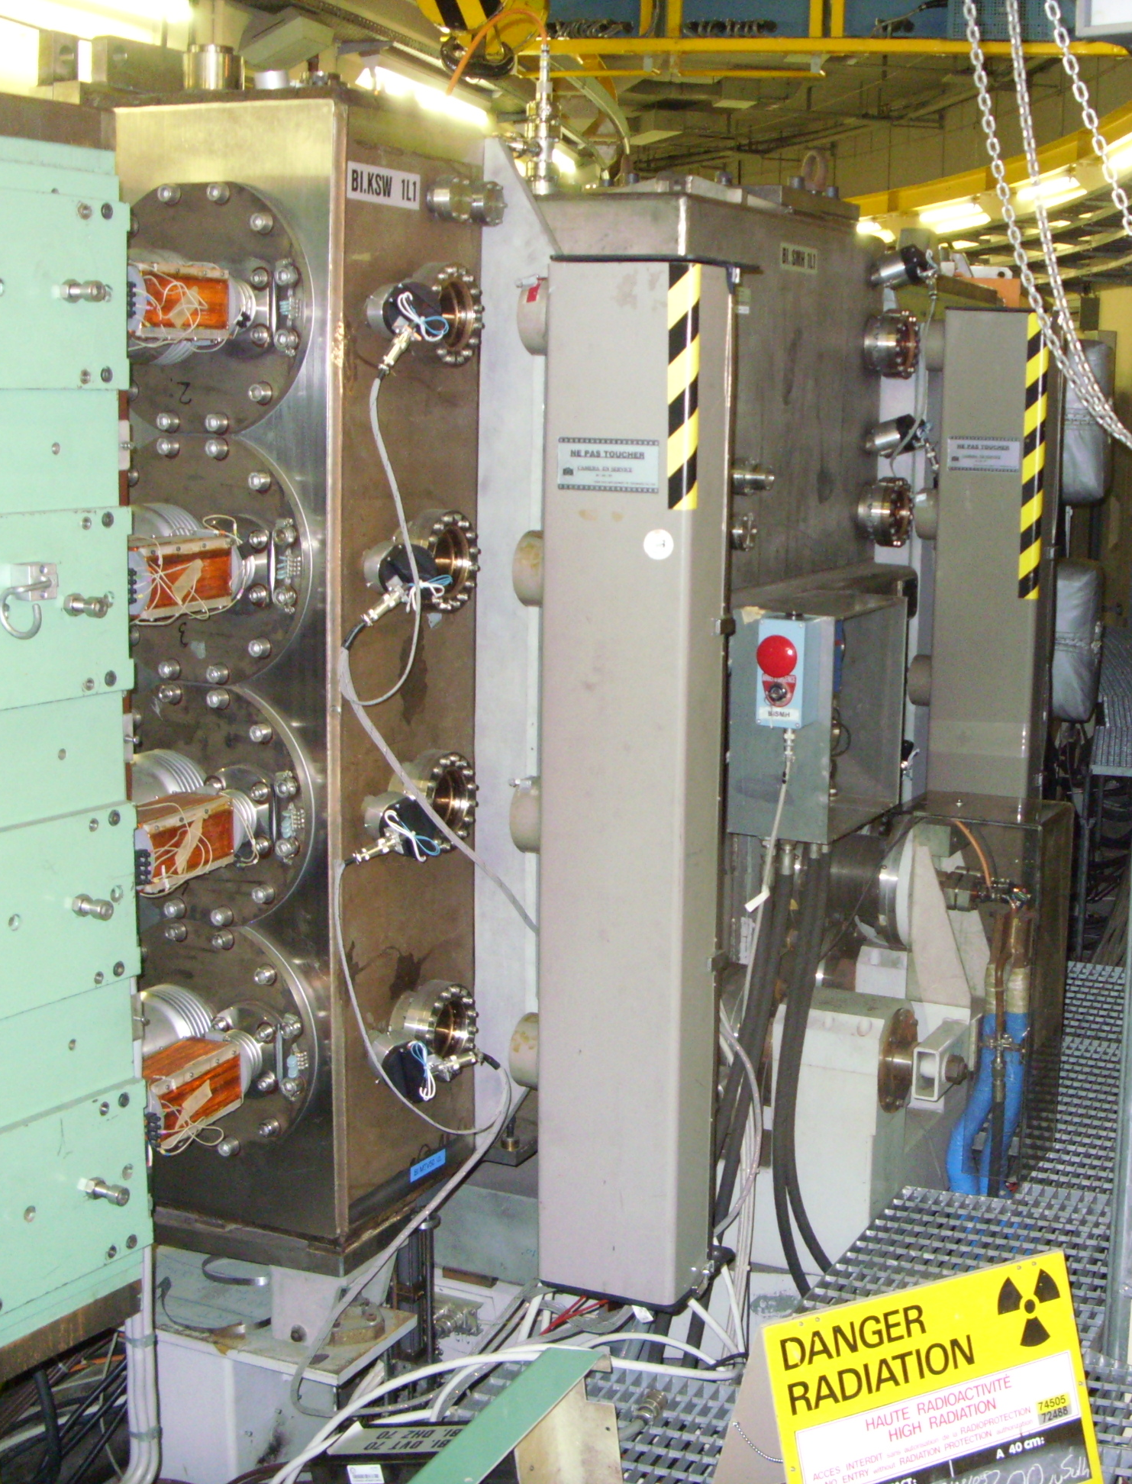
Current PSB Injection Region
Seen from Inside PSB ring
Seen from Outside PSB ring
PLI Meeting Wednesday 14th January 2015

Slide 6
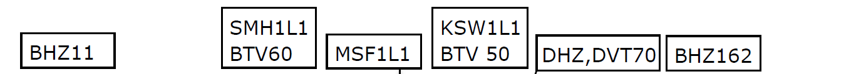
Removal of Current PSB Injection Region
Removal of the SMH1L1 BTV60 MSF1L1 assembly (cyan), this equipment will become obsolete.
Removal of the KSW1L1 BTV50 assembly (green), a new KSW magnet stack shall be installed in sector 16L1 [PSB-MKKSW-EC-0001, EDMS 1422350].
Removal of the vacuum pumping manifolds (blue); these will be replaced by new pumping modules including sector valves.
Remove BIr.DHZ,DVT70 magnets and install new corrector magnet ~2m upstream in the BI line.
Replacement the vacuum chambers of the BHZ162 and BHZ11 magnets (red) by new, shorter,
Inconel vacuum chambers.
PLI Meeting Wednesday 14th January 2015

Slide 7
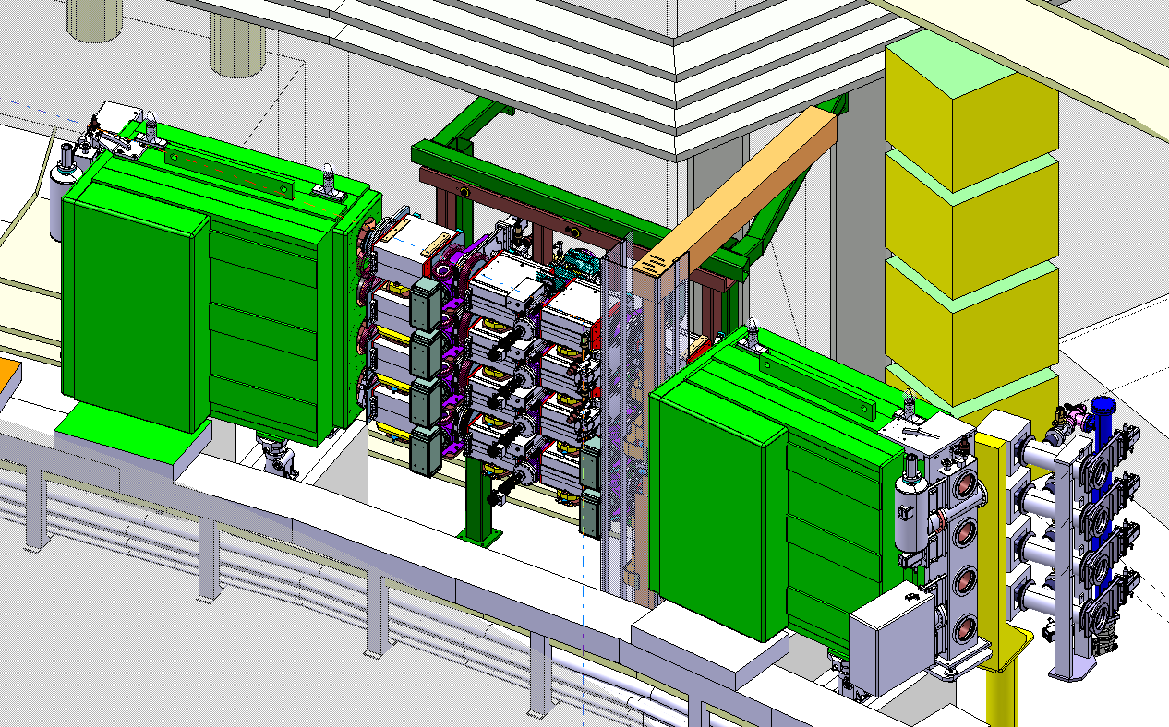
Future PSB Injection Region
3.12 BIR.BSW1L1 POWER CONVERTERS
Engineer in charge: D. Aguglia
Power converters for BSW magnets will be in the BRF2 room of building 361. The BSW1L1.1 (6.7 kA) transformers need to be close to the magnets (~10 m cable).
The alternative option of building smaller transformers installed under the false floor, is still under study.
Initial proposal for busbars, final proposal, still to be studied.
PLI Meeting Wednesday 14th January 2015

Slide 8
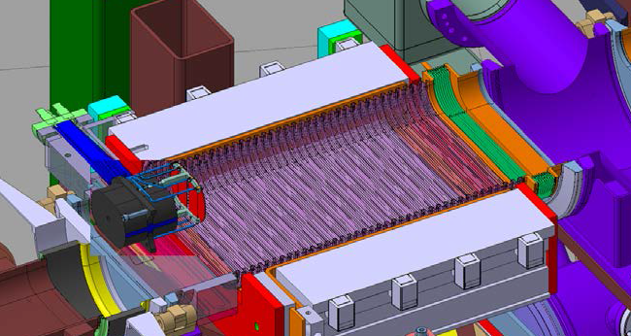
Installation of New H⁻ Injection System - 1
3.4 BSW CHICANE MAGNETS [MSMIF+MSBSW]
  Engineer in charge: J. Borburgh
  Sixteen new BSW chicane magnets, 4 in each ring.
Seen from Inside PSB ring
3.7 H⁰/H⁻ DUMP AND INSTRUMENTATION [TDIMA, BCSEA]
  Engineer in charge: M. Delonca, D. Grenier, F. Roncarolo
  Four new H0/H− dumps with beam current monitors, 1 in each ring1.
3.6 BTV BEAM OBSERVATION SYSTEMS [BTVTS]
  Engineer in charge: S. Burger
  Four new BTV beam observation systems, 1 in each ring1.
3.5 STRIPPING FOIL SYSTEM [TKSTR]
  Engineer in charge: R. Noulibos
  Four new stripping foil handling systems, 1 in each ring1.
PLI Meeting Wednesday 14th January 2015

Slide 9
Installation of New H⁻ Injection System - 2
Seen from Outside PSB ring
3.8 BEAM LOSS MONITORING SYSTEM [BLMIA, BLMDA]
Engineer in charge: C. Zamantzas
  Six new Ionisation Chamber type detectors. Three for ring 1 & 2 and three for ring 3 & 4.
  Eight Diamond type detectors. One per ring downstream of BSW1 and 1 per ring downstream of H⁰/H⁻ dump.
PLI Meeting Wednesday 14th January 2015

Slide 10
Installation of New H⁻ Injection System - 3
Partial from Above PSB ring
3.9 VACUUM PUMPING MODULES [VCDOA]
Engineer in charge: J. Hansen
One new vacuum manifold will be installed in the BI line
and sector valves, one for each ring, upstream and downstream of BHZ162 and BHZ11.
BHZ11
BHZ162
3.11 DHZ-DVT70 MAGNETS
Engineer in charge: A. Newborough
New BIr.DHZ,DVT70 magnets will be installed ~ 2 meters upstream.
Note: The removed ion pumps currently attached to the manifolds upstream and downstream of BHZ162 and BHZ11, will be moved up- and down-stream to existing pumping manifolds.
3.10 BHZ162 AND BHZ11 MAGNETS
Engineer in charge: A. Newborough
The replacement of the BHZ162 magnets is being studied.
PLI Meeting Wednesday 14th January 2015

Slide 11
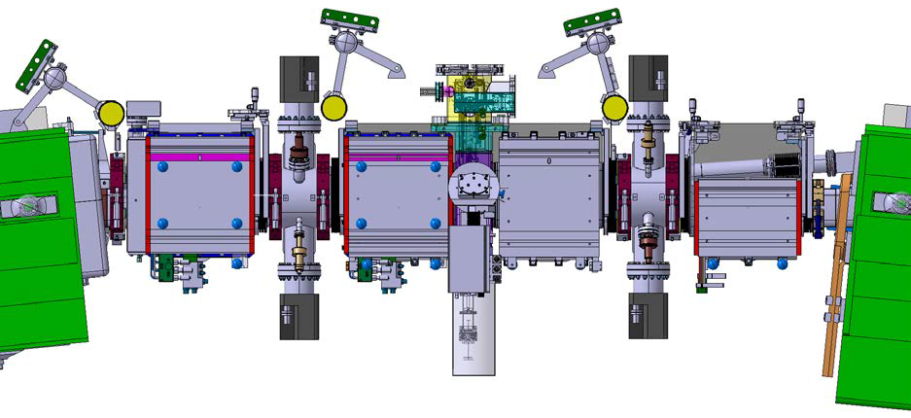
Installation of New H⁻ Injection System - 4
3.10 BHZ162 AND BHZ11 VACUUM CHAMBERS
Engineer in charge: J. Hansen, A. Newborough
The vacuum chambers of the BHZ162 and BHZ11 magnets, will be replaced by new, shorter, Inconel vacuum chambers.
Seen from Above PSB ring
3.13 RF BYPASSES
Engineer in charge: A. Blas
Installation of RF bypasses in clamps to guarantee a path for the high frequency component of the beam image current.
3.9 VACUUM PUMPING MODULES [VCDOA]
Engineer in charge: J. Hansen
Eight new vacuum pumping modules, 2 in each ring equipped with 2 ion pumps and with 1 penning gauge and 1 pirani gauge.
PLI Meeting Wednesday 14th January 2015

Slide 12
Impact on Other Items
4.1 IMPACT ON ITEMS/SYSTEMS
Item/System BHZ162 | Modification of drawing PSBMBHOR0010 for vacuum chamber and replacement of vacuum manifold by new sector valve section.
Item/System BHZ11 | Modification of drawing PSBMBHOR0011 for vacuum chamber and removal upstream vacuum manifold and replacement of downstream vacuum manifold by new sector valve section.
Item/System MSMIF, MSBSW, TKSTR, BTVTS, TDIMA, BCSEA, BLMIA, BLMDA | Complete modification of layout drawing PSBIHENS0017 for new H- Injection system. SMH1L1, BTV60 controls and operation becomes obsolete.
4.2 IMPACT ON UTILITIES AND SERVICES
Demineralized water: | Dedicated manifold for BSW magnet cooling
Compressed air: | Compressed air connections for new vacuum equipment
Electricity, cable pulling: | Removal of all old cables and complete new re-cabling for the H- injection system. DIC (Demande d'Installation de Câbles) and DEC (Demande d'Enlèvement des Câbles) are in preparation.
Vacuum (bake outs, sectorisation…): | New sectorisation of 1L1
Special transport/ handling: | Removal of old equipment, installation of new equipment, construction of dedicated lifting and transport devices.
Survey: | Complete re-alignment of 1L1 section
Others: | As mentioned in paragraph 3.12, some services currently located in that region will need to be relocated in case the installation of the transformers under the false floor will not be possible.
PLI Meeting Wednesday 14th January 2015

Slide 13
Impact on Schedule and Safety
5.2 IMPACT ON SCHEDULE
Proposed test schedule (if applicable): | Approximate planning: 3 months installation, 1 month hardware commissioning, 2 months beam commissioning. Cabling schedule will be adapted to the final work volume. Cabling is not compatible with some other activities, e.g. magnets transport.
Estimated duration: | Approximate planning: 6 months
Flexibility of scheduling: | Required once Linac 4 will be connected to the PSB (currently planned LS2).
6.2 OTHER OPERATIONAL SAFETY ASPECTS
Have new hazards been created or changed? | Yes, internal H0/H- dump activation and stripping foil debrish. The design study of the H0/H- dump are documented in EDMS 1347485.
Could the change affect existing risk control measures? | No
What risk controls have to be put in place? | Work dose planning and intervention scenarios have been studied (EDMS 1355930).
Safety documentation to update after the modification | yes
Define the need for training or information after the change | Work dose planning and intervention scenarios.
PLI Meeting Wednesday 14th January 2015

Slide 14
Impact on Worksite Safety
7.1 ORGANISATION
Operational radiation protection (surveys, DIMR…): | The intervention to install the new Injection Region 1L1 might be an ALARA Level 3 intervention. No intervention scenario after initial installation exceeds ALARA Level 2.
Radioactive storage of material: | BI.SMH ion pumps, BTV60, KSW1L1 magnet stack, BVT50 and vacuum manifolds. Exchanged BHZ Inconel undulated vacuum chambers. The four BI.DHZ.DVT70 corrector magnets. A buffer zone and traceability by TREC will be required.
Radioactive waste: | Obsolete BI.SMH1L1 magnet tank and support, stainless steel 1.5 tons, 1.5 x 1 x 2 m; 3 obsolete BI.SMH magnet stacks including winglets, ferrite yokes, copper coils, stainless steel support chassis, 400 kg each, 1 x 0.5 x1.5 m each; BISMH water cooling manifold, inox 0.4x0.4x0.2 m, 20 kg; A buffer zone and traceability by TREC will be required.
Fire risk/permit (IS41) (welding, grinding…): | Possible adjustment of new to be installed equipment.
Alarms deactivation/activation (IS37): | No
PLI Meeting Wednesday 14th January 2015

Slide 15
Conclusion
3.1 SMH1L1 - BTV60 ASSEMBLY will become obsolete and shall be removed from sector 1L1.
3.2 MSF1L1 - ASSEMBLY shall also be removed from sector 1L1..
3.3 KSW1L1 - BTV50 ASSEMBLY shall be removed and a new KSW stack shall be installed in sector 16L1.
3.4 BSW CHICANE MAGNETS [MSMIF+MSBSW] - Sixteen new BSW chicane magnets, 4 in each ring.
3.5 STRIPPING FOIL SYSTEM [TKSTR] - Four new stripping foil handling systems, 1 in each ring.
3.6 BTV BEAM OBSERVATION SYSTEMS [BTVTS] - Four new beam observation systems, 1 in each ring.
3.7 H0/H- DUMP AND INSTRUMENTATION [TDIMA, BCSEA] - Four new H⁰/H⁻ dumps with beam current monitors, 1 in each ring.
3.8 BEAM LOSS MONITORING SYSTEM [BLMIA, BLMDA] - Six new Ionisation chamber type detectors and 8 diamond type detectors will be installed .
3.9 VACUUM PUMPING MODULES [VCDOA] - All pumping manifolds shall be removed from sector 1L1. One new manifold will be installed in the BI line and the manifolds up- and downstream of BHZ162 and BHZ11 will be replaced by sector valves. Eight new pumping modules, 2 in each ring, will be installed equipped with 2 ion pumps, 1 penning gauge and 1 pirani gauge.
3.10 BHZ162 AND BHZ11 VACUUM CHAMBERS will be replaced by new, shorter, Inconel vacuum chambers. The replacement of the BHZ162 magnets is also being studied.
3.11 DHZ-DVT70 MAGNETS shall be removed from sector 1L1 and new magnets will be installed ~2 m upstream.
3.12 BIR.BSW1L1.[1,2,3,4] POWER CONVERTERS will be installed in building 361. The transformer for BSW1 shall be near the magnets. The option of smaller transformers under the false floor is studied.
3.13 RF BYPASSES - dedicated RF bypasses will be installed.
For all these new system, new cables will need to be installed.
PLI Meeting Wednesday 14th January 2015

