Slide 1

Docker containers …
Sebastien Goasguen,
@sebgoa

Slide 2
Background
Joined Citrix OSS team in July 2012
Associate professor at Clemson University prior
High Performance Computing, Grid computing (OSG, TG)
At CERN summer 2009/2010, help build LXCLOUD based on opennebula
http://sebgoa.blogspot.com

Slide 3
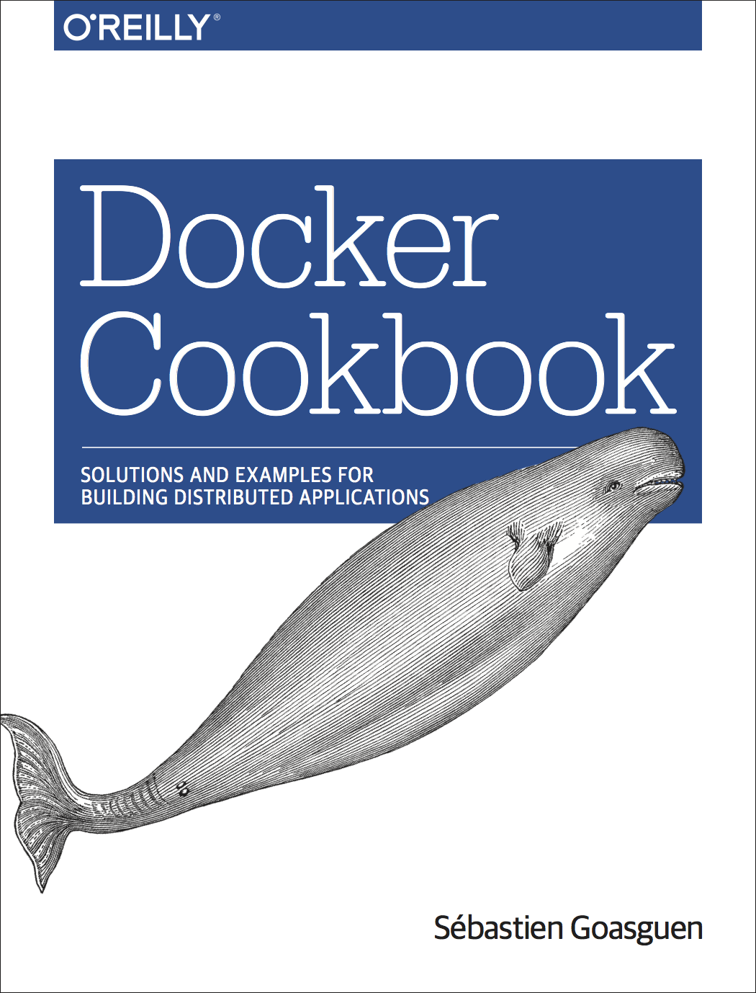
What do I do ?
Apache CloudStack and licloud committer + PMC member
Looking at techs and how they work together
Half dev, half community manager, + half event planner

Slide 4

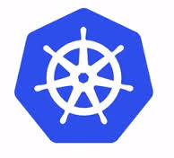

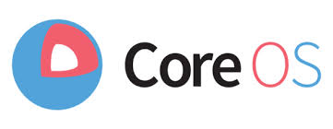
Today’s talk

Slide 5
IaaS History

Slide 6
Opennebula
Eucalyptus
2008
VMWare 1998
HW assisted Virt
2005
Openstack
2010
Xen 2003
EC2
2006
GCE
2012
CloudStack
2010

Slide 7
Goals
Utility computing
Elasticity of the infrastructure
On-demand
Pay as you go
Multi-tenant
Programmable access

Slide 8
So what…
Let’s assume this is solved.
What is not solved:
- Application deployment
- Application scalability
- Application portability
- Application composability

Slide 9
Docker

Slide 10
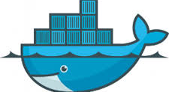
Docker
Linux container (LXC +)
Application deployment
PaaS
Portability
Image sharing via DockerHub
Ease of packaging applications

Slide 11
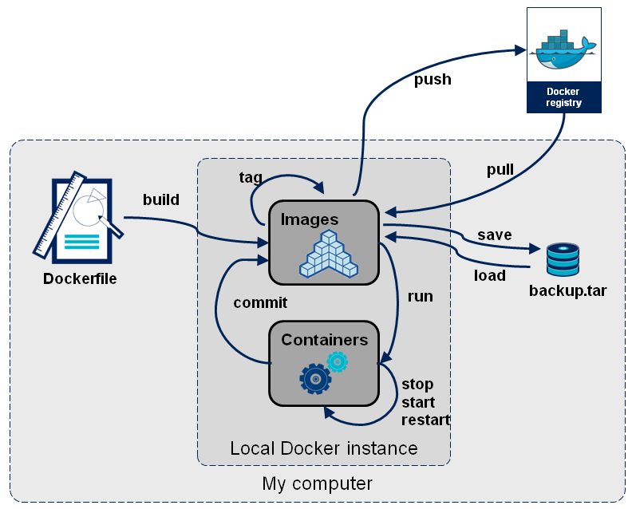
Building docker images
Fair use from http://blog.octo.com/en/docker-registry-first-steps/

Slide 12
Eureka moment #1

Slide 13
Installation
$ sudo curl -sSL https://get.docker.com/ubuntu/ | sudo sh
$ sudo yum install docker

Slide 14
Use
$ docker run busybox echo foobar
Foobar
$ docker run –ti ubuntu:14.04 /bin/bash
root@0156ad334ca4:/#

Slide 15
The App store
$ docker push runseb/application
$ docker pull runseb/application
$ docker run –d runseb/application

Slide 16
Docker gotchas

Slide 17
Networking
Bridge in the host
Port mapping to expose services on the host
Chain DOCKER (1 references)
target prot opt source destination
ACCEPT tcp -- anywhere 172.17.0.4 tcp dpt:www

Slide 18
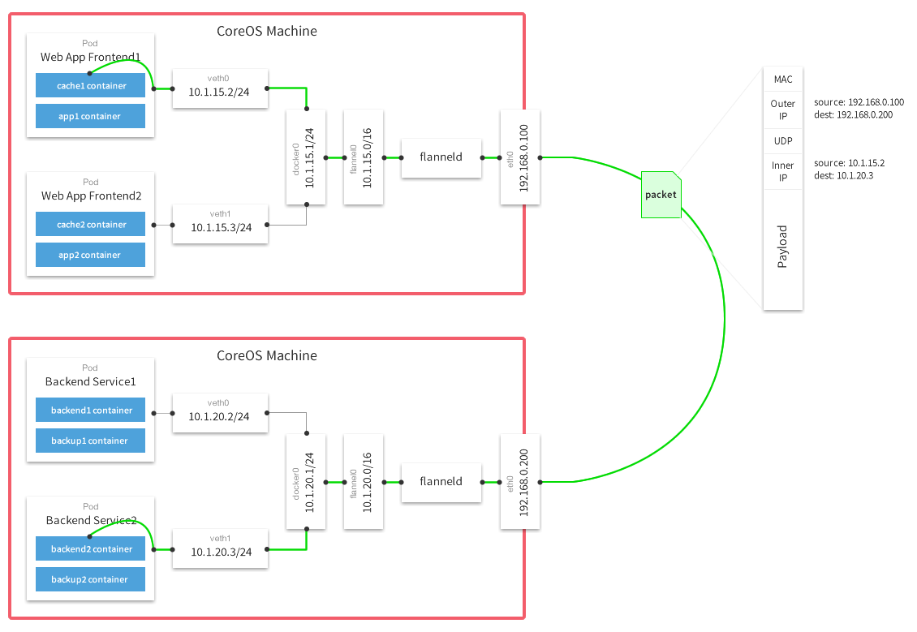

Multi-Host networking
Weave.works
Flannel

Slide 19
Other gotchas
No init system in the container
Foreground processes
Root
Data volumes
Data persistence
How small does an image get for real applications ?

Slide 20
Eureka moment #2

Slide 21
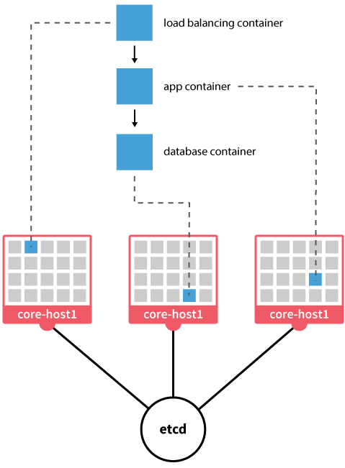
CoreOS

Slide 22
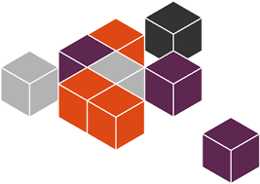


Similar projects

Slide 23
coreOS

Slide 24
CoreOS
Linux distribution
Rolling upgrades
Minimal OS
Docker support
etcd and fleet tools to manage distributed applications based on containers.
Cloud-init support
Systemd units

Slide 25
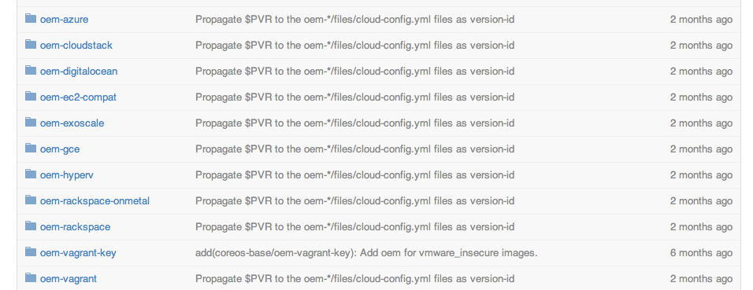
coreOS “OEM”
http://github.com/coreos/coreos-overlay

Slide 26
coreOS “OEM”
http://github.com/coreos/coreos-overlay

Slide 27
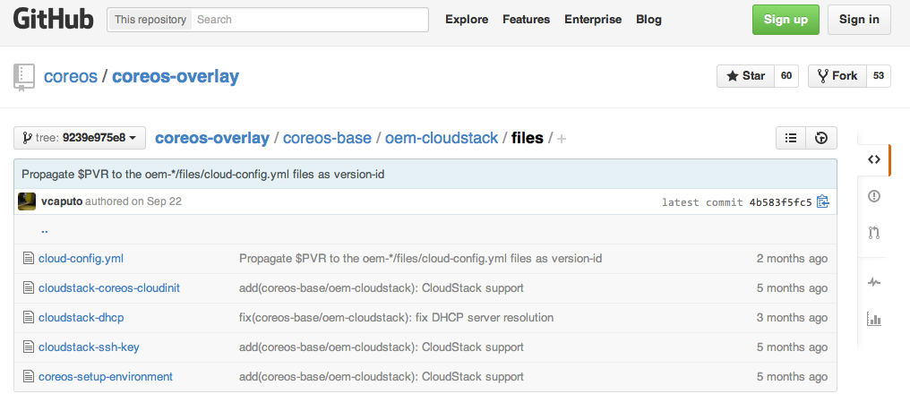
The cloudinit magic

Slide 28
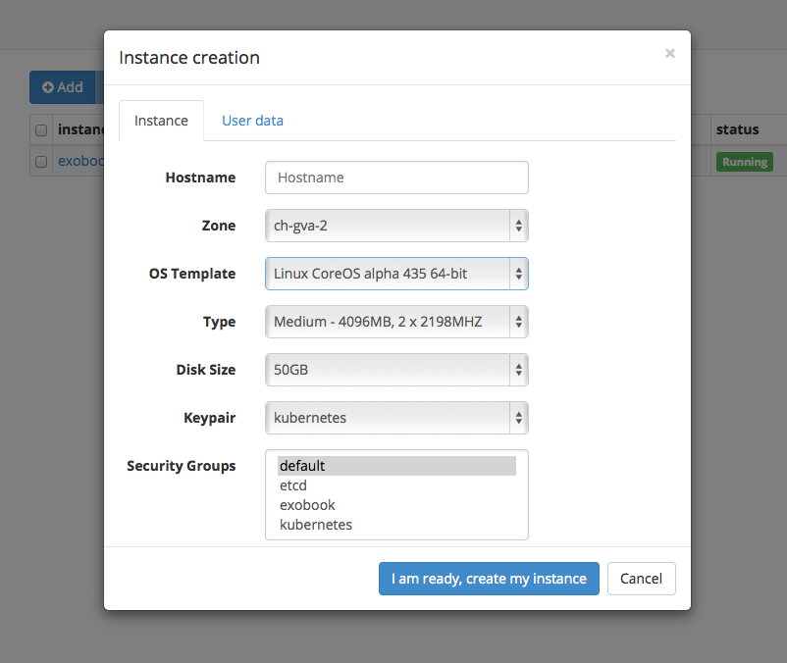
CoreOS on exoscale

Slide 29
Starting containers
#cloud-config
coreos:
units:
- name: docker.service
command: start
- name: es.service
command: start
content: |
[Unit]
After=docker.service
Requires=docker.service
Description=starts ElasticSearch container
[Service]
TimeoutStartSec=0
ExecStartPre=/usr/bin/docker pull dockerfile/elasticsearch
ExecStart=/usr/bin/docker run -d -p 9200:9200 -p 9300:9300 dockerfile/elasticsearch

Slide 30
Opportunity
CERN cloud to offer templates for:
Coreos
Snappy
Atomic
Create a coreOS OEM upstream with cern specific contextualization

Slide 31
DEMO ?

Slide 32
CoreOS clustering
etcd HA key value store
  Raft election algorithm
  Writes when majority in cluster has committed update
  e.g 5 nodes, tolerates 2 nodes failure
fleet distributed init system (schedules systemd units in a cluster)
  Submits systemd units cluster wide
  Affinity, anti-affinity, global “scheduling”

Slide 33
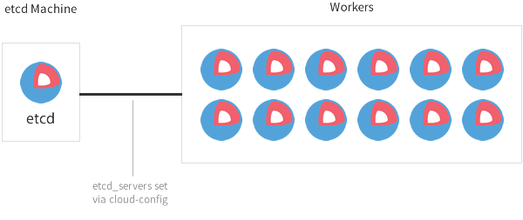
CoreOS Cluster

Slide 34
“Where are you going to run coreOS ?”
“Where are you going to run Docker ?“

Slide 35
- Bare metal cluster
- Public Clouds
- Private Clouds

Slide 36
“How are you going to manage containers running on multiple Docker Hosts ?”

Slide 37

Docker schedulers
Docker Swarm
Citadel
CoreOS Fleet
Lattice from CF incubator
Clocker (via blueprints)
…
Kubernetes

Slide 38
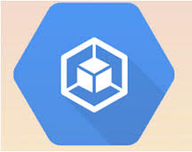
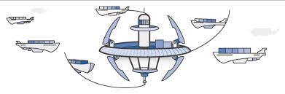
Opportunity
Experiment with a dedicated cluster for container based applications.
Or use a public cloud one:

Slide 39
Kubernetes

Slide 40
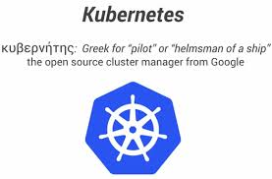
Kubernetes
Docker application orchestration
Google GCE, rackspace, Azure providers
Deployable on CoreOS
Container replication
HA services

Slide 41
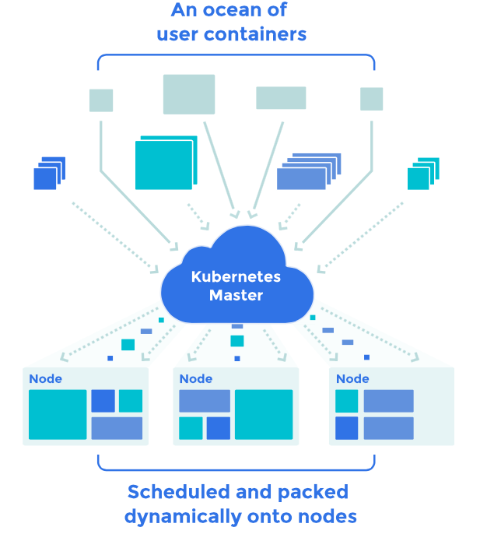

Slide 42
API calls to Kubernetes API
K*
Docker container
K*
Docker container
K*
Docker container
coreOS
coreOS
coreOS
Cloud (e.g CloudStack based = exoscale, openstack based = cern cloud)

Slide 43
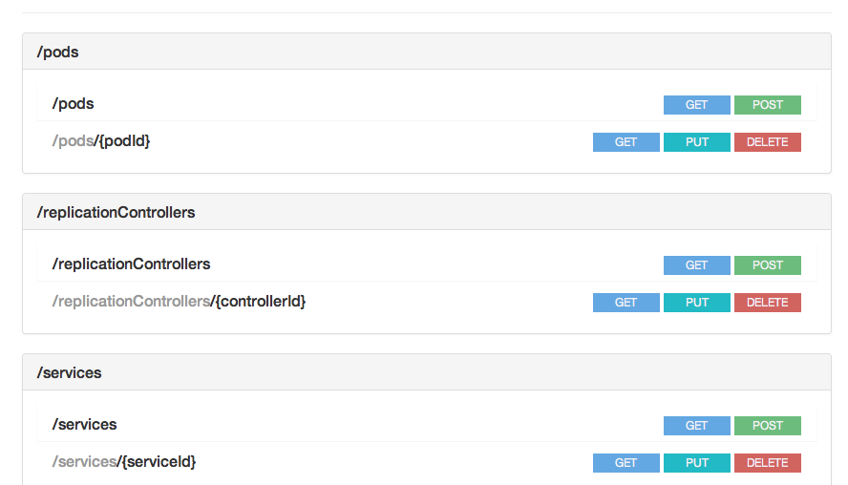
Kubernetes API

Slide 44
Kubernetes Pod
{
"id": "redis-master-2",
"kind": "Pod",
"apiVersion": "v1beta1",
"desiredState": {
"manifest": {
"version": "v1beta1",
"id": "redis-master-2",
"containers": [{
"name": "master",
"image": "dockerfile/redis",
"ports": [{
"containerPort": 6379,
"hostPort": 6379
…
"labels": {
"name": "redis-master"
}
}

Slide 45
Standardizing on pod
Look at the differences between:
k8s pod
AWS ECS task
Ansible Docker playbook
Fig file

Slide 46
?
- hosts: wordpress
tasks:
- name: Run mysql container
docker:
name=mysql
image=mysql
detach=true
env="MYSQL_ROOT_PASSWORD=wordpressdocker,MYSQL_DATABASE=wordpress, \
MYSQL_USER=wordpress,MYSQL_PASSWORD=wordpresspwd"
- name: Run wordpress container
docker:
image=wordpress
env="WORDPRESS_DB_NAME=wordpress,WORDPRESS_DB_USER=wordpress, \
WORDPRESS_DB_PASSWORD=wordpresspwd"
ports="80:80"
detach=true
links="mysql:mysql"

Slide 47
?
wordpress:
image: wordpress
links:
- mysql
ports:
- "80:80"
environment:
- WORDPRESS_DB_NAME=wordpress
- WORDPRESS_DB_USER=wordpress
- WORDPRESS_DB_PASSWORD=wordpresspwd
mysql:
image: mysql
volumes:
- /home/docker/mysql:/var/lib/mysql
environment:
- MYSQL_ROOT_PASSWORD=wordpressdocker
- MYSQL_DATABASE=wordpress
- MYSQL_USER=wordpress
- MYSQL_PASSWORD=wordpresspwd

Slide 48
?
apiVersion: v1beta1
id: wordpress
desiredState:
manifest:
version: v1beta1
id: wordpress
containers:
- name: wordpress
image: wordpress
ports:
- containerPort: 80
volumeMounts:
# name must match the volume name below
- name: wordpress-persistent-storage
# mount path within the container
mountPath: /var/www/html
env:
- name: WORDPRESS_DB_PASSWORD
# change this - must match mysql.yaml password
value: yourpassword
volumes:
- name: wordpress-persistent-storage
source:
# emptyDir: {}
persistentDisk:
# This GCE PD must already exist.
pdName: wordpress-disk
fsType: ext4
labels:
name: wpfrontend
kind: Pod

Slide 49
?
[
{
"image": "wordpress",
"name": "wordpress",
"cpu": 10,
"memory": 200,
"essential": true,
"links": [
"mysql"
],
"portMappings": [
{
"containerPort": 80,
"hostPort": 80
}
],
"environment": [
{
"name": "WORDPRESS_DB_NAME",
"value": "wordpress"
},
…

Slide 50
Opportunity
What type of LHC applications could take advantage of such a model ?
Highly distributed (in the sense of many isolated functions, not X jobs)
Long running services
Scalable layers

Slide 51
Big Data

Slide 52
Clouds and BigData
Object store + compute IaaS to build EC2+S3 clone
BigData solutions as storage backends for image catalogue and large scale instance storage.
BigData solutions as workloads to clouds.

Slide 53
EC2, S3 clone
An open source IaaS with an EC2 wrapper e.g Opennebula, CloudStack
Deploy a S3 compatible object store –separately- e.g riakCS
Two independent distributed systems deployed
Cloud = EC2 + S3

Slide 54



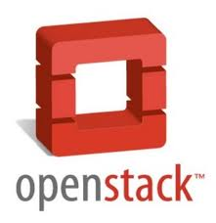
Big Data as IaaS backend
“Big Data” solutions can be used as image catalogue
.

Slide 55
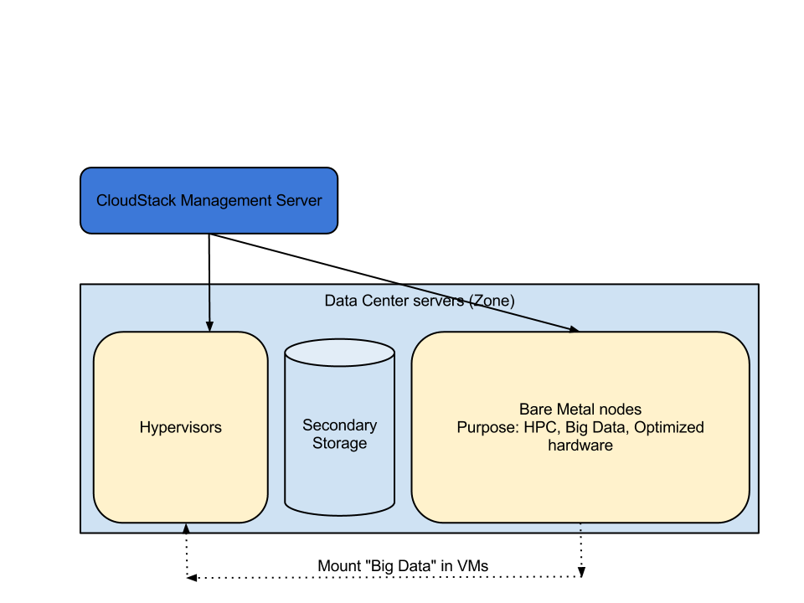
Even use Bare Metal

Slide 56
A note on Scheduling
Core problem of computer science
knapsack is NP complete
Central scheduling has been used for a long time in HPC
Optimizing the cluster utilization requires multi-level scheduling (e.g backfill, preemption etc..)
Google Omega paper 2013
Mesos 2009/2011, ASF Dec 2011

Slide 57
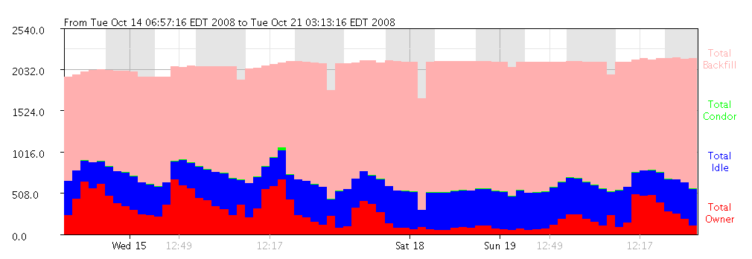
Past: BOINC/Condor Backfill

Slide 58
Food for thought
If Mesos is the answer…
Mesos Framework for managing VM ?
Workload sharing in your data-center:
  Big Data
  VM
  Services
  Containers

Slide 59
Conclusions
Docker is a technology to watch to create distributed applications
Not a replacement for VMs
Packaging experiments applications could be challenging
Supporting the docker networking model in the CERN environment will be difficult.
Could Mesos be used to fill up the clusters and collocate batch and interactive services ?

Slide 60
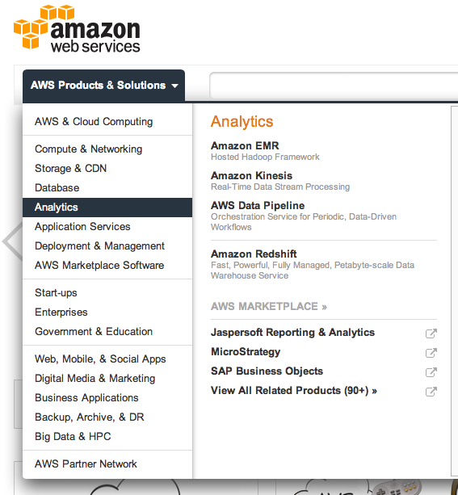
Still behind !

Slide 61



Thanks
Web: http://sebgoa.blogspot.com
Twitter: @sebgoa

