Slide 1
Possible Implication of a Single Nonextensive p_{T} Distribution for Hadron Production
in High-Energy pp Collisions
Grzegorz Wilk
National Centre for Nuclear Research, Warsaw;
in collaboration with : Cheuk-Yin Wong (Oak Ridge National Laboratory)
and Leonardo J. L. Cirto and Constantino Tsallis (CBPF, Rio deJaneiro )
11-th Polish Workshop on Relativistic Heavy-Ion Collisions; 17-18 January 2015
organized by Heavy Ion Reactions Group, Faculty of Physics, Warsaw University of Technology

Slide 2
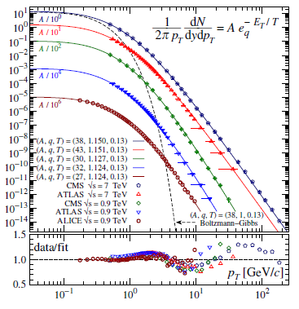
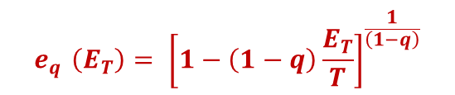
LHC high energy data for
pp → pi…
Fits at midrapidity, one
simple formula used,
q~1.1, T=130 MeV
$$e_{q }\left(E_{T}\right){= \left[1−\left(1−q\right)\frac{E_{T}}{T}\right]}^{\frac{1}{\left(1−q\right)}}$$
?
APPB43(2012)2047
PRD87(2013)114007
1409.3278
1412.0474

Slide 3
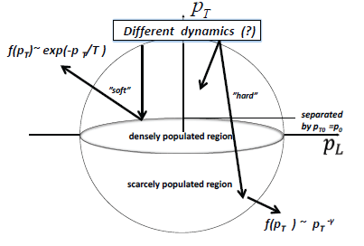
Schematic view of details of the phase space in multiparticle production.

Slide 4
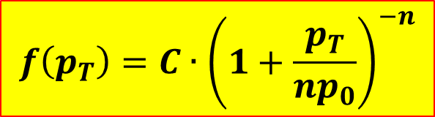
$$f\left(p_{T}\right)=C∙{\left(1+\frac{p_{T}}{{np}_{0}}\right)}^{−n}$$

Slide 5
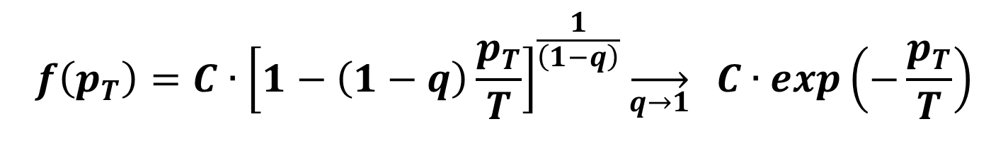
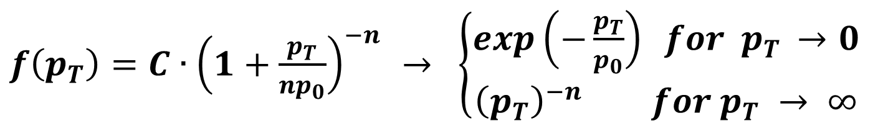
C. Michael, L. Vanryckeghem, J. Phys. G 3, L151;,1977); C. Michael, Prog. Part. Nucl. Phys. 2, 1 (1979); R. Hagedorn, Riv. Nuovo Cimento 6, 1 (198).
$f\left(p_{T}\right)=C∙{\left(1+\frac{p_{T}}{{np}_{0}}\right)}^{−n}$ $→ \left\{\begin{aligned}exp\left(−\frac{p_{T}}{p_{0}}\right) for p_{T }→0 \\ {\left(p_{T}\right)}^{−n } for p_{T} → ∞\end{aligned}\right.$
p₀ = nT, n=1/(q-1)
$$f\left(p_{T}\right)=C∙{\left[1−\left(1−q\right)\frac{p_{T}}{T}\right]}^{\frac{1}{\left(1−q\right)}}\overset{→}{\begin{aligned}q→1 \\ \\ \end{aligned}} C∙exp\left(−\frac{p_{T}}{T}\right)$$
C. Tsallis, J. Stat. Phys. 52, 479 (1988) and Eur. Phys. J. A40, 257 (2009)

Slide 6
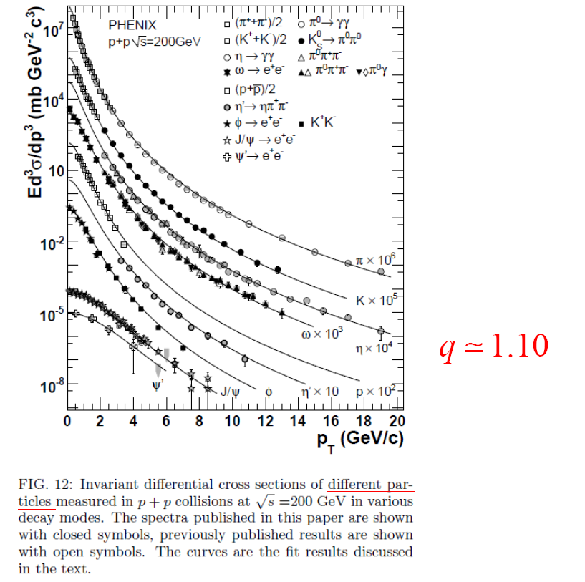
Example
-small and medium p_{T}
Phenix Coll., PRD 83, 052004 (2011)
Fig. 12
Invariant differential cross sections of different particles measured in p p collisions at √s = 200 GeV in various decay modes.
q=1.1 n=10
6

Slide 7
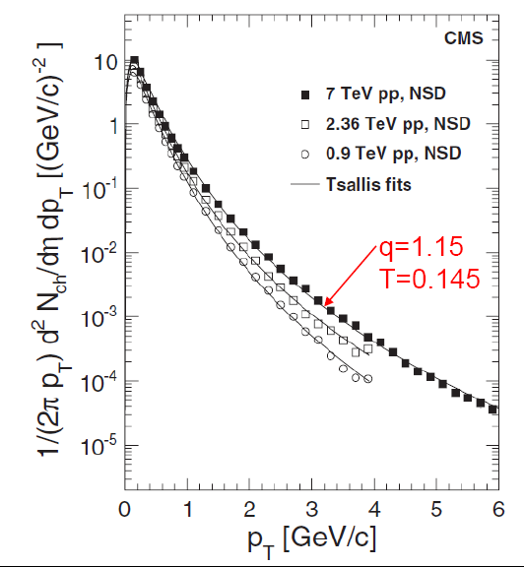
Example
- very large p_{T}
[ JHEP 08, 086 (2011) ]
q=1.15

Slide 8
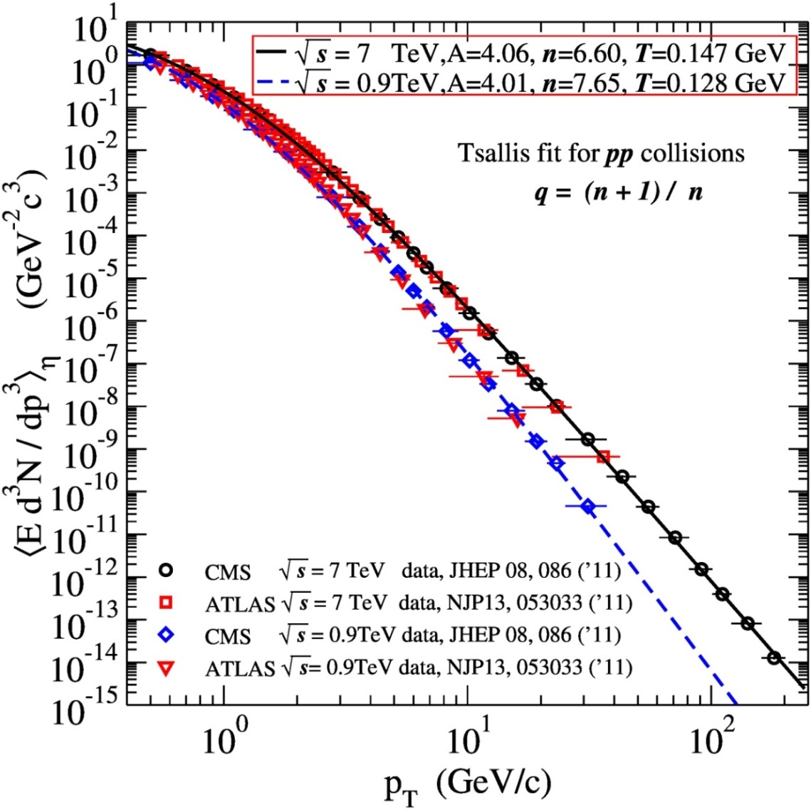
CMS fits recovered in APPB43(2012)2047:

Slide 9
Questions:
What is the physical meaning of n ?
If n is the power index of 1/p_{T}^{n}, then why is n ~ 7,
whereas pQCD predicts n ~ 4 ?
Why are there only few degrees of freedom over such a large p_{T} domain ?
Do multiple parton collisions play any role in modifying the power index n?
Does the hard scattering process contribute significantly to the production
of low-p_{T} hadrons?
What is the origin of low-p_{T} part of Tsallis fits ?
CYW,GW: - Phys. Rev. D87 (2013) 114007;
CYW,GW, LC, CT – arXiv: 1412.0474

Slide 10
Parton Multiple Scatterings:
(*) The contribution from the single collision dominates, but high multiple collisions
comes in at lower p_{T} and for more central collisions
However,
(*) One expects then that for more and more central collisions, contributions with a
greater number of multiple parton collisions gains in importance. As a
consequence, the power index n is expected to become greater when we select
more central collisions (subject to experimental verification).
PMS do not play any substantial role in modyfying power index n

Slide 11
Simplest way to model parton collisions basing on QCD ideas: use the
Relativistic Hard Scattering Model:

Slide 12
The Power Index in Jet Production
[18] D. W. Duke and J. F. Owens, Phy. Rev D30, 49 (1984).

Slide 13
How to get n from data ?
Notice: parameter C regularizes the coupling constant for small values of Q(c_{T} ).
[17] C. Y. Wong, E. S. Swanson, and T. Barnes, Phy. Rev. C, 65, 014903 (2001).

Slide 14
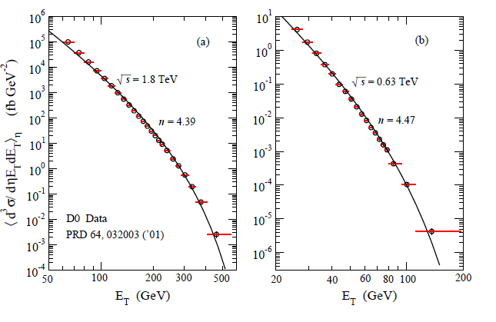
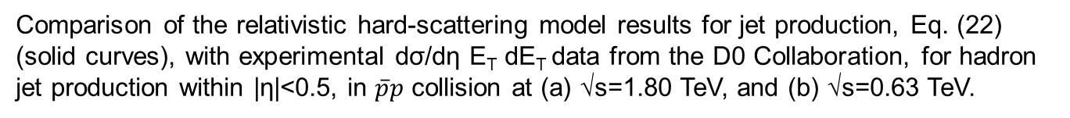
Fits to D0 jet data

Slide 15
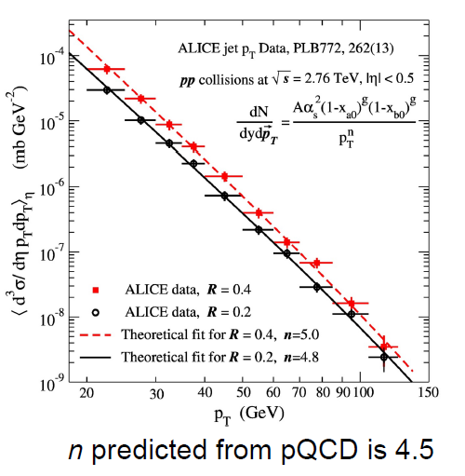
Fits to ALICE and CMS jet data
(without regularization of α(p_{T}); R is clustering parameter used in jet finding algorithms)

Slide 16
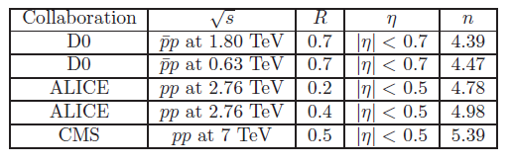
Except for the CMS data at 7 TeV that may need further re-examination, the power
indices extracted for hadron jet production are in approximate agreement with the value of n=4.5 in Eq. (19) and with previous analysis in [10], indicating the approximate validity of the hard scattering model for jet production in hadron-hadron collisions, with the predominant α²_{s} / c⁴_{T} parton-parton differential cross section as predicted by pQCD.
[10] F. Arleo, S. Brodsky, D. S. Hwang, and A. M. Sickles, Phys. Rev. Lett. 105, 062002 (2010).

Slide 17
Change of the Power Index n from Jet Production to
Hadron Production
– one has to account for:
(i) showering (and/or fragmentation),
(ii) hadronization
Jet
production
.
hadrons

Slide 18
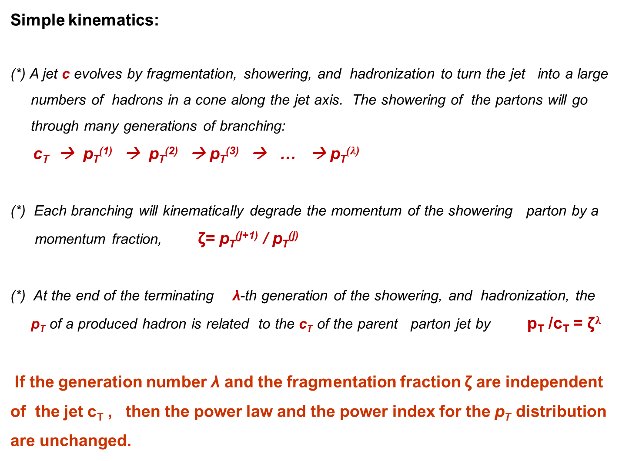
Simple kinematics:
(*) A jet c evolves by fragmentation, showering, and hadronization to turn the jet into a large
numbers of hadrons in a cone along the jet axis. The showering of the partons will go
through many generations of branching:
c_{T} → p_{T}⁽¹⁾ → p_{T}⁽²⁾ → p_{T}⁽³⁾ → … → p_{T}⁽$λ$⁾
(*) Each branching will kinematically degrade the momentum of the showering parton by a
momentum fraction, ζ= p_{T}^{(j+1)} / p_{T}^{(j)}
(*) At the end of the terminating λ-th generation of the showering, and hadronization, the
p_{T} of a produced hadron is related to the c_{T} of the parent parton jet by p_{T} /c_{T} = ζ$λ$
If the generation number λ and the fragmentation fraction ζ are independent of the jet c_{T} , then the power law and the power index for the p_{T} distribution are unchanged.

Slide 19

Dynamical ingredients:
(*) In addition to the kinematic decrease of p_{T} , the showering generation number λ is also
governed by the virtuality, which measures the degree of the off-the mass-shell property
of the parton.
(*) From the different parton showering schemes (PYTHIA , HERWIG, ARIADNE) a general
picture emerges that the initial parton with a large initial virtuality Q decreases its virtuality
by showering until a limit of Q₀ is reached.
(*) As a result of the virtuality ordering and virtuality cut-off (dynamical ingredients):
the hadron fragment transverse momentum p_{T} is related to the parton
momentum c_{T} nonlinearly by an exponent 1 − μ, where μ is a
parameter that can be searched to fit the data:
$\frac{{dc}_{T}}{{dp}_{T}}$= $\frac{1}{1−μ}{\left(\frac{p_{T}}{c_{T0}}\right)}^{\frac{2μ}{1−μ}}$

Slide 20
After the fragmentation and showering of the parton c to hadron p, the hard-scattering
cross section for the scattering in terms of hadron momentum p_{T} becomes

Slide 21
After all this one gets power-law behavior
but this is not Tsallis formula
because low p_{T} behaviour s not correct

Slide 22
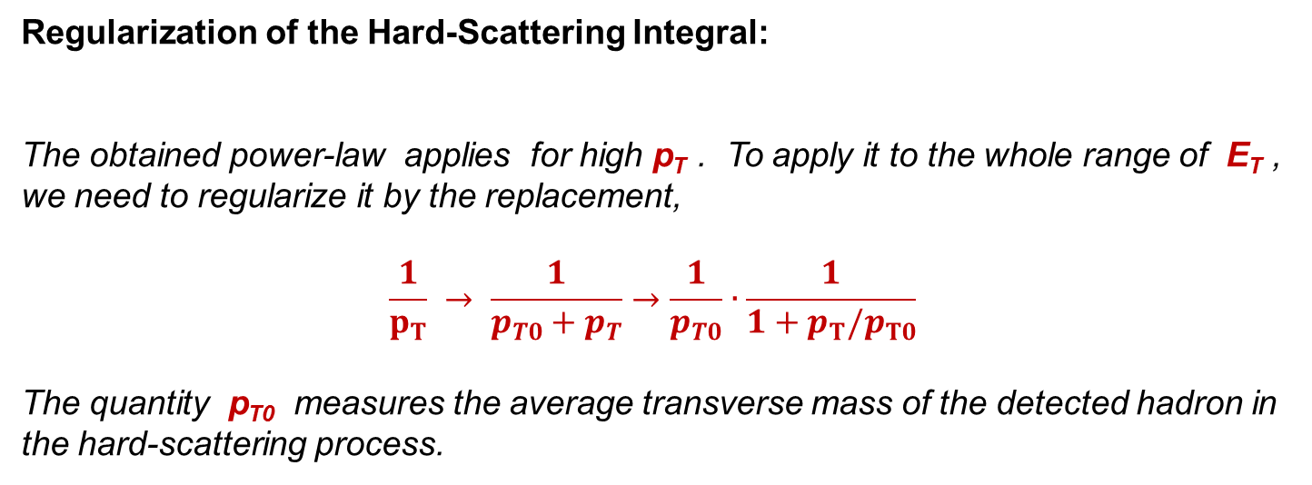
Regularization of the Hard-Scattering Integral:
The obtained power-law applies for high p_{T} . To apply it to the whole range of E_{T} , we need to regularize it by the replacement,
$$\frac{1}{p_{T}} → \frac{1}{p_{T0}+p_{T}}→\frac{1}{p_{T0}}∙\frac{1}{1+p_{T}/p_{T0}}$$
The quantity p_{T0} measures the average transverse mass of the detected hadron in the hard-scattering process.

Slide 23
Notice:
that we have just assumed
the form of Tsallis/Hagedorn
formula showed at the beginning:

Slide 24
Notice: in addition to regularization we were using (following CYW et al.
PRC65(2001)14903

Slide 25
Final result for QCD based derivation:
Looks like Tsallis

Slide 26
Final result for QCD based derivation:
… but with quite complicated prefactor
Looks like Tsallis

Slide 27
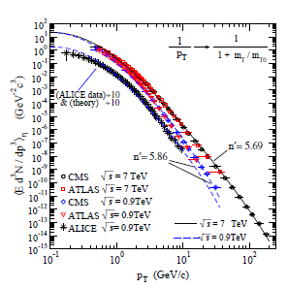
The experimental data
gives n′=5.69 ,
m_{T0} =0.804 GeV for
√s=7 TeV and n′=5.86,
m_{T0} =0.634 GeV for
√s=0.9 TeV.
There is indeed
a systematic change of
the power index n from
jet production to a larger
value n′ in hadron
production.
(The fits to the low p_{T}
region for the ALICE
data can be improved
with a larger power
index n′ )

Slide 28
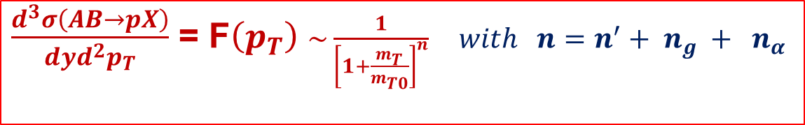
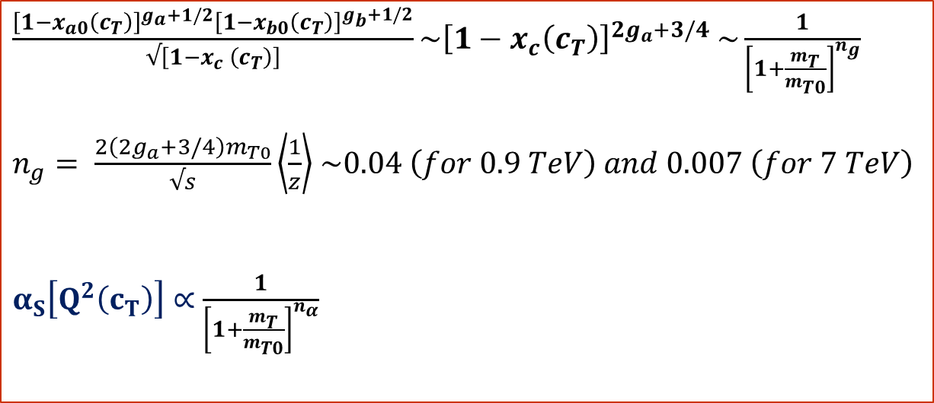
Further Approximation of the Hard-Scattering Integral
For √s>>c_{T} and at y ~0 one has:
$\frac{{\left[1−x_{a0}\left(c_{T}\right)\right]}^{g_{a}+1/2}{\left[1−x_{b0}\left(c_{T}\right)\right]}^{g_{b}+1/2}}{√\left[1−x_{c} \left(c_{T}\right)\right]}\sim {\left[1−x_{c}\left(c_{T}\right)\right]}^{2g_{a}+3/4}$ $\sim \frac{1}{{\left[1+\frac{m_{T}}{m_{T0}}\right]}^{n_{g}}}$
$n_{g}= \frac{2\left(2g_{a}+3/4\right)m_{T0}}{√s}\left\langle \frac{1}{z}\right\rangle$ $\sim 0.04 \left(for 0.9 TeV\right) and 0.007 \left(for 7 TeV\right)$
$α_{S}\left[Q^{2}\left(c_{T}\right)\right]∝$ $\frac{1}{{\left[1+\frac{m_{T}}{m_{T0}}\right]}^{n_{α}}}$
(where n_{α} can be chosen to minimize errors by
matching α_{S} at two points of p_{T} ; it is ~0.3-0.5)
$\frac{d^{3}σ\left(AB→pX\right)}{dyd^{2}p_{T}}$ = F$\left(p_{T}\right)$ $\sim \frac{1}{{\left[1+\frac{m_{T}}{m_{T0}}\right]}^{n}} with n=n^{′}+ n_{g} + n_{α}$

Slide 29
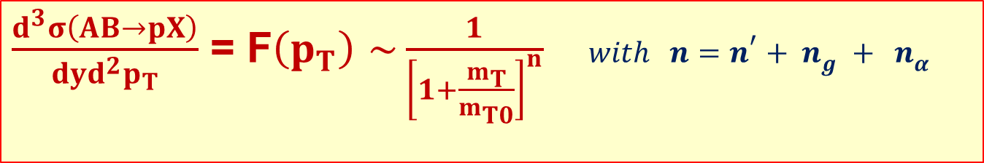
As a consequence of all these simplifying approximations,
we can write the hard-scattering integral
in the approximate form
$\frac{d^{3}σ\left(AB→pX\right)}{dyd^{2}p_{T}}$ = F$\left(p_{T}\right)$ $\sim \frac{1}{{\left[1+\frac{m_{T}}{m_{T0}}\right]}^{n}} with n=n^{′}+ n_{g} + n_{α}$
n′ - the power index after taking into account the fragmentation process,
n_{g -} the power index from the structure function,
n_{α} - the power index from the coupling constant.
Predominant change of the power index from jet production to hadron production arises from the fragmentation process .

Slide 30
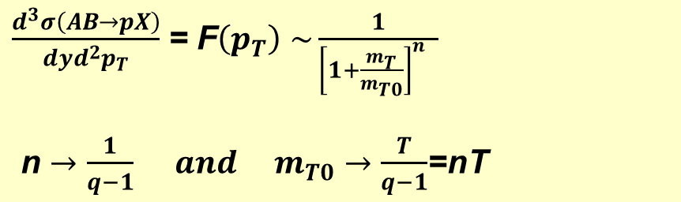

Nonextensive Distribution as a Lowest-Order Approximation
of the Hard-scattering Integral:
Identifying in
$\frac{d^{3}σ\left(AB→pX\right)}{dyd^{2}p_{T}}$ = F$\left(p_{T}\right)$ $\sim \frac{1}{{\left[1+\frac{m_{T}}{m_{T0}}\right]}^{n }}$
n $→\frac{1}{q−1} and m_{T0}→\frac{T}{q−1}$=nT
and considering produced particles as relativistic ( with m_{T} ∼E_{T} ∼p_{T}
and E_{T} ∼E at mid-rapidity y~0 ),
we obtain the nonextensive distribution
$F\left(p_{T}\right)$=A${\left[1−\left(1−q\right)\frac{p_{T}}{T}\right]}^{1/\left(1−q\right)}$
as the lowest-order approximation for the QCD-based hard-scattering integral.

Slide 31
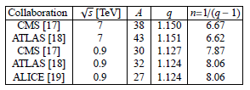

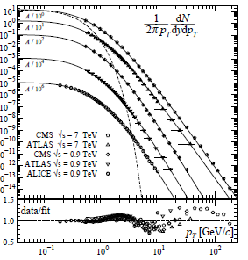
Fits to the experimental transverse
momentum distribution of hadrons
in pp collisions at central rapidity y.
The temperature T = 0.13 GeV, the normalization constant is in units of GeV^{-2}/c^3. The corresponding Boltzmann-Gibbs (purely exponential) fit is presented by the dashed
curve. The ratios data/fit show (?)
a roughly log-periodic behavior
iobserved on top of the
q-exponential one.

Slide 32
Possible interpretation:
The convergence of hard scattering and nonextensivity equations can be considered
from the viewpoint of the reduction of a microscopic description to a statistical-mechanical description.
(*) From the microscopic perspective, the hadron production in a pp collision is a very
complicated process, as evidenced by the complexity of the evolution dynamics in the
evaluation of the p_{T} spectra in Monte Carlo programs.
(*) Starting from the initial condition of two colliding nucleons, there are many intermediate
and complicated processes entering into the dynamics, each of which contain a large set
of microscopic and stochastic degrees of freedom.

Slide 33
Possible interpretation (cont):
(*) There are stochastic elements :
- in the picking of the degree of inelasticity,
- in the picking of the colliding parton momenta from the parent nucleons,
- in the scattering of the partons,
- in the showering evolution of scattered partons,
- in the hadronization of the fragmented partons.
(*) Some of these stochastic elements cannot be definitive and many different models,
sometimes with untestable assumptions, have been put forth.
In spite of all these complicated stochastic dynamics, the final result of the single-particle distribution can be approximated to depend only on three degrees of freedom, after all is done, put together, and integrated.

Slide 34
Possible interpretation (cont):
(*) The simplification can be considered as a “no hair" reduction from the microscopic
description to nonextensive statistical mechanics in which all the complexities in the microscopic description “disappear" and are subsumed behind the stochastic processes
and integrations.
(*) In line with statistical mechanics and in analogy with the Boltzmann-Gibbs distribution, we can cast the hard-scattering integral in the non-extensive form in the lowest-order approximation .
(*) The good agreement with data in the whole range of p_{T} with a single nonextensive distribution and demonstration that the hard-scattering integral can be written as a nonextensive distribution in the lowest-order approximation means that it is reasonable to infer that the dominant mechanism of hadron production in this case is the hard-scattering process.

Slide 35
Conclusions
(*) Particle production in high-energy pp collisions at central rapidity is a complex process that can be viewed from two different and complementary perspectives:
Microscopic description based on pQCD and nonperturbative hadronization at the parton level.
Statistical mechanics, where the single-particle distribution can be cast into a form
that exhibit all the essential features of the process with only three degrees of freedom.
(*) The final result of the hard scattering process can be summarized, in the lowest-order approximation, by :
- power index n which can be represented by a nonextensivity parameter q=(n + 1)/n,
- taverage transverse momentum m _{T0} , which can be represented by an effective
temperature T=m_{T0} /n,
- constant A that is related to the multiplicity .
(*) One uncovers the dominance of the hard-scattering hadron production and the approximate validity of a “no-hair” statistical-mechanical description for the whole transverse momentum region in pp collision at high-energies

Slide 36
Thank you

