Slide 1
Nonlinear coupling?

Slide 2
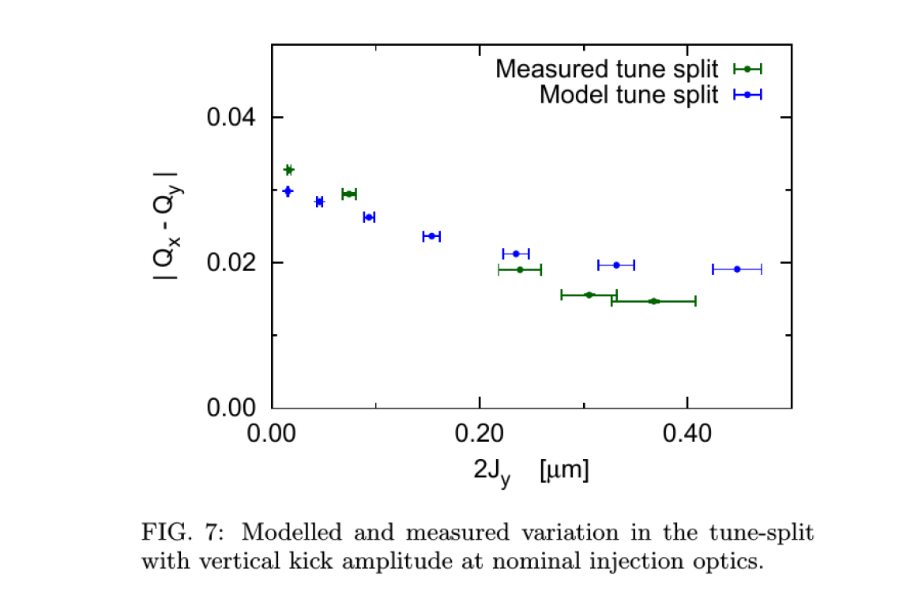
A short review of the background for the study
It was observed that the amplitude detuning decreased with amplitude.

Slide 3
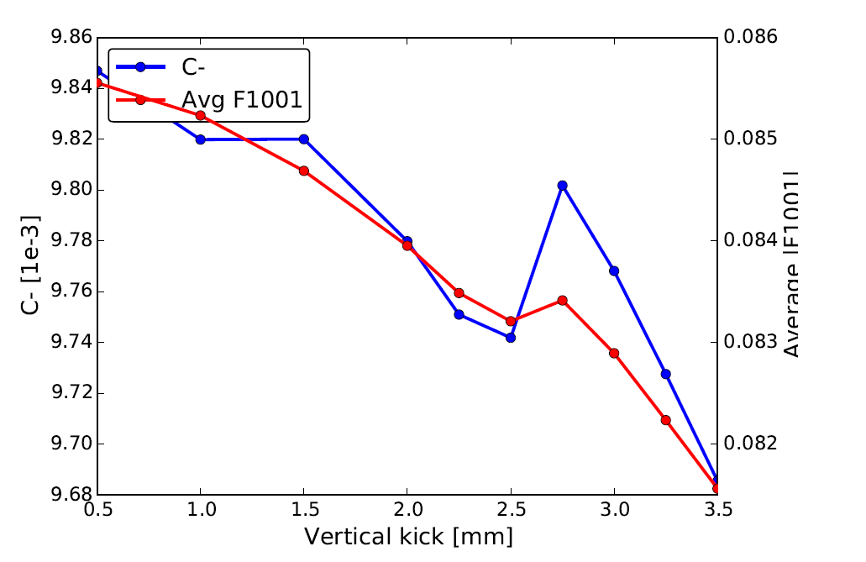
No MO
From Yngves’ studies it seemed like coupling and normal octupole were needed to create nonlinear coupling.

Slide 4
Investigated the impact of the coupling phase
Nominal machine with MO Powered (100%)
Coupling introduced with coupling knobs (C- = 0.01, checked with PTC match)

Slide 5
Changed the starting tune
Nominal machine with MO Powered (100%)
Coupling Introduced with knobs (C- = 0.015, checked with PTC match)

Slide 6
Qx vs Qy
Blue is the smallest kicks and dark red the largest.

Slide 7
Summary
C- reconstructed from the f1001 increases with amplitude of the kick.
  f1001 is a indirect measurement. Next step
The tunes can be closer to each other then what is suggested from the C- reconstructed from tracking data.

Slide 8
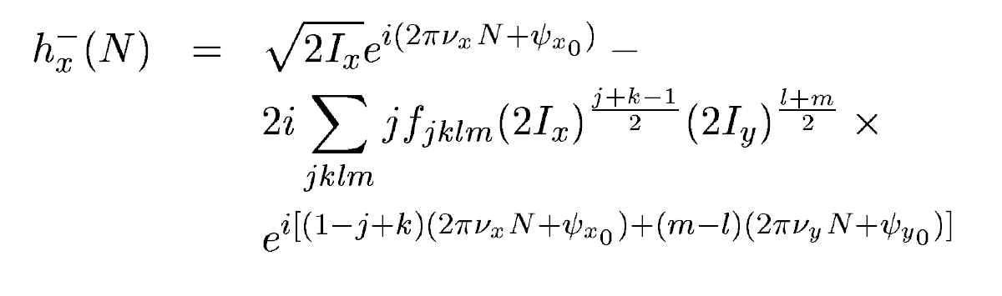
f1001 (j=1, m=1)give rise to a peak in the spectra.
But.. f1012, f1023 will also contribute to the same line.

Slide 9
Next steps:
  Write down the terms that contribute to each line up to octupolar terms.
  Investigate the dependence of each line with the amplitude.
    Should at least explain why we see the increase of C- from f1001

