Slide 1
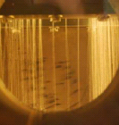
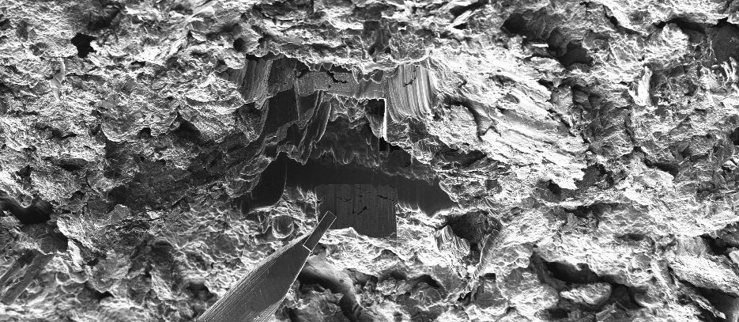
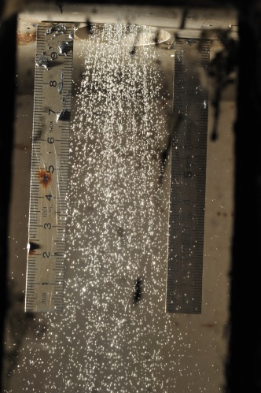
Target Materials
  UC_{X}
  LaC (n-def. Ba, Cs, In, Xe)
  TiC (n-def. K, Sc, Ca)
  MWC nanotubes (B, Be)
  LiF:NaF (Ne, C, O)
Target Concepts
  Liquid Salt (diffusion of Ne)
  Liquid Loop Targets (LIEBE)
  Boron Beams
  Combining VADIS and RILIS
Target and Ion Source Development
Report 2014
Alexander Gottberg

Slide 2
Target Materials

Slide 3
ISOL Target Materials
ISOL Target Materials
commonly or recently used at ISOLDE
* engineered advanced micro or nano structure
Carbides
Oxides
Solid Metals
Molten
Others
Uranium Carbide (UC_{x}) *
Carbon (C) *
Aluminium Carbide (Al₄C₃)
Calcium Carbide (CaC₂)
Lanthanum Carbide (LaC₂) *
Thorium Carbide (ThC₂)
Silicon Carbide (SiC) *
Titanium Carbide (TiC) *
Vanadium Carbide (VC)
Scandium Carbide (ScC₂)
Zirconium Carbide (ZrC)
Gadolinium Carbide (GdC_{x})
Curium Carbide (CmC_{x})
Beryllium Oxide (BeO)
Magnesium Oxide (MgO)
Aluminium Oxide (Al₂O₃) *
Calcium Oxide (CaO) *
Yttrium Oxide (Y₂O₃) *
Cerium Oxide (CeO₂)
Thorium Oxide (ThO₂) *
Hafnium Oxide (HfO₂) *
Zirconium Oxide (ZrO₂)
Barium Oxide (BaO)
Titanium Oxide (TiO₂) *
Strontium Oxide (SrO)
Lanthanum Oxide (La₂O₃)
Uranium Oxide (UO₂)
Titanium (Ti)
Niobium (Nb)
Zirconium (Zr)
Tantalum (Ta)
Tungsten (W)
Molydenum (Mo)
Iridium (Ir)
Vanadium (V)
Hafnium (Hf)
Silicon layers (Si)
Thorium layers (Th)
Thorium/Niobium (Th/Nb)
Tin/Graphite (Sn/C)
Platinum/Graphite (Pt/C)
Plutonium (Pu)
Germanium (Ge)
Tin (Sn)
Ce₃S₄
TeO₂:KCl:LiCl
NaF:LiF
Lead (Pb)
Lead-Bismuth (Pb:Bi)
Gold (Au)
Lanthanum (La)
Lanthanum:Thorium alloy
Lanthanum:X alloys
Uranium-Chromium
Bismuth (Bi)
Praseodymium (Pr)
Neodymium (Nd)
Terbium (Tb)
Gd:Cu
Er:Cu
Pr:B
Uranium (U)
ThF₄:LiF
BaB₆
BaZrO₃
CeB₆
CeS
Zr₅Ge₃
Hf₃Si₃
Hf₅Ge₃
Hf₅Sn₃
Ta₅Si₃
CaB₆
BN
CeS
Zr₅Si₃
Zr₅Ge₃
AlN
Na-zeolite
Ca-zeolite
Tl-zeolite

Slide 4
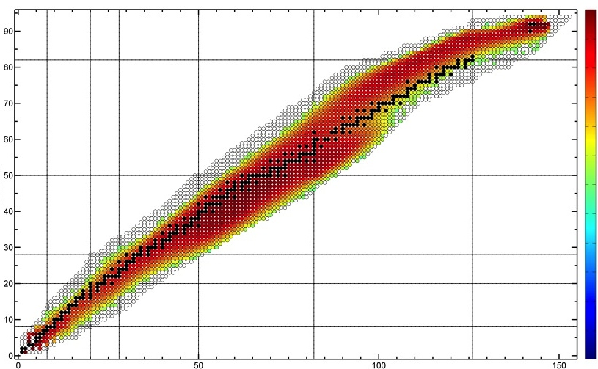
UC_{x} as Benchmark for ISOL-Facilities Worldwide
Actinide targets at ISOLDE in 2011 (2010)
249 shifts out of 396 → 68% of total (72%)
13 new units (12 new, 2 old)
FLUKA production rates in UC₂ by 2 μA X 1.4 GeV protons [1/s]
1· 10¹²
1· 10¹¹
1· 10¹⁰
1· 10⁹
1· 10⁸
1· 10⁷
Protons
1· 10⁶
1· 10⁵
1· 10⁴
1· 10³
1· 10²
1· 10¹
Neutrons

Slide 5
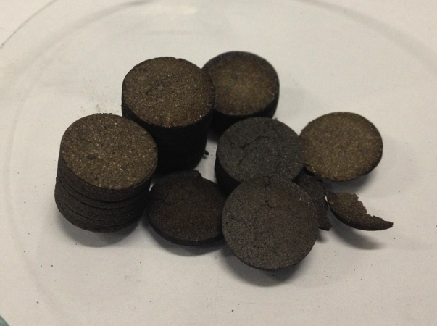
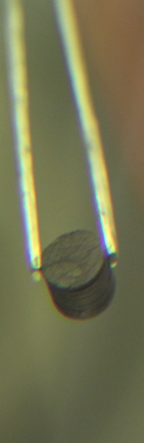
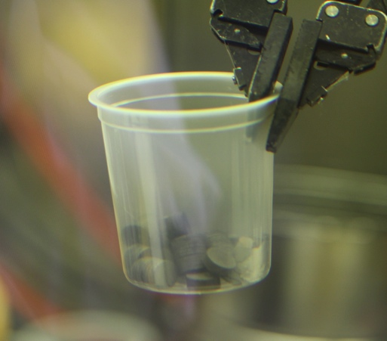
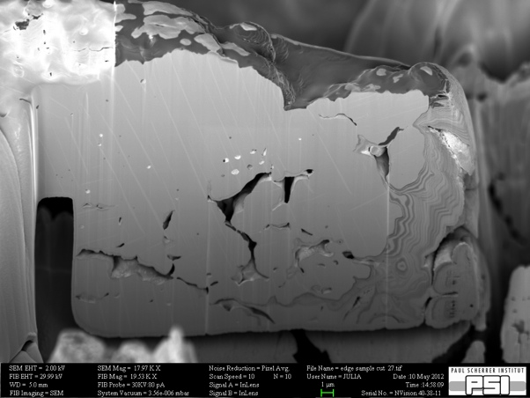
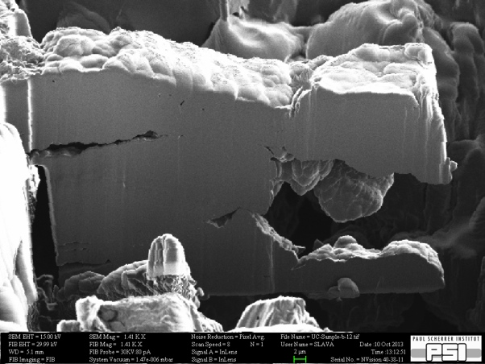
UC_{x} Post-Irradiation Studies
Post-irradiation analysis:
First analysis of an irradiated UC_{X} target in the history of ISOLDE
(important to understand ageing processes and for upcoming waste campaign)
Opening target unit #466 (8.8∙10¹⁸ protons in 2011) in inert-gas hot-cell at PSI, 19 mSv/h on contact with Ta beam window
before irradiation
after irradiation
Pellets appear macroscopically unchanged
Microscopic evolution of pore distribution and grain size under irradiation observable
500 µSv/h on contact with single pellet
Further results of synchrotron investigations under analysis
Ceramography and electron micro-probe analysis on-going
2µm

Slide 6
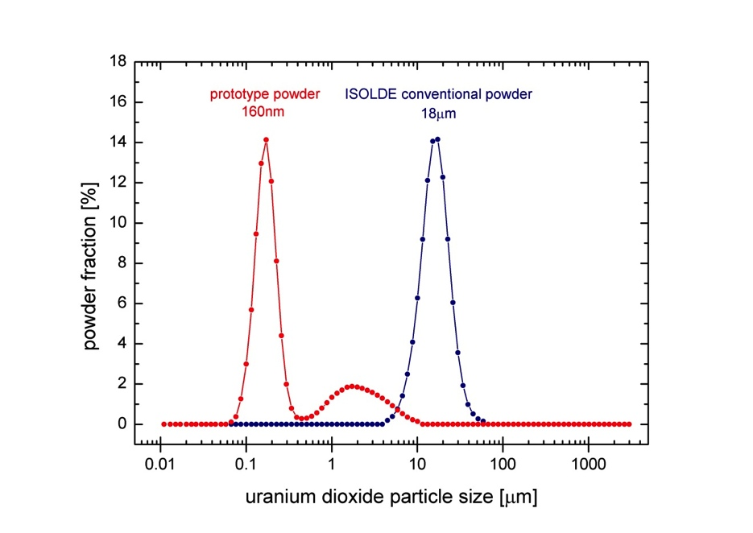
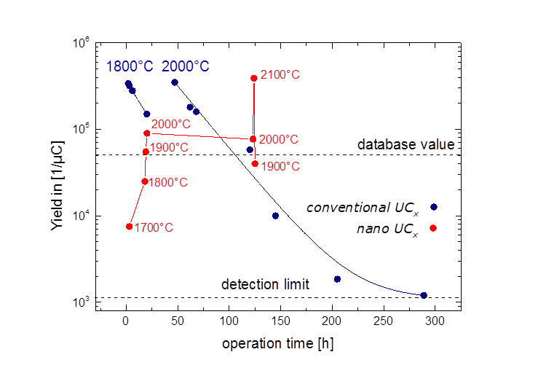
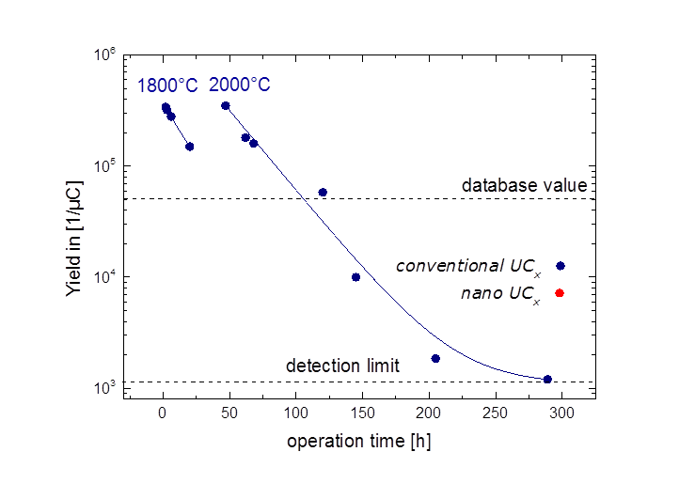
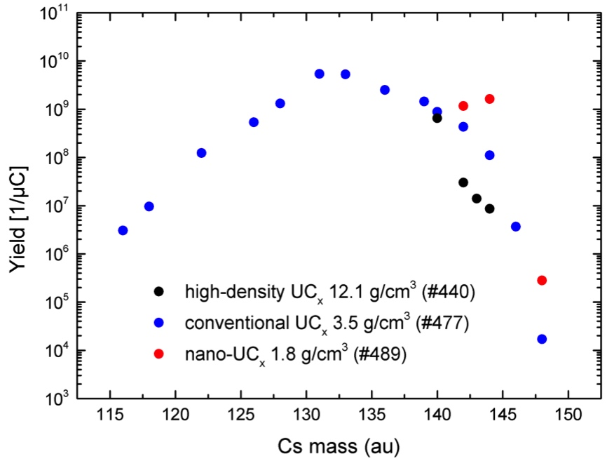
Composing a Recipe for Nano-Grained UO₂
Synthesis of de-novo designed uranium carbide matrixes:
Different microstructures, densities, grain sizes, crystal structures
tested → tailor-made matrix:
Suspension grinding of UO₂ powder to 160 nm
average particle size
Wet-mixing with multi-walled carbon nanotubes
Ultrasound drying of mixture and pressing to 1.6 g/cm³ pellets
Fast reactive sintering to mixed uranium carbide in carbon
nanotube matrix
two orders
of magnitude
Online tests in November
³⁰Na yield evolution under irradiation

Slide 7
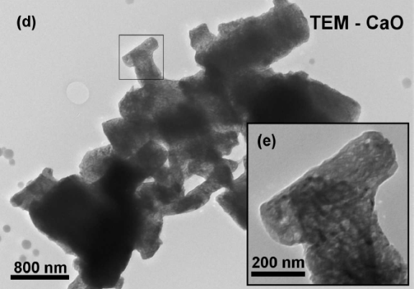
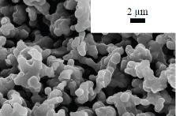
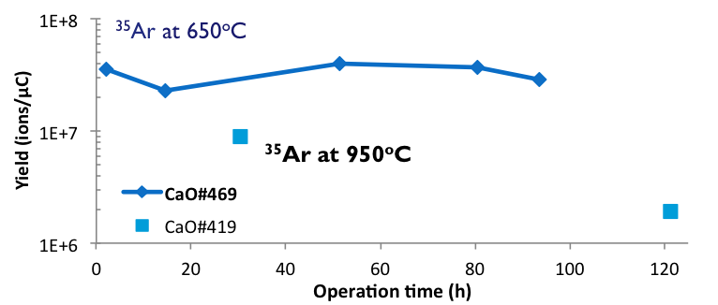
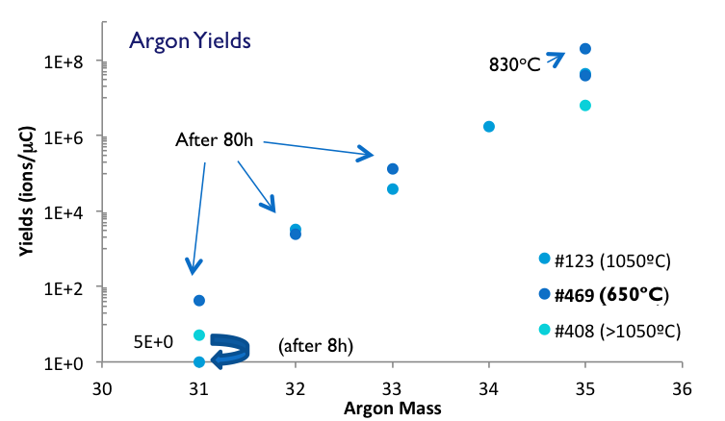
Small Grain Target Materials – so far...
Sub-micron Silicon Carbide
Uranium Carbide – CNT Composite
Calcium Oxide
  1-50 µm SiC considered in the past as a useless target material in terms of release
  Uranium carbide targets are, by far, the most used at ISOLDE.
  Sub-micrometric SiC showed improved release rates of short-lived Mg
UO₂ (micron sized) milled
Patent
  UO₂ (120 nm) + MWCNT
T. Stora, S. Fernandes, S. Mathot, and P. Bowen, “Nanostructured Target for Isotope Production,” WO 2010/034364 A12010.
up to 1800ºC
𝑈𝑂₂+6𝐶→𝑈𝐶₂+2𝐶+2𝐶𝑂
  The ideal target material, for release of, alkali, alkaline-earth and noble gases, was defined:
  Nanometric/submicron grain size
  High porosity (>30%)
  Macroporosity (>100nm)
  No closed porosity
  Very porous structure (75%)
  Much less prone to sinter than conventional UC₂ targets (micrometric UC₂ + Graphite)
  Release rates on many isotopes improved.
Three more this year…

Slide 8
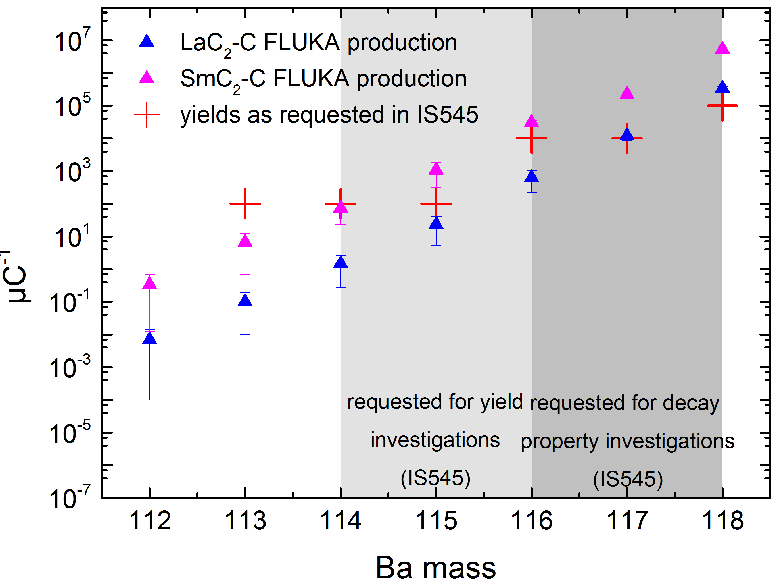
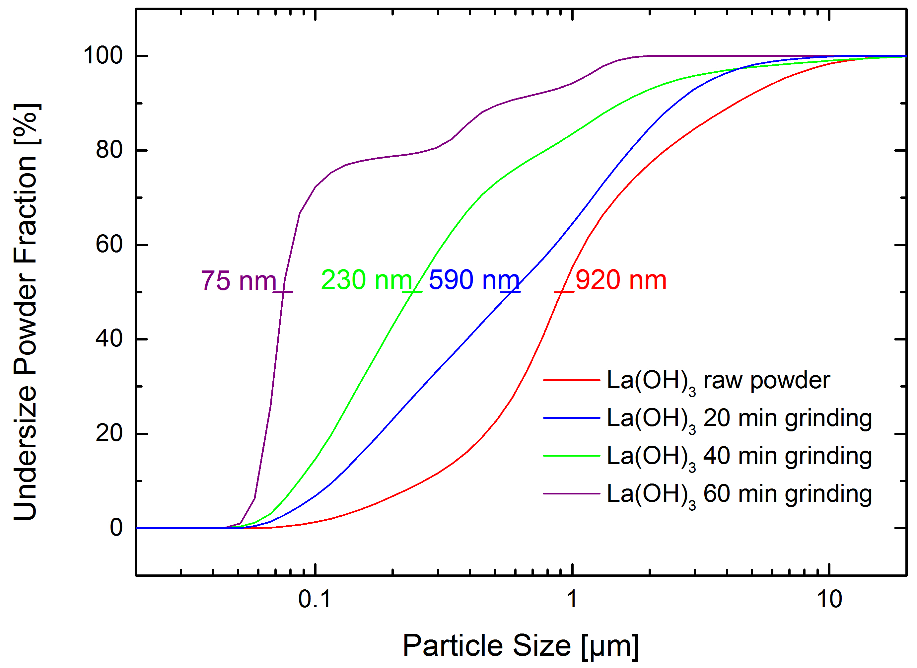
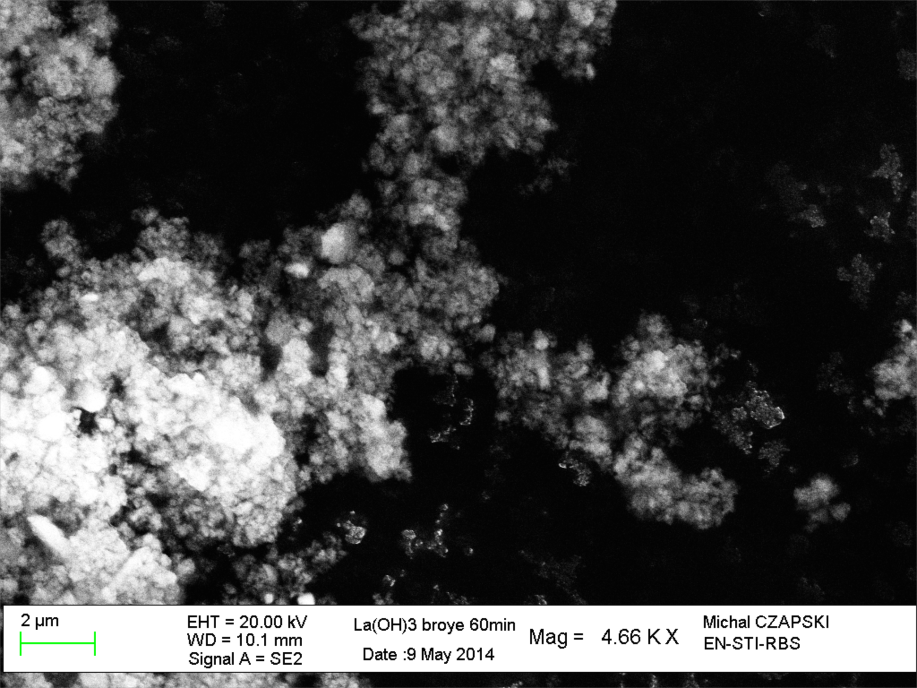
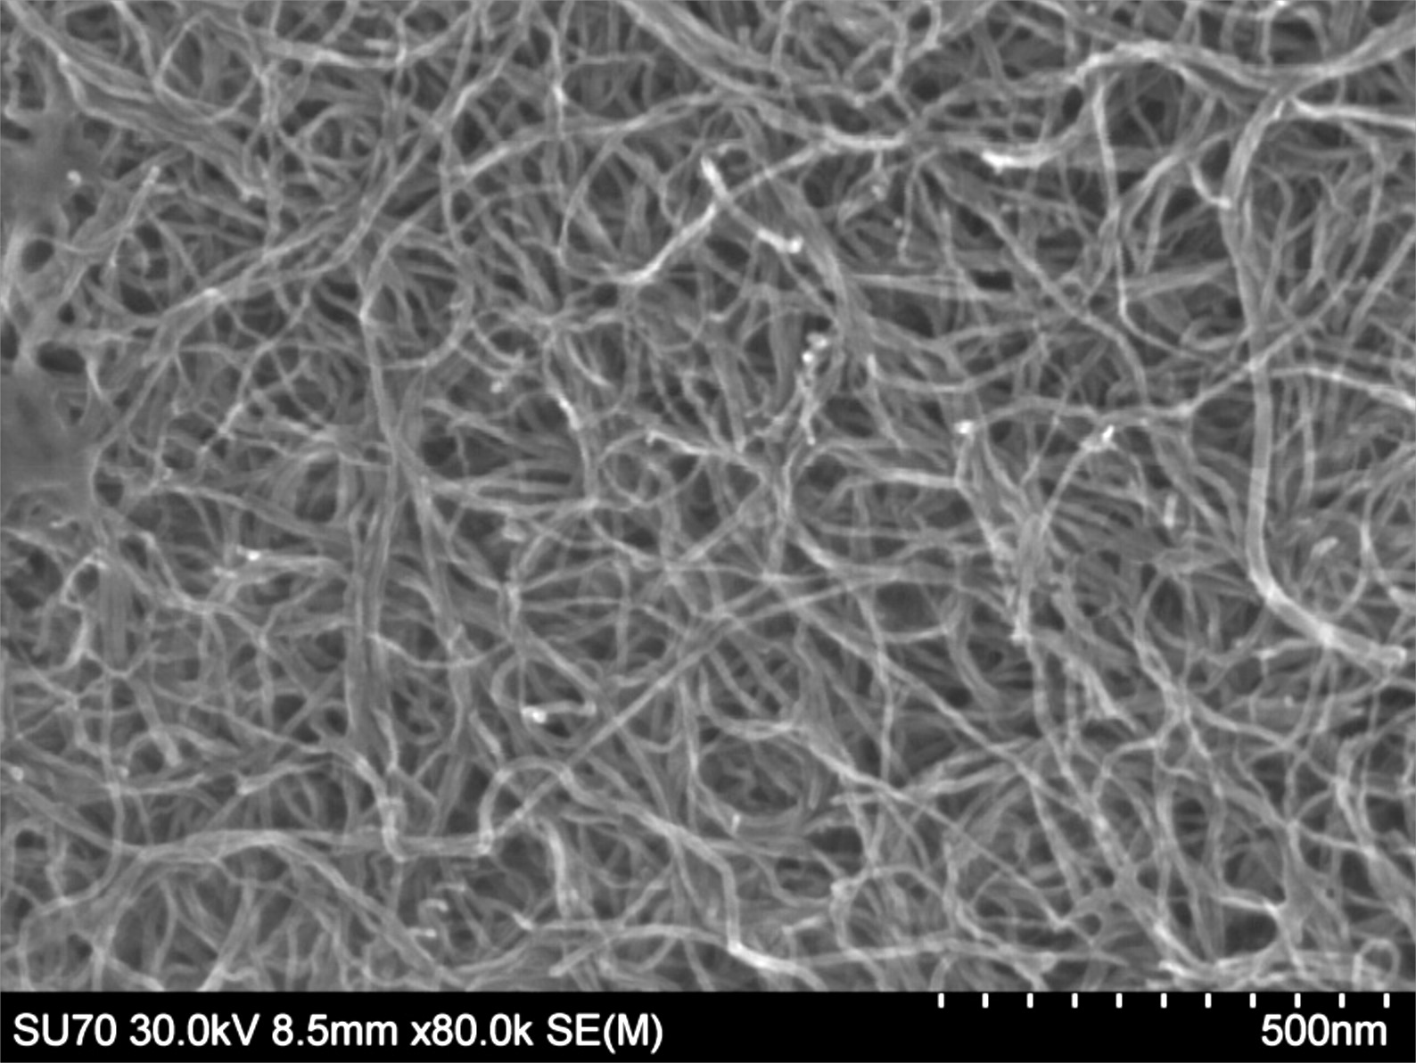
LaC₂–MWCNT Spallation Target Material
FLUKA Production Yields
after comparing all RE as possible spallation target nuclei
La(OH)₃ particle size reduction by suspension grinding
Online tests in November
LaC₂-MWCNT Nano Composite (After Carbo-Thermal Reduction)
Lanthanum Hydroxide Nanopowder
Ultrasound-Dispersed Multi-Walled Carbon Nanotubes
2 µm
500 nm
2 µm
200 µm
After 10 days at 1900°C
After 10 days at 1900°C
Microstructure of UC₂-MWCNT nano composite currently under investigation
J. Guillot, et al.

Slide 9
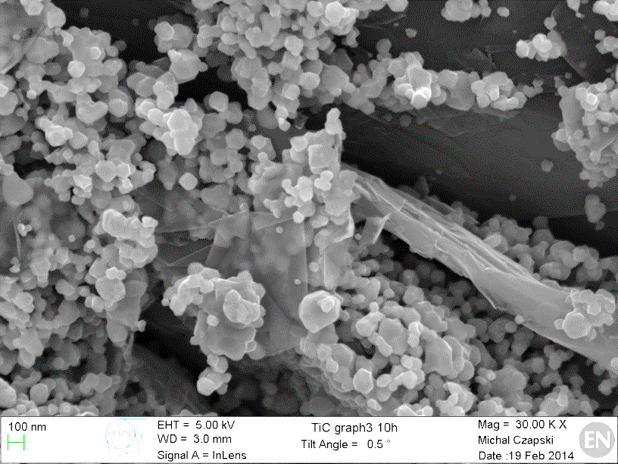
Titanium Carbide-Carbon Composites
Results of TiC nanostructural studies
Mixing TiC and Carbon (different vol. ratios)
TiC +Graphite
TiC + MWC nanotubes
TiC + Carbon black
Test for nanostructure stability at 1500, 1650 and 1800ºC
Keep these parameters at the highest possible temperature
Main quality parameters:
High surface area
High porosity (>30%)
Nanometric TiC grains
Fast diffusion and release of exotic isotopes
J.P. Ramos, et al.

Slide 10
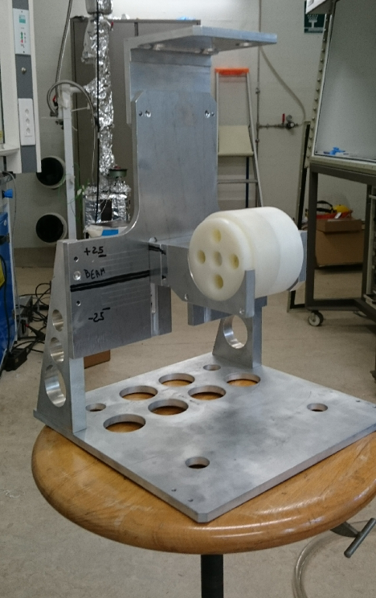
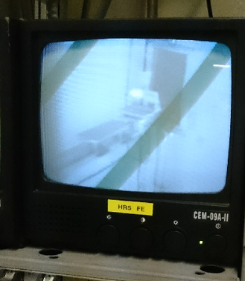
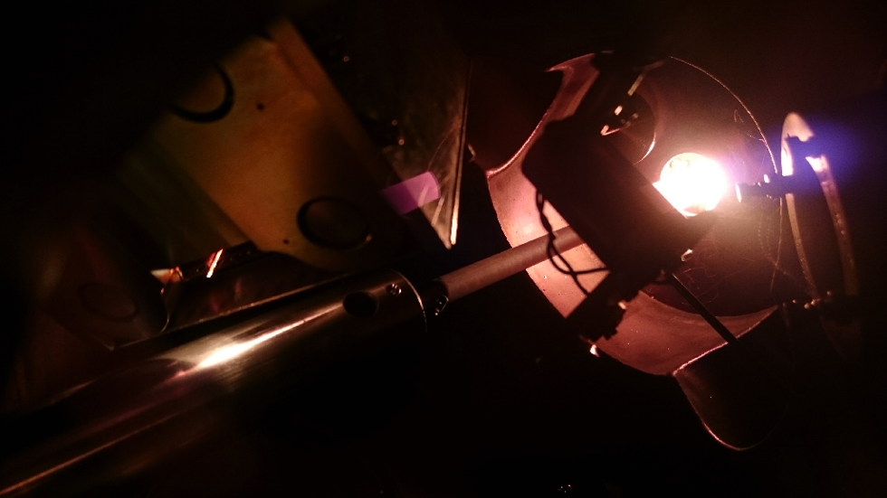
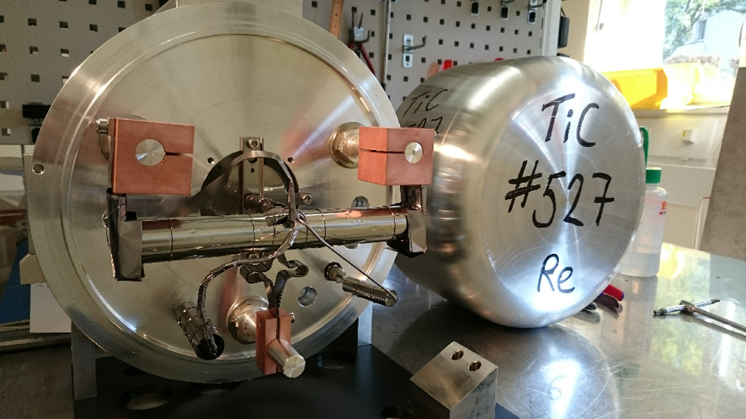
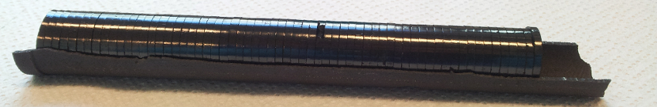
Titanium Carbide-Carbon Composites
Release studies and target prototype
Target going online Today
The three most promising material nanostructures were selected, irradiated and are studied in terms of release.
TiC + Carbon black (50 vol.%) nanostructure, which was stable up to 1800ºC, was selected to produce a full target prototype.
J.P. Ramos, et al.

Slide 11
Production of Boron Beams

Slide 12
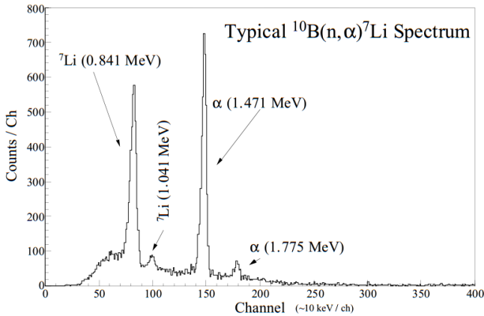
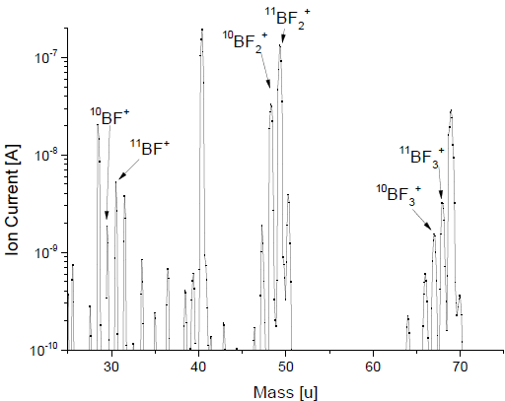
Boron Beams Offline
Determination of suitable target operation parameters
Release studies from different materials using neutron activation
¹⁰B+n⁰
6%: 7Li (1.015MeV + α (1.777MeV)
94%: 7Li (0.840MeV + α (1.470MeV) +γ(0.478MeV)
Ch. Seiffert, et al.

Slide 13
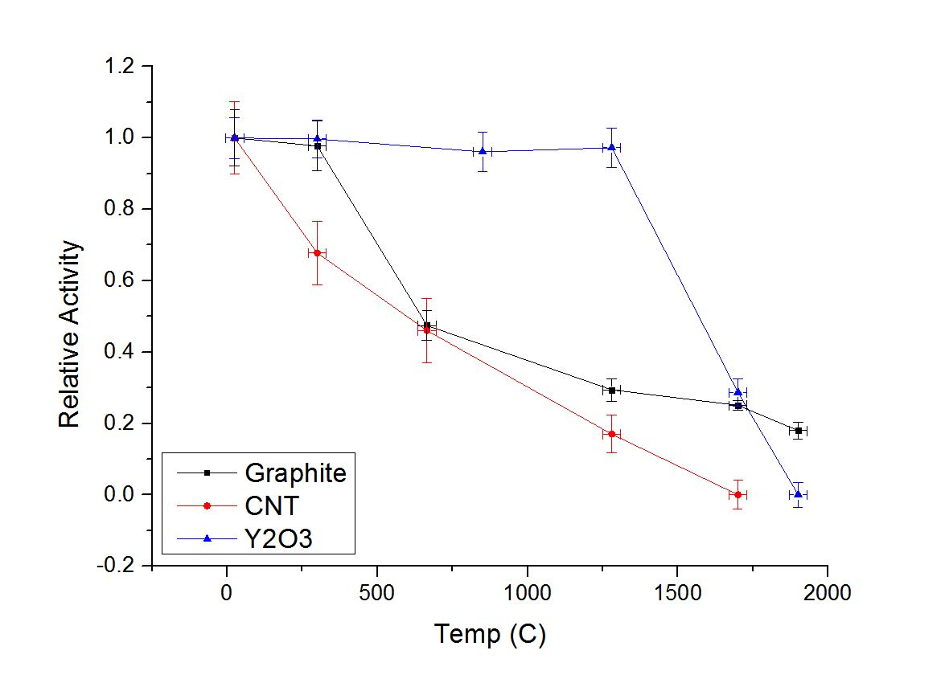
Boron Online
Target unit #499:
  Target material: MWNCT, ρ=0,43 g/cm3
  Standard Ta container, cold transfer line, VADIS ion source
  Injection of SF₆ into container, leak rate= 0,37*10⁻⁴ mbar*l/s, p(SF₆)=0.8-1.8 bar
Determination of release of ⁸B using positron annihilation & ISOLTRAP’s MR-ToF:
  Activity below detection (~7*10¹ 1/uC) limit on masses of ⁸BF_{n}⁺ (n=1,2,3) or BOF
  Activity measured on mass 8 originating from ⁸Li (⁸He) and a positron emitter
  Positron activity corresponds to 3*10² 1/uC
  Proof that activity originates from ⁸B still pending
Ch. Seiffert, et al.

Slide 14
Target Concepts

Slide 15
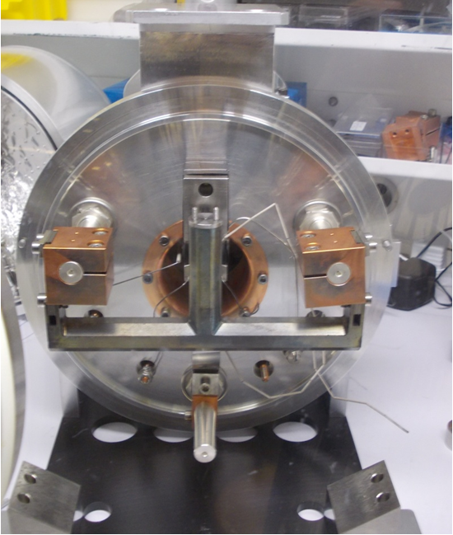
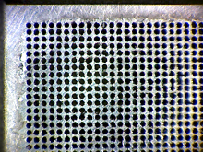
Molten Salt Target
Beta Beams: proposal of neutrino oscillation physics facility:
Production of pure (anti)-ν_{e} beams by storing β emitting ions in a decay ring
Proposal inspired from ¹⁸F production for PET imaging:
NaF target loop (²³Na(p,X),¹⁹F(p,2n)¹⁸Ne)
Rates of 10¹³ ¹⁸Ne/s are predicted exploiting 1 MW, 160 MeV proton beam
Protons
Irradiation chamber
……….
NaF:LiF
700ºC
7 mA, 160 MeV
……….
……….
¹⁸Ne 10¹³/s
Diffusion chamber
Transfer line to ion source
Heat
Exchanger
Pump
21.6 cm
P. Zuchelli, Phys. Lett B 532 (2002) 166
T. Stora, CERN Yellow Report, CERN-2010-003
T.M. Mendonca et al., NIMB 329 (2014) 1
T. Mendonca, et al.

Slide 16
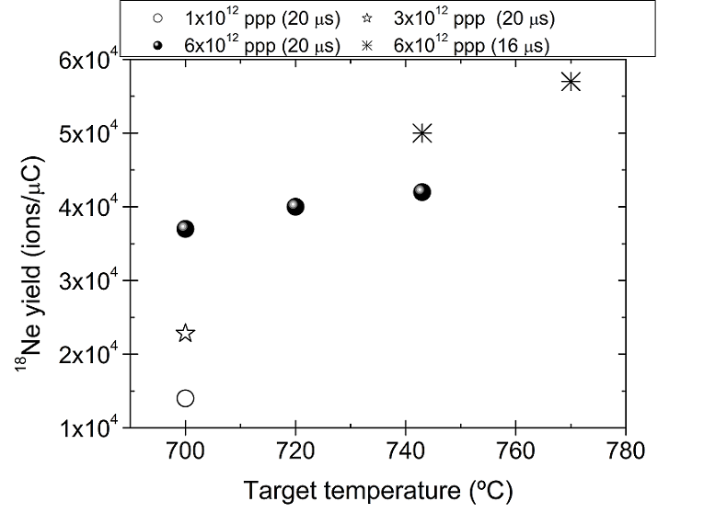
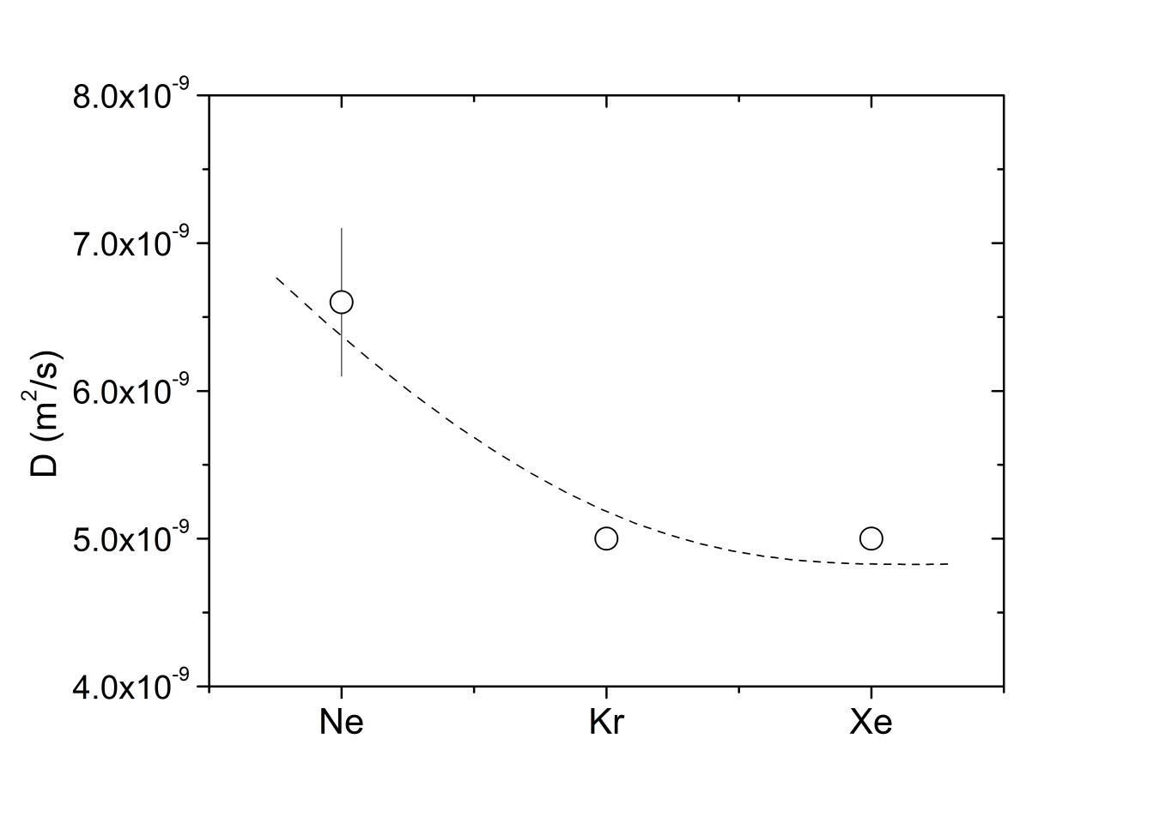
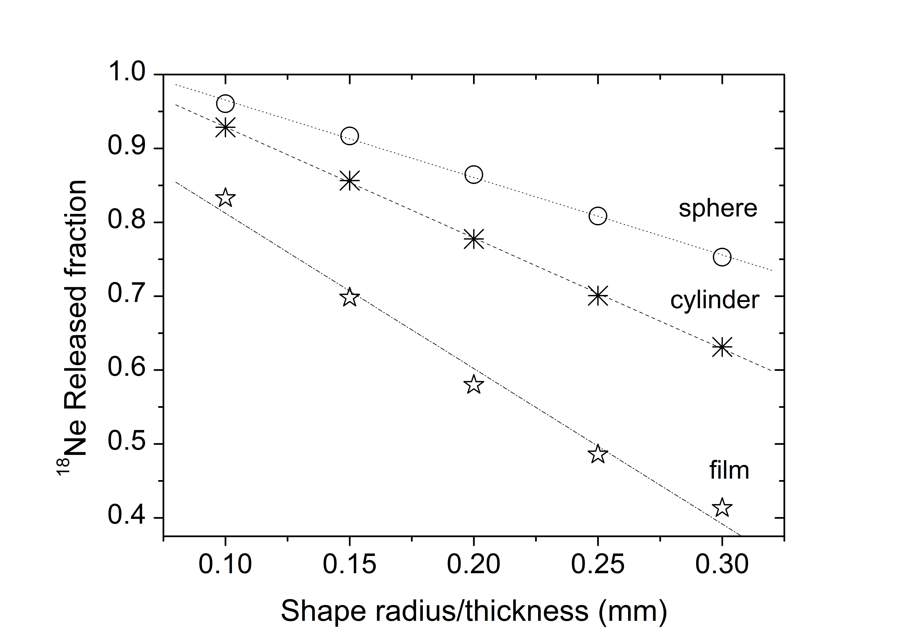
Determination of the Diffusion Coefficient of Ne In NaF:LiF
D(Ne) essential in determination of production rates and dimensioning of the diffusion chamber
Release favoured by smaller sizes
96% release for 100 µm droplet
D(Ne) in NaF:LiF is 8 orders of magnitude higher than oxide targets (CaO, Al₂O₃ with D~10⁻¹⁷ m²/s)
D(Ne) in NaF:LiF ~10⁻⁹ m²/s
T. Mendonca, et al.

Slide 17
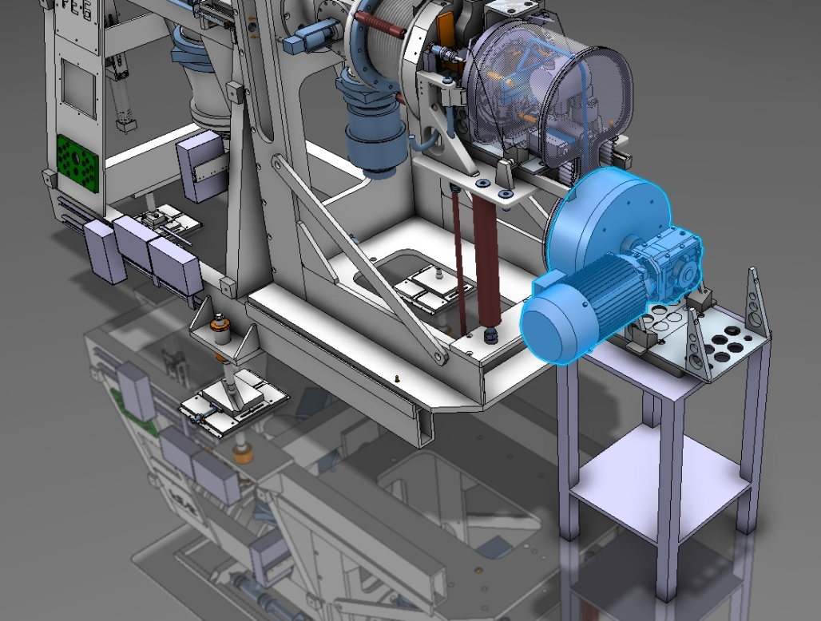
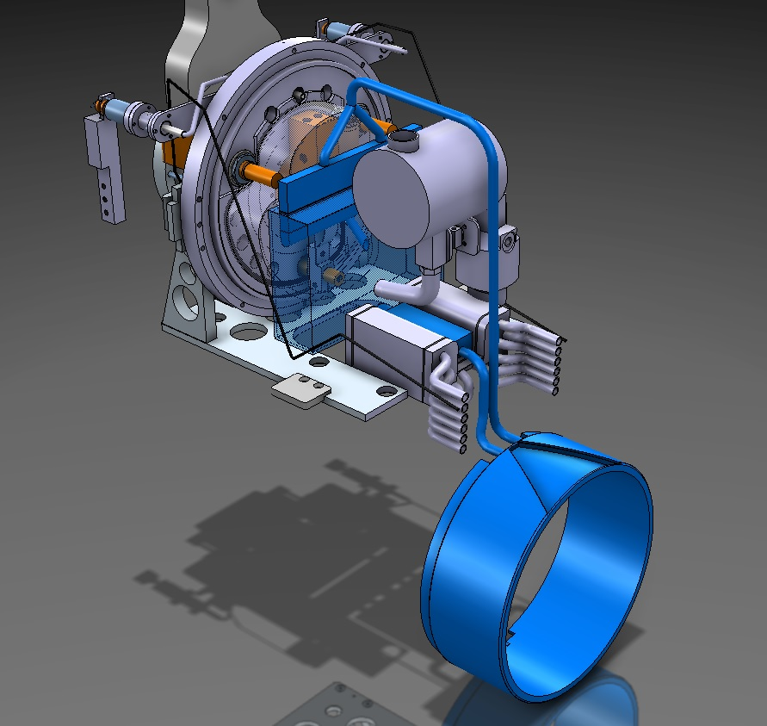
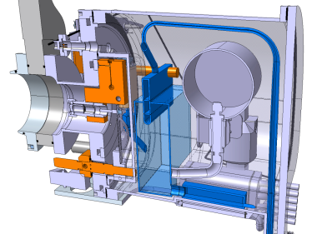
LIEBE Project (Liquid Lead-Bismuth Eutectic loop for EURISOL)
Compatibility with the ISOLDE Front-end
LIEBE target proposed design
(LIEBE Design Study Report)
Fill and drain reservoir
Irradiation chamber
Diffusion chamber
Electromagnetic pump
Heat exchanger
LIEBE Project Design Report, June 2014
T. Mendonca, et al.

Slide 18
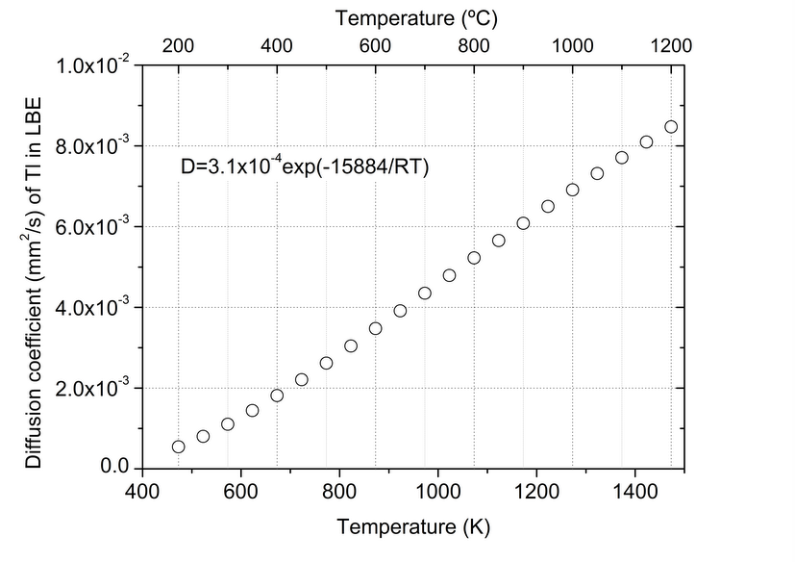
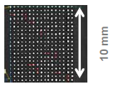
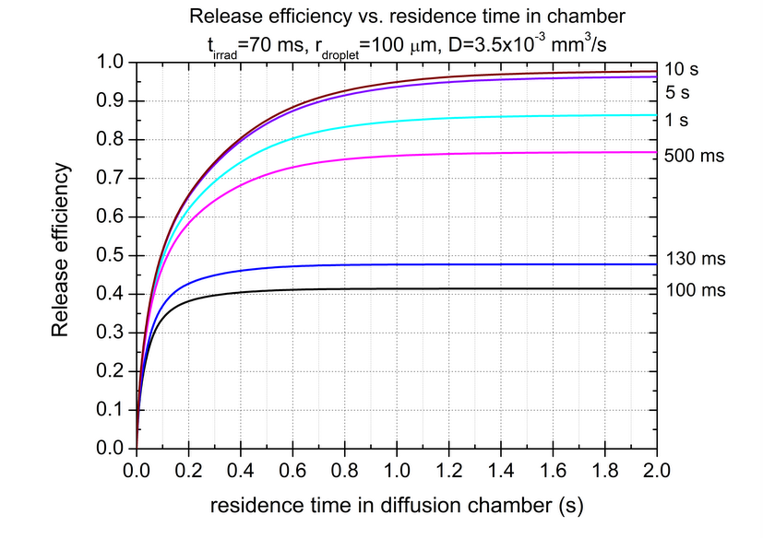
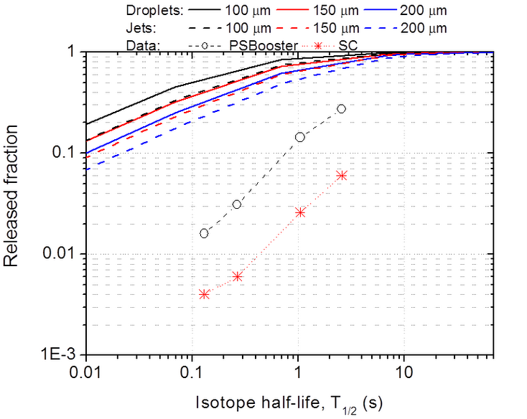
Hg Diffusion Study (Liquid Target)
Improvement of diffusion with temperature
¹⁷⁷Hg (T_{1/2}= 130 ms) as reference:
  Increasing droplet radius will decrease the released fraction
  Diffusion efficiency of 38% for 100 ms, 44% for 200 ms in the diffusion chamber
PbBi shower – Offline tests @ ISOLDE, June.2014
Data collection on droplet size, 0.1 mm holes
Metallic grid for material fragmentation in the diffusion chamber
Static units
T. Mendonca, et al.

Slide 19
Ion Source Development

Slide 20
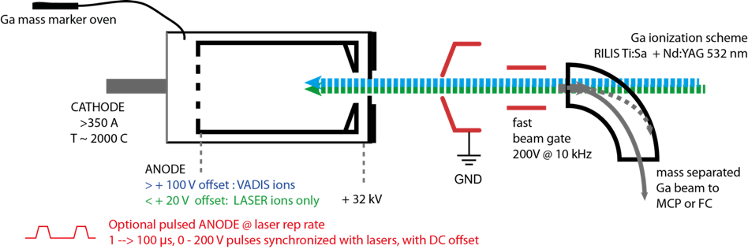
VADIS and RILIS
Drawbacks of hot-cavity laser ion sources
Surface ionized contamination
- long standing issue but no universal solution has been found
Limited ion capacity (~ 1 uA)
- possible issue for EURISOL, ISOL@MYRRHA etc.
Not currently suitable for liquid targets
Limited scope for non-standard RILIS applications
Modified (2.5 mm diameter entrance aperture) VADIS + Ga mass marker
T.D. Goodacre, et al.

Slide 21
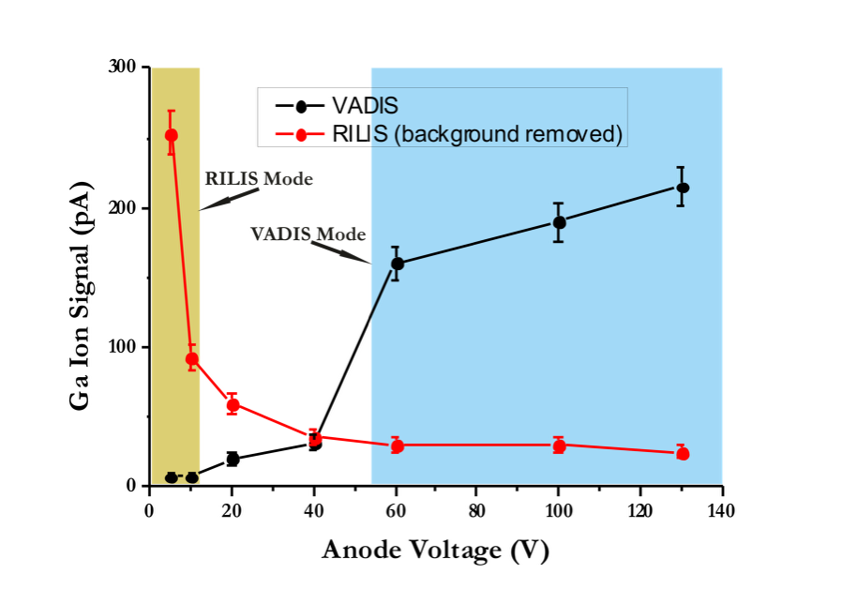
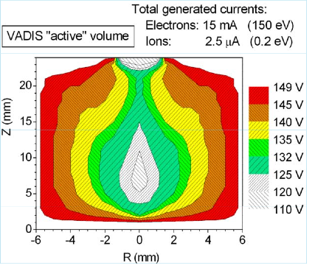
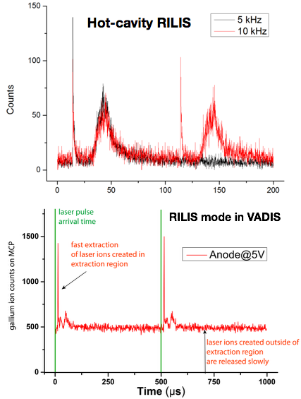
VADLIS Offline Tests
T.D. Goodacre, et al.

Slide 22
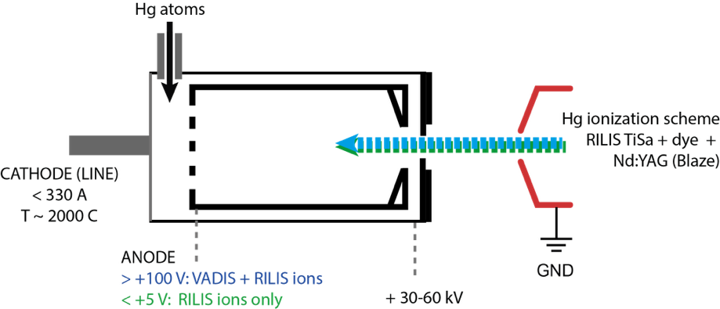
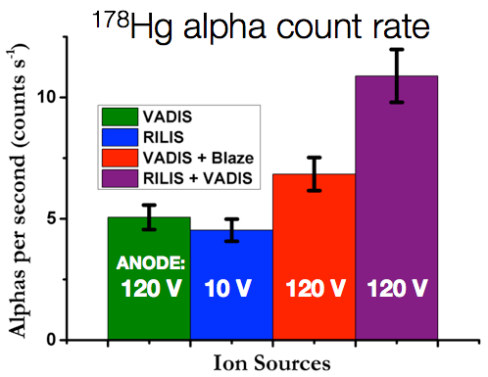
VADIS + RILIS Online with Liquid Pb Target
These measurements were obtained with a standard VADIS under normal operating conditions
➔ More optimization possible
T.D. Goodacre, et al.

Slide 23
Collaboration and Acknowledgement
The team:
Thierry Stora
Tania Mendonça
João-Pedro Ramos
Christoph Seiffert
Melanie Delonca
EN-STI-RBS
Richard Catherall
Tim Giles
Stefano Marzari
Ana-Paula Bernardes
RILIS:
Valentin Fedosseev
Bruce Marsh
Sebastian Rothe
Tom Goodacre
Daniel Fink
Recent Collaborators:
Peter Kunz (TRIUMF)
Friedhelm Ames (TRIUMF)
Aurelia Laxdal (TRIUMF)
Pierre Bricault (SCK CEN)
Antonio Gonçalves (CTN)
Ulli Köster (ILL)
Hans Fynbo (Aarhus)
Adam Stevenson (Saint-Gobain)
Christophe Lau (IPNO)
Sandrine Tusseau (IPNO)
Brigitte Roussiere (IPNO)
Daniel Grolimund
Matthias Martin
Claude Degueldre
Alberto Andrighetto (INFN)
Stefano Coradetti (INFN)
Hanna Frånberg (GANIL)
Pierre Delahaye (GANIL)
Johanna Grinyer (GANIL)
Ana Senos (University Aveiro)
Susanne Kreim (CERN)
Alexandre Dorsival (CERN-RP)
… and many more
Machine shop:
Bernard Crepieux
Micheal Owen
Ermanno Barbero
Thank you for your attention!

