Slide 1




MR-TOF at ISOLDE
GUI – 2014-11-03
Frank Wienholtz
- University of Greifswald -
for the ISOLTRAP Collaboration
http://isoltrap.web.cern.ch
wienholtz@uni-greifswald.de

Slide 2
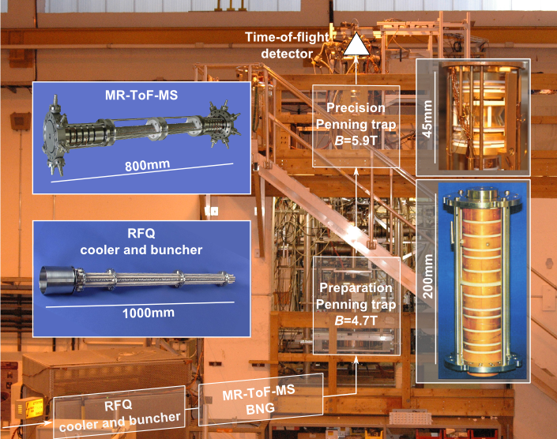
ISOLTRAP overview
ISOLTRAP uncertainty: ; >500 short-lived nuclides investigated
1987
2010
1999
1994

Slide 3
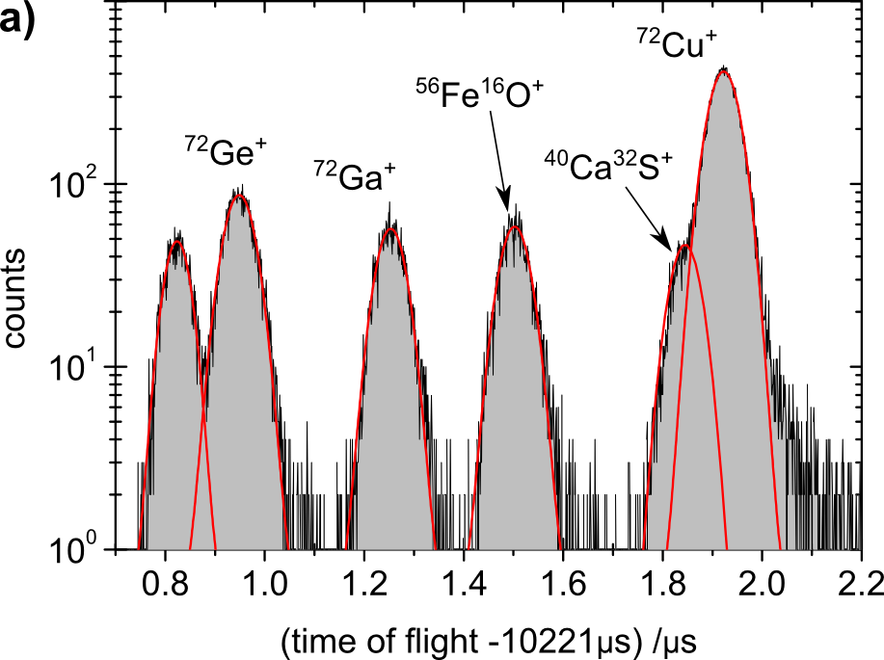
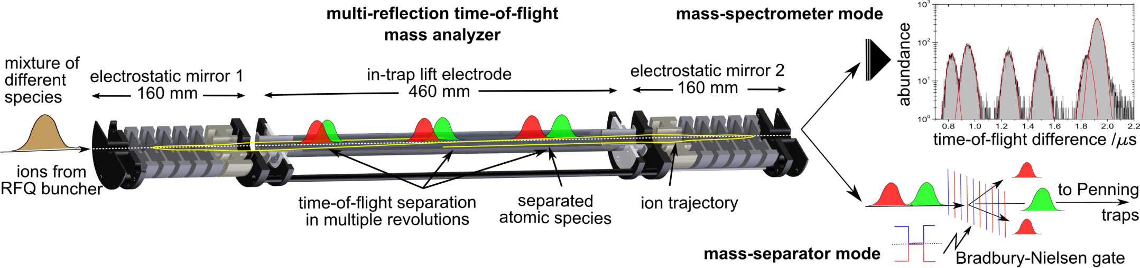
ISOLTRAP overview: MR-ToF-MS¹
mean kinetic energy E_{kin}=2.1keV
ToF separation due to different m/q
RFQ:
Δt≈100ns
ΔE_{kin}/E_{kin}≈3%
Bradbury-Nielsen gate
(BNG)^{2,3}
several applications possible:
high-resolution mass separation with Bradbury-Nielsen gate
for subsequent experiments
observing and gating on separated ion-of-interest to perform further studies
high-precision mass measurements with reference masses
MR-ToF-MS
mass resolving power (FWHM)
m/∆m=100 000 at 12ms
m/∆m=200 000 at 30ms
transmission
≈50% at 30ms
ion capacity
≈1000 per cycle
≈100 000 per second
1: Wollnik & Przewloka, Int. J. Mass Spectrom. Ion Proc. 96, 267 (1990); 2: Bradbury & Nielsen, Phys. Rev. 49, 388 (1936); 3: Plass et al., NIM B 266, 4560 (2008)
Wolf et al., IJMS 313, 8 (2012); Wolf et al., IJMS 349-350, 123 (2013);

Slide 4
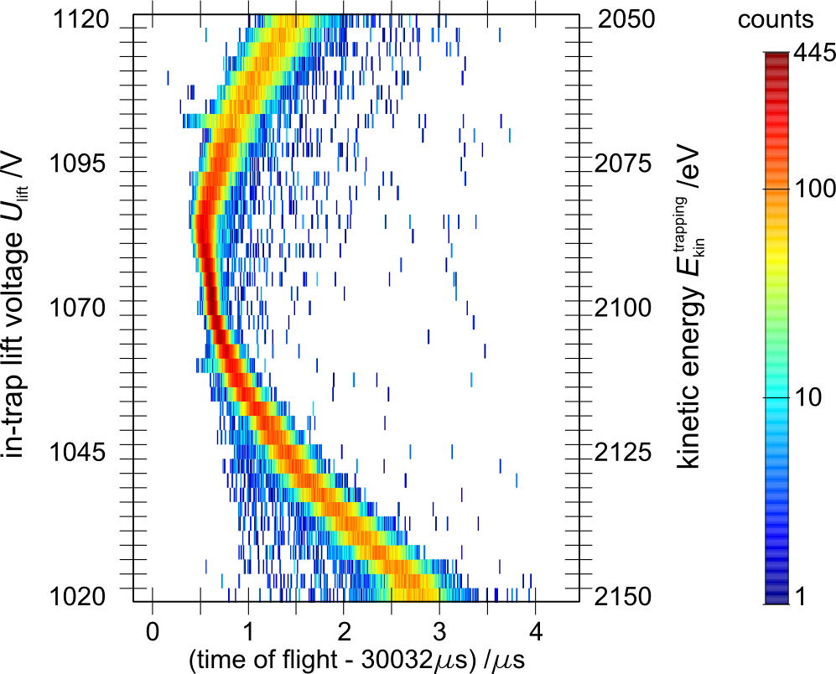
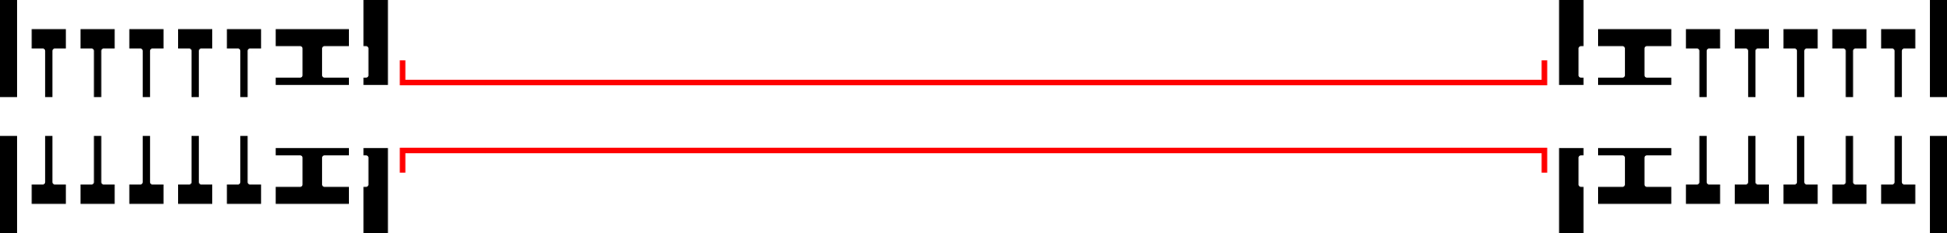
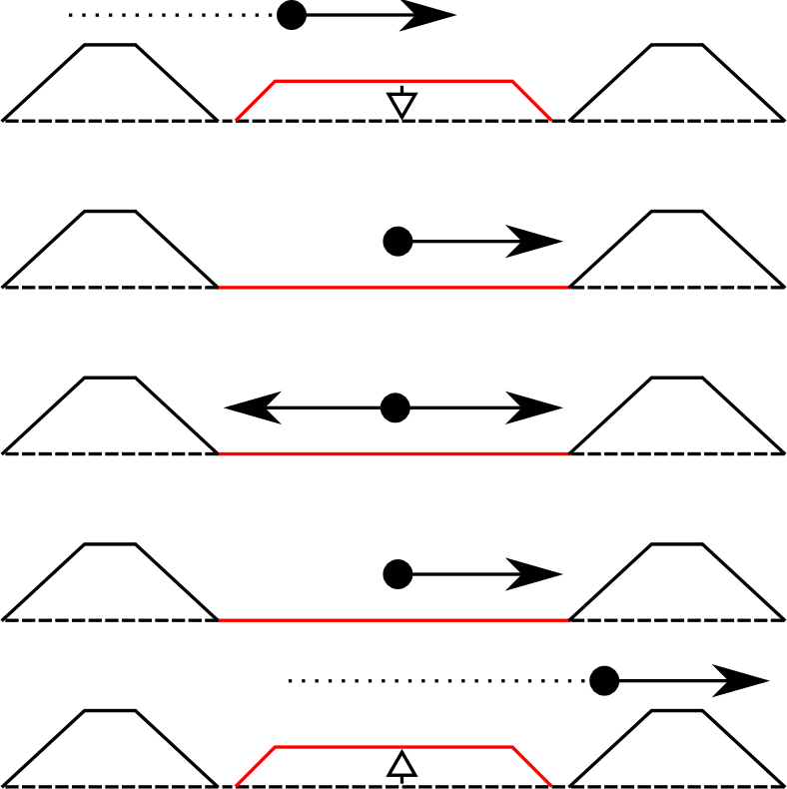
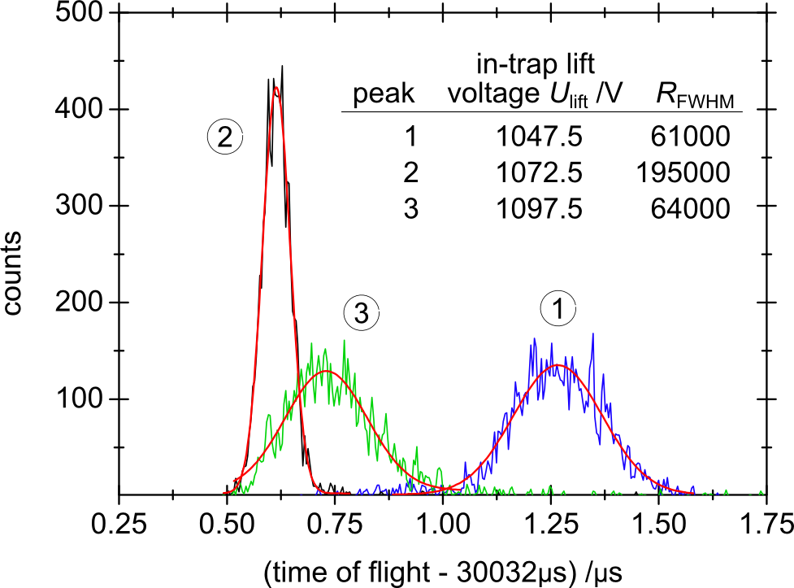
MR-ToF-MS at ISOLTRAP: in-trap lift
capture and ejection with one electrode
➔ simple technique, stable mirror potentials
decouple MR-ToF-MS and adjacent beamline
➔ independent optimization
adjust ions’ kinetic energy
➔ ToF focusing, max. mass resolving power
3
2
1
in-trap lift
Injection
Storage
Ejection
➔ only one parameter to adjust
Wolf et al., IJMS 313, 8 (2012)

Slide 5
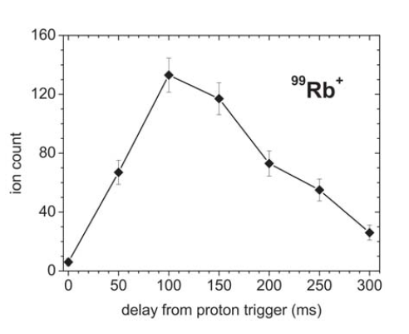
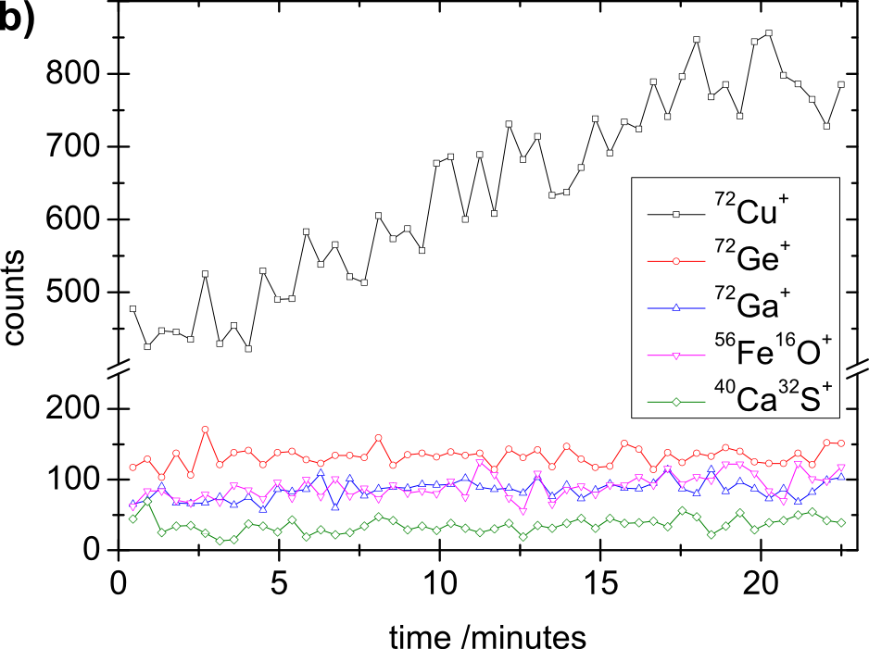
MR-ToF ion-beam analysis
Ion-beam composition analysis
direct feedback for target/line optimization
sampling of release curve possible
single ion sensitivity to detect lowest yields
no upper limit on half-life as with decay station
not hindered by decay branching ratio
target release curve
target heating increased
by 70K
99Rb+
T_{1/2}=54ms
Wolf et al., IJMS 349-350, 123 (2013); Kreim et al., NIM B, accepted for publication (2013)
Notes:
-for example the MR-TOF with its high resolving power can be used to analyse the composition of an ion beam and optimize the target and the ion source because you get a direct feedback and sample your ion beam on a very short time scale
for example you can sampled the release curve as shown here for 99Rb which has a half-life of only 54ms
furthermore you can directly observe the reaction of the yield when changing target and ion source parameters
this was done here in a copper beamtime where the beam constitutes of many different isobars, for example Ge, Ga, and molecules as iron oxide and calcium sulfur
this can be done for stable and radioactive isotopes, independent of branching ratio

Slide 6
MR-ToF ion-beam analysis
Notes:
-for example the MR-TOF with its high resolving power can be used to analyse the composition of an ion beam and optimize the target and the ion source because you get a direct feedback and sample your ion beam on a very short time scale
for example you can sampled the release curve as shown here for 99Rb which has a half-life of only 54ms
furthermore you can directly observe the reaction of the yield when changing target and ion source parameters
this was done here in a copper beamtime where the beam constitutes of many different isobars, for example Ge, Ga, and molecules as iron oxide and calcium sulfur
this can be done for stable and radioactive isotopes, independent of branching ratio

Slide 7
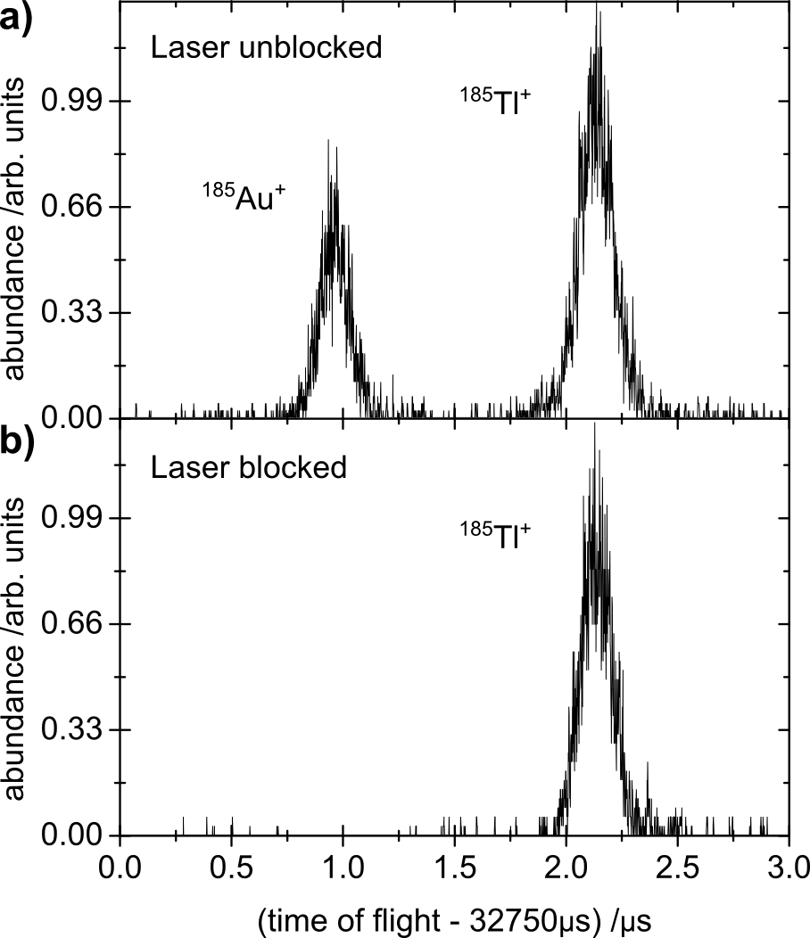
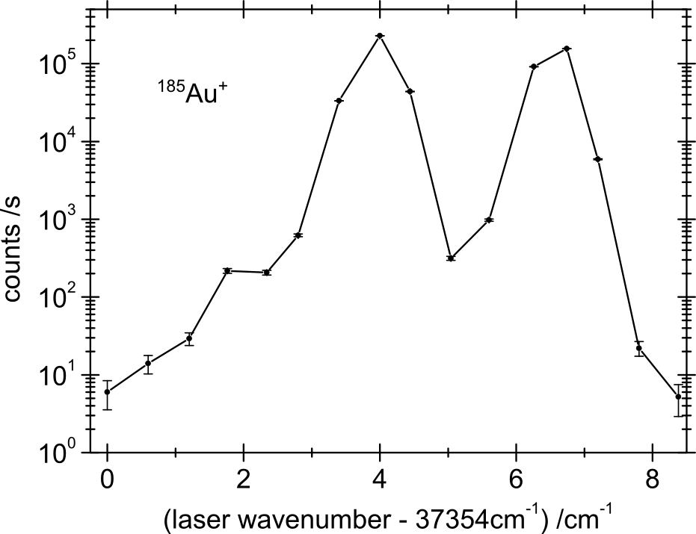
MR-ToF ⬅➔ RILIS yield optimization
MR-ToF analyzer to investigate resonant laser
ionization of nuclides far from stability
fast, sensitive tool to improve ionization eff.
high dynamic range: 1-10e5 counts/s
counts free from background contamination
not limited by decay branching ratio
help to provide isomerically pure beams
185Tl+
185Au+
185Au+
185Tl+
scan: RILIS first excitation step
Wolf et al., IJMS 349-350, 123 (2013); Kreim et al., NIM B, accepted for publication (2013)
Notes:
as shown in the example for the target optimization you can do the same for the ion source as shown here for RILIS
first by blocking the laser you can unambiguously identify your species of interest
then you can simply gate on the time window where your ion of interest species arrives at the detector and take for example the comtanimation as a reference for the average target production
scan the excitation steps of RILIS to optimize the ionization efficiency
reveal hyperfine structure
measure the isotopes shift
help to provide isomerically pure beams
can detect much lower yiedls than farday cup

Slide 8
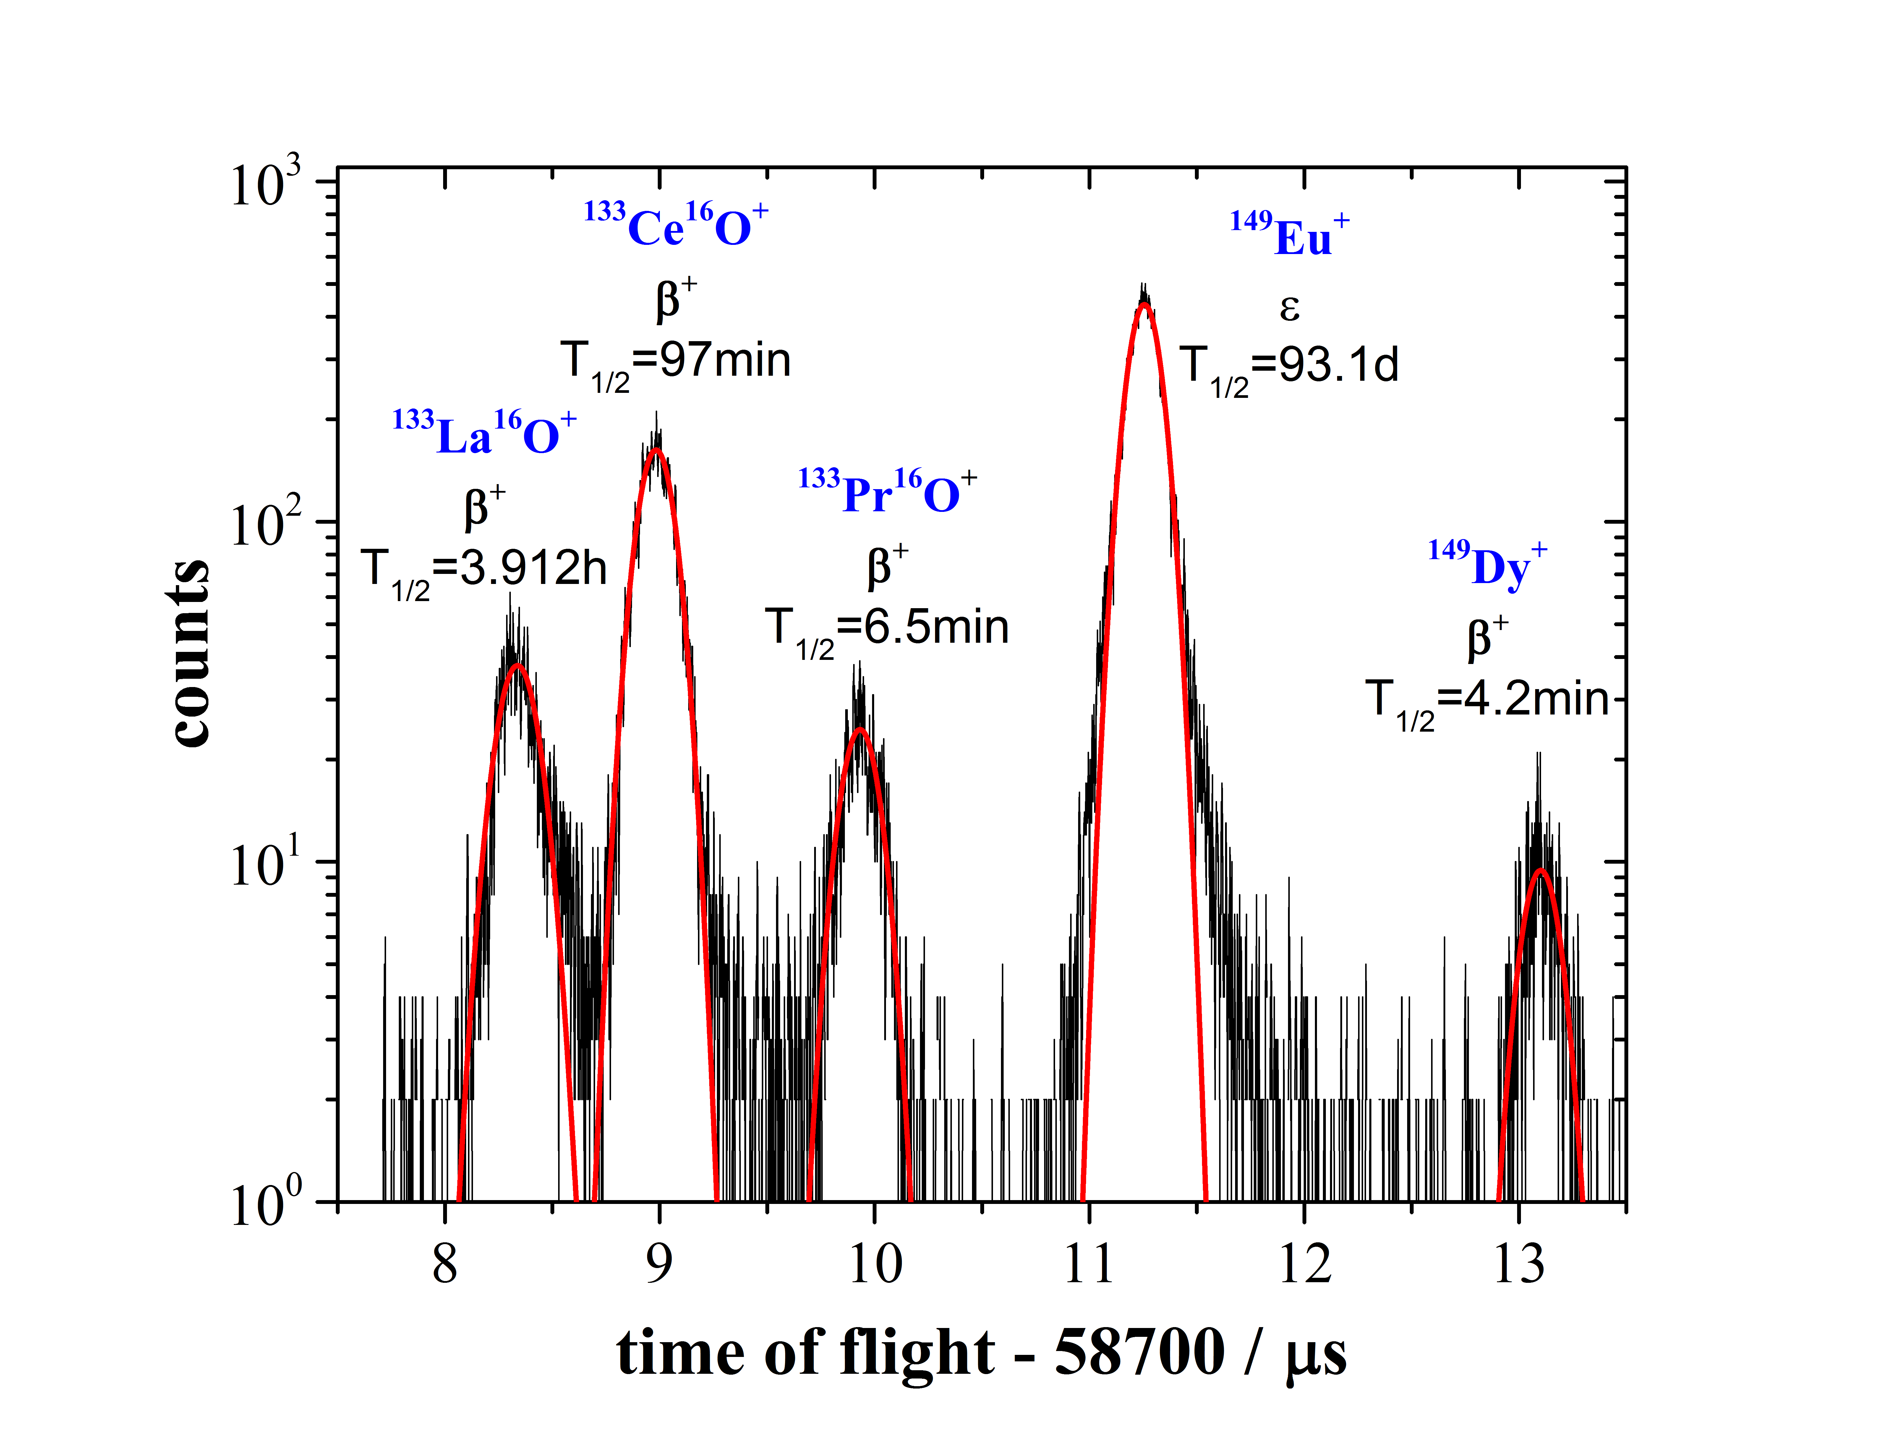
MR-ToF <--> laser scans of hyperfine structure
(Total counts - ¹⁴⁹Dy) / ¹⁴⁹Dy ≈ 70

Slide 9
MR-ToF <--> laser scans of hyperfine structure

Slide 10
MR-ToF half life measurements
A=97
?
⁹⁷Sr
⁹⁷Rb
610 ms
Cooling time in the buncher
In Steps of 60 ms
10 ms
Time of flight after 500 revs

Slide 11
MR-ToF half life measurements

Slide 12
Possible applications @ ISOLDE
Versatile tool for beam analysis especially for ion yields which are not detectable by FCs or accessible by decay spectroscopy
  Continues observation of the beam composition possible
Beam optimisation
  Varying different target parameters
  Beam line optimisation (transport)
  Fast response to laser on/off or protons on/off
  Laser frequency optimisation
Delivery of highly pure beams for experiments with such needs
Beam purification for REX-Trap and EBIS
  Fast stacking in the Penning trap possible

Slide 13











Thanks to…
S. George, M. Rosenbusch, R.N. Wolf, L. Schweikhard
P. Ascher, D. Atanasov, Ch. Böhm, Ch. Borgmann, R. B. Cakirli,
S. Eliseev, T. Eronen, D. Kissler, S. Naimi, K. Blaum
D. Beck, F. Herfurth, A. Herlert, E. Minaya-Ramirez, D. Neidherr, Y. Litvinov
G. Audi, V. Manea, M. Wang, D. Lunney
M. Kowalska, S. Kreim, J. Kurcewicz
J. Stanja, A. Welker, K. Zuber
N. Althubiti, T. Cocolios
M. Breitenfeldt
Grants No.:
05P12HGCI1
05P12HGFNE
http://isoltrap.web.cern.ch
wienholtz@uni-greifswald.de

Slide 14
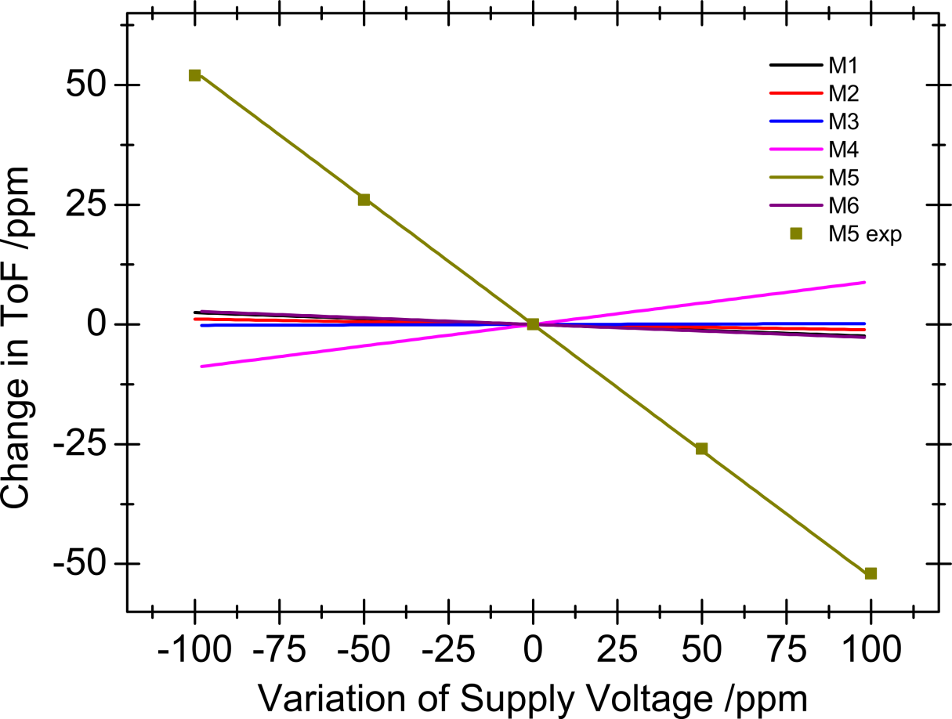
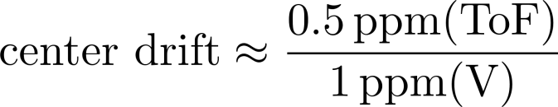
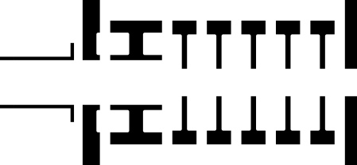
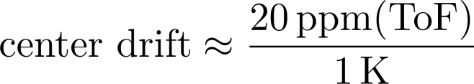
MR-ToF-MS: voltage stability
mirror electrode 5: turn-around point
limiting long-term stability
mass resolving power
M4
M5
Temperature stabilization of supply voltages to <100mK
ToF temperature coefficient:
Wolf et al., NIM A 686, 82 (2012)

