Slide 1
ISOLDE Yield Database
Tania Melo Mendonca
EN-STI-RBS

Slide 2

Motivation
Accurate values of yields are essential for the preparation of the experimental proposals
Data based in published yield values
The yield database is based on ORACLE and has been developed by Manuela Turrion and Ursula Herman-Isycka
Update of the yield database
  Summer student project 2014 of Hayley Osman (Missouri State University)
  Complemented with update of ionization and release parameters by Janka Stritsovska (Comenius University, Slovakia)

Slide 3
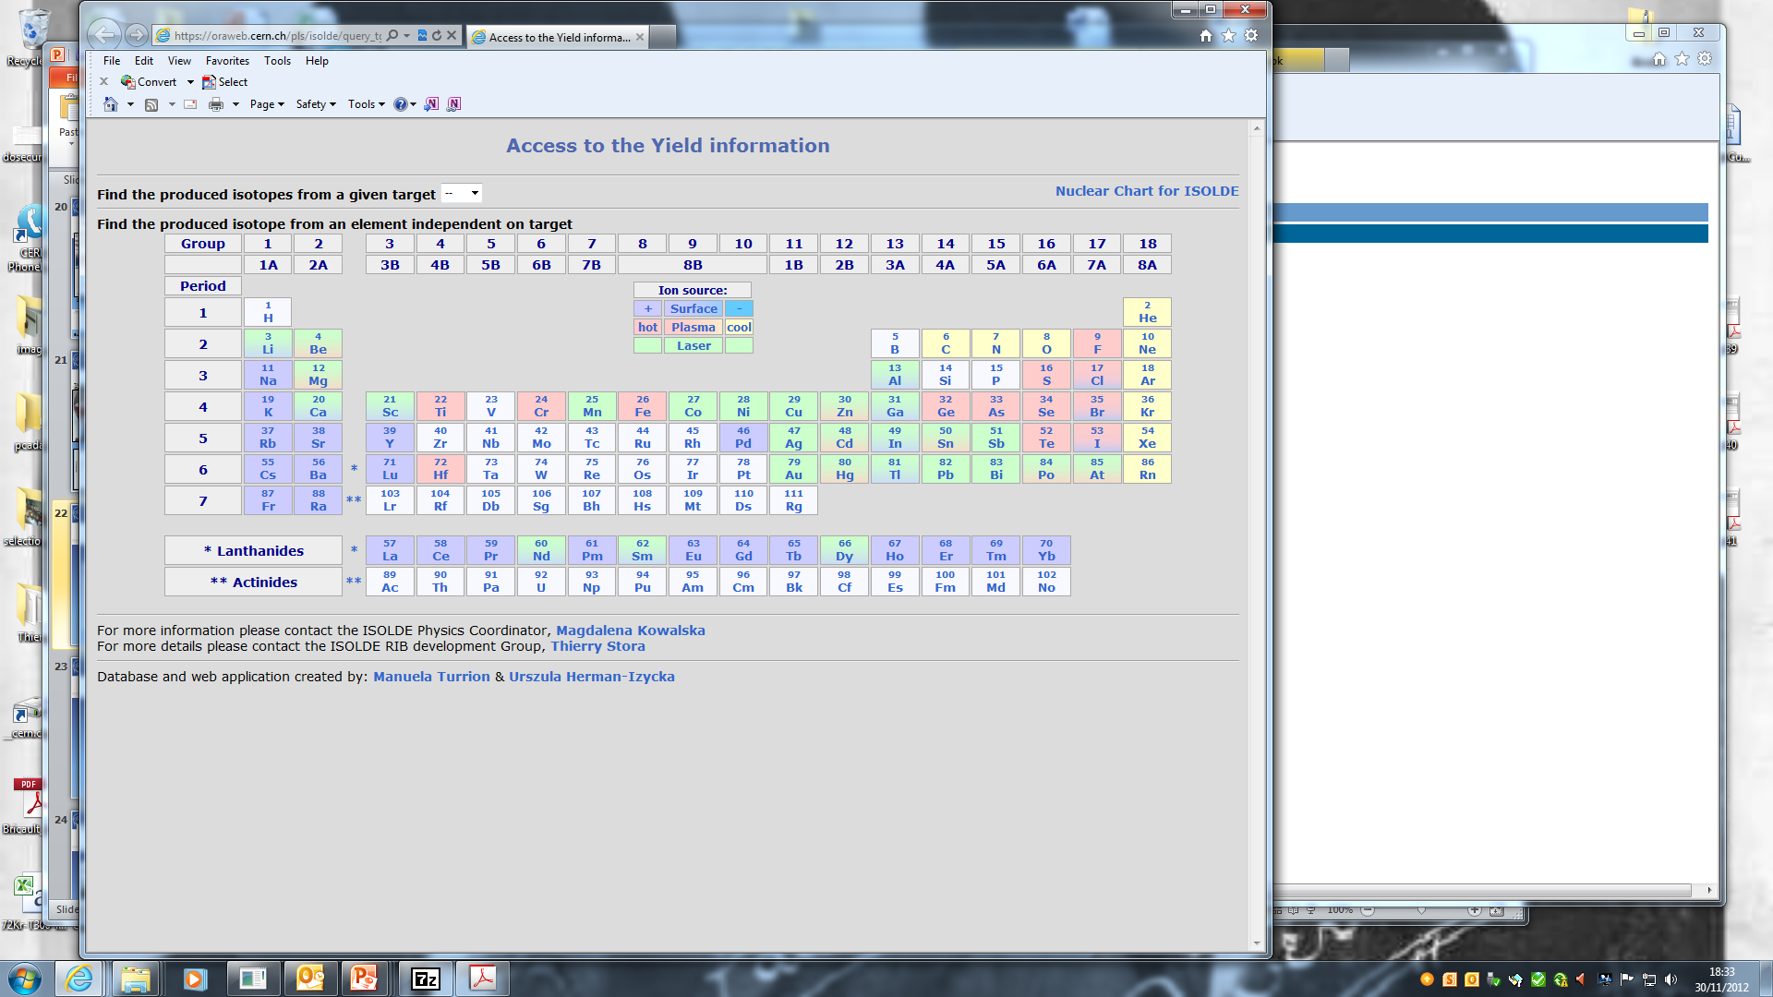
Beam developments in the past 5 years
X5 ³⁰Na Re ion source
X10 ^{20,21}Mg
sub-μm SiC
Molecular beams
Molten salt
target
¹⁷C as CO+
Helicon Ion source
⁷⁰⁺Ni beams
Purification
of ⁸⁰⁻⁸²Zn,¹³⁰Cd
with quartz
(ΔHads)‏
Nano UC_{x}
⁹Be(n,α)⁶He
⁴⁸Cr
x250
1st Fe RIB
Nano
CaO
Y₂O₃
⁴⁴TiF₃⁺
Au beams
by laser ionis.
X5 VADIS
X3-10
VADIS
1st beams@JAEA
Purif Fr, Ra
With LIST
Purification of lanthanide beams ¹⁴⁰Nd, ¹⁴⁰⁻¹⁴²Sm:
GdB₆ ion source cavity + RILIS

Slide 4
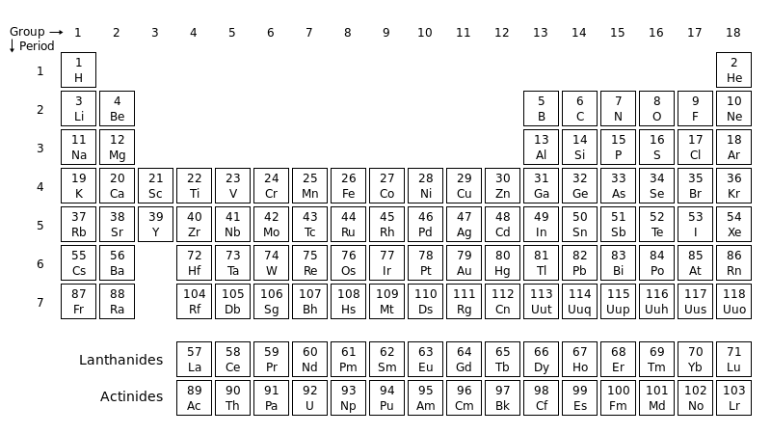
Current Database Statistics
Total Yields Reported: 2330
Isotopes of 68 Elements
Missing ~6 years of yield data!
Hayley Osman – Summer Student Project 2014

Slide 5
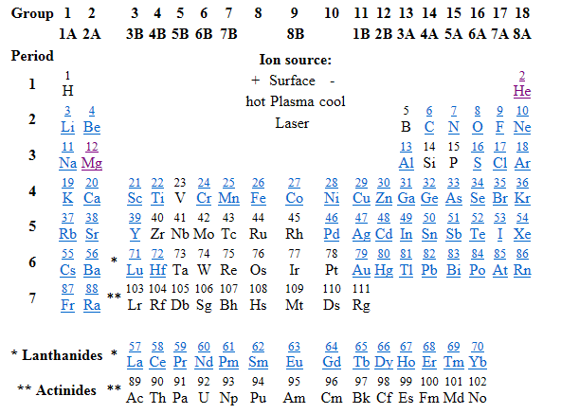
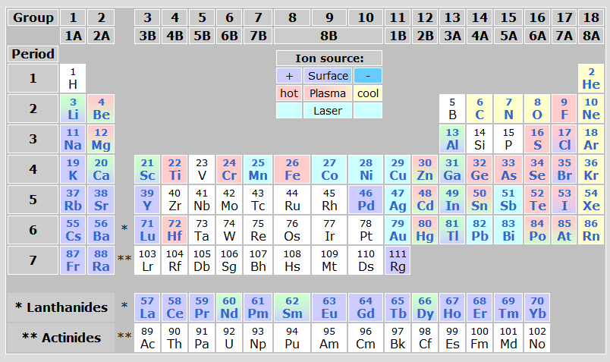
Update of the database
Update of yield data following recent developments and publications
Graphical restoration (lost with new ISOLDE website)
Cloned database for data update and analysis of the problems

Slide 6
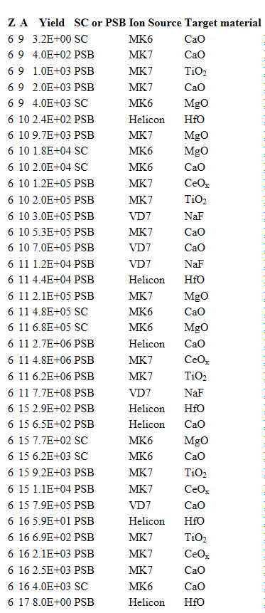
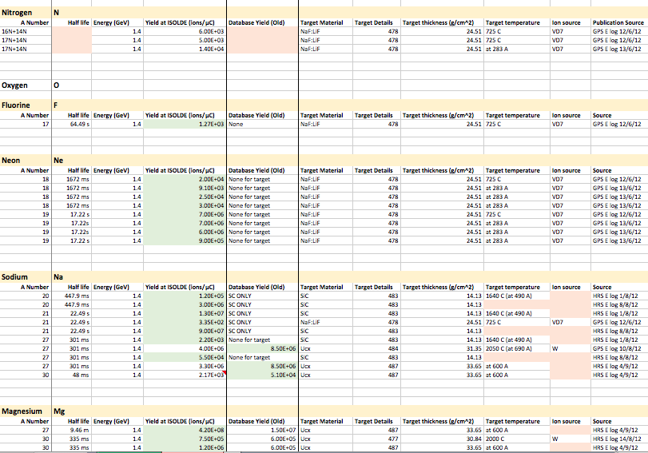
Yield data update
200+ Publications reviewed
205 Yield entries
2 Years of E-logs (~1,500 entries)
184 Unpublished yield entries
Hayley Osman – Summer Student Project 2014

Slide 7
Yield data update
3 New Elements
Ti
Fe
Au
Cloned Database
33 New Isotopes
Hayley Osman – Summer Student Project 2014

Slide 8
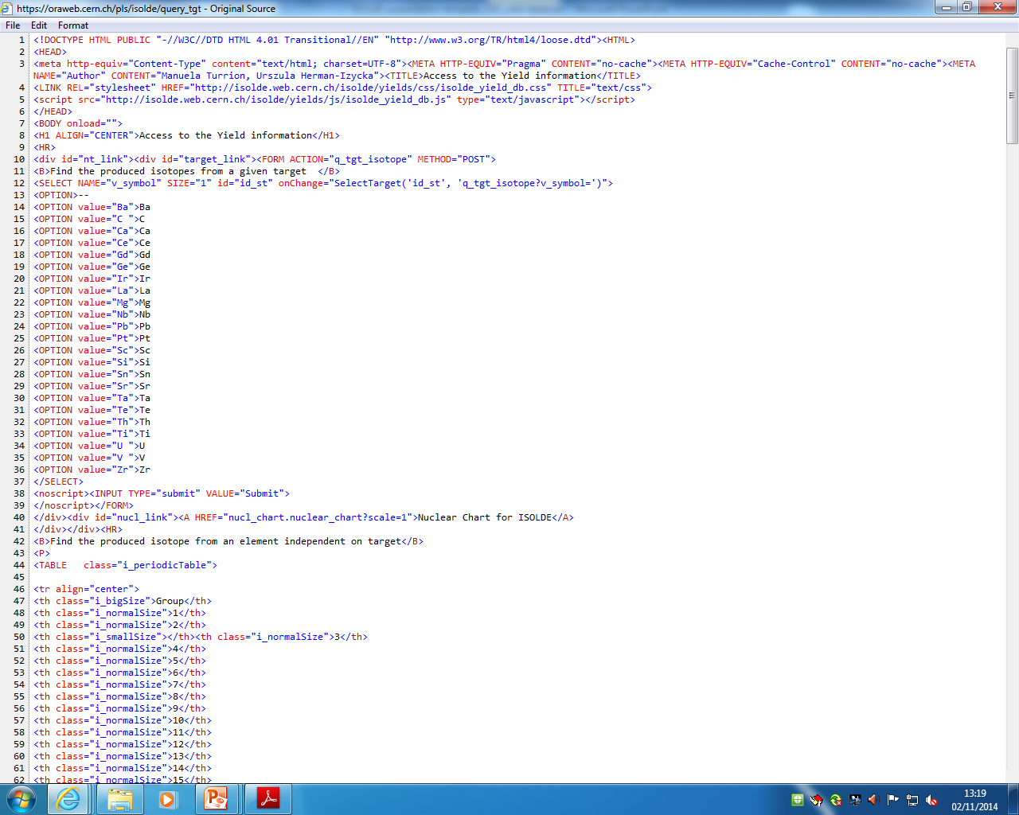
Graphical Restoration
Graphical layout lost with change of the ISOLDE website
Update of database code needed to restore graphics

Slide 9
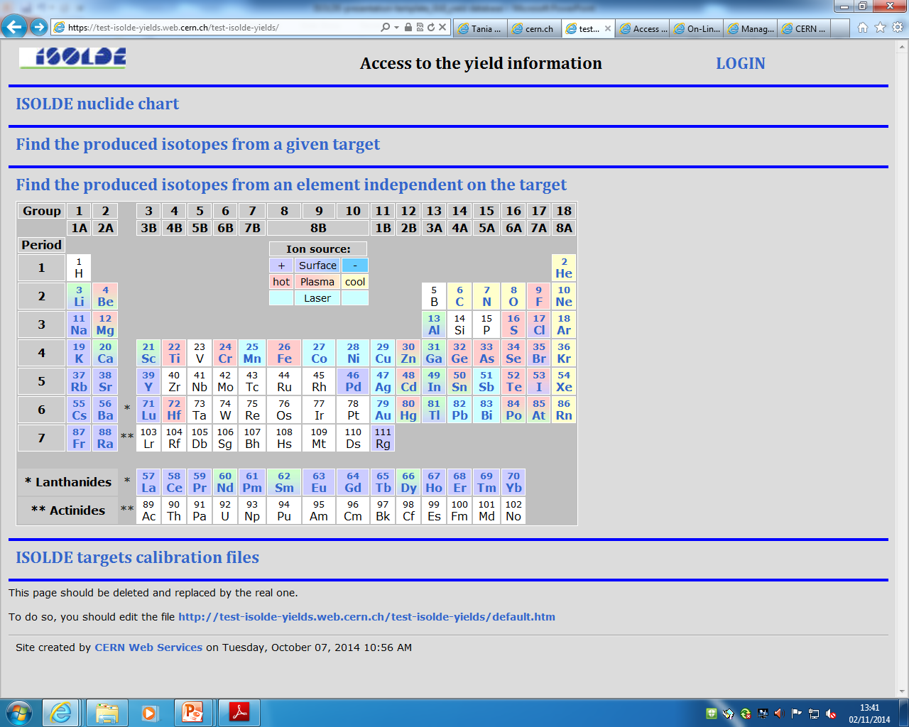
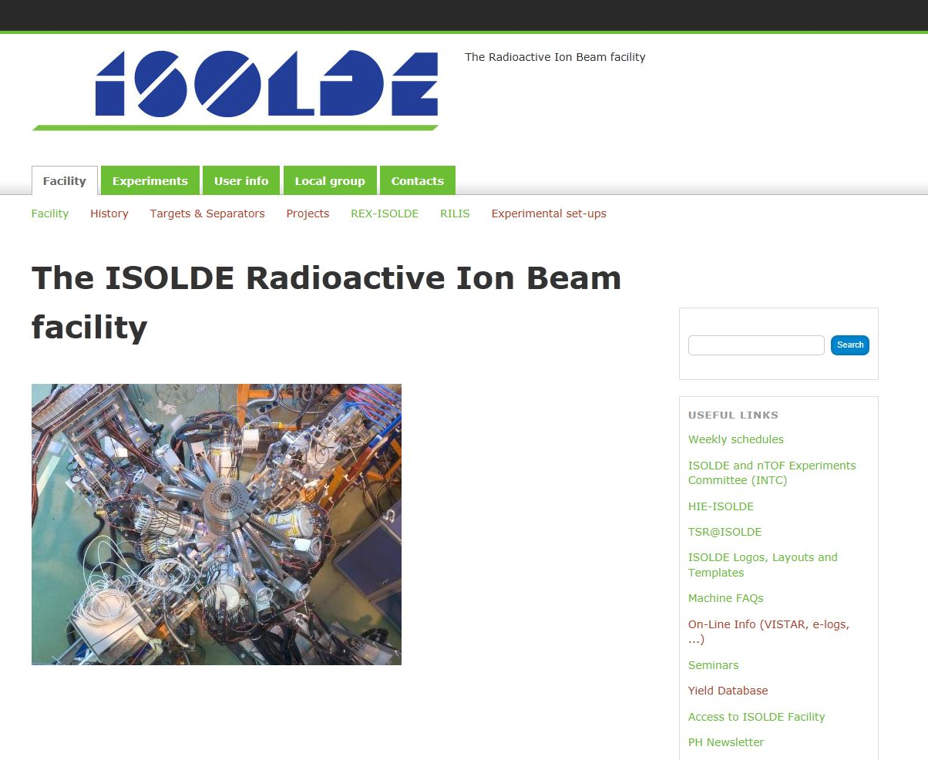
Graphical restoration - proposal
Creation of website with target information
Link to database
Graphical restoration process ongoing

Slide 10
Summary
Yield data update:
33 new isotopes included
205 new yield entries
Graphical restoration
Proposal of creating website hosting target information and link to database
Transparency to future Isolde website changes
Diffusion and effusion information to be included
Thank you for the attention!

Slide 12
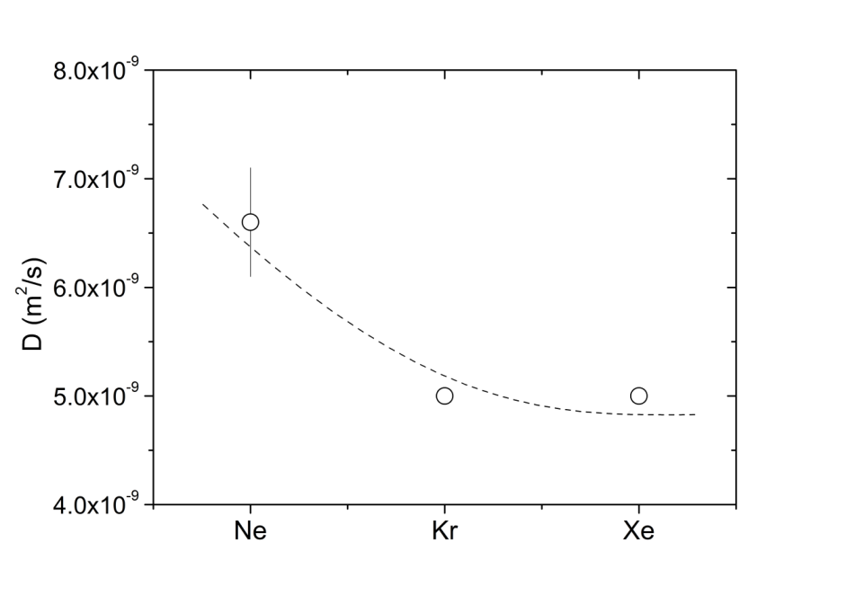
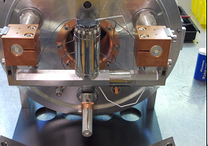
Molten NaF:LiF salt target
2014 experimental campaign
Online run from the 29th October to 1st November
Despite several problems at the start of the run (no thermocouples, HV trippings…) we could successfully validate the results obtained in 2012.
Preliminary results show yields for ¹⁹Ne of 1e7/ uC and ¹¹CO of 6.7e8/uC.
Systematic measurement of data for the Ne diffusion coefficient in fluoride salts. Data analysis just started…
D(Ne) in NaF:LiF is 8 orders of magnitude higher than oxide targets (Data from 2012 run)
(CaO, Al₂O₃ with D~10⁻¹⁷ m²/s)

