Slide 1














4th annual ARDENT workshop TRAINING COURSE
Passive detectors Part 2 (Nuclear Track Detectors)
Antonio PARRAVICINI, MI.AM
Thu. 25/06/2015, 09:00

Slide 2
Track Detectors
SSNTD are solid dielectric materials (photographic emulsion, crystal, glass or plastic). Widely used for several applications:
Radon measurement
Fast neutron dosimetry
Thermal neutron dosimetry
Cosmic rays detection
LR115 Cellulose nitrate layer on a clear polyester base
CR-39 PADC- Poly allyl diglycol carbonate

Slide 3
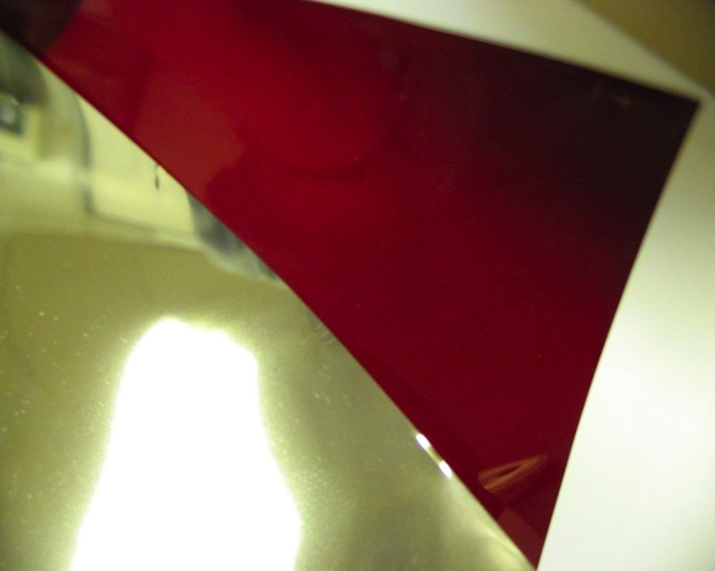
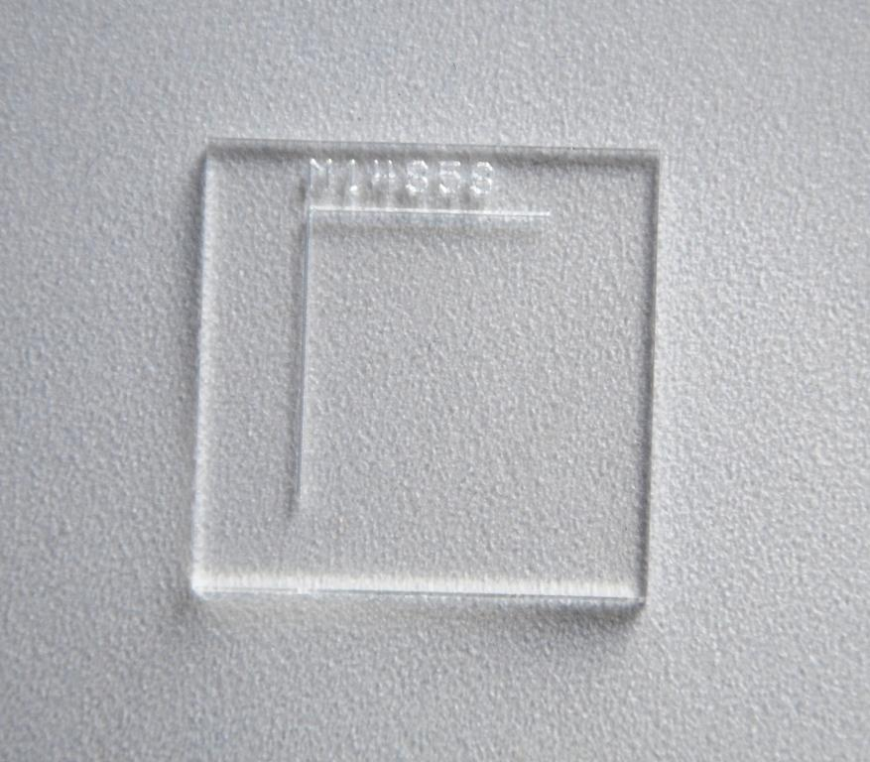
Track Detectors
LR115
CR-39

Slide 4
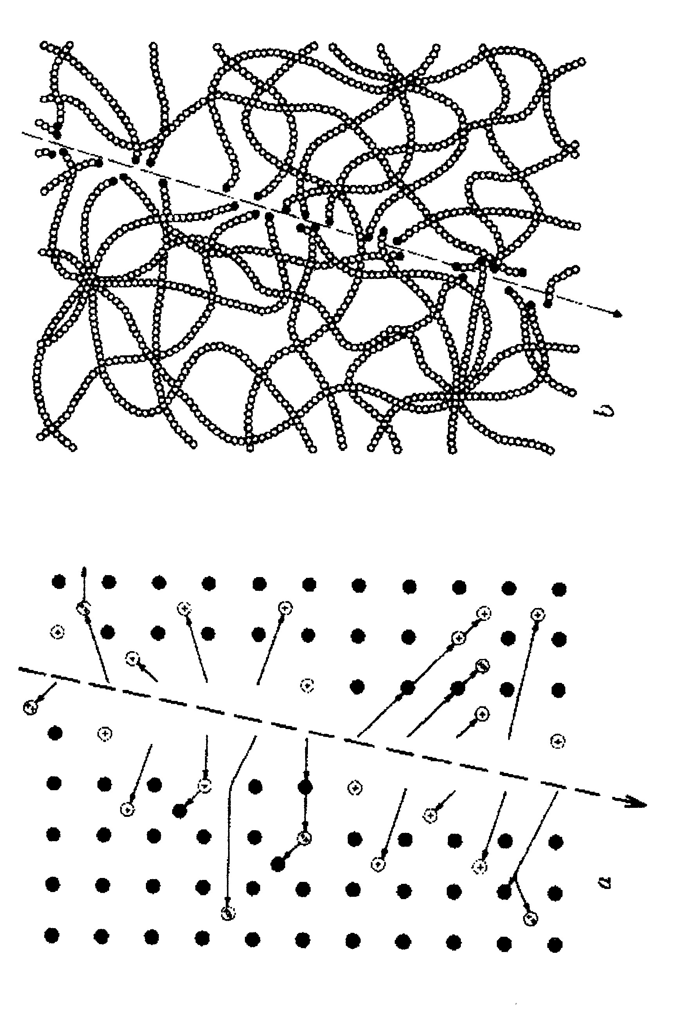
Track Detectors
PRINCIPLE OF TRACK DETECTORS
When a ionizing charged particle pass through a dielectric material the transfer of energy to electrons results in a trail of damaged molecules along the track path

Slide 5
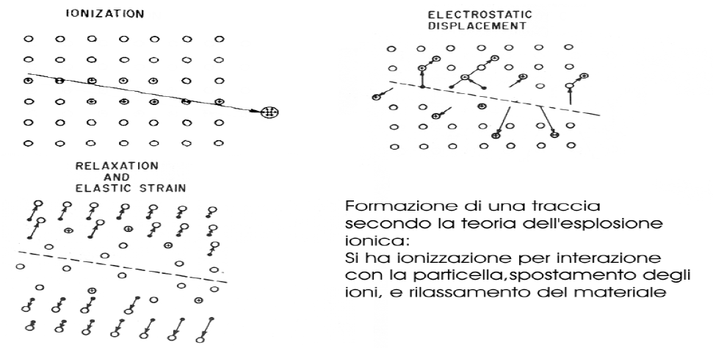
Track Detectors
Ion explosion theory
Ionization
Electrostatic displacement
Relaxation and elastic strain

Slide 6
Track Detectors
The tracks bacame visible by a chemical etching (acid or basic solution):
during the etching, material is removed at Vt velocity along the track and isotropically at Vb velocity from the bulk material.
Principle of the track detector: Vt (track etch rate) >Vb (bulk etch rate)
The dimension and shape of the track depend on:
Energy of the impinging particle
Incidence angle
Etching procedure (etchant, temperature, duration)

Slide 7
Track Detectors
There is a dE/dx threshold for damage production
dE/dx
E

Slide 8
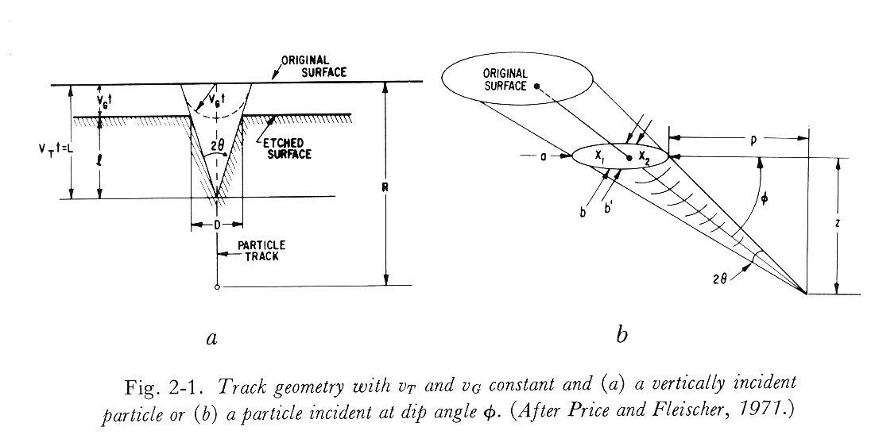
CR-39 Track Detectors

Slide 9
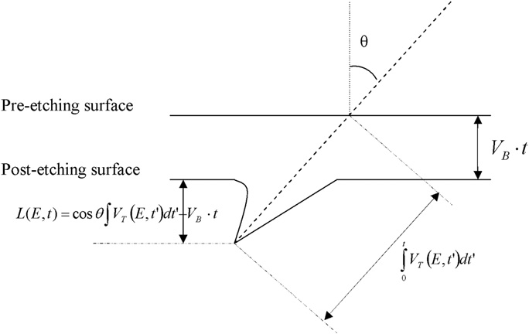
Track Detectors
There is a limit angle: if θ> limit angle →no track
Track is visible if
the lenght of the removed material along the track path, multiplied by cosθ, must be bigger than the thickness of the surface layer removed during etching

Slide 10
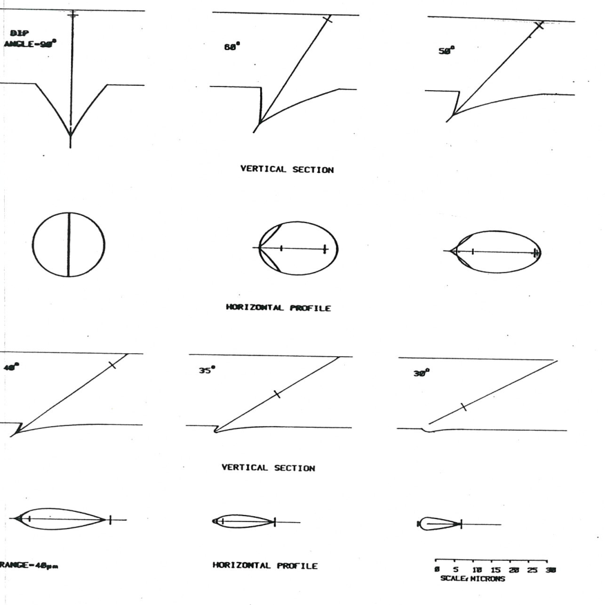
CR-39 Track Detectors
CR-39
Shape of the track as funtion of incidence angle

Slide 11
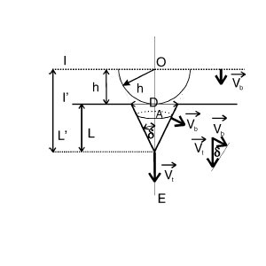
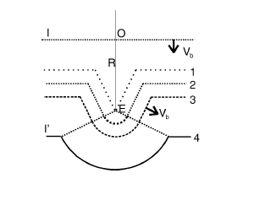
CR-39 Track Detectors
overetching: round shape

Slide 12
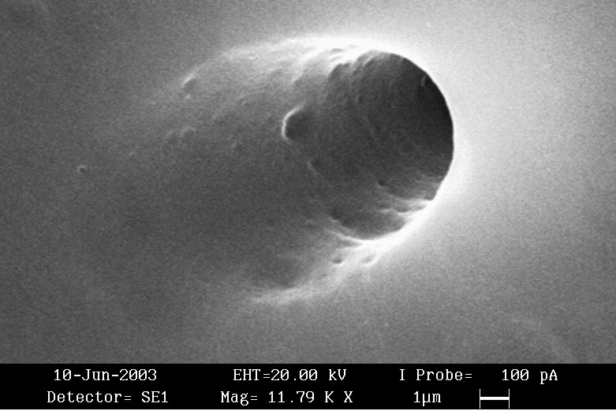
LR115 Track Detectors
Example of after etching track in a LR115 film

Slide 13
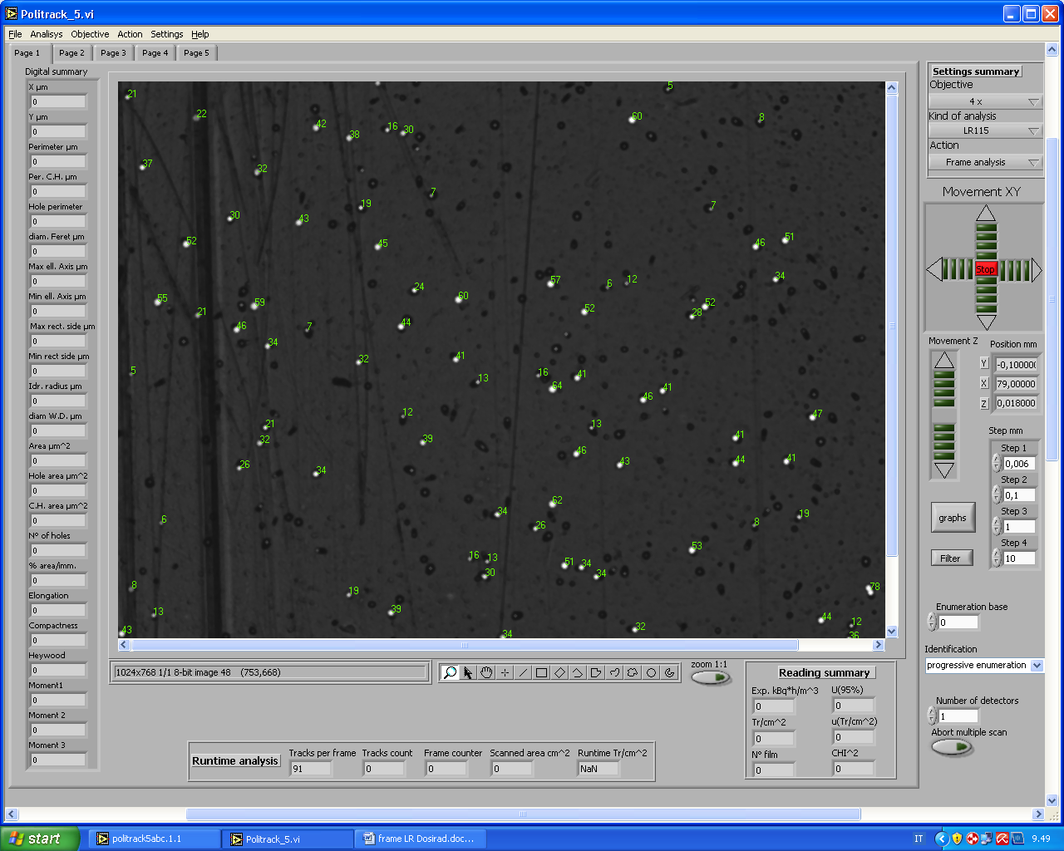
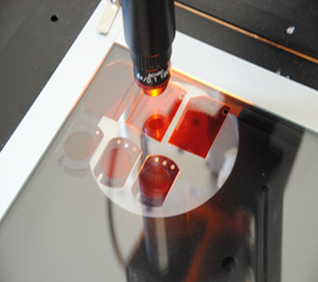
Reading LR115 Detectors
LR115 OPTICAL READING
Tracks appear as white holes on a dark background.
Count the tracks
Measure the track area
(correction for etching )
R A D O N I N T H E E N V I R O N M E N T
2 0 1 5 M A Y 2 5 - 2 9 , K R A K O W

Slide 14
Reading LR115 Detectors
Spark counter
Aluminized Mylar film
LR115
HV
electrodes

Slide 15
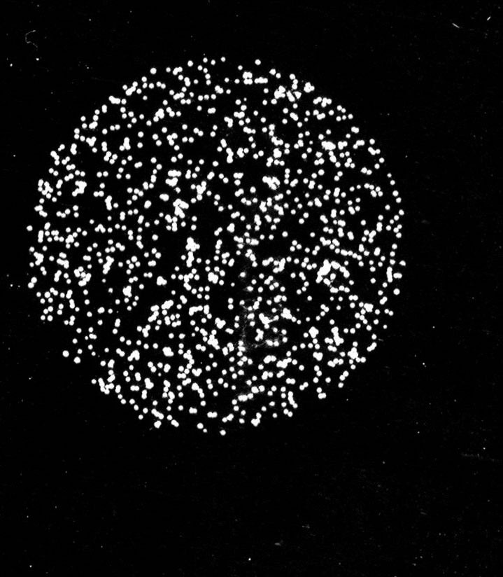
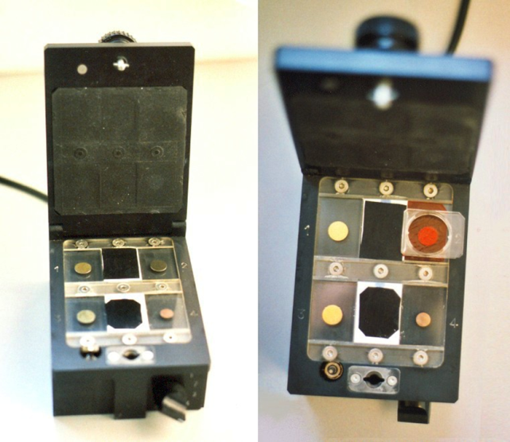
Reading LR115 Detectors
Spark counter
Aluminum Mylar film after spark counter reading

Slide 16
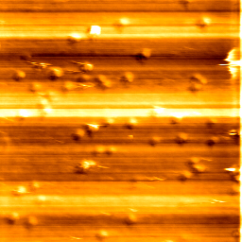
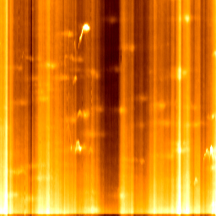
CR-39 Track Detectors
CR-39 detector irradiated by alfa particles (before etching)
Diameter of latent tracks is 70-100 nm. Frame is 5 micrometer (AFM).

Slide 17
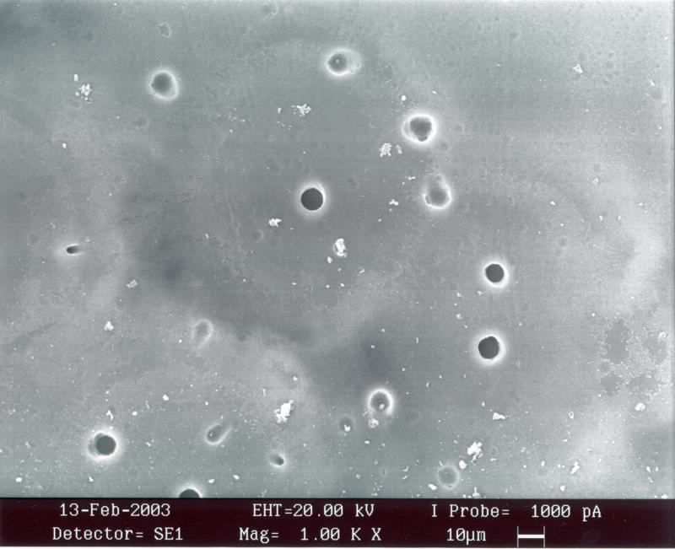
CR-39 Track Detectors
Example of after etching tracks in a CR-39 detector

Slide 18
CR-39 Track Detectors
Variation of Vt along track path
Vb=1.83 µm/h

Slide 19
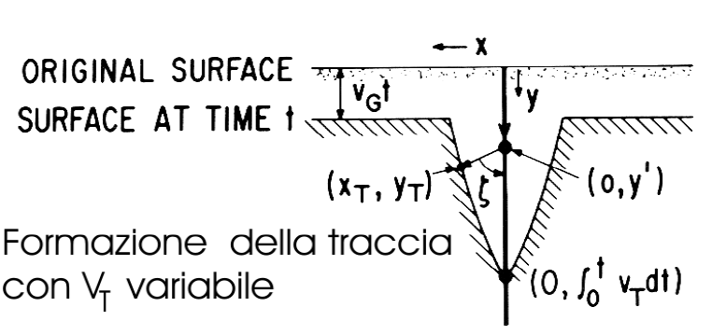
CR-39 Track Detectors
Variation of the track etch rate along the alpha particle trajectories: Vt decreasing

Slide 20
CR-39 Track Detectors
Variation of the track etch rate along the alpha particle trajectories: Vt increasing

Slide 21
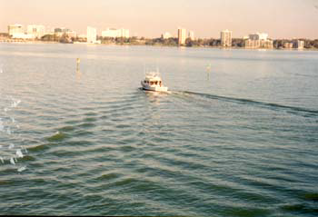
CR-39 Track Detectors
To understand chemical etching geometry think as Vt is the velocity
of the ship and Vb is the wave motion velocity in water

Slide 22
CR-39 Track Detectors
Track lenght as function
of etching time

Slide 23
CR-39 Track Detectors
Track lenght as function of etching time
Longitudinal section and top view of etched tracks of 90 MeV 7Li ions entering the detectors at = 0◦ (left side) and = 40◦ (right side) for different etching times, t (a) t = 3:5 h, (b) t = 4:33 h. Magnification: 950.
B. Dorschel et al. / Radiation Measurements 37 (2003) 563 – 571

Slide 24
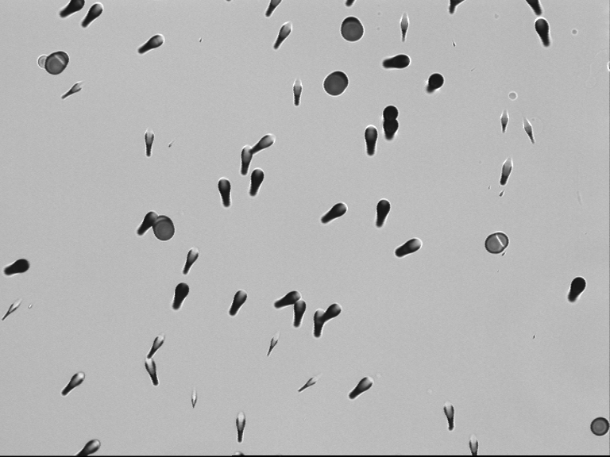
CR-39 Track Detectors
Alpha and fission fragment tracks in CR-39 exposed to Cf-252 source.

Slide 25
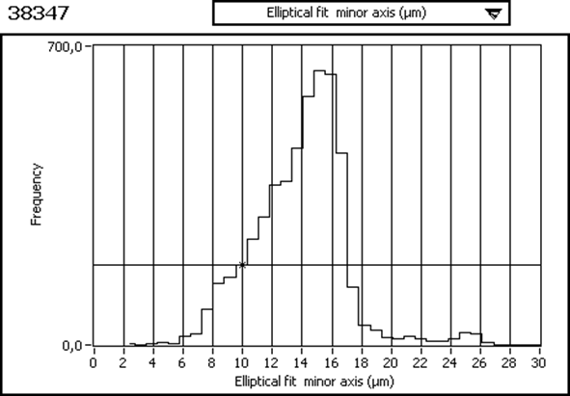
CR-39 Track Detectors
CR-39- Etching NaOH, 98°C, 1 hour
CR-39 exposed to Cf-252
Minor axis histogram
Two peaks:
alpha particles
fission fragments
The second peak allows to evaluate Bulk velocity (Vb) during etching, in this case about 12 microns/hour.

Slide 26
CR-39 Track Detectors
Measure of Vb - Bulk velocity
Fission fragments tracks Vt >> Vb
V=Vt/Vb, If V>>1 then
h removed bulk material thickness, D track diameter (dip angle 90°)
We can measure D and since h=D/2
=> Vb is equal to D/2 (removed thickness) / time of etching

Slide 27
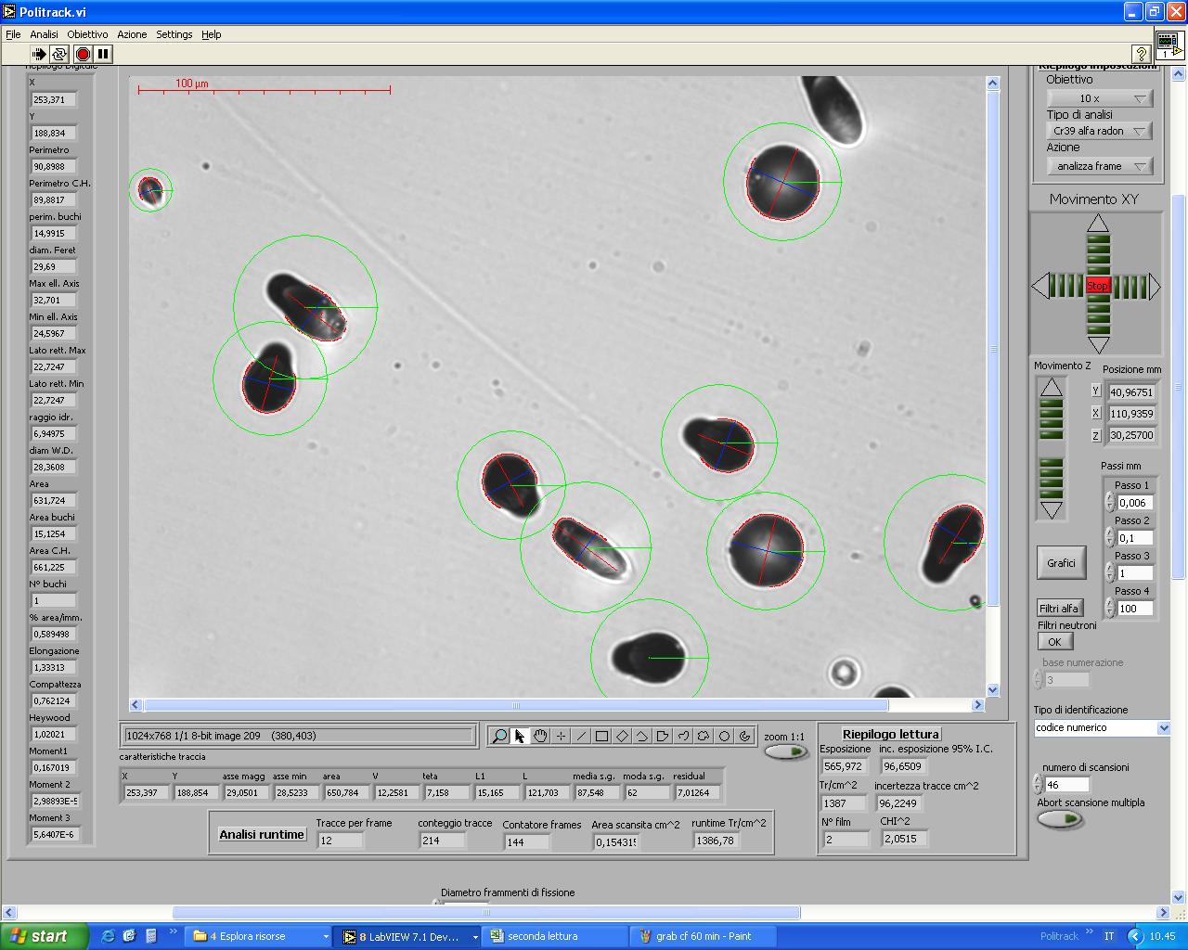
CR-39 Track Detectors
Measure of track parameters using automatic systems
Count the tracks
Filter tracks
(reduce background)
Morphological analysis (discriminate the particles and impinging angles)

Slide 28
NTD Application
CR-39 NEUTRON DOSIMETRY AND SPECTROMETRY
CR39 coupled to a Boron converter as thermal neutron detector inside Bonner sphere
Use of recoil protons (radiator-degrader tecnique)
Calculation of particle LET and impinging angle with direct estimation of equivalent dose

Slide 29
CR-39 neutron dosimetry
1. Bonner sphere (polyethylene neutron moderator)
CR-39 coupled to a Boron converter. The reaction is
The neutron is detected by the 1.47 MeV alfa particle
Number of tracks is proportional to thermal neutron fluence (inside Bonner sphere)
¹⁰B(n,alfa)⁷Li
CR39
Bonner sphere
Boron converter
M. CARESANA ET AL. Radiat Prot Dosimetry (2007) 126(1-4)

Slide 30
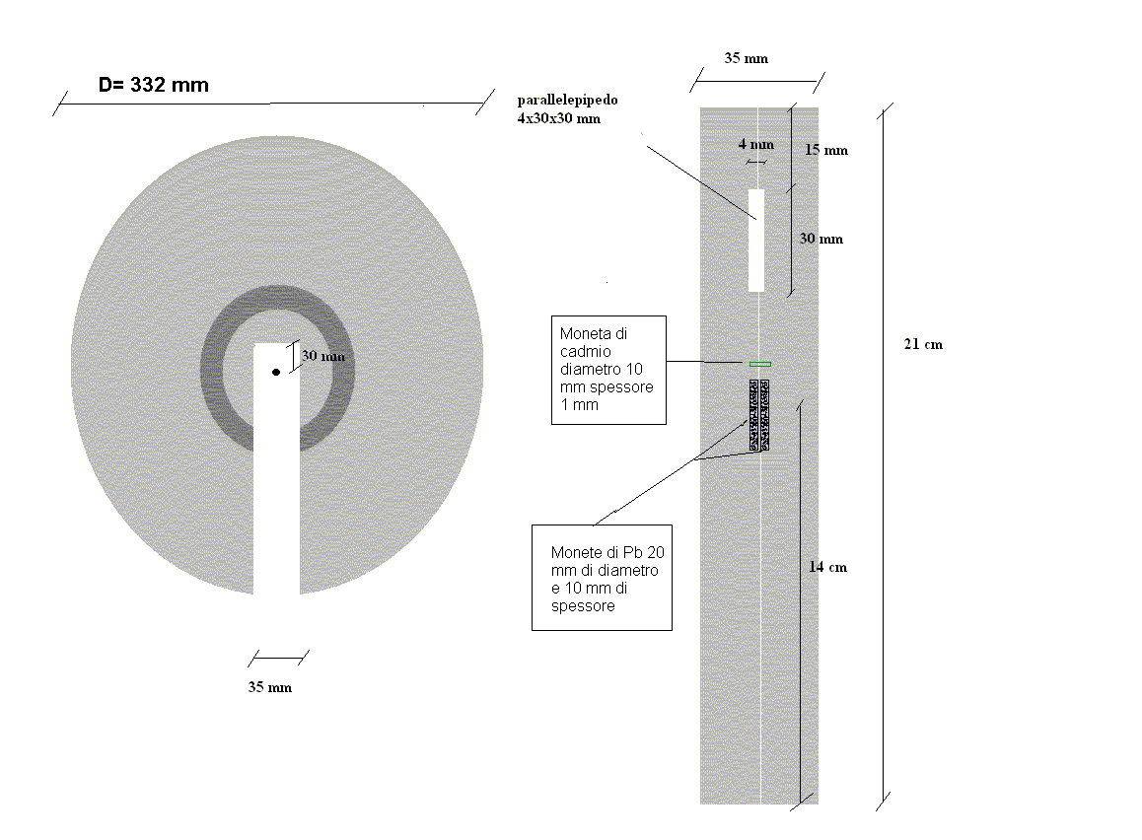
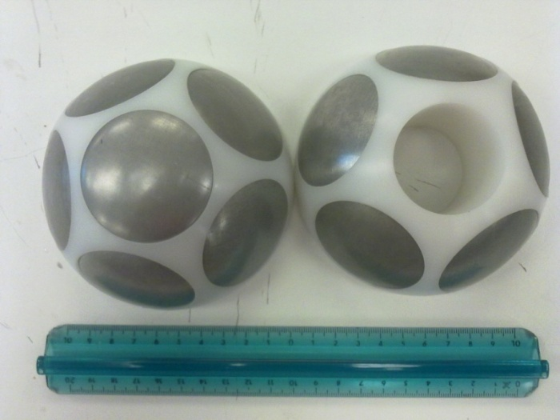
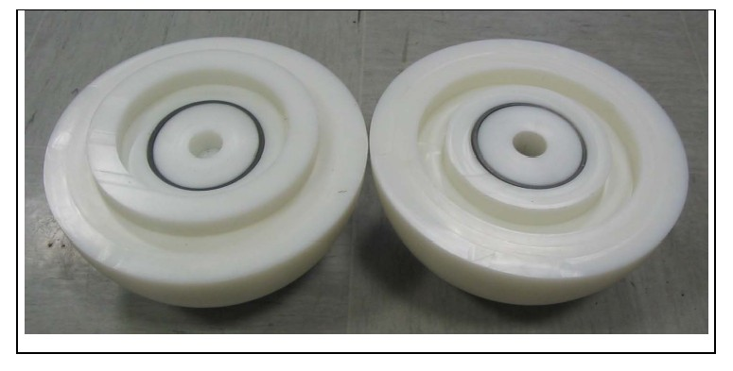
CR-39 neutron dosimetry
Bonner sphere
Single detector version: sensitivity 10 tracks/cm^2 per µSv
Double detector: sensitivity: 6 tracks/cm^2 per µSv

Slide 31
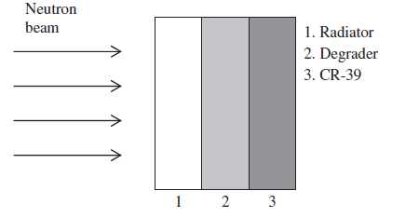
CR-39 neutron dosimetry
2. CR39- radiation degrader neutron spectrometer
1. Radiator: high density polyethylene
2.Degrader: aluminium (purity 99%)
3. Detector CR-39
Recoil protons are generated inside the radiator (external radiation component)
Recoil protons generated inside the detector (proton self radiator)
Carbon and oxygen recoil nuclei generated inside the detector (ion self radiator)

Slide 32
CR-39 neutron dosimetry
3. LET spectrometry
The adsorbed dose delivered by a charged particle impinging at an angle θ on the surface of a material of ϱ density is
ϵ is the energy imparted to the mass m, A is the area, x the lenght of the track,
I the thickness of the material affected by the energy deposition
(dE/dx) is the stopping power averaged over the lenght x
avg LET is the mean LET averaged over x
Note: the particle energy loss (stopping power) is considered equal to the energy transferred to the target (mean LET) as the energy loss by secondary electrons bremsstrahlung is considered negligible)

Slide 33
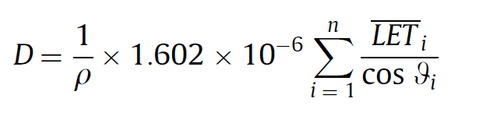
CR-39 neutron dosimetry
Assuming n particles impinge on the unit area (A=1 n= tracks/cm^2) the dose (mGy) can be calculate using
And the dose equivalent (mSv) can be calculated by
Avg. LET is expressed in keV µm⁻¹
Q(LET) is the ICRP quality factor
ρ is the density of the material (ρ = 1.31 g·cm⁻³ for CR-39)

Slide 34
CR-39 neutron dosimetry
A) Vt=Vt(E,x) is related to restricted energy loss REL(E,x) and we can use this relation ⁽¹⁾
V=Vt /Vb = 0.93+3.14×10−3REL − 7.80×10−6REL²+1.11×10−8REL³−5.27 × 10−12REL⁴ for 33 MeV/cm <REL< 560 MeV/cm
V=Vt /Vb= 1.30+3.80×10−4REL+4.9×10−7REL² for REL > 560 MeV/cm
B) Assuming that delta electrons with E>350eV do not contribute to track formation, we can use a polynomial fit we to relate LET and REL.
→we can relate V to LET
(1) B. Dorschel , et al. 2002 Dependence of the etch rate ratio on the energy loss of light ions in CR-39
Radiat. Meas. 35, 287-292.

Slide 35
CR-39 Track Detectors
V=V(E,t) and V=V(E,x) functions calculated through the V=V(REL(E,x)) function for 1.2 MeV protons impinging perpendicularly on the detector surface. The simulated etching conditions are Vb=9.8 µm h⁻¹ and 1.5 h of etching time.

Slide 36

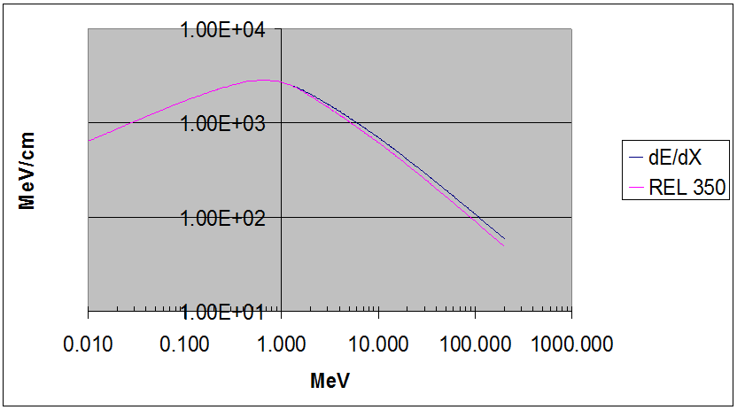
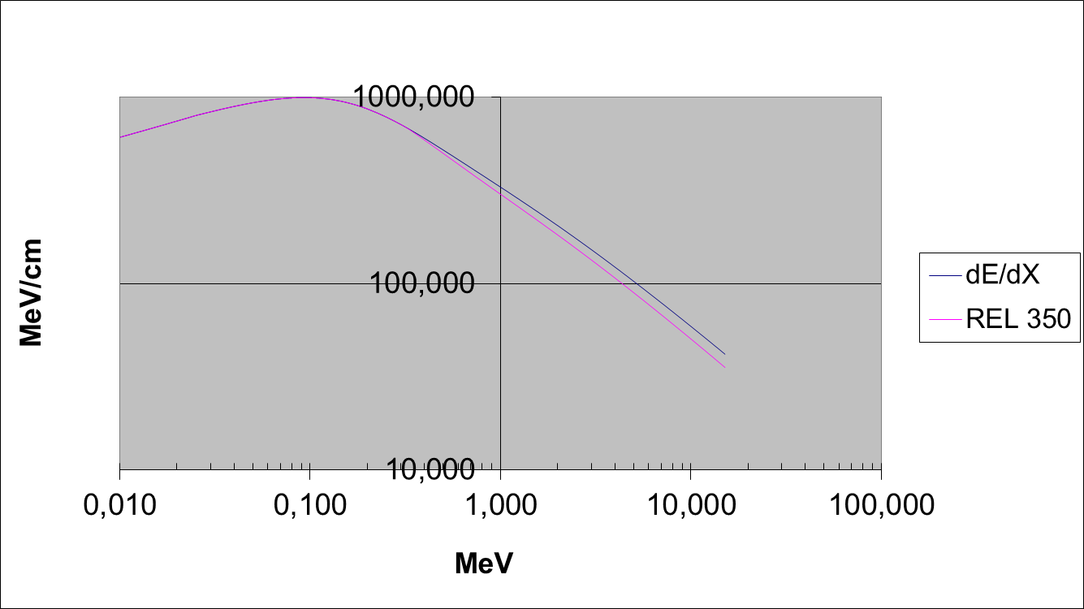
LET and REL in PADC for alpha particles and protons
Alpha particles
Protons

Slide 37
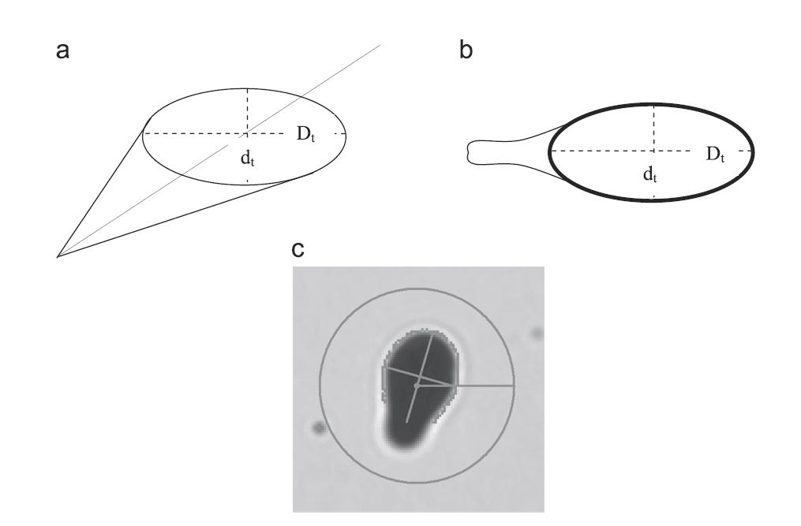
CR-39 neutron dosimetry
LET spectrometry – experimental procedure
d= track opening minor axis
D= track opening major axis
h= removed thickness
D, d and h are measured

Slide 38
CR-39 neutron dosimetry
By defining
It is possible to calculate V and θ from the track parameters
Since relationship between V and LET is known, we can calculate dose

Slide 39
¹⁰B(n,alfa)⁷Li
E_{alpha} =1.47 MeV
E_{lithium} =0.84 MeV
Ion | Mean LET meas | Mean LET calculated
Alfa | 220 keV/µm | 250 keV/µm
Li | 400 keV/µm | 280 keV/µm
M. Caresana et al. Study of a radiator degrader CR39 based neutron spectrometer NIMA 620 (2010), p.368–374

Slide 40
LET measurement Am-241 and Uranium
Am-241 E=5.5MeV
Etching 60’
Removed thickness 10 µm
Avg LET measured 130 keV/µm
Avg LET calculated 140 keV/µm
Unat E₁=4.2MeV E₂=4.77MeV
Etching 40’
Spessore rimosso 6.7 µm
Source | Mean LET meas | Mean LET calculated
U-234 | 145 keV/µm | 148 keV/µm
U-338 | 170 keV/µm | 187 keV/µm

Slide 41
THANK YOU !

