Slide 1

Early Stage Researcher 9: October 2014 – June 2015
Benedikt Bergmann
Institute of Experimental and Applied Physics, Czech Technical University in Prague, Czech Republic
PRAGUE – 22.06.2015

Slide 2
Experimental activities: Overview
Los Alamos Neutron Science Center (Dec. 4 - 7, 2014)
  Broad neutron spectrum from few hundrets of keV up to 600 MeV
  Timepix (1 mm) and Timepix3 (300 µm)
SPS at CERN (Feb. 20 – 25, 2015 and March 31 – April 9, 2015)
  Argon ions (75 GeV/A, 15 GeV/A, 150 GeV/A)
  Timepix and Timepix3 (different thicknesses)
Nuclotron of JINR, Dubna (March 10 – 15, 2015)
  Carbon ions 1 GeV/A
  Timepix (1 mm), Timepix telescope and Timepix3 (different thicknesses)
Van-de-Graaff in Montreal (May 16 – 24, 2015)
  Protons up to 11.4 MeV
  Timepix (CdTe, GaAs, Si) and Timepix3 (500µm)

Slide 3

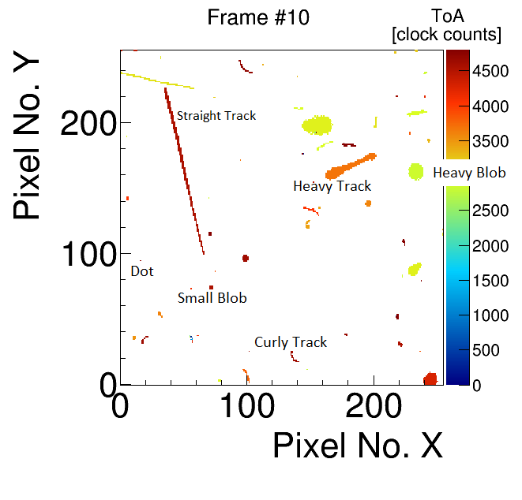
Reminder:
Pattern recognition – definition of different cluster types
Low Energy Transfer Events (LETE):
Dots (photons and electrons ~ 10 keV)
Small Blobs (photons and electrons)
Curly Tracks (electrons MeV range)
Straight Tracks (MIPs, Muons, ...)
High Energy Transfer Events (HETE):
Heavy Tracks, Heavy blobs (Heavy ionizing particles, e.g. Alpha particles, protons)
1.4 cm
Frame taken with a Timepix (1 mm, 400V, t_{Acq.} = 100µs) in the LANSCE neutron beam.
Notes:
Dot , small blob indicating low energy transfer!
Heavy track and heavy blob indicating HET to the sensor layer!

Slide 4
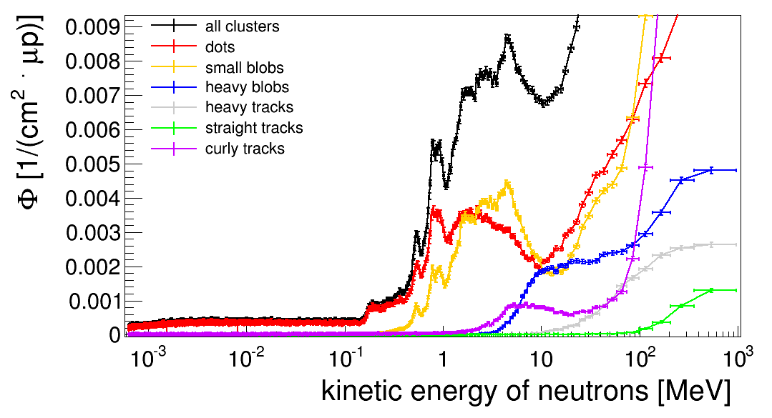
TIMEPIX at LANSCE:
Cluster shapes (detector responses) as a function of neutron kinetic energy
The ToF technique*⁾ was used to assign the detector responses to the corresponding neutron energies (track by track).
Heavy events due to nuclear interactions appear
Peaks of resonance neu-tron elastic scattering
Gammas from the 1st excited level of silicon (1.78 MeV)
*) see: B Bergmann et al 2014 JINST 9 C05048

Slide 5
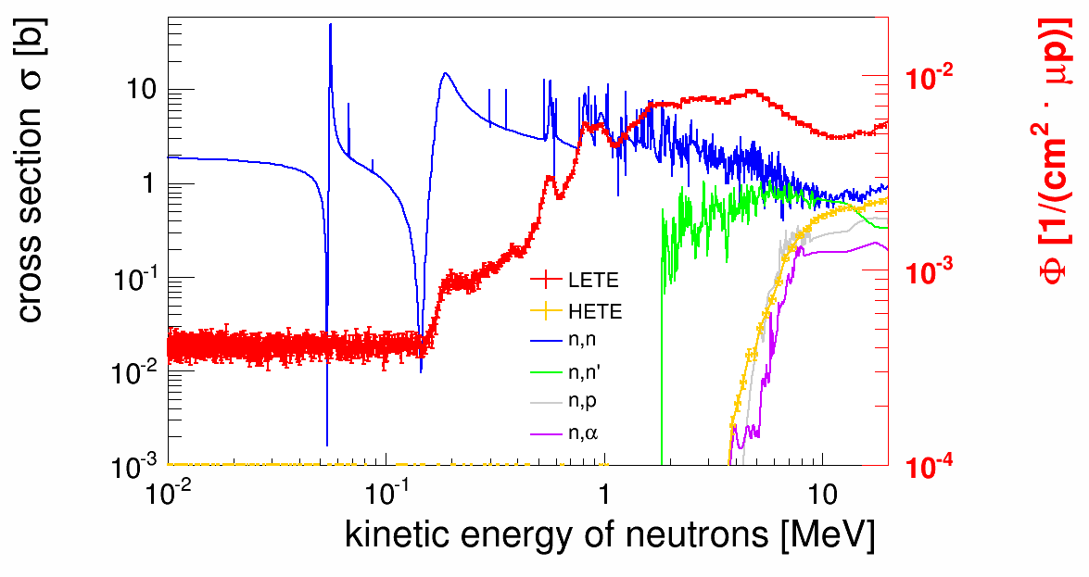
TIMEPIX at LANSCE:
Interpretation of the signatures by means of radiation damage
E_{ion} < Detector threshold (4.5 keV)
Category 1 - Low energy deposition by pure ionization:
Curly tracks, straight tracks
No damage
Category 2 – Low energy deposited by the recoil silicon of scattering reactions (small angle):
Dots, small blobs (LETE)
Displacement damage
Category 3 - High local charge deposition, e.g. in Si(n,X)-reactions:
Heavy tracks and heavy blobs (HETE)
Single Event Upsets (SEU) and Multiple Bit Upsets (MBU), permanent damage
Notes:
Description of categories in heading, signaures as examples

Slide 6
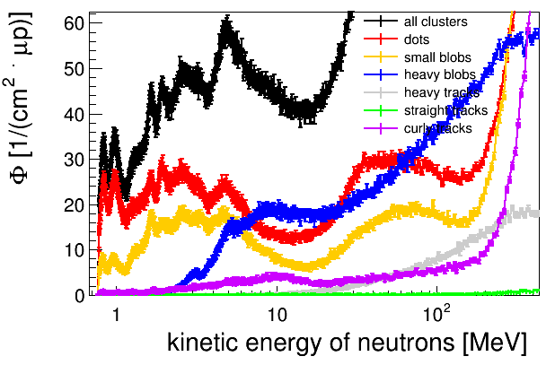
TIMEPIX3 at LANSCE:
Cluster shapes (detector responses) as a function of neutron kinetic energies
Same behaviour as for Timepix
Better time resolution leads to better selection of neutron kinetic energies

Slide 7
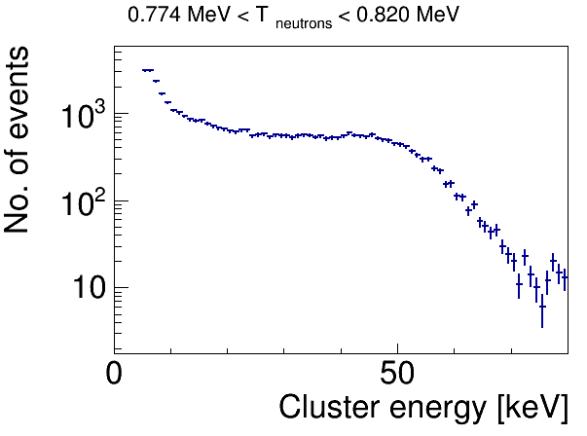
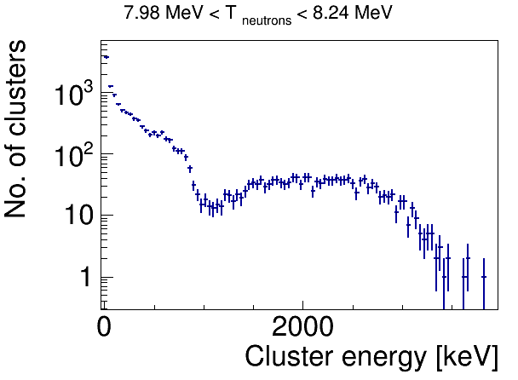
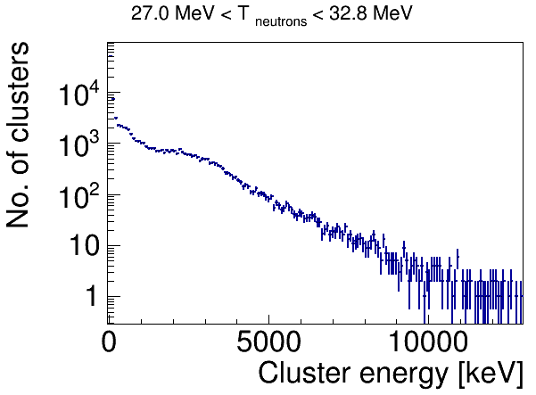
TIMEPIX3 at LANSCE:
Examples of energy spectra for selected neutron energy intervals
T_{si,max} in elastic scattering
T_{si,max} in elastic scattering
  Time-of-Flight technique used to select quasi-monoenergetic neutrons:
    ΔT_{n}/T_{n} up to ~ 1% (T_{n} < 10 MeV)
    ΔT_{n}/T_{n} ~ 7% (T_{n} ~ 30 MeV)
  Investigate the spectrum of deposited energies by means of a pulse shape analysis
Notes:
Kremenek, Kroha – excitation function

Slide 8
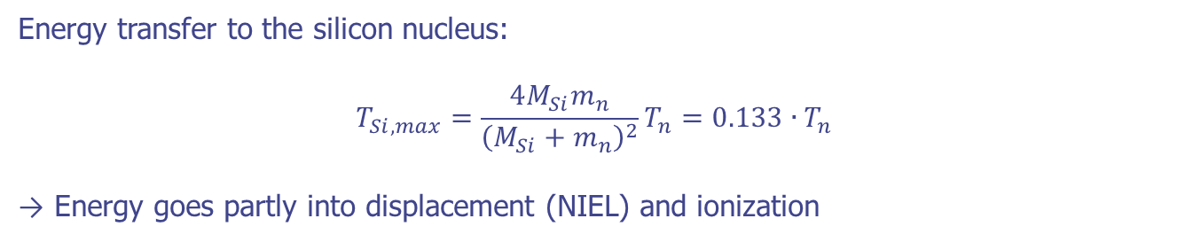
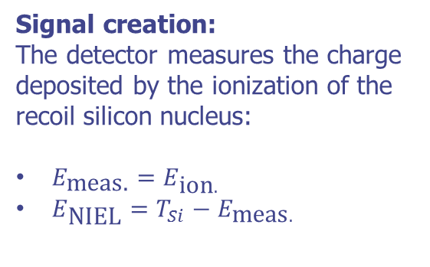
TIMEPIX3 at LANSCE:
Interpretation of the measured energy spectra
Energy transfer to the silicon nucleus:
$$T_{Si,max}=\frac{4M_{Si}m_{n}}{{\left(M_{Si}+m_{n}\right)}^{2}}T_{n}=0.133∙T_{n}$$
→ Energy goes partly into displacement (NIEL) and ionization
Signal creation:
The detector measures the charge deposited by the ionization of the recoil silicon nucleus:
$E_{\text{meas}\text{.}}=E_{\text{ion}.}$
$E_{\text{NIEL}}=T_{Si}−E_{\text{meas}.}$
T_{si,max} = 0.133.T_{n}= 106 keV

Slide 9
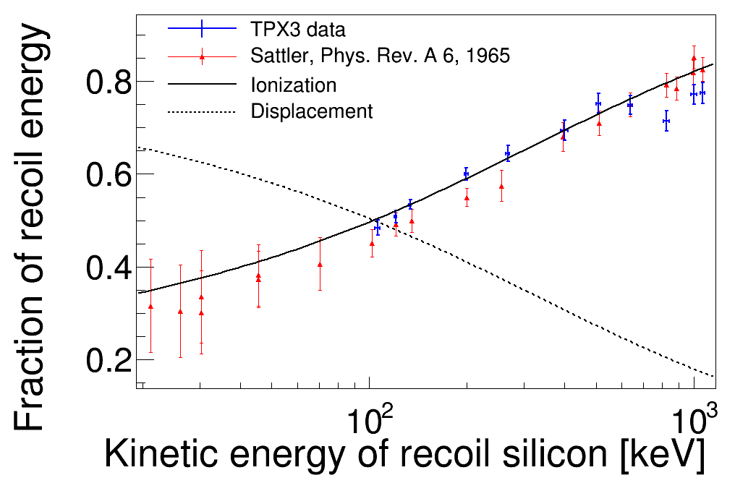

TIMEPIX3 at LANSCE:
Neutron scattering - Losses by ionization vs losses due to displacement
*⁾ The formulae for the calculation can be found in: C. Leroy and P.-G. Rancoita, Rep. Prog. Phys. 70 (2007) 493–625
*⁾
*⁾
$$f_{\text{meas}}=\frac{E_{\text{edge}}}{T_{\text{Si}\text{,}\text{max}}}$$

Slide 10
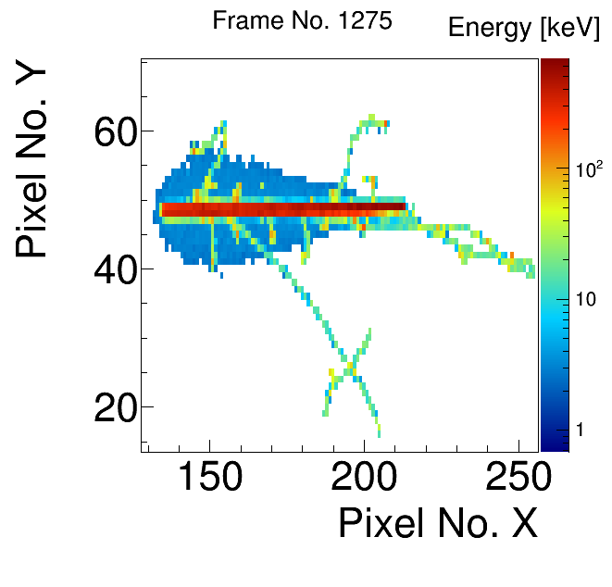
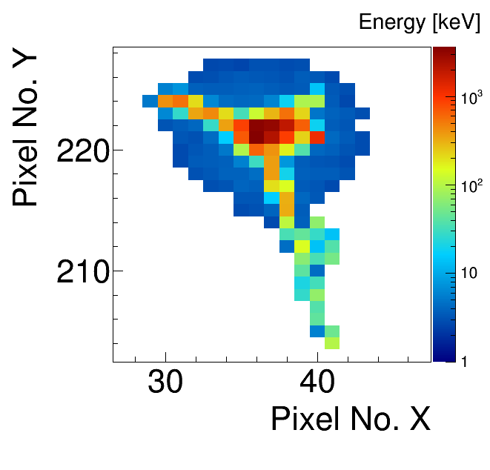
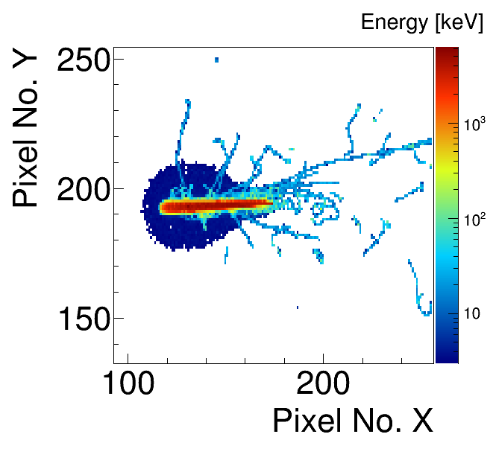
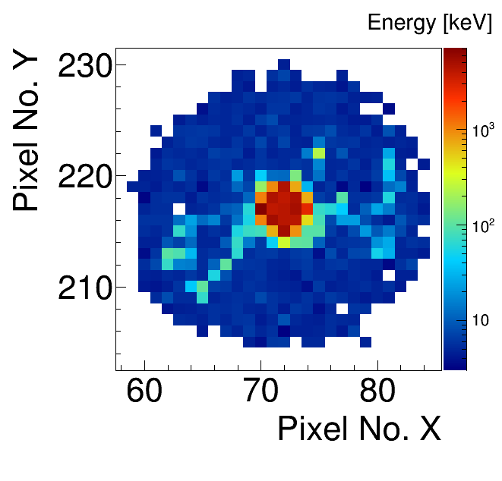
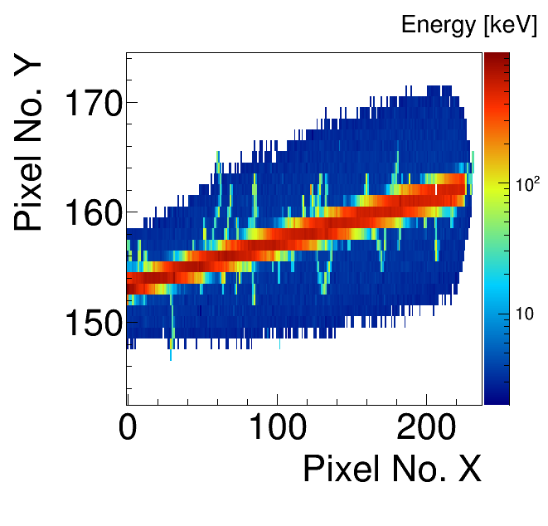
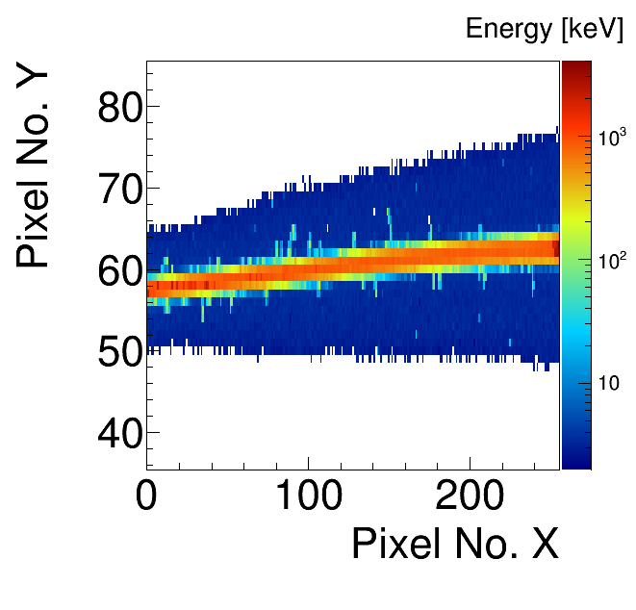
TIMEPIX:
Detector responses in the form of tracks from different ion species
C-12 ions of 1 GeV/A as measured at the nuclotron at JINR in Dubna (Moscow Region): Irradiation at 75° to the sensor normal (left) and perpedicular irradiation (right).
Argon ions of 75 GeV/A measured at the SPS H8 beam line at CERN. The detector was irradiated at 70° to the sensor normal (left) and perpendicular (right)
Measurements at HIT in Heidelberg:
Oxygen ion of 250 MeV/A (left) and Carbon ion of 200 MeV/A passing through the sensor parallel to the surface.

Slide 11
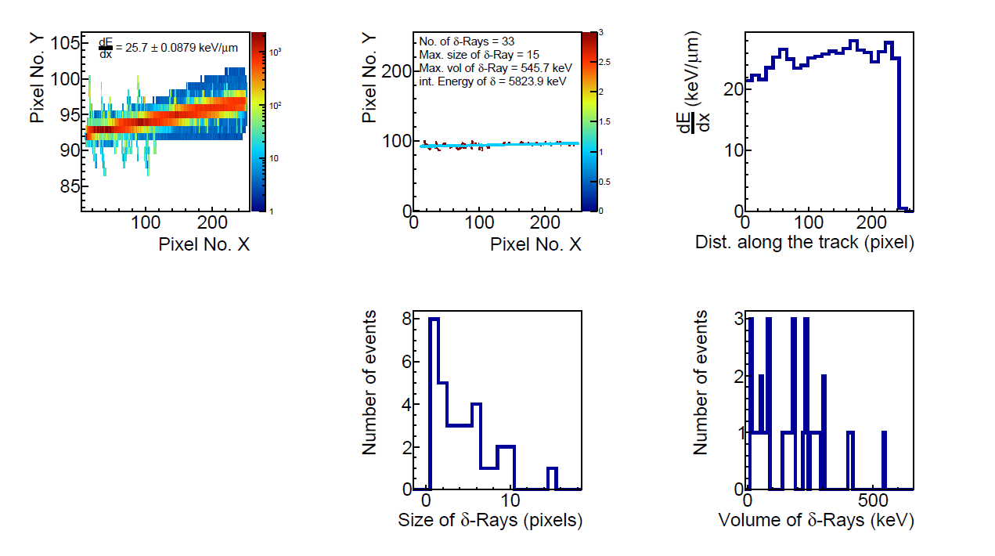
TIMEPIX:
Event-by-event evaluation of a Carbon ion 300 MeV/A event
Tracks will be evaluated and interpreted by means of:
Energy (dE/dx measurements) of the track
Geometry (width, roundness)
Characterization of the delta electrons (energy, angle)

Slide 12
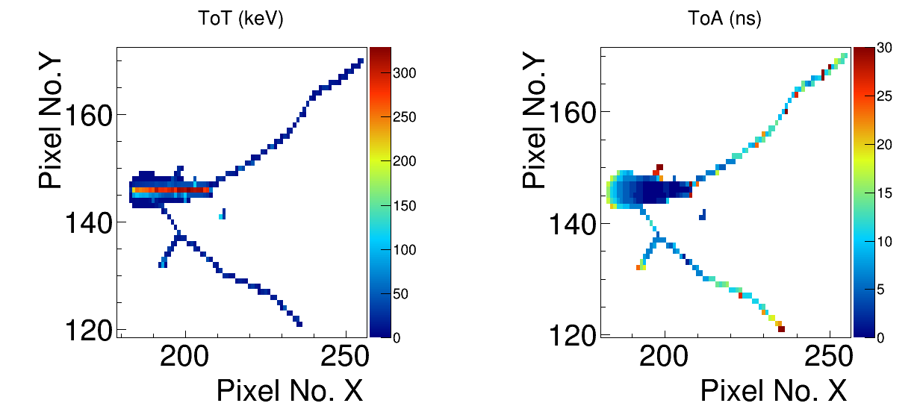
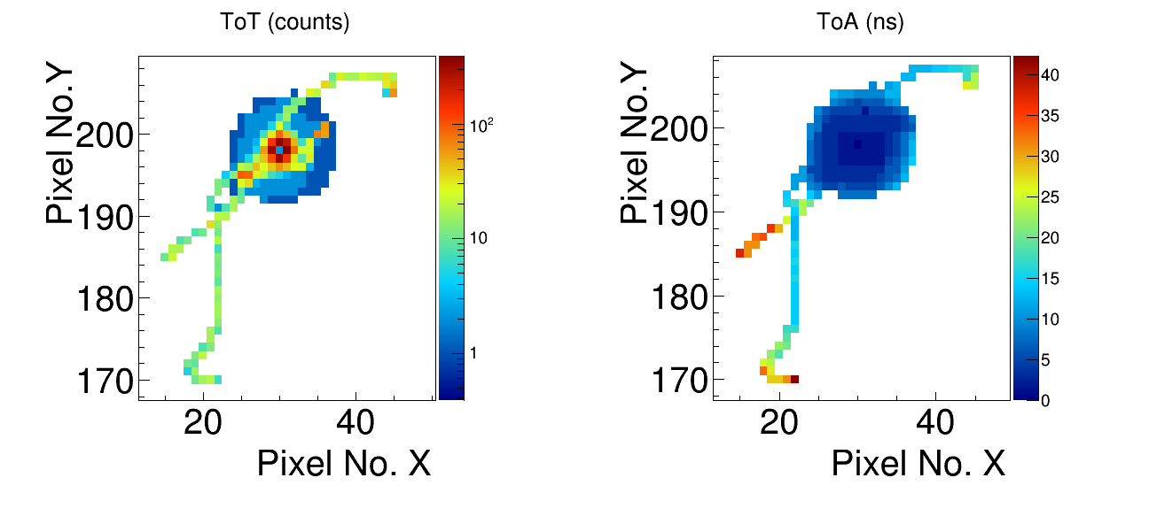
Outlook:
First measurements with the TIMEPIX 3
Carbon ion 1 GeV/A:
300µm thick device
Bias 90 V
75 degree
Argon ion 150 GeV/A
675 µm thick
Bias 400V
0 degree
Time resolution of 1.56 ns allows to resolve the drift time of the charge carriers.
→ Information about the interaction depth (3D tracking of particles within the sensitive volume)

Slide 13
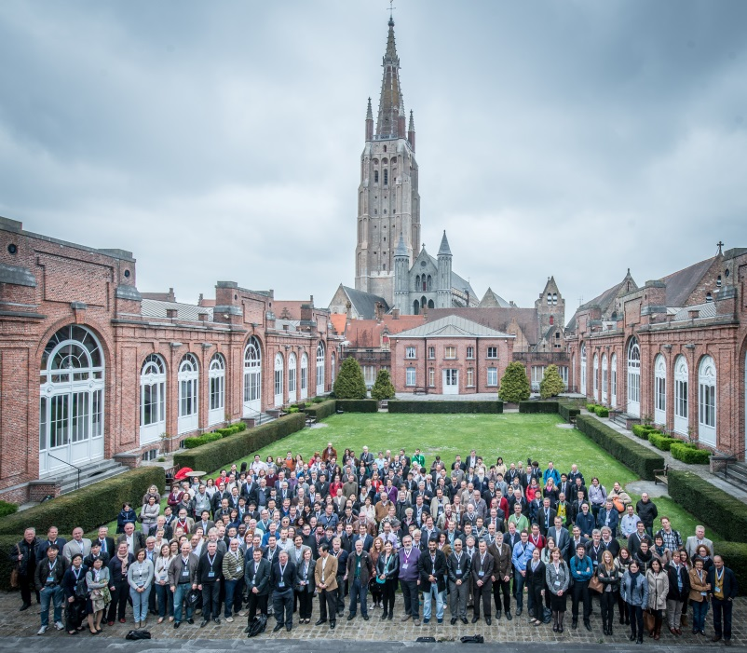
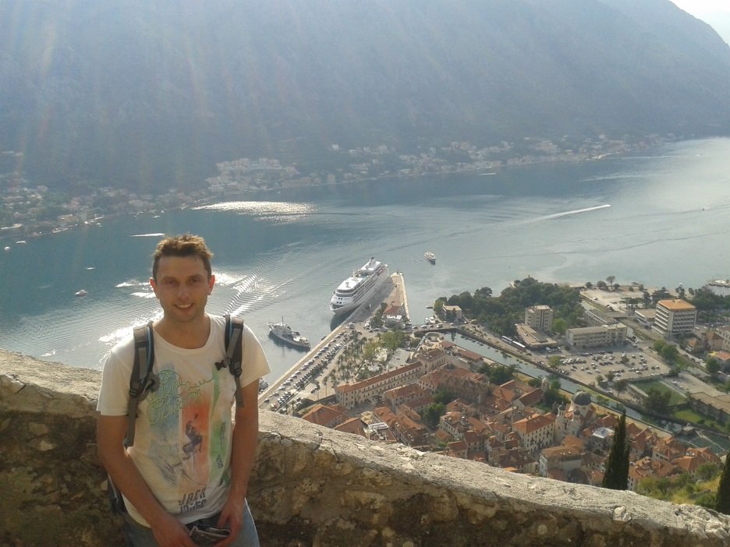
Conferences
IEEE, Seattle, Nov. 8 – 15, 2015
MMND (Micro-, Mini & Nanodosimetry), Port Douglas, Oct. 20 – 23, 2014
IM 2015 (International Confrence on Individual Monitoring of Ionising Radiation), Bruges, April 19 – 24, 2015
RAD 2015, Budva, June 8 – 13, 2015

Slide 14
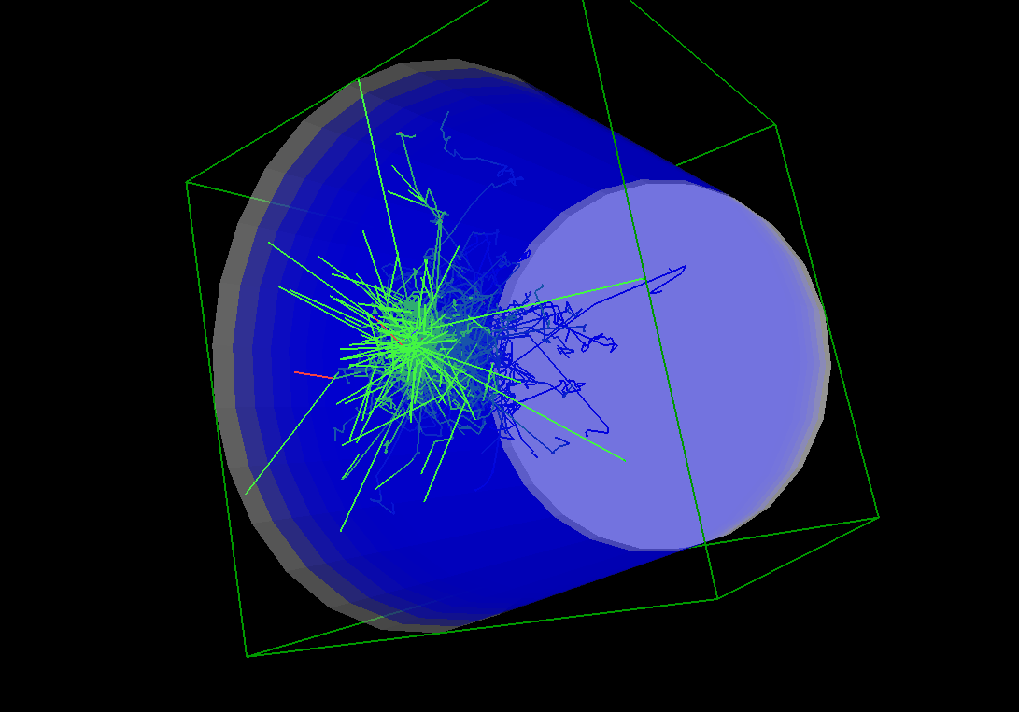
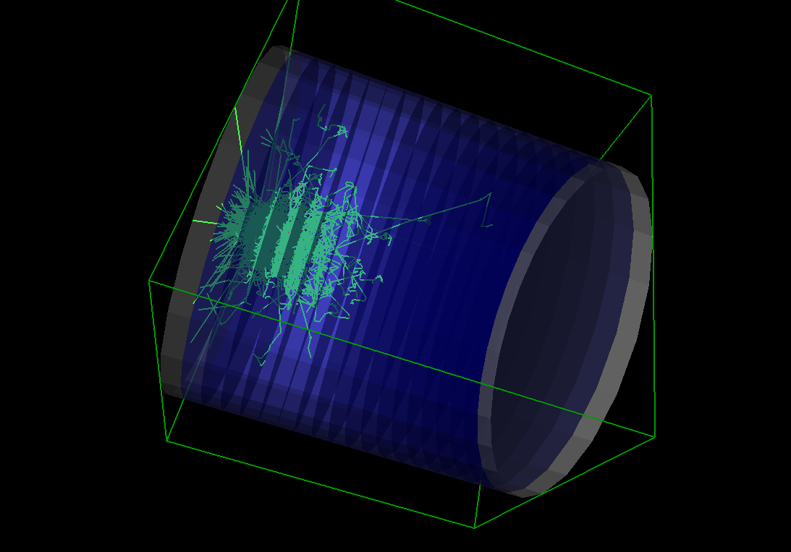
Workshops, Training and other Activities
Workshops
  3rd Annual ARDENT workshop in Schwarzenbruck (Sept. 29 – Oct. 3, 2015)
  MPX meeting at CERN (Feb. 18, 2015)
  SWG 2015 (Spring Workshop on Geant 4), Casta-Papiernicka, SVK (April 26 – May 1, 2015)
Training
  Czech language training (ongoing)

Slide 15
Future Activities:
Experiments, Secondment and planned Training
Secondment
  Erlangen, September 2015
  Business and administration secondment (?) – IBA (?)
Other Training
  Czech language courses – ongoing

Slide 16
Thank you for your attention!

