Slide 1
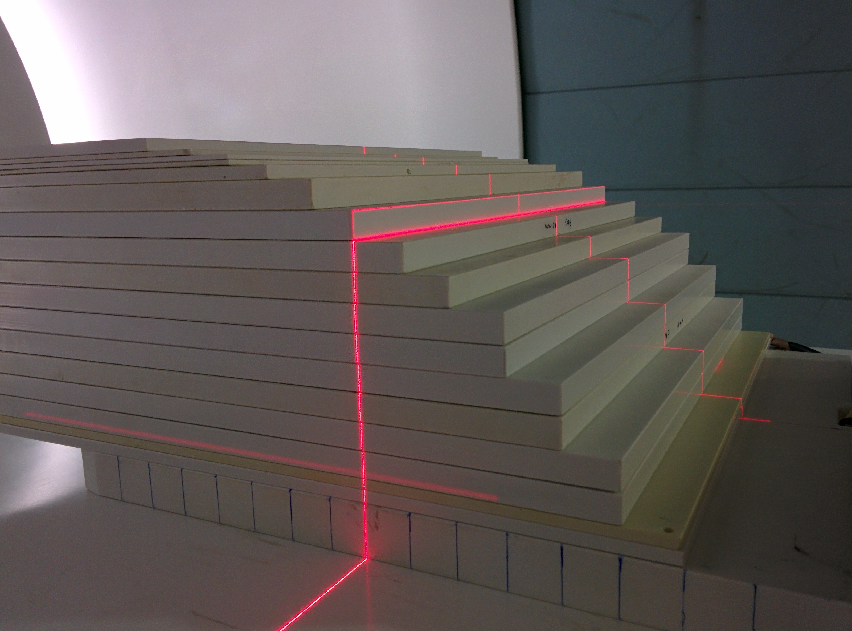



ARDENT final meeting almost on top of a 3 years stairway
Michele Togno - IV ARDENT Annual Meeting, Prague - June, 23rd 2015

Slide 2
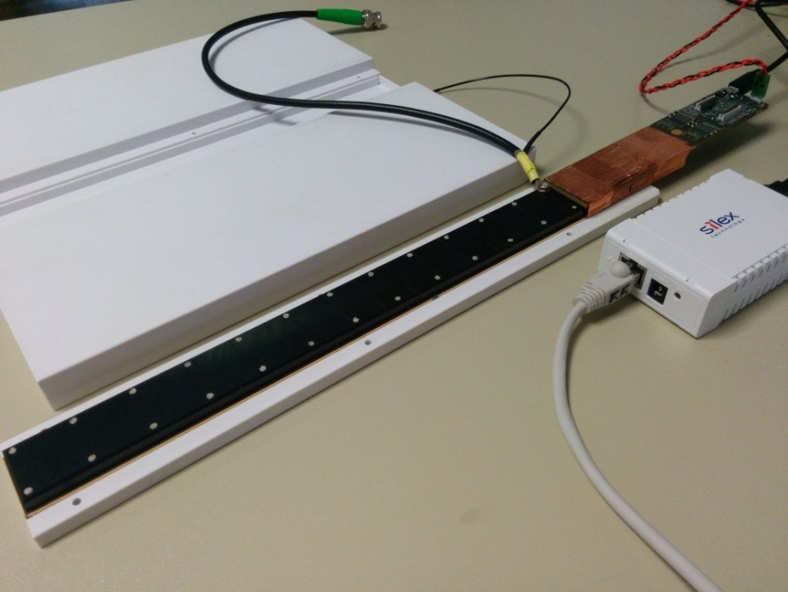
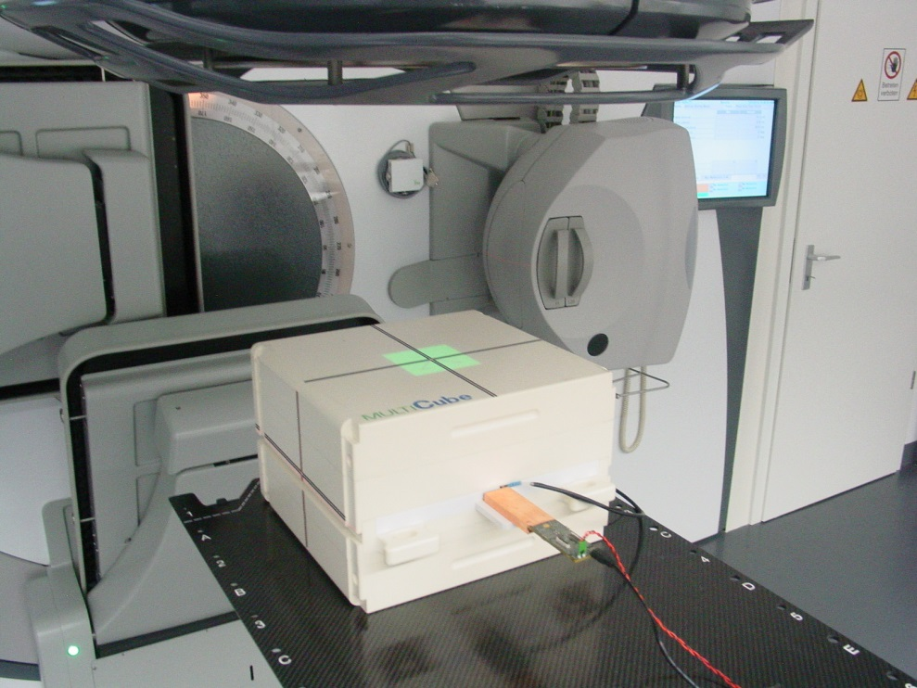

We are talking about…
Air vented ionization chambers
4 mm³ sensitive volume
3.5 mm pitch
1 mm inter-electrode distance
Ionization current ~pA
Absolute dose measurement
Machine quality assurance
Patient quality assurance
MV x-rays & PBS proton beams

Slide 3
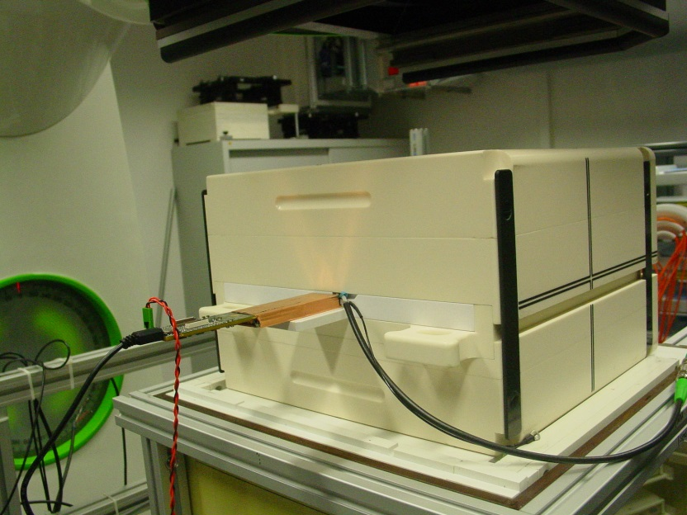


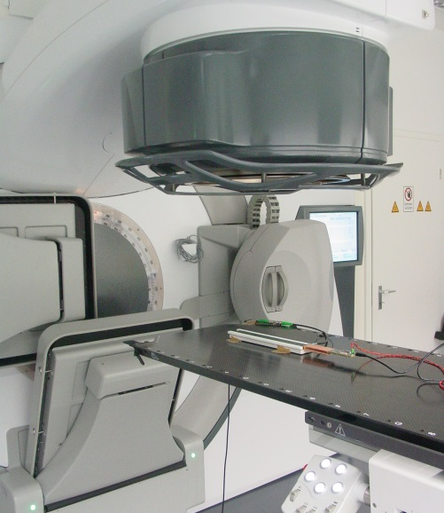
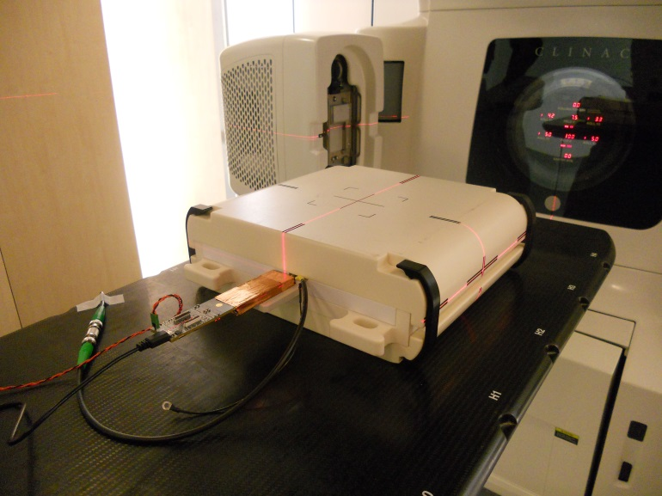
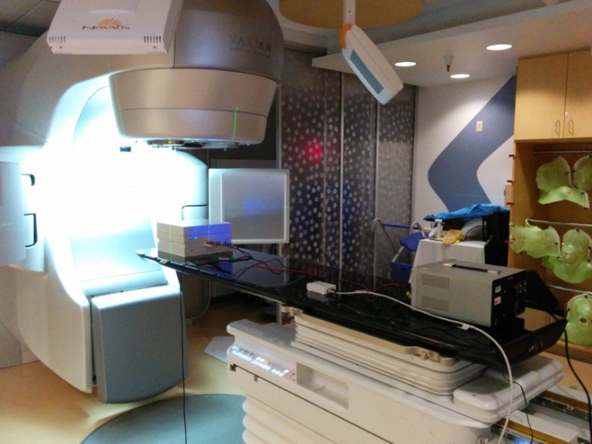
We are talking about…
⁶⁰Co & MV x-rays @:
IBA DosLab
Klinikum rechts der Isar (Munich)
University of California San Francisco (CA)

Slide 4
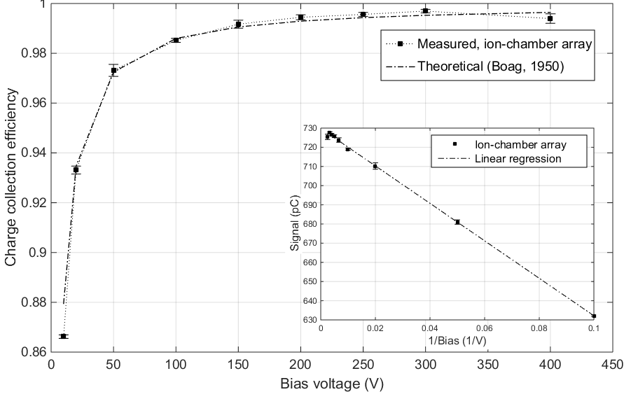
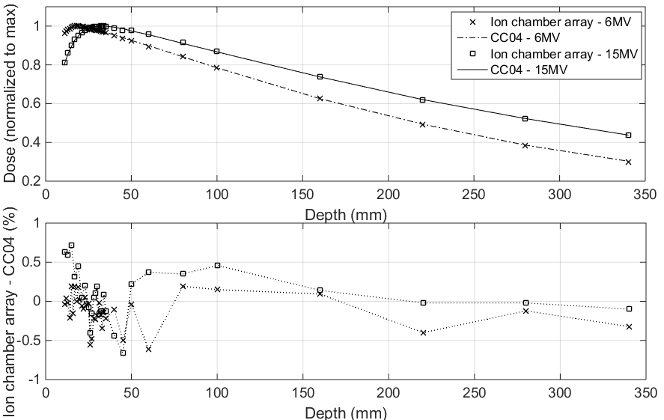
Already presented @ 3rd annual meeting
Charge collection efficiency
>99.5% ± 0.3% with 250 V
@ 2.7 mGy/pulse
Tissue to Phantom Ratio
(Elekta Agility linac)
6 MV & 15 MV
<0.6% difference after d_{max}

Slide 5
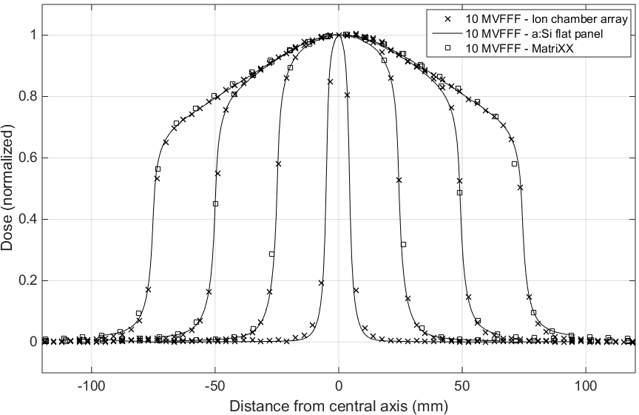
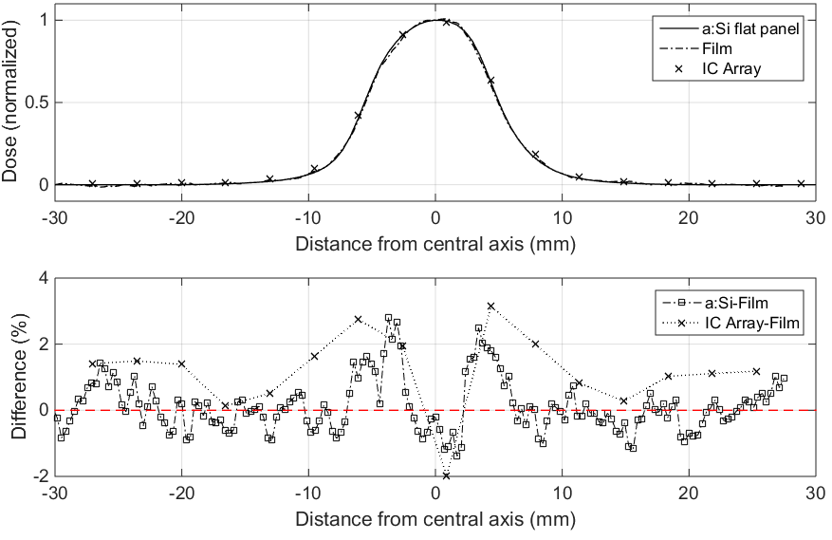
Already presented @ 3rd annual meeting
10 MVFFF dose distributions
(Elekta Agility linac)
Remarkable penumbra definition
(measurements at d_{max})
10 MV, 1x1 cm² field
(Varian TrueBeam linac)
Performances comparable to a:Si flat panel (0.2 mm res.)

Slide 6
Outline
Experimental Activity
  Characterization with clinical beams – patient QA
  Characterization at PT Center Czech s.r.o.
  Ongoing activities
  What happens down the road?
  Trainings
  Conferences & Dissemination
  Conclusions

Slide 7
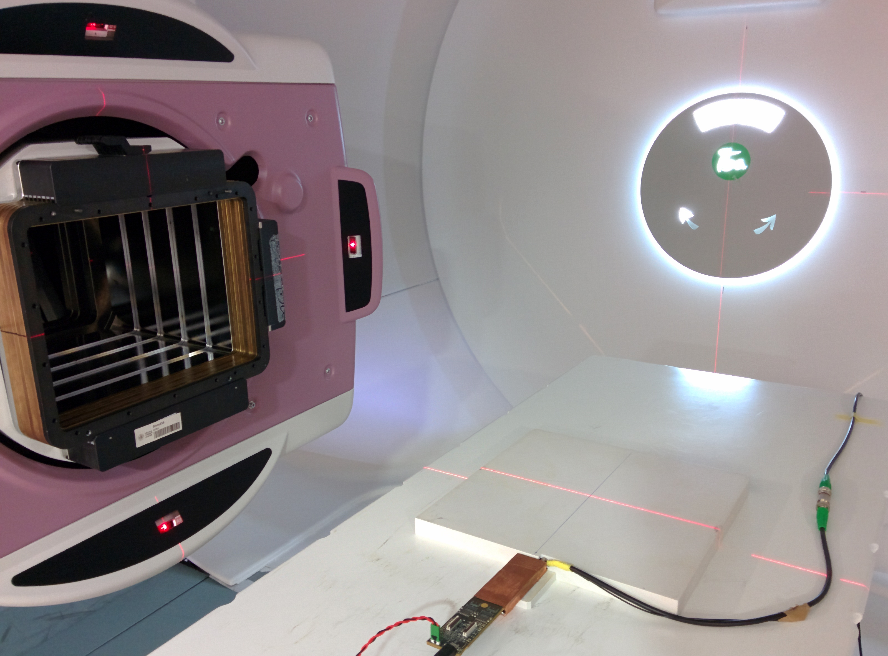
Experimental Activity
Michele Togno - IV ARDENT Annual Meeting, Prague - June, 23rd 2015

Slide 8
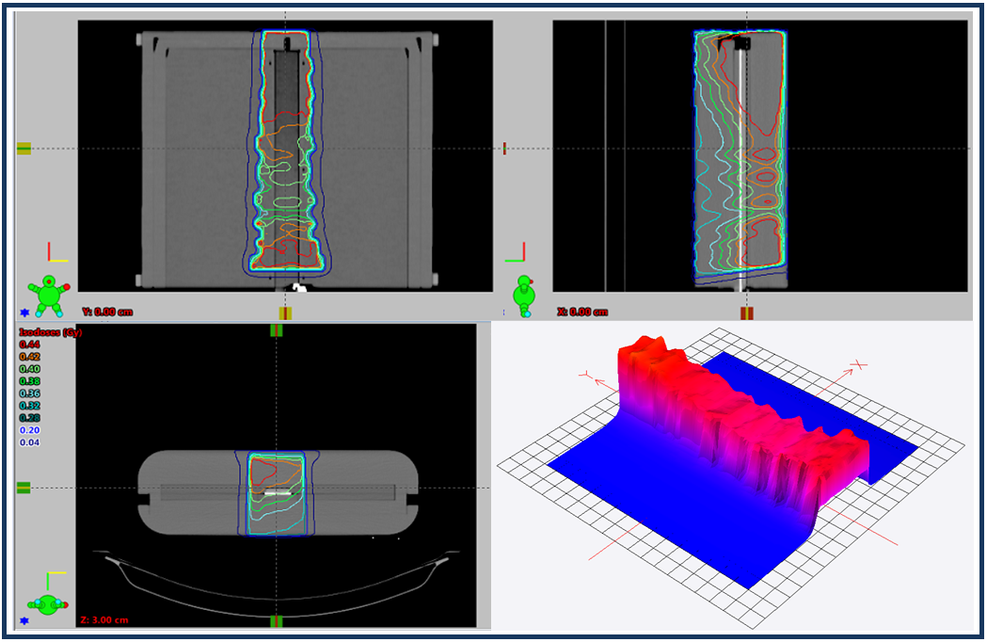
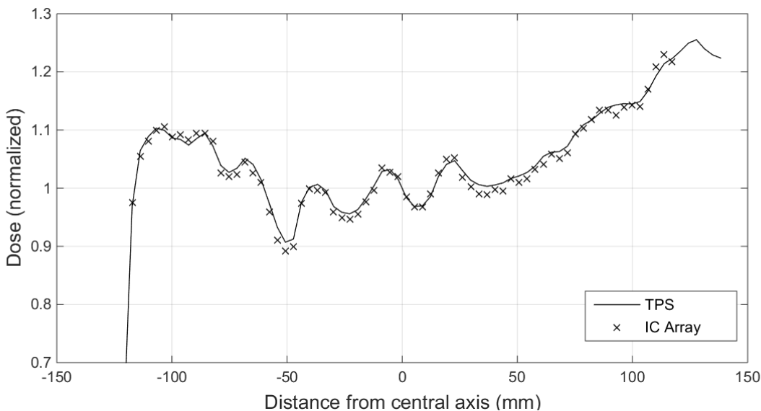
Patient Plan Verification (MV x-rays)
CT imaging of detector + phantom
Dose recalculated on the acquired imagine for a direct comparison
Clinical localization: spine
Technique: sliding window IMRT
(Varian Trilogy linac, 6 MV)
Average difference <1%

Slide 9
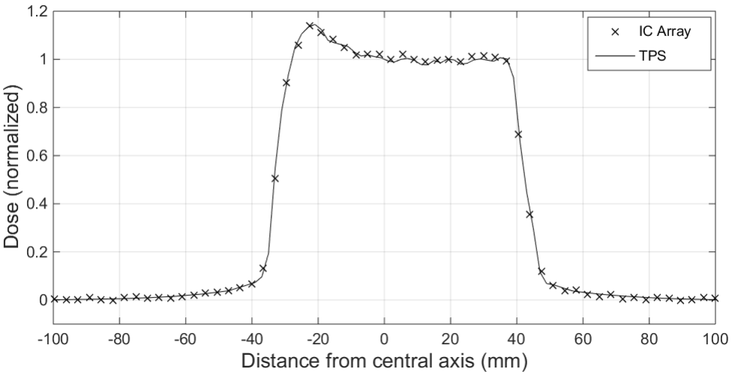
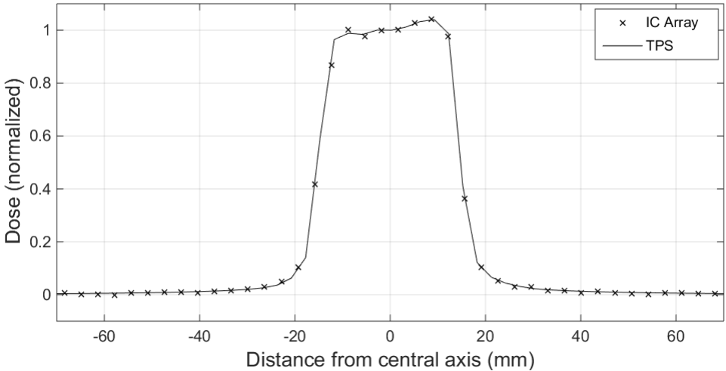
Patient Plan Verification (MV x-rays)
Clinical localization: prostate
Technique: step & shoot IMRT
(Varian TrueBeam linac, 6 MV)
Average difference with TPS <1%, max deviation in the target 2.0% and 1.3%
Clinical localization: lesion at the base of the skull
Technique: VMAT
(Varian TrueBeam linac, 6 MV)

Slide 10
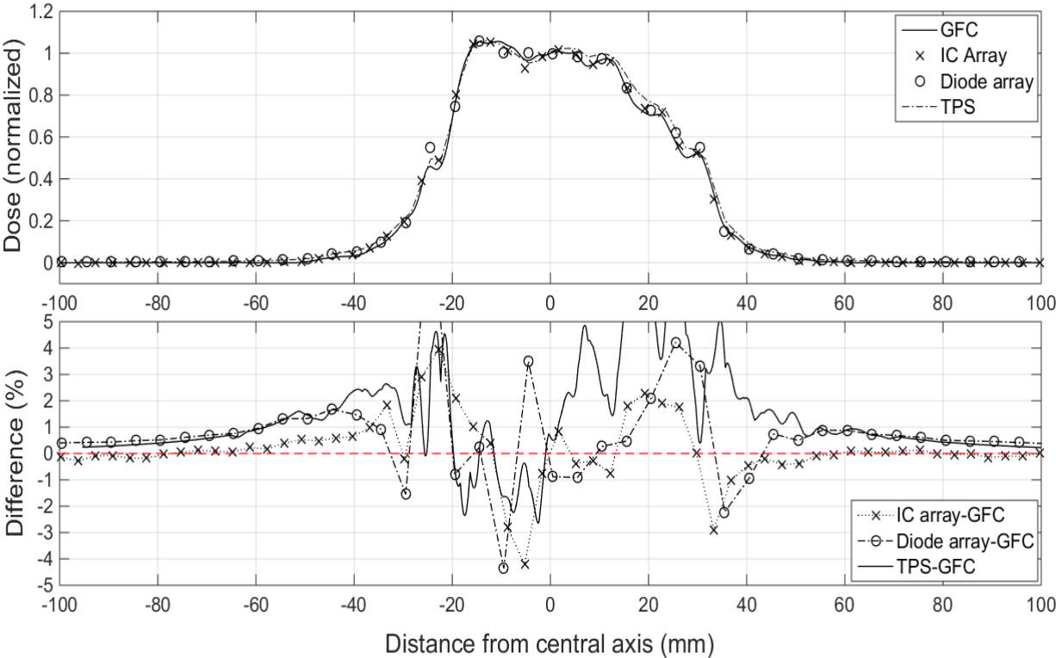
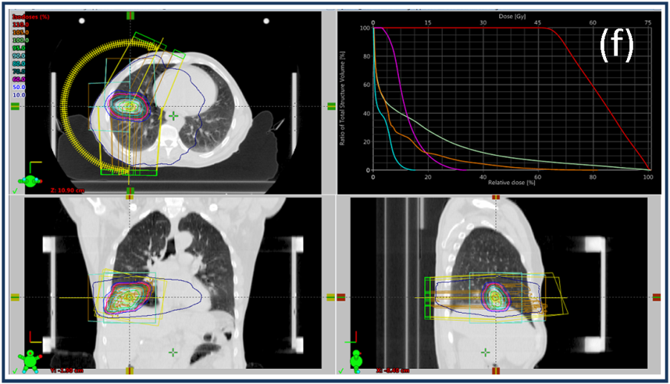
Patient Plan Verification (MV x-rays)
Clinical localization: lung
Technique: VMAT
(Varian Trilogy linac, 15 MV)

Slide 11
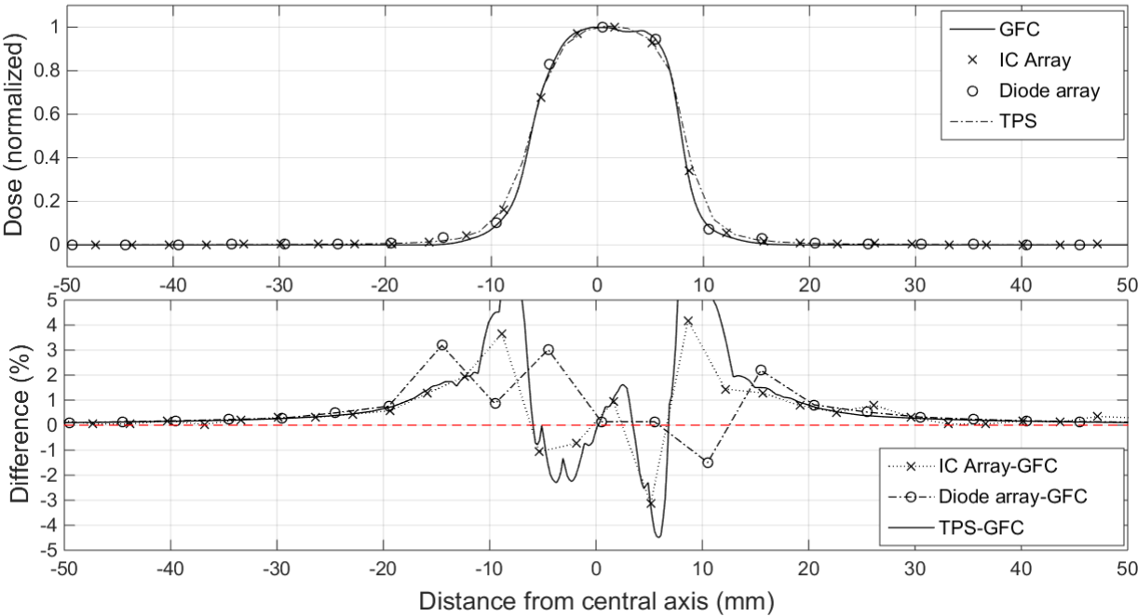
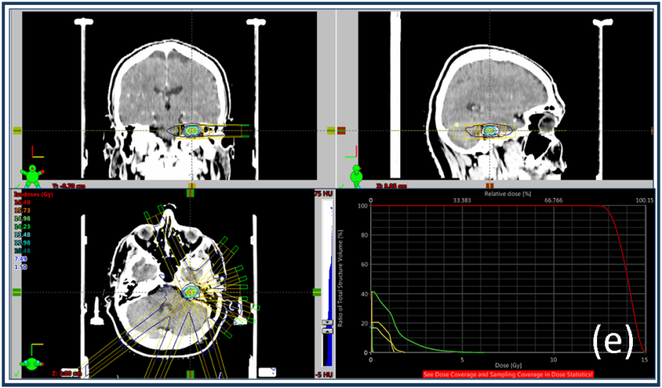
Patient Plan Verification (MV x-rays)
Clinical localization: brain
Technique: SRS – 9 fields
(Varian Trilogy linac, 15 MV)

Slide 12
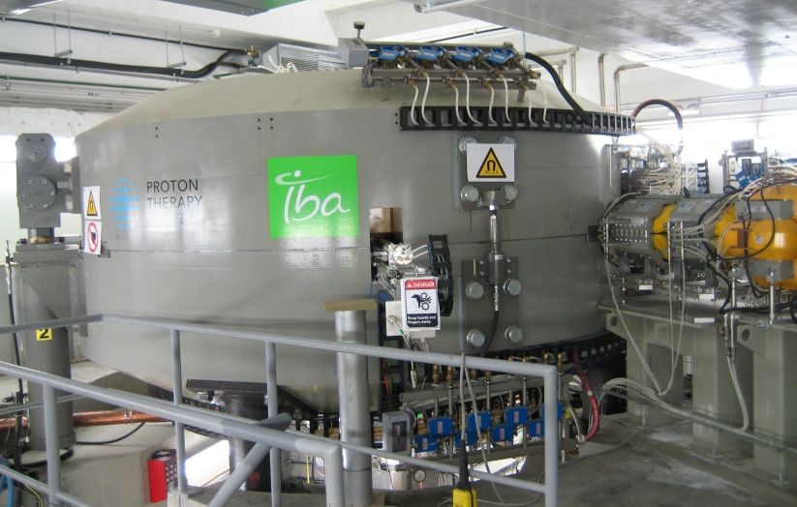

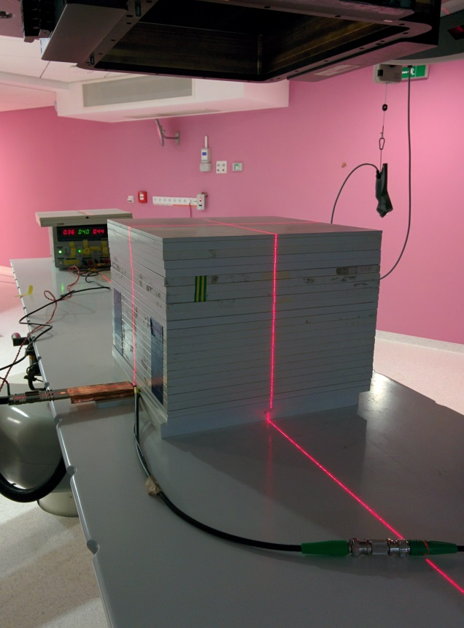
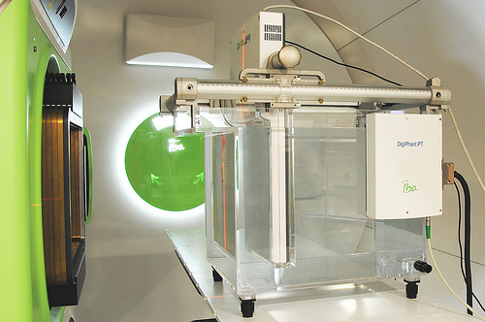
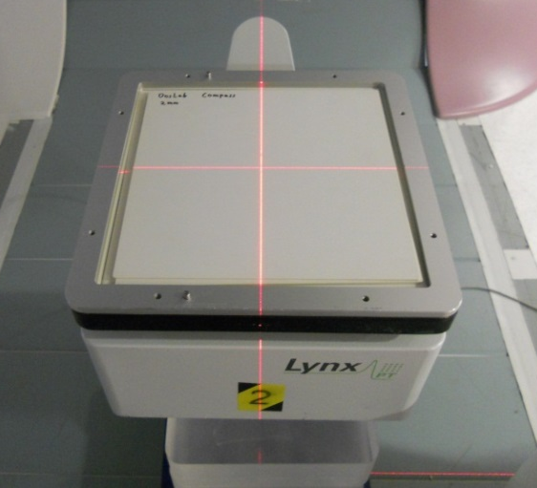
Characterization with p⁺ beams
PBS mode only
∼1ms pulse duration,
∼10ms pulse period,
3.5mm spot σ at 226MeV
Maximum clinical p⁺ current ∼6.2nA
Patient QA
Machine QA

Slide 13
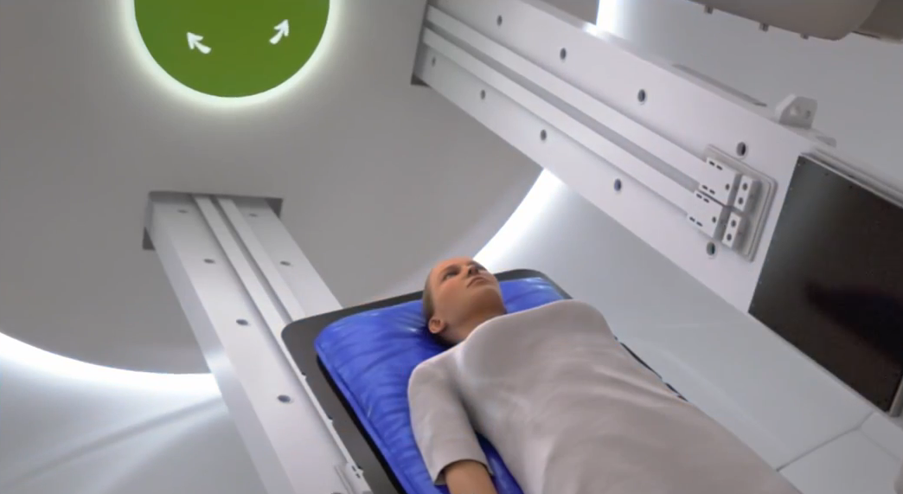
PBS (Pencil Beam Scanning)

Slide 14
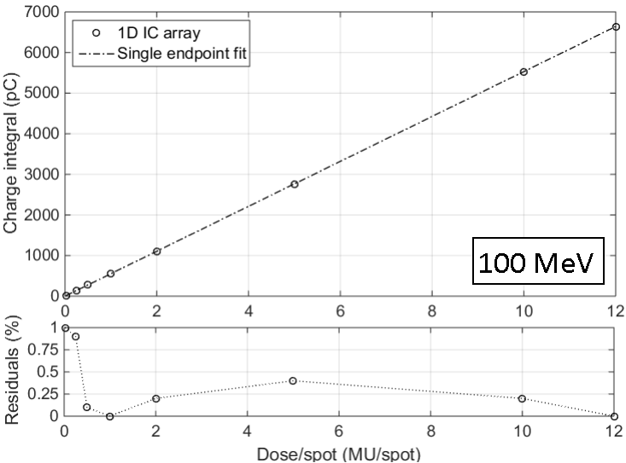

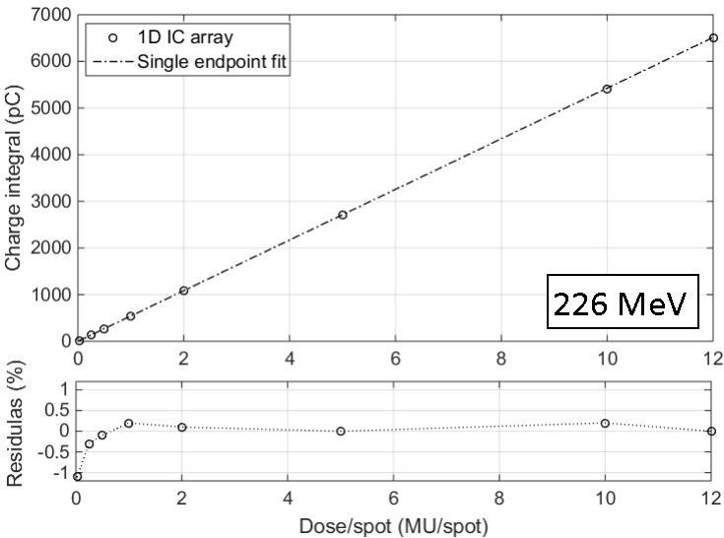
Dose linearity
Dose linearity <±1%
Dose range: 5 cGy ÷ 30 Gy
Dose/spot range: 0.02 MU ÷ 12 MU
2 cm depth of measurement

Slide 15
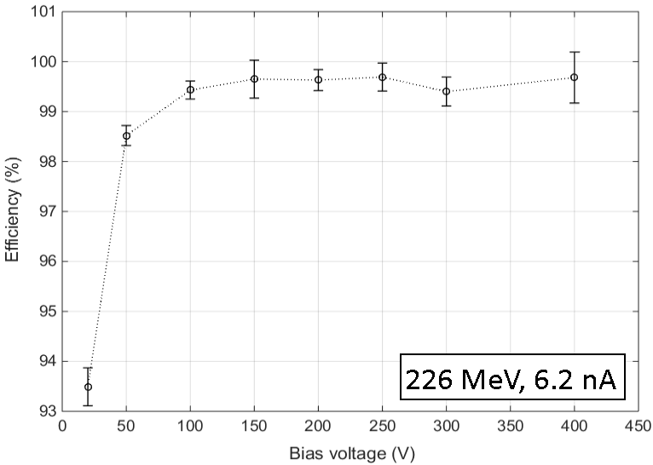
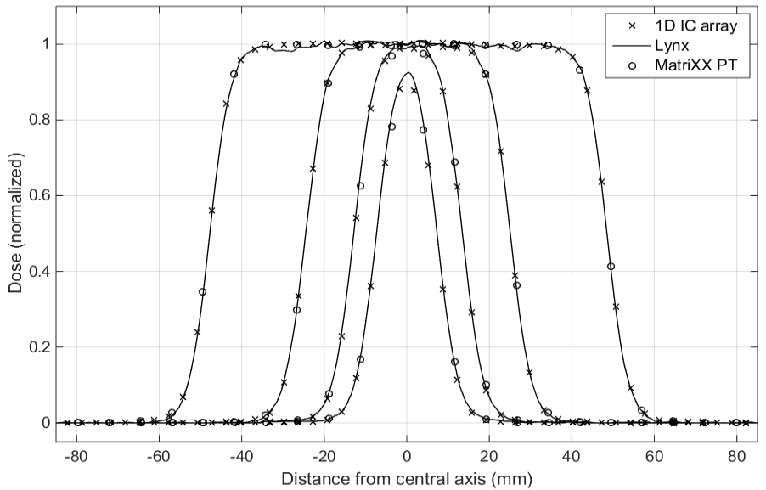
Efficiency & beam profiling
Charge collection efficiency
>99.7% ± 0.3% with 250 V
@ 6.2 nA beam current
Linear dose distributions of different spot map sizes (5x17, 9x17, 17x17, 33x17)
Spot spacing is 2.5 mm; 226 MeV @ 11 m depth of measurement

Slide 16
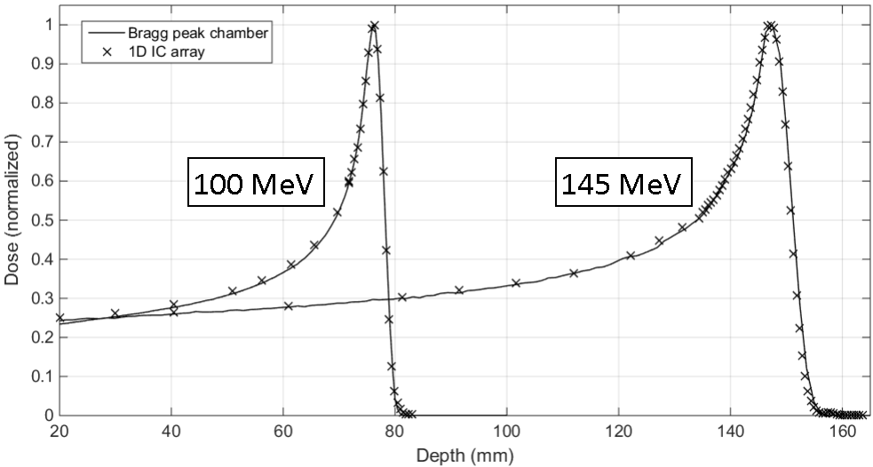
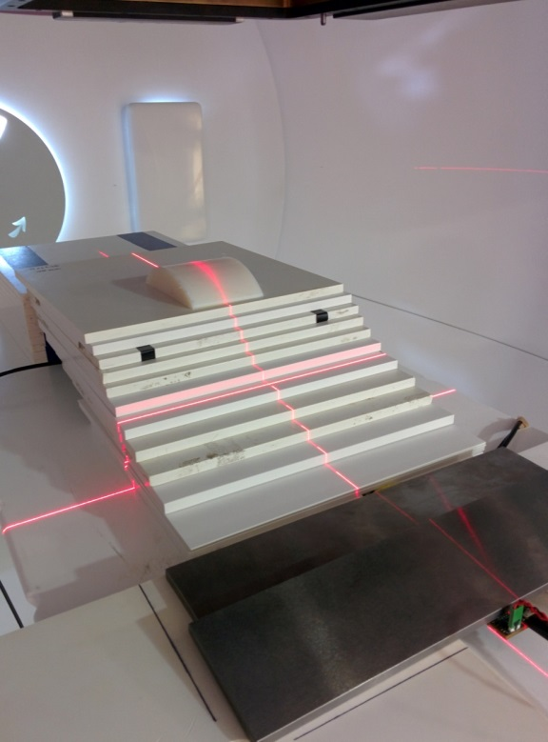

Bragg peak distributions
Pristine Bragg peak distribution @ different energies (measurement performed in only two shots)
Bragg peak chamber as reference

Slide 17
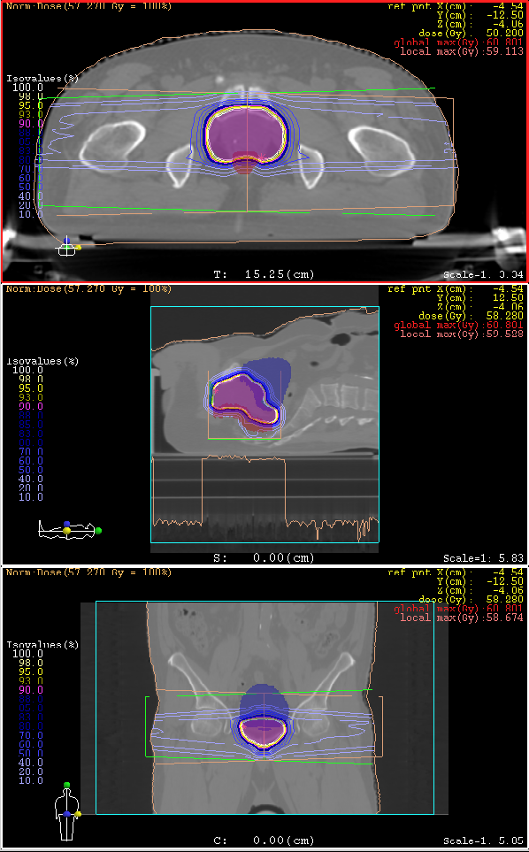
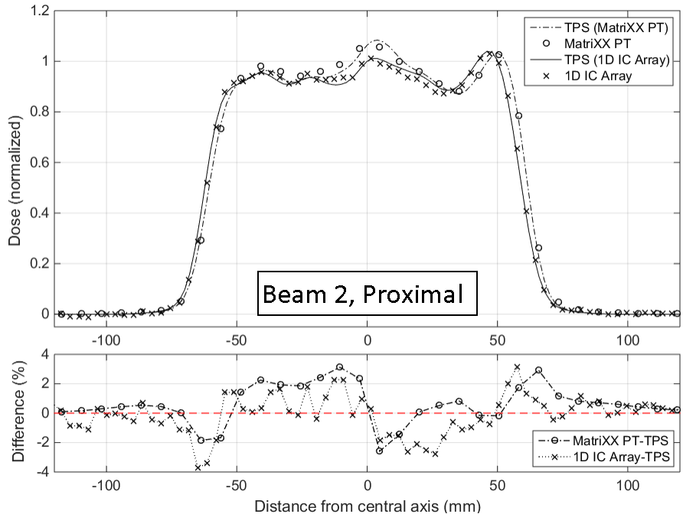
Patient Plan Verification (p⁺)
Clinical localization: prostate
Technique: IMPT, 2 fields 180°
Dose distributions measured in the proximal, middle and distal part of the treatment volume (i.e. @ 17, 20 and 23 cm depth)

Slide 18
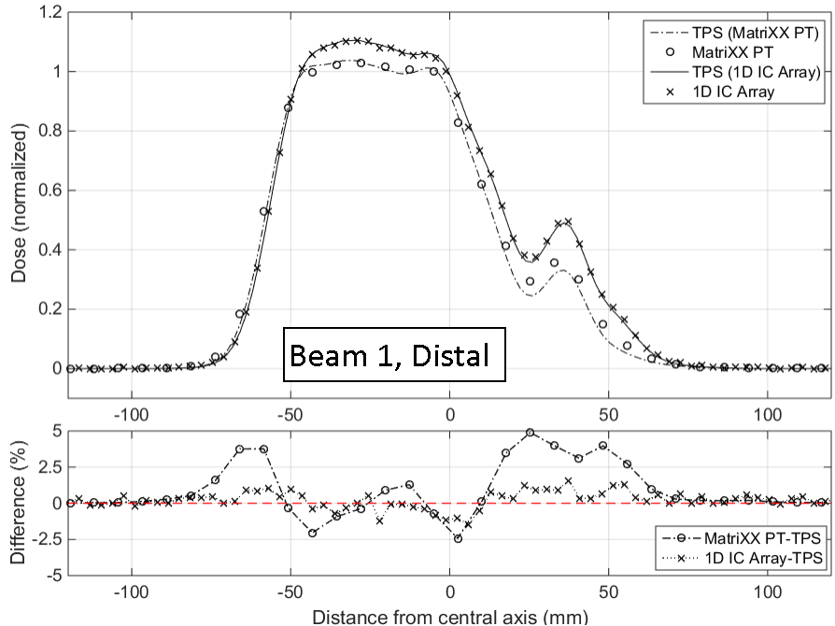
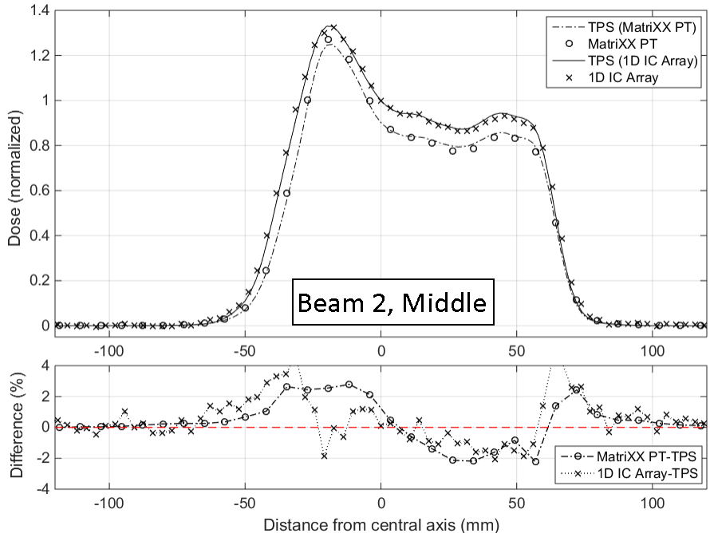
Patient Plan Verification (p⁺)
Slight different setup for the 1D IC array and the MatriXX: TPS distributions have been re-calculated
Average difference with TPS is always below 1%
Good performances when modulation is high

Slide 19
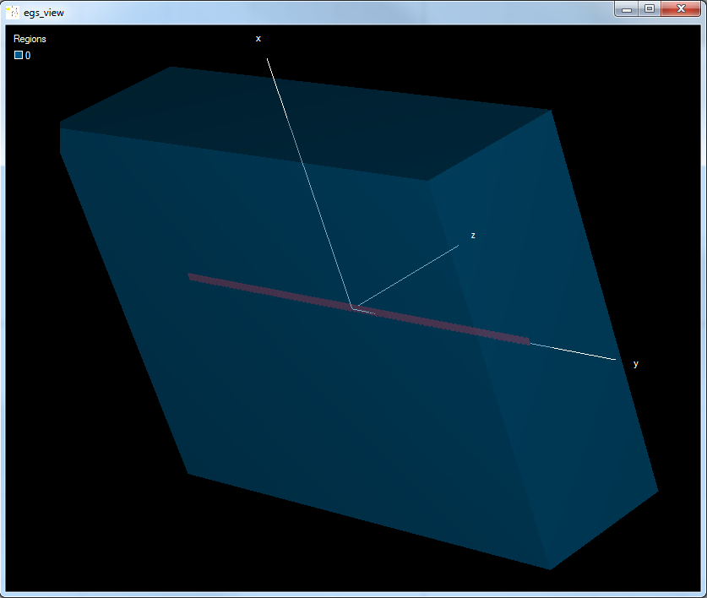
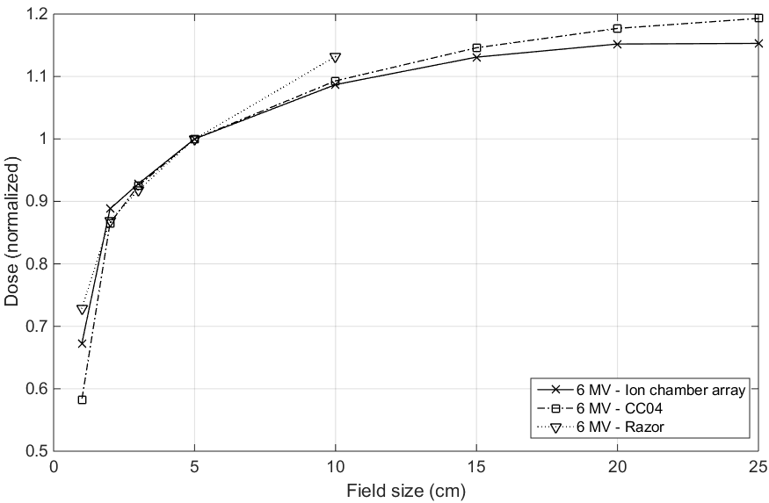
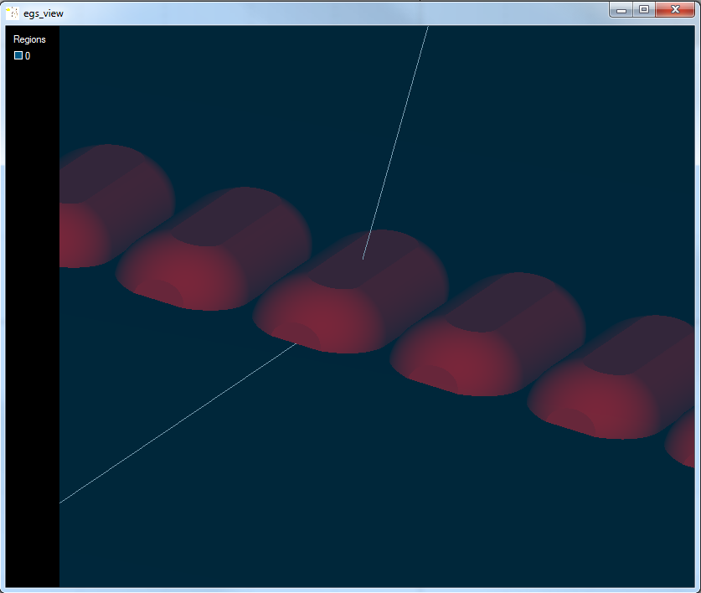
Ongoing activities
Monte Carlo investigation with EGSnrc
Main purpose: find out why the array underestimates the dose (up to 4%) for large fields when measuring the OFs

Slide 20
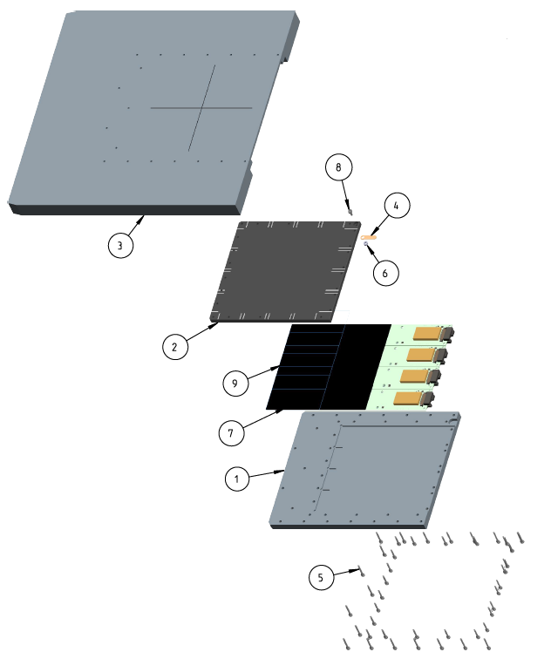
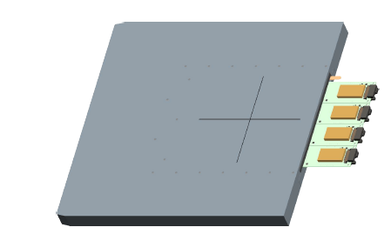
What happens down the road?
Extension to 2D of new IC technology
Slightly modified design but sensitive volume has not been changed; new dedicated firmware and acquisition software
First 2D prototype will feature an active area of 12.8x12.8 cm² (detector ready end of June)

Slide 21
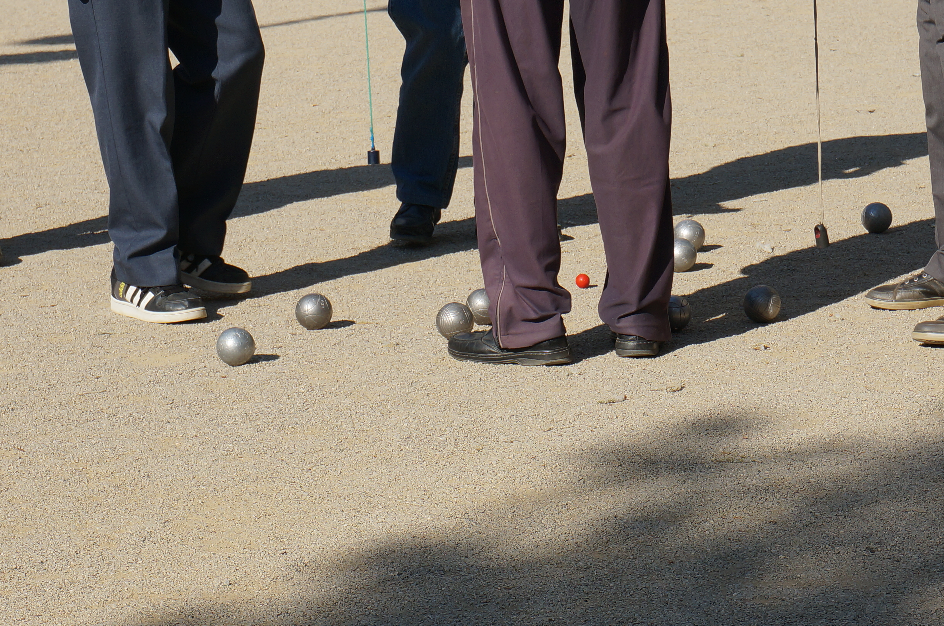
Trainings
Michele Togno - IV ARDENT Annual Meeting, Prague - June, 23rd 2015

Slide 22
B&A training @ STMicroelectronics
Two weeks training at STMicroelectronics (Catania, Italy)
  B&A
  Technical (semiconductor devices production - see Francesca presentation)
  B&A
    Semiconductor Market e company presentation
    Q&R, R&D department presentation
    Development process insight and program management
    Business administration of a corporation
    Business opportunities, market penetration and development
    Funded programs, scope, objectives and opportunities
    IP & Patents

Slide 23
Educational session @ PTCOG 2015
3 days intensive course on proton therapy:
  Physics: rationale for particle, physics of particle beams, basis and models of radiobiology, technical aspects of beam delivery, clinical aspects of beam delivery, treatment planning, scanning beams, radiation shielding, instrumentation, clinical commissioning, uncertainties, quality assurance of systems
  Clinical: new methodologies in clinical treatment of different types of lesions (pediatrics, base of skull, head and neck, central nervous system…); re-irradiation, clinical experience with ions (CNAO)
  Technical: overview on accelerators, beamlines and gantries, patient alignment, how to select and start-up a facility, future outlook on PT

Slide 24
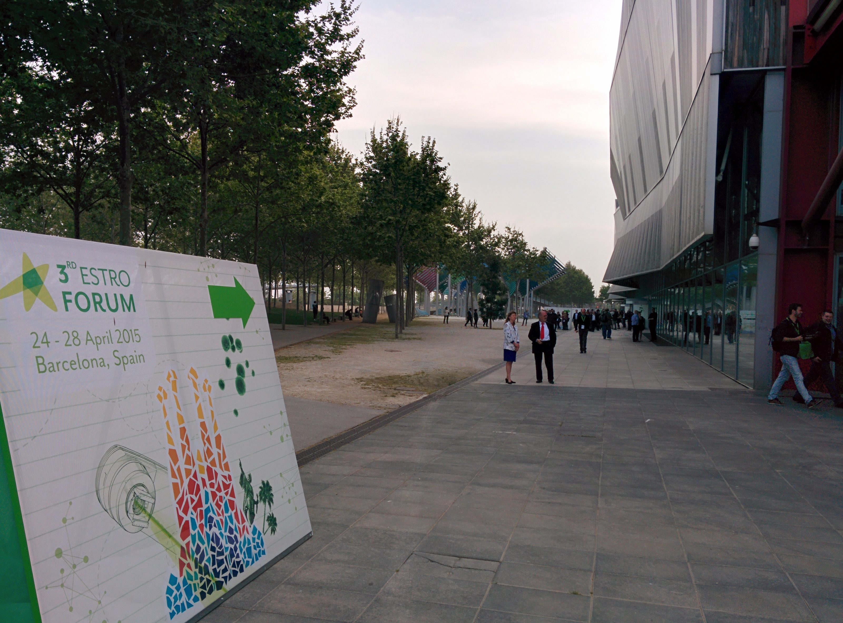
Conferences & dissemination
Michele Togno - IV ARDENT Annual Meeting, Prague - June, 23rd 2015

Slide 25
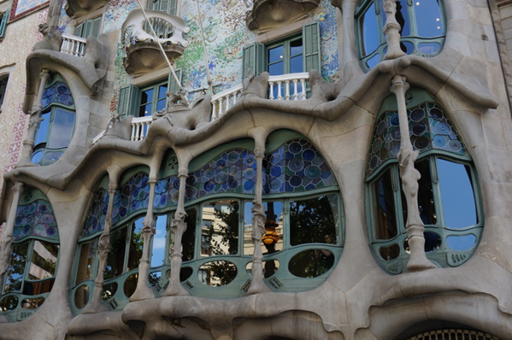

3rd ESTRO Forum 2015 – Barcelona
Physics Biennial Meeting: MRI, 4D imaging, small fields, recent detectors, new technologies in RT, hypo-fractionation and SBRT, side effects, adaptive RT
Young Scientist poster presentation: “Clinical evaluation of an innovative ionization chamber technology for patient quality assurance”
PTCOG 2015 – San Diego (CA)
Scientific Meeting: advances in IMPT and carbon, planning robustness, range uncertainties, tumor motion, in-room imaging
General poster presentation: “Characterization of a high resolution air filled ionization chamber array technology for proton therapy QA”
Med. Phys. “Development and clinical evaluation of an ionization chamber array with 3.5 mm spatial resolution for quality assurance in advanced radiotherapy techniques”
Invited talk at the university (29th June): A new ion chamber technology for QA in external beam radiotherapy

Slide 26
Conclusions
The second prototype based on the new air vented ion chamber technology has been deeply and successfully tested with clinical photon and proton beams
Main features introduced: high resolution for ion chamber based array, long term stability, sensitivity independence on dose per pulse, radiation hardness
Monte Carlo analysis to refine the detector design & performances (in progress)
Results presented at three major conferences in the RT field (AAPM, ESTRO, PTCOG), dissemination through papers is ongoing
New 2D detector assembling nearly done
University activities: tutoring program completed
PhD thesis: ongoing

Slide 27




Make your way
Michele Togno - IV ARDENT Annual Meeting, Prague - June, 23rd 2015

Slide 28
Backup Slides

Slide 29
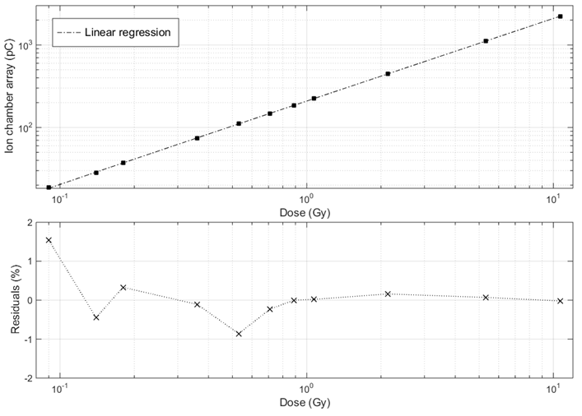
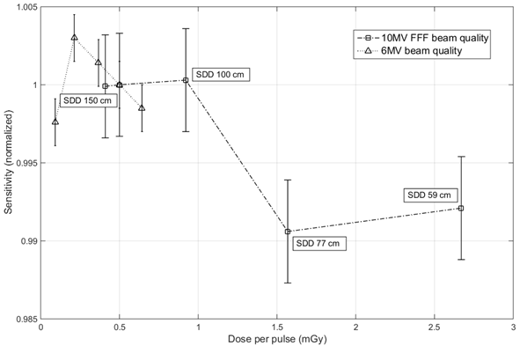
Dose linearity & efficiency

Slide 30
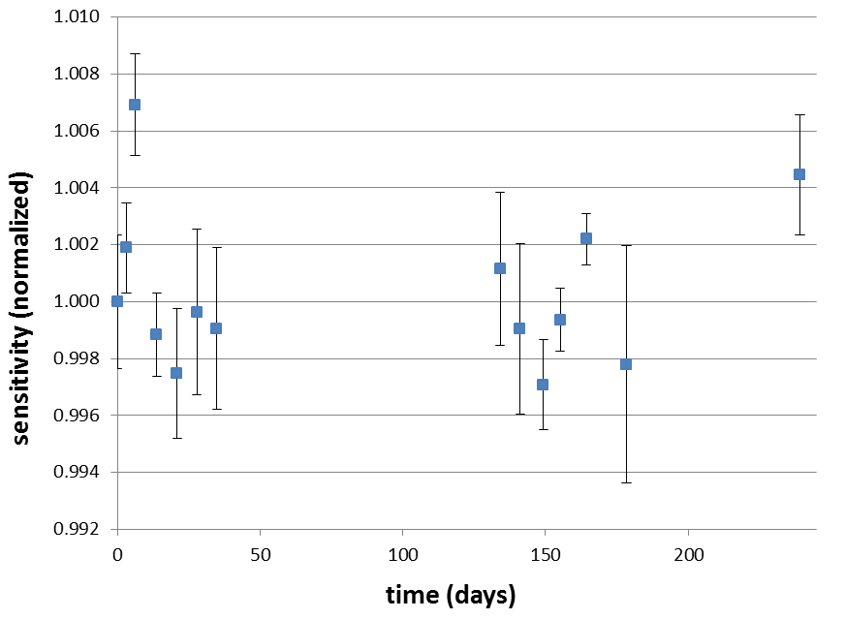
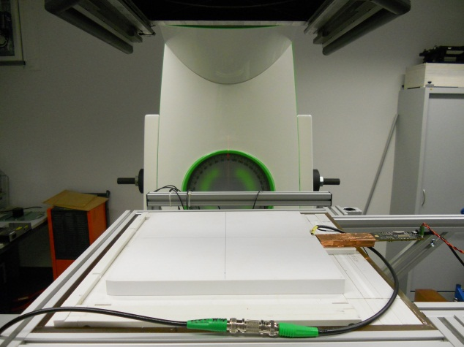
Long term stability
Long term stability is constant within 0.5% (1σ)

Slide 31
1D dose distributions
Penumbra definition for flat 6 MV & 15 MV photon beams (Elekta Agility linac)

Slide 32
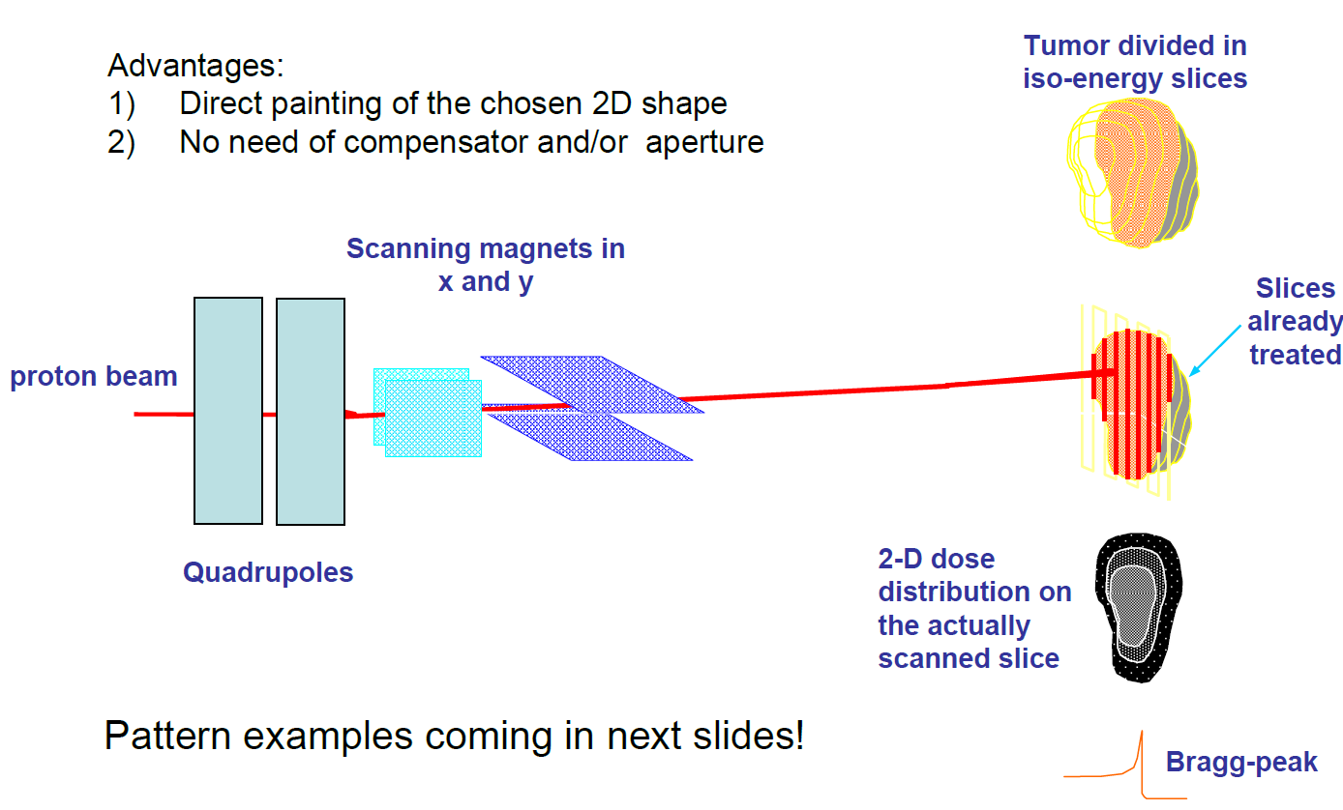
Proton PBS technique

