Slide 1


Francesca Bisello
ESR 10
IV ARDENT
Annual Workshop
22-26/06/2015
Prague
Francesca Bisello, Prague 23-06-2015, IV ARDENT Workshop

Slide 2
Outline:
Research Activities
  Dosepix detector
  1D monolithic silicon array
Trainings, Conferences, Outreach
Future Activities
Conclusions
Francesca Bisello, Prague 23-06-2015, IV ARDENT Workshop

Slide 3
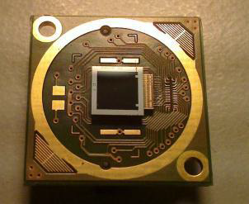
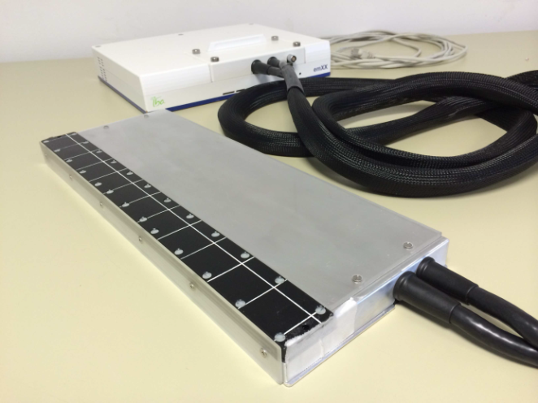
Research Activity:
Semiconductor detectors in clinical QA in radiotherapy and diagnostics
Francesca Bisello, Prague 23-06-2015, IV ARDENT Workshop

Slide 4
Dosepix: QA in Diagnostics- kVpmeter
Non invasive kVp-meter: closely spaced photodiodes filtered by different thickness and materials : time consuming calibration curves
Detector :
Performed studies: 1. Chip Characterization
2. kVp-meter in Mammography (22-35 kV) by the analysis of the impinging spectrum
Single photon counting detector
16 x 16 pixels
Pixels size: 220x220 μm , 55x55 μm
Sensor material : 300 μm silicon
Time-over-Threshold
Programmable front end settings
16 Digital Thresholds /pixel
Francesca Bisello, Prague 23-06-2015, IV ARDENT Workshop

Slide 5
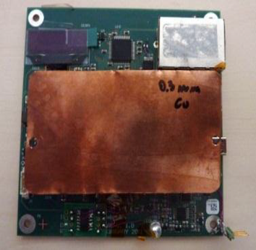
Dosepix: QA in Diagnostics- kVpmeter
Detector characterization I
0.1-0.3 mm Cu additional filtration to prevent spectra distortion due to analog pile up
Tube setting:
30 kV, 20 mAs
Mo-Mo
Big Pixels
Francesca Bisello, Prague 23-06-2015, IV ARDENT Workshop

Slide 6
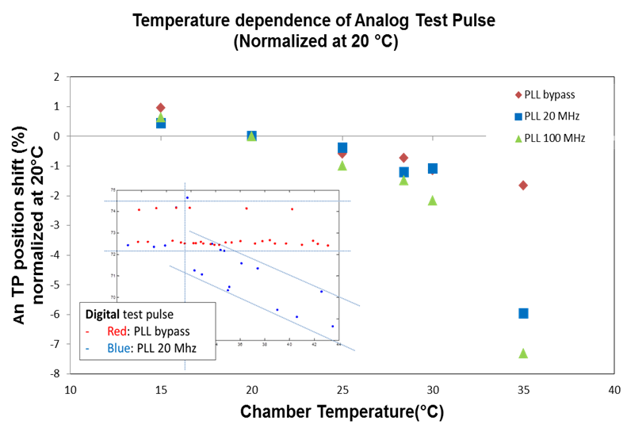
Dosepix: QA in Diagnostics- kVpmeter
Detector characterization II
Source of instability for temperature fluctuation: PLL circuit
Francesca Bisello, Prague 23-06-2015, IV ARDENT Workshop

Slide 7
Dosepix: QA in Diagnostics- kVpmeter
Detector characterization III
Radiation Tolerance studies
Radiation tolerance of the assembly
kVp-meter in radiology based on calibration curves (50 Gy /calibration curve)
Stability of Spectrum (Binning Mode)
Irradiation: 40kV photons, X-Ray tube, W-anode
200 Gy, 50Gy/step, 3 days annealing
Mean
Position 60keV photopeak
0.982 Quantile
Francesca Bisello, Prague 23-06-2015, IV ARDENT Workshop

Slide 8
Dosepix: QA in Diagnostics- kVpmeter
Detector characterization
Radiation Tolerance studies
150 Gy
100 Gy
50 Gy
Francesca Bisello, Prague 23-06-2015, IV ARDENT Workshop

Slide 9
Dosepix: QA in Diagnostics- kVpmeter
Detector characterization
Radiation Tolerance studies
Conclusion
Additional filtration reduce influence of analog pile up (0.1-0.3mm Cu)
Source of instability vs external temperature: PLL circuit
Radiation tolerance studies:
Higher cumulated dose to stabilize the electronics
Deviation within 2%: regulation limit
Re-calibration recovers damages due by radiation
Tests on going:
One chip: 5kGy cumulated dose, 1 months annealing
Francesca Bisello, Prague 23-06-2015, IV ARDENT Workshop

Slide 10
Dosepix: QA in Diagnostics- kVpmeter
kVpmeter Algorithm
Operation Voltage | 22 – 35 kV
Current·s | 20 mAs
Inherent Filtration | 0.3mm Mo
Dose | 1.7-7.4 mGy
Dose Rate | 8.2-21.4 mGy/s
Additional filtration | 0.1 mm Cu
Reference detector:
MagicMax Universal, IBA Dosimetry GmbH, Schwarzenbruck (DE)
Method:
Find the quantile who minimizes the difference with reference detector
Francesca Bisello, Prague 23-06-2015, IV ARDENT Workshop

Slide 11
Dosepix: QA in Diagnostics- kVpmeter
kVpmeter Algorithm
Conclusions:
Experimental method for kVp reconstruction in mammography within regulation
Long term stability on going
Francesca Bisello, Prague 23-06-2015, IV ARDENT Workshop

Slide 12
1D Silicon Array: QA in Radiotherapy
Needs in Radiotherapy: High spatial resolution
Large sensitive area
Radiation Tolerance
Low sensitivity changes with dose-rate ( dose per pulse)
Detector :
Facilities: IBA Dosimetry, ICC Doselab, schwarzenbruck, Germany
Azienda Ospedaliera Universitaria Careggi, Florence, Italy
Perelman Center for Advanced Medicine, Philadelphia, PA, USA
True Beam and Clinac iX, Varian Medical System, Palo Alto, CA
Pennsylvania Hospital, Philadelphia, PA, USA
CyberKnife G4 Accuray Inc., Sunnyvale, CA
Epitaxial monolithic Silicon diodes
1mm pitch
24 cm length
sensitivity changes with dose (0.2%/kGy)
dose per pulse changes (±1% in the range 0.1–2.3 mGy/pulse)
Francesca Bisello, Prague 23-06-2015, IV ARDENT Workshop

Slide 13
1D Silicon Array: QA in Radiotherapy
1. IMRT and SBRT Patient Plan Verification: 6 clinical cases
Comparison with TPS, film and diode array
SBRT, 6MV, clinical site: Liver, SDD : 99.3 cm
1D Array—Film (%) | 2D diode array—Film (%)
0.86 | 1.84
Francesca Bisello, Prague 23-06-2015, IV ARDENT Workshop

Slide 14
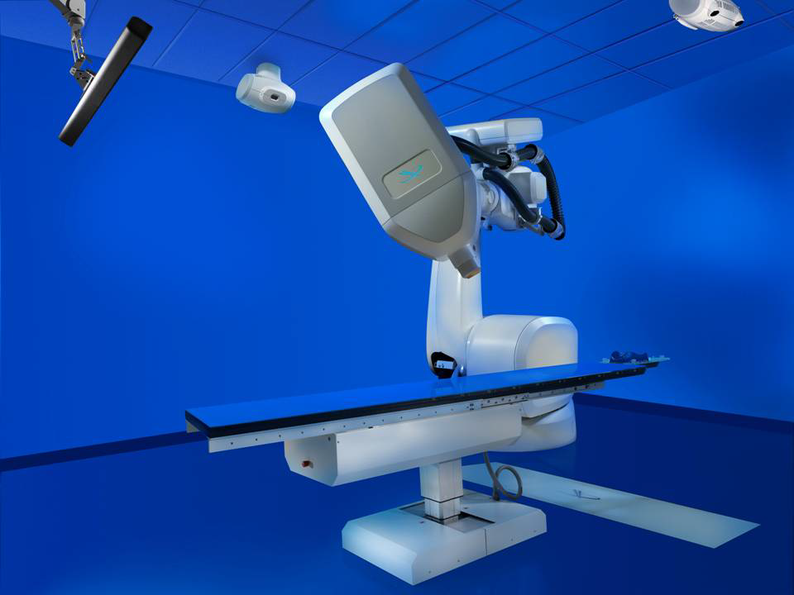
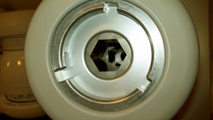
1D Silicon Array: QA in Radiotherapy
2. Machine Quality Assurance
Commissioning of an Iris Collimator for robotic radiosurgery: physical properties
6 degree freedom
Collimator 5 to 60 mm
Constant tumor tracking
- Used in clinics : fields > 10 mm
Francesca Bisello, Prague 23-06-2015, IV ARDENT Workshop

Slide 15
1D Silicon Array: QA in Radiotherapy
Commissioning routine for small photon field
Iris collimator beam profiles:
1D array
Scanning diode
Francesca Bisello, Prague 23-06-2015, IV ARDENT Workshop

Slide 16
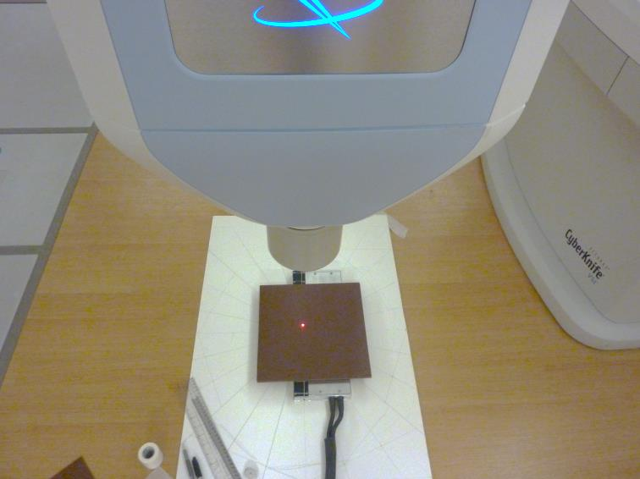
1D Silicon Array: QA in Radiotherapy
Characterization of Iris collimator
G.Echner et al. Phy.Med. Biol. 54 (2009)5359-5380
Transmission
1D Array | 0.09%
Echner et al. | 0.05%
Circularity | σ (mean radius)
1D Array | 0.61% (0.18 mm)
Echner et al. | 0.8% (0.25mm)
Francesca Bisello, Prague 23-06-2015, IV ARDENT Workshop

Slide 17
1D Silicon Array: QA in Radiotherapy
Conclusions
Good performance in dose plan verification of conformational radiotherapy compared with commercial solution
The characterization of Iris collimator provide goods results compared with radiographic films.
Poster Presentation, 57th AAPM Annual Meeting, Anaheim, CA
“ Characterization of a novel high resolution 1D Silicon monolithic array for small field commissioning and quality assurance”
Francesca Bisello, Prague 23-06-2015, IV ARDENT Workshop

Slide 18
B&A Training : ST Microlectronics
12-23 January 2015
B&A topics ( see Michele´s presentation)
Technical topics:
  Steps involved in the wafer processing
  (Photolithography, Ion Implantation, Wet etching…)
  Visit at production lines
Francesca Bisello, Prague 23-06-2015, IV ARDENT Workshop

Slide 19
Conferences
57th AAPM annual meeting, July 12-16, Anaheim, CA
- AAPM DIAGNOSTIC PHYSICS REVIEW COURSE
- Small photon field Dosimetry
Outreach
- Presentation for high school students part of Educational guidance activities
“Physiscs in Medicine: Research and Application”, January 8, 2015
Francesca Bisello, Prague 23-06-2015, IV ARDENT Workshop

Slide 20
Conclusions
Dosepix detector has been characterized in the mammography flux and energies
An experimental method for the kVp reconstruction has been established
Planned activity: simulation of analog pile up in the chip front end
1D monolithic silicon array has been characterized as machine and quality assurance tool
Good agreement with commercial and reference detectors
Next Acitivities: PhD Thesis
Francesca Bisello, Prague 23-06-2015, IV ARDENT Workshop

Slide 21
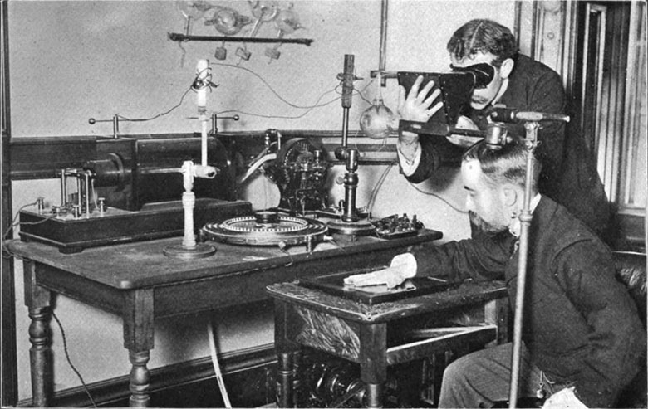
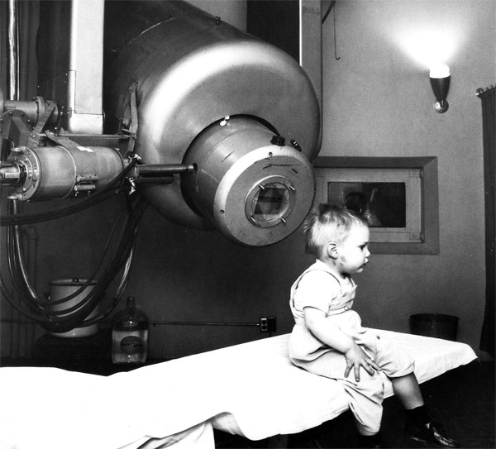
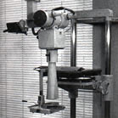
Thank you for your attention
Francesca Bisello, Prague 23-06-2015, IV ARDENT Workshop

Slide 22
Backup

Slide 23
Dosepix: QA in Diagnostics- kVpmeter
Detector characterization
Radiation Tolerance studies
Francesca Bisello, Prague 23-06-2015, IV ARDENT Workshop

