Slide 1
Status BI-TL MADX Optics Studies
C. Bracco

Slide 2
Goal
MADX version of the BI-TL optics: all optics and all 4 rings!
  Crosscheck with “PATH” optics
  Check layout (quads positions etc.)
  Define effect of SC
  Provide MADX optics for quick checks (aperture, steering, etc.)

Slide 3
Optics
Lattice manually derived from “Path” output
“s” coordinates not rechecked wrt existing TL
Quads strengths and initial conditions (start of BHZ20) given by Alessandra
 | L [m] | B [T/m] | B [T/m] | B [T/m]
 |  | Large | Nominal | Small
QFN50 | 0.255 | -1.1909 | -1.1909 | -1.1909
QDN55 | 0.255 | 1.3859 | 1.3859 | 1.3859
QFN60 | 0.255 | -1.82279 | -1.82279 | -1.82279
QDN65 | 0.255 | 1.15105 | 1.15105 | 1.15105
QFW70 | 0.467 | 0.401532 | 0.401532 | 0.401532
QDN75 | 0.255 | -1.46635 | -1.46635 | -1.46635
QFN10 | 0.255 | 1.0816 | 1.0816 | 1.0816
QDN20 | 0.255 | -0.40911 | -0.40911 | -0.40911
QFW30 | 0.461 | -1.40927 | -1.40927 | -1.40927
QDW40 | 0.461 | 1.65575 | 1.65575 | 1.65575
QFW50 | 0.461 | -1.33639 | -1.33639 | -1.33639
QDW60 | 0.461 | 1.06024 | 1.06024 | 1.06024
BI.QN10 | 0.462 | -1.04465 | -1.28068 | -1.04465
BI.QN20 | 0.462 | 1.01876 | 1.22486 | 1.01876
BI.QN30 | 0.462 | -0.96627 | -0.82535 | -1.02548
BI-QN40 | 0.462 | 0.972508 | 0.914672 | 0.99931
BI-QN50 | 0.466 | -1.84028 | -2.13851 | -1.6121
BI-QN60 | 0.466 | 2.015537 | 2.359182 | 1.781536
(X,BGX') 100%-Emittance [m.rad] | 1.47E-05
(X,BGX') 90%-Emittance [m.rad] | 1.36E-06
(X,BGX') RMS-Emittance [m.rad] | 3.26E-07
(Y,BGY') 100%-Emittance [m.rad] | 9.63E-06
(Y,BGY') 90%-Emittance [m.rad] | 1.35E-06
(Y,BGY') RMS-Emittance [m.rad] | 3.15E-07
(PHI,dE) 100%-Emittance [deg.MeV] | 3.45E+01
(PHI,dE) 90%-Emittance [deg.MeV] | 1.09E+00
(PHI,dE) RMS-Emittance [deg.MeV] | 2.52E-01
(X,X') Alpha [1] | 4.43E-01
(X,X') Beta [m/rad] | 2.30E+01
(Y,Y') Alpha [1] | -3.78E-01
(Y,Y') Beta [m/rad] | 2.28E+01
(PHI,dE) Alpha [1] | 6.34E+00
(PHI,dE) Beta [deg/MeV] | 2.74E+03
dx [m] | 3.173212
dyp | -0.02713
dy [m] | 0.021362
dxp | 0.020699
Change sign in MADX (H⁻)

Slide 4
Nominal Betax Ring3

Slide 5
Nominal Bety Ring3

Slide 6
Bump to DIS
QN30 and QN40 (off-centered ➔ SBENDS)
> 0.3 mm wrt 5.19 mm
0.4 mm
Check mutual distance QN30-QN40……(or DVT30 strength)

Slide 7
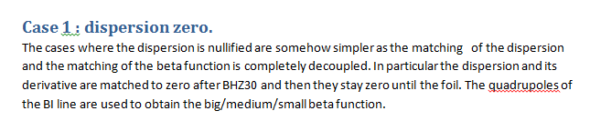
Dispersion
BHZ30
-0.13 m
-0.78 m
BHZ20

Slide 8
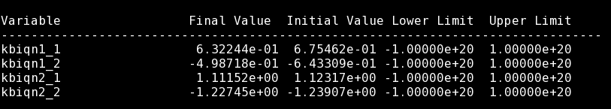
Matching 1
Matching: bx_foil = 5, by_foil = 4, ax_foil = 0, ay_foil = 0
Only BI Quads but QN30-QN40 (not affect bump to DIS)
BI line

Slide 9
Matching 1
Matching: bx_foil = 5, by_foil = 4, ax_foil = 0, ay_foil = 0
Only BI Quads but QN30-QN40 (not affect bump to DIS)
BI line

Slide 10
Matching 1
Matching: bx_foil = 5, by_foil = 4, ax_foil = 0, ay_foil = 0
Only BI Quads but QN30-QN40 (not affect bump to DIS)
Non zero!! (even larger than unmatched case)
BHZ30
-0.22 m
-1.01 m
BHZ20

Slide 11
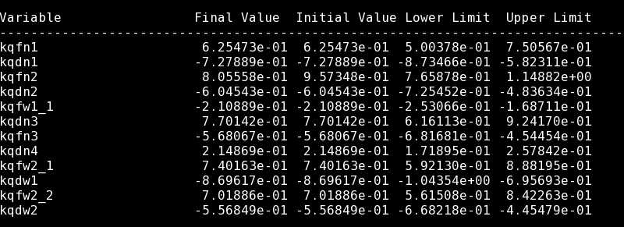
Matching 2
Matching: bx_foil = 5, by_foil = 4, ax_foil = 0, ay_foil = 0
BHZ30
BHZ20

Slide 12
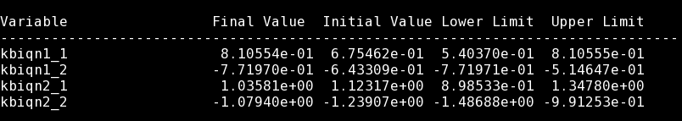
Matching 2
Matching: bx_foil = 5, by_foil = 4, ax_foil = 0, ay_foil = 0
BI line

Slide 13
Matching 2
Matching: bx_foil = 5, by_foil = 4, ax_foil = 0, ay_foil = 0
BI line

Slide 14
Next Steps
Agree on matching (Dispersion ok?)
Define how to take into account SC
Check “s” coordinates (close bump towards DIS)
Optics for TL to 4 rings
Check other optics for all rings (0 dispersion, large and small beta + -1.4 m dispersion, nominal, large, small beta)

