Slide 1
Emittance vs Intensity
(~LHC beams)
E. Benedetto
LIU injection meeting
13/10/2014

Slide 2
Emittance vs. Intensity curve
Simulate the curve with Linac4
Measured
Extrapolated ~βγ²

Slide 3
Simulations with PTC-Orbit
Transversely MATCHED distribution (Gaussian) (*)
  With a given emittance
  Scan on the Intensity
  Scan on the working point
Let it evolve for ~7ms, during the fall of the chicane bump
Quadrupolar errors at the BSW + eddycurrents + Compensation QDE3, QDE14 (time varying)
  Beta-beating (mostly in vertical)
  Excitation of half-integer
  Excitation of the integer line
Should be enough… (?)
(*) In longitudinal (for the time being): I let a “rectangular” distribution evolve in an accelerating bucket, h1+h2. NOT YET optimized…

Slide 4
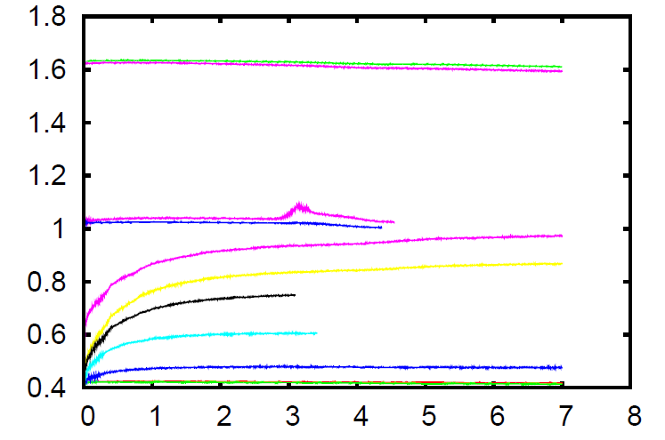
Emittance evolution
(Ex*+Ey*)/2
350e10
350e10
350e10
350e10
175e10e10
ms
…Forgive me for the zoo of lines !!!

Slide 6
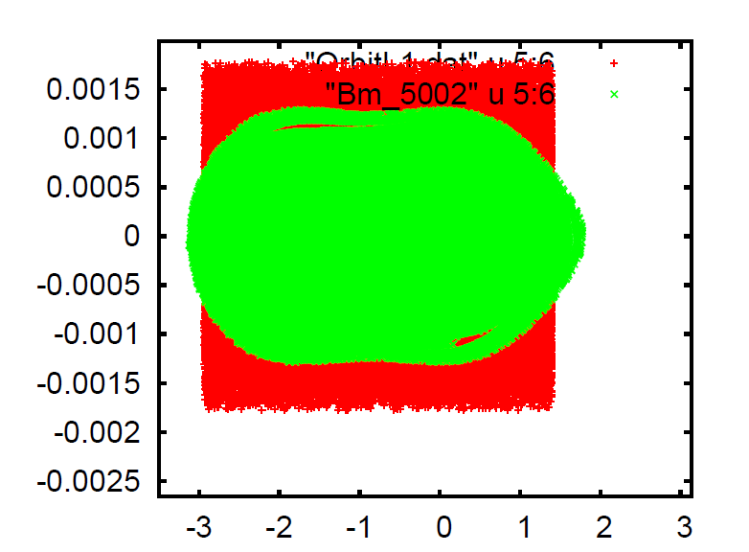
Longitudinal emittance
ΔE=0.6e-3 rms
680ns

Slide 7
Summary
First ~rough approach
Assuming no specific L4 intensity, no painting, Gaussian beams.
Longitudinal emittance should be computed!!!
Scan on the working point:
  Expect some gain in the H plane if going far from Qx=4.0
  It should work since not a conventional MultiTurn inj (losses at septum!).
What does it happen if transverse painting @ different Qx?

