Slide 1

H⁻ injection simulations
13th October 2014
Jose L. Abelleira, Chiara Bracco

Slide 2
Current issues
Issue with cluster SCL6 (only PTC ORBIT)
Finding way to adapt the code from ORBIT to PTC ORBIT (with help of F. Schmidt and Sarah Cousineau, ORLN)
Teapot.cc
ORBIT version used current PTC ORBIT
buildTPlattice(const String &MADTwissFile,
const String &MADLATFile,
const Integer &nstepTPD,
const Integer &fringeD,
const Integer &nstepTPM,
const Integer &fringeM,
const Integer &nstepTPQ,
const Integer &fringeQ,
const Integer &nstepTPB,
const Integer &fringeB,
const Integer &nstepTPS,
const Integer &fringeS,
const Integer &nstepTPK,
const Integer &fringeK)
buildTPlattice(const String &MADTwissFile,
const String &MADLATFile,
const Integer &nstepTPD,
const Integer &nstepTPM,
const Integer &fringeM,
const Integer &nstepTPQ,
const Integer &fringeQ,
const Integer &nstepTPB,
const Integer &fringeB,
const Integer &nstepTPS,
const Integer &nstepTPK)
replaceTPQ(const String &n, const Integer &order,
const String &et, const Real &tilt,
const Real &kq,
const Integer &nsteps,
const Integer &fringeIN,
const Integer &fringeOUT)
replaceTPQ(const String &n, const Integer &order,
const String &et, const Real &tilt,
const Real &kq,
const Integer &TPsubindex,
const Integer &nsteps,
const Integer &fringeIN,
const Integer &fringeOUT)

Slide 3
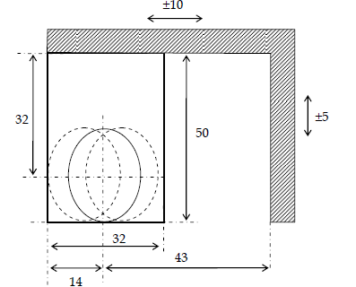
Current work. assumptions
All simulations run with this foil size
And taking into account a current of 26 mA at injection (from the 50 mA at the source)

Slide 4
status
Define optimum KSW waveforms for ISOLDE
Add aperture tolerances (± 1 mm) and check impact on losses (ISOLDE)
Check if any improvement is obtained combining a horizontal offset and painting.
Provide Elena with best distribution (ISOLDE)
Vary bx of the initial distribution from 5.6 m to 2.5 m and see if, by varying the KSW waveform, any improvement (more uniform distribution) is achievable (ISOLDE)
Vary the horizontal tune (ISOLDE):
MATLAB code to simulate ideal (linear) particle evolution in the phase space to study the influence of the tune in the painting without ORBIT simulation

Slide 5
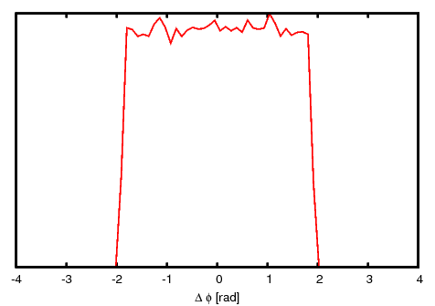
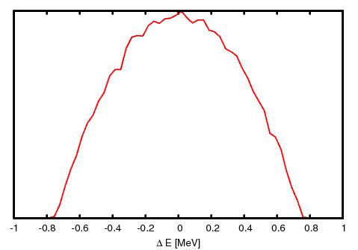
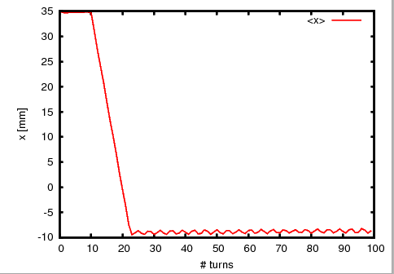
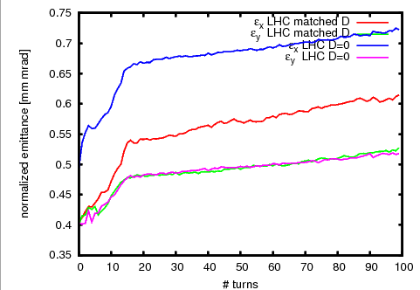
Results : LHC beam
1.62x10¹² particles
5x10³ macroparticles
No longitudinal painting. σ_{ΔE}=336 keV
sim62 sim63
10-turn injection

Slide 6
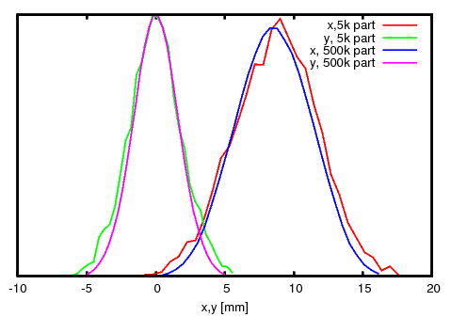
Results : LHC beam
Beam profile after 100 turns
sim62
sim36

Slide 7
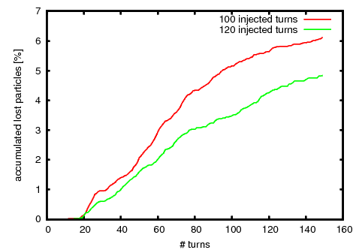
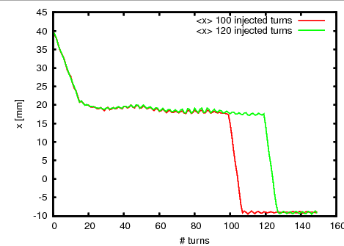
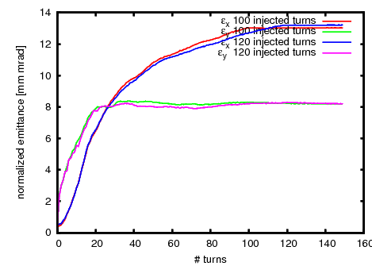
Results : ISOLDE beam
Longitudinal painting
100 turns, 1.60x10¹³ part
120 turns, 1.95x10¹³ part
5x10³ macroparticles
Vertical offset : 10 mm
Too many losses
I₁=0.57*35 mm
t₁=15 μs
I₂ =0.50*35 mm
t₂=[100,120] μs
ε_{x}=13 μm
ε_{y} = 8 μm
sim55
sim56

Slide 8
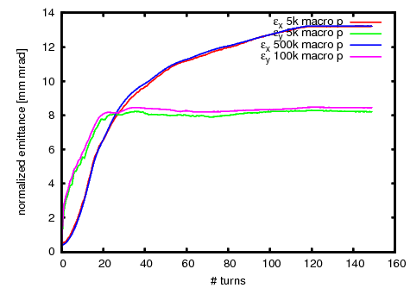
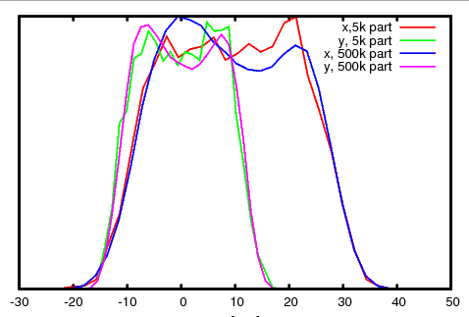
Results : ISOLDE beam
For 120 injected turns, compared with a full simulation with 500k macro particles
sim56
sim58

Slide 9
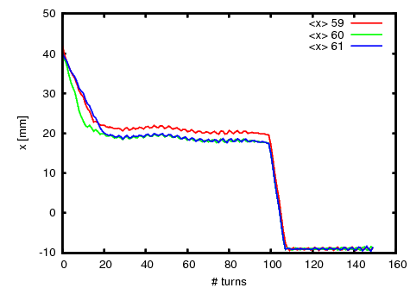
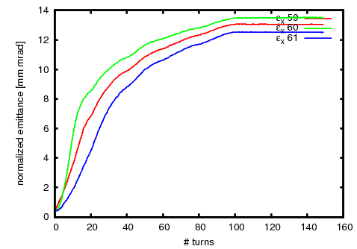
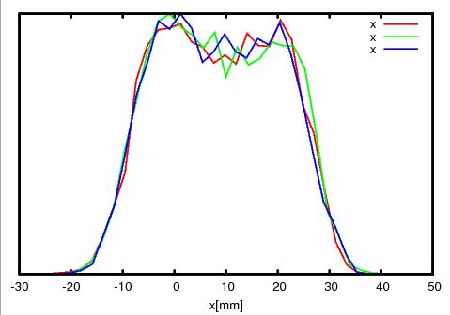
Results : ISOLDE beam
Influence of transverse offset
    -no change appreciated with 5k particles (more resolution needed)
 | x_offset
sim59 | -2
sim60 | 0
sim61 | -2

Slide 10
Planing
Revise aperture and add tolerances for ISOLDE beam. (17/10/2014)
Tune study. Matlab model simulating injection for different turns. (17/10/2014)
Verify the previous results with 500k particles. 22/10/2014
With PTC-ORBIT
Try with βx=5.5->2.5 (22/10/2014)
Repeat x_offset study (22/10/2014)

Slide 11
Conclusions
5k macroparticles seem enough to adjust the KSW waveform, as no big effect from spacecharge on the order of injection time
Still need 500k to define well the beam profile, and to verify emittances.

Slide 12
