Slide 1
Tracking studies with high intensity beam (160MeV case)
Magdalena Kowalska
supervised by Elena Benedetto
LIU-PSB Injection Studies Meeting
13 October 2014

Slide 2
Goals of the studies
Fact: With the H- injection we will have the possibility to paint transverse profile of the beam.
The main goal is to determine the best beam profile in terms of emittance and intensity preservance, to reduce the halo and to minimize the losses.

Slide 3
Current studies and results
Studies made using PTC-ORBIT
Intensity = 1100 e10
Number of macro particles = 500 000
Transverse bin = 256x256
Longitudinal bin = 128
10000 first turns at 160 MeV
Assuming no acceleration and no ramp of the magnets
Super Gaussian transverse distribution
Normalized horizontal emittance = 15 mm mrad
Normalized vertical emittances 10 mm mrad

Slide 4
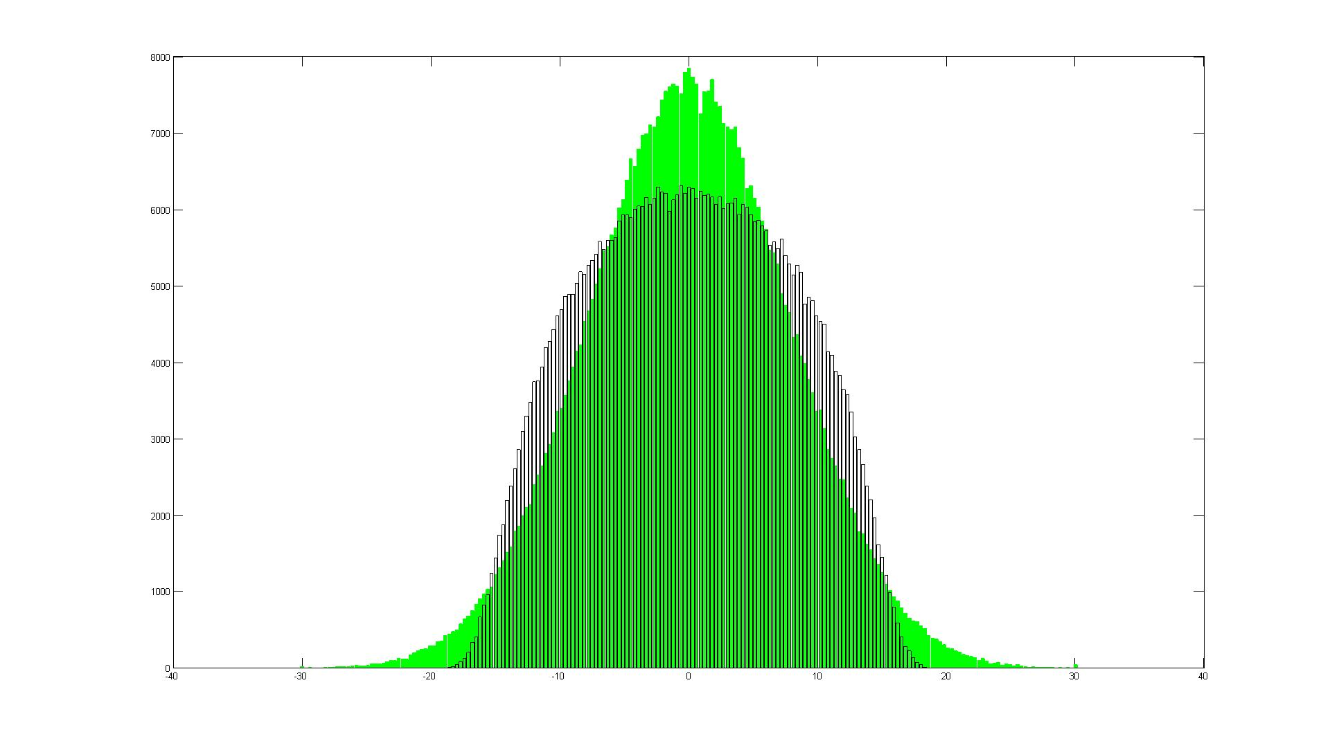

Studies of the best beam profile
(vertical plane), 160 MeV case
Formula for Super Gaussian distribution:
$g\left(x\right)= \frac{1}{\sqrt{2π }σ_{0}}exp (\frac{{−\left(abs\left(x\right)\right)}^{N}}{2σ_{0}^{N^{}}})$
with $σ=σ_{0}{(\frac{π}{2}) }^{\frac{2}{N}−1}$
Comparison between Supergaussian distribution for N=10 (in bars) and N=2 (in green)

Slide 5
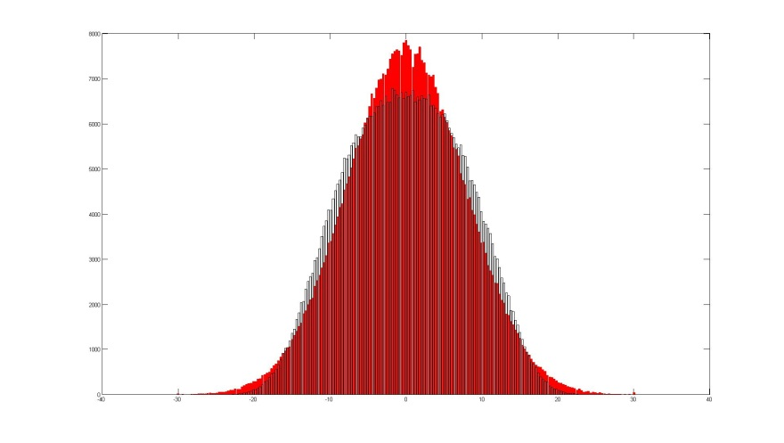
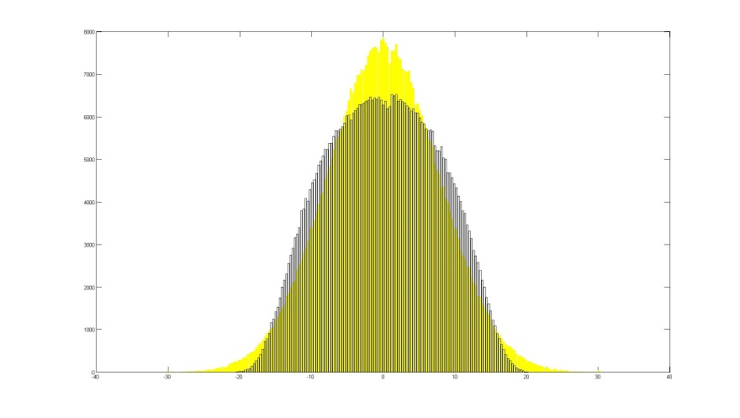
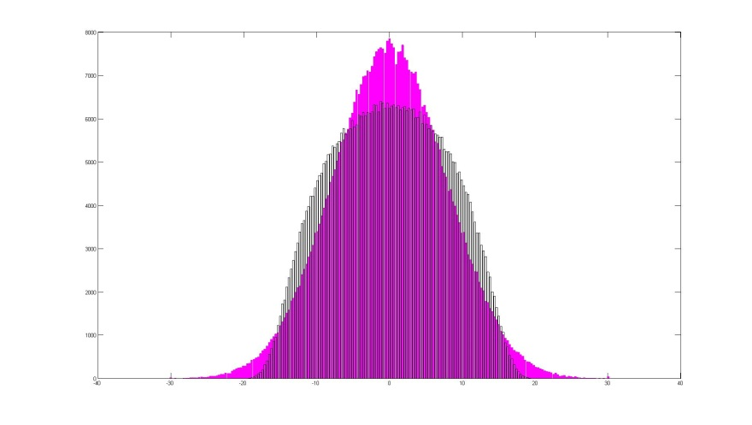

Studies of the best beam profile
(vertical plane), 160 MeV case
Supergaussian
with N=2 vs N=4
y plane
Supergaussian
with N=2 vs N=6
y plane
Choice of the N parameter influence the beam profile shape.
Supergaussian
with N=2 vs N=8
y plane
Supergaussian
with N=2 vs N=8
y plane
Supergaussian
with N=2 vs N=10
y plane
Distributions generated for different N with the same horizontal and vertical emittances.

Slide 6
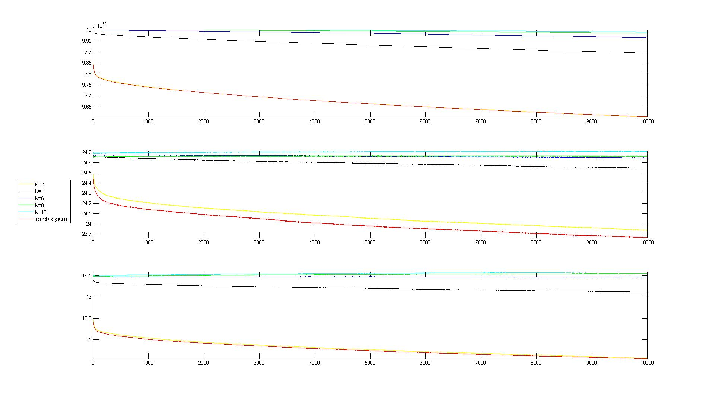
Studies for different beam profiles
Intensity evolution
Legend:
standard
Gauss
N=2
N=4
N=6
N=8
N=10
Losses decrease with increasing N
RMS horizontal emittance evolution
Emittances evolution follow the losses pattern
RMS vertical emittance evolution

Slide 7
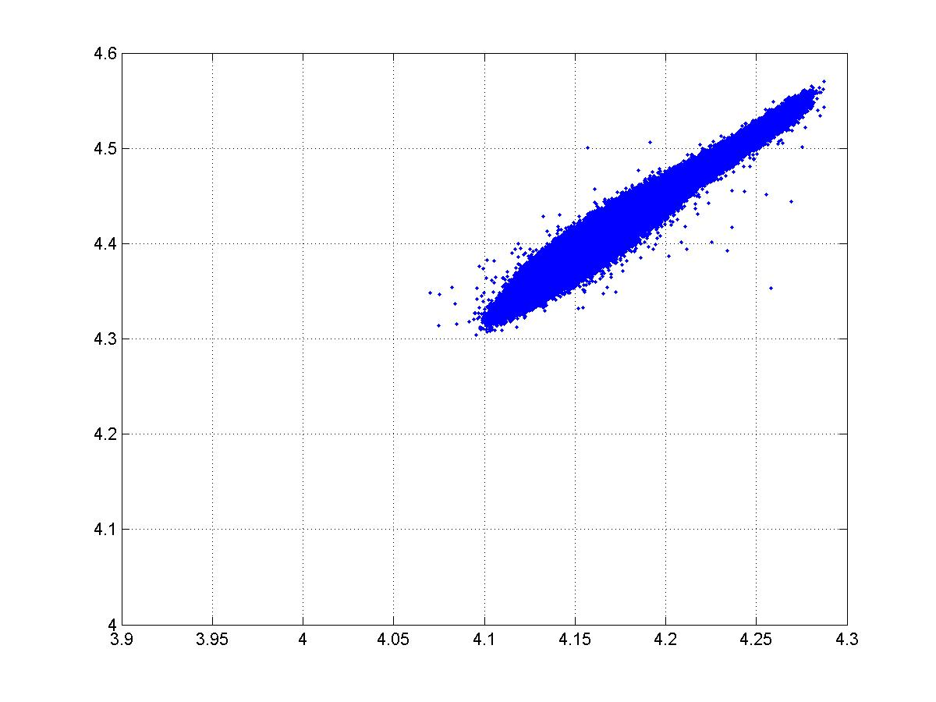
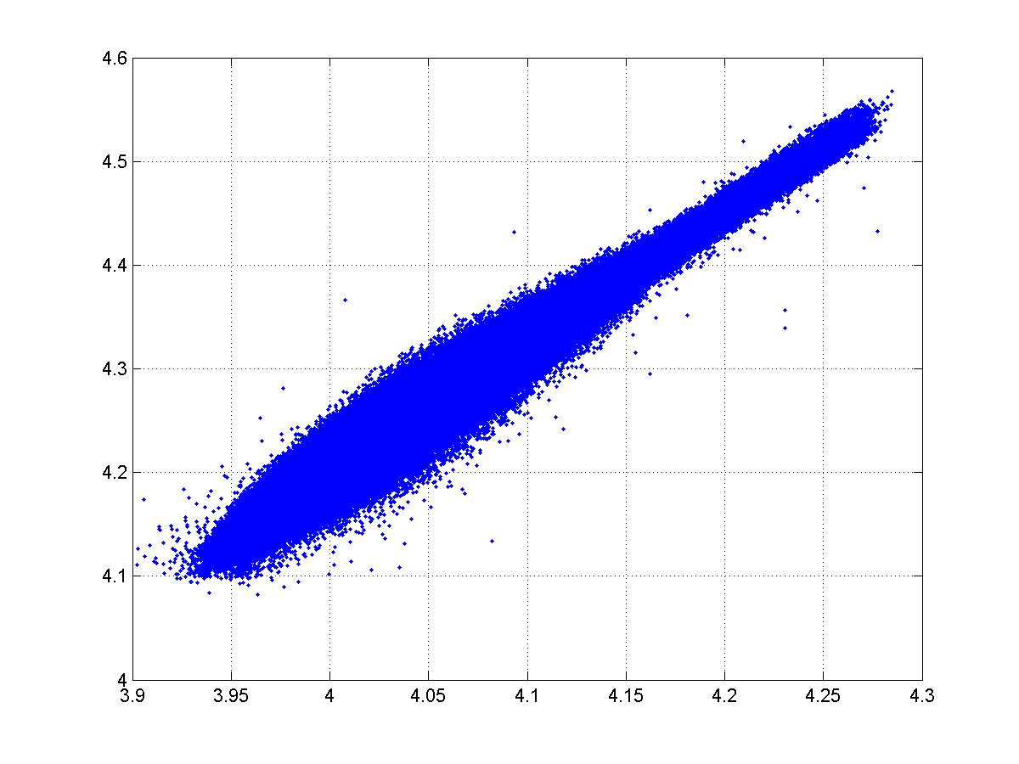
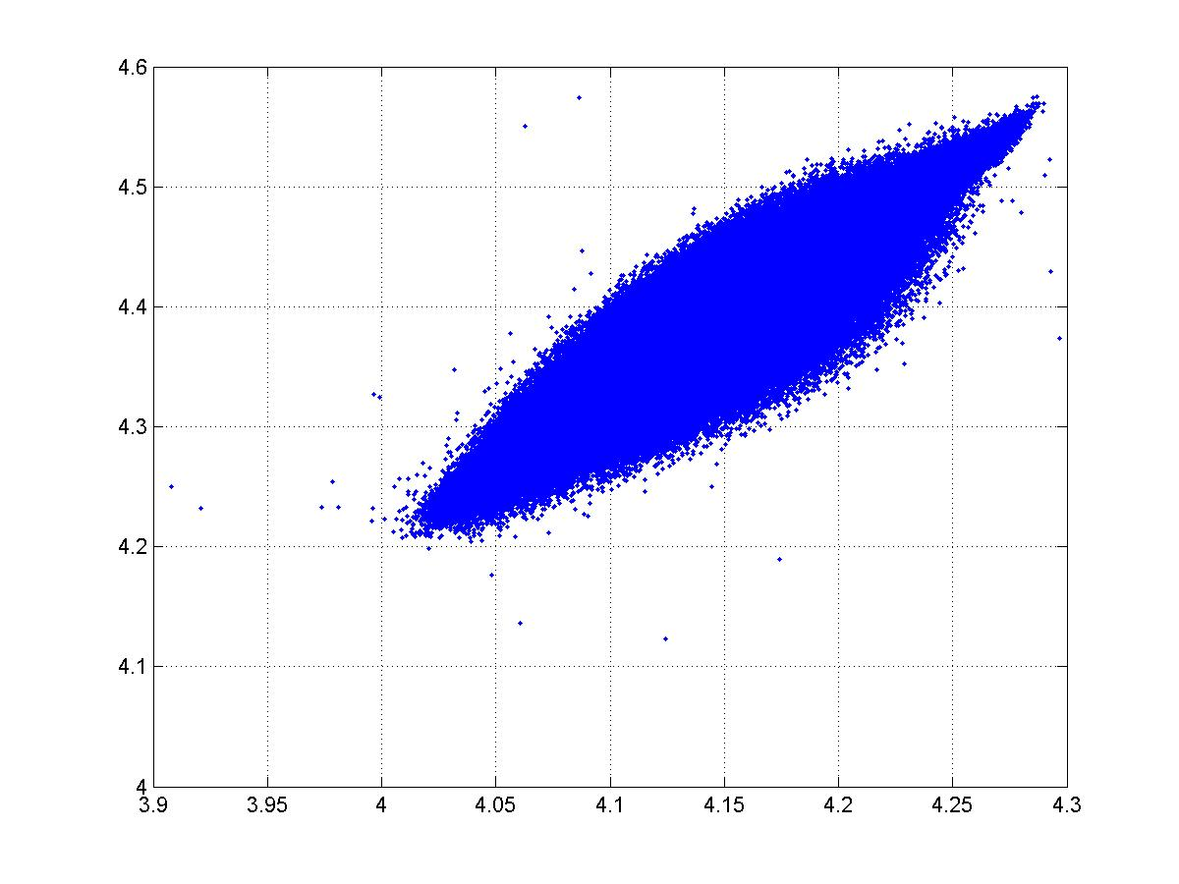
Tune spread as a function of beam profile (peak height), 160 MeV case
ΔQx = 0.180
ΔQy = 0.245
Tune footprint for Supergaussian N=10 at 160 MeV
ΔQx = 0.345
ΔQy = 0.449
ΔQx = 0.264
ΔQy = 0.349
Tune footprint for Supergaussian N=2 at 160 MeV

Slide 8
Work plans
and
Determine the beam parametres at injection for H- 160 MeV case (intensity, emittances)
Run the simulation for assumed scenarios
Run the simulations for the painting scheme (i.e. the KSW functions and offsets) produced by Jose and Chiara

Slide 9
Summary and outlook
It would be nice to determine the initial beam parameters and how flexible we are in terms of the transverse painting (open question to the others)?
Super Gaussians, with exponent > 6, seem to represent quite well HI beam transverse profile.
Measurements at 160 MeV are foreseen for incomming days in order to observe real beam and to perform the best fit for the transverse profile.

Slide 10
Tune spread as a function of beam intensity (peak height), 160 MeV case
ΔQx = 0.180
ΔQy = 0.245
Tune footprint for Supergaussian N=10 at 160 MeV
ΔQx = 0.345
ΔQy = 0.449
Tune footprint for Gaussian N=10 at 160 MeV with double intensity

