Slide 1
Advanced FPGA design
Andrea Borga
andrea.borga@nikhef.nl

Slide 2
Outline
First part: theory
  … from the previous lesson
  Considerations on Hardware Description
  Gateware workflow
  Takeaway thoughts
Second part: practice
  Eye diagrams
  Pseudo Random Bit Sequences (PRBS)
  FPGA serializers and deserializers

Slide 3
… from the previous lesson

Slide 4
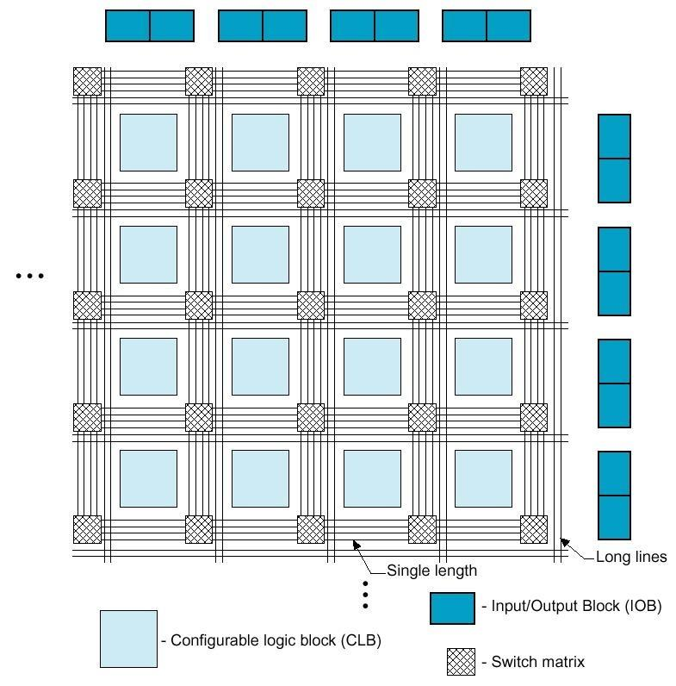
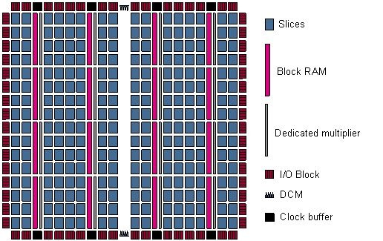
FPGAs : Field Programmable Gate Arrays
Array (Matrix) like structure made of:
  Look-Up-Table (LUT) to implement combinatorial logic
  Flip-Flops (FF) to implement sequential logic
  Routing network to interconnect the logic resources
  I/O logic to communicate with outside logic
  Clock Management: Phase Locked Loops (PLLs), Digital Clock Managers (DCMs)
  Hard-Macros: Digital Signal Processing (DSP) cells, SRAMs, PCIe, Gigabit Transceivers, etc.
Configurable Logic Block
(CLB)

Slide 5
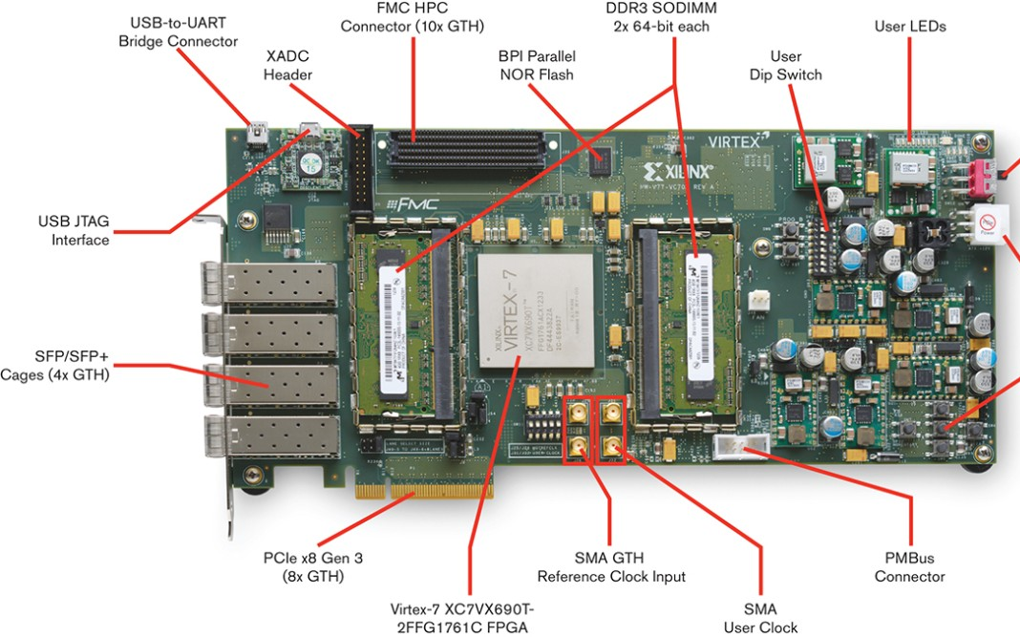
Example: Xilinx Virtex-7 development board
http://www.xilinx.com/products/boards-and-kits/dk-v7-vc709-g.html

Slide 6
Digital (Gateware) Design is NOT programming
Sequential
Processing
Single Core CPU
Hyper-Threaded
Graphics Processing
Unit (GPU)
Parallel
Processing
Single Core CPU
Multi Core CPU
FPGAs
Programming
Code is written and translated into instructions
Instructions are executed sequentially by the CPU(s)
Parallelism is achieved by running instructions on multiple threads/cores
Processing structures and instructions sets are fixed by the architecture of the system
vs.
Digital (Gateware) Design
No fixed architecture, the system is built according to the task
Building is done by describing/defining system elements and their relations
Intrinsically parallel, sequential behaviour is achieved by
Finite-State-Machines (FSMs) and registers
Description done by schematics or a hardware description language (HDL)

Slide 7

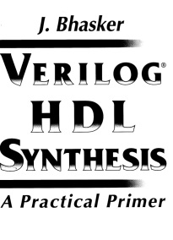
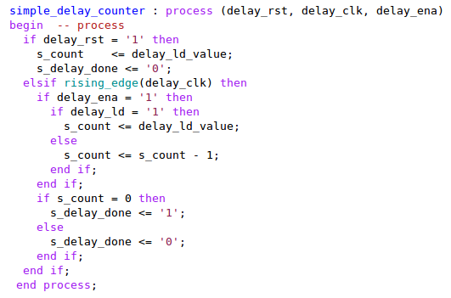
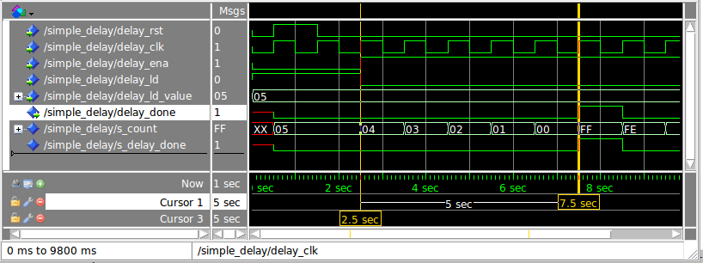
Hardware Description Language (HDL)
As the name suggests it is a language used to describe hardware:
so you have to use it to do so!
Let’s discuss the simple example of a wait statement
In C (Unix, #include <unistd.h>)
sleep(5); // sleep 5 seconds
In VHDL this is not synthesizable, but you can use it in test benches
This is (one) way to do it in synthesizable VHDL
not a realistic clock (1sec)
this is enormous!

Slide 8
Gateware design workflow… a la carte!
Schematic
or HDL Design
IP Cores/Macros
Behavioral Simulation
Synthesis
Functional Simulation
Translate/Map
Post translate/map
simulation models
SDF*
Constraints
Place & Route
Timing Simulation
Program Device
(bitfile)
Debugging
* Standard Delay Format

Slide 9
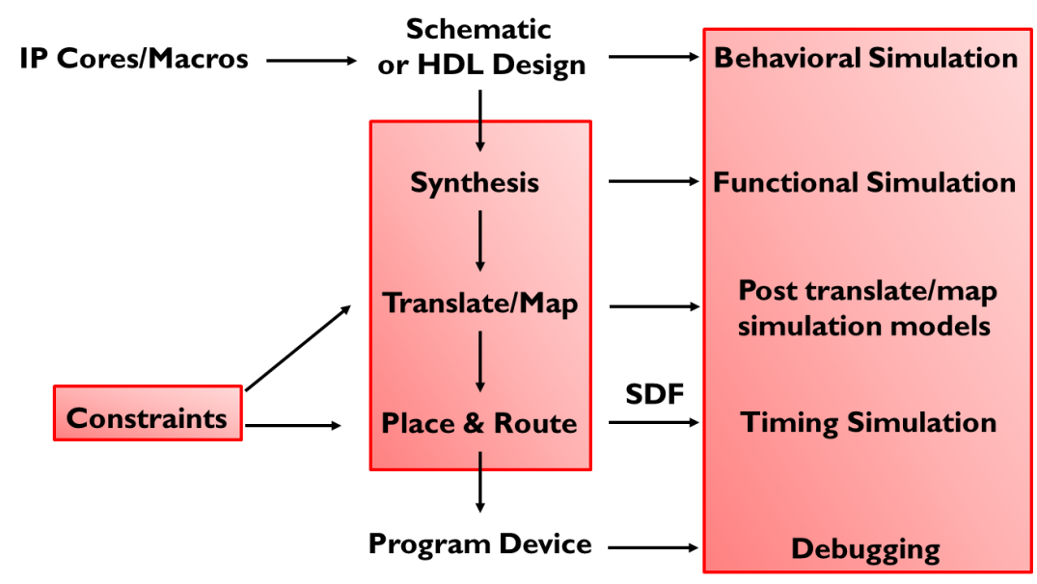
Gateware design workflow… a la carte!
2
1
3
Implementation flow:
what turns a line of code into a blinking LED?
Verification flow:
why is the statement above not (always) true!
Design constraining:
how to force your game rules

Slide 10

Implementation flow

Slide 11
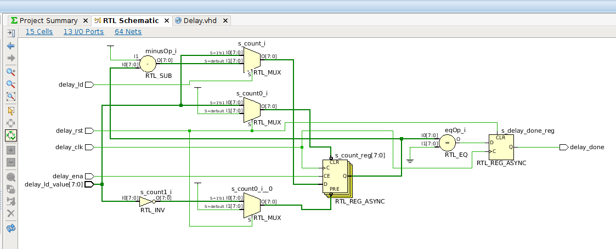
Implementation flow: synthesis
Register Transfer Level (RTL)
a design abstraction which models a synchronous digital circuit in terms of the flow of digital signals (data) between registers and logical operations performed on those signals. (http://en.wikipedia.org/wiki/Register-transfer_level)
Elaborated (RTL) Design
counter control
counter Flip-Flops
registered output
Xilinx Vivado 2014.4 design flow

Slide 12
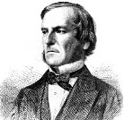

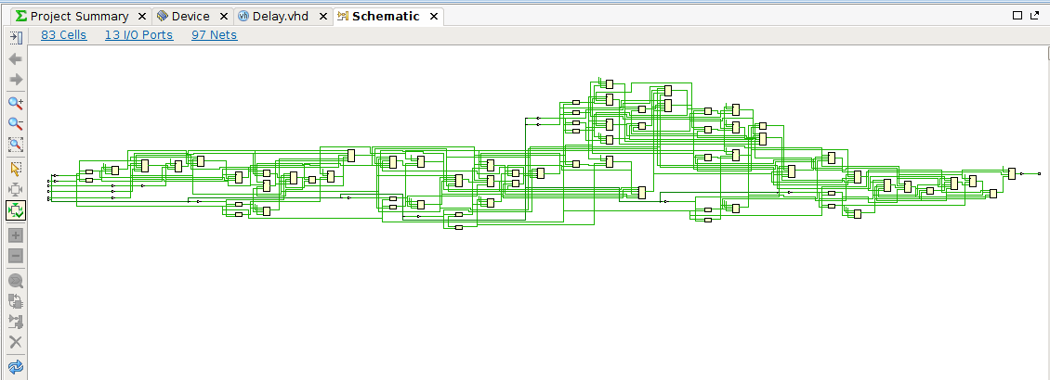
Implementation flow: synthesis
Synthesis
translates the schematic or HDL code into elementary logic functions
defines the connection of these elementary functions
uses Boolean Algebra and Karnaugh maps to optimize logic functions
generates a device independent net list
1815 - 1864
1924 -
Synthesized Design
Xilinx Vivado 2014.4 design flow

Slide 13
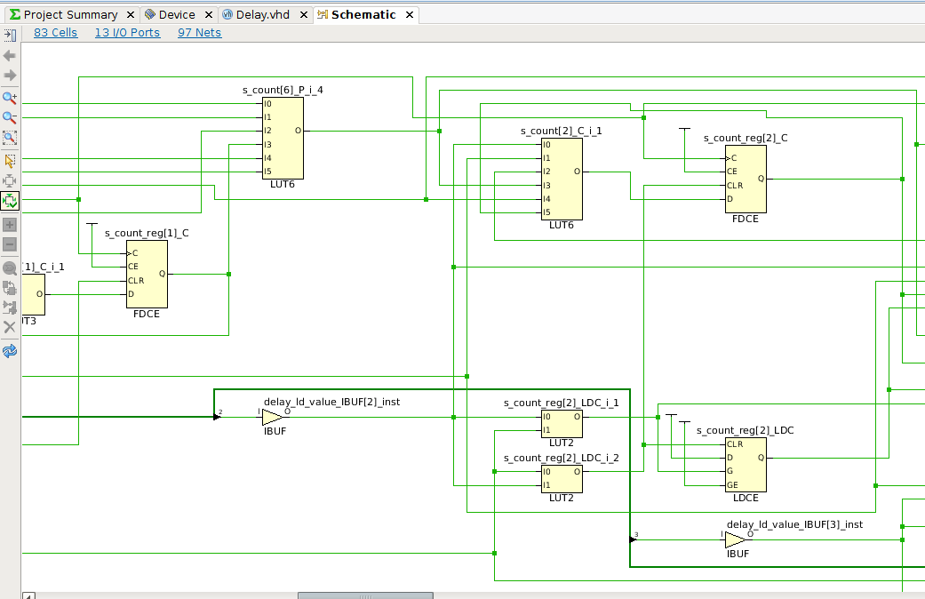
Implementation flow: synthesis
Synthesis
translates the schematic or HDL code into elementary logic functions
defines the connection of these elementary functions
uses Boolean Algebra and Karnaugh maps to optimize logic functions
generates a device independent net list
1815 - 1864
1924 -
Synthesized Design
Xilinx Vivado 2014.4 design flow

Slide 14
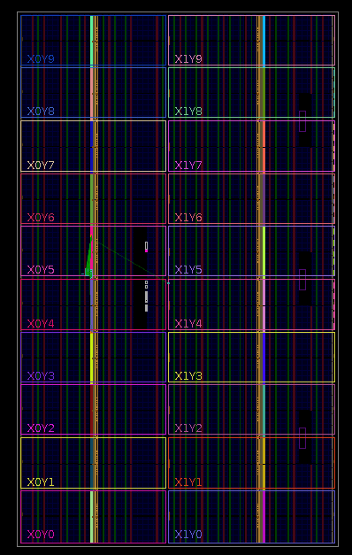
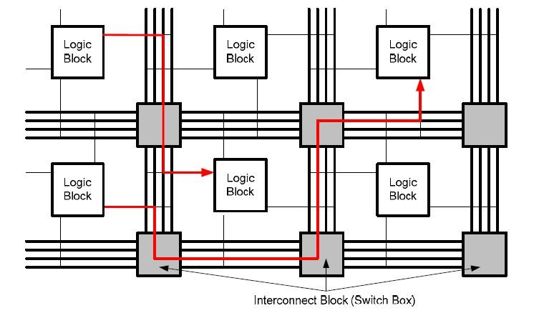
Implementation flow: mapping and routing
Translate / Mapping
translates the device independent net list into technology specific elements
checks the content of black boxes (e.g. IP cores)
checks if the design can fit the target device
maps these elements into the FPGA logic cells
Place and Route (P&R)
places the basic elements on the logic cell grid
routes the signals between the logic cells
can be “guided” by constraints:
  location constraints
  timing constraints
Virtex-7 690T floorplan
Xilinx Vivado 2014.4 design flow

Slide 15
Implementation flow: routing the counter
Virtex-7 690T floorplan
Xilinx Vivado 2014.4 design flow

Slide 16
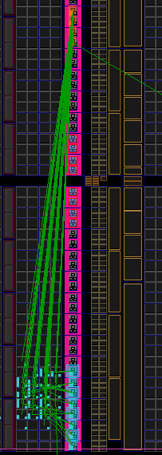
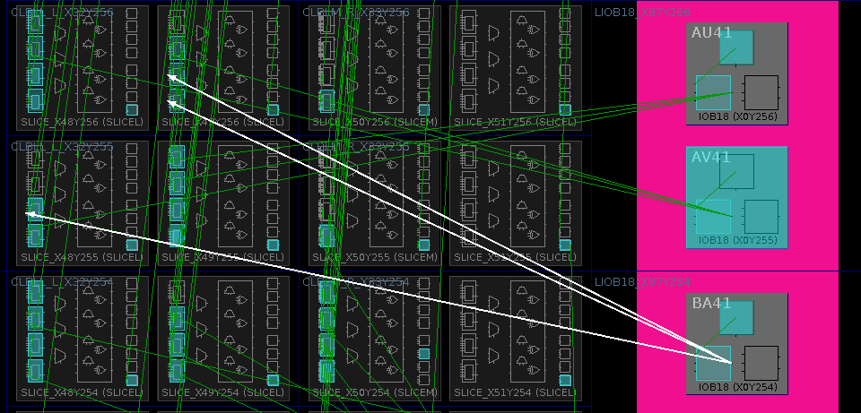
Implementation flow: routing the counter
Perfect example of a badly constrained design!☺
Virtex-7 690T floorplan
Xilinx Vivado 2014.4 design flow

Slide 17
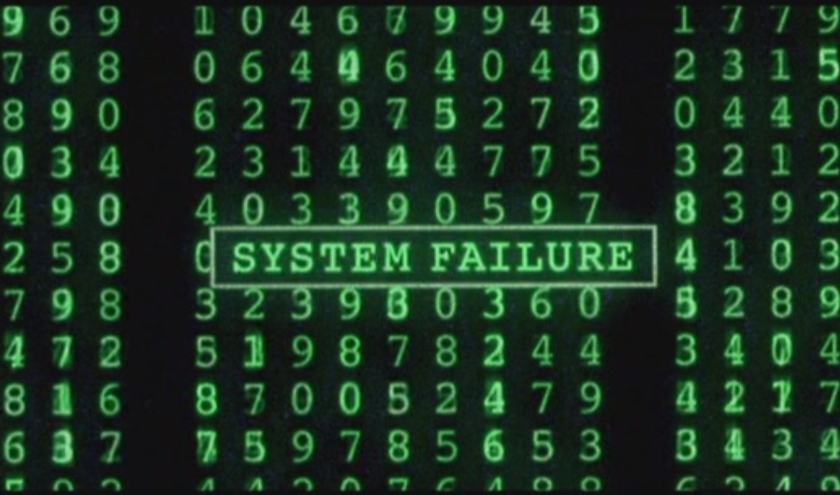
Verification flow

Slide 18
Verification flow: simulation
Verification of a design by an HDL simulator.
  Industry standard → MentorGraphics Modelsim (or Questasim)
  Try out some free alternatives → Icarus Verilog (http://iverilog.icarus.com/)
  Try out some free alternatives → GHDL (http://ghdl.free.fr/)
Event-based simulation to recreate the parallel nature of digital designs
  The simulator time is sliced in delta delays
  At each step of the delta delay all clauses (e.g. clock rising edge) are evaluated
  The outcome of an event is computed and the logic updated
Different levels of simulation:
    behavioral: fastest, simulates only the behavior of the design
Example: MentorGraphics Questasim

Slide 19
Verification flow: simulation
  functional: fast, uses realistic functional models for the target technology
  the least used by HDL designers … why?
    Mostly because these days you can (almost) trust your tools (a bit) more
    What happens if you use the VHDL statement?
    signal <= ‘X’; -- unknown (misused to connect to anything)
  post translate and map simulation models: similar to the above but with information (about the actual primitives) of the translation and mapper steps
  timing: slow, most accurate. Uses Place & Route design + SDF (Standard Delay Format)
    in the past was used to detect routers errors in placing designs…
    when routers where not so smart and FPGAs where not so fast!
    what if the propagation delays of the bits
    of our counter where not equal?
    or greater than the clock speed?

Slide 20
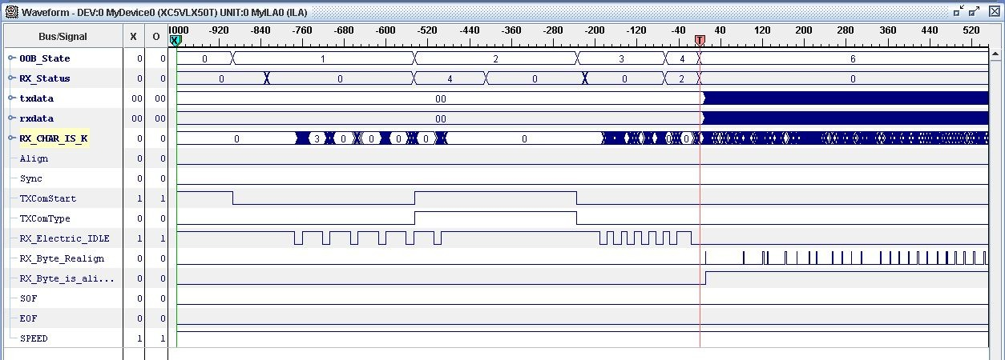
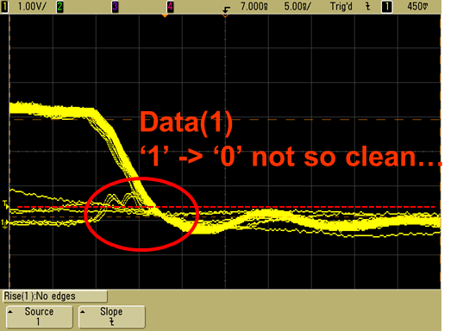
Verification flow: debugging
Your desing is up… and also running?
Most FPGA vendors provide internal logic analyzer cores
  ISE ChipScope, Vivado Set up Debug (Xilinx)
  SignalTap (Altera)
Can be embedded into the design and controlled by JTAG
Allow also the injection of signals
It is at times extremely useful to spy inside the FPGA… but this doesn’t replace an oscilloscope… as signal integrity issues can be on the PCB
Remember… it’s hardware!
Example: ChipScope waveform window (Xilinx ISE)

Slide 21

Design constraining

Slide 22
Design constraining
Remember: you are describing your hardware!
Constraining is becoming so important that it is turning into a
(not yet) standardized language of it own:
  .qsf: Quartus II Setting File (Altera)
  .sdc: Synopsis Design Constraints (de facto standard)
  .ucf: User Constraint File → .xdc Xilinx Constraint File (Xilinx)
Two types of constraints:
  Location constraints
  Geographical position and pin related
  Timing constraints
    clock and timing related

Slide 23
Design constraining: location
FPGAs usually provide a large number of I/O pins for communication with the outside world
Large variety of I/O standards supported: 3.3V CMOS, 2.5V LVDS, SSTL, …
I/O pins can be assigned more or less freely
BUT
I/O cells are grouped in I/O banks → All cells in an I/O bank need to use either the same standard or a similar one (with the same voltage level), e.g. 3.3V CMOS is not compatible with LVDS
LVDS signals always come in dedicated pairs
Clock signals should use dedicated clock input pins → routed internally over a dedicated network
High-Speed serial interfaces (PCIe, Gigabit-Transceivers) or hard macros might need dedicated pins as well
Good Practice
Try to locate pins belonging to one design module close to each other → avoid routing across chip
PCB Designers:
  Check your I/O assignment with a preliminary design with only I/O pins instantiated
  Check for SSN (Simultaneous Switching Noise)
  Use back-annotation of I/O pins to optimise fan-out and routing of signals

Slide 24
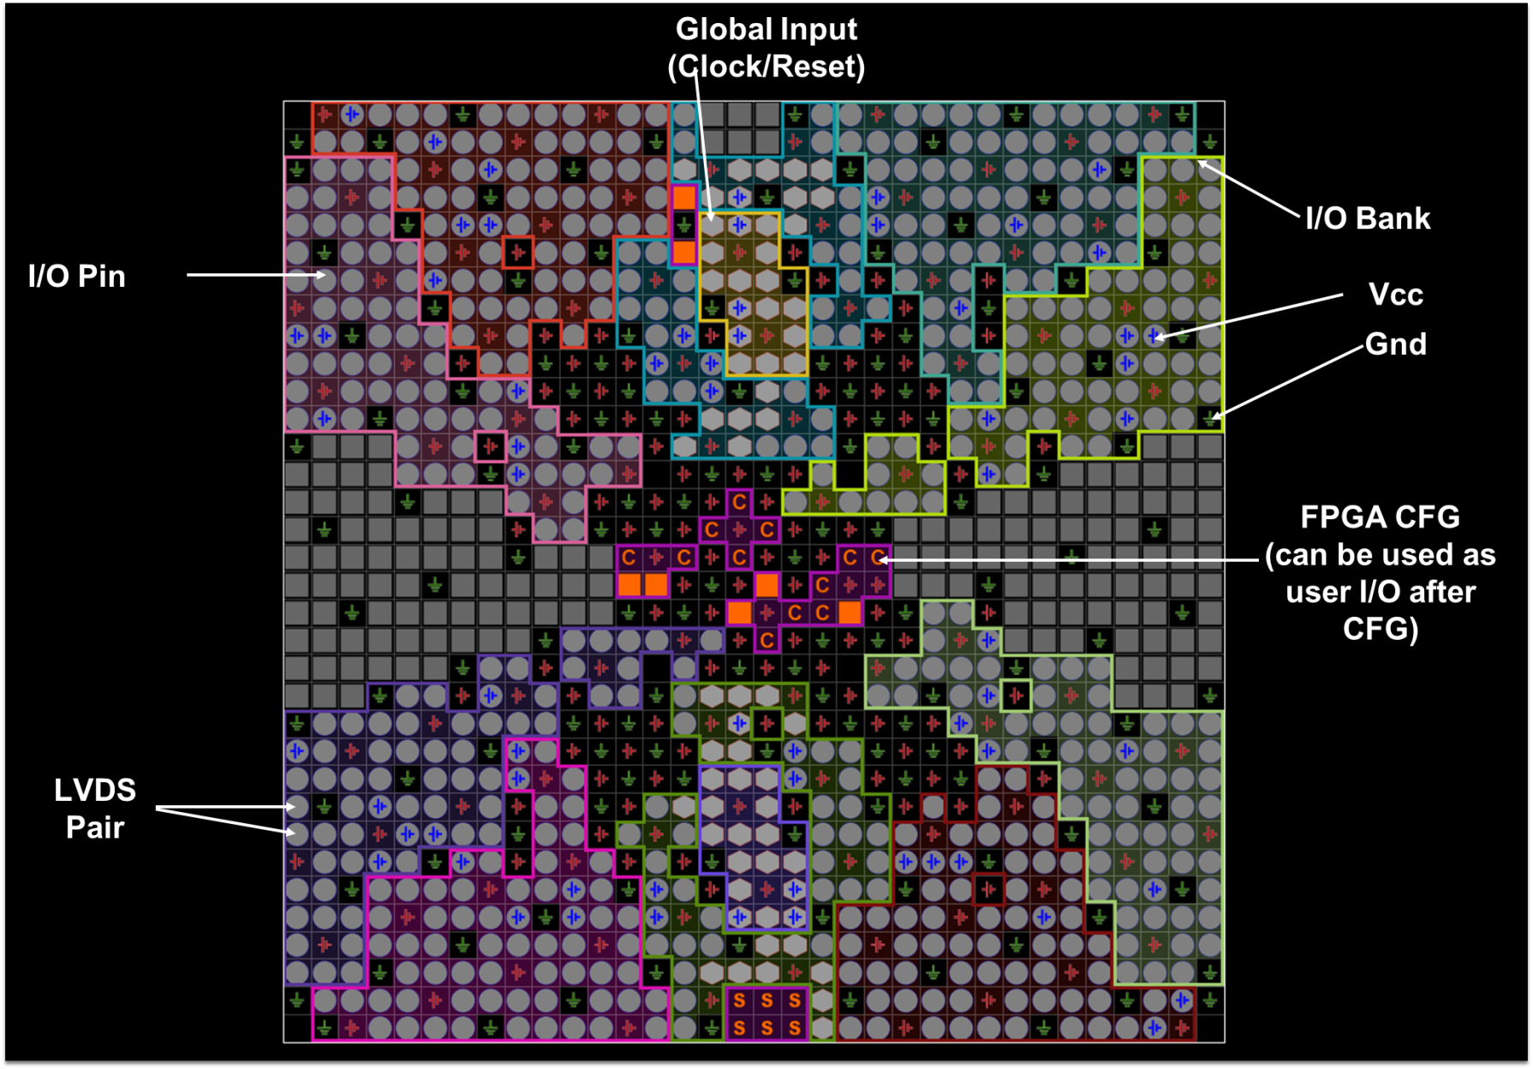
Design constraining: location
Example: Virtex-4 LX40-FF1148 Package & Pinout View

Slide 25
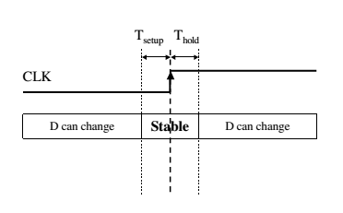
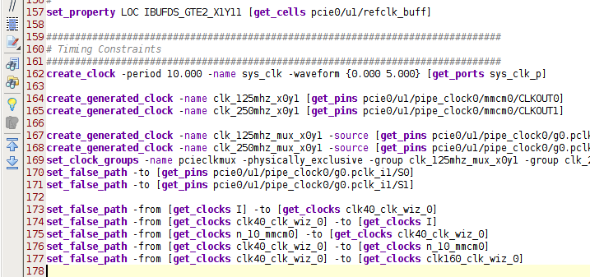
Design constraining: timing
Timing constraints
  clock period
  setup and hold times
  path delays: highlight critical connections
  false paths: force ignoring some connections
See for example: Xilinx Vivado Using Constraints (UG903)
Remember the story of the propagation delay in the timing simulation?
(the positioning of Flip-Flops?)
If you do a good job constraining… you can spare yourself the timing simulation!
Xilinx Vivado 2014.4 design flow

Slide 26

Takeaway thoughts

Slide 27
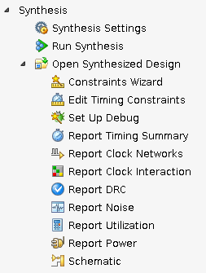
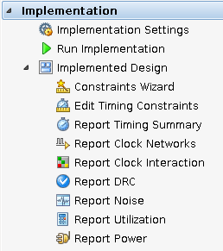
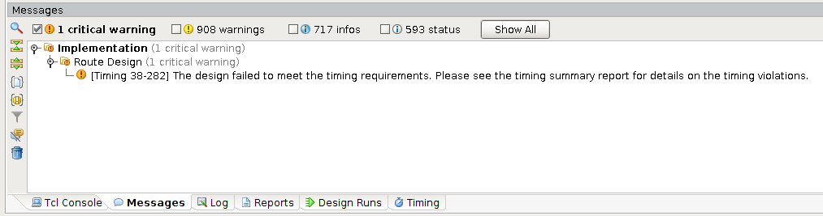
Takeaway: don’t ignore reports!
Learn to carefully review reports
The reason why your design is not functioning as intended…
can be right in front of your eyes!
Especially check timing and… don’t run designs that haven’t met timing!
Xilinx Vivado 2014.4 design flow

Slide 28
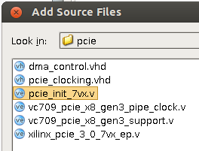
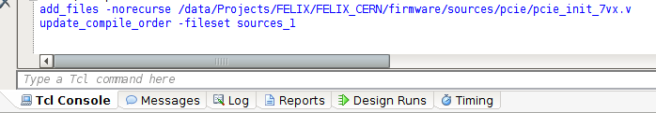
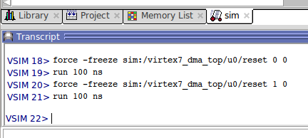
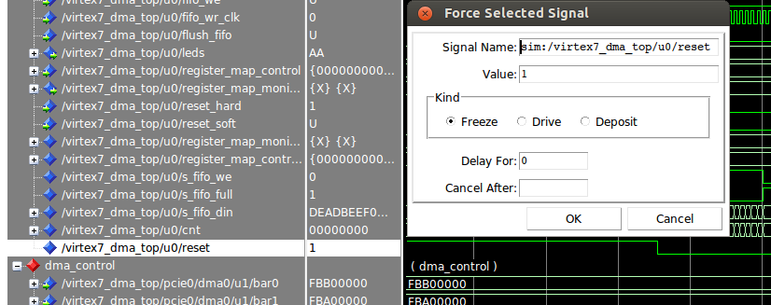
Takeaway: scripting for Gateware designs
Design tools can be scripted: Tool Command Language (TCL)
Parameters/Options can be passed via command-line (makefile, shell scripts)
You have much more control and reproducibility on your procedures
(you can forget about checking a tick-box, and you will, sooner or later…)
allows for complete automation → design servers and nightly build
Xilinx Vivado 2014.4
Simulators can be controlled with TCL and even used to create test benches
(slower but extremely flexible)
MentorGraphics Questasim v10.2

Slide 29



Takeaway: more tips
Describe your hardware: think hard…ware!
RT…M! Seriously… you HAVE to, especially with FPGAs (family overview, DC and Switching, clock resource, Transceiver Guides, Package and pinout)
Consider your FPGA full at 70% or you’ll get nice surprises from your router…
Digital designs are analog in essence (especially with ever higher clock frequencies)
Share share share…
Celebrate your achievements!

Slide 30
FPGAs… so what?
Practical example

Slide 31
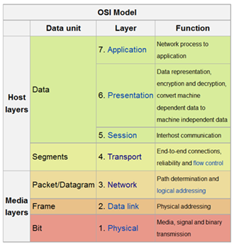
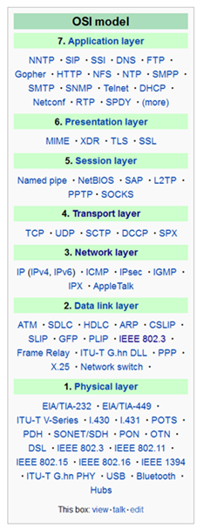
ISO / OSI model: You are here…
International Organization for Standardization / Open System Interconnection:
if you are talking about engineering, can’t do a talk without!☺
It is a conceptual model that characterizes and standardizes the internal functions of a communication system by partitioning it into abstraction layers
A layer serves the layer above it and is served by the layer below it
by function
by protocol
FPGAs
http://en.wikipedia.org/wiki/OSI_model

Slide 32
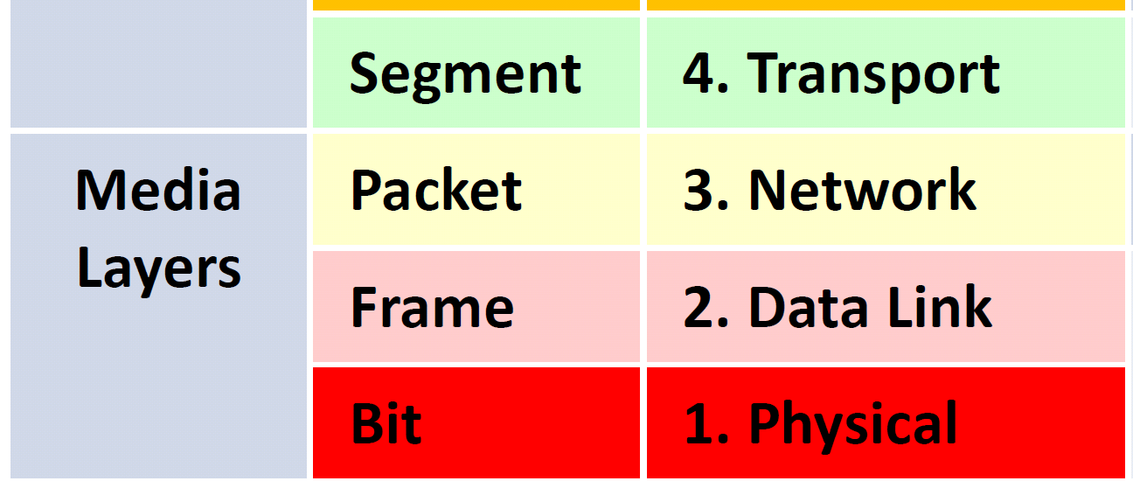
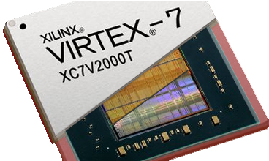
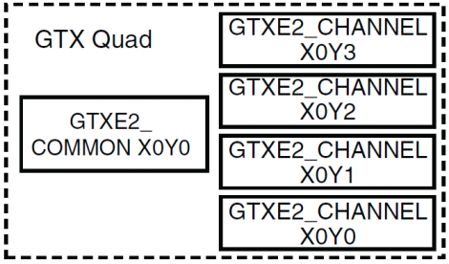
System Architecture: You are here…
A Gigabit-Transceiver is one of the many gadgets surrounding gate logic widely available in modern FPGAs
Very popular since a lot of applications have demanding and fast (serial) I/O requirements
?
Gigabit-Transceiver X

Slide 33
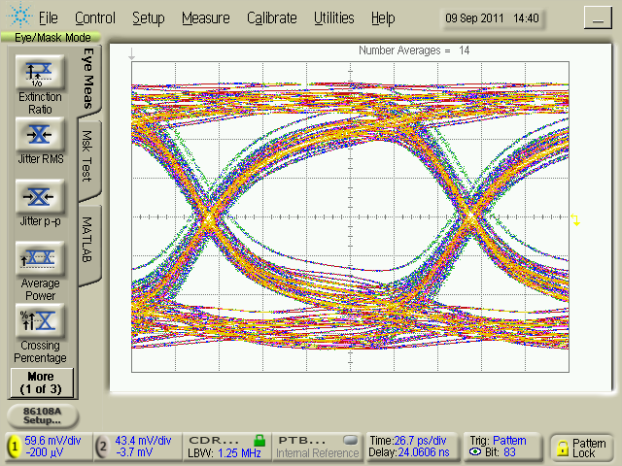
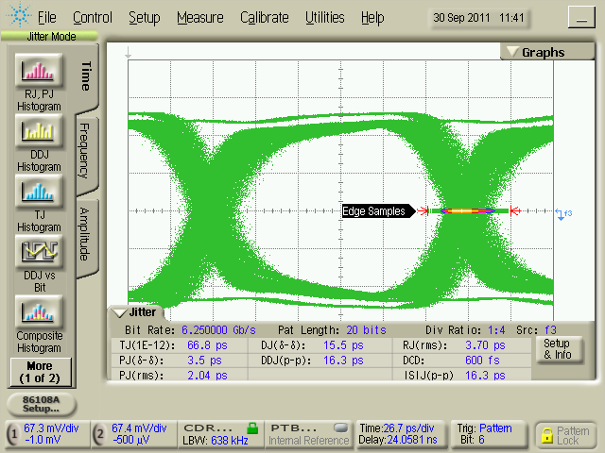
Eye Diagrams
An eye diagram (eye pattern) is the first measure of the quality of a transmission channel: how good are my “ones” and “zeroes”?
Essential information on transmission quality can be obtained from these diagrams : amplitude (voltage) stability, time stability,, etc.
It is all about the probability to sample the signal correctly
Instrument: Agilent 86100C DCA-J

Slide 34
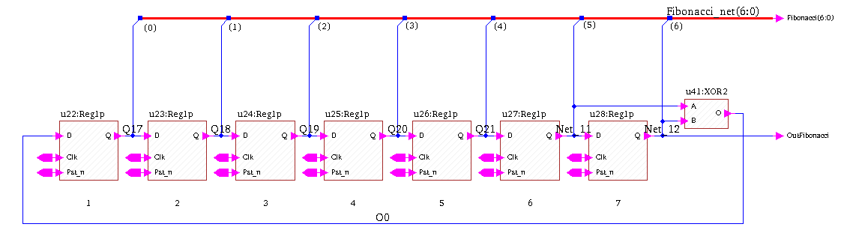
Pseudo Random Bit Sequence (PRBS)
A PRBS is a sequence of bits that are pseudo-random. That is, they are not really random but they can be used where a good approximation to random values is required → test vectors, white noise
They are often implemented using Linear Feedback Shift Registers (LFSR)
The arrangement of taps for feedback in an LFSR is a polynomial mod 2
  PRBS = x⁷+ x⁶ + 1
Maximum number of sequences: 2^{n}-1
It starts from a “seed value”, the only forbidden state is all-zeroes (no exit)
Fibonacci LFSR
http://en.wikipedia.org/wiki/Linear_feedback_shift_register

Slide 35
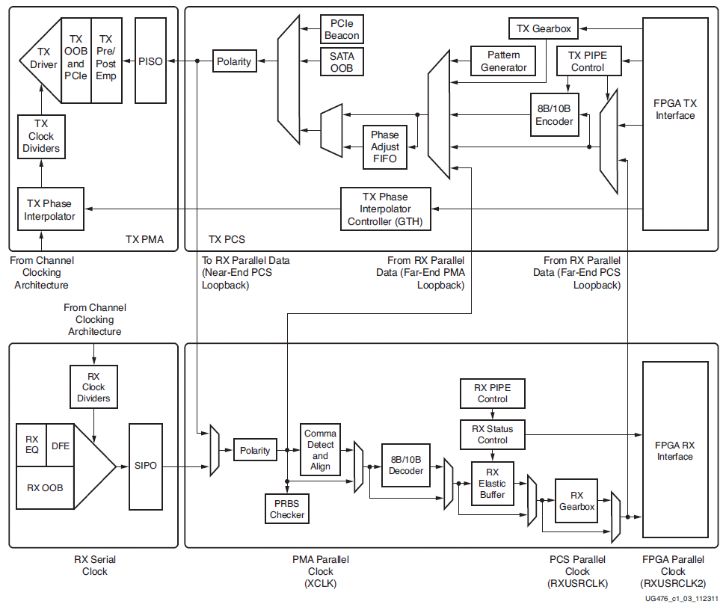
Xilinx Virtex-7 Serializers Deserializers
FPGA pins to PCB board
User Logic
Good news: the PRBS is a built-in function of most modern transceivers!
The next step is to write your own code and drive a link!
www.xilinx.com/support/.../user.../ug476_7Series_Transceivers.pdf

Slide 36

Pitbullen!
We may face (very) difficult problems…
Never let go!
It may take a while… but victory will be yours!
Thank you very very much to:
Torsten Alt (FIAS) and Peter Jansweijer (Nikhef)

