Slide 1
INJECTION OF ISOLDE BEAMS
J.L. Abelleira, C. Bracco

Slide 2
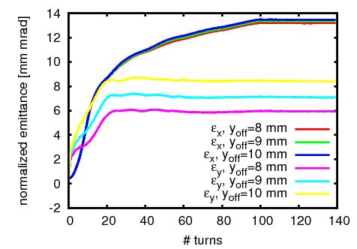
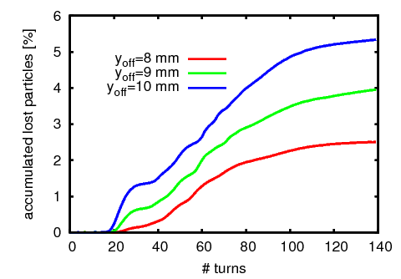
500k macroparticles
betx=5.51623, bety=3.69963, alfax=0.00006447, alfay=0.000096156, Dx=-1.39,Dpx=0.000202
MAXdecayKSW=35 mm/10 μs
I₁=0.57*35 mm
t₁=15 μs
I₂ =0.50*35 mm
t₂=[100,120] μs
I_{f}=45.9mm/5
t₃= t2+(If-I2)/(MAXdecayKSW);

Slide 3
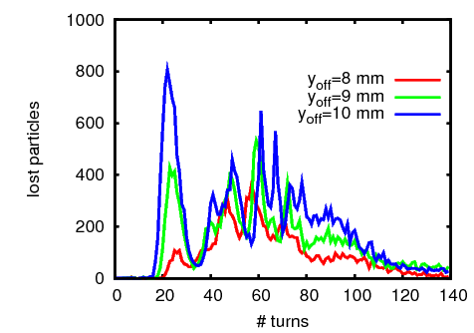
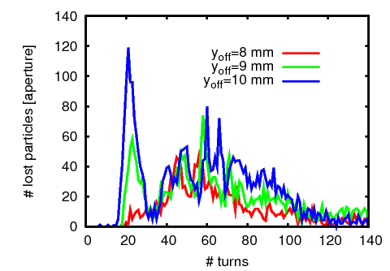
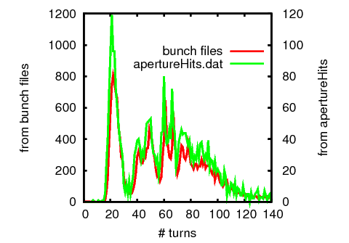
Losses
From the output bunch files
From apertureHits.dat

Slide 4
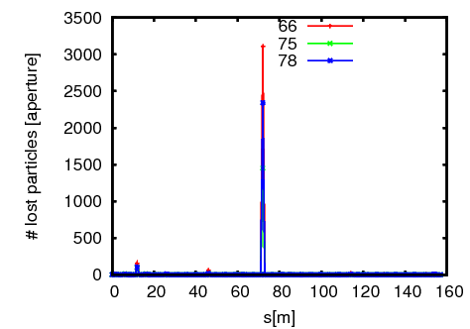
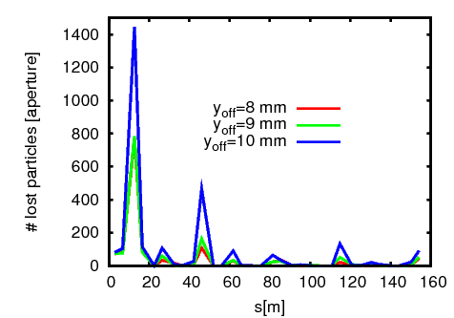
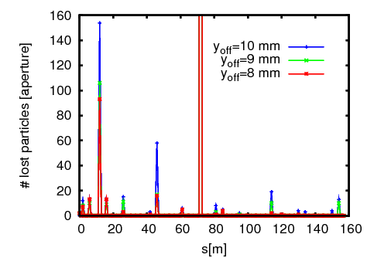
From apertureHits.dat
From Orbit.out

Slide 5
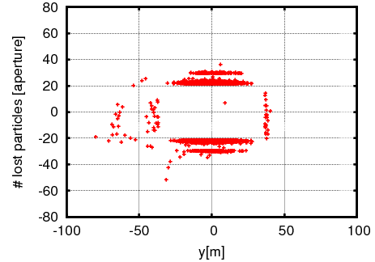
0.0309 (RBEND MADX)
0.0295 (scrap MADX)
0.022 (ORBIT)
0.06535 (RBEND MADX)
0.061 (scrap MADX)
0.041 (ORBIT)

Slide 6
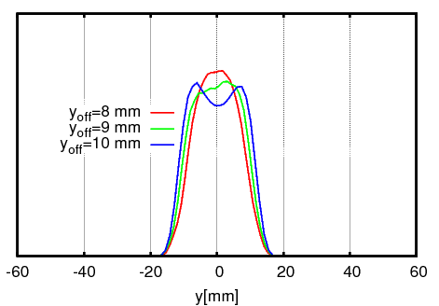
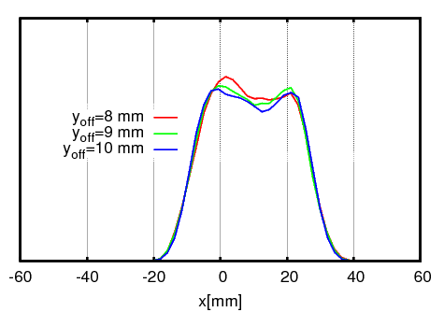
Study of vertical offset in injection

