Slide 1
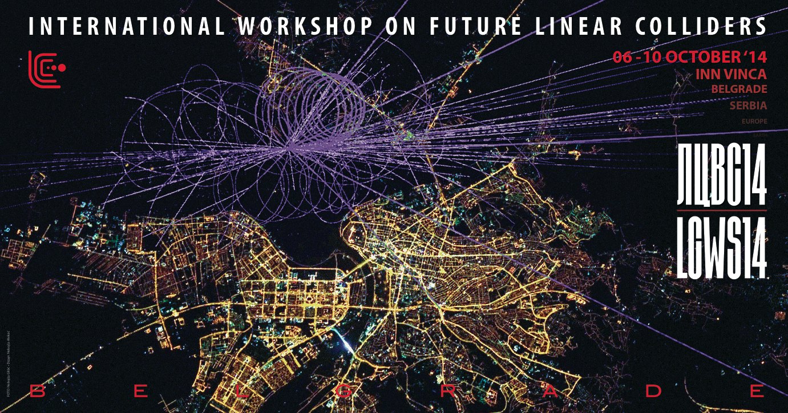

Perspectives for a CALIFES test facility beyond 2016
R. Corsini

Slide 2
Context
CTF3 went well beyond its initial task of demonstrating CLIC two-beam scheme feasibility
Has a well established scientific program until end 2016
Definitely want to stop CTF3 after that (limited resources)
➔ What next?
Additional considerations:
  Initial plan was to evolve gradually towards DB front-end, shifting resources from CTF3 to the front-end, however this is now delayed and resources are somewhat lower
  CONCERN: no local (CERN) real testing capability with beam (diagnostics and components) beyond 2016
  ➔ May keep using part of the CTF3 Installation (CALIFES) for testing after 2016. Possibly interesting beyond CLIC scope (within and outside CERN).

Slide 3
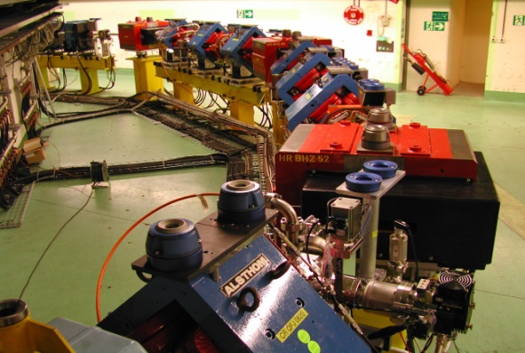
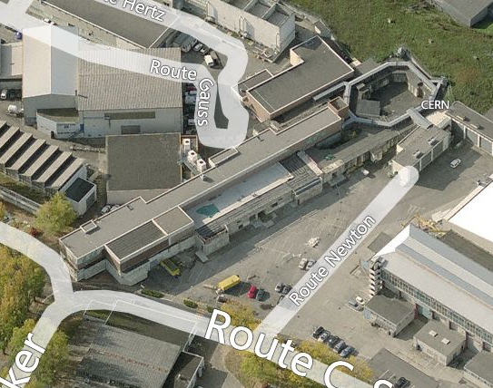
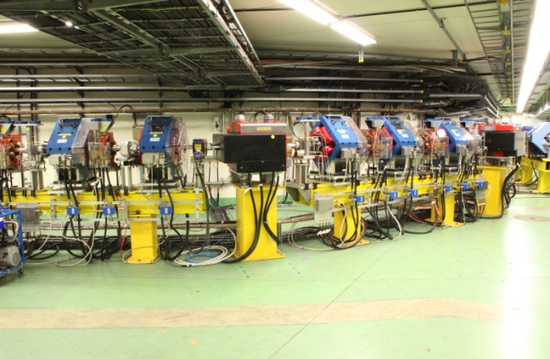
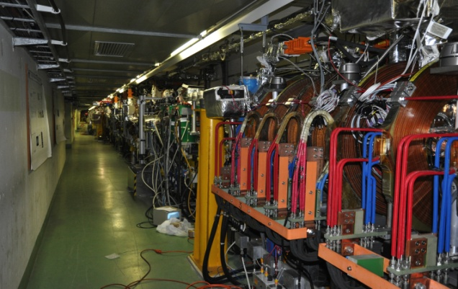
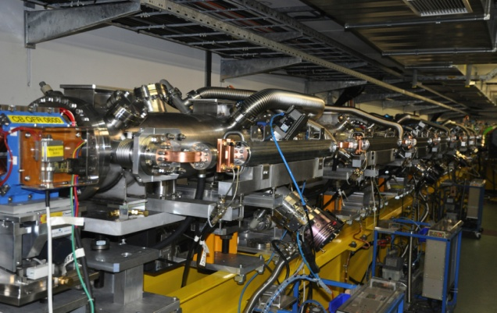
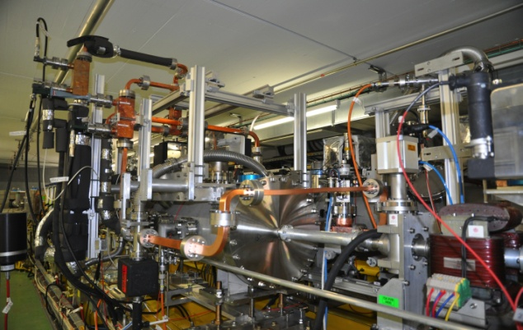
CLIC Test Facility (CTF3)
DELAY LOOP
COMBINER
RING
CLEX
DRIVE BEAM LINAC
TBL
TBTS

Slide 4
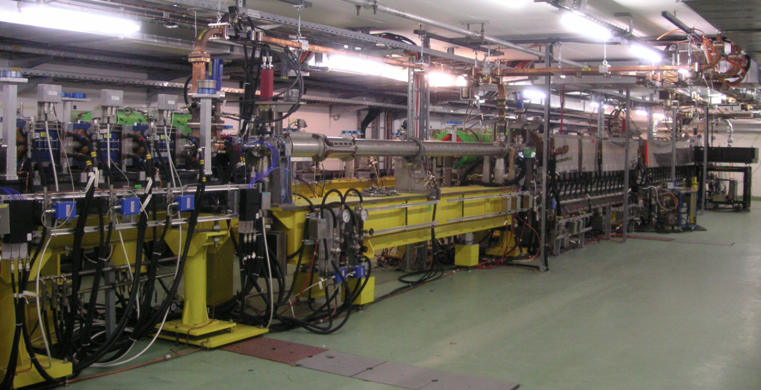
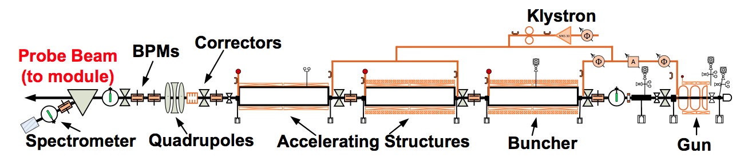
CALIFES

Slide 5
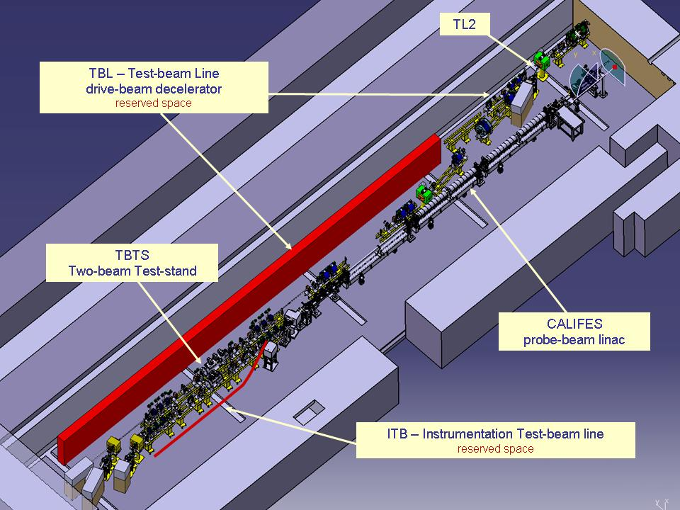
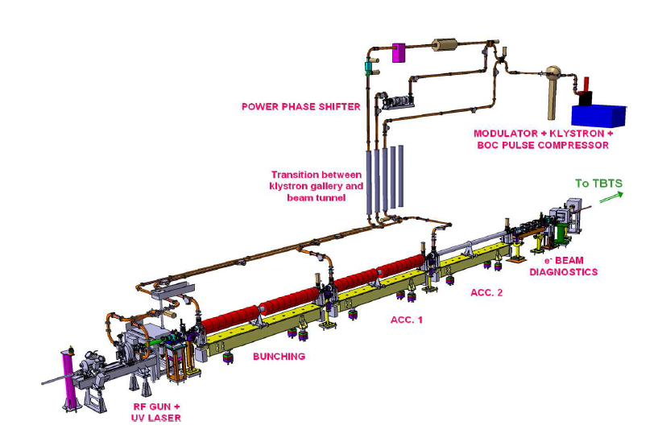
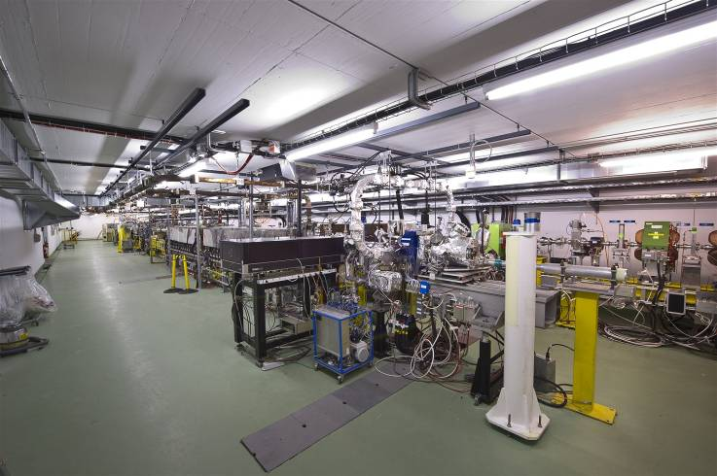
CALIFES hall & infrastructure
Convenient hall (42 x 8 x 2.6 m³) with proper concrete shielding (2.8 m) and large access.
Instrumentation & klystron gallery just above
An up-to-date Laser lab, (80 m laser beam line, partly under vacuum)
Fully equipped (conditioned air, water, access control. No crane.
CLEX

Slide 6
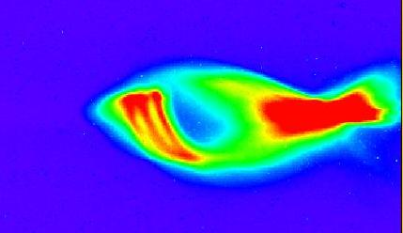

CALIFES
Parameters | Specified | Verified | Comment
Energy | 200 MeV | 205 MeV | Without bunch compression
Norm. emittance | < 20 π mm.mrad | 4 π mm.mrad | With reduced bunch charge
Energy spread | < ± 2 % | ± 0.5 %
Bunch charge | 0.6 nC | 0.65 nC | With new photocathode
Bunch spacing | 0.667 ns | 0.667 ns | Laser driven
Nb of bunches | 1-32-226 | from 1 to 300 | Limited by RF pulse length
rms. bunch length | < 0.75 ps | 1-2 ps and above
Repetition rate | 0.8 – 5 Hz | 0.8 – 5 Hz | Upgrade possibility to 10 Hz
CALIFES
Swiss FEL injector (courtesy Simona Bettoni)
Up to now used on TBTS, from November: ➔ Two-Beam module
Growing activities over the last years on beam diagnostic/components testing

Slide 7
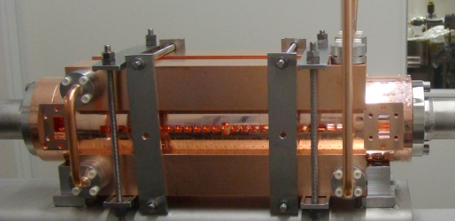
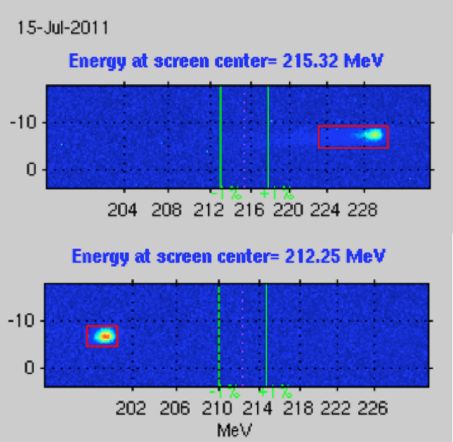
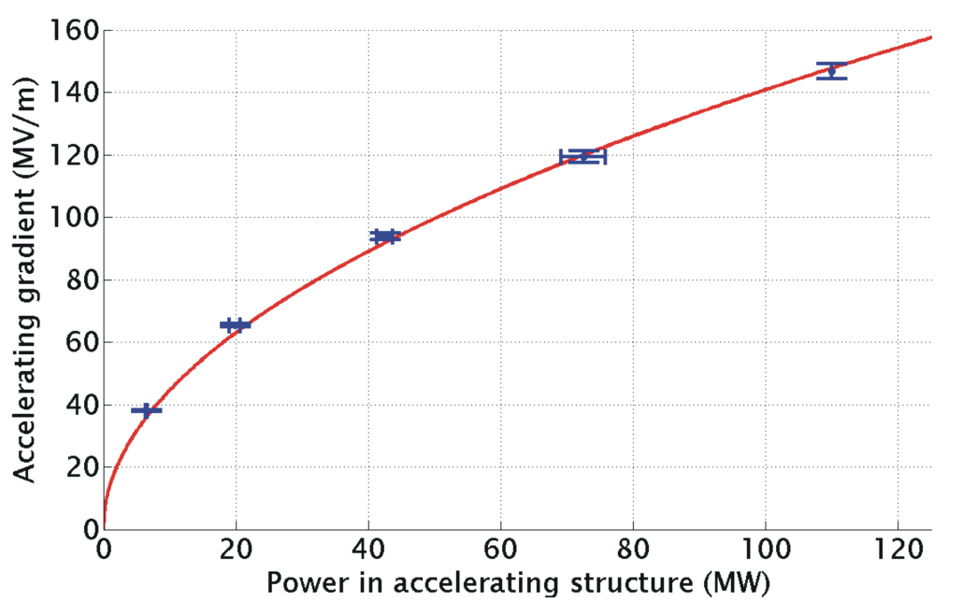
Two beam acceleration in TBTS
TD24
Two-Beam Acceleration demonstration in TBTS
Up to 145 MV/m measured gradient
Good agreement with expectations
(power vs. gradient)
Maximum stable probe beam acceleration measured: 31 MeV
⇒ Corresponding to a gradient of 145 MV/m
CLIC Nominal, unloaded
Drive beam ON
CLIC Nominal, loaded
Drive beam OFF

Slide 8
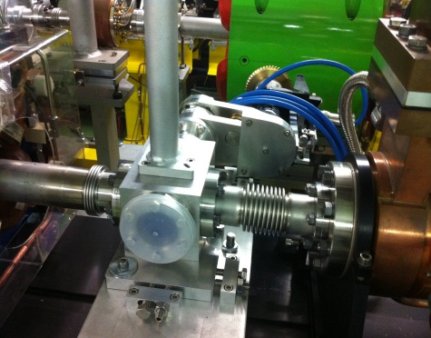
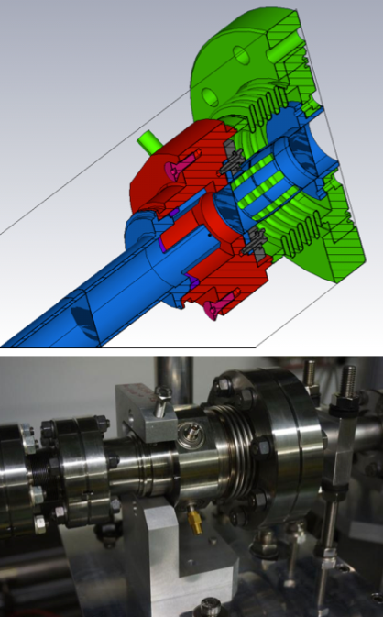
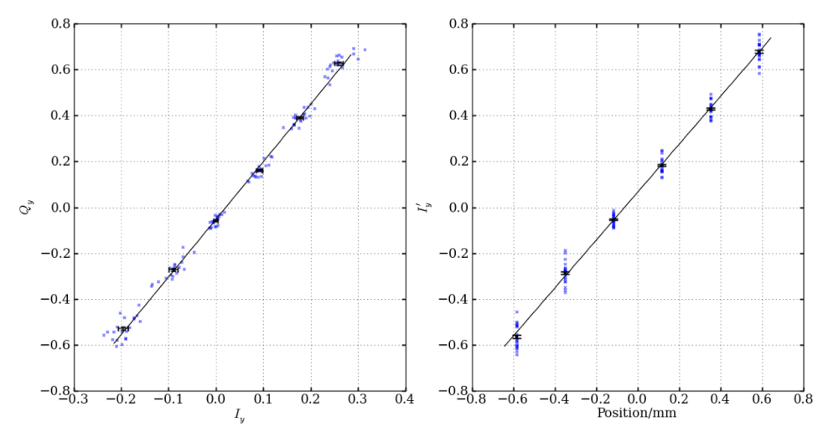
Beam Diagnostic Tests in CLEX
Electro-optic bunch profile monitor
in CALIFES
(CERN-Dundee University)
Stripline Drive Beam BPM in TBL
(CERN-LAPP)
Cavity Main Beam BPM
in CALIFES/TBTS
(CERN-JAI at Royal Holloway)

Slide 9
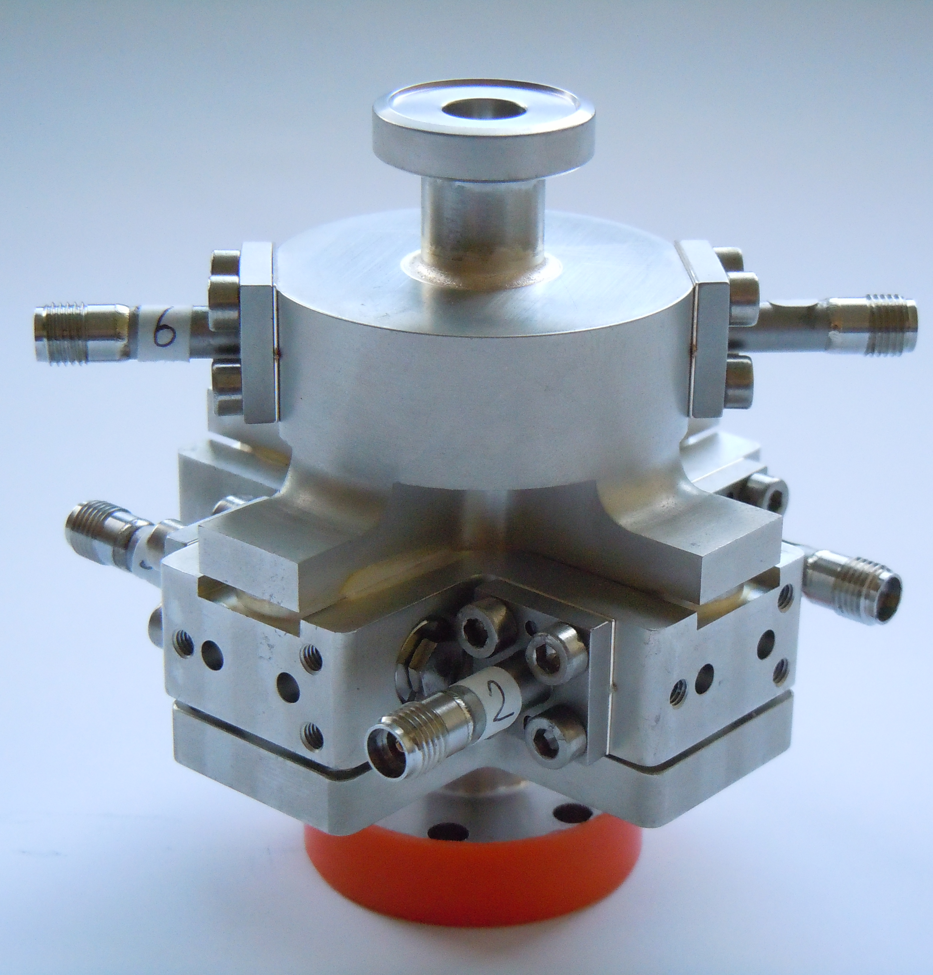
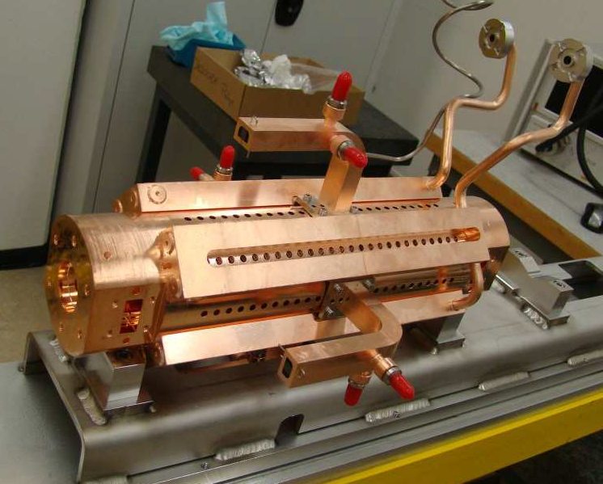
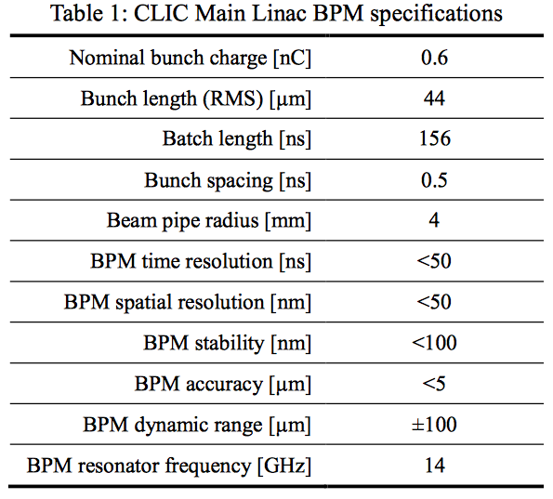
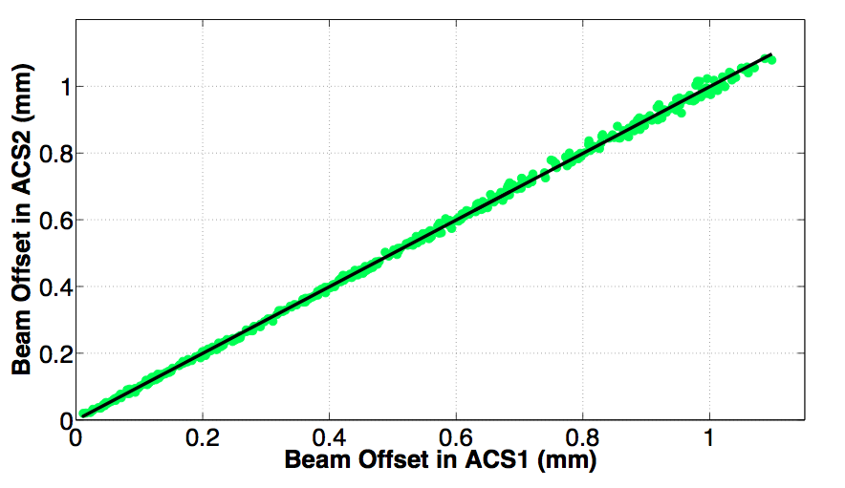
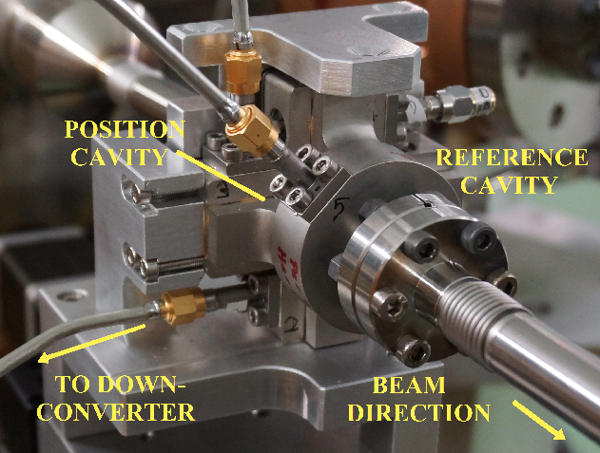
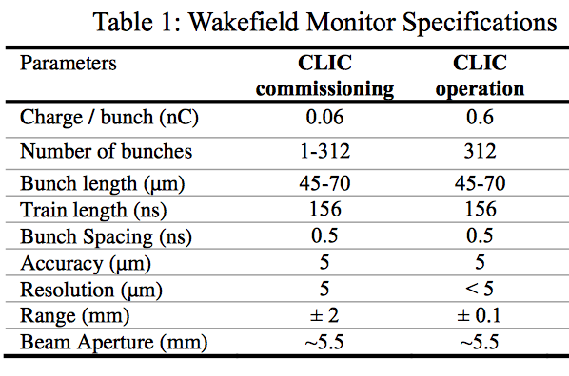
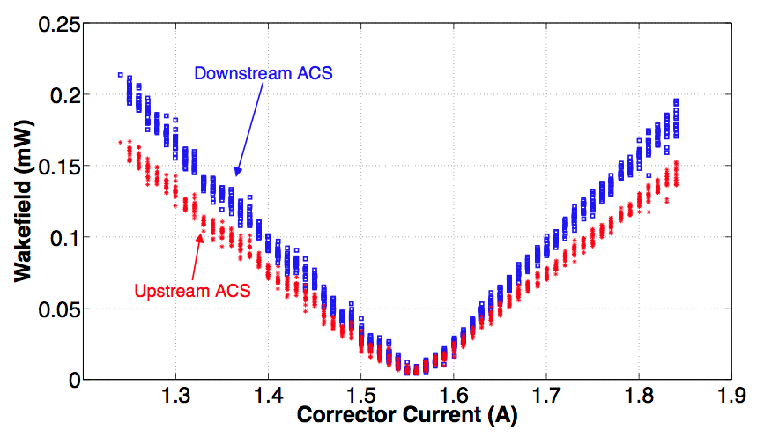
Recent CLIC diagnostics tests
Main linac BPMs
Wake-field monitors
Under further development and testing at CTF3
Resolution tested in CTF3

Slide 10
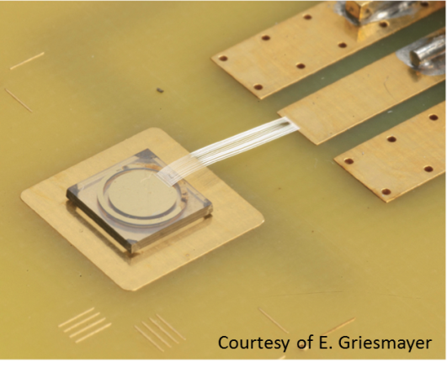
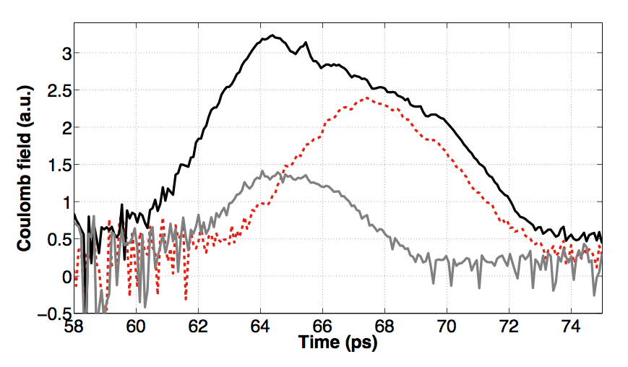

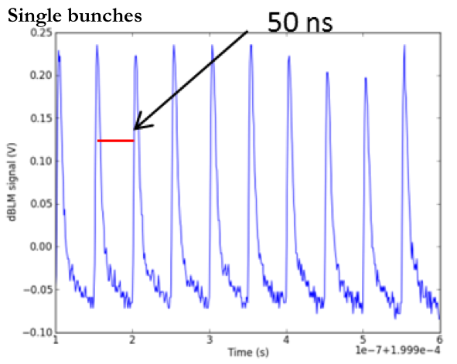
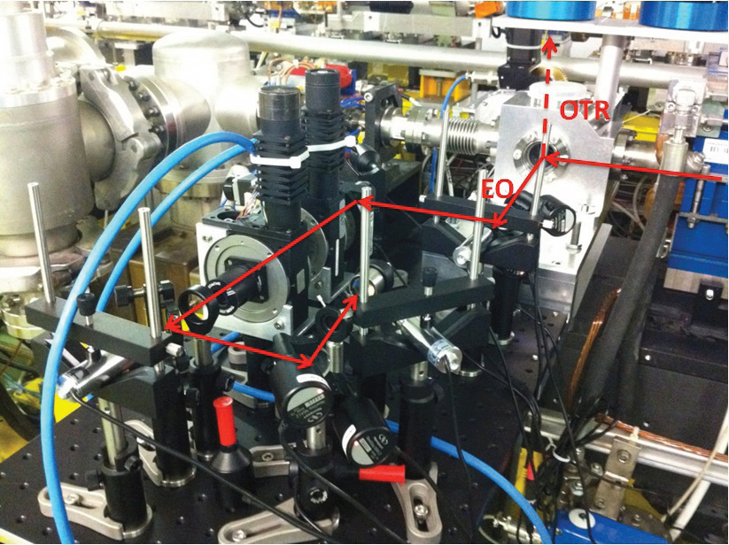
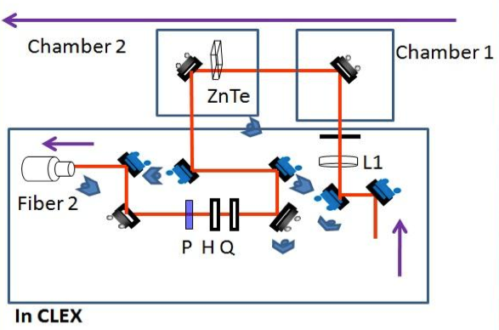
Other recent (CLIC) diagnostics tests
Diamond Beam Loss Monitor
EOS bunch length monitor
Bunch temporal structure measured with a longitudinal profile monitor based on electro-optic spectral decoding for different bunch charges.

Slide 11
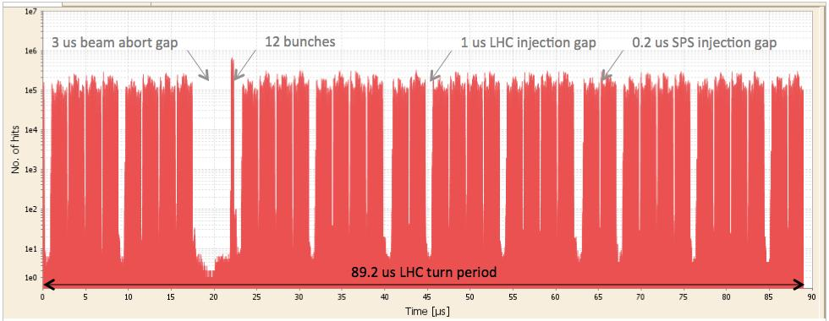
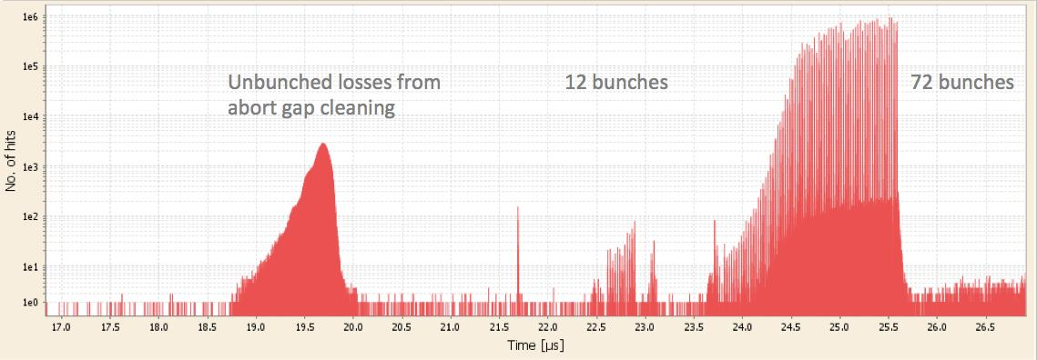
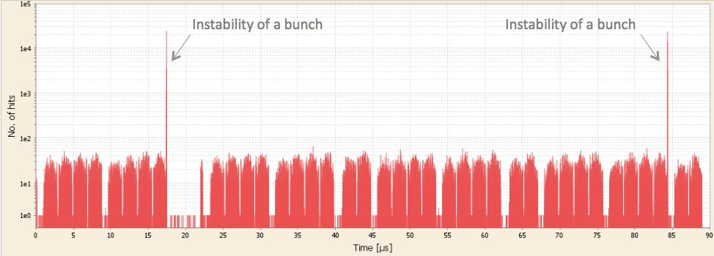
Time resolved beam loss using diamond BLM
Diamond Beam Loss Monitor
LHC bunch structure near abort gap
Abort cleaning and un-bunched beam
Single bunch
instabilities

Slide 12
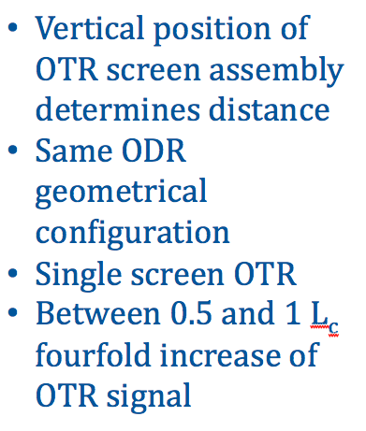
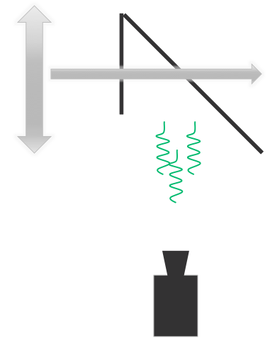
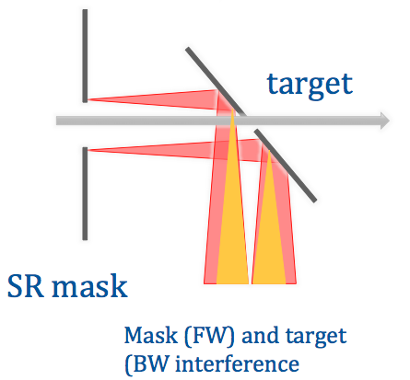
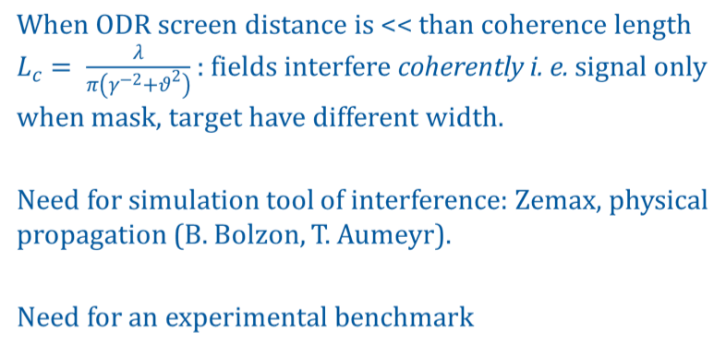
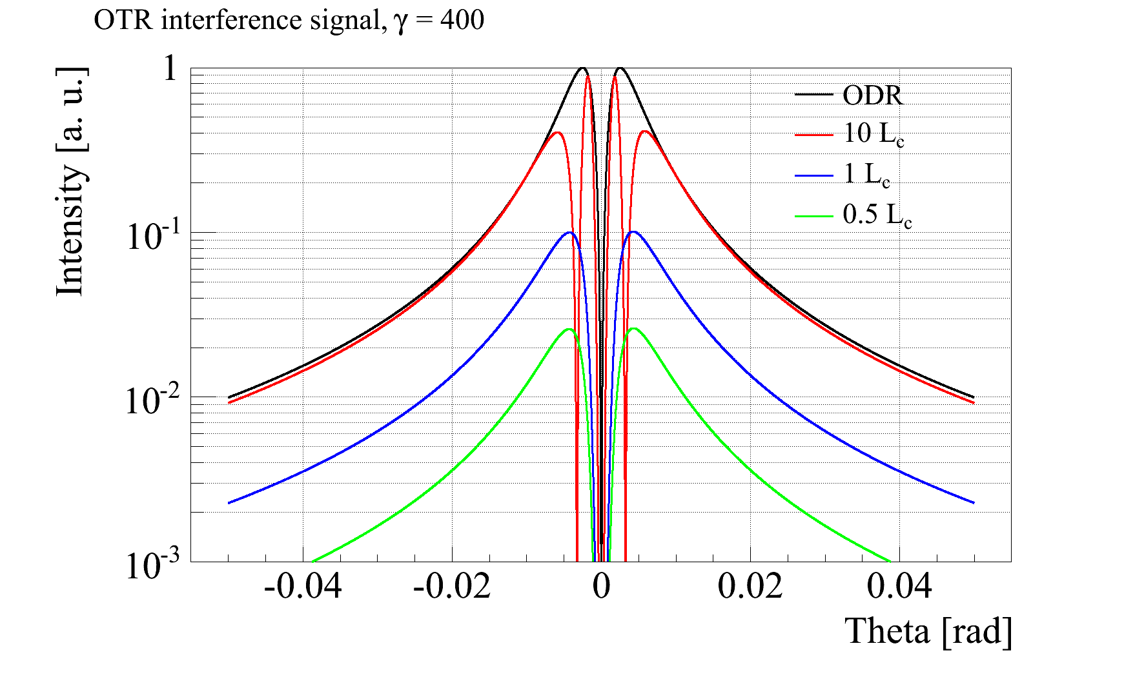
Other recent (CLIC) diagnostics tests
OTR interference
S. Mazzoni,
T. Lefevre

Slide 13
Rationale for CALIFES as a test facility beyond 2016
Need to keep beam test capability on CLIC diagnostics (and other issues) locally at CERN after CTF3 stop
Potential interest of other projects/groups from CERN (AWAKE? LHC? …) and outside – beam diagnostics and other
Possibility of beam tests during long shut-downs
Keep experimental electron expertise alive at CERN, including laser and photo-cathodes – again link with AWAKE
Provide training ground for young accelerator physicists at CERN and collaborating institutes
…

Slide 14
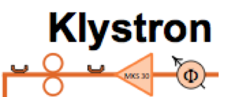



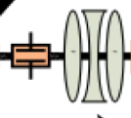
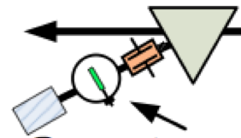

Future CALIFES – minimum configuration
Present
Future: CALIFES for beam instrumentation test
Test Area
Spectrometer
  Add an available S-band klystron + modulator
    More RF power (beam energy), more flexibility (power in 1st structure, phase in structures 2 and 3), possibility of running without RF pulse compression
  Reconfigure present TBM area as test area
  Most (all) hardware already existing

Slide 15
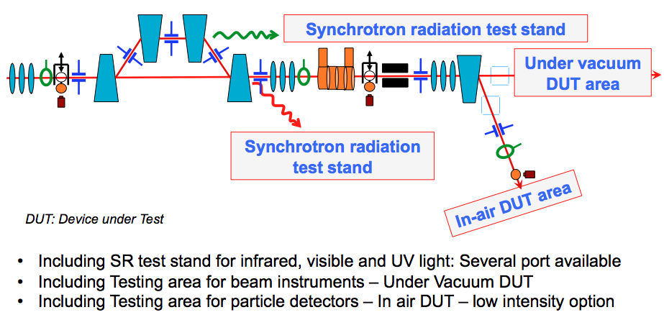
“Ultimate” test area layout to cover BI needs
Magnetic chicane
Shorten or lenghthen
100fs up to 200ps
Collimator
- Reduce the bunch intensity before the DUT zones
- Reduce bunch length further in combination with RF deflector
RF deflector
for crabbing
T. Lefevre

Slide 16
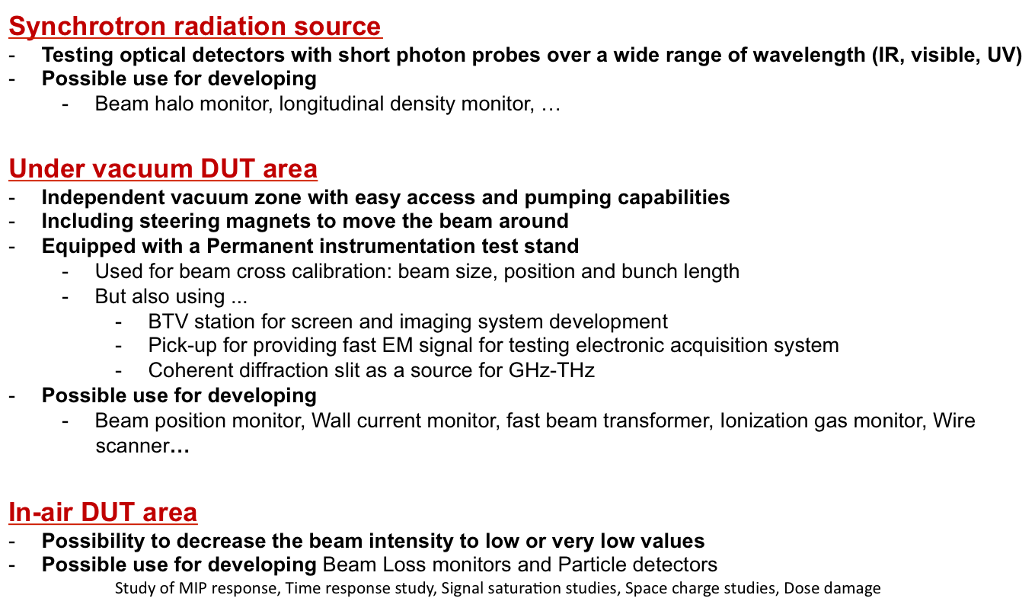
Use for diagnostics tests

Slide 17
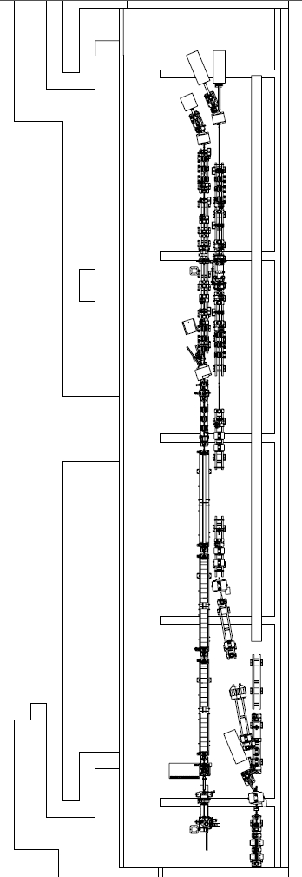
Previous studies – the Instrumentation Beam Line
A preliminary study has been done: “Short Pulse Capabilities of the Instrumentation Beam Line – V. Ziemann – 6 May 2010”
  Short pulses (200 fs – 35 μm) are necessary to mimic the CLIC main beam for instrumentation tests
  Pulses of 20 μm are achievable with a chicane R₅₆ = 2 cm and energy encoding of 10⁻³ , maximum energy reduced to 78% of the on-crest one
Other option ➔ four-bend chicane
All equipment will be available from the DB lines (magnets, powers, chambers…)

Slide 18
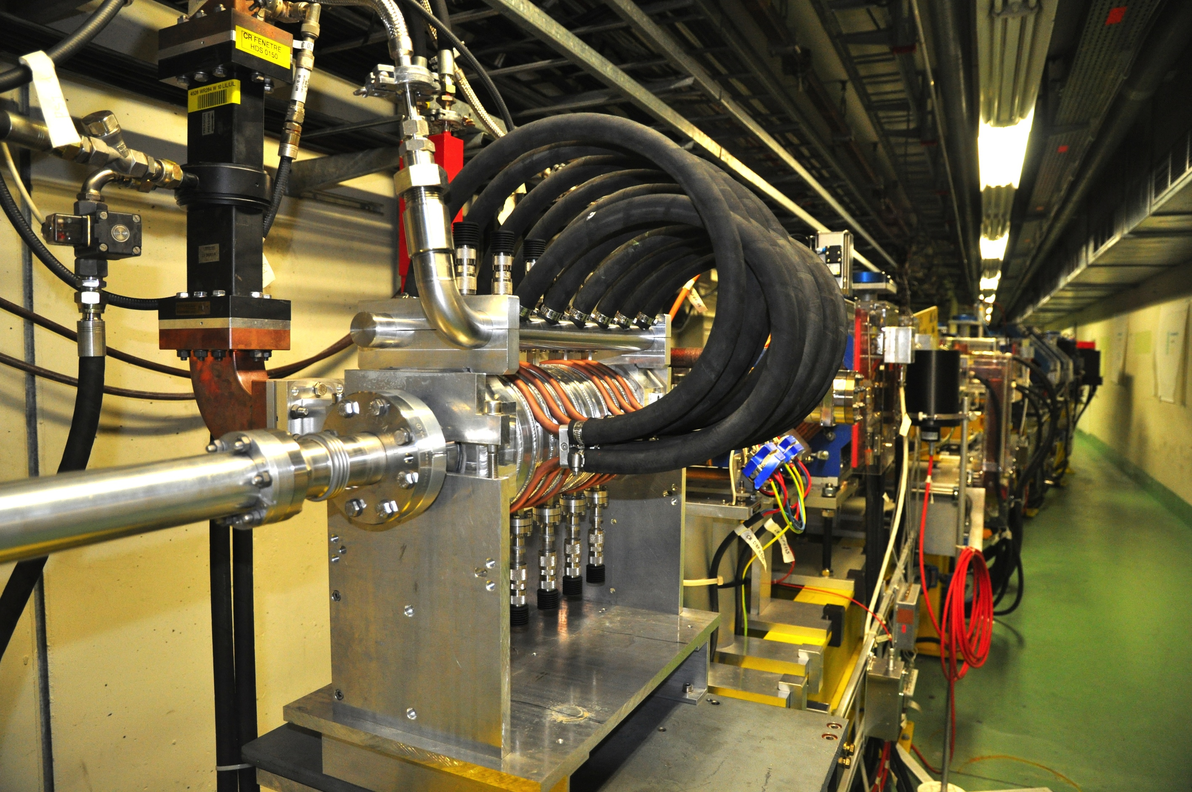
Bunch length flexibility
In many cases a (very) short bunch length is required
May be accessible using a magnetic chicane or dogleg (need some compression studies, implications on off-crest phase, short range wake-fields)
Other possibility, RF deflector + collimator (crabbing). May also implement a two-deflector solution (RF bump) to remove crabbing
Should continue bunch compression studies in CALIFES 2015-2016 with streak camera, EOS and possibly RF deflector

Slide 19
X-band
CALIFES may provide an unique opportunity to test X-band structures/modules with beam
XBOX1 located very close (distance comparable to present low-loss line for dog-leg beam loading experiment)
Straight-forward solution: connect to XBOX1 for beam testing in CLEX
An upgraded CALIFES beam may be not too far from what is needed for FELs: “Playing ground” for X-band FEL beam studies and developments
Future possibility: test a full X-band module (for X-band FEL or klystron-based CLIC) – may need an additional modulator/klystron
Add more? …

Slide 20
Layouts?
26.5 m
42 m
4.7 m
Stand Alone Test Stand
8 m
26.5 m
42 m
4.7 m
Low loss circular waveguide
Stand Alone Test Stand
8 m

Slide 21
Summary of possible evolutions
Keep CALIFES for beam instrumentation test
  Add an available S-band klystron, modify waveguides
  Add a chicane, another dedicated klystron for deflector
  Change the deflector to a CR one
  Closed RF bump + collimator for bunch length control
  (Switch for the PHIN gun for higher charge)
(Push the beam line toward the X-Box1 in CTF2)
Or transport the 12 GHz power to CLEX
  Add a 12 GHz crab cavity for bunch length diagnostic
  (Add an undulator, a Compton scattering experiment…)
Produce special beam for Wakefield study
  2 bunches of different energies with adjustable delay
  Single bunch, short range wakes (A. Latina)

Slide 22
Some consideration on resources
Given the present CTF3 material budget/manpower, one may roughly evaluate the resources needed to keep CALIFES running after 2016 to about:
  200-300 kCHF/year (including M to P – students and PJAS)
  About 5 FTEs (staff and fellows)
The above would include a minimum upgrade (1 ½ additional klystron, rearrangement of test area)
Will do a more precise evaluation, including more ambitious upgrade options

Slide 23
Outlook
CALIFES may be a reasonably cheap multi-purpose test facility
  Useful within the CLIC study – potentially much wider interest
  (Would help if enough support should come from outside the CLIC study or/and outside CERN)
Minimum to medium upgrades will enhance flexibility/usefulness
Connection to XBox1 seems logical step
  Possibilities of further upgrades
Need more refined cost/resource assessment and evaluation of scientific case
Develop an integrated proposal, considering other beyond CTF3 options.

Slide 24
ADDITIONAL CONSIDERATIONS,
MATERIAL FOR DISCUSSION

Slide 25
List of potential options (non exhaustive…)
Shut-down CTF3 completely and re-use for other scopes the buildings and whatever hardware may be requested (3 GHz power stations, magnets, power supplies…)
Refurbish CTF3 as part of new lepton injection chain at CERN (potential interest for SPS damping ring tests, plasma wake-field experiments in AWAKE, future lepton accelerators…)
Keep CALIFES probe beam injector running as a generic test facility for testing diagnostics and other components. May include additional X-band powering.
House the DB Front-End in CTF3 (CLEX or Linac?). Possible option: plug Front-End before the CTF3 linac.
Extend CTF3 running limited to first part of the linac, for X-band beam loading tests. Option: use dog-leg for X-band RF production - testing?
F. Tecker
W. Farabolini
S. Doebert

Slide 26
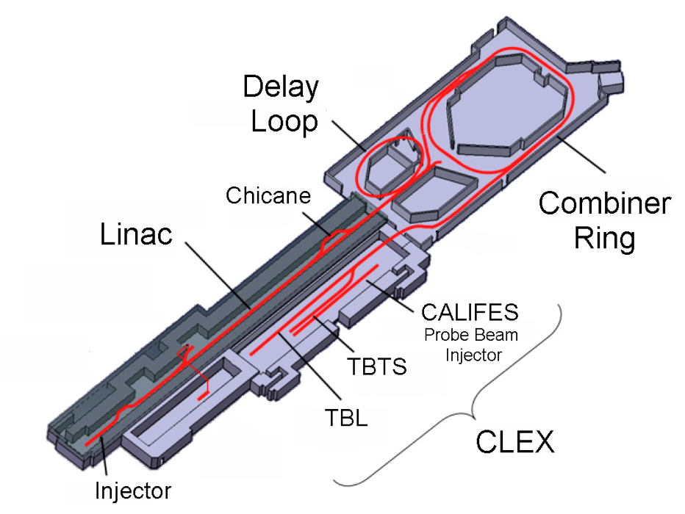
Options
Lepton Injector Chain
Dog-leg
CALIFES
facility
DB Front End

Slide 27
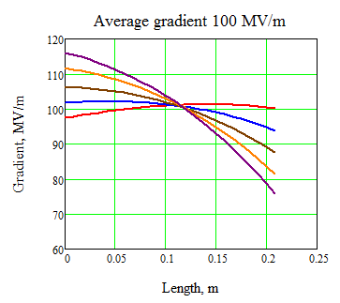
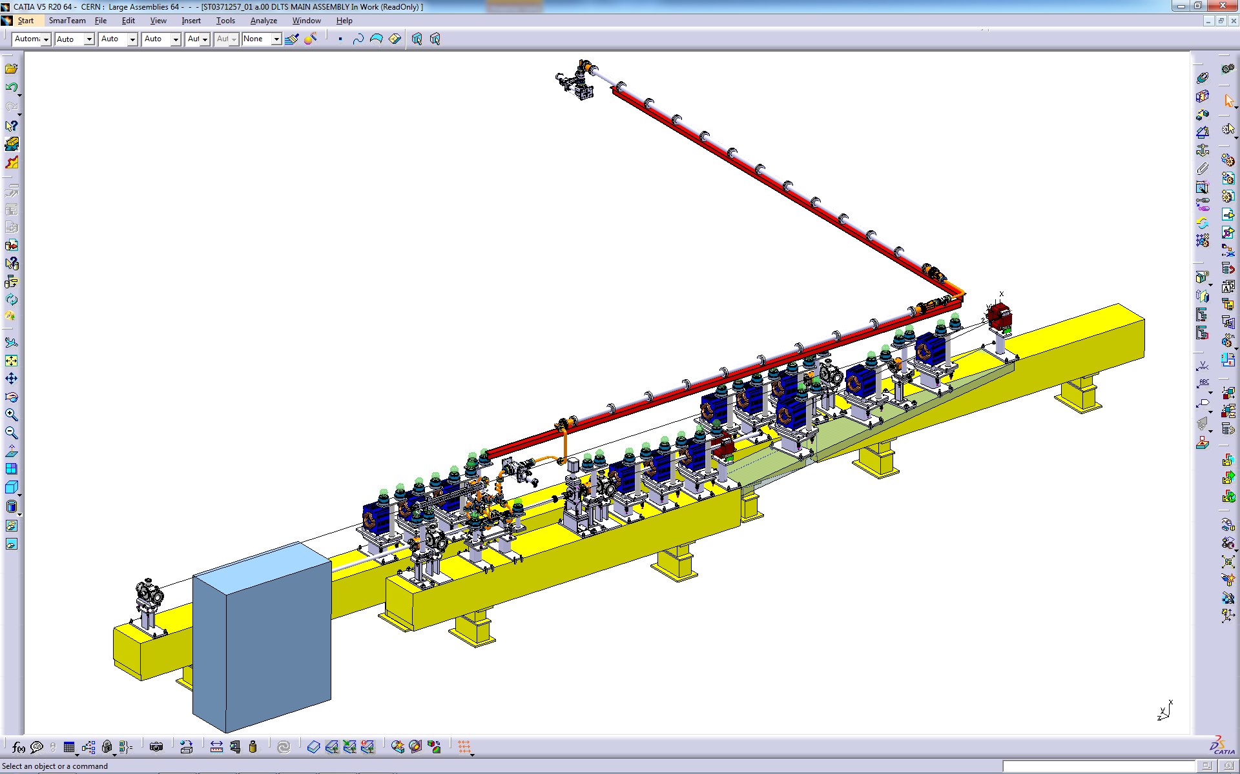
Beam Loading run beyond 2016
From here to 2016 ~ 3 test slots (one per year) – not a large statistics
In this time scale could have a new CLIC structure prototype from rebaselining
May want to test it, especially if the gradient profile turns out to be different from the present one
Need relative small infrastructure – 5 MKS, first 50 m of linac
DELAY LOOP
BL - BDR experiment
COMBINER RING
LINAC
CLEX
Gradient along the structure
RF
Unloaded
∅ 50 mm circular waveguide
Average gradient 100 MV/m
T24 structure installed in CTF3
Increasing current
Loaded (CLIC)
Drive beam, 1-3A, 100-50 MeV

Slide 28
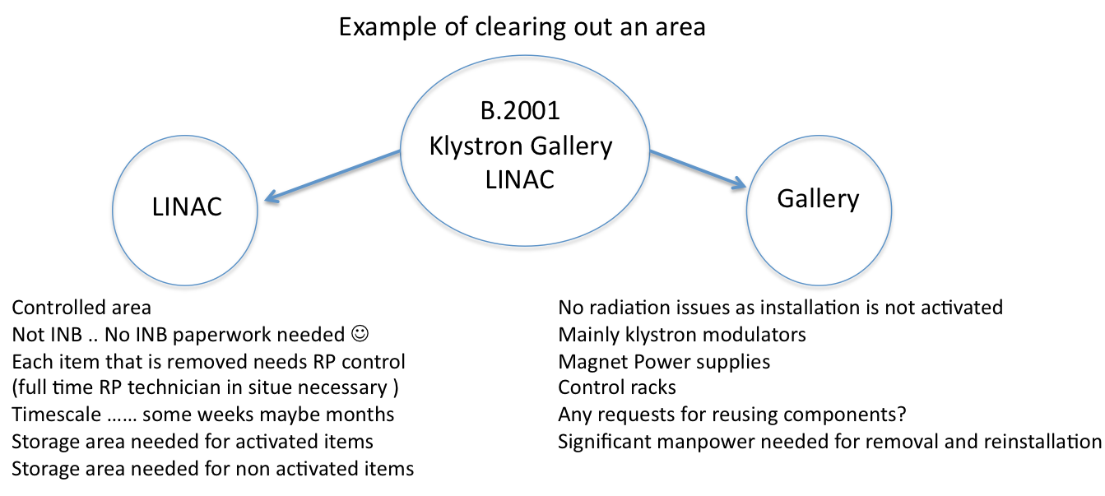
CTF3 Decommissioning issues
G. McMonagle

Slide 29
CTF3 Decommissioning & re-use issues
G. McMonagle
Simplest solution close the complex and lock the doors
Continue running CTF3
  Costs
    New access control system needed
    Upgrade of modulator controls (get rid of non supported CAMAC)
    manpower
Reuse the Linac and rings for electron injector to PS
  Costs
    New access control system needed
    Upgrade of modulator controls (get rid of non supported CAMAC)
    manpower
CLEX
  Keep CALIFES operational
    New access control system needed SOLVED
New DB injector test area
    Use LINAC area but probably need civil engineering work in CTF2 area to allow modulators and klystrons to be installed (too large for gallery)
CTF2
  Continued PHIN tests, X band test area
    New access system needed SOLVED

Slide 30
Additional considerations II
Decommissioning ≠ zero resources !
It may be wise to “mothball” CTF3, also to keep open the possibility to re-start CTF3 after 2016 if needed (new module generation?) and according to CERN priorities
Hovever, this clashes with requests to re-use CTF3 buildings and equipment…
The shut-down paradox:
“Given an accelerator facility, the cost of running it is in general lower or equal than the cost of a shut-down”.
G. McMonagle

Slide 31
CONCLUSIONS
Many options for decommissioning/re-use/transformation of CTF3 area & equipment.
Not all option consistent with each other
Main limitation will come from resources
Very good start in evaluating possible options
Still need quite some work, especially on evaluation of resources
Should come back with a well laid out plan (with a few options) by end 2014

Slide 32
RESERVE

Slide 33

Yearly cost of CTF3 running
2012 running, relevant budget codes in blue
Include some consolidation and upgrade

Slide 34

Yearly cost of CTF3 running
Spent 2013
(kCHF)
340
13
170
26
890 (1200)
58
50
Taking out upgrades, divided by sub-systems
1550 (1860)
+ Manpower: about 15 FTE, including M to P

Slide 35
Contribution to AWAKE
Awake needs 20 MeV electron source with low charge, small emittance and possibly short bunches
One CTF3-type Klystron-Modulator would be needed to power the injector
PHIN (Califes) type gun could be used
Some diagnostics, vacuum equipment and magnets might be useful
CTF-team experience would be likely helpful as well
Test facility and pre-commissioning in CTF2 area?

Slide 36


Building re-use, an example: ERL Test Facility
Currently CTF3 to end operation in 2017
Size could be ok when annexing some parts of the current Linac buildings
Complicated topology. Could be easier to re-assemble
Could accommodate quench tests in CTF2 and CTF3 buildings
Already crowded area
60 x 24
N. Catalan-Lasheras
LHeC Workshop 2014

