Slide 1
LHC R2E for vacuum control systems
Pawel Krakowski
TE-VSC-ICM
Vacuum, Surfaces & Coatings Group
Technology Department
Automation Forum-electronics session, 6 Nov 2014

Slide 2
Introduction
Types of ionizing radiation
Radiation levels in LHC
Radiation effects on electronics
Vacuum controls exposed to radiation
LHC R2E activities

Slide 3
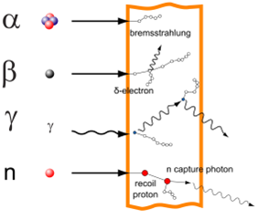

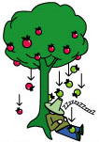

Types of Ionizing radiation
Charged particles interact strongly
and ionize directly
Bq [s⁻¹] the quantity of radioactive material that decays per second
Fluence [cm⁻²∙y⁻¹] (HEH – High Energy Hadron) the total number of particles that intersect a unit area in a specific time interval of interest.
Gy [J∙kg⁻¹] (Dose) the absorption of one joule
of radiation energy by one kilogram of matter
Sv [J∙kg⁻¹] the health effect of low levels
of ionizing radiation on the human body.
Depends on the type of radiation.
Neutral particles
interact less, ionize indirectly, penetrate further
The source
How many apples fall from a tree in time ?
Hits received by the sleeper
The particle
Will the headache be the same regardless of the size or weight of the apple?
How many apples will fall on this area in a year?

Slide 4
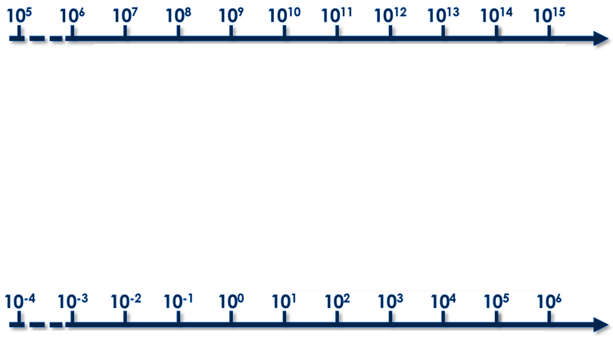

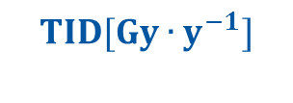

Radiation levels in LHC
$$HEH [{cm}^{−2}{∙y}^{−1}]$$
environment
Earth orbit
deep space
LHC machine electronics
Experiments
Protected
UJ
Shielded
RE/UA
Tunnel
ARCs/LSS
Experiment
caverns
Commercial
Custom Boards
+commercial
Hardened
RadTol
Damage
R2E
Single-Event
Effects
R2E
Cumulative
damage
Material
Damage
$$TID[Gy∙y^{−1}]$$

Slide 5



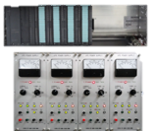

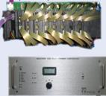







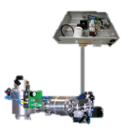
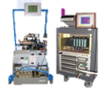





Vacuum controls in LHC
Underground service areas
only used
without beam
Accelerator tunnel
Mobile equipment
Sector valves and ion pumps
Pressure gauges
Other
Pumps and gauges
LSS : only passive components
ARC : some active components

Slide 6
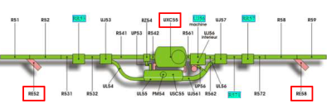


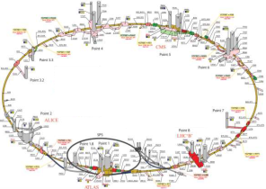
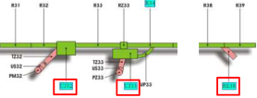
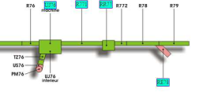

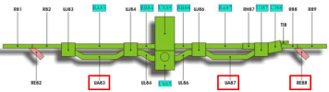

Vacuum controls in service areas
USC55
RE52
RE58
RE42
UA43
UA47
RE48
RE62
UA63
UA67
RE68
P3
P4
P5
P6
P2
P7
UJ32
UJ33
RE38
P1
P8
UJ76 Patchpanels only
TZ76
RE78
RE22
UA23
UA27
RE28
RE82
UA83
UA87
RE88
UA151
RE18
For now all controls in low HEH areas and negligible TID

Slide 7
HEH flux levels in service areas
Location |  | RUN-2 |  | RUN-3 | HL-LHC
 |  | 2015 | [2016; 2018] | [2020; 2022] | [2025; 2035+]
 |  | HEH Fluence [cm⁻²y⁻¹]
REs | shielding as is | - | 1E+06 | 2E+06 | 4E+06 | 8E+06
UA23, UA83 | ok, but to be monitored during operation | 1E+06 | 2E+06 | 4E+06 | 8E+06 | 2E+07
TZ76 (1st 15m), UA63/67 (behind ducts) UJ33
All Other OK
with HL-LHC
TID is negligible all the time
HEH fluence will increase by one order of magnitude

Slide 8


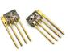


Radiation effects on electronics
Cumulative
accumulating during the whole LHC lifetime, due to the energy deposited by radiation in the electronics
TID
(Total ionizing dose)
the dose is deposited by particles passing through the materials constituting the electronic devices.
MOS
Bipolars
DD
(Displacement damage)
Optoel.
Radiation effects
Stochastic
immediate effects very
localized, event induced by
a single particle
SEE (Single event effects)
Transient
SEU
SEFI
CMOS
Destructive
SEL
SET
SEGR
SEBO

Slide 9
Displacement damage
Atomic level
Frankel defect
Silicon atoms
n
no charge
Vacancies
Defects accumulate and gradually destroy the silicon lattice

Slide 10

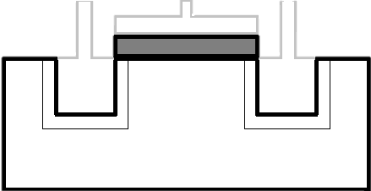
Radiation effects on electronics
MOS transistor
Charged particle
Source
Gate
Drain
Gate Oxide
n-type
extra electrons
p-type
extra holes
SiO insulator
Charged particle ionize the matter creating electron-hole pairs

Slide 11
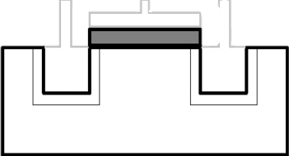
Radiation effects on electronics
What can happen after…?
TID (Total Ionizing Dose)
SEE (Single Event Effect)
holes accumulate and gradually degrade the transistor function
electrons collected by junctions create
parasitic current

Slide 12

Radiation effects on electronics
CMOS
N
P
P
N
N
P
Parasitic bipolar transistors
Latch-Up:
  causes VDD and GND to short
  Can result in self-destruction, at best a malfunction requiring a power cycle

Slide 13
Radiation effects on electronics
TID + DD
SEE
  In time components degrade slowly
  Electronics can work without any signs
  of malfunction
  There are no unwanted “stops”
  Failures can appear and rapidly increase in frequency
  The final failure can be predicted Interventions can be planned
Destructive failures possible
Immediate interventions needed
Expected life time
Nonzero probability of a failure
Failure probability
Failure probability
Gy ∙ y⁻¹
Time
HEH [cm⁻¹∙y⁻¹]
Threshold
Notes:
Cumulative effects are gradual effects taking place during the whole
lifetime of the electronics exposed in a radiation environment. A device
sensitive to TID or displacement damage will exhibit failure in a radiation
environment when the accumulated TID (or particle fluence) has reached its
tolerance limits. It is therefore in principle possible to foresee when the
failure will happen for a given, well known and characterized component.
On the contrary, Single Event Effects are due to the energy deposited by one
single particle in the electronic device. Therefore, they can happen in any
moment, and their probability is expressed in terms of cross-section. A
device sensitive to SEE can exhibit failure at any moment since the
beginning of its operation in a radiation environment.

Slide 14

Requirements for radiation tests
Radiation test in 4 easy steps
Radiation environment
Where in the machine the electronics is installed?
What levels of radiation are expected?
  TID (Gy)
    >1-5 Gy/y
  HEH (n/cm²)
    >1E7 n/cm²/y
Rad-effects of Concern
  Component classification:
    component type
    based technology
    available expertizes and reports
  Effects and criticality
Test procedure
Test Facilities
sample design and irradiation procedure
sample readouts and powering
best statistics as possible
CHARM &Co-60
PSI
Fraunhofer
other

Slide 15
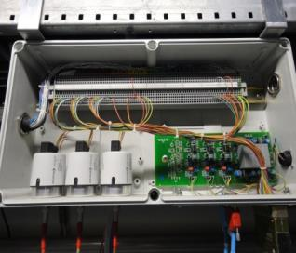
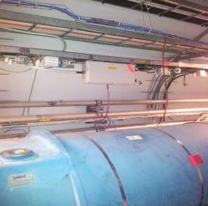
Vacuum controls equipment near ARC dipoles
Equipment installed in radiation environment:
Front-end electronics for Pirani and Penning
In total 224 connection boxes:
  328 active Pirani
  328 active Penning
Pawel Krakowski
Pawel Krakowski
Penning
Pirani

Slide 16
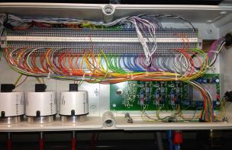
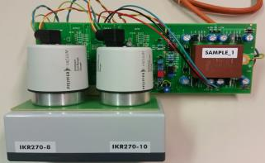
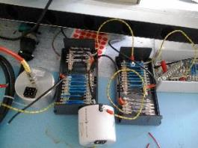
Vacuum controls equipment near ARC dipoles
RUN-1
2011 |  | 2012
HEH Fluence [cm⁻²y⁻¹] | Dose [Gy y⁻¹] | HEH Fluence [cm⁻²y⁻¹] | Dose [Gy y⁻¹]
- | - | 1E+08 | 0.2
RUN-2
2015 |  | [2016; 2018]
HEH Fluence [cm⁻²y⁻¹] | Dose [Gy y⁻¹] | HEH Fluence [cm⁻²y⁻¹] | Dose [Gy y⁻¹]
2E+08 | 0.4 | 2E+08 | 0.4
RUN-3
[2020; 2022]
HEH Fluence [cm⁻²y⁻¹] | Dose [Gy y⁻¹]
4E+08 | 0.8
HL-LHC
[2025; 2035+]
HEH Fluence [cm⁻²y⁻¹] | Dose [Gy y⁻¹] | HEH Fluence [cm⁻²y⁻¹] | Dose [Gy y⁻¹]
8E+08 | 1.6 | 2E+09 | 3.2
  in order to survive run-2 and run-3 (10 years), electronics must withstand min 80 Gy
  for another 10 years of HL-LHM, an ~160 Gy must be accounted
  radiation tests will be done up to max 500Gy [~2 x (80 + 160)]
  to evaluate up to which TID they withstand
  Samples will be shipped to Fraunhofer Institute by the end of October
  if they do not withstand next 10 years (run2 + 3),
    replacement must be foreseen, or an alternative design must be considered

Slide 17
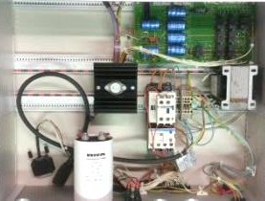
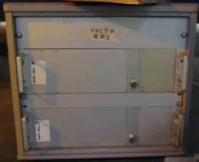
Vacuum controls equipment near MQ
24VDC power supply for fixed vacuum pumping groups near quadruples
  running in the presence of beam
  installed near ARC quadrupoles, and in the LSS near SMs and ITs
No data for IT!
  Specification for the TID/SEE
  radiation test under preparation
  Alternative design or relocation
  must be taken into account
Location | RUN-1 |  | RUN-2 |  |  |  | RUN-3 |  | HL-LHC
 | HEH Fluence [cm⁻²y⁻¹] | Dose [Gy y⁻¹] | HEH Fluence [cm⁻²y⁻¹] | Dose [Gy y⁻¹] | HEH Fluence [cm⁻²y⁻¹] | Dose [Gy y⁻¹] | HEH Fluence [cm⁻²y⁻¹] | Dose [Gy y⁻¹] | HEH Fluence [cm⁻²y⁻¹] | Dose [Gy y⁻¹] | HEH Fluence [cm⁻²y⁻¹] | Dose [Gy y⁻¹]
 | 2012 |  | 2015 |  | [2016; 2018] |  | [2020; 2022] |  | [2025; 2035+]
ARC MQ | 3E+08 | 0.5 | 5E+08 | 1.0 | 5E+08 | 1.0 | 1E+09 | 2.0 | 2E+09 | 4.0 | 4E+09 | 8.0
DS MQ | 3E+09 | 5.0 | 5E+09 | 10.0 | 5E+09 | 10.0 | 1E+10 | 20.0 | 2E+10 | 40.0 | 4E+10 | 80.0
DS Worst | 5E+09 | 10.0 | 1E+10 | 20.0 | 1E+10 | 20.0 | 2E+10 | 40.0 | 4E+10 | 80.0 | 8E+10 | 160.0
IT | ? | ? | ? | ? | ? | ? | ? | ? | ? | ? | ? | ?

Slide 18
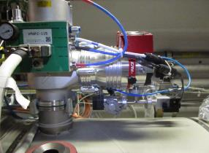
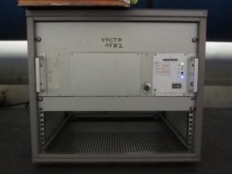
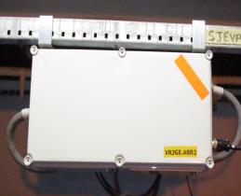
Options for equipment relocations
Replacement of 96 Turbo molecular pumps and their controllers. Currently Alcatel ACT250R controller is installed directly under
the ARC MQ cryostats, near to the pump installation.
Proposed solution:
      Long cable connection between controller installed in radiation safe areas (alcoves, caverns) and the HiPace 300 pump installed on the cryostat
Other options are taken into consideration

Slide 19
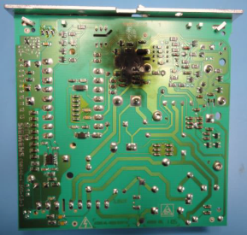
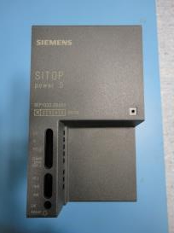
Failures in P7 before relocation
Beam dumps due to vacuum controls failures, induced by radiation :
Very small statistics (5 events)
2 Blockings of PLC
3 switching power supplies in valve controllers were burned
Piquet intervention in P7
Equipment | Date
PLC | 03.09.2012
PLC | 29.09.2012
DC Power Supply | 11.05.2012
DC Power Supply | 05.10.2012
DC Power Supply | 07.10.2012

Slide 20
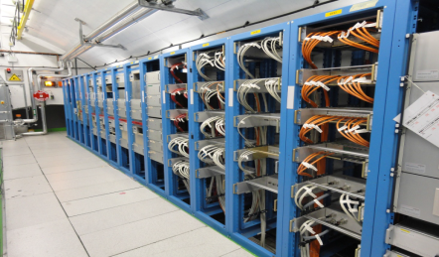
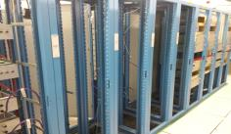
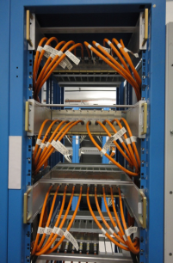
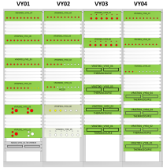
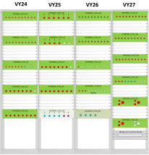
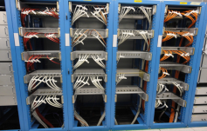
Vacuum equipment relocation in P7
48 patch panels installed in UJ76
8 of 27 existing racks used
patch panel groups the same equipment
~ 280 cables extended from the UJ76 to
the TZ76 by a maximum length of ~180m

Slide 21
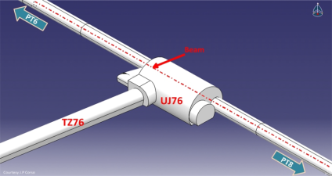
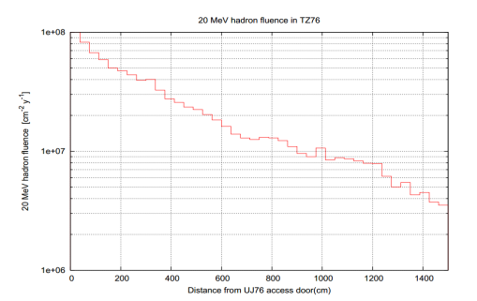
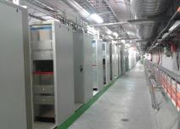
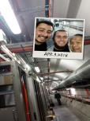
Vacuum equipment relocation in P7
All equipment relocated to TZ76 corridor
~200 new interracks cables installed
The closest Vacuum rack is located more than 100 m from UJ76 access doors, where the flux is
< 1E+6 [cm⁻²y⁻¹]
Considered as safe for electronics
Old installation
Relocation
~100 m
UJ access door
Not safe
15 m
HEH 1%
Safe
Pawel Krakowski

Slide 22
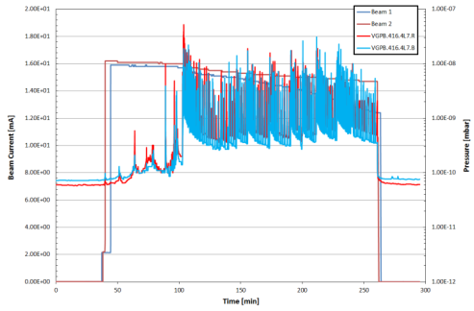
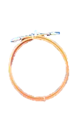

Problems not solved by P7 relocation
source of fluctuations in Penning readings in LSS7
HV cable ? gauge ? controller?

Slide 23
Thank you for the attention

