Slide 1
SCVUs Developments (Part One)
Electronics Developments for VPIs (Part Two)
Marco Roda
TE-VSC-ICM
06/10/2014
[AUTOMATION FORUM] Electronics Session
Internship student - MSc
Notes:
It’s been 1 year and 2 months I have beem working in this section;
Explain my internship;
2 Projects I have been Working – 2 Parts!!
SVCUs
Sputter Ion Pumps PROFIBUS Electronics Developments!!

Slide 2
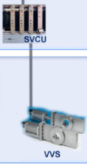
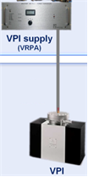
Introduction
Sector Valves Control Unit (SVCUs)
  System architecture Overview
    LHC
    SPS
    CPS
  SVCUs Controller Firmware and Upgrades
    Control Card Hardware
    Altera Quartus Software
    Modelsim Simulations
Electronics Developments for Sputter Ion Pump Controllers
  Current System Architecture for VPI controllers
  New PROFIBUS Interface Card for VPI Controllers
[AUTOMATION FORUM] Electronics Session

Slide 3
Part I: Sector Valves Control Unit (SVCUs)
[AUTOMATION FORUM] Electronics Session
Internship student - MSc
Notes:
Part One:
- Sectro Valves Control Unit!!

Slide 4


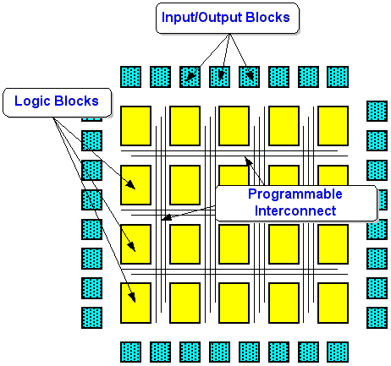
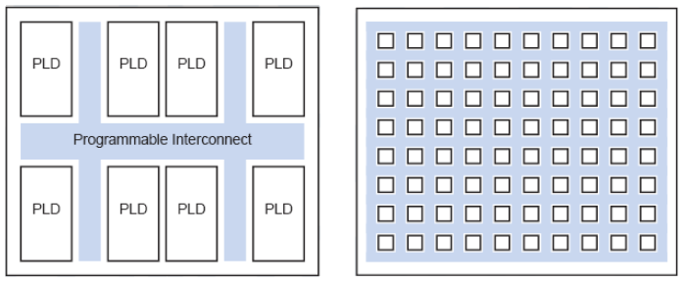
SVCUs
Progammable Logic Devices
2 Main Manufacturers
  Altera
  Xilinx
FPGAs
(Field-Progammable Gate Array)
  High Complexity
  Up to 150,000 flip-flops
  Clock managment
  DSP fucntions
  On-chip RAM
  On-chip uProcessor
CPLDs
(Complex Progamable Logic Device)
  Low Complexity
  Up to 500 flip-flops
  “Glue Logic”
  Low Power consuption (50 uAmps)
  Battery equipments
CPLDs
FPGAs
[AUTOMATION FORUM] Electronics Session

Slide 5
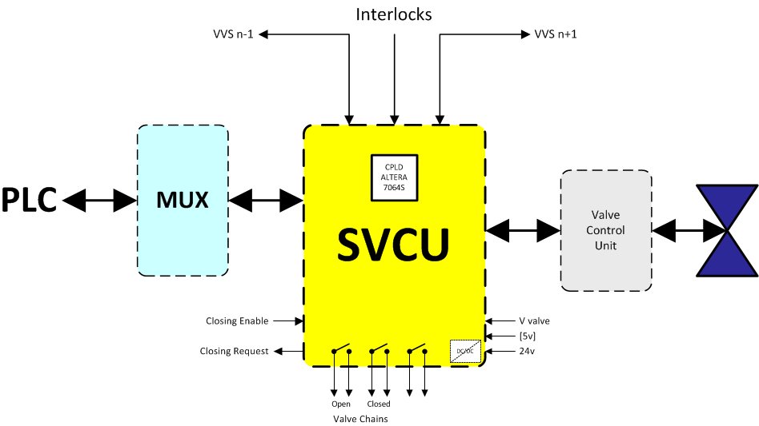
SVCUs
General SVCUs System Architecture
  PLC Controlller
  MUX
  SVCU Electronic Card
  Interlocks system
  Valve Control Unit
  VVS
[AUTOMATION FORUM] Electronics Session

Slide 6
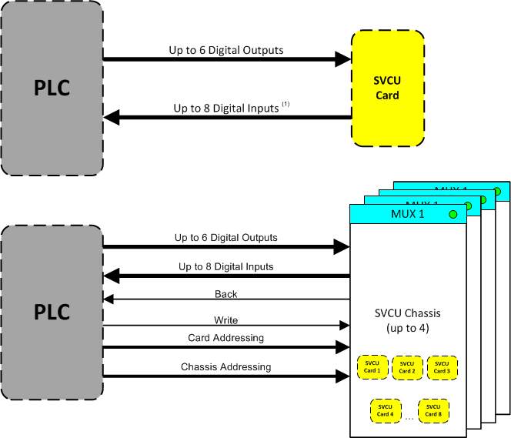
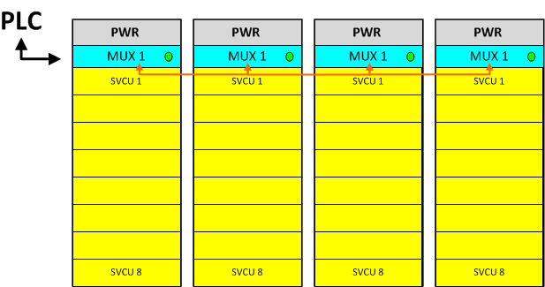
SVCUs
SVCUs MUX Architecture
  Up to 4 SVCU chassis
  Up to 8 SVCU cards per Chassi
  Fully Remote and Local control
  6 Digital Outputs
  8 Digital Inputs
[AUTOMATION FORUM] Electronics Session

Slide 7
SVCUs
Interlocks
  LHC
    Local Interlocks to/from previous SCVU card
    Local Interlocks to/from next SCVU card
    4 Local Pressure Interlocks from gauges
  SPS
    Global Interlocks to/from next and previous SCVU card
    Local Interlock from previous SVCU card
    Local Interlock from next SVCU card
    Delta Pressure Interlock from previous SVCU card
    Delta Pressure Interlock from next SVCU card
  CPS
  Local Interlocks to/from pervious SVCU card
    Local Interlocks to/from next SVCU card
[AUTOMATION FORUM] Electronics Session

Slide 8
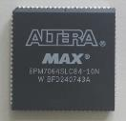
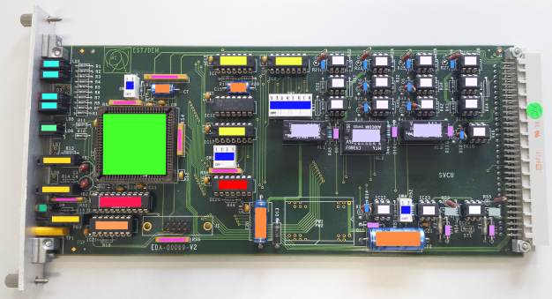
SVCUs
SVCU Controller – Altera MAX 7000S series
General electronic card for LHC, SPS and CPS
Metalic front panel with status LEDs and Open/Close Valve button
CERN’s general crate connection with all the I/Os
DIP-Switchs on board to choose which interlocks are needed
On-board Optocouplers for differential interlock signals
Altera MAX 7000S series
EPM7064SLC84-10N
64 Macrocells
68 I/O ports
84 pins
5V as Power Supply
[AUTOMATION FORUM] Electronics Session

Slide 9
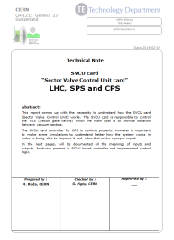
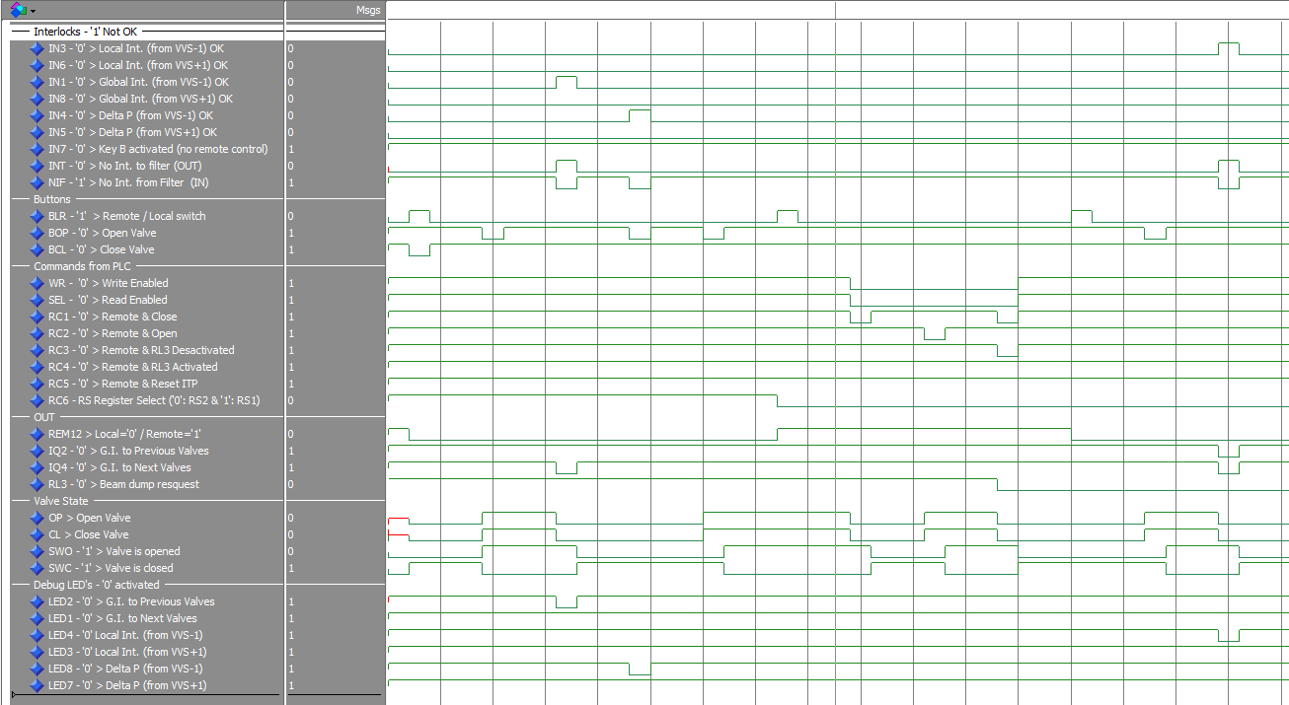
SVCUs
SVCUs upgrades
LHC, SPS and CPS
  Logic gates language into VHDL in Quartus II
  Modelsim simulations
  EDMS Documentation
CPS
  CPS CPLD firmware was the same as SPS one
  Delete SPS interlocks and leave only the CPS ones
EDMS documents
Modelsim simulations
[AUTOMATION FORUM] Electronics Session

Slide 10
Part II: Electronics Developments for
Sputter Ion Pumps
[AUTOMATION FORUM] Electronics Session
Internship student - MSc

Slide 11
PROFIBUS slave for Sputter Ion Pump
Goals
Study Electronics of Sputter Ion Pumps
Market survey of PROFIBUS ASIC slaves
Design and Development a PROFIBUS slave prototype for Sputter Ion Pumps
[AUTOMATION FORUM] Electronics Session
Notes:
The goals for the PROFIBUS slave project

Slide 12
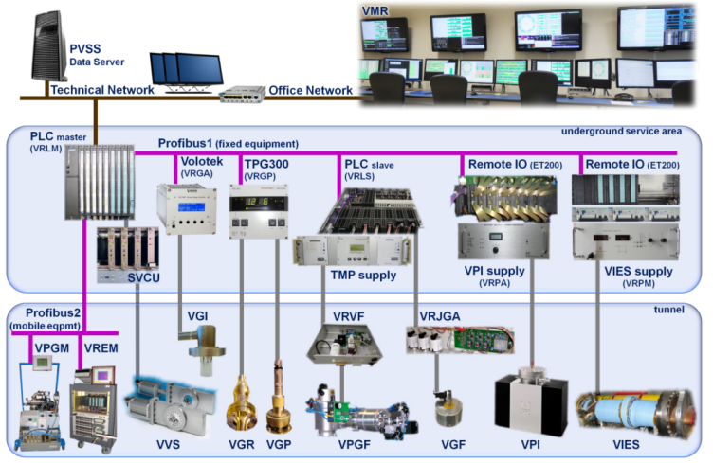
PROFIBUS slave for Sputter Ion Pump
Vacuum System Architecture
[AUTOMATION FORUM] Electronics Session

Slide 13
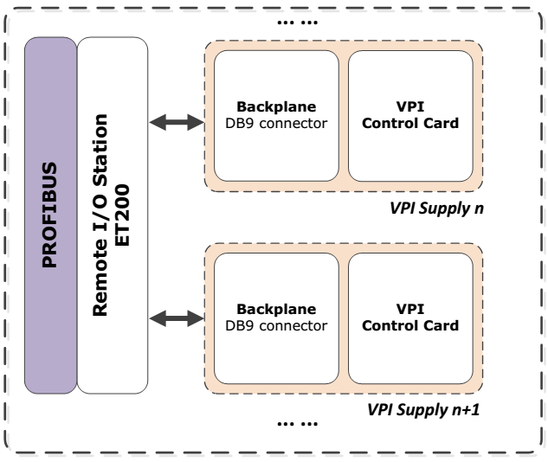
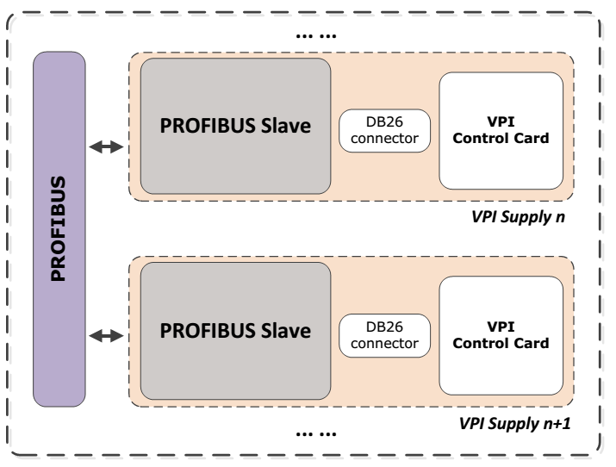
PROFIBUS slave for Sputter Ion Pump
Sputter Ion Pump Architectures
Current Sputter Ion Pump Architecture
New Sputter Ion Pump Architecture
[AUTOMATION FORUM] Electronics Session

Slide 14
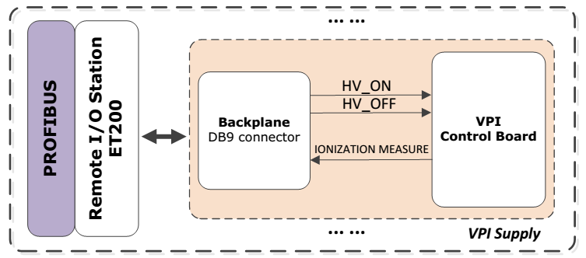
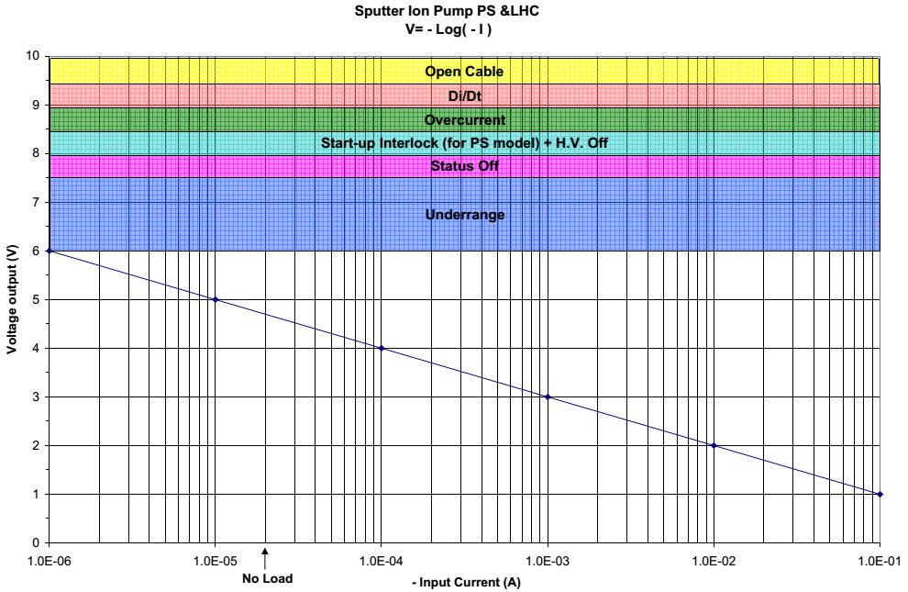
PROFIBUS slave for Sputter Ion Pump
Current Sputter Ion Pump Signals
Digital Inputs from PLC
  “HV_ON” : Turn ON the High-Voltage
  “HV_OFF”: Turn OFF the High-Voltage
Analog Output to PLC
  “IONIZATION MEASURE” : [0-6V]
  Interlock
  Over Current
  Di/Dt (Time Out)
  Open Cable
  The other 4V are used to send info about the VPI’s status:
[AUTOMATION FORUM] Electronics Session

Slide 15
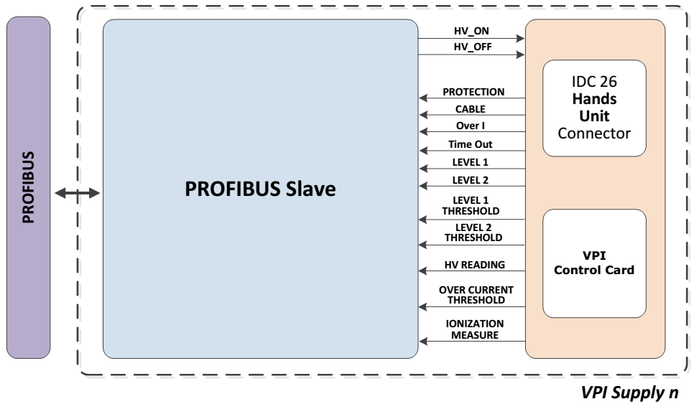
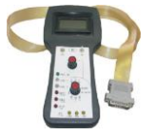
PROFIBUS slave for Sputter Ion Pump
New Sputter Ion Pump Signals
11 Inputs (from PROFIBUS Slave to PLC)
Digital
Analog
2 Outputs (from PLC to PROFIBUS Slave)
“CABLE”
“PROTECTION”
“OVER I”
“Time Out”
“LEVEL 1”
“LEVEL 2”
“LEVEL 2 THRESHOLD” [0 - 5V]
“LEVEL 1 THRESHOLD” [0 - 5V]
“HV READING” [0 - 5V]
“OVER I THRESHOLD” [0 - 5V]
“IONIZATION MEASUE” [0 - 10V]
“HV_ON”
“HV_OFF”
Both Digital
[AUTOMATION FORUM] Electronics Session

Slide 16
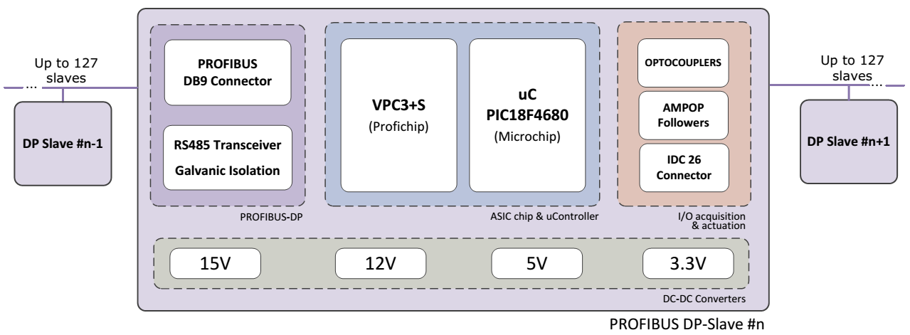
PROFIBUS slave for Sputter Ion Pump
PROFIBUS-DP Slave Modules
4 Main Modules:
  PROFIBUS-DP
  ASIC & uController
  I/O Acquisition & Actuation
  DC-DC Converters
[AUTOMATION FORUM] Electronics Session

Slide 17
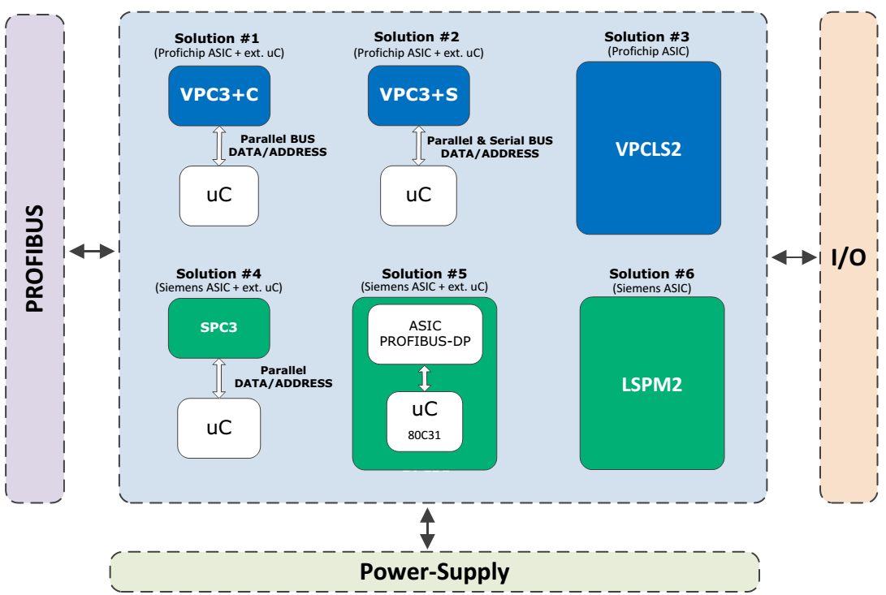
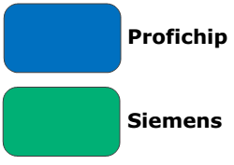
PROFIBUS slave for Sputter Ion Pump
ASIC PROFIBUS chip
ASIC used: VPC3+S
(Solution #1)
SPI serial BUS
2k RAM
11
DP-VO, V1 & V2
Ultra Low Power, 3V3
Up to 12Mbps
[AUTOMATION FORUM] Electronics Session

Slide 18

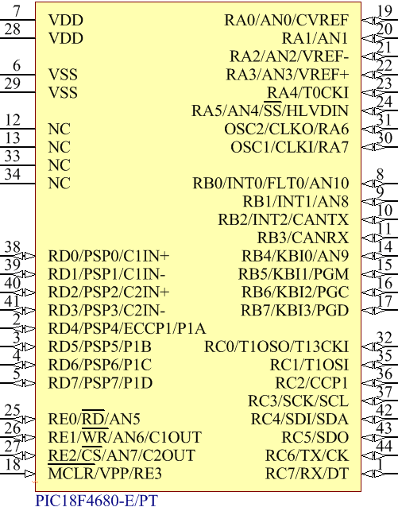

PROFIBUS slave for Sputter Ion Pump
uControllers
2 Main Manufacturers
  Microchip
  Atmel
Digital/Analog Electronic Device
General I/O Ports
Peripheral Modules
  USART (RS232)
  ADC
  MSSP (SPI, I2C)
  Ethernet
  CCP (Capture/Compare/PWM)
  ...
PIC18F4680 – 44 pins TQFP
18F Family
8-bit Registers
5 GP I/Os Ports
ADC Analog Channels
[AUTOMATION FORUM] Electronics Session

Slide 19
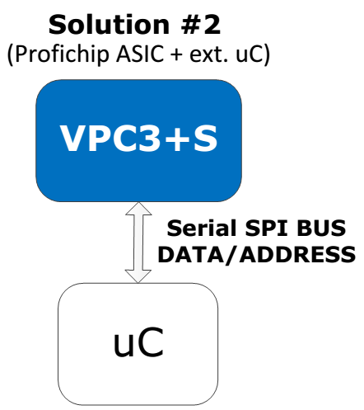
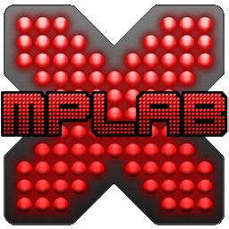
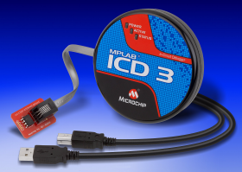
PROFIBUS slave for Sputter Ion Pump
uController – PIC18F4680
Peripheral Highlights:
5V as Power-Supply
MSSP port (Master and Slave modes)
  3-wire SPI
  2-wire I2C
5V ADC
  10-bit
  Up to 11-channels
  Up to 100 ksps
44 Pins
Software & Hardware RESET
Four Crystal modes, up to 40 MHz
Phase Lock Loop (PLL)
Program Memory: 64kB
Needed Modules for VPI Controller:
1x SPI
4x Analog Inputs
10-bit ADC Channels
7x Digital Inputs
2x Digital Outputs
At least 9 I/Os
1x USART
At least 50kB of Program Memory
[AUTOMATION FORUM] Electronics Session

Slide 20
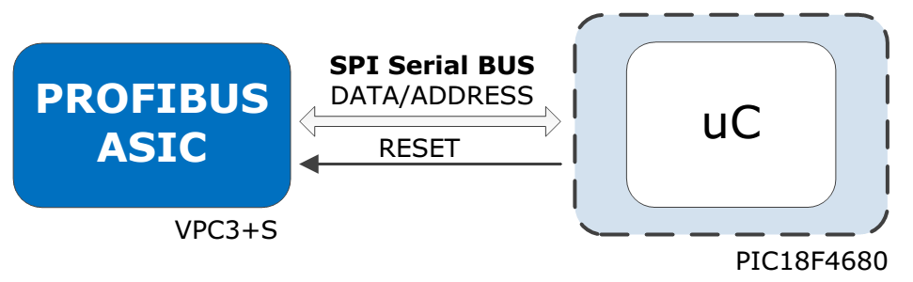
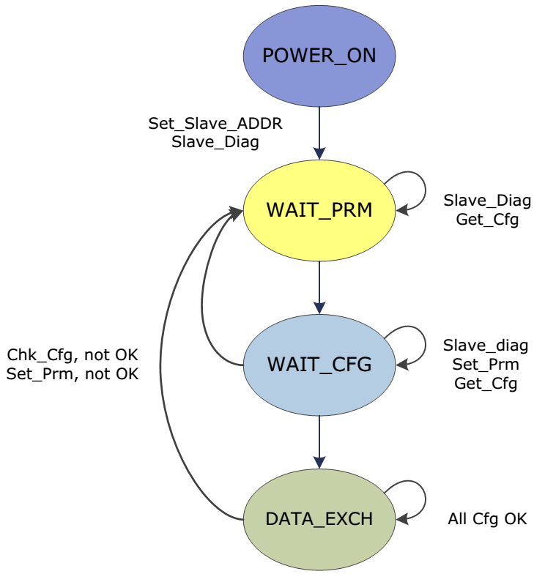
PROFIBUS slave for Sputter Ion Pump
uController - ASIC Interface
SPI Interface – 4 Wire Communication
MOSI (Master Output Slave input)
MISO (Master Input Slave Output)
SCK (Serial Clock)
SS (Slave Select)
PROFIBUS State Machine
4 Main States
2 State for the slave configurations
[AUTOMATION FORUM] Electronics Session

Slide 21
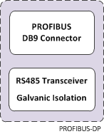
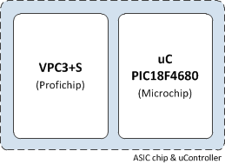
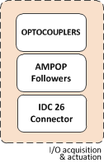
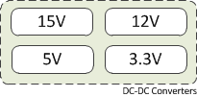
PROFIBUS slave for Sputter Ion Pump
PROFIBUS-DP module
D Sub-9 PROFIBUS Connector
ADM2486 Chip used Transceiver
Galvanic Isolation
ASIC & uController
VPC3+S used as PROFIBUS ASIC
PIC18F4680 used as ucontroller
Interfece between ASIC & uController – SPI
USB connection for LabView control
I/O Acquisition & Actuation
2x Optocouplers
14x Operational Amplifiers
DC-DC Converters
4x Voltage Levels on-board
15V from VPI controller (IDC26 connector)
12V: HV_ON & HV_OFF Relays
5V: uController
3V3: PROFIBUS ASIC
[AUTOMATION FORUM] Electronics Session

Slide 22
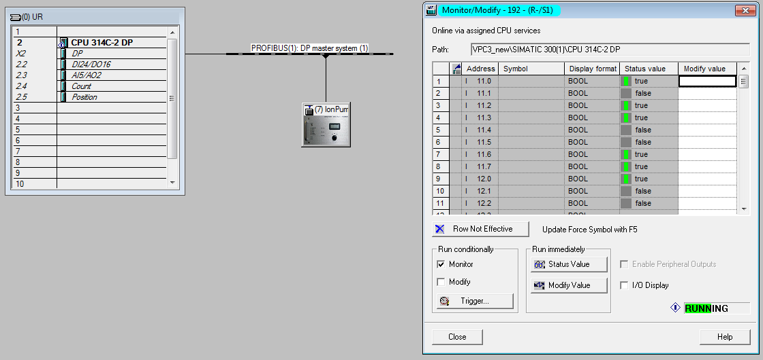
PROFIBUS slave for Sputter Ion Pump
PLC Master Interface
11 Input Bytes (Slave to Master)
2 Output Bytes (Master to Salve)
[AUTOMATION FORUM] Electronics Session

Slide 23
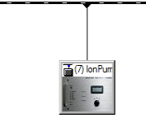
PROFIBUS slave for Sputter Ion Pump
PLC Master Interface – I/Os
11 Input Bytes (Slave to Master)
  2 Bytes: Level 1 Threshold read
  2 Bytes: Level 2 Threshold read
  2 Bytes: Over Current Threshold read
  2 Bytes: Ionization Measure
  2 Bytes: High-Voltage read
  1 Byte
    Open Cable
    Protection
    Level 1
    Level 2
    Over Current
    High-Voltage
2 Output Bytes (Master to Slave)
  1 Byte: Turn ON High-Voltage
  1 Byte: Turn OFF High-Voltage
PROFIBUS(1): DP master system (1)
GSD file was created
[AUTOMATION FORUM] Electronics Session

Slide 24
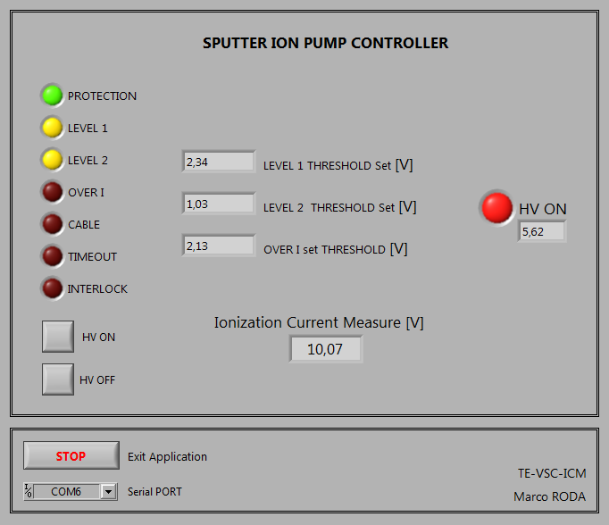
PROFIBUS slave for Sputter Ion Pump
LabView Interface
USB connection
2 Buttons
  Turn ON/OFF the High-Voltage
Level 1 Threshold read
Level 2 Threshold read
Over Current Threshold read
High-Voltage read
Ionization Measure read
VPI’s Status LEDs
[AUTOMATION FORUM] Electronics Session

Slide 25
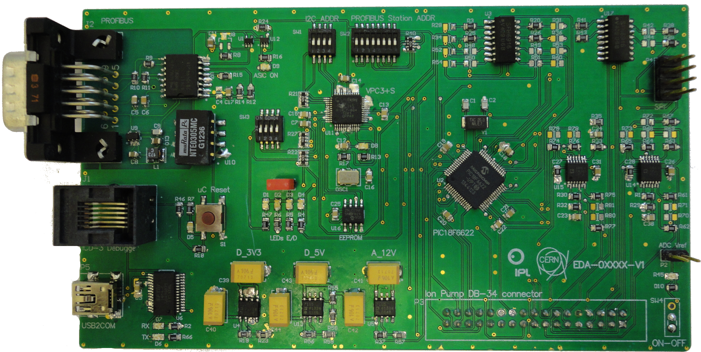
PROFIBUS slave for Sputter Ion Pump
Prototype Development
Fisrt Approach:
General PROFIBUS Slave
0 Ohm Resistors to switch between applications
IDC-36 connector
23 uController I/O pins
[AUTOMATION FORUM] Electronics Session

Slide 26
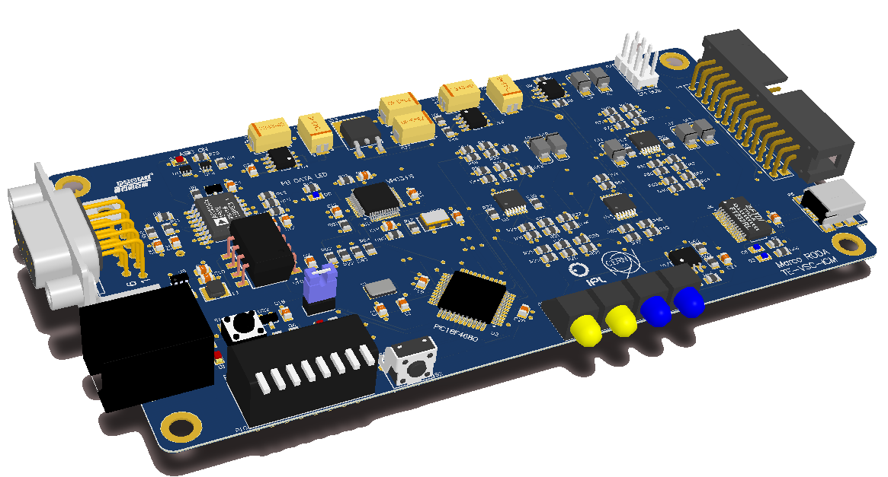
PROFIBUS slave for Sputter Ion Pump
Final Prototype
Sputter Ion Pump PROFIBUS Slave
IDC-26 Hands-Unit connector
13 uController I/O pins (digital & analog)
Dip-Switch to set PROFIBUS station Address
On-Board Data Communication & Power-Supply LEDs
[AUTOMATION FORUM] Electronics Session

Slide 27
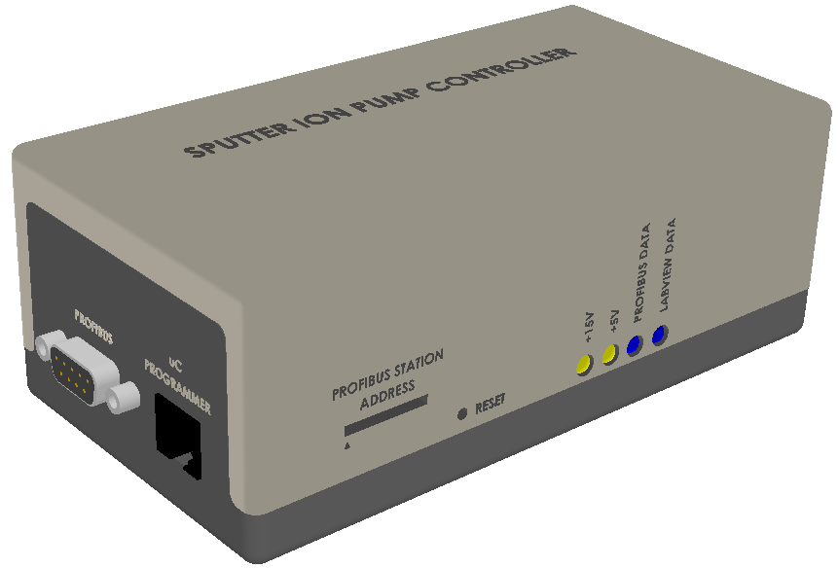
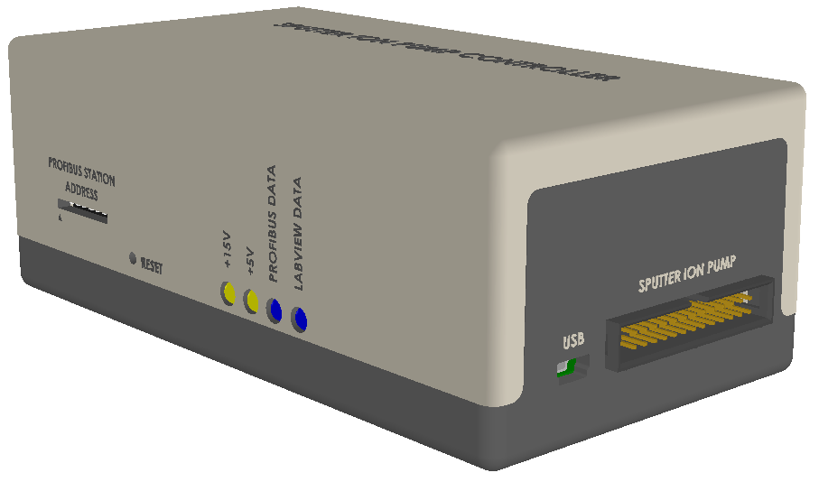
PROFIBUS slave for Sputter Ion Pump
Final Prototype – Plastic Box
Communication Status LEDs
IDC-26 Connector to VPI Controller
Dip-Switch to set PB station address
RESET button
USB Connection
To be attached on the VPI Controller
[AUTOMATION FORUM] Electronics Session

Slide 28
PROFIBUS slave for Sputter Ion Pump
Conclusions and Future Work
SVCUs system for LHC, SPS and CPS was documented and upgraded
Complete PROFIBUS Slave was designed
Plastic Box with the PCB inside to be attached on the VPI’s controllers
No need of Remote I/O station ET200 anymore
Only 1 PROFIBUS connection
Threshold levels and Over current are now available on the PLC side
2 Platforms to control Sputter Ion Pump Controllers
  PLC Master
  LabView
[AUTOMATION FORUM] Electronics Session

Slide 29
Thank you very much for your Attention
QUESTIONS ??
Marco Roda
TE-VSC-ICM
06/10/2014
[AUTOMATION FORUM] Electronics Session
Internship student - MSc
06/10/2014

