Slide 1

DrupalCon Amsterdam
September 2014
Cath Noble
ENTICE, 5 November 2014

Slide 2

Drupal 8
Beta release – available for download at https://www.drupal.org/drupal-8.0.0-beta1
Can now build basic sites in D8
Training
  1-day session “D8 for Drupalistas”. Increasingly expected to have coding skills (php)
  Drupal 8 Multi-language lab session
    https://docs.google.com/document/d/1lOz23Y1MitPEkdxVU593mt4AuMw4wscsU_IZz-TP5JM/edit?usp=sharing
Simpler and more intuitive interfaces (site builder, editor, content provider)

Slide 3
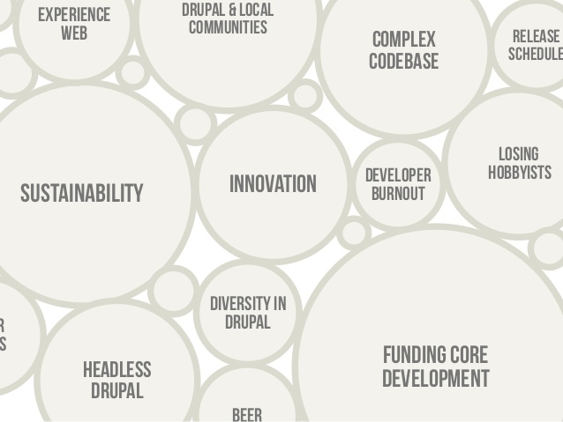
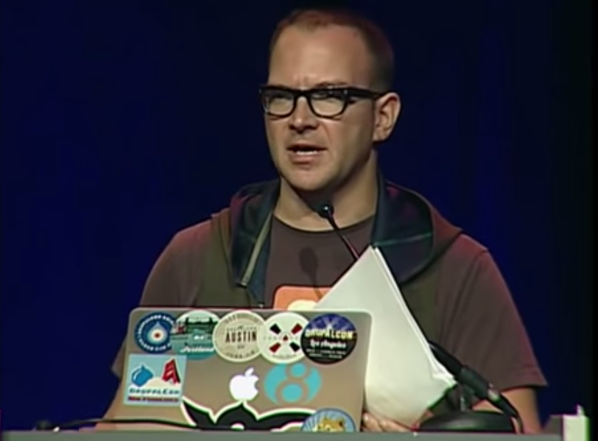
Keynotes
Dries Buytaert
  As a project grows, its reach widens, but so does its complexity and cost of maintenance and management.
  See keynote: https://amsterdam2014.drupal.org/keynote-dries-buytaert
Cory Doctorow
  Thought-provoking ‘activist’ keynote on “information wants to be free”
  Free software, lobbying overissues such as security of the computers that fill our lives, Digital Rights Management, surveillance and net neutrality.
  See keynote: https://amsterdam2014.drupal.org/keynote-cory-doctorow

Slide 4
Summary
D8 is on the horizon, and it’s bigger and betterer!
  More intuitive to build, use and create than D7
  But still a lot to iron out
Drupal is getting big, and more commercial
  Drupal community trying to work out how to balance its increasing interest from the corporate world, with its roots as a community project.

