Slide 1
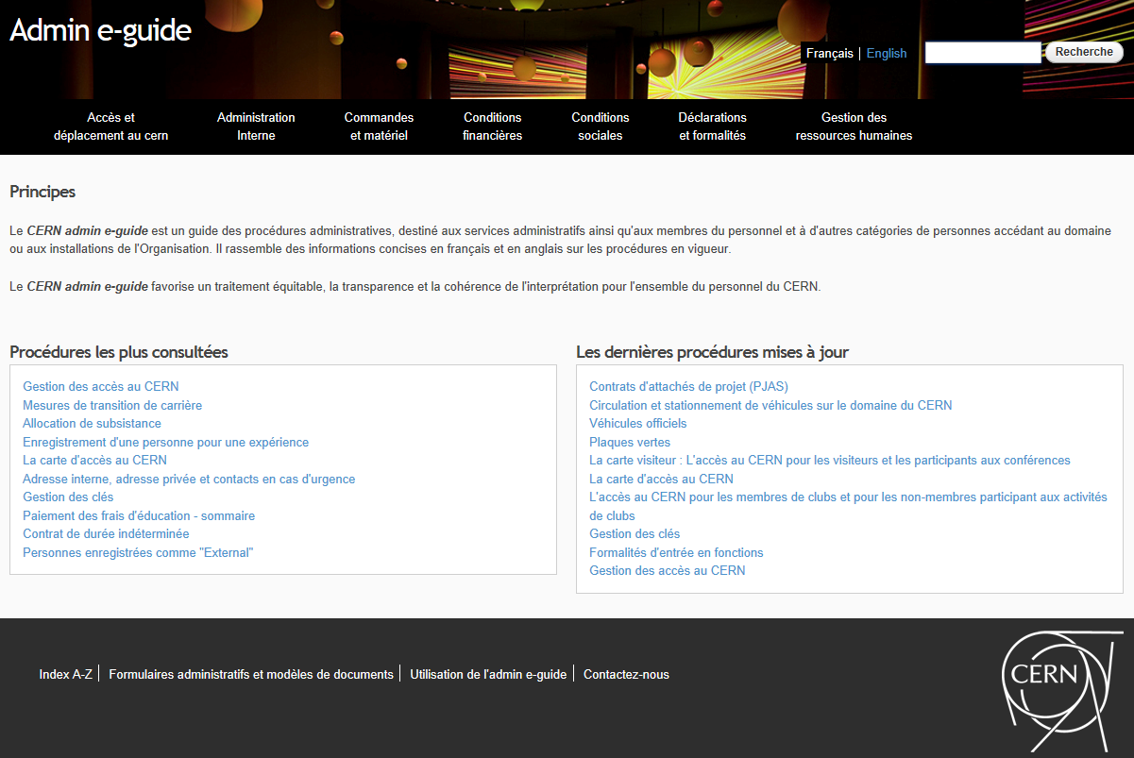
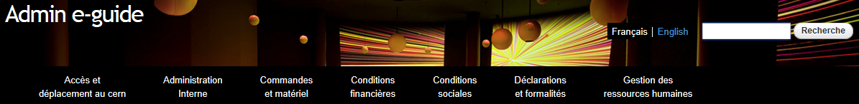
ADMIN E-GUIDE
Migration to Drupal
Almudena Solero DG-RPC-PA 5/11/2014

Slide 2
Topics
  Admin e-guide: brief overview + some figures
  Existing problems
  Why Drupal
  Migration highlights
  Key modules
  First experience
  Next steps and expectation

Slide 3
Admin e-guide: brief overview
Definition → administrative procedures guide
Aim → to simplify the information search on administrative topics
Applicable to → administrative services and all members of personnel
History :
  started in 1993 as “Administrative Procedures Manual“
  since 2010: Admin e-guide with Sharepoint Designer→ no CMS supported

Slide 4
Admin e-guide: Some figures
220 procedures
14 FAQs → 500 questions
Support of French and English
Current website:
  October 2014: 2343 visitors
  Green plates procedure: 396 viewed

Slide 5
Existing problems
Heavy workload on maintenance
  No automatic index
  Lack of flexibility
  Manual multi-lingual support

Slide 6
Why Drupal
Separation of content and appearance
Flexible and scalable
Strong on accessibility
Supported by IT dep.
Close collaboration with HR department → content sharing

Slide 7
Migration highlights
Architecture and site building:
Contractor (LINALIS)
  CERN standard theme does not meet our requirements
Migration of content: CERN
New feature: Access management
  Public: procedures useful for ex or future MoP
  Restricted: internal procedures

Slide 8
Key modules
All the typical modules (some examples)
  Views → Drupal can't live without it, allows the visualization of every data easily
  Linkit → provides an easy interface for internal and external linking
  Frequently Ask Questions → offers an easy configuration of questions on the FAQ pages
CERN search → provides relevant results

Slide 9
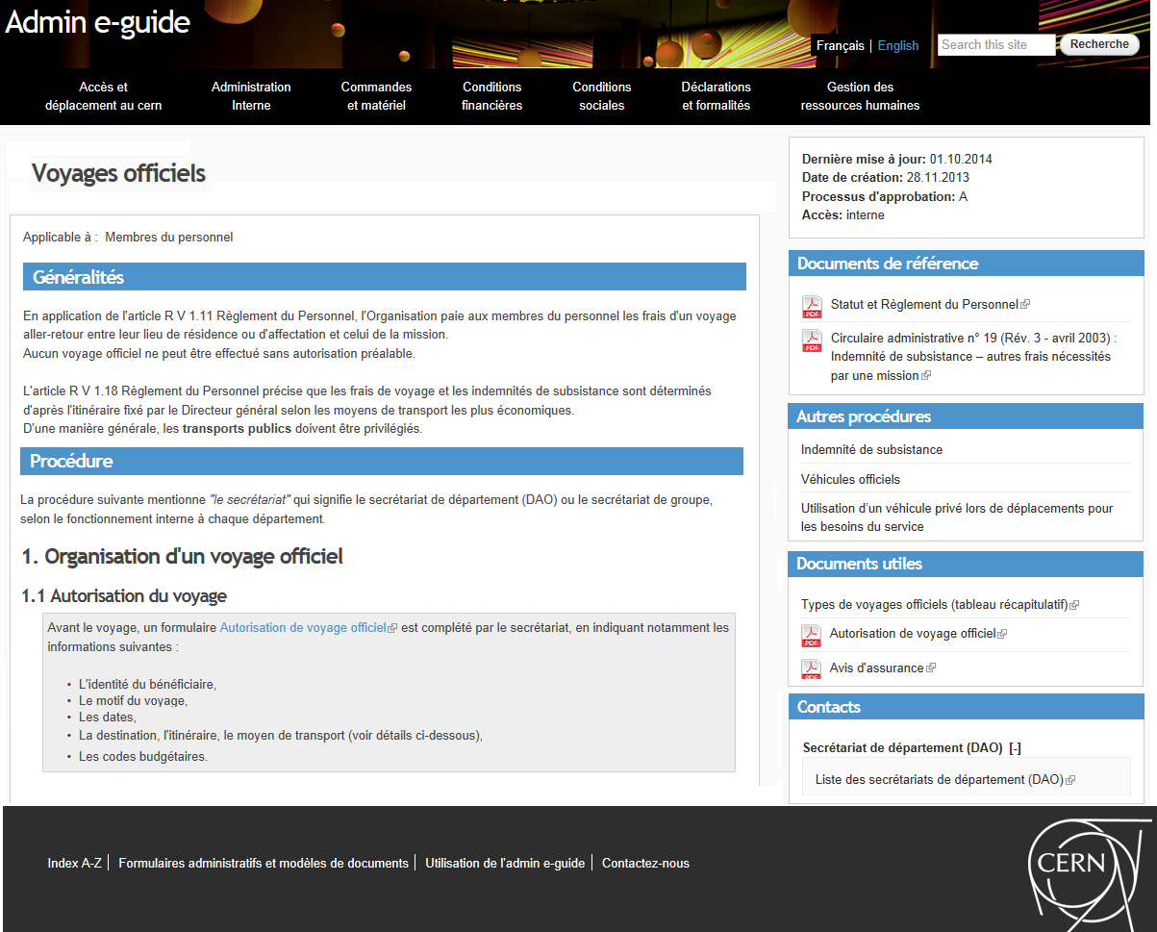

Slide 10
First experience
Automatic
  Index
  Multi-lingual support
Flexibility on:
  data & access management
Revision monitoring
easy maintenance
Too technical & focus on experts → dependency
Future improvements → lack of training for non-expert

Slide 11
Next steps
Site in production in November with IT support
Communication in the CERN Bulletin
Expectations
Less workload for maintenance and updates of content
More time for real improvements → future website development

