Slide 1
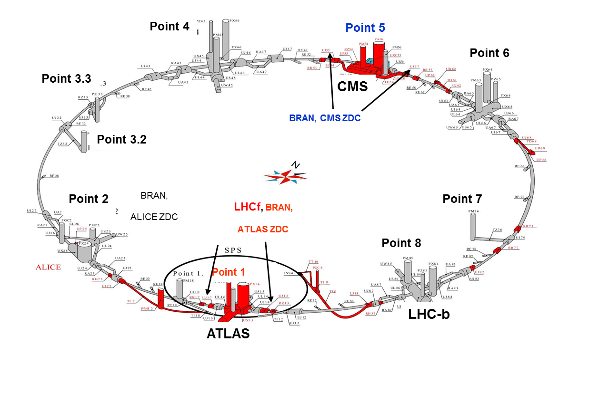
TAXN AT P8, SOME CONSIDERATIONS TOWARDS CONCEPTUAL SPECIFICATION
F. Sanchez Galan, WP8 meeting 4-11-14

Slide 2
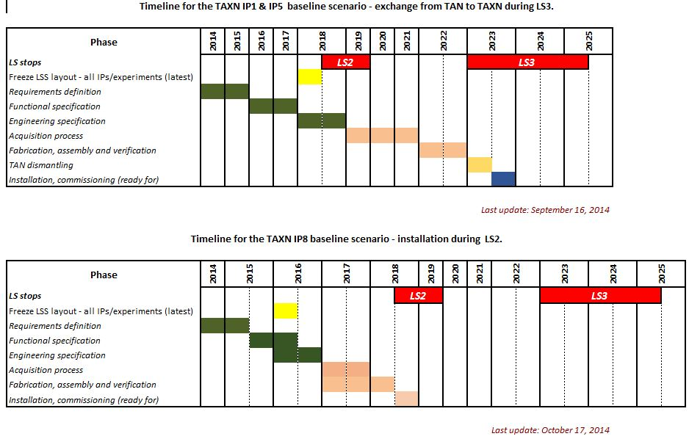
TAXN at P8 Timeline
F. Sanchez Galan, WP8 meeting 4-11-14

Slide 3
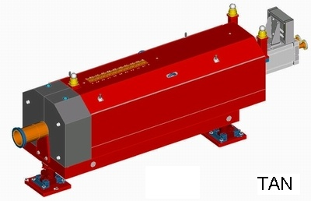
Rappel
Four identical
  Neutral Beam Absorbers (TAN)
First installation: TANC.4R5 (4-5 April 2006)
The TAN transport and installation was scheduled before the cryomagnets were installed in the concerned sectors.
Official name | Location | Beam height (mm) | Tunnel access shaft | Average travel distance (km) | Dcum (Start) (m) | Dcum (End) (m)
TANC.4R5 | R571 (5R) | 950 | PX64 | 3.3 | 13469.6916 | 13473.9416
TANC.4L5 | UJ53 (5L) | 950 | PX64 | 3.3 | 13184.9416 | 13189.1916
TANAL.4L1 | RI132 (1L) | 1100 | PX24 | 3.3 | 26514.3832 | 26518.6332
TANAR.4R1 | RI171 (1R) | 1100 | PX24 | 3.3 | 140.25 | 144.50
F. Sanchez Galan, WP8 meeting 4-11-14

Slide 4
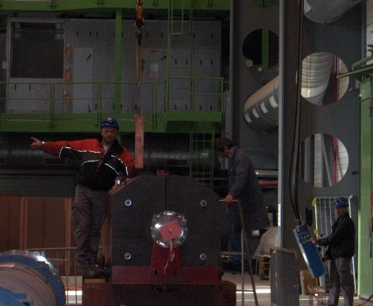
Location in LHC
In each TAN
1 slot with 10 movable Cu bars
Slot : l1000 x w95 x h605
Possibility to add instrumentation
F. Sanchez Galan, WP8 meeting 4-11-14
TAN study group, 21/09/2012 A. L. Perrot 4

Slide 5

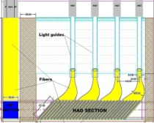
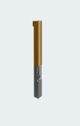
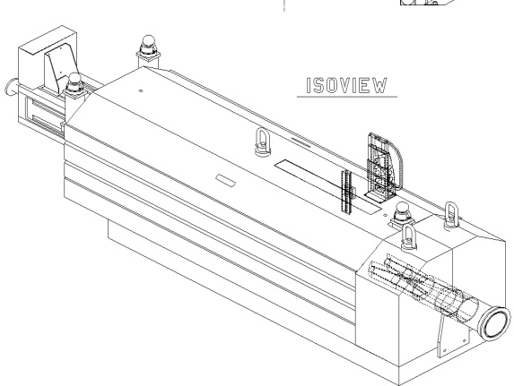

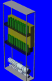
Location in LHC
CMS ZDC
ECAL
HCAL
ATLAS ZDC
BRAN
BRAN
LHCf
TAN detectors
Point 1
TAN detectors
Point 5
LHCf: LHC forward physics
BRAN: Beam RAdiation Neutrals monitor
ZDC: Zero Degree Calorimeter
ECAL = Electromagnetic CALorimeter
HCAL = Hadronic CALorimeter
F. Sanchez Galan, WP8 meeting 4-11-14
TAN study group, 21/09/2012 A. L. Perrot 5

Slide 6
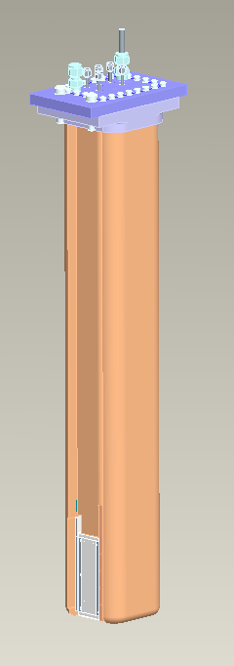
Beam RAte Neutrals monitor (BRAN)
Role:
monitor and optimise the LHC relative luminosity on a bunch by bunch basis
(idea: utilising the very forward flux of secondaries from IP that are intercepted by the TAN)
BRAN detector:
- designed and built by Berkeley
- work in collaboration with BE/BI
- segmented, multi-gap, pressurized Ar-N₂ ionisation chamber
(4 quadrants; 1 quadrant: 60 gaps of 0.5mm separated by 1mm thick Cu plates)
Location:
in both TANs on each side of IP1 and IP5
Courtesy of K. Chow- LBNL
F. Sanchez Galan, WP8 meeting 4-11-14
TAN study group, 21/09/2012 A. L. Perrot 14

Slide 7
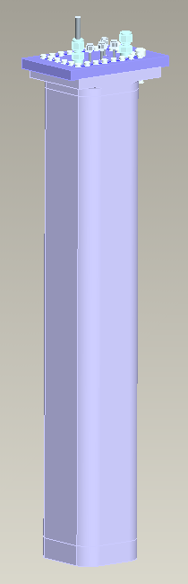
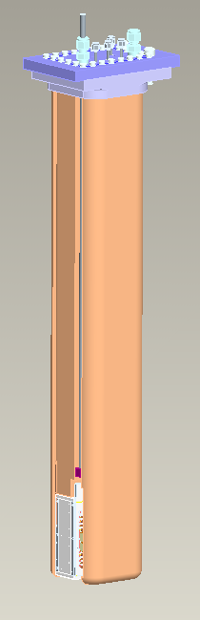
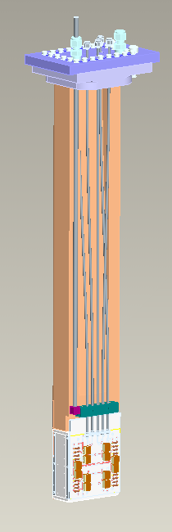
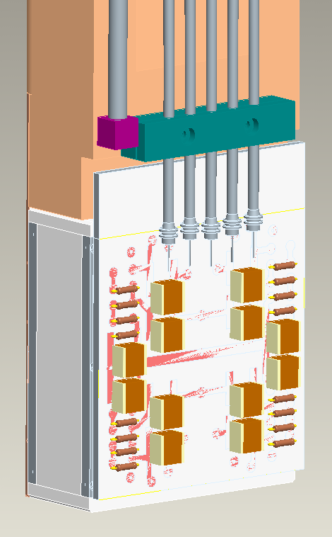
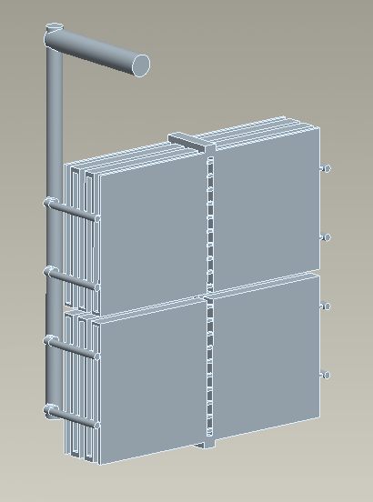
BRAN – inside views
Detail of ionization chamber area
Peel off case
Remove copper
filler bars
Courtesy of K. Chow- LBNL
F. Sanchez Galan, WP8 meeting 4-11-14
TAN study group, 21/09/2012 A. L. Perrot 15

Slide 8
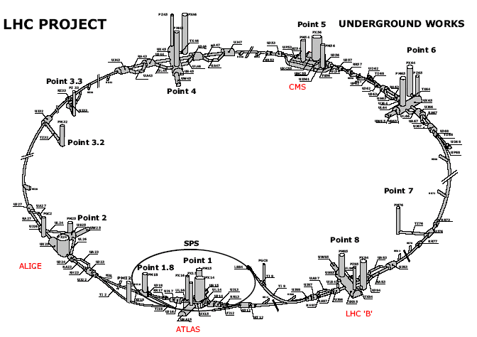
Transport and installation
Main constraints
Access shafts: PX24 and PX64 ⇒ travel distance in the tunnel ~3.3 km instead of ∼140 m.
F. Sanchez Galan, WP8 meeting 4-11-14
Notes:
PX64: DCUM:16628.1770 m
TANC.4R5 in R571: DCUM: 13471.8166 m
TANC.4L5 in UJ53 (R532): DCUM: 13187.0666 m
Distance from PX64 to TANC.4R5=3.156 km
Distance from PX64 to TANC.4L5=3.441km
PX24: DCUM: 3296.7504 m
TANAL.4L1 IN RI132: DCUM: -142.3750m (LEFT OF IP1)
TANAR.4R1 IN RI171: DCUM: 142.3750 m
Distance from PX24 to TANAL.4L1= 3.439 km
Distance from PX24 to TANC.4R1=3.154 km

Slide 9
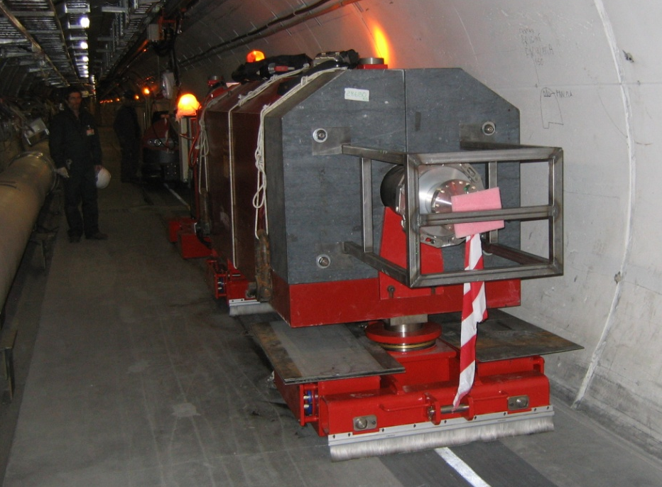
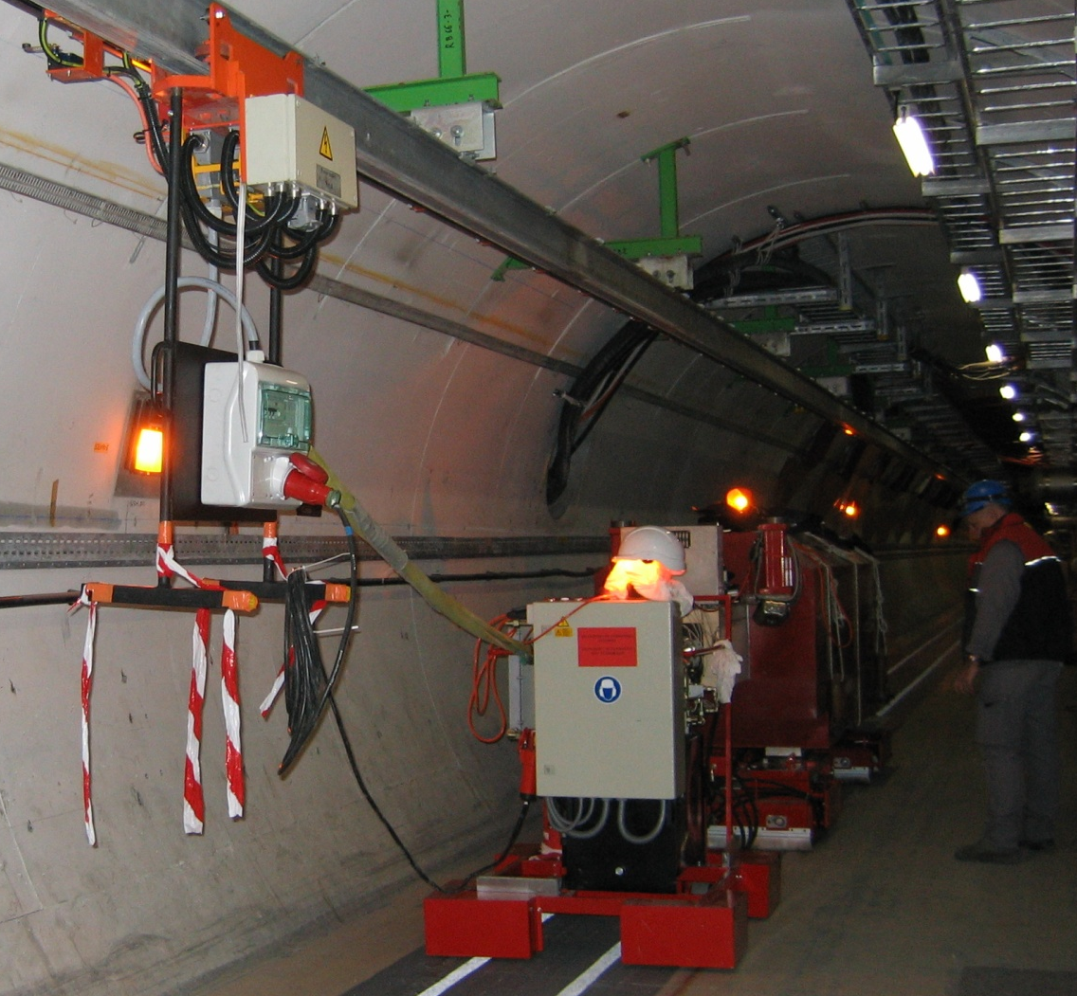
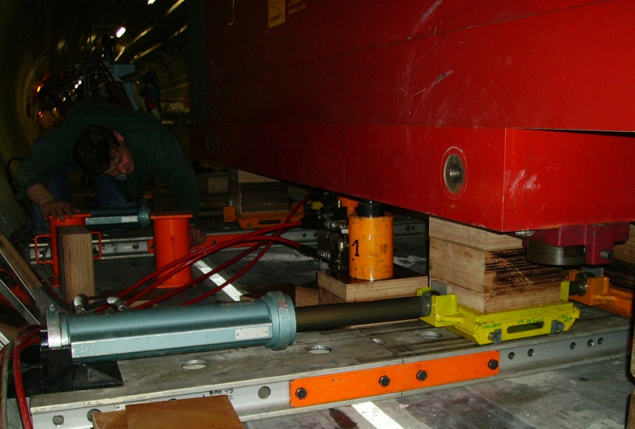
Transport and installation
Installation process
F. Sanchez Galan, WP8 meeting 4-11-14

Slide 10
TAXN- What to include, when?
Current lay-out is based on an independent absorber
BRAN is not included
LS2 or LS3 depending on what TAN?
IF LS2
Installation not trivial
Need to avoid hands-on during LS3, close equipment will change?
F. Sanchez Galan, WP8 meeting 4-11-14

