Slide 1
Development of a new technology for the next generation of 3D Pixel Sensors for HL-LHC within the INFN (ATLAS-CMS) R&D program in collaboration with FBK
Sabina Ronchin
S. Ronchin TREDI 2015

Slide 2
Introduction
  A lot of experiments require thin detectors, but are thin 3D feasible?
  Key point:
    Too thin (or thinned) 6-inch wafers are not suitable to process
    from double sided process to single side process
    on “special” wafers...
S. Ronchin TREDI 2015

Slide 3
Are thin 3D feasible ?
Two possible technological approaches
  Local thinning
  Single side
  Processing thicker wafers with local thinning of sensor active areas by DRIE (1) or TMAH (2) could be done
1.
2.
G. Pellegrini et al., NIMA 604 (2009) 115
  Back end process:
  thinning the processed wafers
  Single side
  “special” wafers: Epi, SOI, Si-Si…
  After bump
S. Ronchin TREDI 2015

Slide 4
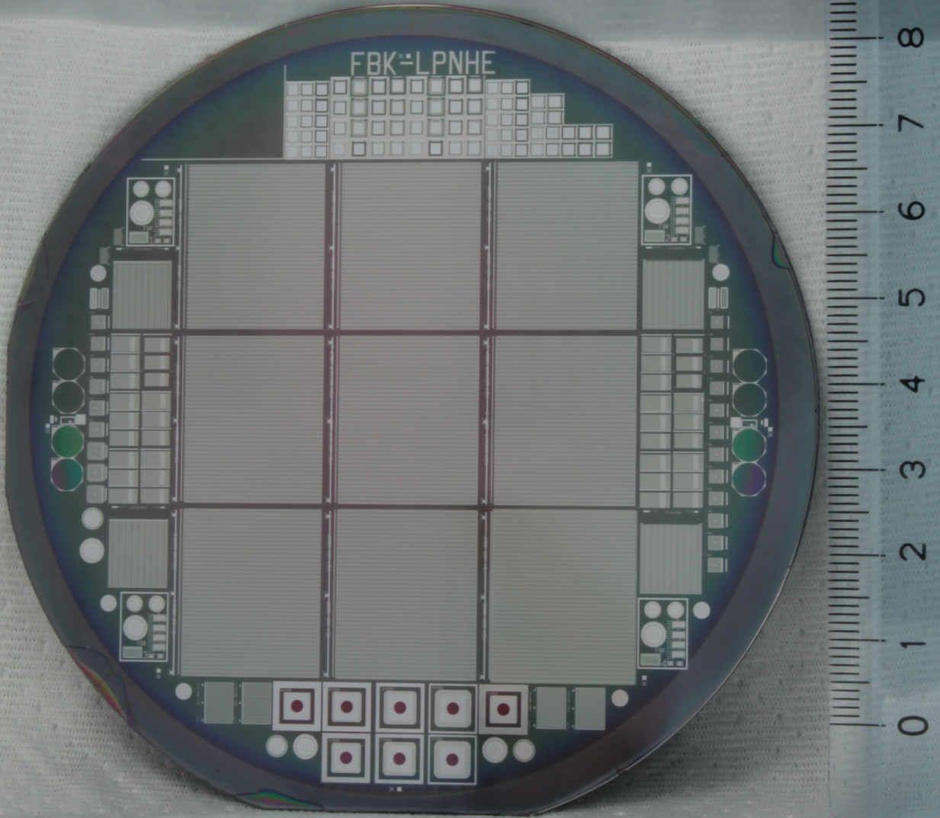
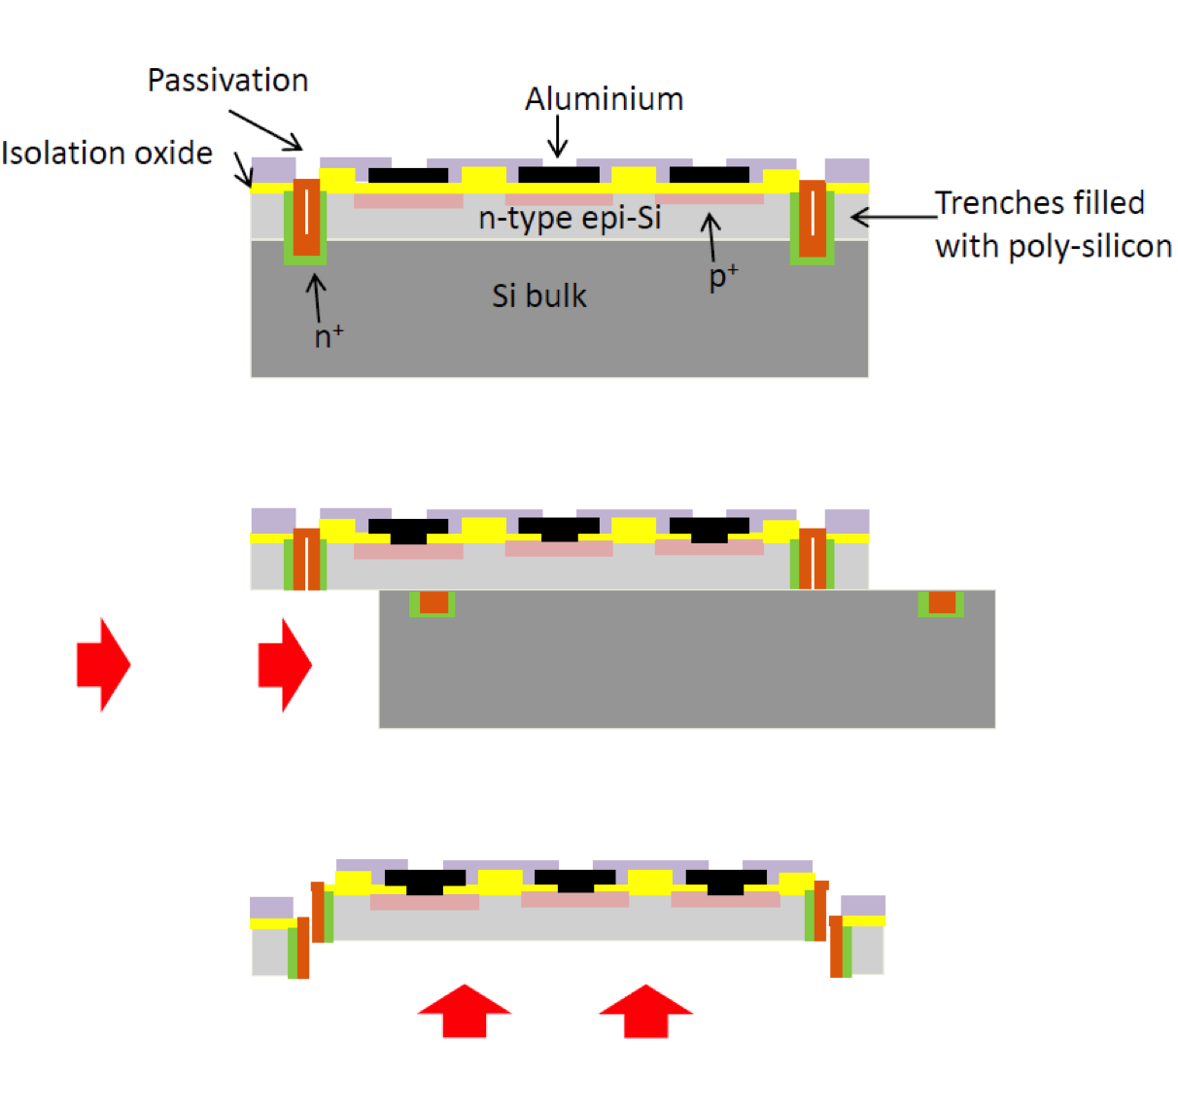
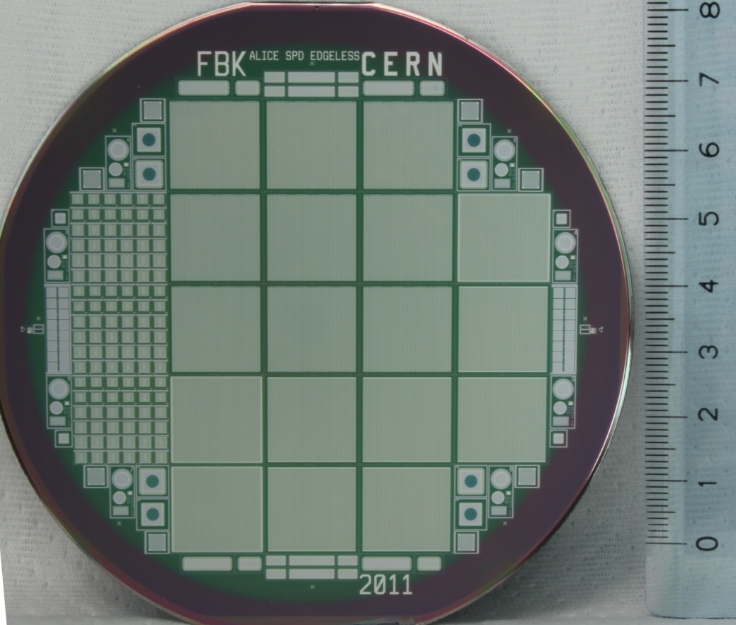
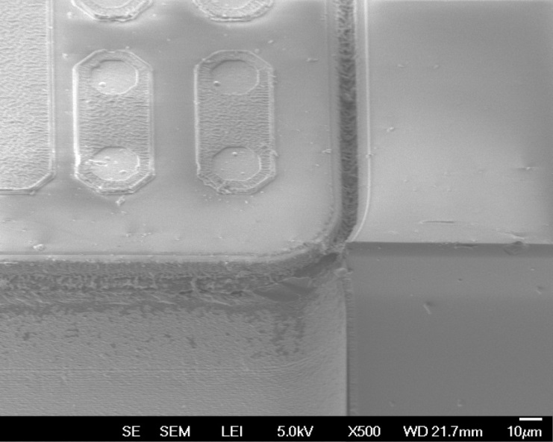
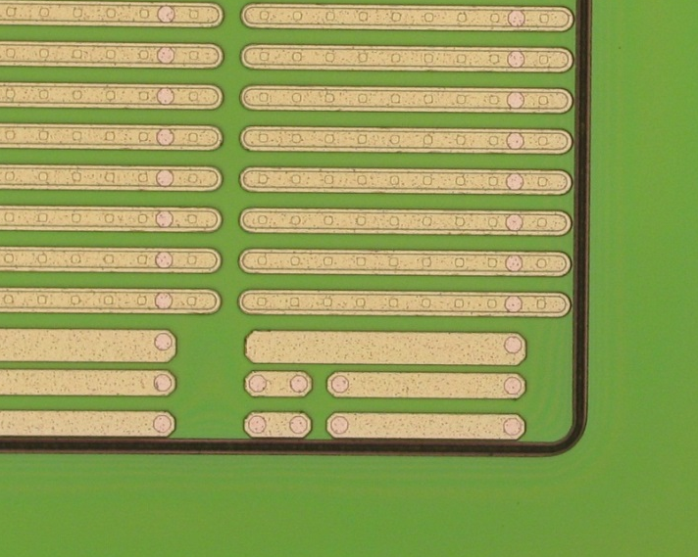
FBK past experience on back end process: edgless technology
Substrate
thinning (by IZM)
thin n⁺ epi-layer
Device separation along the trenches
SOI (200um Fz) ATLAS
Epi
PANDA
ALICE
Trench filled with polisilicon
S. Ronchin TREDI 2015

Slide 5
Thin Si3D: proposed fabrication approach
Thin silicon HR-p-type active layer (100-150 μm)
Ohmic columns depth > device wafers
Junction columns depth < device wafers
Compatible with edgless
p+ HR Si
p++ LR Si
Single side process with support wafer
S. Ronchin TREDI 2015

Slide 6
Most critical issues
  Identify the “best” row material
    We need a “processable” thin silicon substrate (100-150 μm)
  Controls of the hole depth
    Optimization of DRIE process
  Doped Polysilicon Filling
    Hole must be filled or partially filled
  Two DRIE on the same wafer side
  Deep SiO₂ etching
S. Ronchin TREDI 2015

Slide 7
  Identify the “best” row material
Thin silicon with support wafer
p+ high Ωcm wafer
Two possibilities:
  Epi or Si-Si
  SOI
Under bump metallization
Support wafer thinning (removal)
back-side metal deposition
100-150μm
p++ low Ωcm wafer
p+ high Ωcm wafer
100-150μm
p++ low Ωcm buried region
200 nm Silicon oxide
p++ low Ωcm wafer
S. Ronchin TREDI 2015

Slide 8
Thin Si3D: the two technological options
Epi or Si-Si wafer
SOI wafer
p+ HR wafer
p+ HR wafer
p++ LR wafer
p++ LR wafer
Ohmic columns must be passing through the bonding oxide
S. Ronchin TREDI 2015

Slide 9
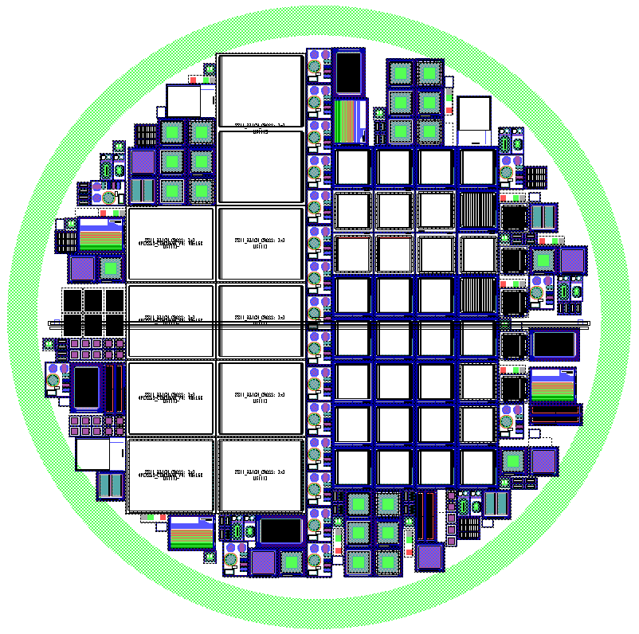
Planar test run on Si-Si to test available wafers
CMS
ATLAS
Wafers
Si-Si Icemos silicon wafers, 100±2μm and 130±2μm active material with a ρ>3000 Ωcm
Process
n-on-p planar process
three p-spray doses
Layout
Many test structures
10 ATLAS & 30 CMS pixel design
Test Devices
S. Ronchin TREDI 2015

Slide 10
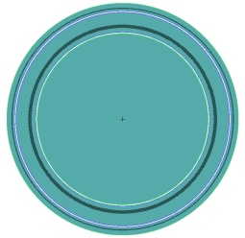
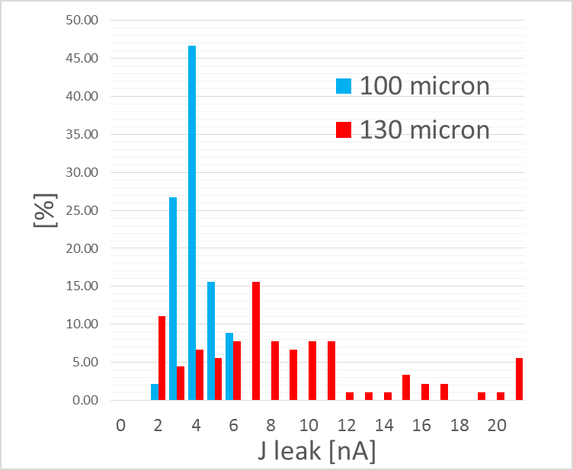
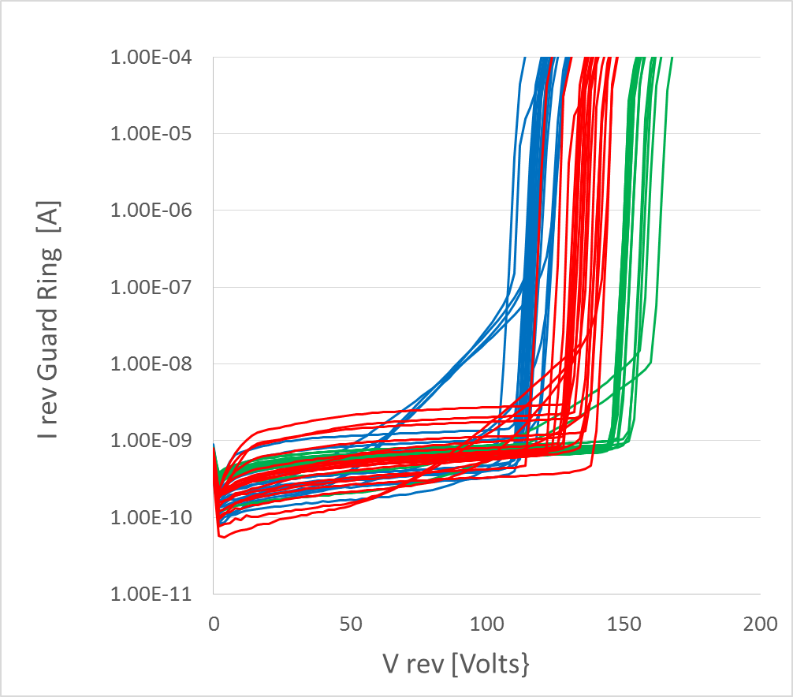
FBK test diode IV measurements
Circular 4mm2 diode with two GR
J leak [nA/cm²]
Guar Ring I _{rev} on 3 wafers
3 p-spray dose
Low Medium High
J_{leak} distributions on 135 diodes
S. Ronchin TREDI 2015

Slide 11
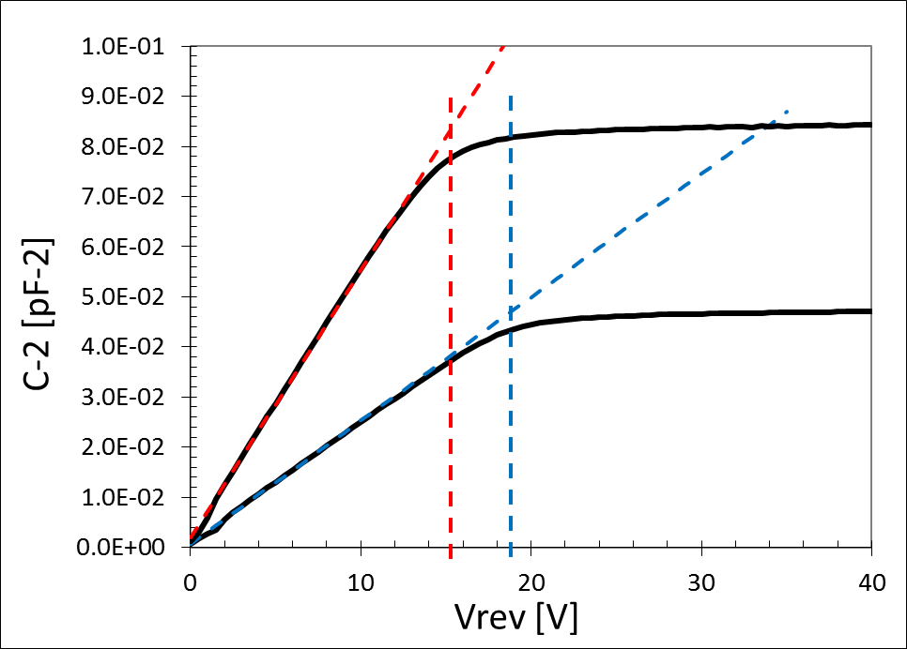
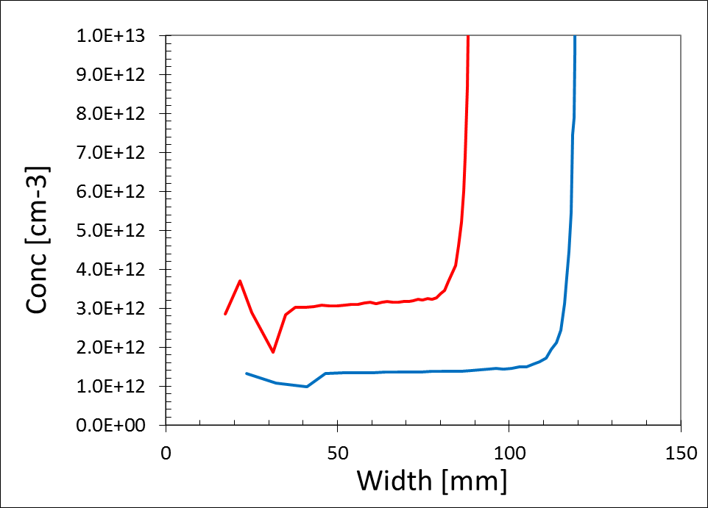

Test diode: CV measurements
$$\frac{1}{C^{2}}$$
Concentration profile from CV
Doping 1 – 3 E12
Thickness about 10micron less than the nominal value
V_{dep} 16V and 20V
S. Ronchin TREDI 2015

Slide 12
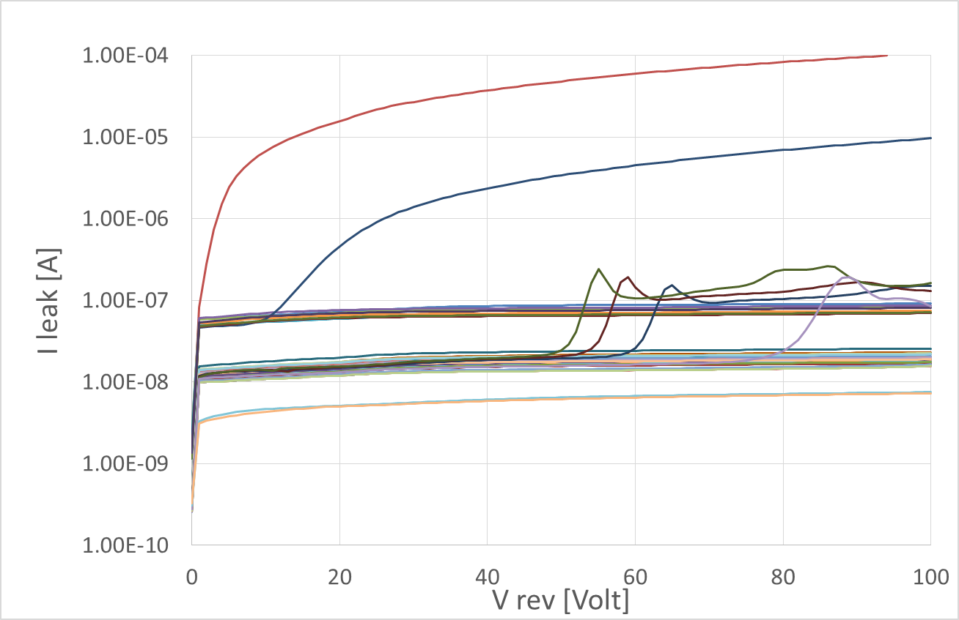
Pixel detectors: IV measurements on W81
ATLAS FEI4
Comments:
40 devices (10Atlas + 30CMS)
Some defective devices
V _{BK} > 100V
I _{leak} decrease if detectors area decrease
CMS
CMS without Bias Grid
only a small part of the detectors is depleted
S. Ronchin TREDI 2015

Slide 13
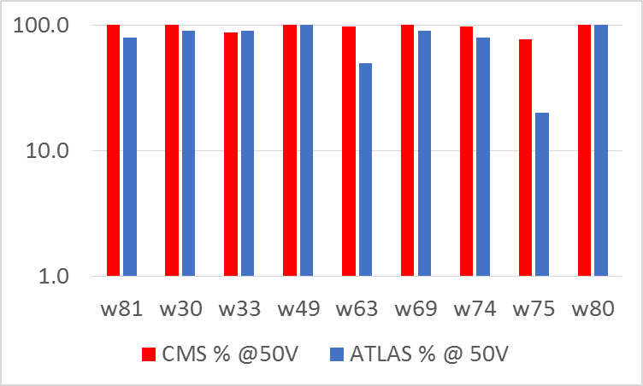
Pixel detectors: statistics
“good” detectors if
ATLAS I_{leak} < 1E-7 @ 50V
CMS I_{leak} < 5E-8 @ 50V
V _{depl} 20V
ATLAS 70/100
(70%)
CMS 257/270 (95%)
S. Ronchin TREDI 2015

Slide 14
Most critical issues
  Identify the “best” row material
    We need a “processable” thin silicon substrate (100-150 μm)
✓
  Controls of the hole depth
    Optimization of DRIE process
p+ HR wafer
  Doped Polysilicon Filling
    Hole must be filled or partially filled
p++ LR wafer
  Two DRIE on the same wafer side
  Deep SiO2 etching
S. Ronchin TREDI 2015

Slide 15
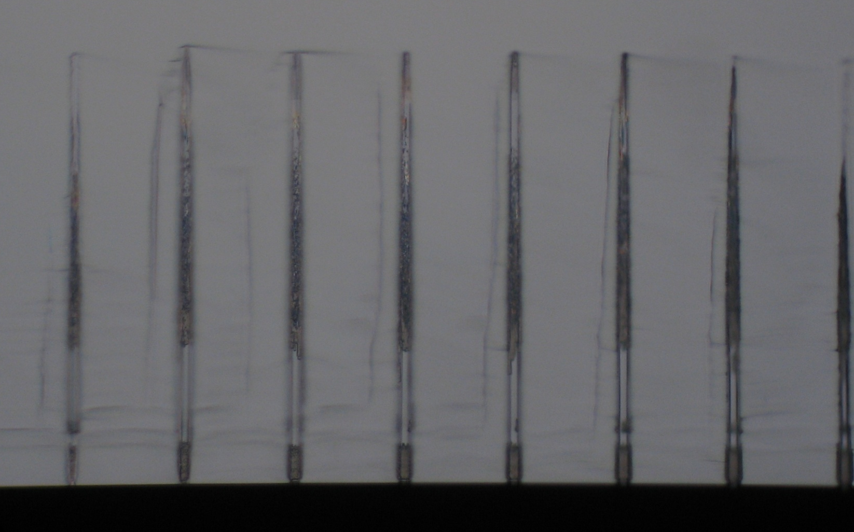
  Controls of the hole depth (1)
    Optimization of DRIE process
Holes with ∅=5 μm
3.4 μm
TSV deeper than 130 μm
155 μm
4.7μm
S. Ronchin TREDI 2015

Slide 16
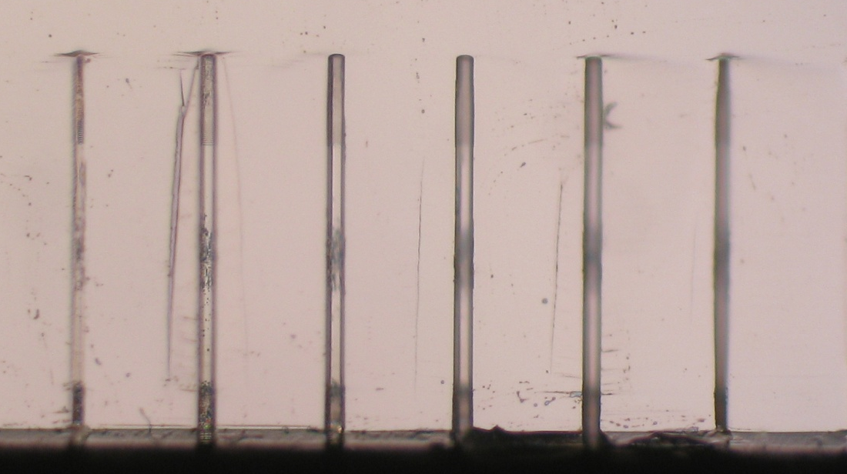
  Controls of the hole depth (2)
    Optimization of DRIE process
Holes with ∅=5 μm
5.3 μm
Not TSV shallower than 130 μm
117 μm
5.3 μ m
S. Ronchin TREDI 2015

Slide 17
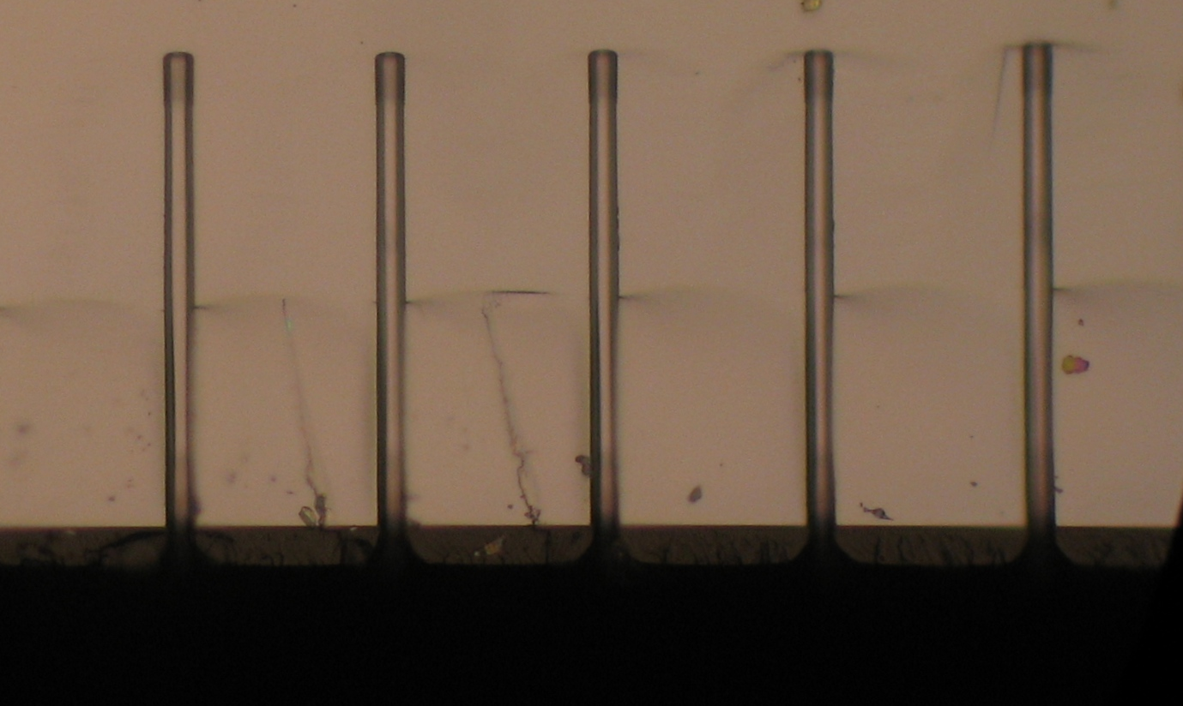
  Controls of the hole depth (3)
    Optimization of DRIE process
Holes with ∅=5 μm
5.3 μm
Not TSV shallower than 100 μm
88 μm
5.5 μ m
S. Ronchin TREDI 2015

Slide 18
Most critical issues
  Identify the “best” row material
    We need a “processable” thin silicon substrate (100-150 μm)
  Controls of the hole depth
    Optimization of DRIE process
  Doped Polysilicon Filling
    Hole must be filled or partially filled
  Two DRIE on the same wafer side
  Deep SiO2 etching
✓
✓
S. Ronchin TREDI 2015

Slide 19

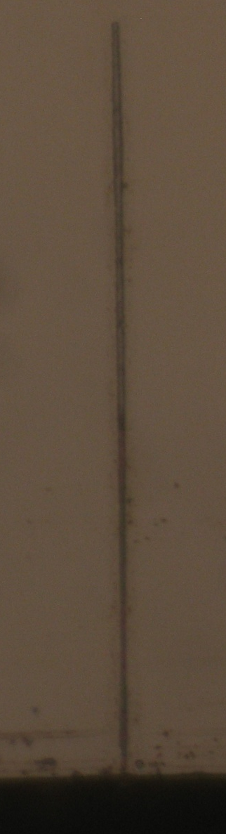
  Doped Polysilicon Filling (1)
    Hole must be filled or partially filled
4μm Poly-Si
Poly-Si filling of a 5 μm hole
5.3μm
1μm
S. Ronchin TREDI 2015

Slide 20
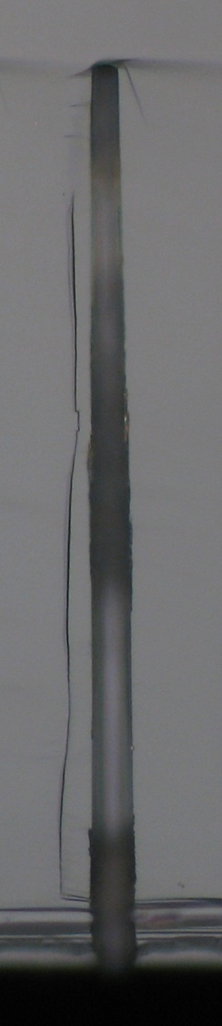
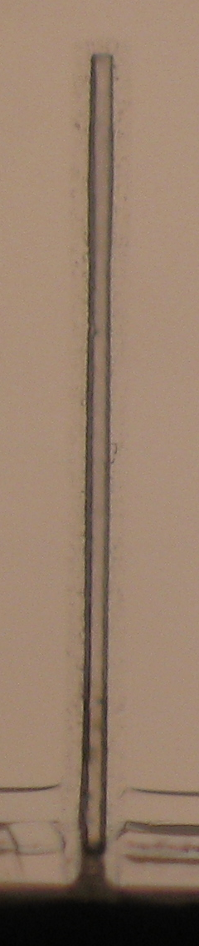
  Doped Polysilicon Filling (2)
    Hole must be filled or partially filled
4μm Poly-Si
Poly-Si filling of a 12 μm hole
The photoresist
closes the hole
12.5μm
4.5μm
S. Ronchin TREDI 2015

Slide 21
Most critical issues
  Identify the “best” row material
    We need a “processable” thin silicon substrate (100-150 μm)
  Controls of the hole depth
    Optimization of DRIE process
  Doped Polysilicon Filling
    Hole must be filled or partially filled
  Two DRIE on the same wafer side
  Deep SiO2 etching
✓
✓
✓
S. Ronchin TREDI 2015

Slide 22
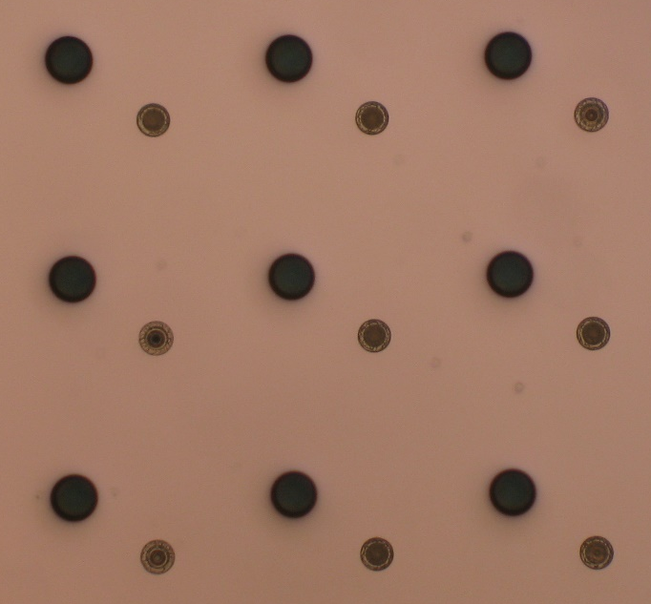
  Two DRIE on the same wafer side
Reducing the hole diameter with a polysilicon deposition
First holes
partially filled
with poly-Si
14µm
Picture from the surface
with photresist after second DRIE
SEM image
S. Ronchin TREDI 2015

Slide 23
Most critical issues
  Identify the “best” row material
    We need a “processable” thin silicon substrate (100-150 μm)
  Controls of the hole depth
    Optimization of DRIE process
  Doped Polysilicon Filling
    Hole must be filled or partially filled
  Two DRIE on the same wafer side
  Deep SiO2 etching
✓
✓
✓
✓
S. Ronchin TREDI 2015

Slide 24
  Deep SiO2 etching
Photoresist
200 µm Si
200 nm SiO₂
2 μm poly
200 nm etched SiO₂
2 μm poly-Si
S. Ronchin TREDI 2015

Slide 25
Most critical issues
  Identify the “best” row material
    We need a “processable” thin silicon substrate (100-150 μm)
  Controls of the hole depth
    Optimization of DRIE process
  Doped Polysilicon Filling
    Hole must be filled or partially filled
  Two DRIE on the same wafer side
  Deep SiO2 etching
✓
✓
✓
✓
✓
S. Ronchin TREDI 2015

Slide 26
Conclusions
Designed a new technology for 3D single side detectors on thin material
Settled most process critical issues
Validation of acquired Si-Si material
Ready to start a new 3D batch!!!

Slide 27
Thanks for your attention
S. Ronchin TREDI 2015

