Slide 1
Industrial production of silicon strip sensors with Infineon
TREDI2015

Slide 2
Outline
Motivation
Overview about the project
Results from the Electrical Characterization with new results
Beam Test results
Outlook
Summary

Slide 3
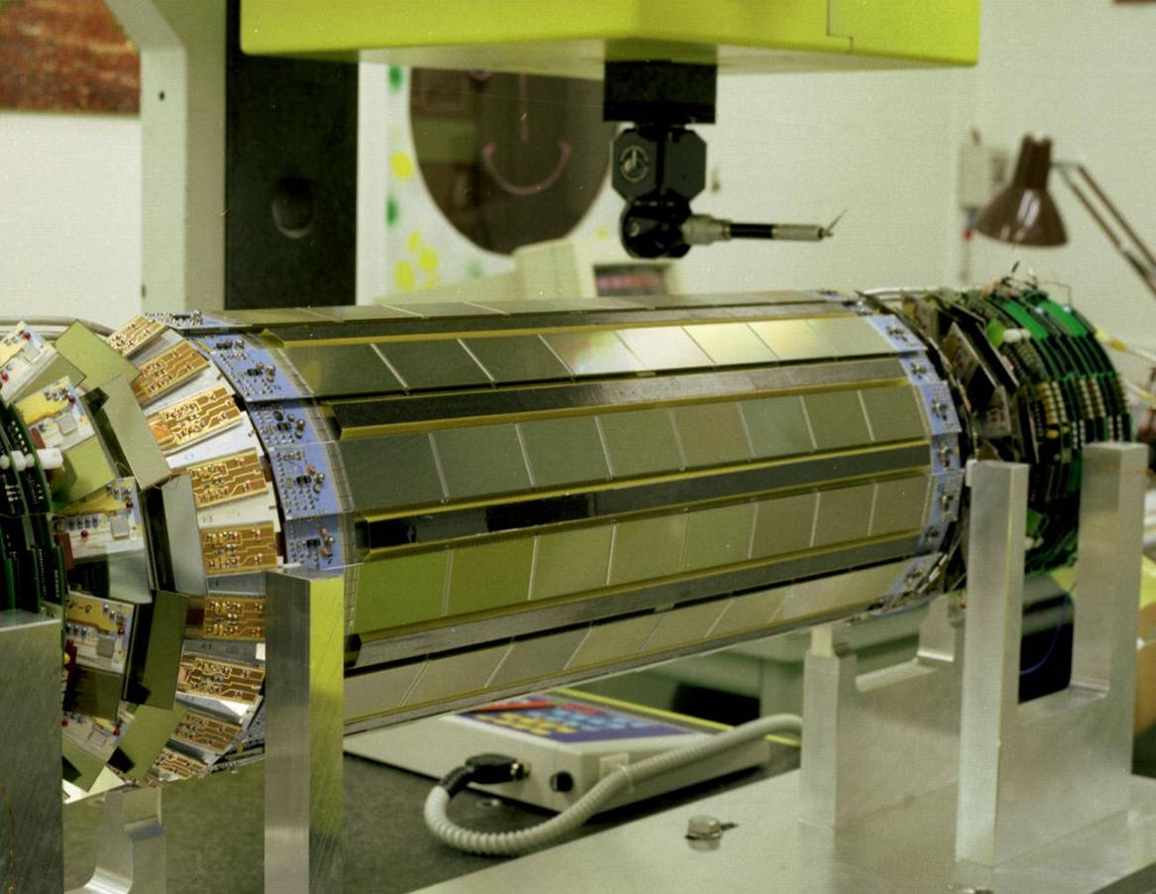
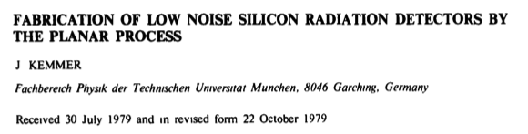
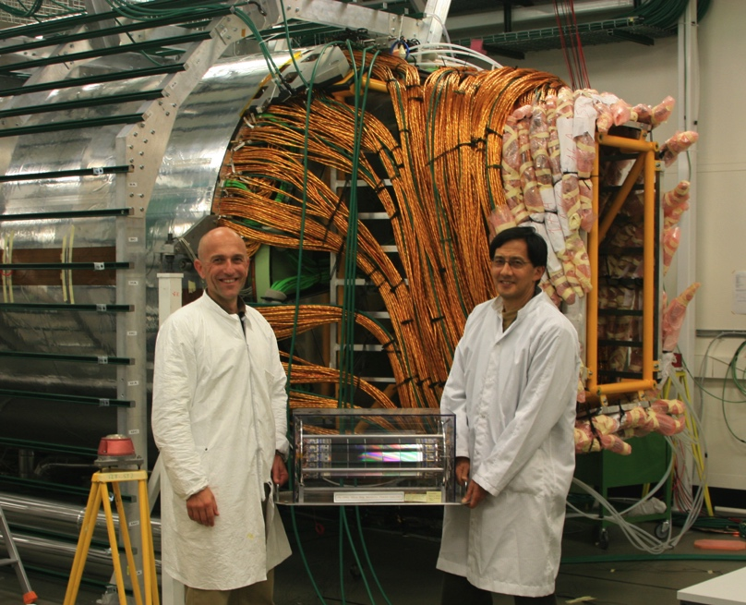
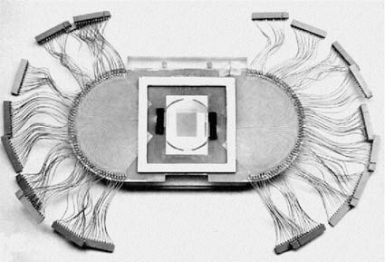
Motivation
Silicon detectors are an impressive success in HEP experiments
DELPHI microvertex - 1990
DELPHI vs. CMS Tracker - 2006
NA11 - 1980

Slide 4
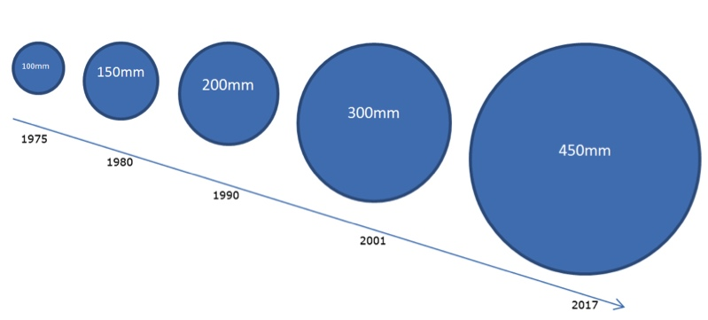
What has changed since the 80ies
Silicon surface
  Today: Up to 200 m² (CMS)
  Similar size for the phase II upgrades of CMS and ATLAS
  almost 800 m² for CMS high granularity calorimeter
  CALICE Si-W-Calo: 2000 m²
Wafer Size
  NA11 started with 2” and 3”
  Today 6” (150 mm) is standard
  → Introduced in the Industry in the 80ies!

Slide 5










Silicon Producers worldwide
Small Scale Production
(few 10-100 wafers per year)
  Many institutes and companies
  6” available at many sites
  Broad spectra of quality and price
For large scale production
(few 1.000 – 10.000 wafers per year)
  Currently only one (high quality) producer
  Dual or multi-source strategy would be preferable
Possible new producer: Infineon
  Wafer Output (Villach): 50.000 per week
  Production up to 12” wafers could be possible

Slide 6
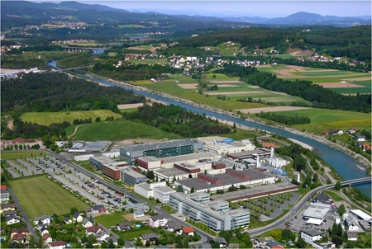
Company profile
Infineon is one of the major players in the semiconductor business
  29,000 employees worldwide
Main target markets
  Automotive, Power, Chip Card
Villach (Austria): R&D and “frontend” production
  3,300 employees (1200 in R&D)
  Production in clean room of class 1 with 10,000 m² area
Infineon@Villach (Austria)

Slide 7
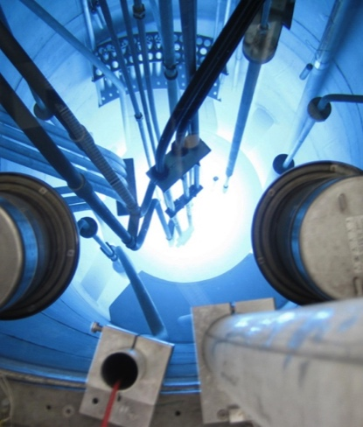
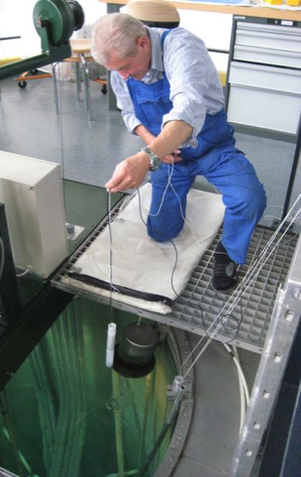
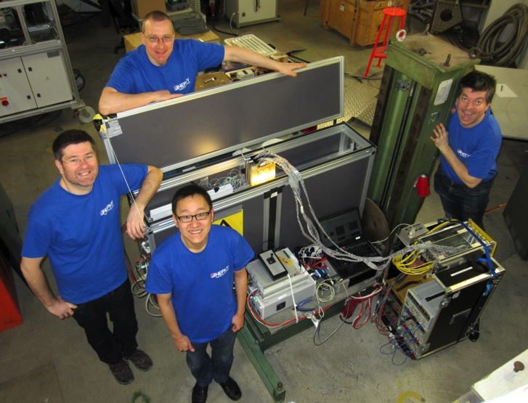
Timeline of the project
April 2009: delegation from HEPHY visited Infineon Villach and discussed joint development
October 2011-February 2012: First batch production
October 2012: Beam tests and Irradiation
  Beam tests at SPS, Gamma Irradiation at SCK-CEN Mol, Belgium
Nov 2012-Feb 2013: Production of a second batch
  July 2013: Neutron irrad at ATI Vienna and proton irrad at KIT
August 2013-January 2014: batch 3
  Jan 2014: beam test at DESY
April 2014-Oct. 2014: batch 4
  Nov 2014: beam test at SPS
In parallel since 2013: Discussion about 8” Production
TRIGA Mark II @ ATI Vienna
Beam Test @ DESY Jan 2014

Slide 8
Comments on the Collaboration
Since the beginning of 2010 we held weekly video meetings
We are discussing all technical details directly with the engineers in an bottom-up approach
Attribution of resources to the project was (and is still) low, but steadily increasing (at HEPHY and Infineon)
The design of the masks was entirely made by us
The production was accompanied by two diploma students
We received every wafer from the production batch
→ no hidden losses

Slide 9
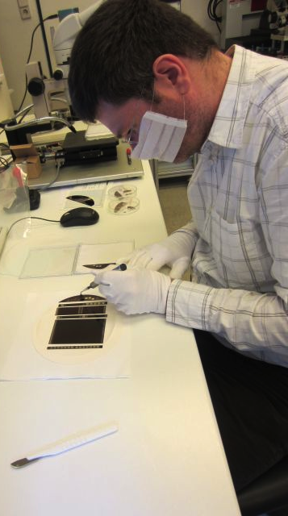
Baseline for the production up to now
Goal: re-produce the same sensors CMS tracker is using now
Wafer Material
6 inch diameter, 300 micron thickness
Float-zone n-type substrate,
~1.2 kOhm cm resistivity
Process Specifications
AC coupled p-in-n strips
SiO₂/Si₃N₄ sandwich coupling dielectric
PolySi resistor biasing
→ 8 photomasks

Slide 10
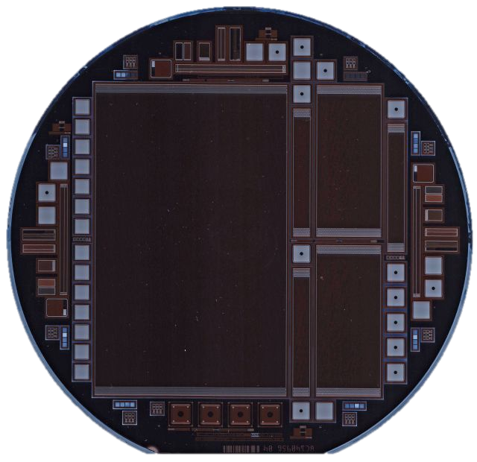
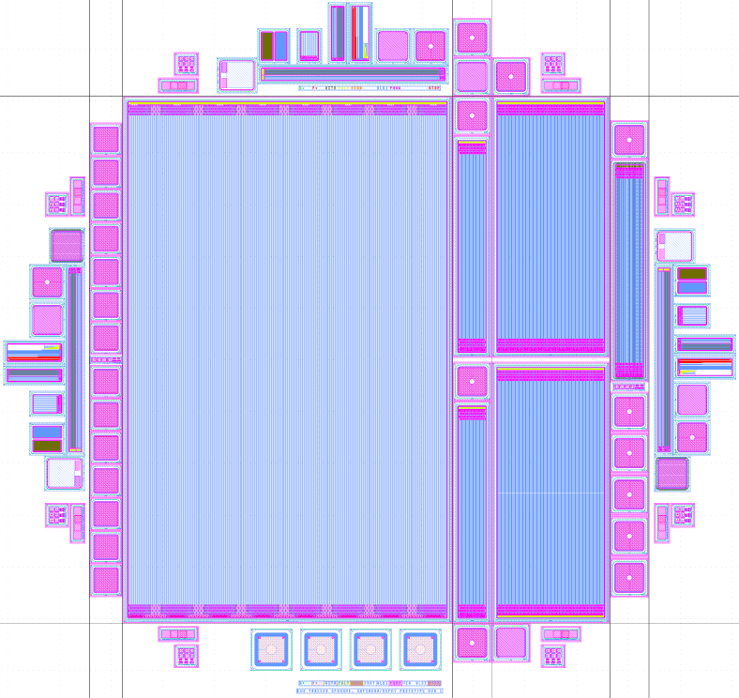
Wafer Layout
Large Sensor: STL
Small Sensor: STS
Strixel Sensor: SX2
Irradiation Sensor: STI
CMS halfmoons (Test structures)
Large number of diodes and MOS
SIMS fields
halfmoon
Row of diodes
STI
STS
STI
halfmoon
STL
halfmoon
Row of diodes
SX2
STI
Row of diodes
RD50 diodes

Slide 11

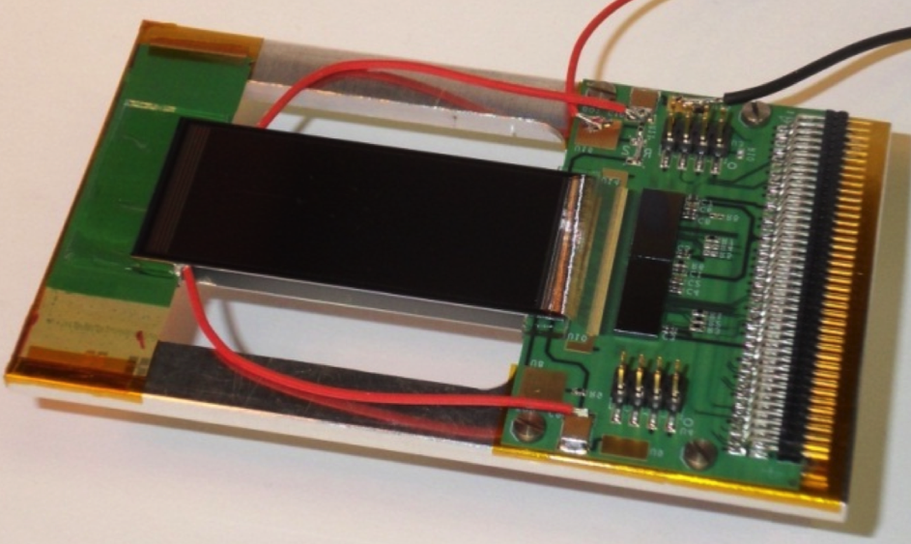


Main Device Properties
Sensor STL
Sensor STS, SX2 and STI
120 µm pitch
20 µm strip implant width
Size: 64 x 102 mm
512 strips (4xAPV)
80 µm pitch
20 µm strip implant width
STS and SX2:
  Size: 23 x 50 mm
  256 strips (2xAPV)
STI: 64 strips, 42.4 x 7 mm
STI
STS
CMS Track Trigger Prototype Module with two Infineon STS Sensors
SX2: Strixel

Slide 12
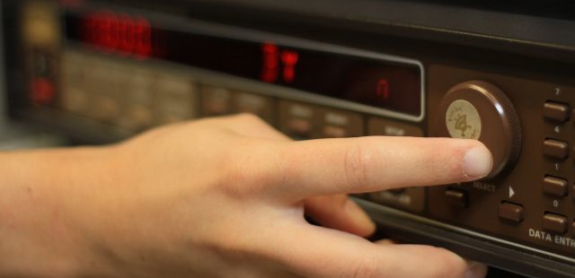
Results from the electrical Characterization

Slide 13
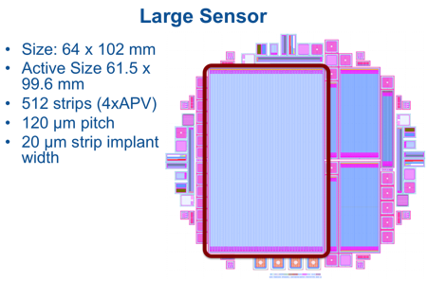
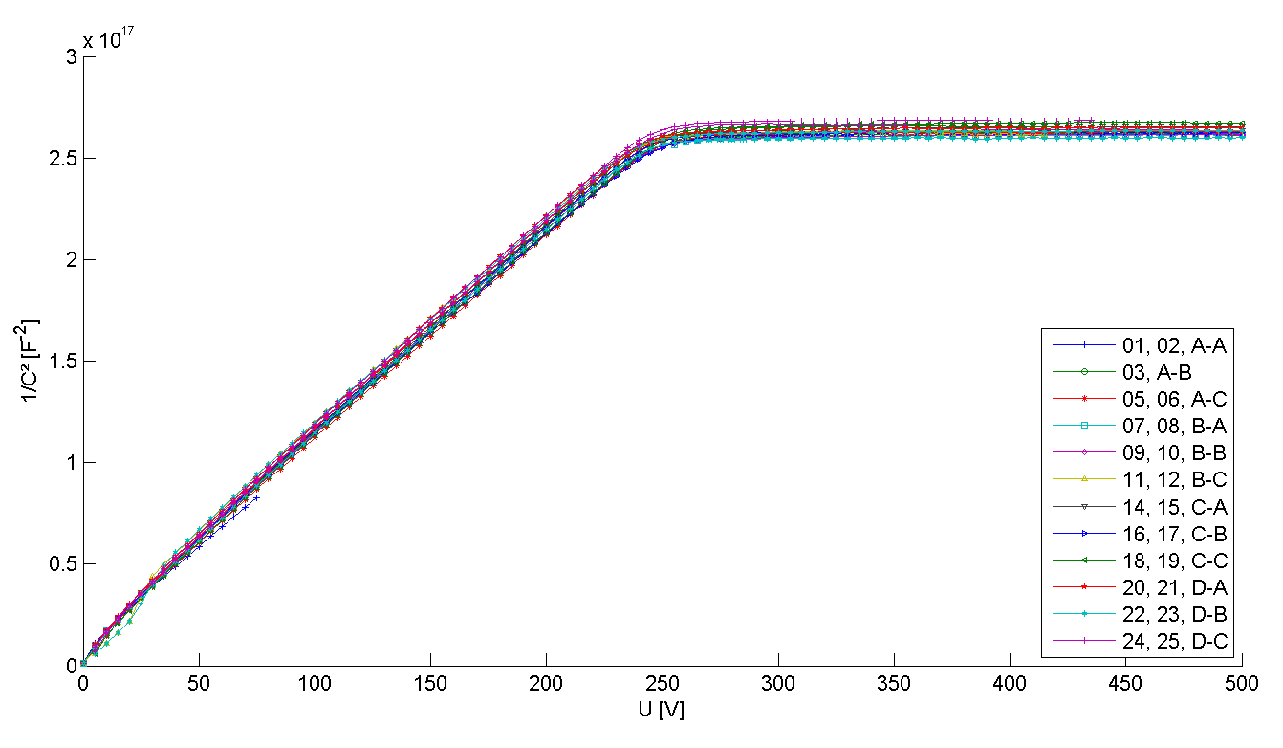
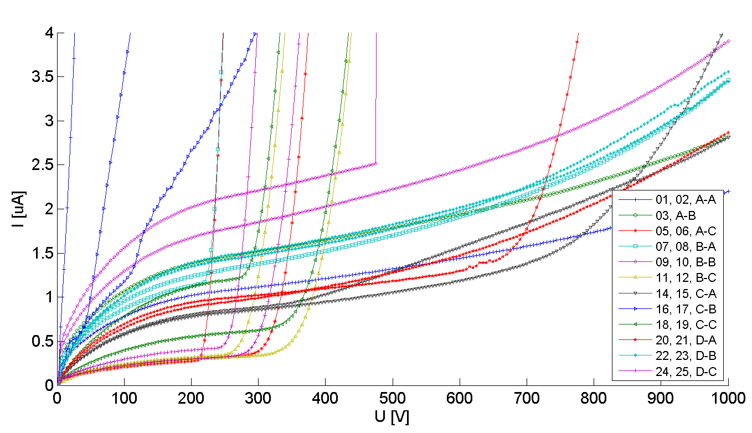
Global Parameters of first batch
CV-Curves
Uniform for all sensors on all wafers
Depletion voltage well
defined ≈ 240 V
  Corresponds to 1.2 kΩcm and matches specs of bulk material
IV-Curves
Many sensors are stable
up to 1000 V
Some sensors with very low leakage current but early breakdown
  Different treatment of the backside
  n+ implant
1/C² for large sensors
IV for large sensors

Slide 14
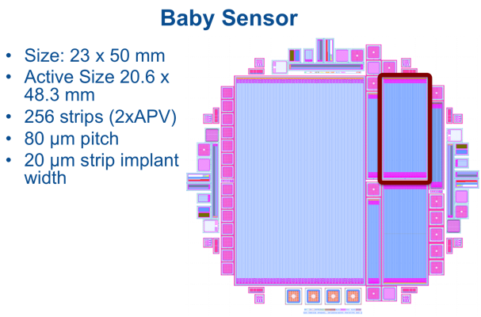
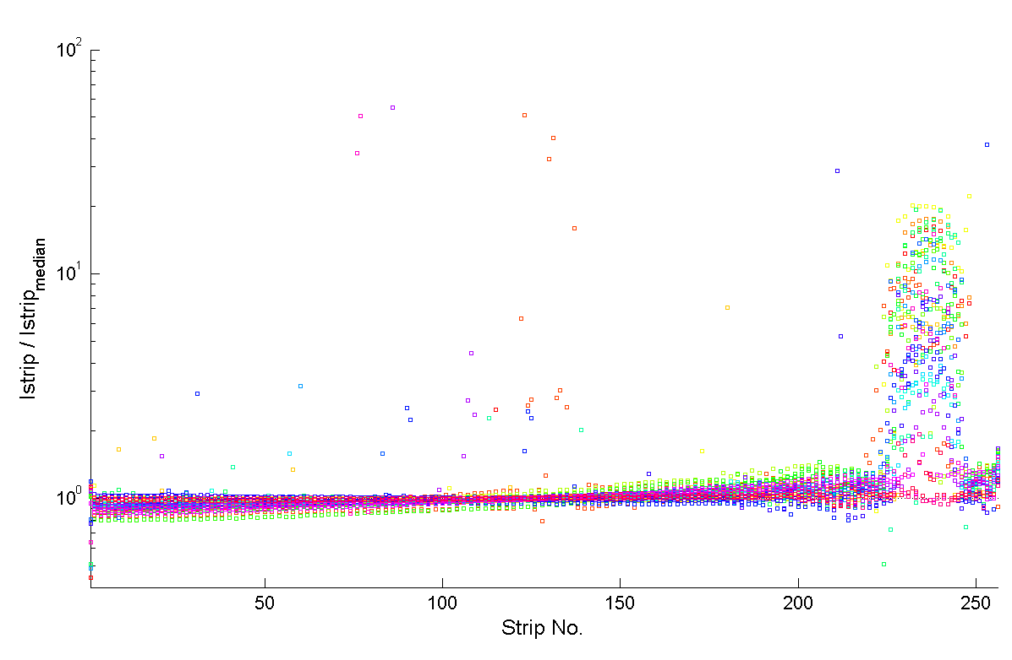
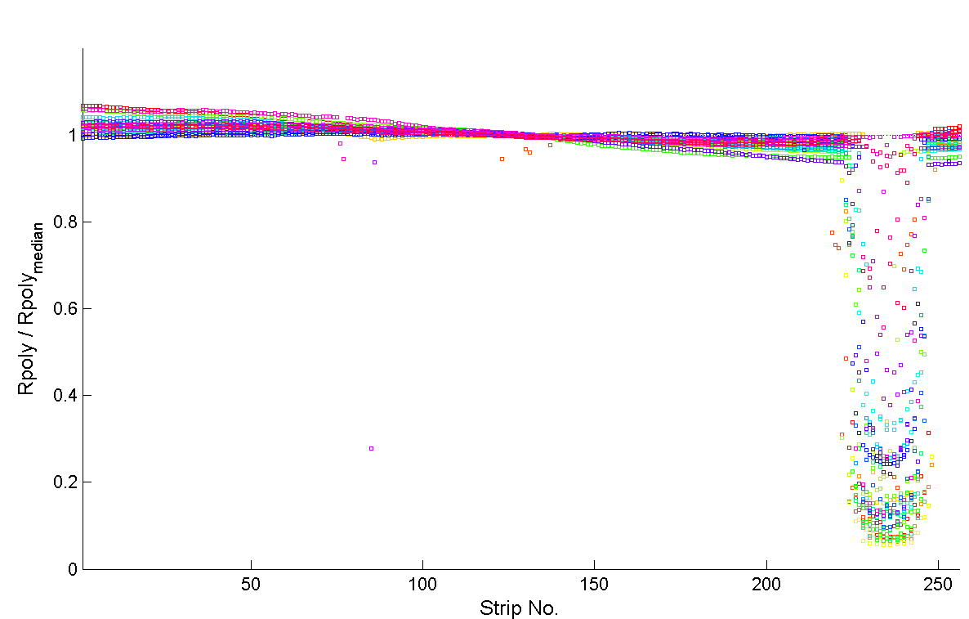
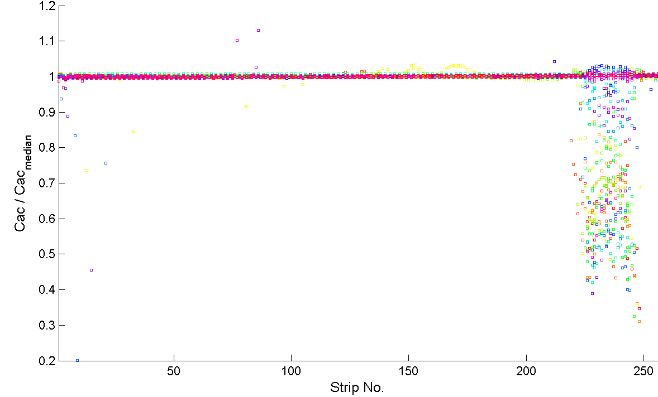
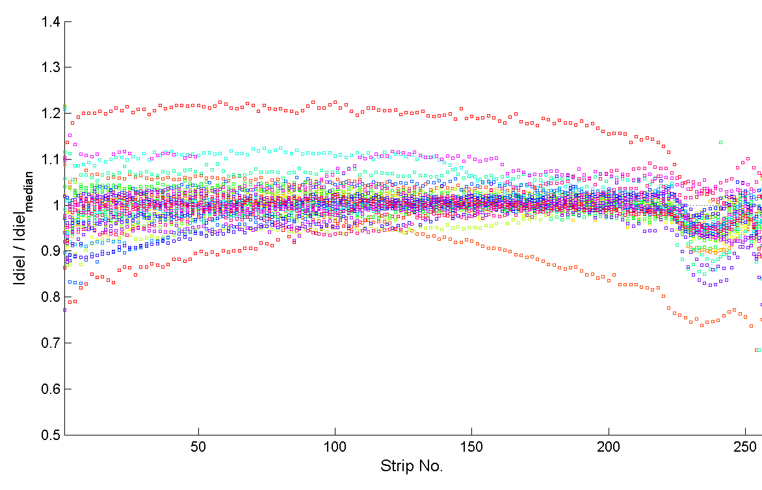
„Bad Strip“ Area
Accumulation of anomalous strips around strip no. 222-248
Istrip/Istrip_{median}
Rpoly/Rpoly_{median}
Cac/Cac_{median}
Idiel/Idiel_{median}

Slide 15
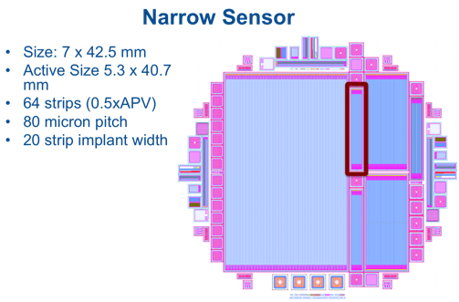
Low R_{int}: “bad strips” are shorts
Low Inter-strip Resistance
  Measurement shown for narrow sensor with only 64 strips
  Good outside of “Bad Strip Area” (> 10 GΩ)
  “Bad Strip Area” from strip 30 – 50 shows very low strip isolation (< 1MΩ), i.e. shorted strips
Seen on all sensors

Slide 16
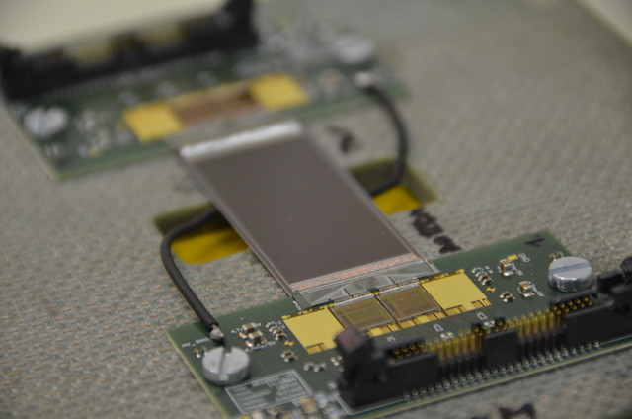
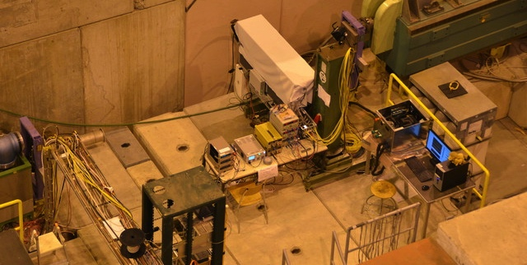
Beam test at CERN‘s SPS
Two detector modules built with baby sensors
Two detector modules built with strixel sensors
Readout chips (APV25) same as in the CMS Tracker
Readout system is a prototype for the Belle II Experiment
Detector modules were
  Tested at CERN
  Gamma irradiated in Mol, Belgium (because of available irradiation slot)
  Tested again at CERN
Strixel
Sensor
Module
Setup at
CERN North Area
H6 beam line

Slide 17
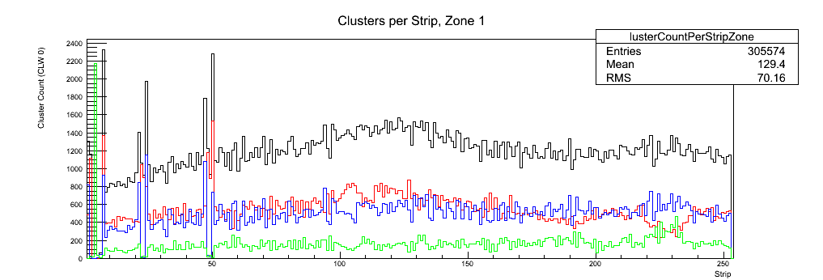
Selected results: Cluster Widths
“Bad Strip Area” does not stand out clearly in beam profile
  Area seems to be fully efficient
But clusters are wider in “bad strip area”
  Would be expected for bad strip isolation

Slide 18
Selected results: η distribution
η distribution
before irradation
η distribution
After irradation
→ 100 kGy of γ →
„good“
strip area
Gamma irradiation cures the bad strip region
„bad“
strip area
“Bad Strip Area” shows a distorted η distribution
  Outside bad area it looks fine
After γ irradiation η distribution looks fine for all strips

Slide 19



Other ways of curing the bad strips

Slide 20
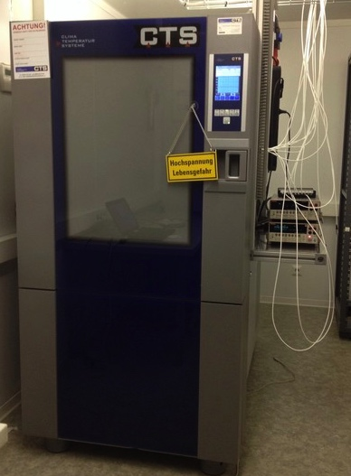
Temperature tests
Manipulate the area of bad strips in an positive way → heat up sensors
Therefore the climate chamber at HEPHY was used (max temp. 180 °C)
Heating procedure:
  100 °C for 6 h
  180 °C for 17 h
  180 °C for 90 h
→ Strip parameters continuosly getting better

Slide 21
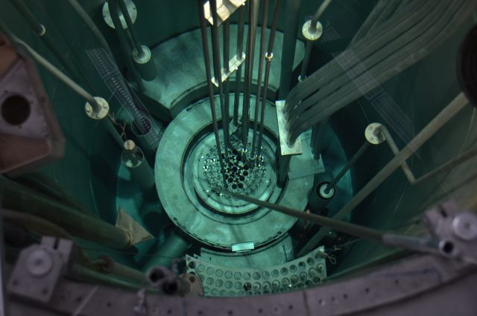
Neutron irradiation
STI sensors were irradiated to a fluence of about 1E11 n_{eq} cm⁻² using our Triga Mark II nuclear reactor
Region of bad strips vanished after irradiation

Slide 22
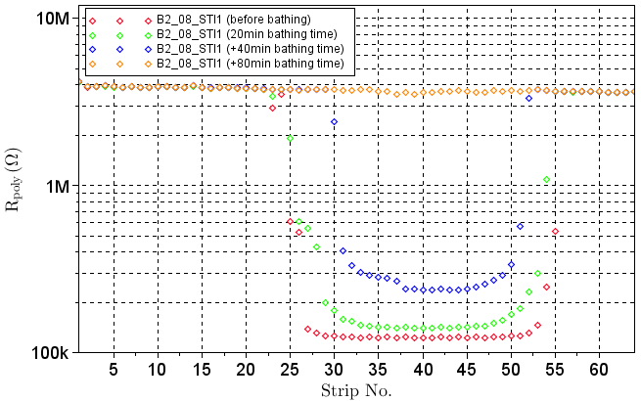
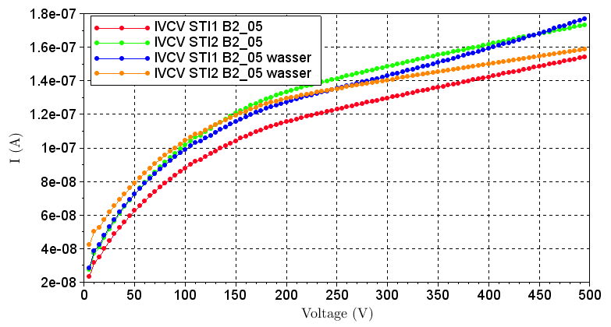
Bathing in deionized water
Sensor STI1 of batch 2 wafer 08 was bathed for different time periods in deionised water
Before bathing
20min bathing
+40 min bathing
+80 min bathing
Parameters continuously restore (same for Istrip, Cac etc.)
Bathing restores sensors
Rpoly STI1

Slide 23
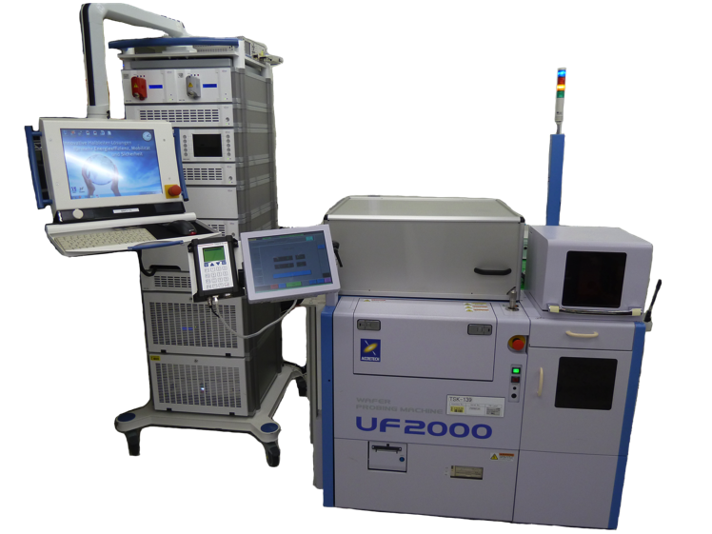
In the meantime at Infineon

Slide 24
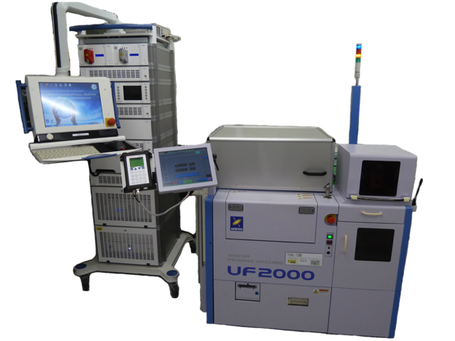
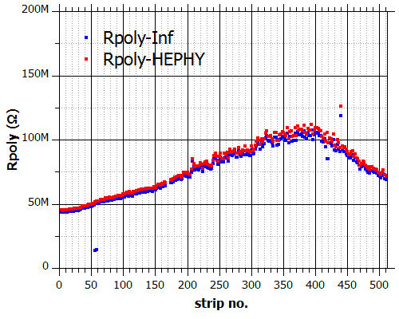
Test Setup at Infineon
Infineon was setting up test equipment to mimic our electrical characterization
They use standardized
Automated Test Equipment (ATE)
  tests undiced wafers only!
Today, they are able to measure the same per strip parameters as HEPHY (except for inter-strip parameters!)
Very good agreement of measured parameters
(HEPHY also measured the STL sensor on the undiced wafer)
→ No Area of bad strips for undiced wafers!

Slide 25

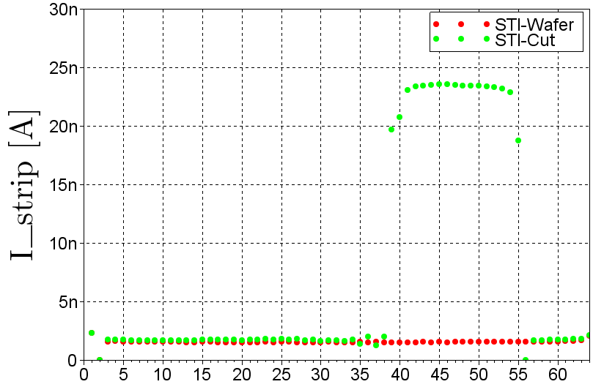
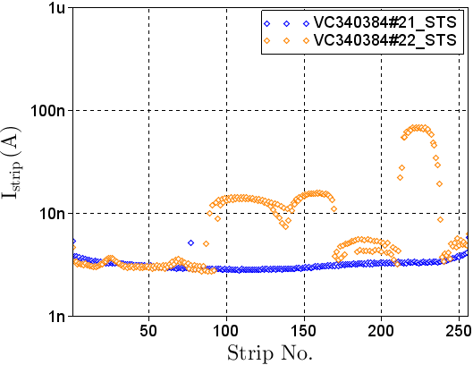
Dicing tests
Measurement on bare wafer
Measurement after dicing
Initially not much thought was put into dicing
  Seemed trivial to us – but nothing is
Electrostatic charges generated during the dicing process can influence strip isolation
  ESD topic well known at Infineon and other vendors
  Several ESD protection methods are available
Possible way to reduce electrostatic charges → CO₂-bubbler
  CO₂ added to the dicing water in order to carbonize it
  Resistivity of the dicing water:
  17 MOhm cm → 0.5 MOhm cm
Infineon diced some wafer with and without CO₂-bubbler
Diced without CO₂ bubbler
Diced with CO₂ bubbler

Slide 26
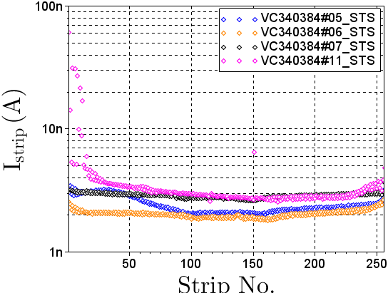
Batch 3/4: different passivation layer thicknesses/materials
Sawed with CO₂ bubbler, new masks
One assumption was that the passivation layer is more sensitive to static charges
Comparison of 4 sensors with the same specifications expect for the passivation layer
No significant changes among the different sensors can be observed
Defective area for sensor 11 is untypical (no low R_{int} observed)
Passivation 1
Passivation 2
Passivation 3
Passivation 4

Slide 27
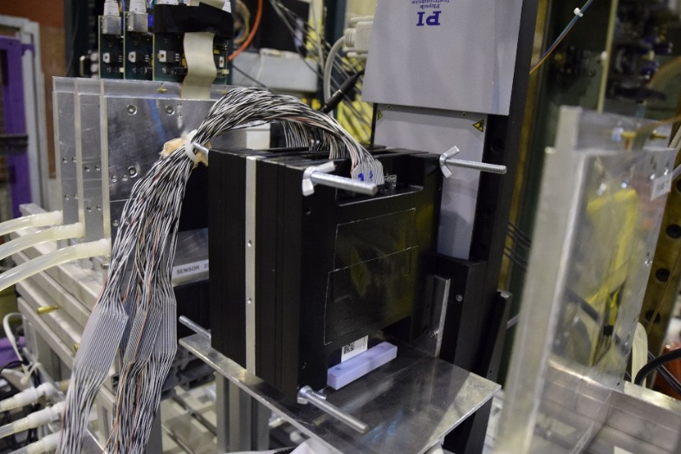
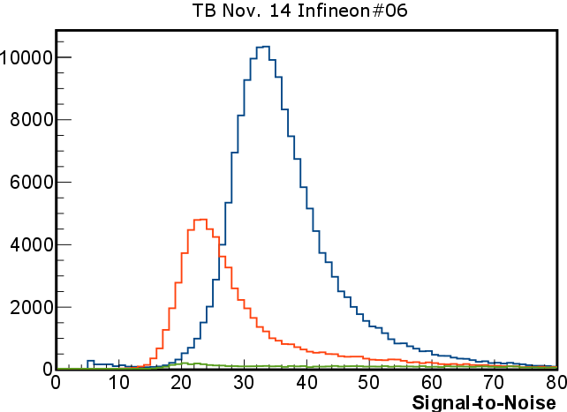
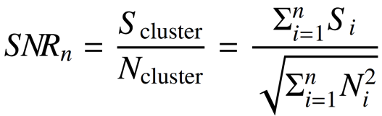
Beam Test at SPS in Nov 2014
After electrical measurements, STS sensors of wafers 5, 6, 7 and 11 were assembled in modules for beam tests at the SPS (North Area H6B)
Sensors were read out with APV25 Chips
Only the STS sensor of wafer 11 shows a narrow defective area on the far left (reminder)
DUT’s were placed into the EUDET Telescope Setup:
  Primary use: Trigger information
  Secondary use: Tracking (to be prepared)
Infineon DUT’s – 4 modules parallel to telescope planes
CW 1
CW 2
CW ≥ 3

Slide 28
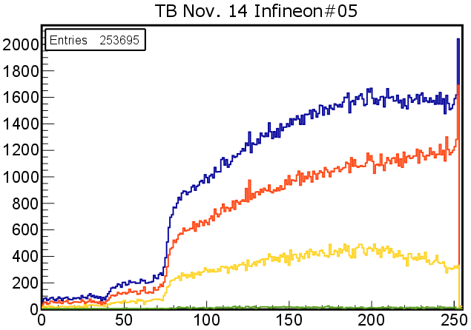
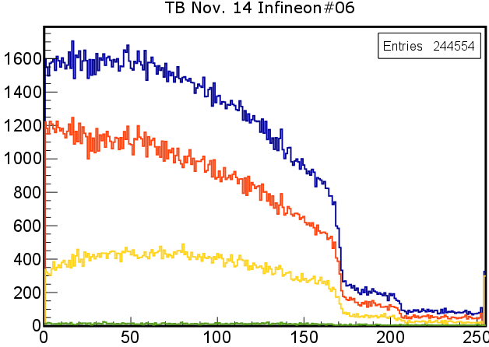
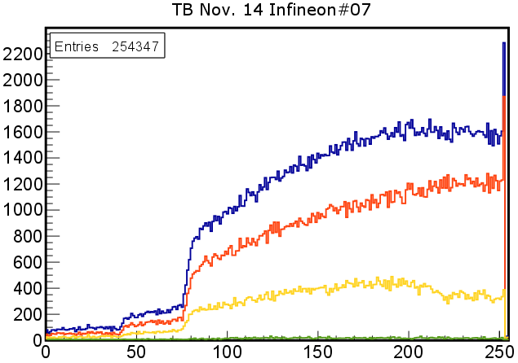
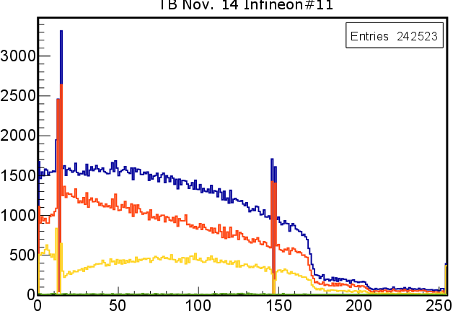
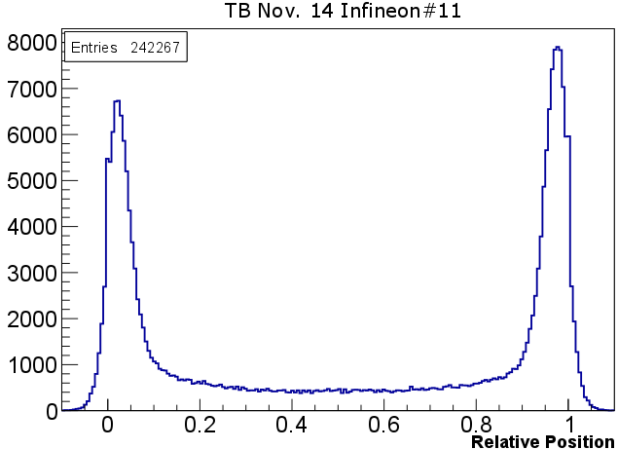
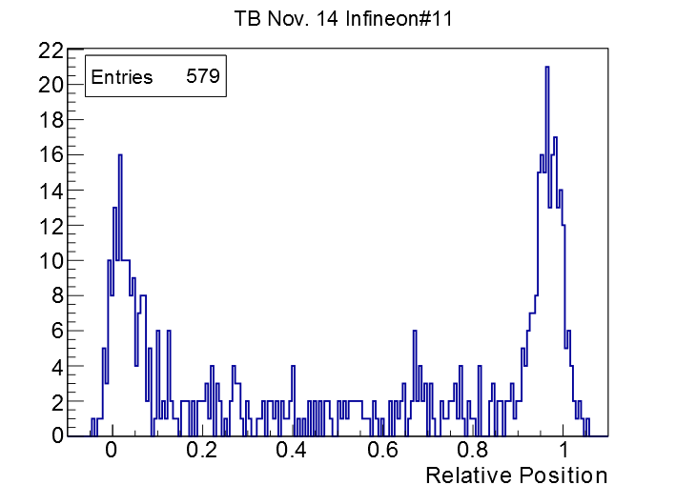
Beam Test at SPS in Nov 2014 (cntd.)
CW 1
CW 2
All CW
Beam spot is fairly small due to small overlap of trigger PM’s
Beam profiles look reasonable
Sensor 11 shows small irregularities for strip numbers 0-10 (more events with CW2 and less for CW1) → correlated to electrical characterization
Detailed look to eta distribution does not show charge-up
Not even in small region of strip 1-10
η distr. of all
sensors
η distr. of strips 1 to 10

Slide 29
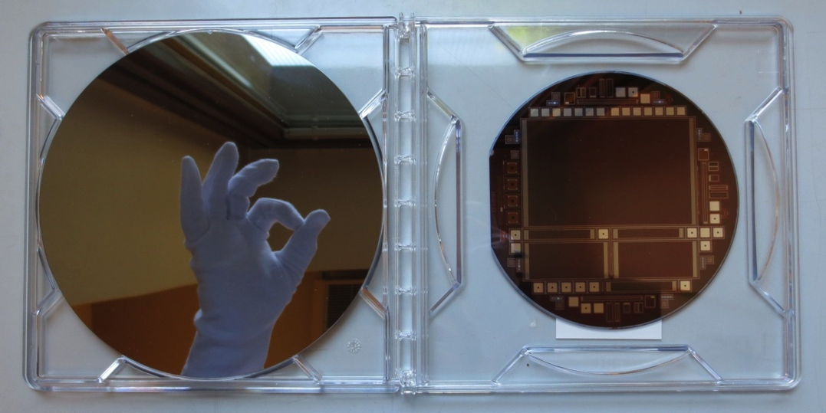
Outlook

Slide 30
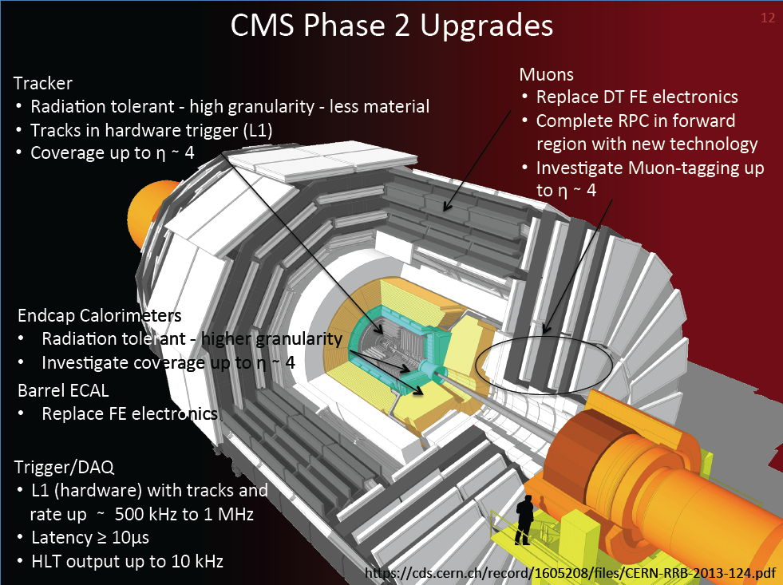

Slide 31
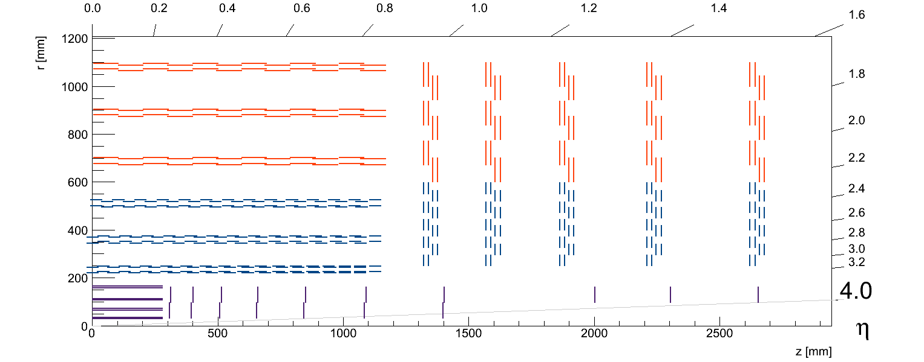
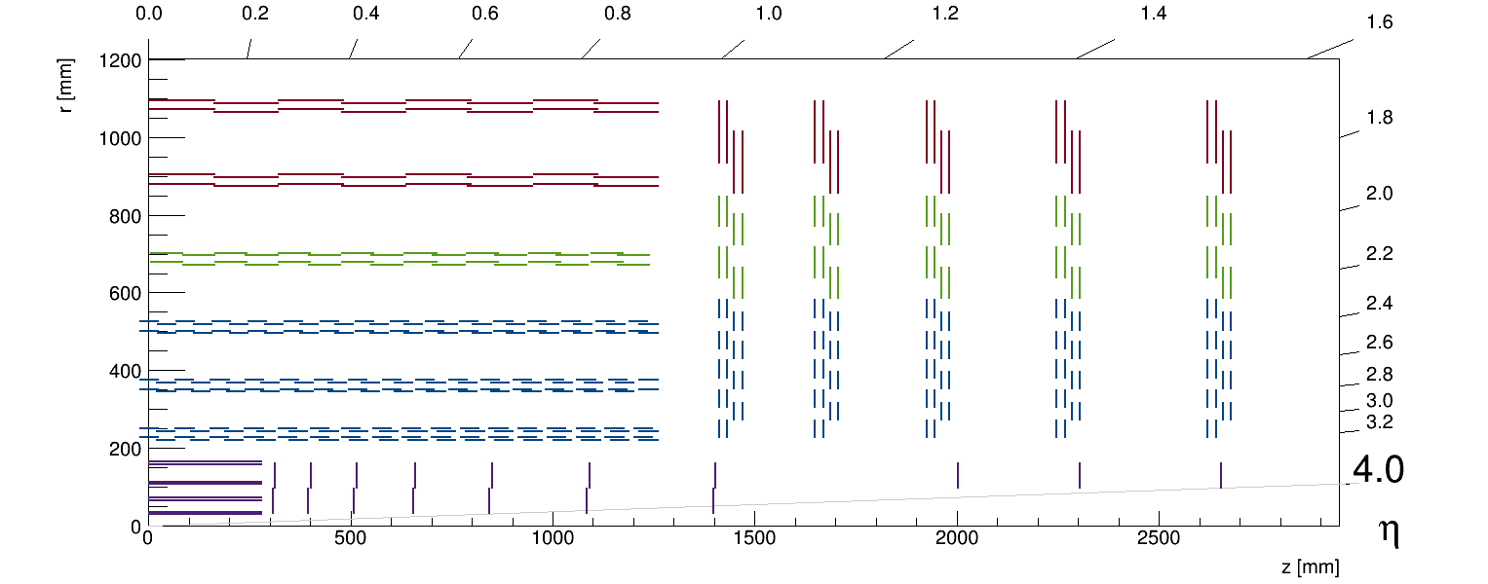
CMS Plan for Phase II upgrade
During LHC long shutdown 3 (2022-2024): CMS will install a completely new silicon tracker
The current layout is based on 6” sensors only comprising of two module types:
Layout with larger sensors from 8 inch wafers:
2S_Long
2S MODULES
2S_Short
PS MODULES
PS MODULES

Slide 32
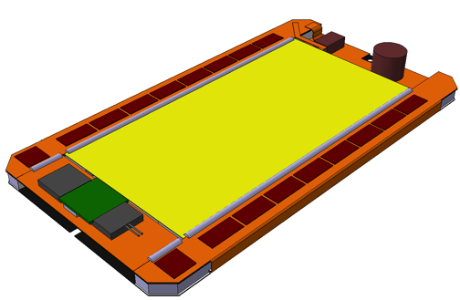






Wafer layout when CMS is going to 8”
PS Module:
  Module size stays the same
  three sensors instead of two on one wafer
2S Module:
  Fork single 2S concept into two: 2S_{long} and 2S_{short}
Could be a significant cost saving
PS module
2S module

Slide 33


Outlook for 2015
Infineon developed a process for thin (200-300µm) 6” and 8” wafers in 2014 after we started already some discussions in 2013
Both ATLAS and CMS will go for p-type substrate because of radiation hardness reasons
CMS will have a test production on both wafer diameters in 2015
  We are currently finishing the layout, tape-out in two weeks from now
  Wafer to be ready in summer 2015
8”
6”

Slide 34



CMS High Granularity Calorimeter
Both the endcap crystal calorimeter and the plastic scintillator calorimeters will need to be replace after LHC operations due to radiation damage.
CMS is investigating in detail the possibility of using a high granularity calorimeter with ~2.5M channels of silicon pads.
Total silicon area: 780 m²
Single-Sided DC-Coupled
p-on-n / n-on-n
200um / 100um
active thickness
  Sensor Surface cm²
  Square Hexagonal
  6” wafers ~ 100 ~ 130
  8” wafers ~ 180 ~ 230

Slide 35
Summary
Collaboration with Infineon started already five years ago with bottom-up approach
Several batches in p-on-n technology produced
  Baby sensors used by CMS for lab and beam tests with new CBC readout chip
  “bad strip” area identified as charge-up problem and solved
  Open question: Are Infineon sensors more sensitive to charge-up (to be investigated) and how to mitigate this behavior
Process flow for n-on-p technology with 200/300 µm thickness developed
  Will be used for both 8” and 6” test submission by CMS in 2015

Slide 36

The end

Slide 37






Beam Tests and Irradiations with Infineon Sensors
Performance has been tested in several beam tests at CERN and DESY
  Confirms region of bad strip isolation previously seen in electrical characterization
Several irradiations, e.g. with Neutrons at Atominstitut of TU Vienna
  Test radiation hardness
  Qualify reactor as irradiation center (determine neutron spectrum)
bad
good
Beam
profile
during e-/e+
DESY testbeam
Triga Mark II Reactor ATI
Theory
Infineon

Slide 38
Batch overview
Batch | Date | masks | dicing | split groups | features
1 | 2012 | original |  | Strip dielectric, backside implant | photoresist left
2 | Q1 2013 | original |  | R_poly variation, backside implant
3 | Q4 2013 | original | partly CO2 | backside implant, passivation
3.5 | Q1 2014 | original | CO2 | passivation
4 | Q3 2014 | 3 new layers | partly CO2 | passivation

Slide 39




Mask layout changes for batch 4
Three new masks were designed for batch 4 for these layers:
  Passivation, contact holes, metal
Main changes:
  Additional AC pads close to Rpoly on every even strip → easier to measure for ATE setup
  No complete passivation window for bias- and guard ring → could lead to improvements concerning electrostatic charge
  Increase space to contact holes on DC pad to take metal over-etch into account

Slide 40



Comparative Measurements – Redesigned Masks
All sensors sawed with CO₂ bubbler
Comparison of Istrip of STS sensors with old and new masks independent of the applied passivation layer
Sensors produced with the new masks show nearly no affected strips!
Deeper investigations necessary
Old masks
New masks
(Changes in passivation layer should allow charges to dissipate easier)

