Slide 1
Second RD51 CB meeting – 14/10/2008
AGENDA
Approval of the agenda
Approval of the minutes of the 17/4/08 CB meeting in Amsterdam
  Minutes circulated via e-mail on 5/5/08
RD51 internal organization
RD51 management for next term
MoU (Hans Taureg’s report)
Common funds (Leszek Ropelevsky’s report)
Next meetings
AoB

Slide 2
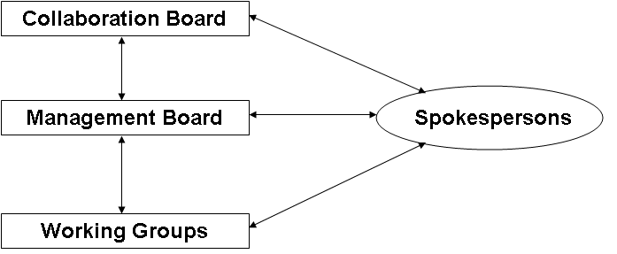
RD51 internal organization
MANAGEMENT STRUCTURE:
(see RD51 proposal, section IV)
Spokespersons elected by the CB for 2 y

Slide 3
RD51 internal organization
ABOUT managemnet, decided:
The initial mandate starts on 15.10.2008 for a period of one year,
that subsequent mandates should be for two years, and that a
person may be reelected to a position.

Slide 4
RD51 management for next term
ELECTED:
2 Co-spokespersons Leszek Ropelewski, Maxim Titov
Collaboration Board Chair Silvia Dalla Torre
Deputy CB Klaus Desch
members of the MB: Amos Breskin
Ioanis Giomataris
Fabio Sauli
Harry van der Graaf
Andrew White
Appointed:
H.Taureg as secretary of the MB/CB and as finance coordinator

Slide 5
RD51 management for next term
Present WGCs:
WG1 Paul Colas, Silvia Dalla Torre
WG2 Harry van der Graaf, Vladimir Peskov
WG3 Frank Simon, Andrew White
WG4 Alain Bellerive, Rob Veenhof
WG5 Michael Campbell, Werner Riegler
WG6 Hans Taureg, Erik van der Bij, Ioanis Giomataris
WG7 Matteo Alfonsi

Slide 6
RD51 internal organization
Institutions joining RD51, decisions:
What follows is to be applied after RD51 is formally approved (expected: 5/12/2008)
CM voting by e-mail to speedup the procedure.

Slide 7
MOU and COMMON FOUND
MOU MAIN ITEMS:
Intellectual property
Request to CERN (light ones)
Common founds
  Light model
  Financial resources to run the collaboration (Collaboration meeting)
  Maintenance and operation of common structures

Slide 8
MOU TIME LINES
STATUS & TIME LINES
MOU draft distributed to the CB members last week
comments from the CB members till 01 November
If no major changes needed
  Give MoU to institute management for comments and acceptance
Sign shortly after RD51 approval (RB approval expected on 05.12.2008)
  MoU signature procedure (CERN and Institutes !) can start in January 2009

Slide 9
Next meetings
DECISIONS:
RD51 meetings, periodicity
2 collaboration meetings per year, one outside and one at CERN
2009:
  first meeting: at the end of the Crete Conference on MPGD (12-15/6/08), namely on 16-17/6/2008
  second meeting at CERN in approximately one year from now

