Slide 1

LHC BLM system:
Status of changes during LS1+
BI Technical Board December 2014
Christos Zamantzas on behalf of the BLM team.

Slide 2
Overview
Hardware Changes
  Tunnel installation & Acquisition electronics
  Surface installation & Processing electronics
Firmware/Server Changes
  BLETC and BLECF
Application Changes
  Updates, additions and wishlist
Verification & Commissioning
  RSM, Dry-Runs, Checkout, Beam Commissioning
Injection Interlock Inhibit
  Solution agreed and planning

Slide 3
LHC BLM system:
Hardware Changes
Listing main actions to be performed or developed in the system

Slide 4
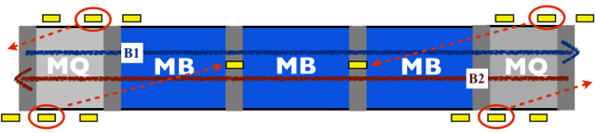
Modifications in the tunnel installation
ECRs in preparation
✓
Dismantle all detectors in the ARC and DS (~2500) and
Dismantle 70% of the detectors in LSS (~1000)
  in order to allow intervention in the interconnections
Exchange 40 multiwire cables with the NES18 type
  Reduce noise on 240 detectors
  Continuation of campaign to exchange all noisy installations
Relocate 816 detectors
  New supports, cable extensions, cable trays needed
  Improve protection
  see Eduardo Nebot Del Busto’s presentation for the reasons
✓
✓
✓
New locations of the detectors

Slide 5
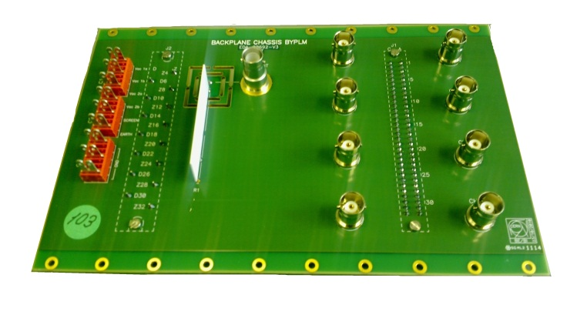
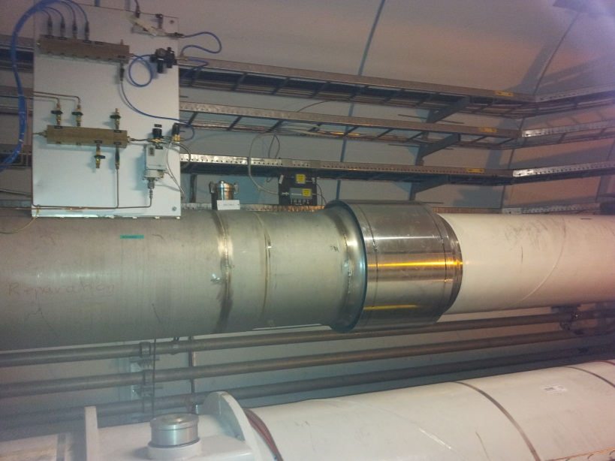
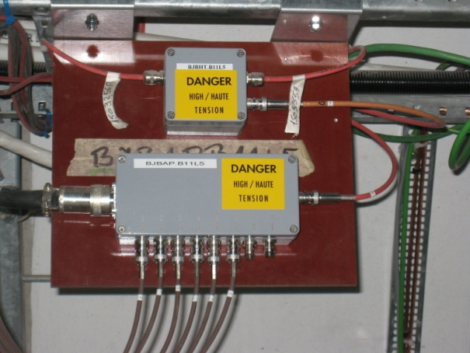
Modifications in the tunnel installation
✓
ECR in preparation
Exchange 360 acquisition crate backplanes
  Improve stability, add features
Modify 309 signal distribution boxes
  Allow reset of the complete sector
Installation/Connection to WorldFIP
  Straight Section needs additional electronics
  Allow remote access per card
Add everywhere High Voltage divider boxes
  Increase accuracy
Modify 40 High Voltage distribution boxes
  Add suppressor diodes and resistors
  Only in areas with high losses
✓
✓
Improved backplane
✓
to do
For more info see Ewald Effinger’s presentation in 73th MPP

Slide 6
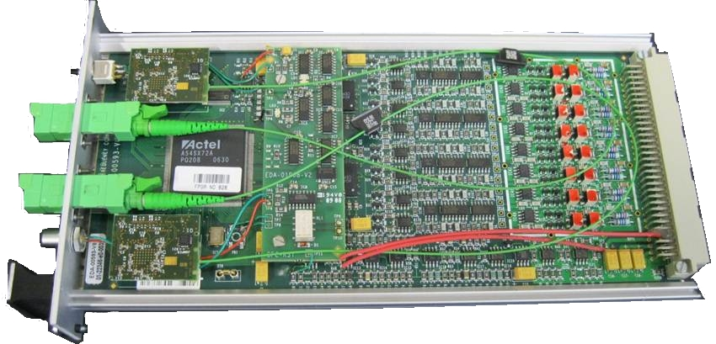
Modifications in the ACQ electronics
Modify all BLECF modules (~700)
  Change limit for the HV level detection flag
    currently too restrictive for proper use by the SIS.
    change detection level from 1370V to 950V
  Change laser settings of the GOH
    increase transmission power to give more margin of attenuation
    add ~ 30% more power
✓
cancelled

Slide 7
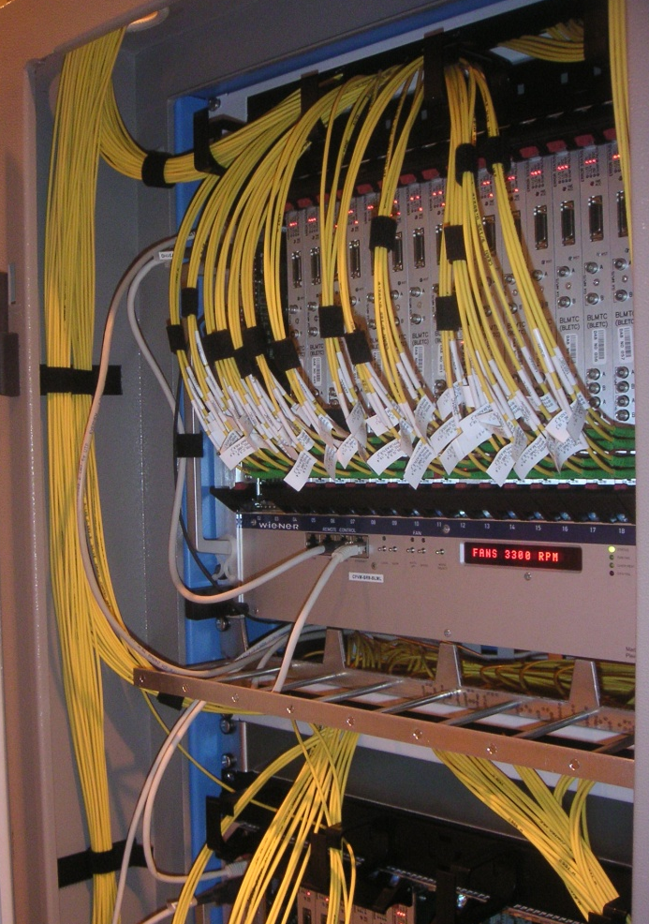
Modifications in the surface installation
Replacement of all racks
  Add temperature regulated racks
  Remove and disconnect complete installation (crates, cables, power etc)
  Reconnection/replacement of all fibre patchcords (~1600 fibres)
Modifications for apt interventions
  Replacement of all rear connection cables
  Allow direct access to power supplies and rear rack connections
Add two new crates for possible future Injection Interlock Inhibit implementation:
  Install additional racks in P2 and P8
  Separate problematic monitors for injection
  see also Wolfgang Bartmann’s presentation
✓
✓
✓

Slide 8
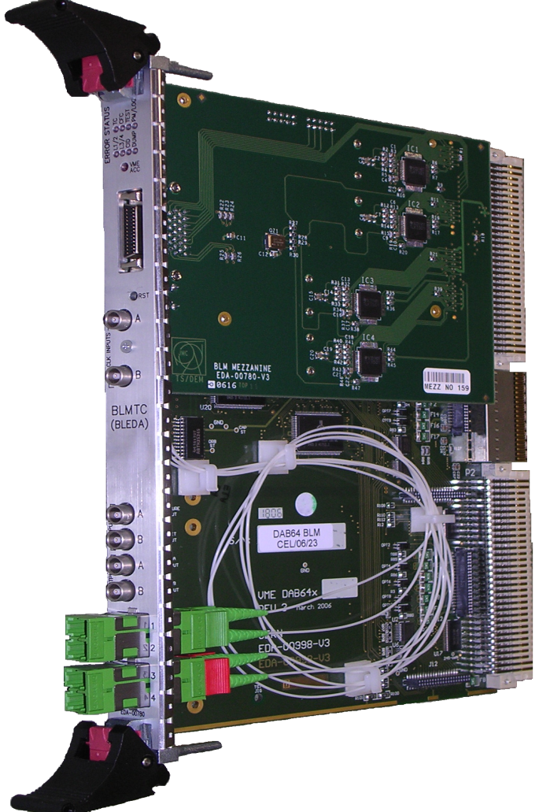
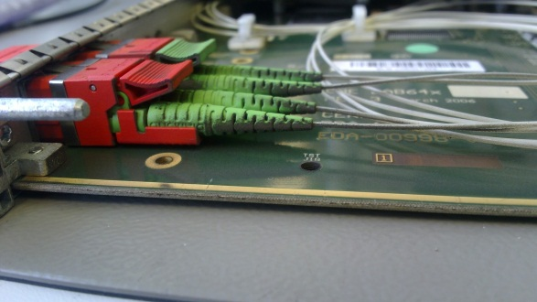
Modifications in the TC electronics
Maintenance of all processing modules (~400)
  Fix or Replace ~ 20% of mezzanines
  Clean-up of the optical adaptors and connectors
Shuffle optical links
  Expect to improve availability by removing common mode failure
  80% of optical link errors and failures were in LK: 1-2
Optical Link 1 input is less reliable
✓
✓
E2000-APC input connections to four optical fibres.
Accumulation of dust on the connectors

Slide 9
Expert Name Convention Change
1 2 3 4 5 6 7 8 9 10 11 12 13 14 15 16 17 Official name
BLMQI.06R7.B1E30_MQMxxx(_S)
BLM location or feature:
Q – Quadrupole
B – Dipole (Bending)
T – Collimator (Target)
E – Extra
D – Dump Line
P – Direct Dump (Protection)
C – Cryo
I – Injection lines (TI2,TI8,TT41)*
X – eXperiments
2 – Coupled detectors
M – Mobile detectors
Position:
01-34 - number of cell
L or R - side from IP
1-8 - IP
xxxx - distance from beginning of TD [dm]
Observed elements:
- Up to two elements (e.g. MQ, MQXA or MBA.A-MBB)
- Function (batt, hv)
- Distance from IP6 [m] _ Change of TD diameter [mm]
- Distance from beginning of Dump Core [m]
Position on the element:
for B1/2 from beam direction:
10+i at the entrance
20+i at the middle
30+i at exit
for B0 from IP:
10 – first
20 – second
Beam relation:
B1 – Beam 1
B2 – Beam 2
B0 – Centre
Detector type:
I – IC
S – SEM
L – LIC
F – FIC
D – Diamond
S – Silicon
B – ACEM (Bunch meas.)
C – Channel Check
Transverse position:
E external
I internal
C central
T top
B bottom
L left to beam direction
R right to beam direction
Optional:
_S – second coupled monitor
(counting from beam direction)
_T – vertical slice test monitor
_DUMP – inside beam dump

Slide 10
Database Updates
Completed:
  900 channels have been updated in MTF, LAYOUT and LSA
  21,000 new Logging variables created
  2,000 Logging variables renamed
On-going actions:
  Data on 300 channels to be updated
  Slots for 30 new channels to be added
  Rename of 10,000 Logging variables

Slide 11
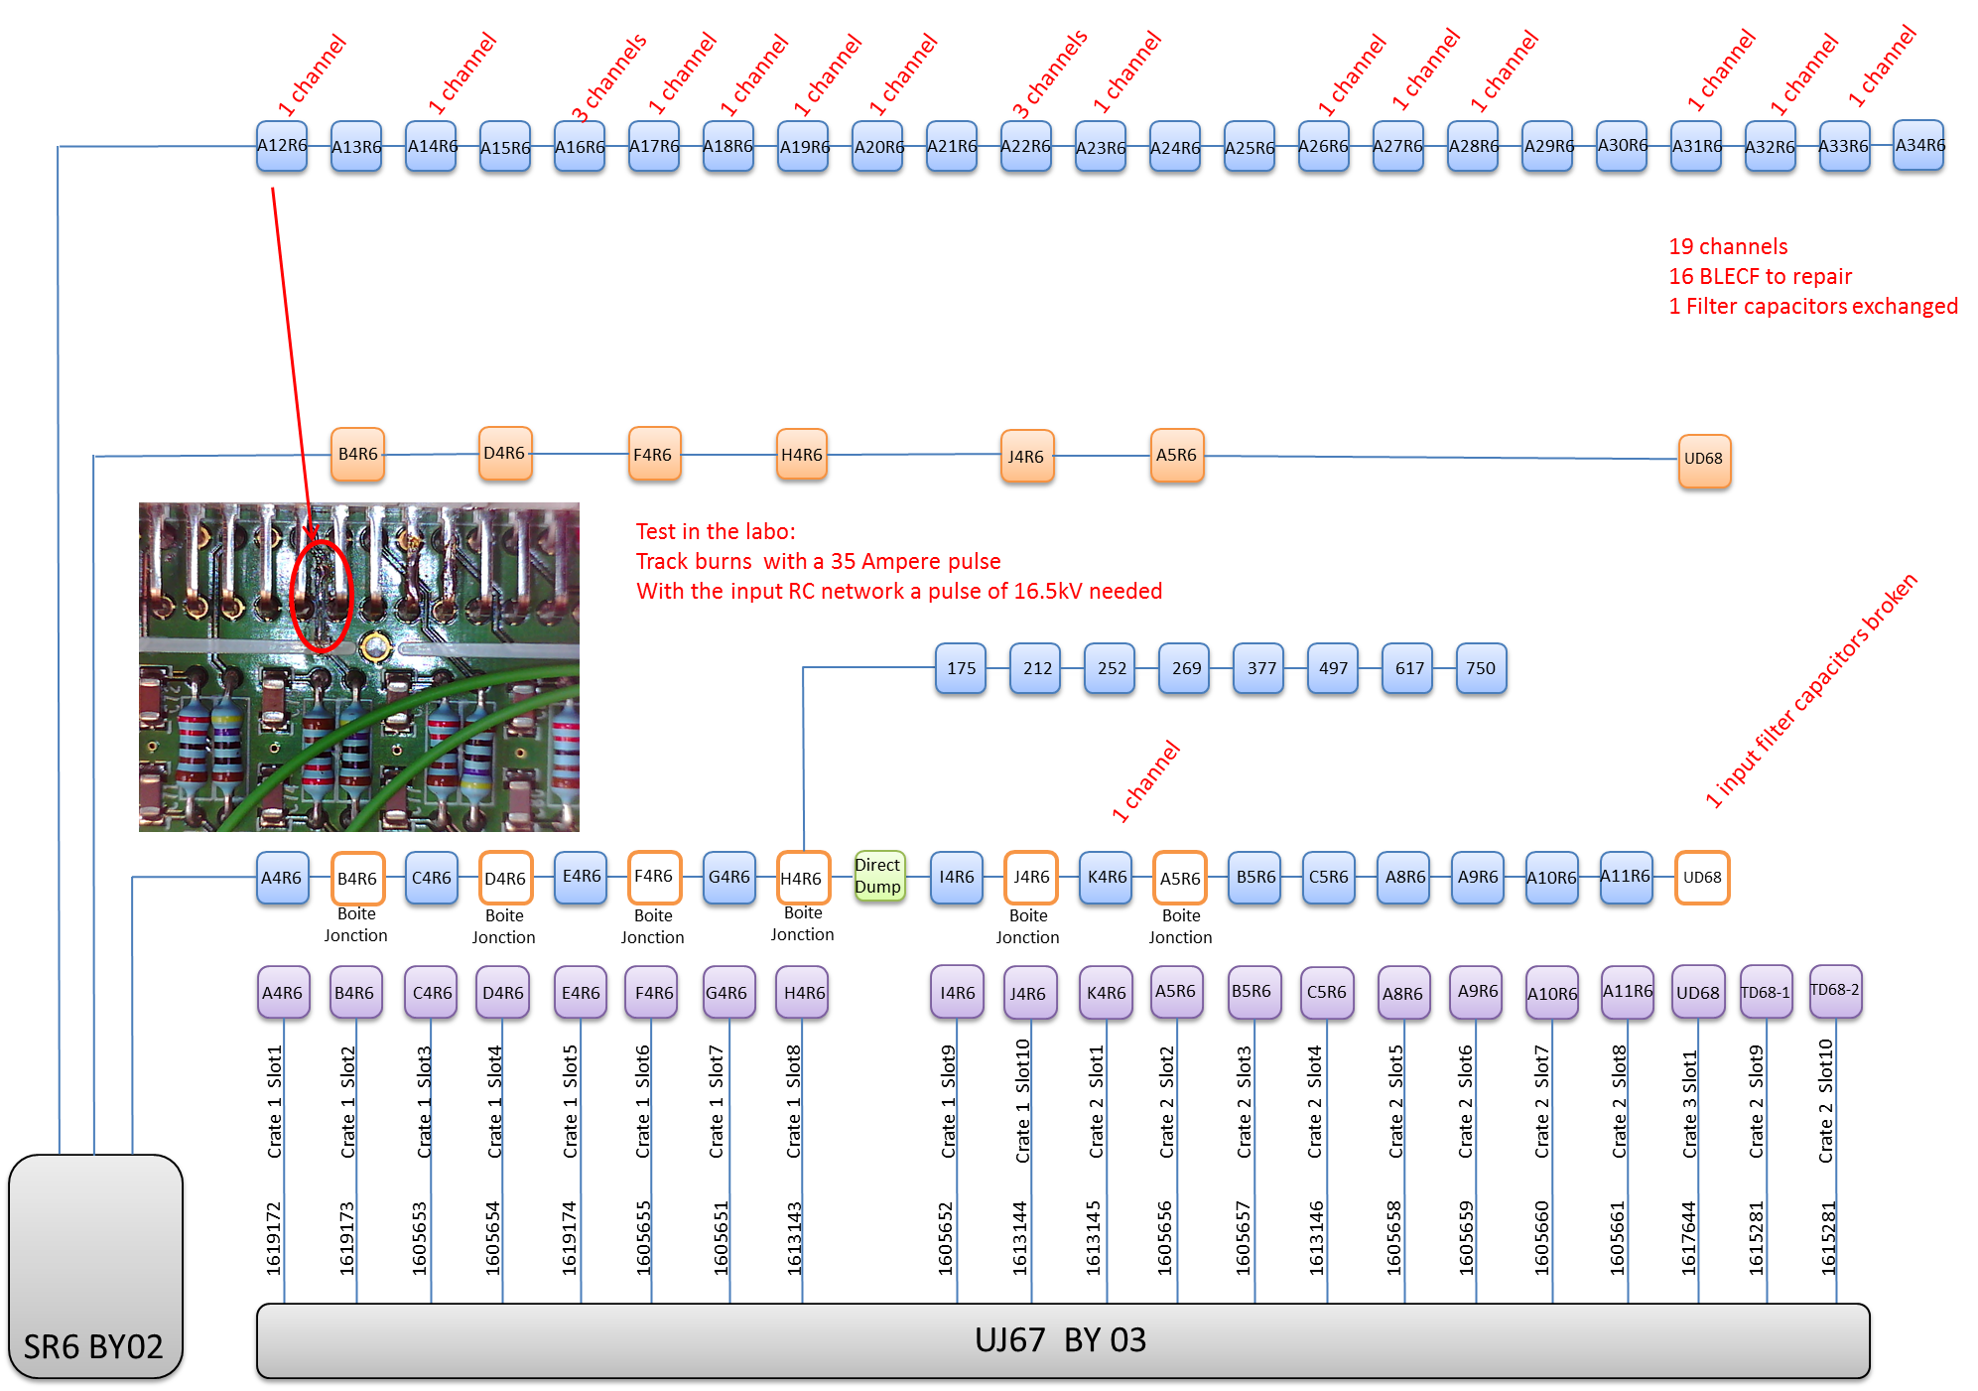
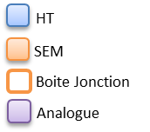
Incident in IP6: 6R
Ewald

Slide 12
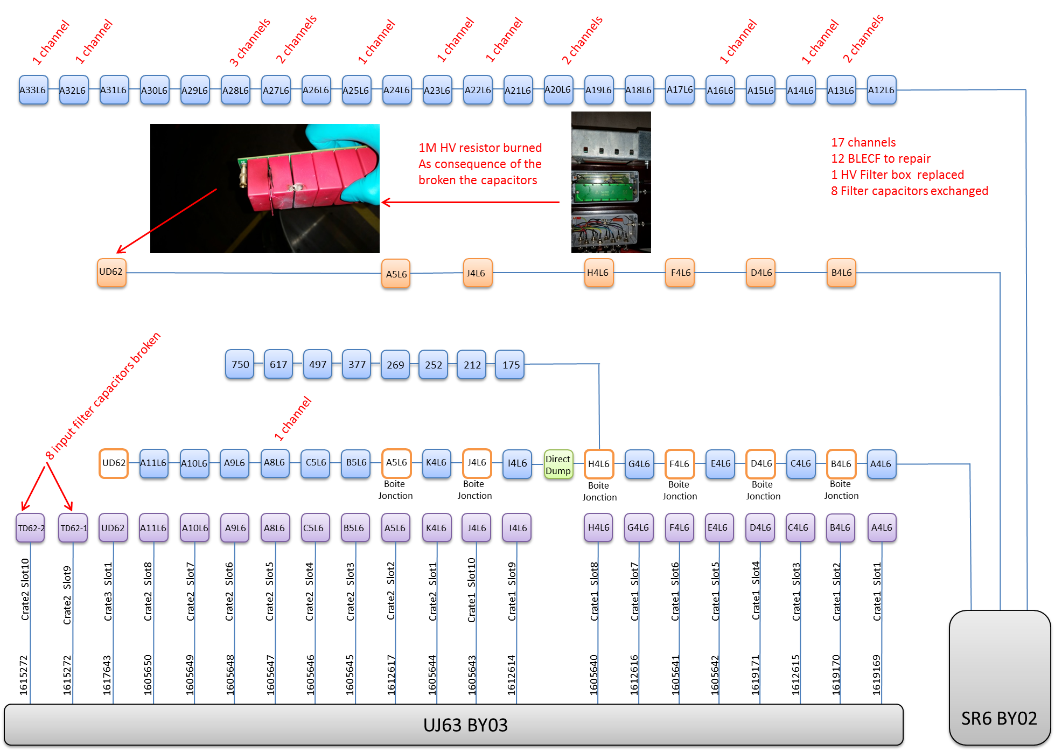
Incident in IP6: 6L
Ewald

Slide 13
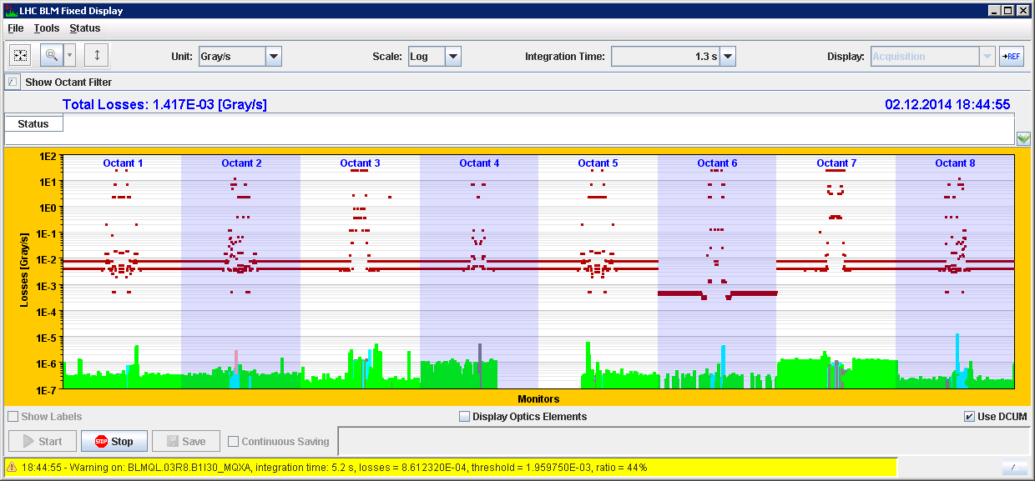
2014/12/02: Status of the installation
All crates operational
3,216 channels complete, 687 channels with issue
  280 ch. from S45 (cards not yet installed)
  95 ch. from IP6 (cards in repair)

Slide 14
LHC BLM system:
Firmware & SERVER Changes

Slide 15
Current State of Firmware/FESA
All functionality present in Run 1 is again operational with the new CPU for both BLETC and BLECS modules.
Tested:
  Logging (measurements and statuses), XPOC, PM, IQC
  Read/write of threshold values and system parameters
  Online MCS check
  Sanity Checks

Slide 16
Modification of the BLECS firmware
Combiner and Survey firmware additional modifications:
  Higher priority:
  Improve regular automatic system checks
    block increase of input offset
    add timeout for check completion
  Improve connectivity check
    Increase range of values allowed
  Improve Energy value reception and logging
    fast changes of energy values are propagated to the BLETC modules but not logged
  Lower priority:
  Add better compatibility with new CPUs
    new VMEbus core with MBLT mode
    new memory map optimized for block transfers
  Preparation for the “Injection Interlock Inhibit” feature

Slide 17
Modification of the BLETC firmware
Processing Module firmware additional modifications:
  Higher priority:
  Add better compatibility with new CPUs
    new VMEbus core with MBLT mode
    new memory map optimized for block transfers
  Improve PM and UFO Buster buffers
    increase size to 43,690 samples per channel
  Improve XPOC buffer
    split data and triggers per beam
  Lower priority:
  Improve data for Collimation Beam Based Alignment
    increase data rate (now at 12.5 Hz)
FESA server will need to be updated accordingly

Slide 18
LHC BLM system:
Software Changes

Slide 19
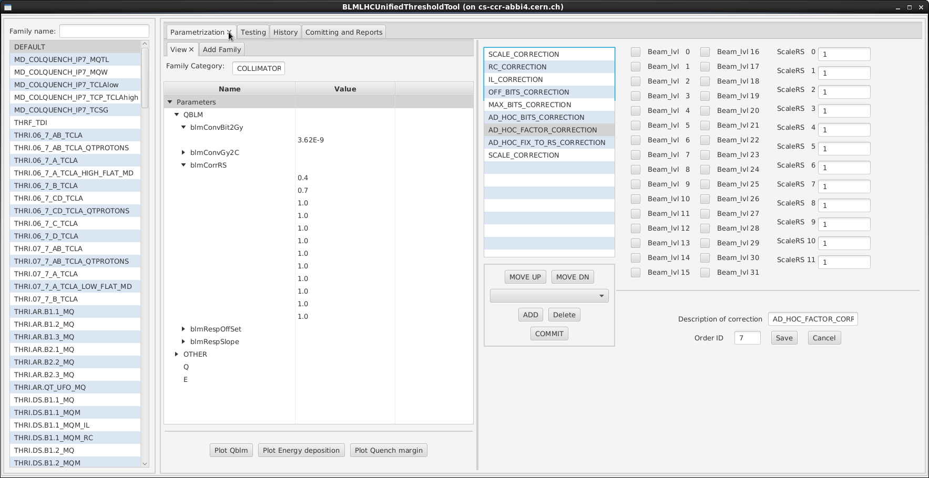
Threshold Management Application
Blazej & Stephen
View on parameterization and correction functions

Slide 20
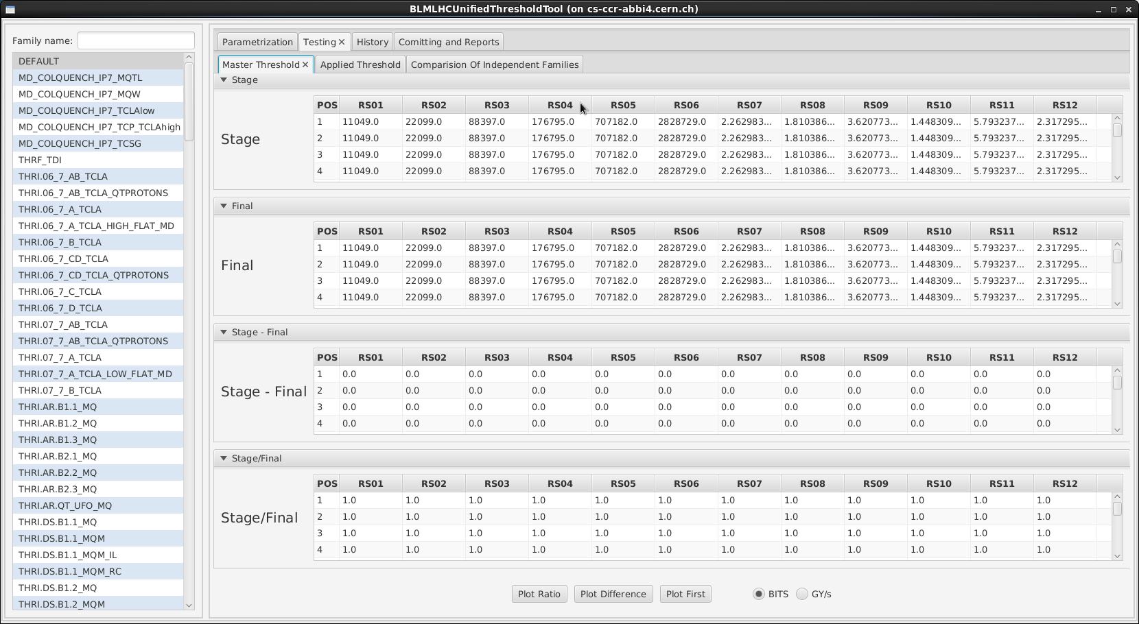
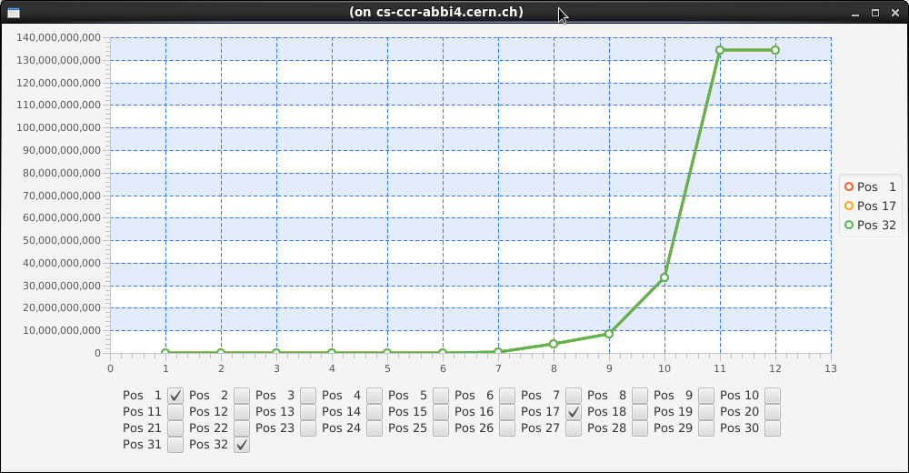
Threshold Management Application
Blazej & Stephen
View and Plotting of Threshold values

Slide 21
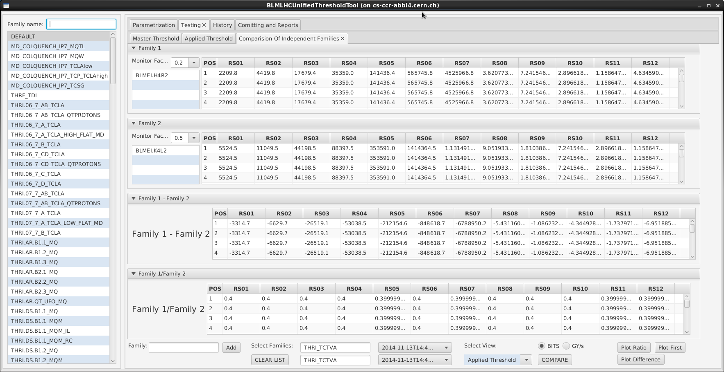
Threshold Management Application
Blazej & Stephen
Comparison of thresholds for different families and different dates

Slide 22
Threshold Management Application
Blazej & Stephen
Application ready wrt specifications
  GUI implemented
  DB middle-tier connection
To Do:
  Improve plots (SW)
  Fixing bugs and data in DB (CO)
  Computation algorithms missing (BL & CO)
  Extensive testing of the application and DB logic of threshold values calculation (BL & SW)

Slide 23
Other Applications
Blazej & Stephen
Moved to Maven and some corrections:
  System Parameters application
  Threshold Values application modifications
  Connectivity Check results viewer
  Master table viewer
Expert Applications are all operational
  Next year to be moved also to Maven
To correct:
  System Status application (via Concentrator)
  Mobile Monitor Setup application

Slide 24
Application Improvement wishlist
System Parameters application (BE/SW)
  automatic fill of serials when a card is exchanged
  step increase of connectivity check limits
System Status application additions (BE/OP)
  give global overview
  provide system error cause
System Management application (BE/OP and BE/CO)
  Generate new monitors/parameters, Drive settings to electronics, Initiate/Abort checks
  provide a clear procedure for actions to be taken
  avoid errors due to complexity of the generic applications (generation, trim etc)
Monitor Factor application (BE/OP)
  show history
  compare two points in time
  roll back of changes (very useful for MDs, etc.)

Slide 25
LHC BLM system:
Verification & Commissioning

Slide 26
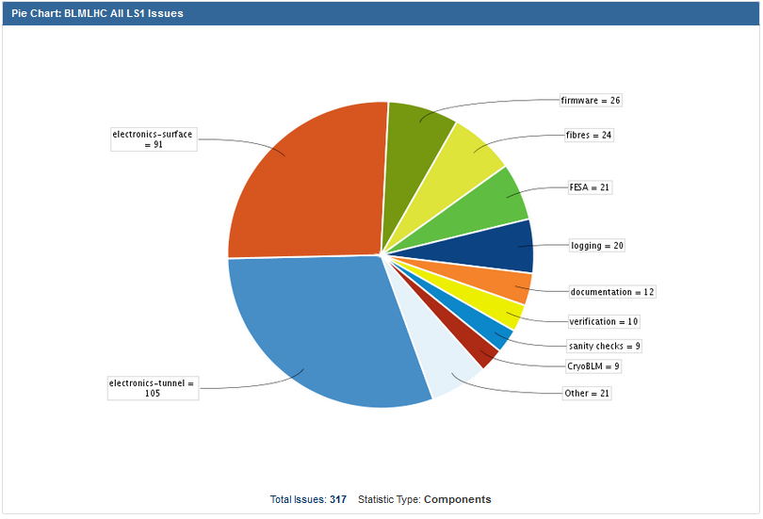
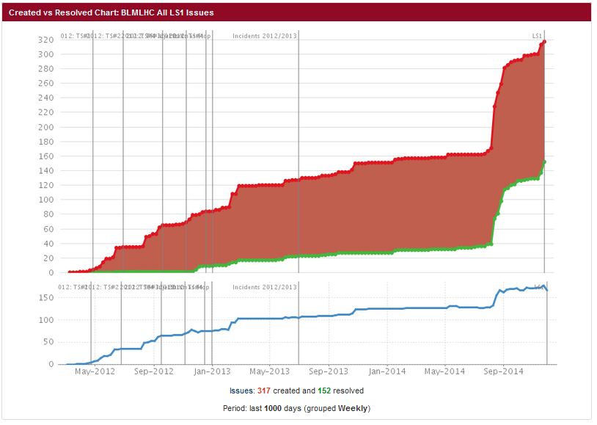
Issue Tracking
On-going actions:
  Check all optical connections
  Check behaviour of each card
  Check behaviour of each channel
  Check all interlock connections
To start in 2015:
  Update all serial numbers
  Calculate new Connectivity
  check limits

Slide 27
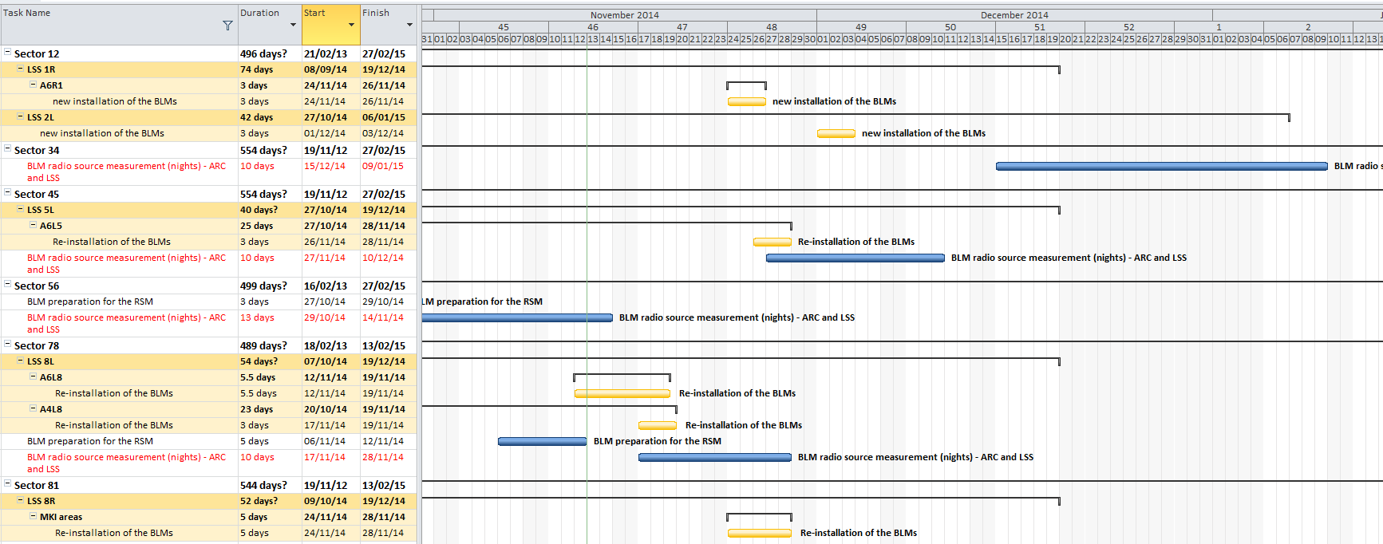
Radiation Source Measurements
Slava
Last two sectors pending:
  S45: W49 installation, W50 measurements
  S34: W51 measurements
In 2015, selective measurements in areas with many issues

Slide 28
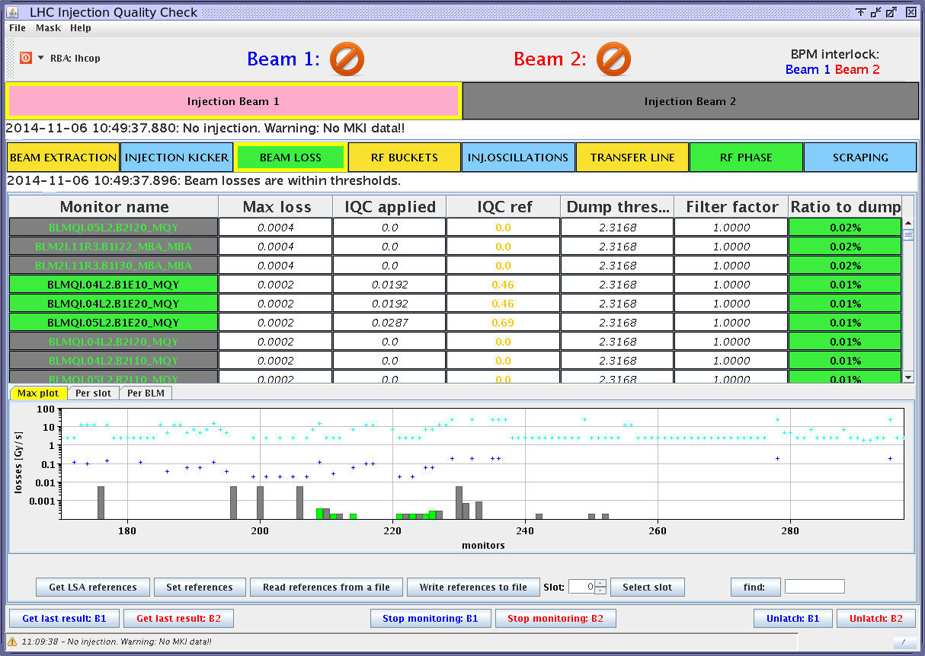
Dry-Runs
Completed already 3; several issues identified and corrected
W50 dry-run (last) to verify:
  triggered acquisitions (IQC, XPOC, PM) fixed displays,
  acquisition of continuous data not blocked when trigger arrives
IQC display during Dry-Run, November 6-7 2014

Slide 29
System Checkout
When the installation is complete and all operational: 2 major and time consuming checks
Exhaustive threshold triggering
  automatic test in all the LHC crates
  30-50 hours
Large scale HV modulation tests
  each test consists of 200 x modulation checks to verify the integrity of the monitors and connections,
  Results are used to calculate accurate detection limits
  3-5 nights

Slide 30
Commissioning with Beam
Tests to perform with beam:
Test transmission time USER_PERMIT
  Measure system latency between beam loss and interlock
MPS functionality of the BLM
  All crates and channels can provoke an interlock
Interface of direct BLMs with the LBDS
  Verify the system can provoke an interlock
Performed together with FMCM by OP:
Threshold and reaction time at 450GeV
Threshold and reaction time at physics energy

Slide 31
LHC BLM system:
Injection Interlock Inhibit
Details on the modifications planned and the new functionality

Slide 32
Modifications: Installation
Move relevant detectors to separate acquisition cards
  See ECR for injection BLMs for the list of monitors involved.
  Re-cabling of signal and power distribution is necessary for some.
  Note: we asked initially the current grouping of monitors to not be broken. This was later agreed to be an unrealistic demand.
Add two new processing crates
  Connect to the standard interlock daisy chain between crates
  Will be the last in the chain to avoid inhibiting other crates’ interlocks
Add new processing modules and connect fibres.
Update the MTF, LAYOUT and LSA databases with this configuration.
All to be completed during LS1

Slide 33
  Configuration in SR2 & SR8
Interlock daisy chain from BLETC 1 to BLECS
Termination
Crate 4 (I)
U
BLETC
1
U
BLETC
2
U
BLETC
16
U
BLECS*
4
Termination
M
M
M
M
U_{A}
U_{B}
M_{A}
M_{B}
Configuration
in SR2 & SR8
Crate 2
U
BLETC
1
U
BLETC
2
U
BLETC
16
U
BLECS
2
Termination
M
M
M
M
U_{A}
U_{B}
M_{A}
M_{B}
Interlock daisy-chain from BLECS 4 to CIBUs
Crate 1
U
BLETC
1
U
BLETC
2
U
BLETC
16
U
BLECS
1
Termination
M
M
M
M
U_{A}
U_{B}
M_{A}
M_{B}
Legend:
Unmaskable beam permit
CIBU
UnMaskable
UBI
Maskable beam permit
Unmaskable Beam Info
BIS
network
CIBU
Maskable
MBI
Maskable Beam Info

Slide 34
Modifications : Hardware
Modify the BOBM (BST master) configuration to forward a timing event related to the injection
  There are several to choose from,
  e.g. HIX.FW-CT, HIX.W100-CT, HIX.W20-CT, HIX.AMC-CT.
Modify the BOBR (BST receiver) configuration to distribute the timing event in the backplane of the crate.
  A pulse is broadcasted to all cards through a dedicated line of the VME64x P0 connection whenever the event is received
Modify the BLECS firmware to force the Beam Permit line for a fixed period of time when it receives the injection signal and certain other conditions are satisfied.
  Persistent FESA settings per crate will (in the future can become part of the MCS parameters):
    Activate/Disactivate the inhibit functionality.
    Define the time the beam permit is forced to TRUE
  Inhibit of the output will happen only under certain conditions:
    during injection,
    energy is 450 GeV,
    …

Slide 35
  Interlock Inhibit Functionality
Interlock daisy chain from BLETC 1 to BLECS
Termination
Crate 4 (I)
U
BLETC
1
U
BLETC
2
U
BLETC
16
U
BLECS*
4
Termination
M
M
M
M
Injection
Event
BOBR
Termination
U_{A}
U_{B}
M_{A}
M_{B}
Crate 3
Crate 2
Interlock daisy-chain from BLECS 4 to CIBUs
Crate 1
U
BLETC
1
U
BLETC
2
U
BLETC
16
U
BLECS
1
Termination
M
M
M
M
U_{A}
U_{B}
M_{A}
M_{B}
Legend:
Unmaskable beam permit
CIBU
UnMaskable
UBI
Maskable beam permit
Unmaskable Beam Info
BIS
network
CIBU
Maskable
MBI
Maskable Beam Info

Slide 36
Additional information
The modified firmware, at this time, cannot affect the total reliability of the system but it can affect its availability, i.e. false dumps.
Measurement or threshold values will not be modified at any time, i.e. no blinding.
Interlocks by channels over threshold values will always be logged.
  For all channels and all integration periods at 1 Hz
  Though, it will be not possible to know when exactly or how many times inside the 1 s the interlock occurred.

Slide 37
Deployment Plan
At TS1 deploy special BLECS firmware on new crates
  separate crates have been installed
  detector distribution (+use of LICs) has been done
  new functionality only on the two new injection crates
  injection signal via the BOBR (via backplane)
During 2015 maintain two BLECS firmware
  evaluate the need of the inhibit functionality
  discover the optimal settings and safeguards required
  (deadtime, max. repeat, checks etc.)
  modify further firmware and deploy as necessary
  (MPP has accepted reduced reliability for these two crates)
At WTS 2015, depending on outcomes,
  decide if functionality is needed
  deploy common firmware to all BLECS modules
  move FESA settings to DB parameters with MCS

Slide 38
Summary
Most of the system has been completely re-installed
All system modules have been modified and underwent maintenance
Primarily the changes aim to reduce failures and errors
  Optical links
  HV power supply
  Sanity checks
Additional changes aim to improve
  Remote control of cards and crates
  Data collection and distribution
  Improve ability to maintain the installation
Complete re-commission will be necessary
  Rad-source measurements
  MPS checklist

Slide 39
Thank you

Slide 40
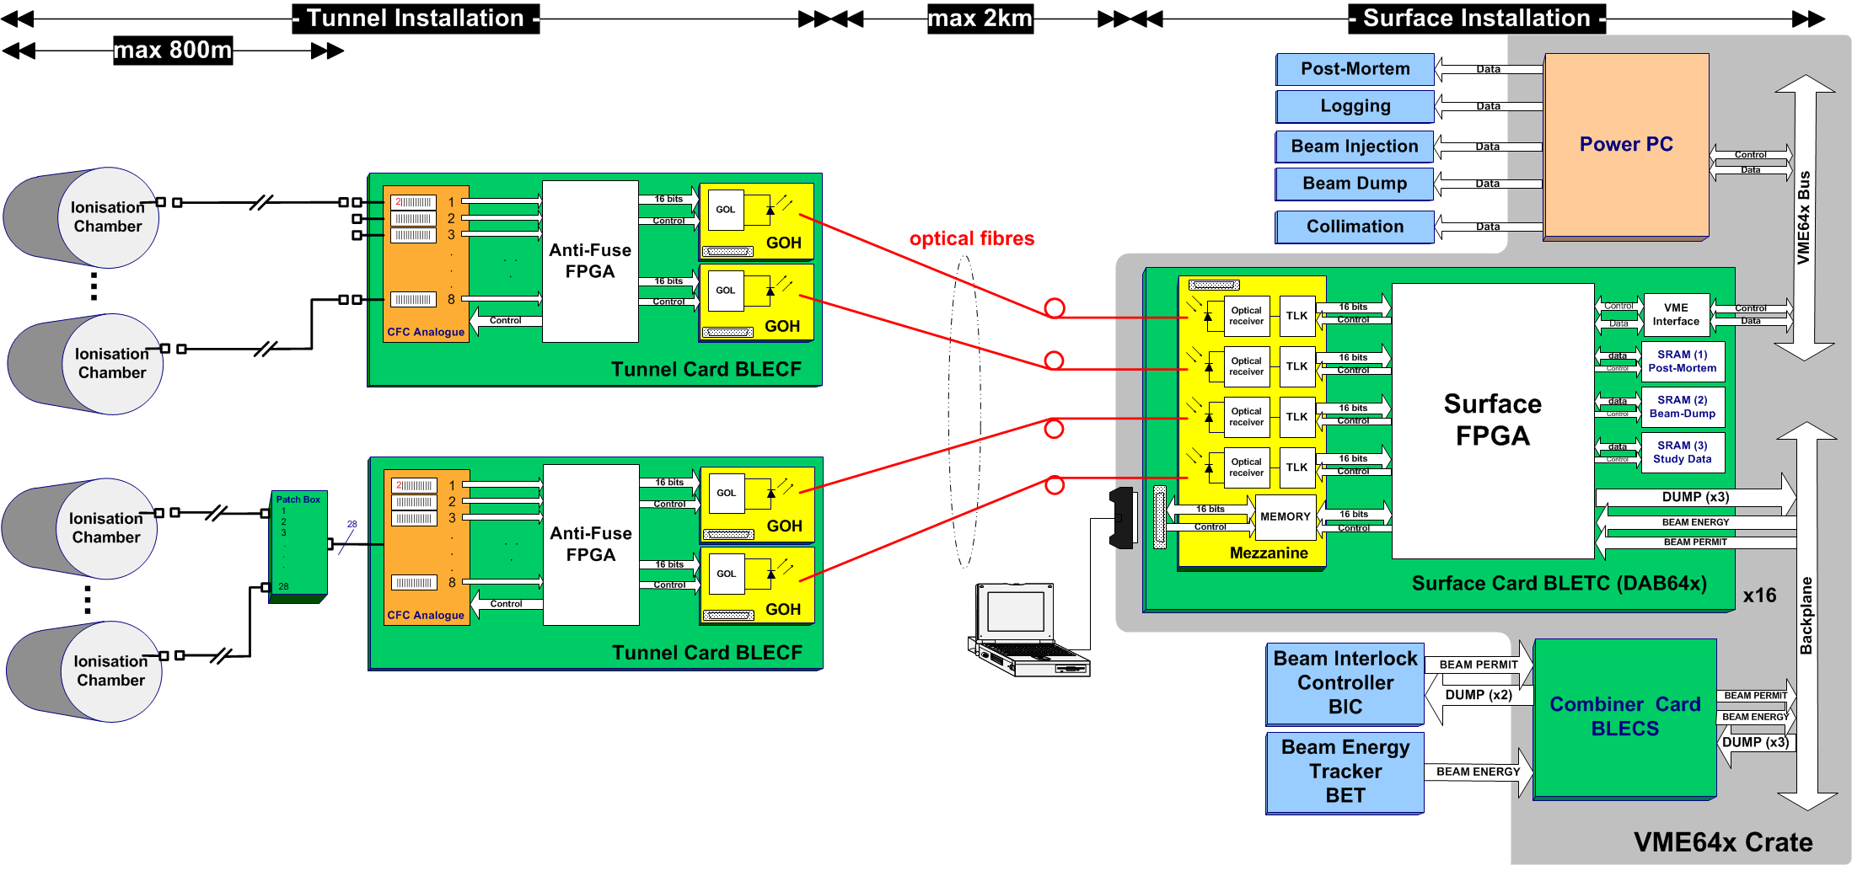
LHC BLM System Overview

