Slide 1
Update on SuperFRS Procurement and Construction
M. Winkler, H. Müller, E.J. Cho, P. Schnizer
5th CERN-GSI Committee Board Meeting

Slide 2
Outline
Status SC Dipoles (including updated schedule)
Status SC Multiplets (including updated schedule)
Status on Energy Buncher Magnets
Status on other components (examples)
  Radiation Resistant Magnets
  Focal-plane Chambers, Beam Diagnostics and Instrumentation
Status on Civil Construction
Summary
Notes:
In-Flight → energies as high as 1500 MeV/u

Slide 3
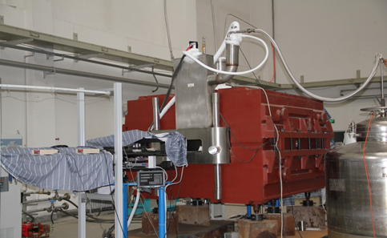
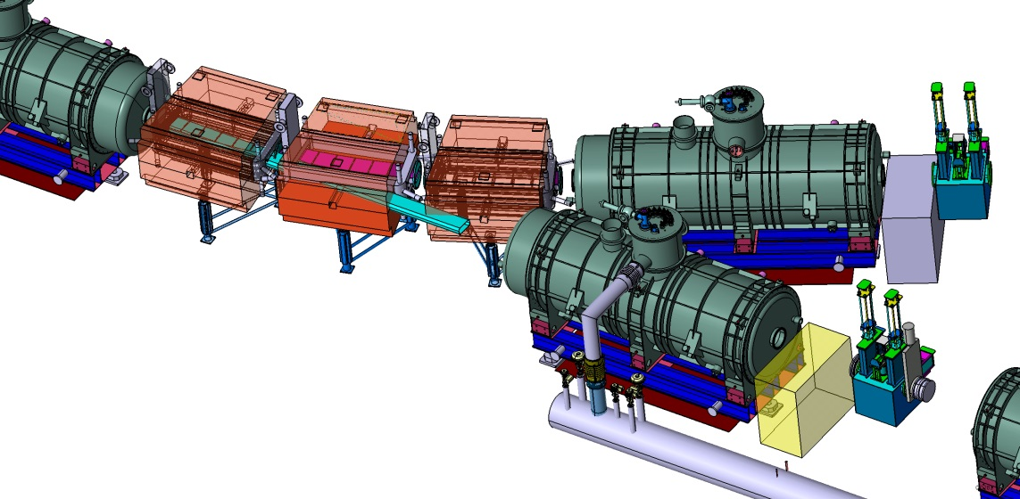
SC Dipole Magnets
Overall Status:
Collaboration agreement with CEA/Saclay signed (11/2013):
Technical Kick-off 1/2014
IMP Visit 04/2014 (CEA & GSI)
PDR July 3, 2014 (includes external advisor)
FDR Dec. 11, 2014 (excluding branching dipoles)
Tender by FAIR starts 01/2015
(option on special dipoles)
Pre-Serie unit ready for testing: Q4/2016
Series testing: Q4/2017 – Q4/2019 ( Q3-Q4/2020)
3 dipole units 11°
21 dipole units 9.75°
  3 times modified cryostat
Iron dominated
Warm iron
SC coil, (LHe ≈ 30 l)
Aperture ±190mm x ±70mm
Weight: 50 to 60 ton
Prototype built and tested (FAIR China Group)
Branching Point
cryostat & yoke
modification
small yoke
modification

Slide 4
Collaboration with CEA/Saclay
Status on SC Dipoles
Focus so far on the short dipole version
Project includes
Magnetic design
Cryogenic Design
Quench Analysis
Mechanical Design (including
cool down, magnetic forces)
Protection & Quench Detection
Instrumentation
Interfaces (cryogenics, PC, DMU, ...)
Procurement Strategy:
  several coordination meetings FAIR, GSI, CEA; next will be Dec. 12, 2015
  tender for 1 lot (i.e. complete magnet)
  branching units as option
  9 ‘pre-bidder information meetings’ be done
  qualifying phase starts Jan. 2015
  Wire is under procurement separately (qualifying phase finished)
Time schedule updated

Slide 5
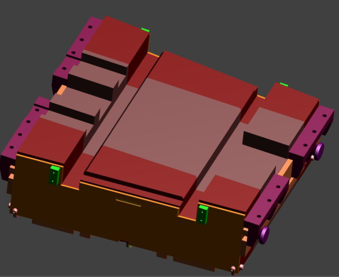
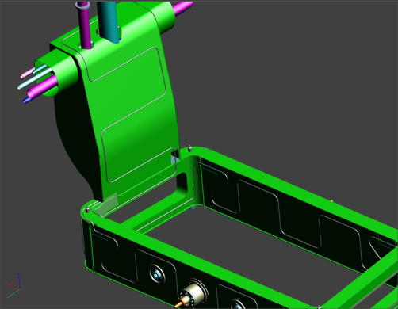
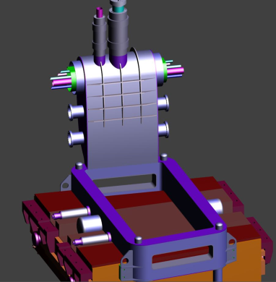
Collaboration with CEA/Saclay
Status on SC Dipoles
Starting Point: IMP CAD model
Magnetic design adopted and finalized
Modification of cryo/mechanical design
  motion of the cryostat during ramp
  no any more support collision between successive magnets
  cryo-interface on both sides
  common cryo-interface multiplets/dipoles
  pressure request 20 bar
Instrumentation, QP/QA
IMP
PDR
towards FDR

Slide 6
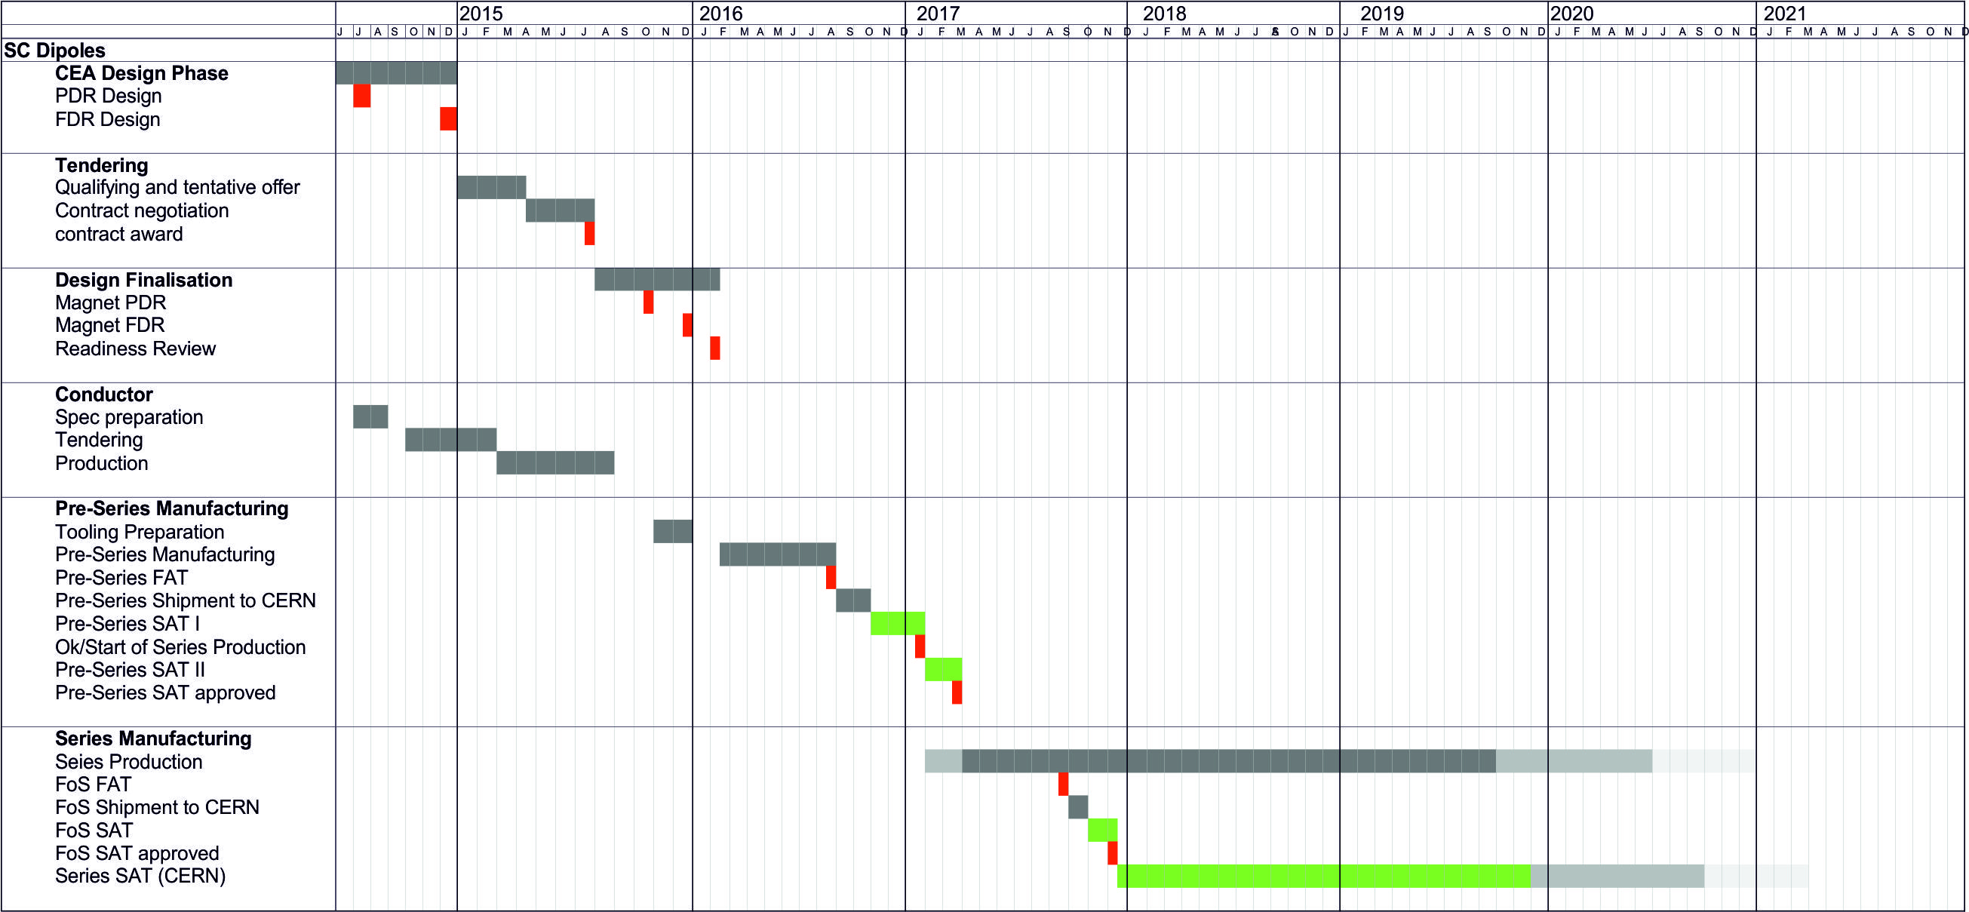
Overall Manufacturing and Testing Schedule for SC Dipole Units
next steps:
  finalize of the 11° units
  design of branching units (2015)
  interfaces (cryoline, mechanical), CERN review planed for 07/2015 (external support)
  floor loading (GSI)

Slide 7
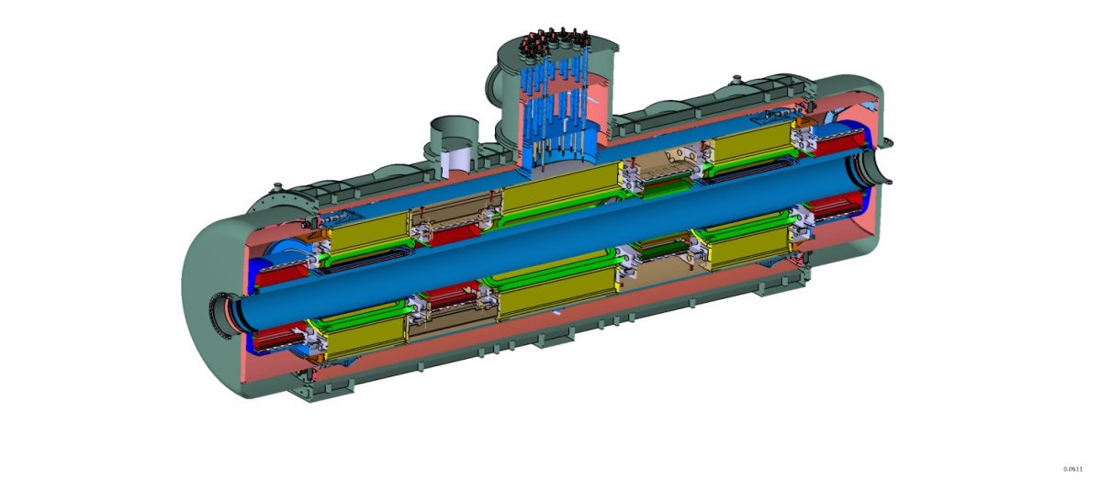
SC Multiplets
Overall Status:
Tender opened in Q3/2013
Tender was running regularly including 2nd round negotiation (Q2/2014)
Tender needed to be interrupted and re-initalized during 3rd round negotiation
  change of lot distribution required
  establishing and assessment of revised tender documents
  process supervision by a specialist solicitor
  processing along a revised and agreed time line
  new documents are sent out
  offers expected CW 3/15
  bidder interest still very high (they are calling frequently)
contract signing expected Q1/2015
FAT of first short multiplet Q2/2017
FAT of first long multiplet Q3/2017
Series testing: Q2/2018 – Q1/2021
7 m
25 long multiplets (mainly MS)
8 short multiplets (PS)
Quadrupol triplet / QS configuration
up to 3 sextupoles and 1 steerer
Octupole coils in short quadrupoles
iron dominated, cold iron (≈40 tons)
common helium bath, LHe ≈ 1.300 l
warm beam pipe (38 cm inner diameter)
per magnet 1 pair of current leads
max. current <300A for all magnets

Slide 8
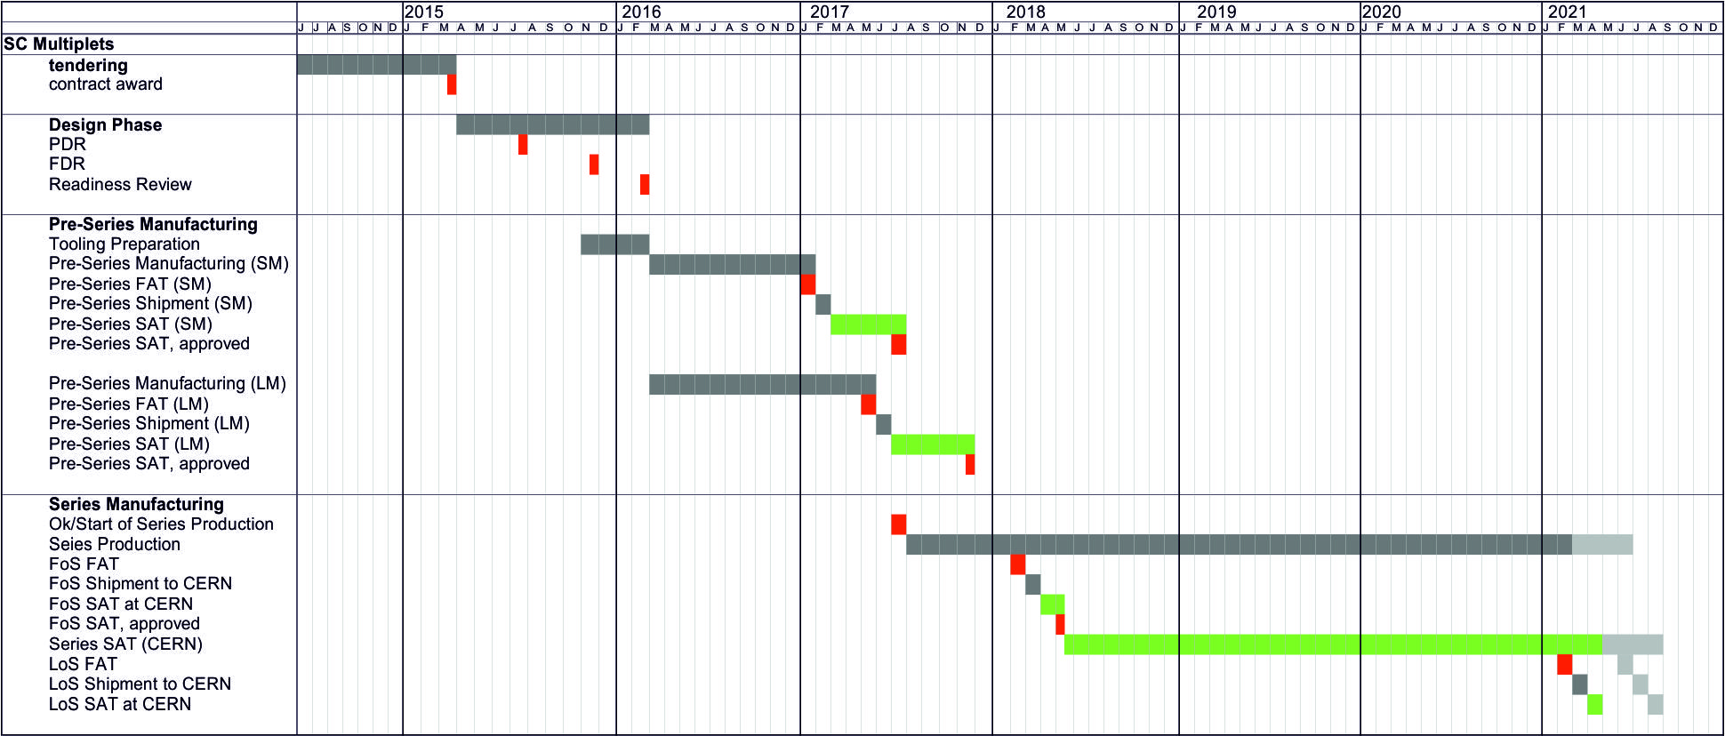
Overall Manufacturing and Testing Schedule for SC Multiplet

Slide 9
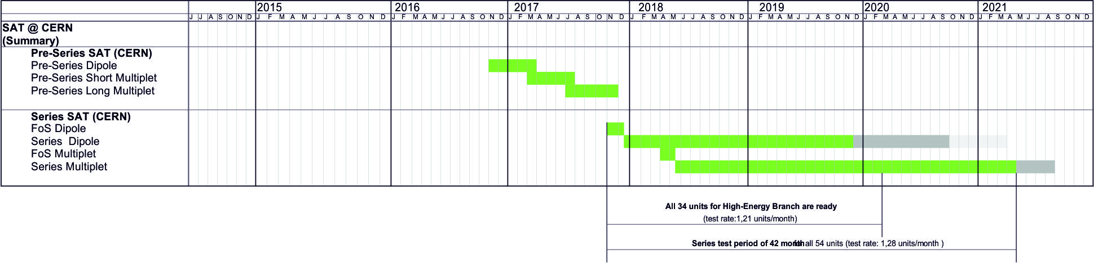
Summary Schedule for SC Magnet Testing at CERN
probably, if bidder 2 will be awarded

Slide 10
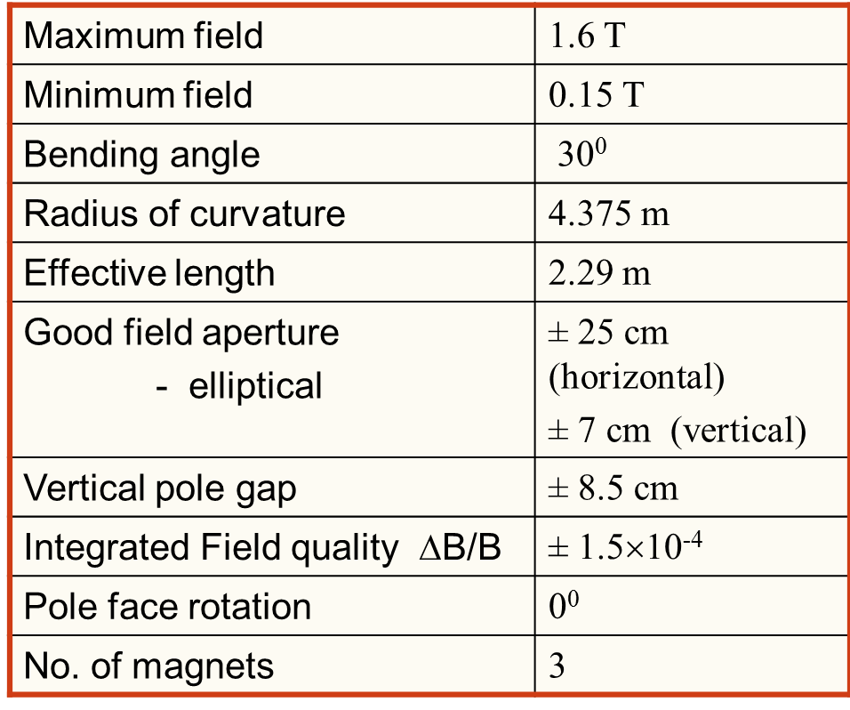
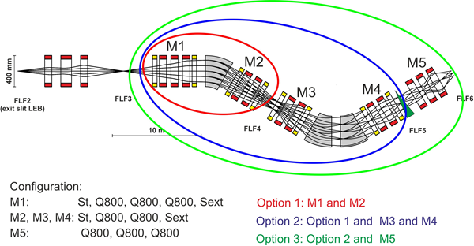
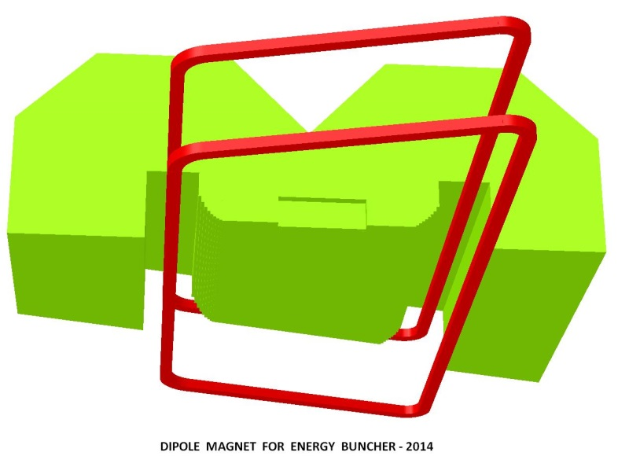
Magnets for Energy Buncher
Magnets are Indian in-kind
VECC colleagues finalizing magnetic design
3 dipole units with 30°deflection angle
    superferric, warm iron, SC coils
    challenging: required field quality
    new design: weight ≈67 ton + cryostat
    Multiplet: identical magnet parameters like used in the separator, but different configuration required
    Indian representative indicated interest to test these magnets at CERN during IKRB

Slide 11
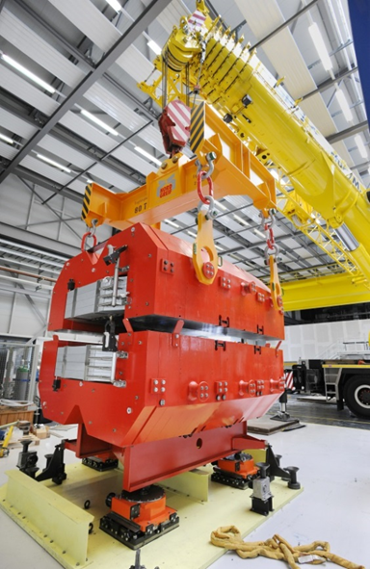
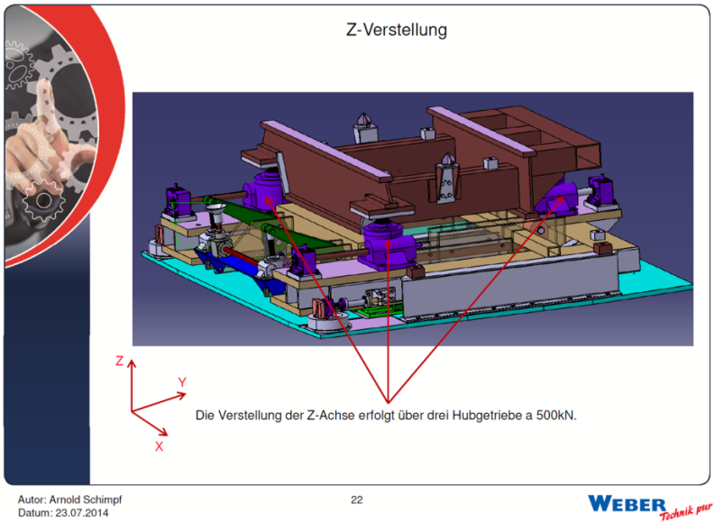
Radiation Resistant Magnets
(at the Target Area of Super-FRS)
Normal conducting magnets using MIC cable
3 dipole units, 3 quadrupoles, 2 sextupoles
Prototype dipole built (95 ton) and tested by BINP
Handling tests at GSI in 08/2014
Remote alignment under revision
Remote connectors under revision
Specification in preparation,
Tendering via FAIR Q1-Q2/2015

Slide 12
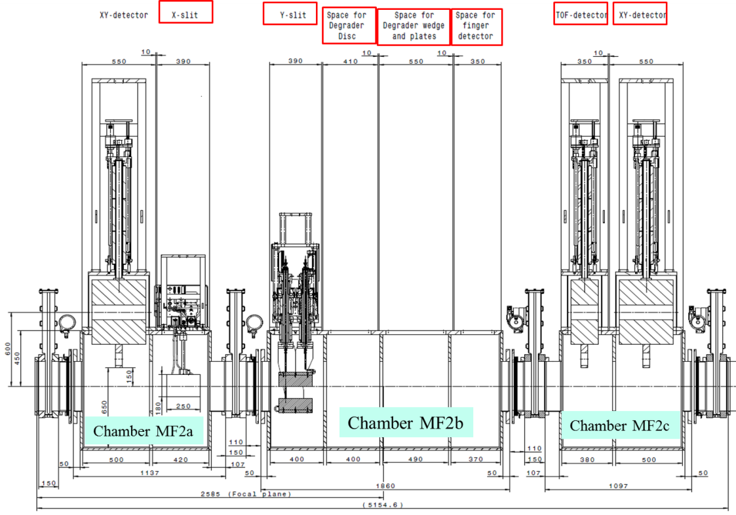
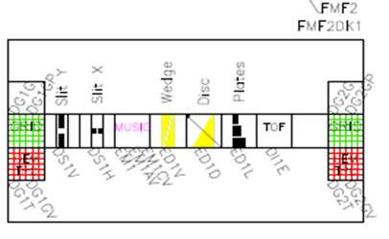
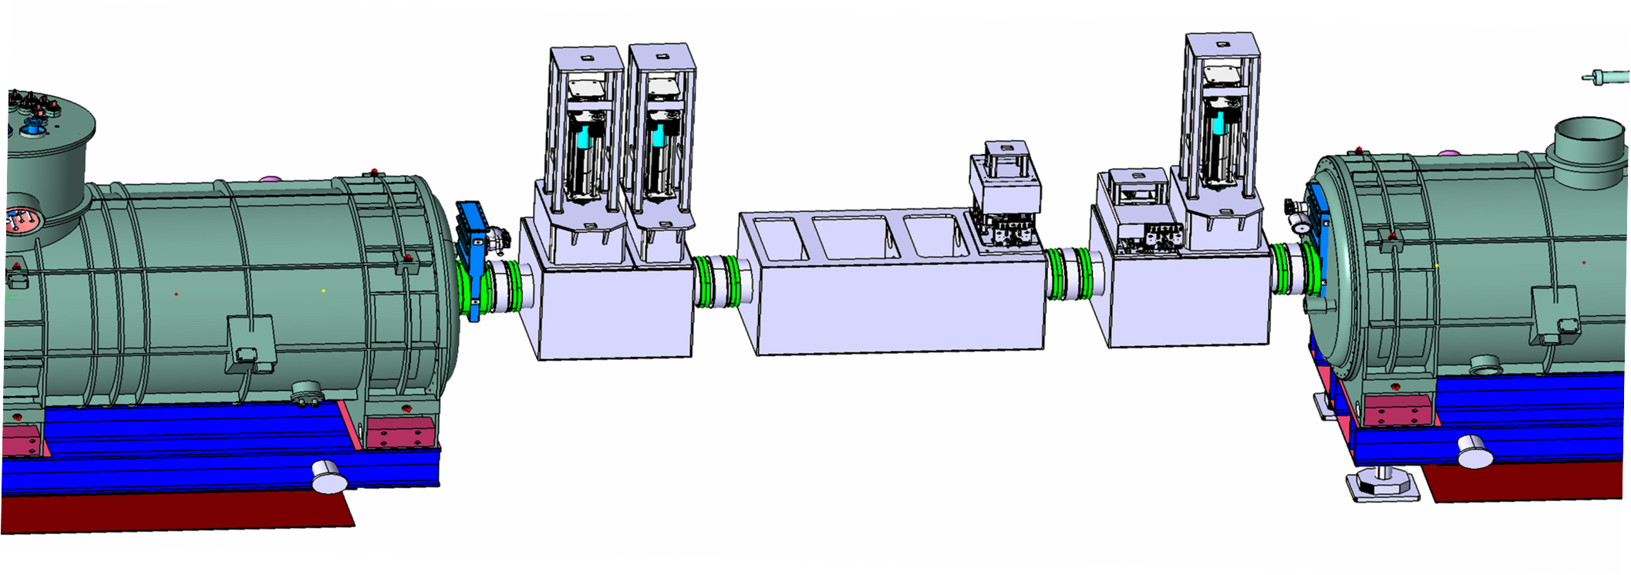

Focal Plane Installation / FMF2
Chamber design
Instrumentation scheme
3) Include it into DMU
8 inserts
1.860 mm
new NUSTAR sub-collaboration requires more flexible focal-plane arrangement
moving and precise re-alignment under investigation

Slide 13
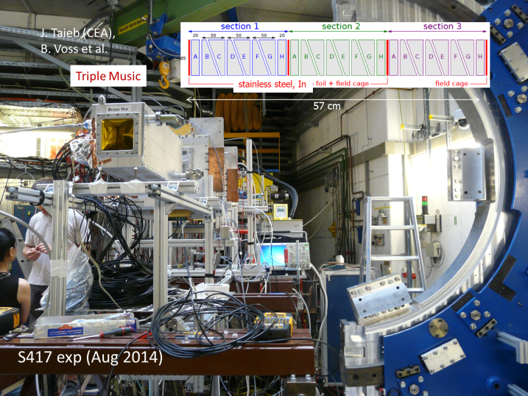
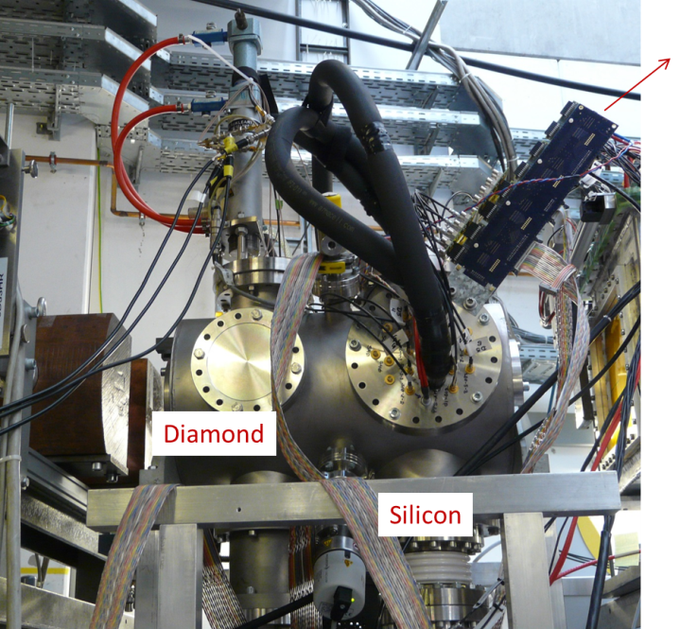
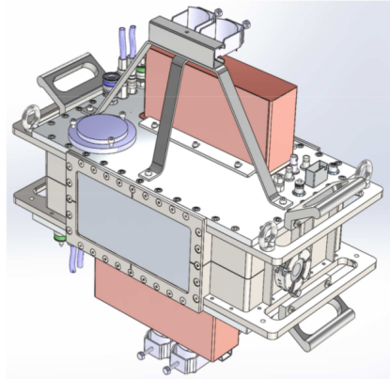
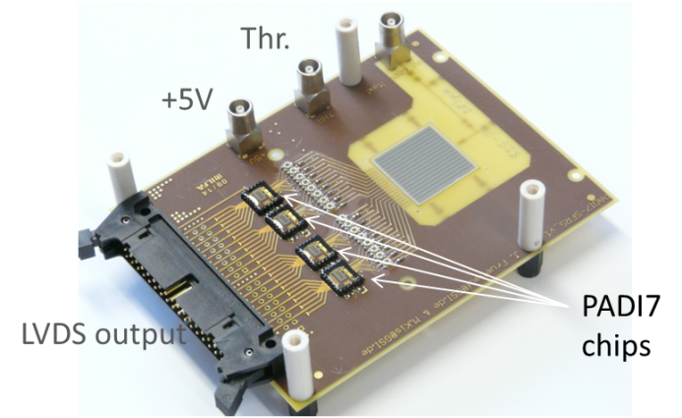
Beam Diagnostics
    Full isotope identification (x, y, x', y', DE and TOF)
    Operation modes: fast- and slow-extracted beams
    Various detector systems
      GEM-TPC (Finnish in-kind)
      SEM-GRID & ladder system (Finnish in-kind)
      Silicon detectors (Russian in-kind)
      Diamond detectors (Russian in-kind)
      MUSIC detectors (EoI Finland)
    Various test beam-times during summer 2014 at FRS
Diamond strip
detector
GEM TPC
prototype

Slide 14

Beam Instrumentation
(slits, degrader, secondary targets, ...)
x/y Slit-systems
  Overall 18 slit pairs required
  Remote handling foreseen
  Specification established
  Collaboration contract with KVI-CART
  Kick-off done 01/2014
  PDR done 08/2014,
    Pre-design existing
    thermal simulation / cooling issues considered
  Pre-Series slit-system expected Q3/2015
x-slit system:
block size: 200mm x 200 mm
y-slit system:
Block size: 400mm x 90 mm
Material: Densimet
Media pannel,
robot operated

Slide 15
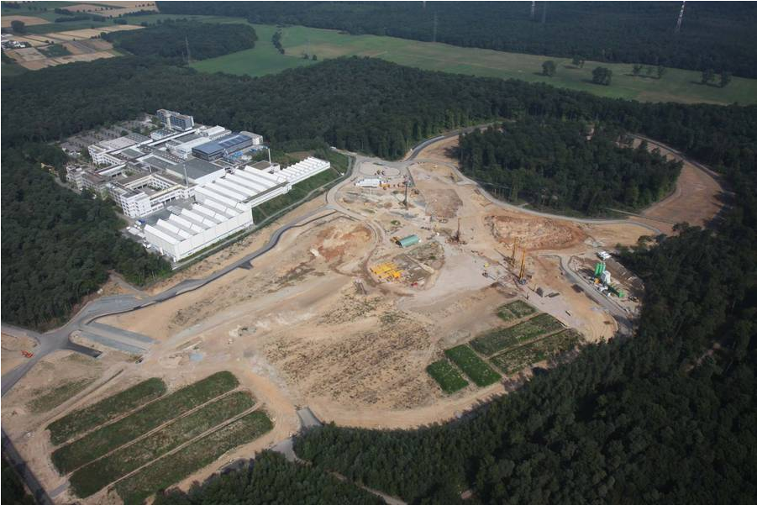
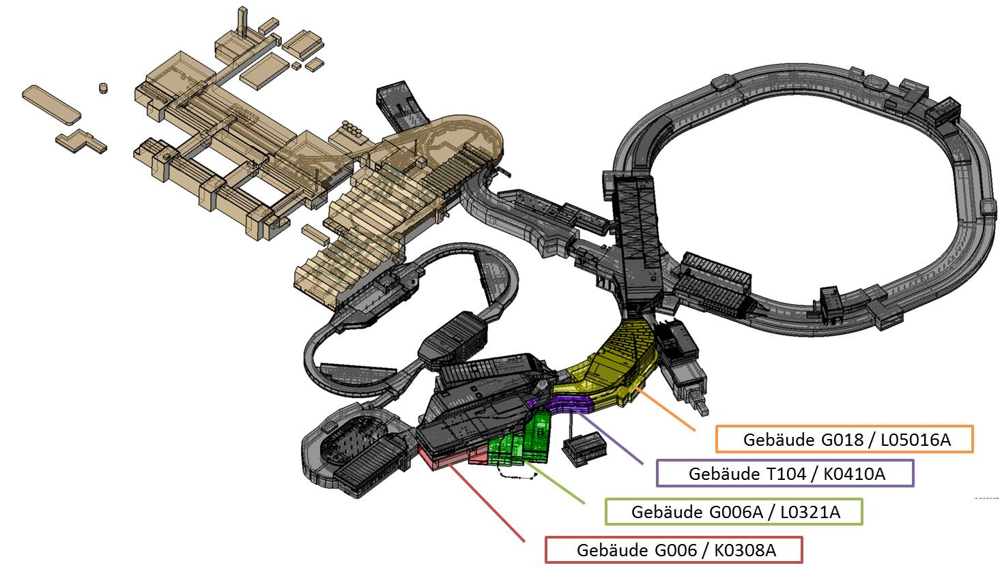
FAIR Civil Construction
E. Mahner, 2nd Joint Meeting of the
FAIR & GSI Scientic Council, Oct. 23, 2014
Super-FRS Area
Super-FRS and NUSTAR Experiments
Q2/2021:
Super-FRS expected
‚ready for beam‘
Q2/2018:
Super-FRS Buildings & Tunnel
expected ‚ready for installation‘

Slide 16
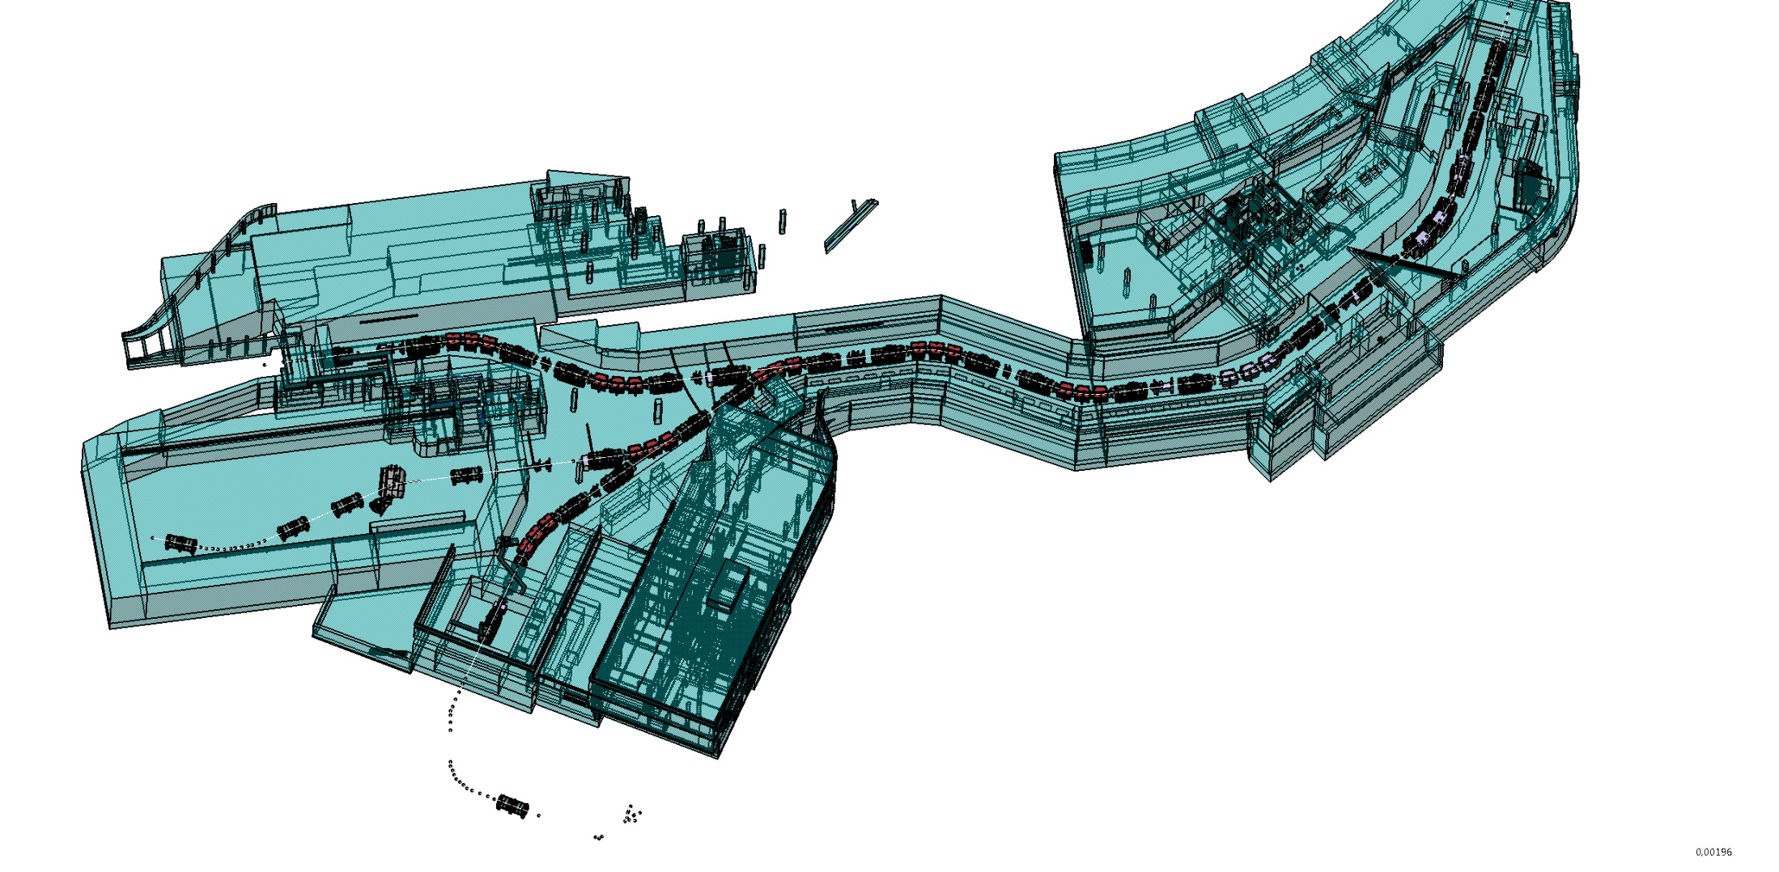
Super-FRS Buildings (MSV)
Basic evaluation completed
Preliminary planning completed
Approval planning completed
Execution planning under approval
Running: route planning (crane cable, pipes, cryo)
Formwork planning & Tendering
Establishing cable data bank → tender of cables
Build. 006a, Service building
3 floors (~2000 m²)
Technique (PS, controls, ... )
Experimental preparation
Control room, electronics
Gas supply, gas mixing station
Main tunnel access
FLF2
Experimental Area
Build. 018, Target building
5 floors
Target area, shielding
Technique (PS, controls, ... )
Hot Cell complex
Focussing system
Tunnel 103
(Separator tunnel, supply tunnel)
To CR
FHF1
(End Focus HEB)
Build. 006
(High-Energy cave)
On top: Build. 17.2
(FAIR service building)
100 m

Slide 17
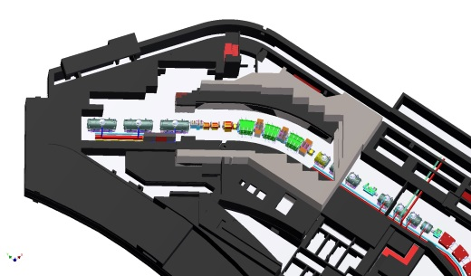
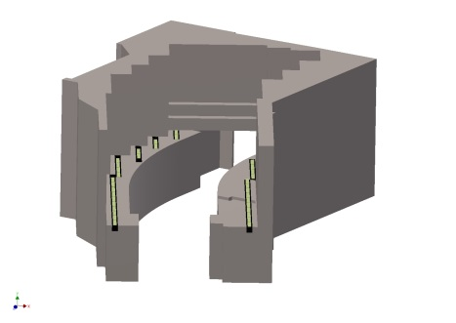
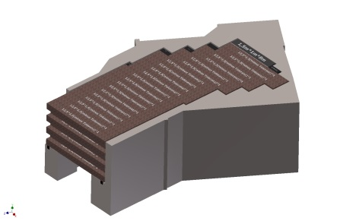
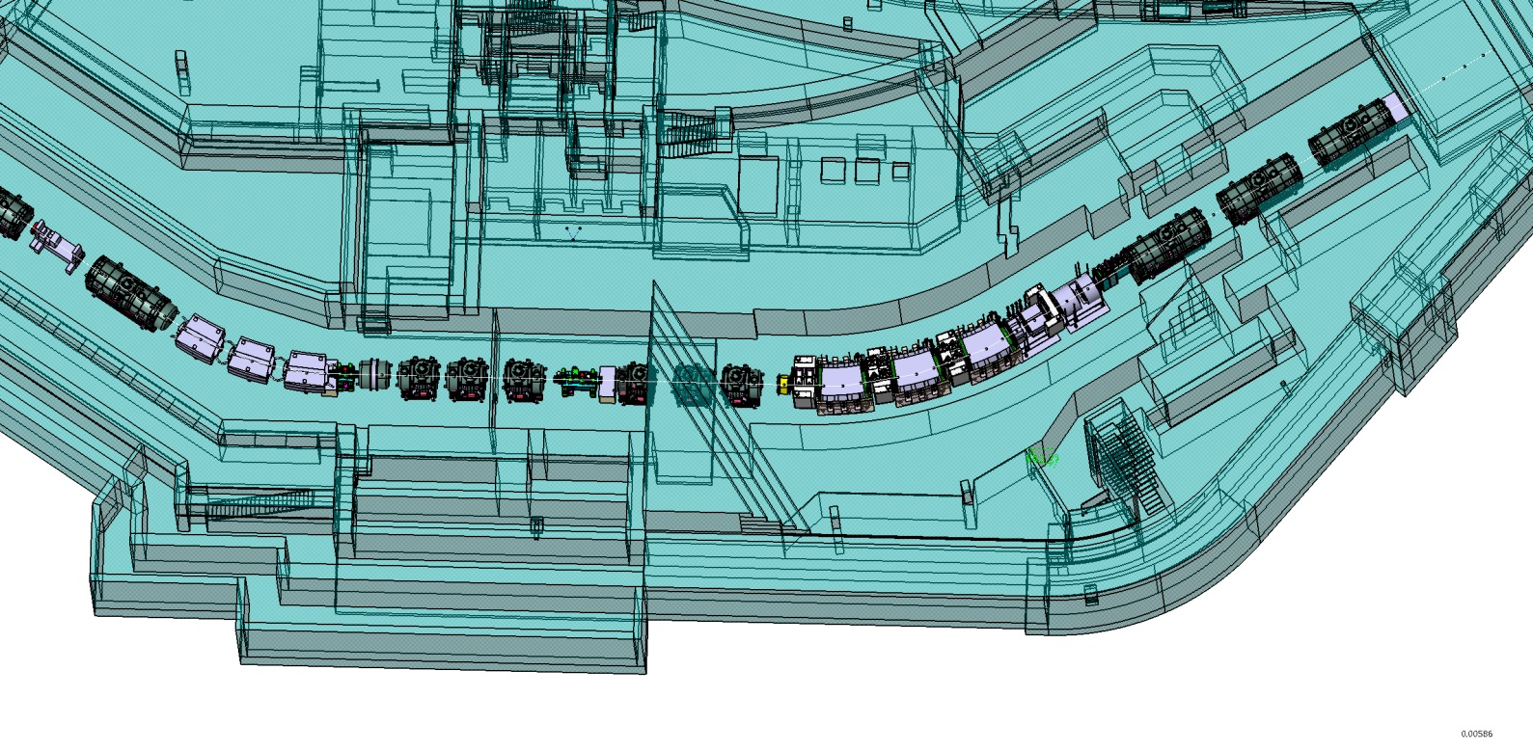
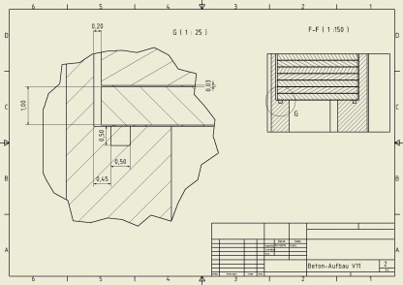
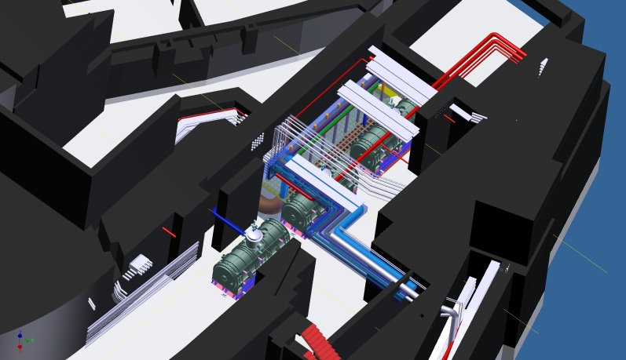
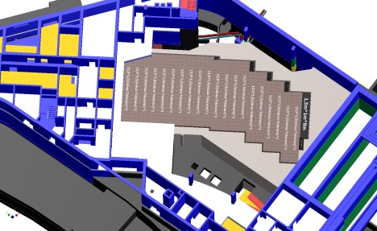
Target Building (Build. 018)
Shielding planning, including details
  input for radio-protection approval
Decission: FAIR will get one common cryo-plant
new connection to cryo-plant – DB 2
cryo connection DB2 – TFS
Media planning TFS and target maintenance area
Hot Cell planning
FAIR Cryo-Plant
DB 2
Target Focussing System
SIS 18 / SIS100

Slide 18
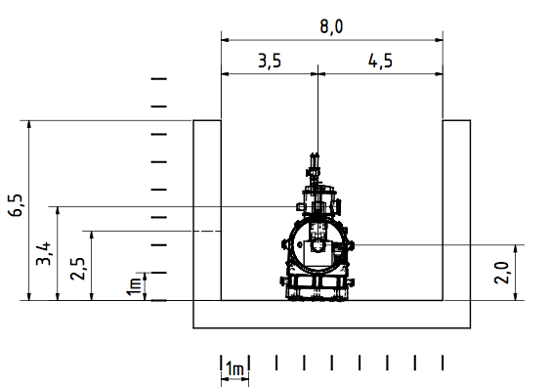
Super-FRS Tunnel Cross Section
Tunnel height: 6.5 to 7.0 m
(partly slewing cranes
@ focal plane stations)
Von Christina Will
Service Tunnel
W: 2.5 m, H: 4 (7) m
Cable feed through
Media side
beam
beam axis height
Access side:
~3 m
Cryo-Lines
Notes:
18

Slide 19
Summary
FDR on dipole design next week, start of tender in Jan. 2015, pre-series unit expected for CERN testing in Q4/2016
Tender of SC Multiplets was interrupted; now running again, contract award expected for Q1/2015, (1st) pre-series unit expected for Q2/2017
Series test of dipole/multiplet units expected between Q4/2017 – Q1/2021
Development of various other items (EB magnets, NC magnets, beam diagnostics and instrumentation) in progress
Civil Construction
  FAIR combined schedule (buildings, accelerators, experiments) proposed
  Super-FRS buildings ‘ready for installation’ expected in Q2/2018
  in the moment concentrating on target building (shielding issues as well as media- and cryo-supply)

