Slide 1

The Organization of Large Scientific Collaborations
RIGI Design Society Seminar at CERN
March 26, 2015 Markus Nordberg

Slide 2
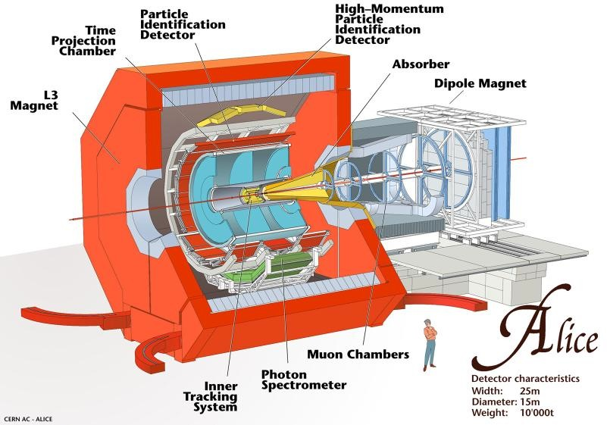
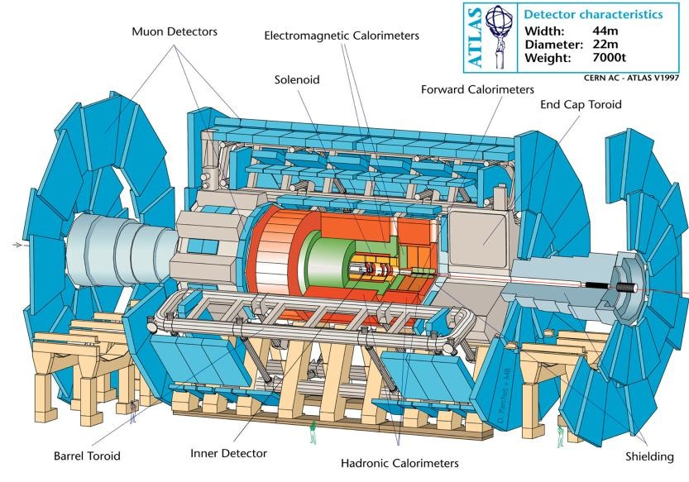
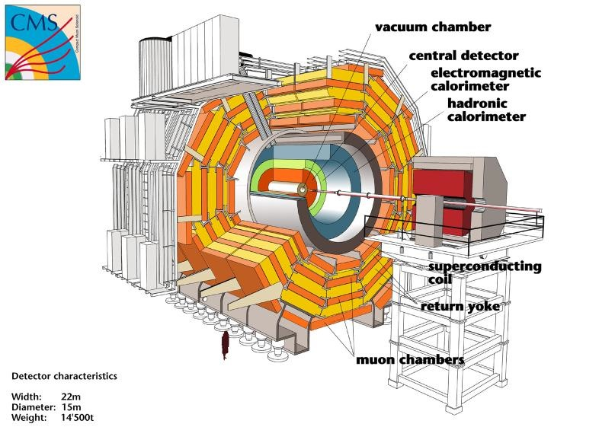
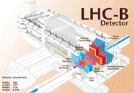
LHC Experiments

Slide 3


Slide 4
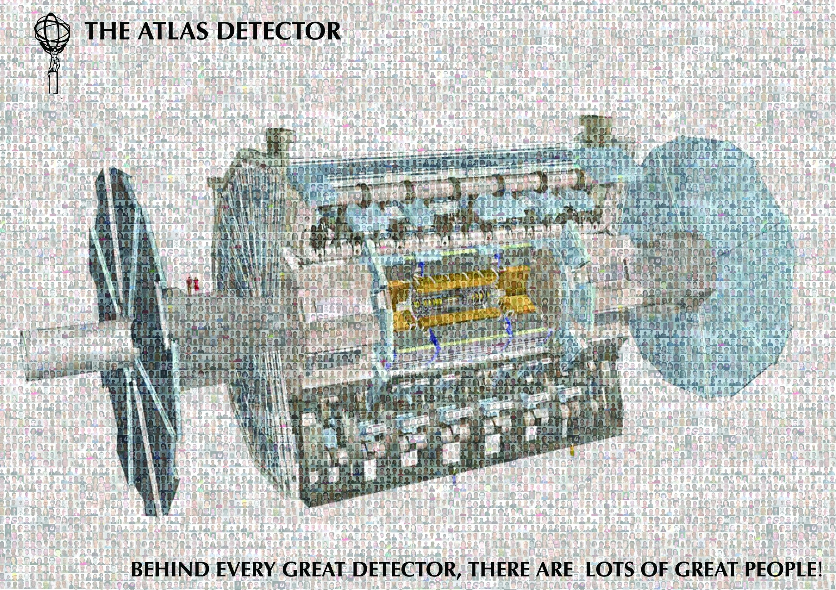

Slide 5
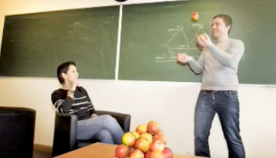
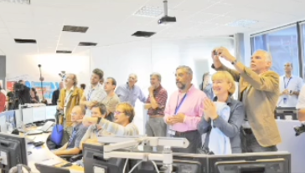
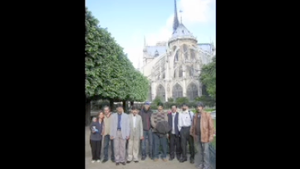
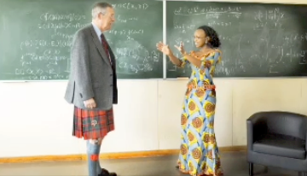
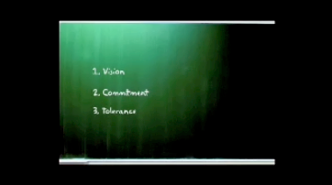
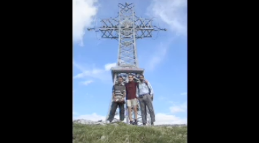
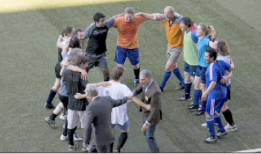
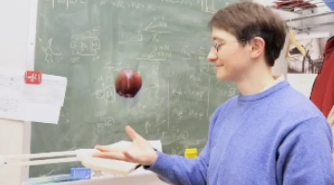
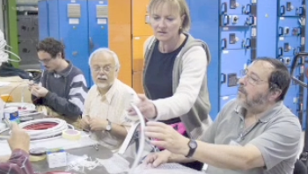
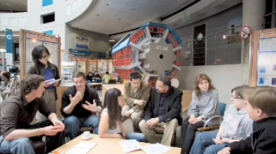
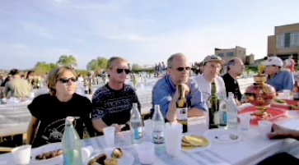
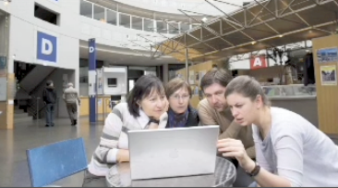


Slide 6


Slide 7


Slide 8
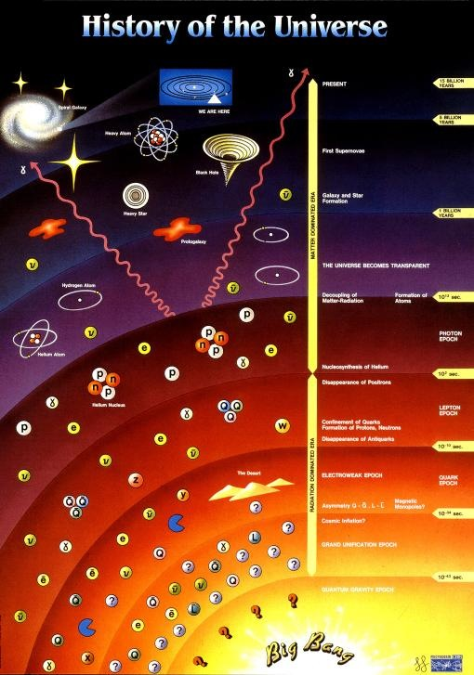




Slide 9
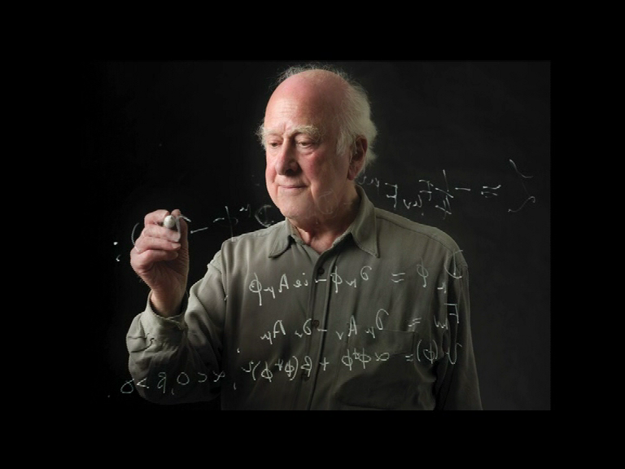

Slide 10


Slide 11
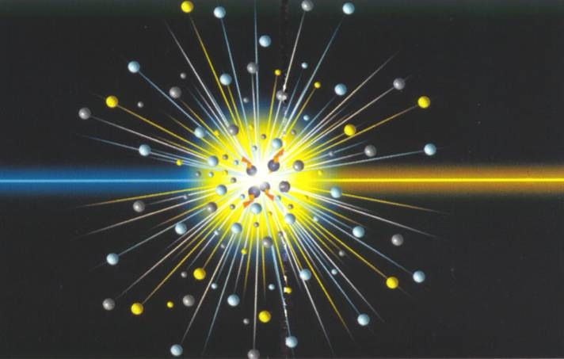

Slide 12
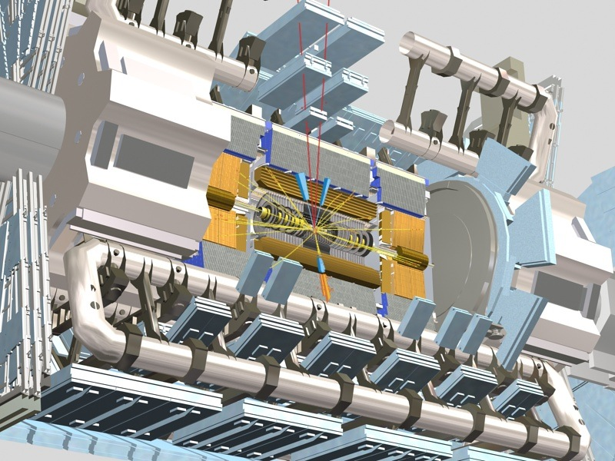
ATLAS
03/20/2009
M.Nessi

Slide 13
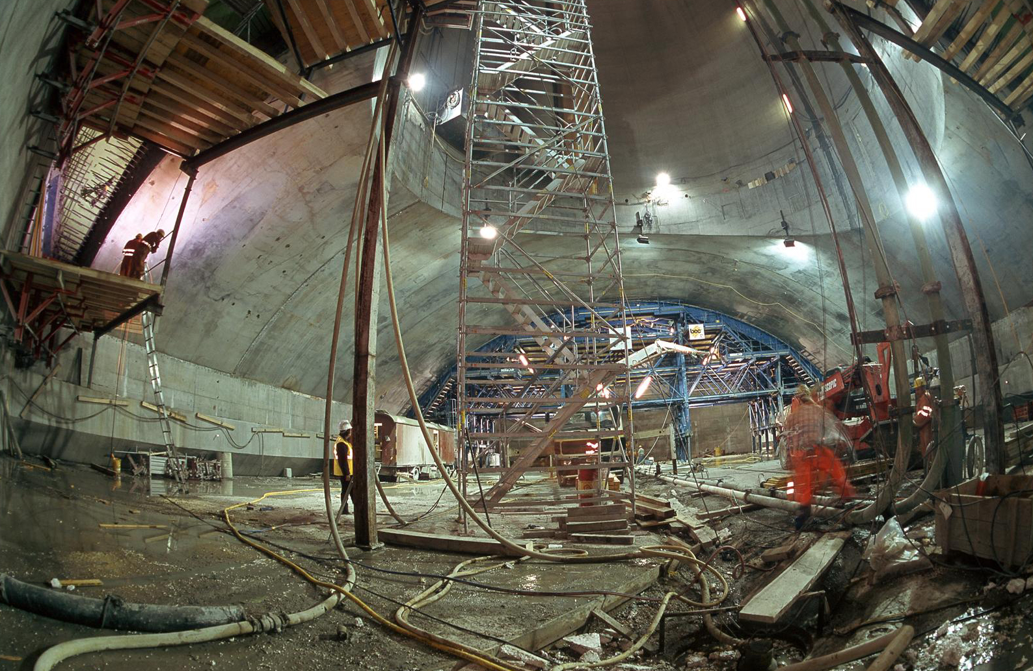
03/20/2009

Slide 14
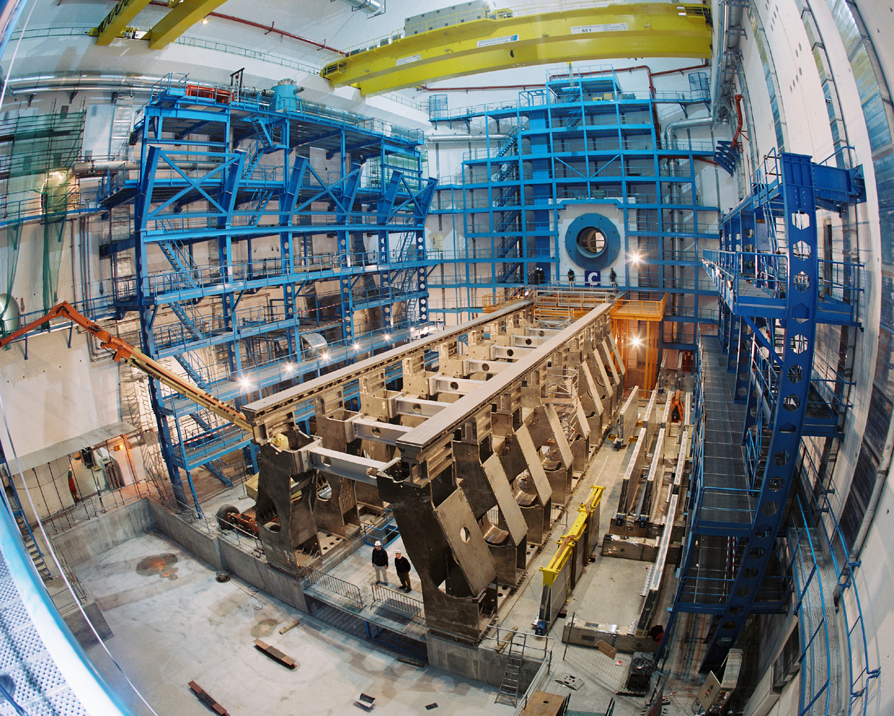
03/20/2009

Slide 15
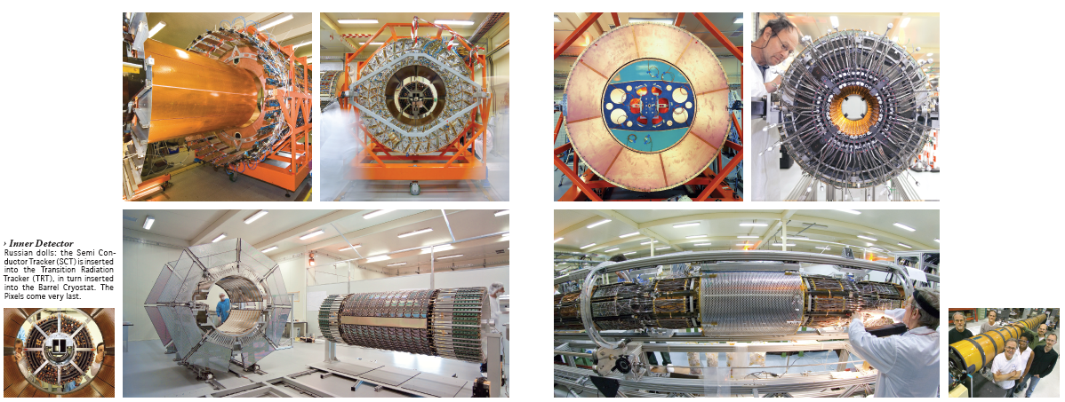
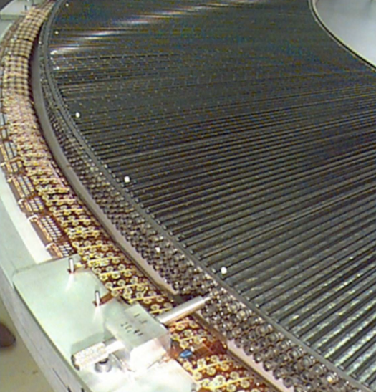
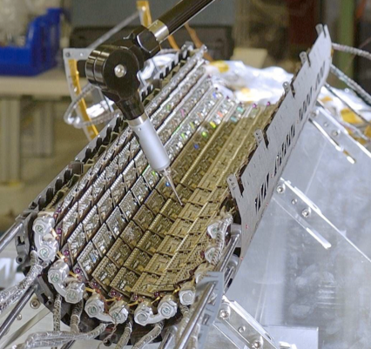
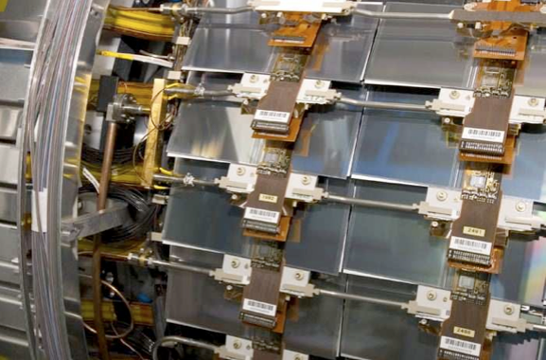

Slide 16
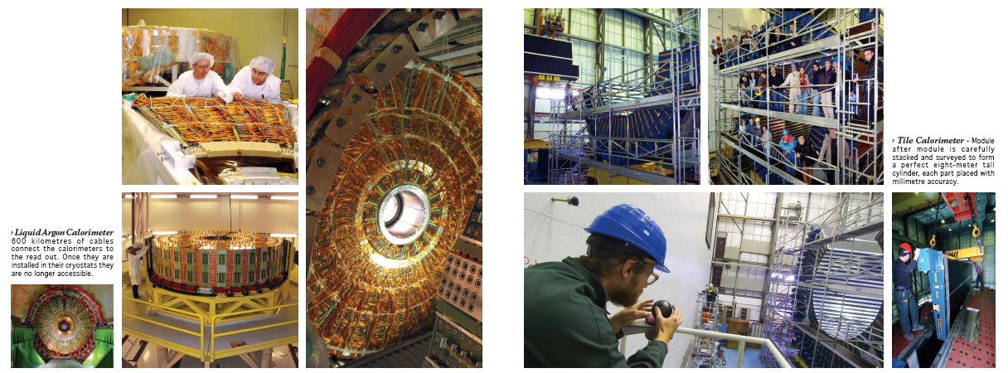
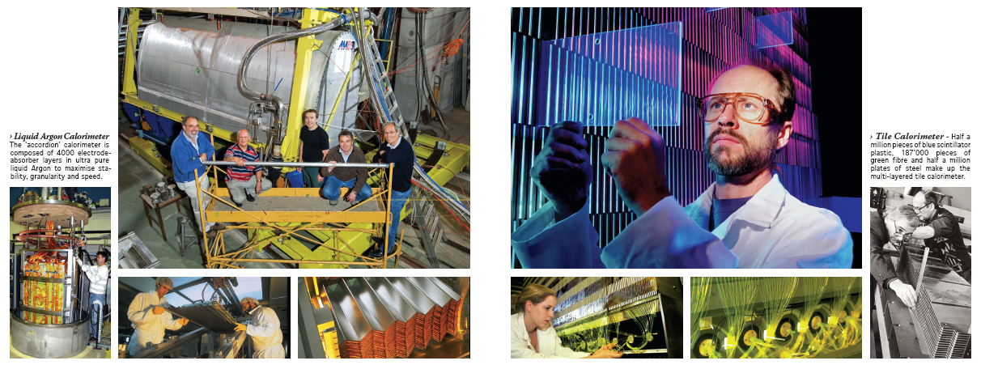
Marzio Nessi

Slide 17
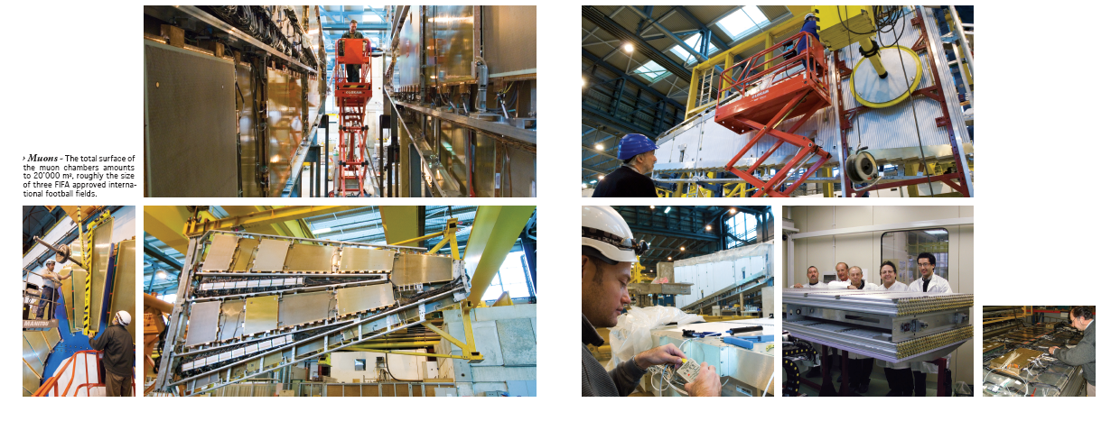
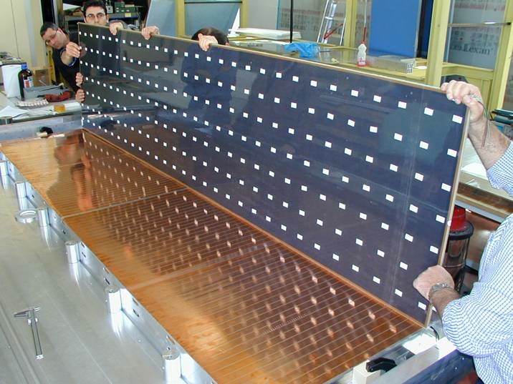
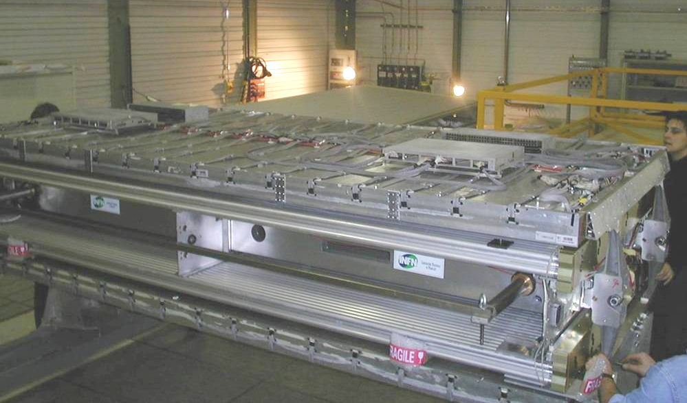
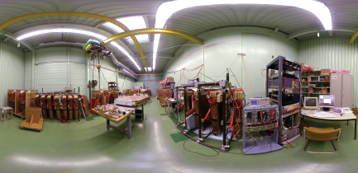

Slide 18
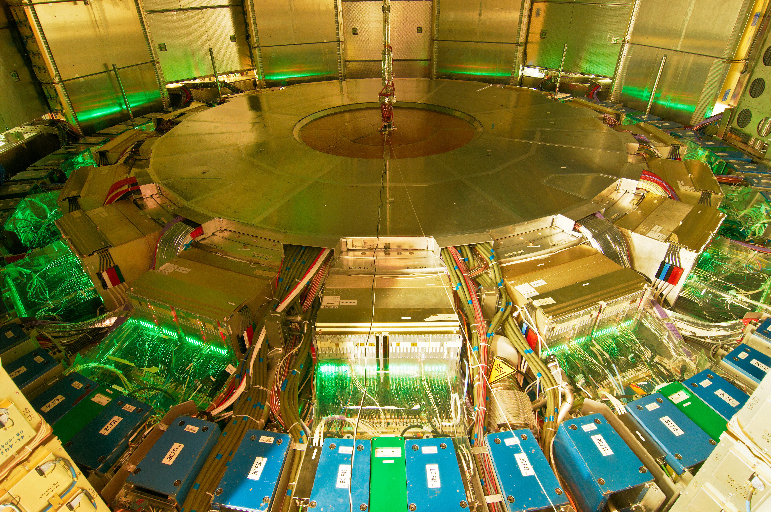
April 2008
03/20/2009

Slide 19
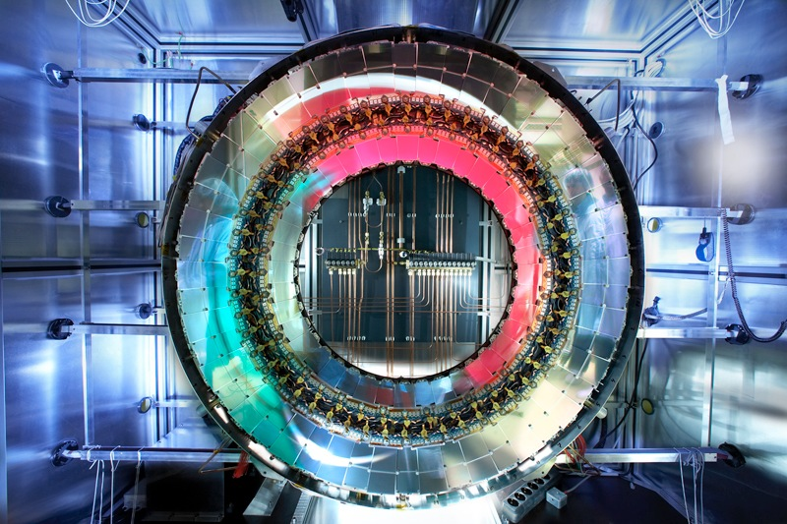

Slide 20
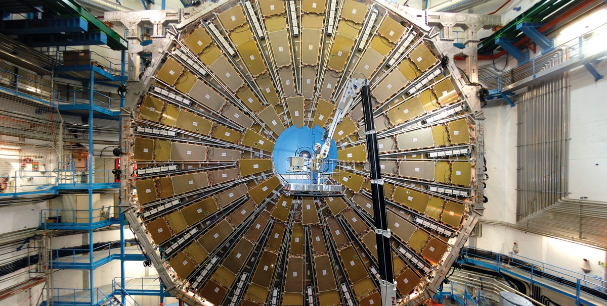
03/20/2009

Slide 21
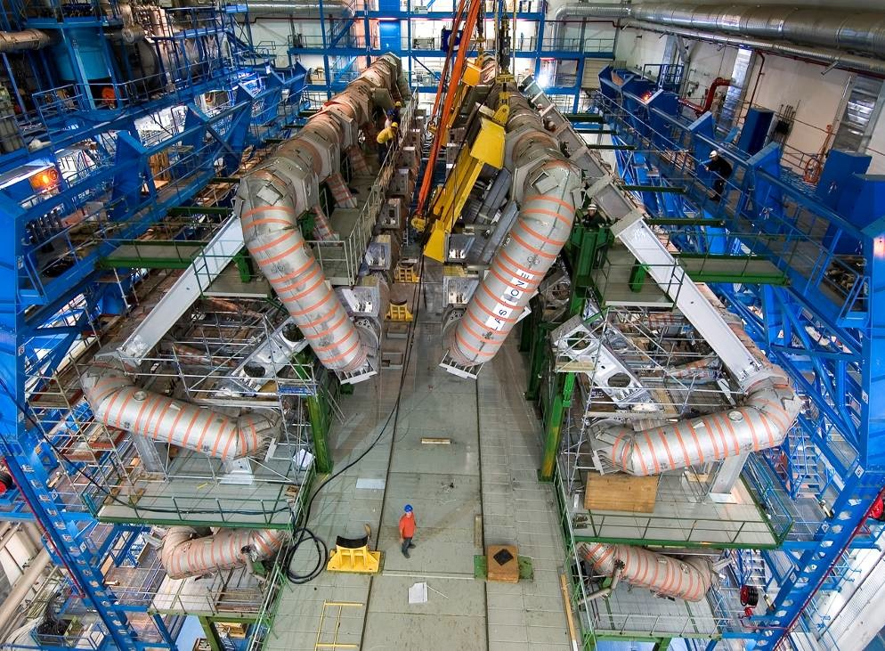
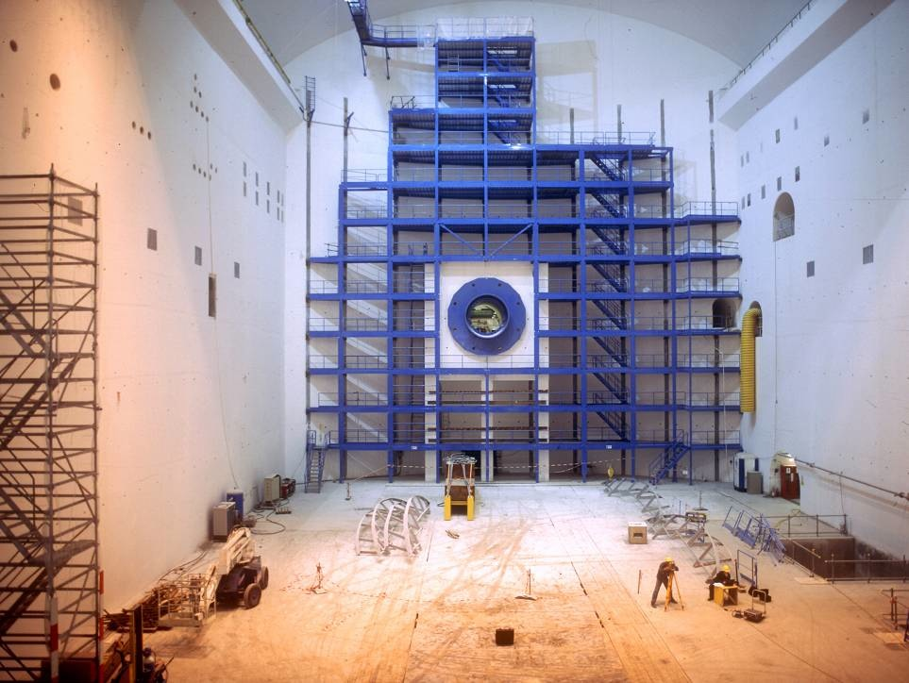
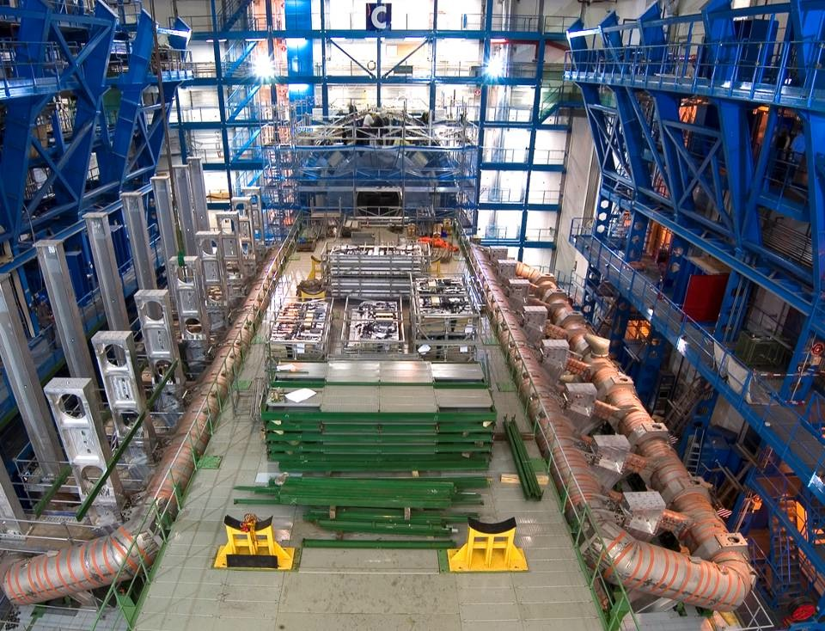
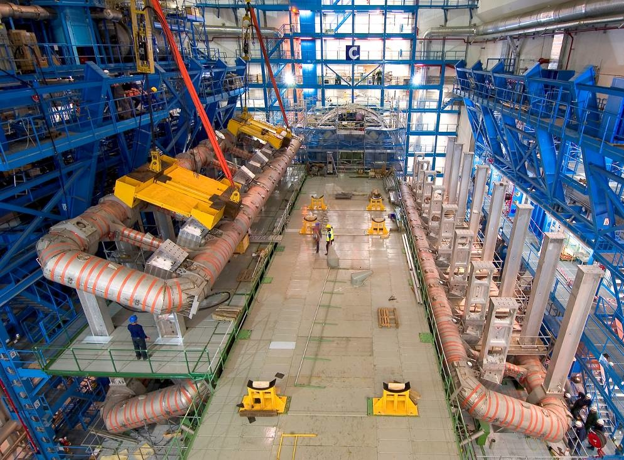
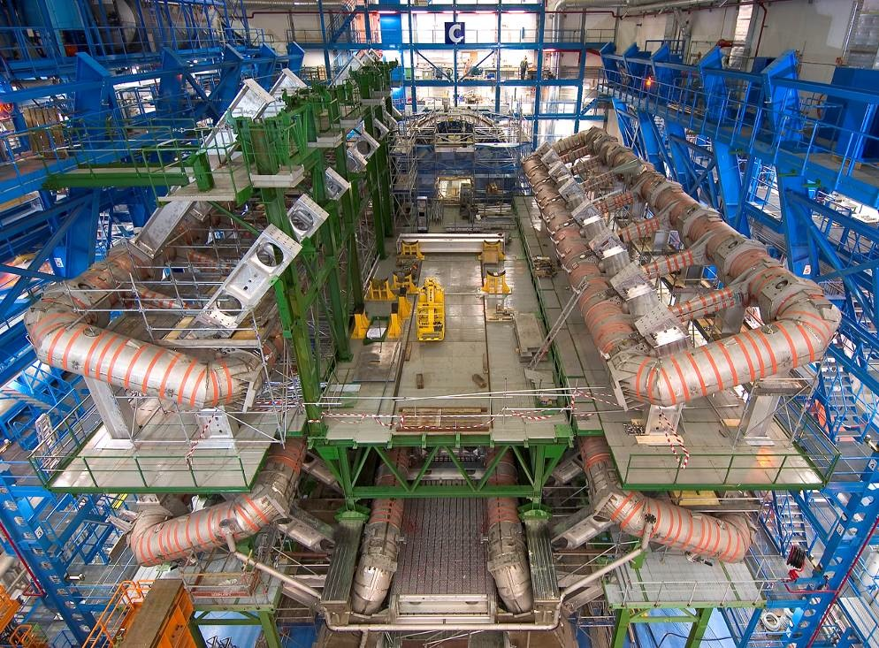
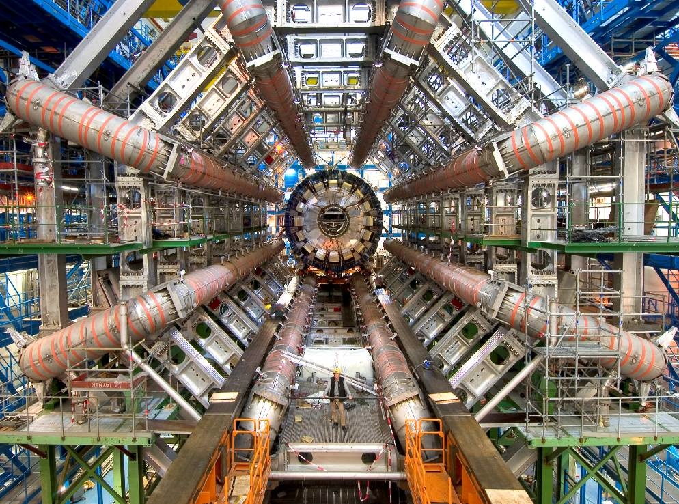
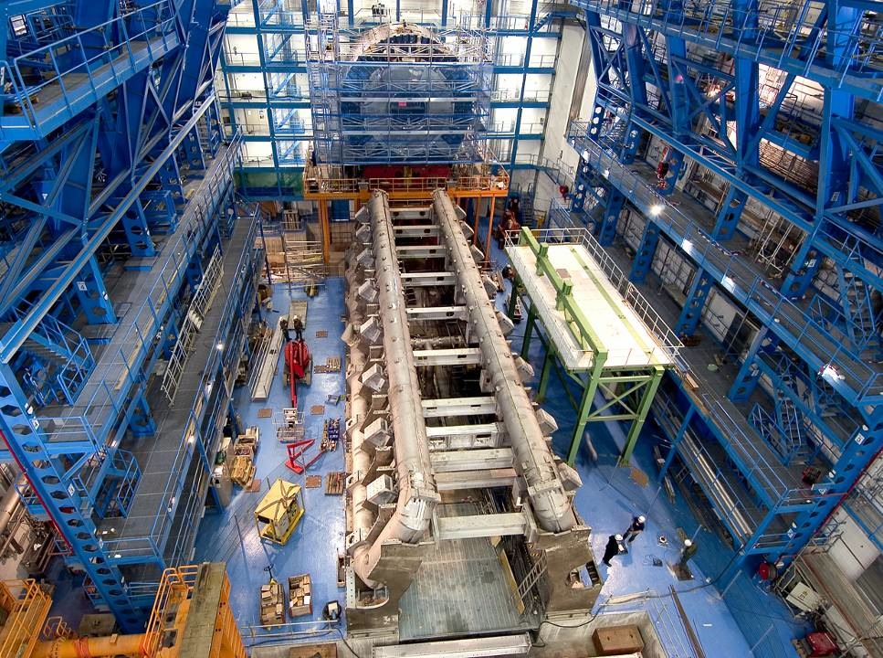
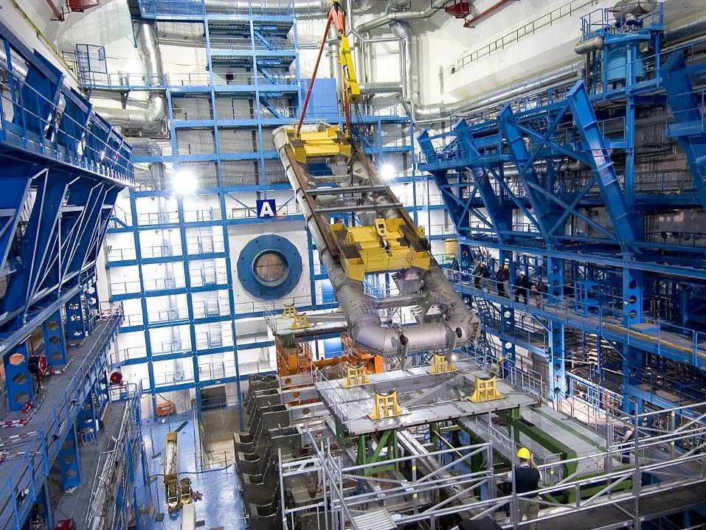
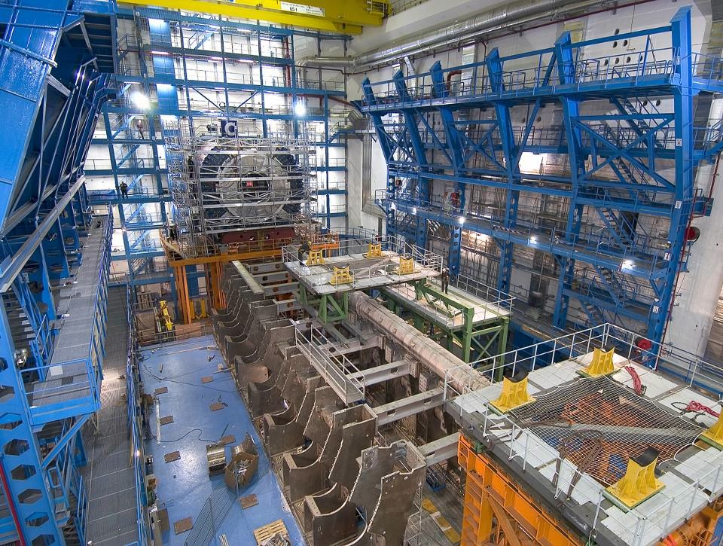
ATLAS Cavern

Slide 22
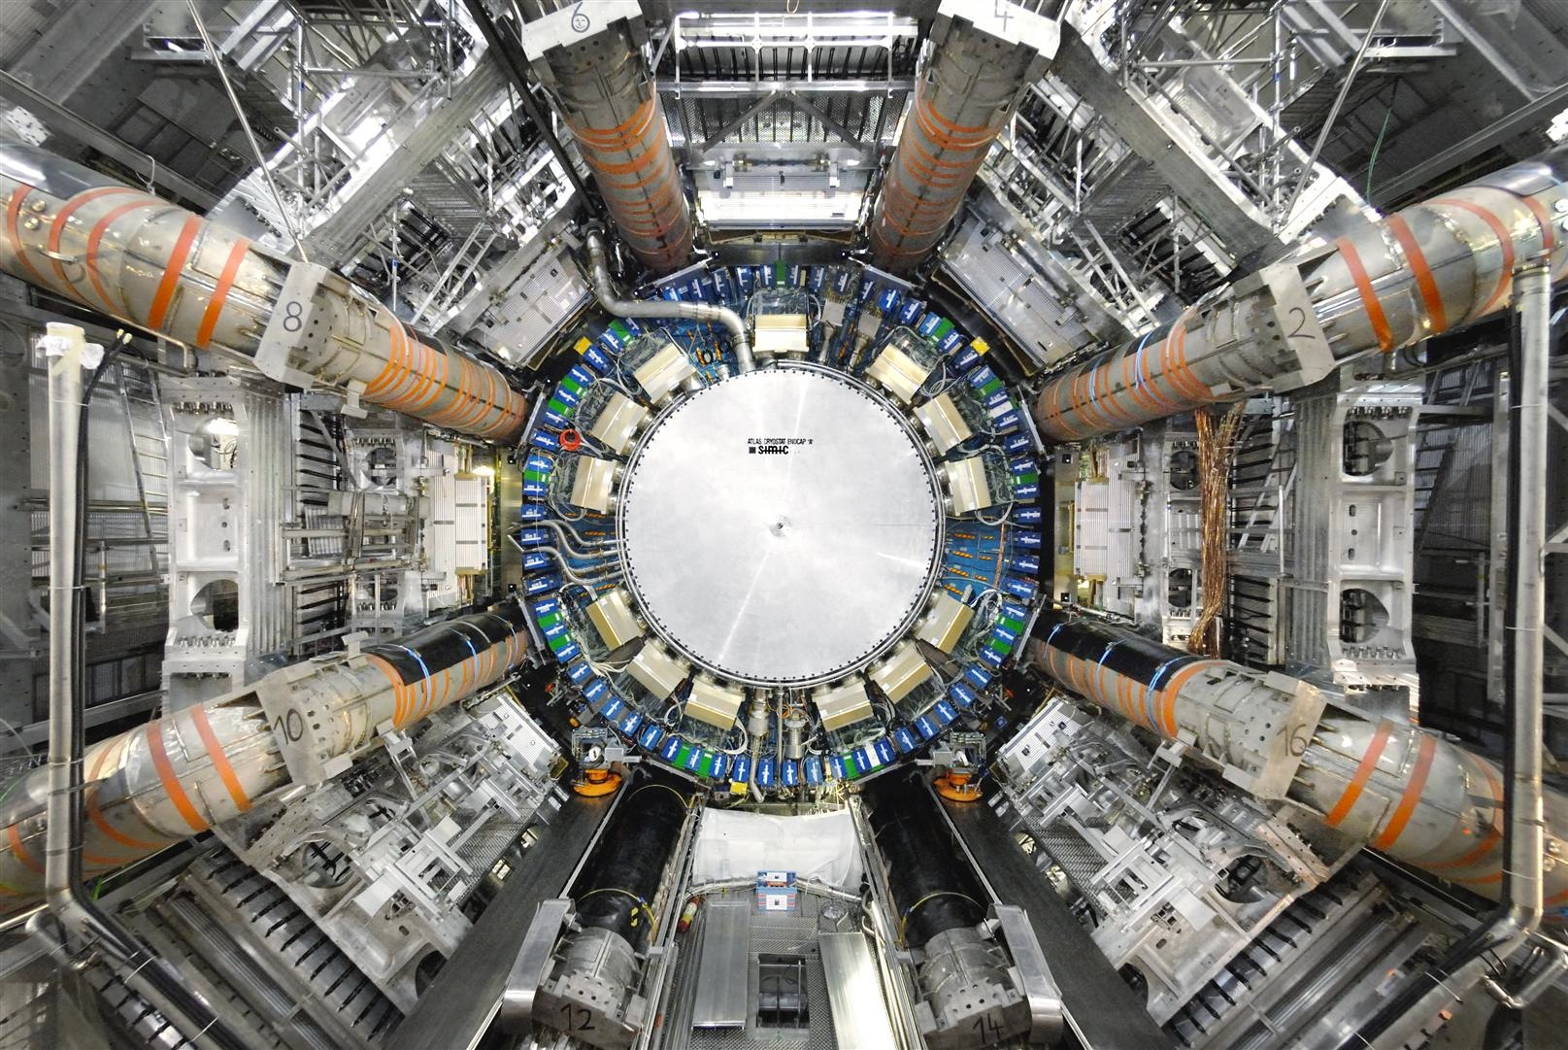

Slide 23
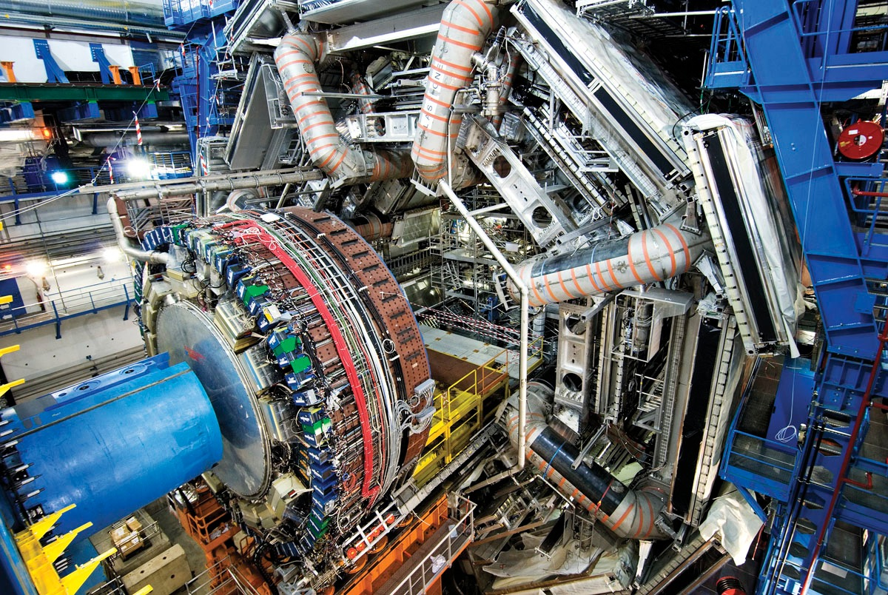

Slide 24
Albany, Alberta, NIKHEF Amsterdam, Ankara, LAPP Annecy, Argonne NL, Arizona, UT Arlington, Athens, NTU Athens, Baku, IFAE Barcelona, Belgrade, Bergen, Berkeley LBL and UC, HU Berlin, Bern, Birmingham, UAN Bogota, Bologna, Bonn, Boston, Brandeis, Bratislava/SAS Kosice, Brookhaven NL, Buenos Aires, Bucharest, Cambridge, Carleton, CERN, Chinese Cluster, Chicago, Chile, Clermont-Ferrand, Columbia, NBI Copenhagen, Cosenza, AGH UST Cracow, IFJ PAN Cracow, UT Dallas, DESY, Dortmund, TU Dresden, JINR Dubna, Duke, Frascati, Freiburg, Geneva, Genoa, Giessen, Glasgow, Göttingen, LPSC Grenoble, Technion Haifa, Hampton, Harvard, Heidelberg, Hiroshima, Hiroshima IT, Indiana, Innsbruck, Iowa SU, Irvine UC, Istanbul Bogazici, KEK, Kobe, Kyoto, Kyoto UE, Lancaster, UN La Plata, Lecce, Lisbon LIP, Liverpool, Ljubljana, QMW London, RHBNC London, UC London, Lund, UA Madrid, Mainz, Manchester, CPPM Marseille, Massachusetts, MIT, Melbourne, Michigan, Michigan SU, Milano, Minsk NAS, Minsk NCPHEP, Montreal, McGill Montreal, RUPHE Morocco, FIAN Moscow, ITEP Moscow, MEPhI Moscow, MSU Moscow, Munich LMU, MPI Munich, Nagasaki IAS, Nagoya, Naples, New Mexico, New York, Nijmegen, BINP Novosibirsk, Ohio SU, Okayama, Oklahoma, Oklahoma SU, Olomouc, Oregon, LAL Orsay, Osaka, Oslo, Oxford, Paris VI and VII, Pavia, Pennsylvania, Pisa, Pittsburgh, CAS Prague, CU Prague, TU Prague, IHEP Protvino, Regina, Ritsumeikan, UFRJ Rio de Janeiro, Rome I, Rome II, Rome III, Rutherford Appleton Laboratory, DAPNIA Saclay, Santa Cruz UC, Sheffield, Shinshu, Siegen, Simon Fraser Burnaby, SLAC, Southern Methodist Dallas, NPI Petersburg, Stockholm, KTH Stockholm, Stony Brook, Sydney, AS Taipei, Tbilisi, Tel Aviv, Thessaloniki, Tokyo ICEPP, Tokyo MU, Toronto, TRIUMF, Tsukuba, Tufts, Udine/ICTP, Uppsala, Urbana UI, Valencia,
UBC Vancouver, Victoria, Washington, Weizmann Rehovot, FH Wiener Neustadt, Wisconsin, Wuppertal, Würzburg, Yale, Yerevan
A GLOBAL PROJECT
The project comprises ~4000 people in the collaboration + thousand of industrial relations

Slide 25
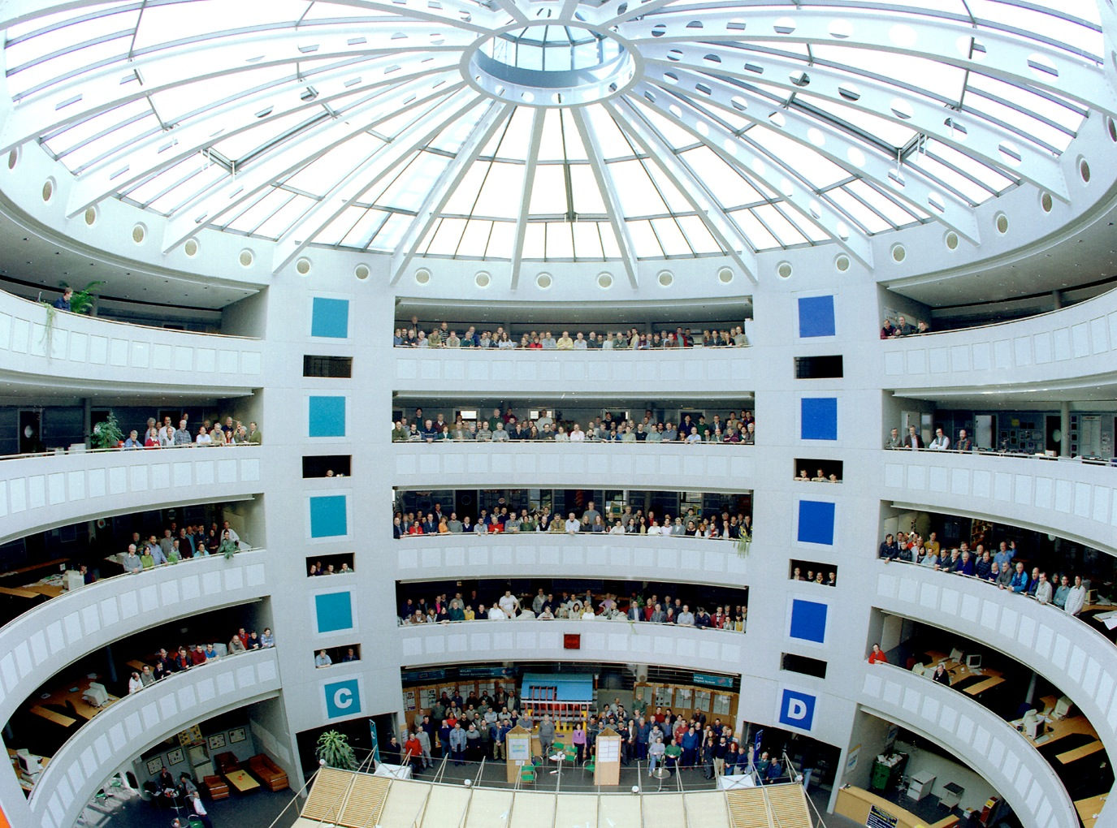

Slide 26
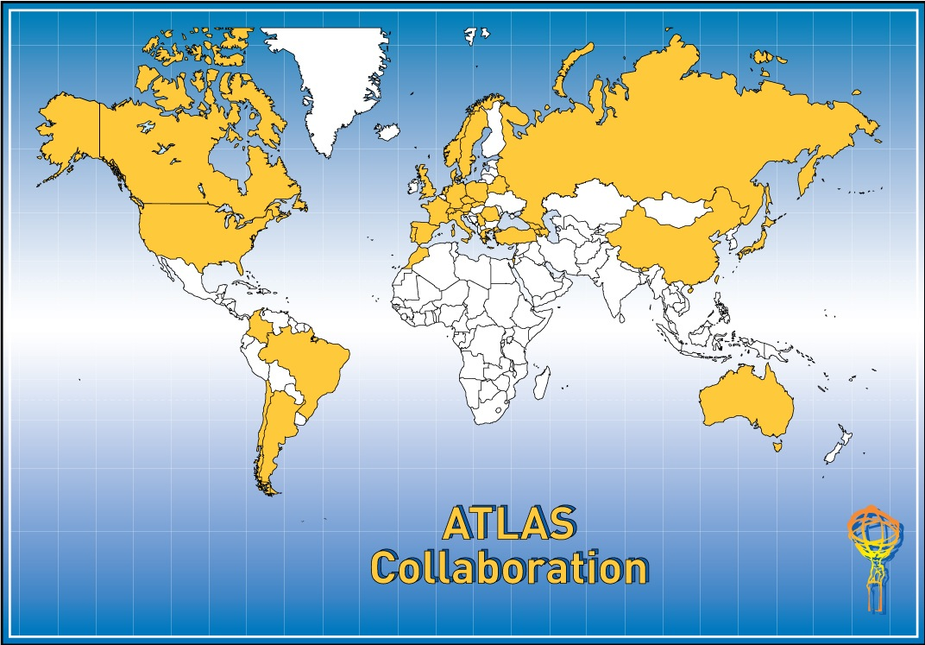
38 Countries
175 Institutions
2988Scientific Authors
(1807 with a PhD)

Slide 27


Slide 28


Slide 29
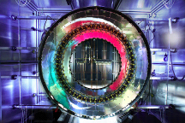
Memorandum of Understanding (MoU)
  The Project Charter is the Memorandum of Understanding (MoU)
  Legally non-binding agreement based on best effort
  Drafted between CERN (Host Lab) and Funding Agencies, the MoU describes the sharing of detector hardware construction responsibilities and costs
  Relationship between the Host Lab and an Experiment is broadly defined
  Fundamental principle of deliverables (in-kind contributions)
    Potluck party
    Deliverables grouped around sub-projects
    Items not pledged for are pooled centrally, funds collected as “tax”
  The construction cost envelope in 1995 Swiss Francs was 475 MCHF
      Direct costs, excluding manpower, R&D, institute infrastructure, prototyping, VAT
      Major exchange rates fixed (e.g. $/CHF=1.1; GBP/CHF =1.8)
      No centralized budget contingency
      CERN provides technical infrastructure support, but is also a participating scientific institute
  Project personnel (management, project leaders, coordinators) are elected by the community
  Participating institutes have equal voting rights

Slide 30

Communitarian Bonds
  Shared Vision
    One common aim of “Out of this world” discoveries; such as the Higgs
    Better understanding of the fundamental forces and particle (Big Bang)
  Shared Commitment
    Passion to “Can-do”
    Members of Collaborations prepared to solve the encountered technological (and human) challenges
    Willingness to accept also less glorious tasks for the common good
    Some have been working for the Experiments since mid 1980s…
    Trust in colleagues fulfilling their commitments (MoU)
  Shared Tolerance
    Willingness to work together, irrespective of geographical location or language barriers
    Willingness to share information
    Principle of “Raw Diamond”

Slide 31

Cultures of Collaborations
  There are several underlying sub-cultures in a Collaboration
    Physics culture versus Engineering culture
    Hardware oriented culture versus software/computing etc.
    Sub-system cultures (e.g. ”Calo culture versus Muons culture”)
    Geographical cultures (“North versus South; West versus East”; languages)
  Such cultural diversity originates itself from
    Global nature of modern high energy physics (38 countries, 70 nationalities in a big Experiment)
    Decentralized nature of resources, diverse funding sources
    Different ways to account and organize resources
  Project cycles and dominating cultures
    Sub-system/engineering culture more dominant during construction
    Physics culture very strong during project definition (design); then resurfaces when physics analysis starts

Slide 32

How are (tough) decisions made?
  Consensus-driven approach
  Bottom-up approach, in consultation with Collaboration management
    Collaboration management can’t dictate, instead coordinates and steers the process
  Keep everyone on board!
  “Factorize” the encountered problems as much as possible
  Working groups come up with alternative solutions, they select and propose the most suitable one
  Leave tough decisions to the last possible moment (without compromising the schedule)
  Collaboration Board approves collaboration actions (one institute, one vote)
  Financial matters approved by a Board represented by ~40 countries
    But I do not recall for the past 12 years any voting

Slide 33






Rainbow perhaps but no Waterfall?
Progress
B
Theory
A
Design
Prototyping
Construct
Install
Operate
Time

Slide 34

Anything to Learn From?
  Lessons learned?
    It can be done ☺
    But not necessarily best solution for more conventional projects
  What should be changed or improved (for the future)?
    Handling of contingency
    Sharing of responsibilities (better mechanisms to ensure deliverables)
  Can it be replicated?
    Sure; for next generation physics experiments (and not only PP)…
    Projects around eScience have similar characteristics (see next slide)
    Open science/innovation models
    Industrial R&D management models (laissez-faire)?

Slide 35

Conclusions
  A large scientific project can be described as
    Complex
    Global
    Culturally diverse
    Shared vision, commitment and tolerance
    Efforts made to hear the individual
  Collaborations are not managed like a corporation
  Instead,
    Run by self-managed individuals and teams
    Have a Spokesperson, not a CEO
    Guided by engagement, discussions, trial & trust, and justification rather than hierarchical powers or ex-ante directives
    A challenge for coordination …
  So what is it?
    Your comments and views would be much appreciated!

