Slide 1
The designer's perspective: on-going studies on superconducting magnets
Superconducting Magnets for HEP Accelerators
RIGI Design Society Seminar, 24-27 March 2015
D. Smekens, CERN TE-MSC-LMF

Slide 2
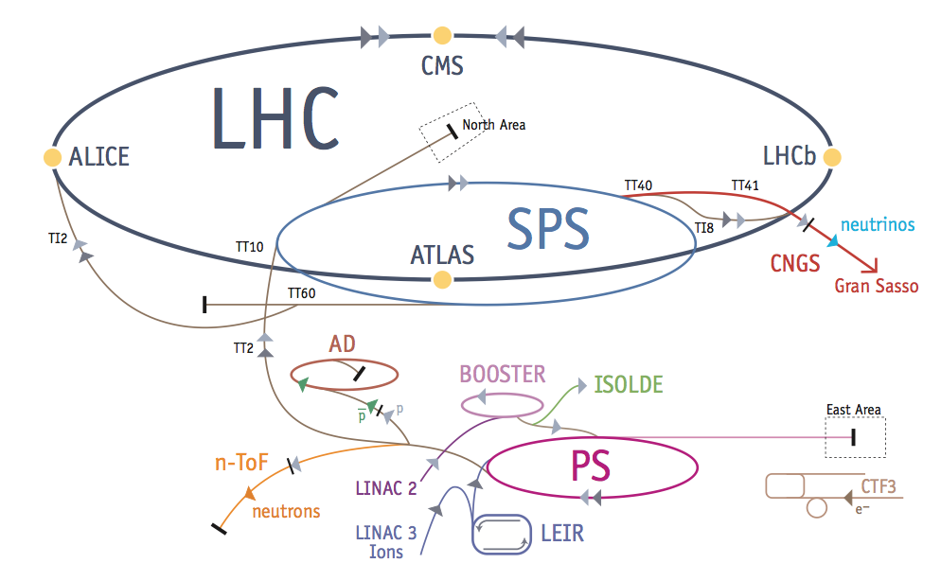
Magnets for HEP Particle Accelerators
CERN Accelerator chain: a lineage of (mostly) circular machines
Guiding charged particle beam:
  for transverse motion, only magnetic field is considered
  Lorentz: F=qE + q (Bxv)
  when v=~ c => 1 Tesla ⬄ 3E8 V/m
  Main dipoles: bending (steering)
  Main Quadrupoles: focusing
Illustration : “The LHC Guide. Facts and Figures” CERN-2009
http://cds.cern.ch/record/1165534/files/CERN-Brochure-2009-003-Eng.pdf
Notes:
Bxv is vectoriel product: cannot accelerate a coaxial beam. Transverse dynamic: magnets, magnetic field ; Longitudinal dynamic: RF cavities, electric field

Slide 3
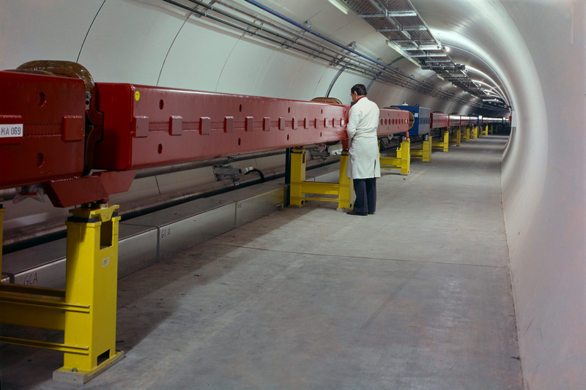
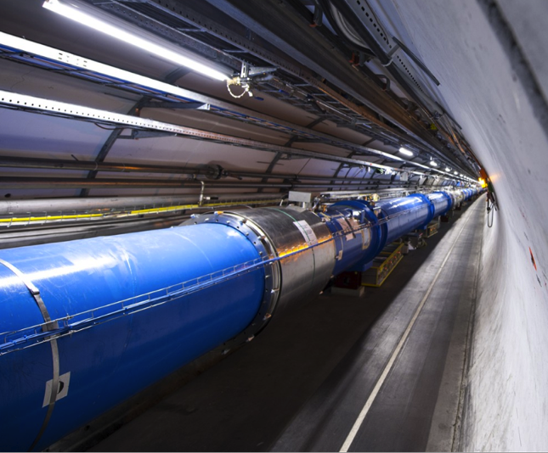
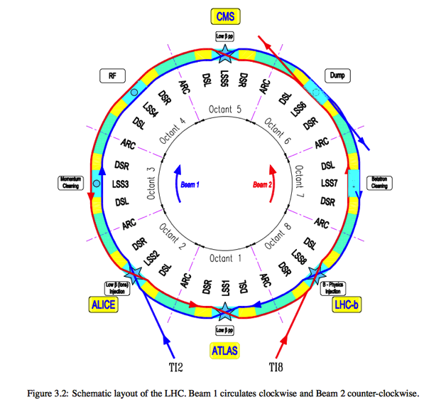
Synchrotrons & Colliders
Synchrotrons typically use a conventional FODO structure (in the arcs), with typically several bending dipoles (MB) installed in between focusing / defocusing quadrupoles (QF/QD)
Other major components such as RF, beam dumps, injection/extraction: kickers and electrostatic septas for beam injection/extraction are placed in the straight sections between arcs
Magnets for circular accelerators require extremely uniform magnetic field
Illustrations: CERN SPS Synchrotron Main Ring (year started 1974)
CERN LHC Collider Main Ring (year started 2008)
LHC Beam Circulation Scheme
Notes:
Note: each family of main magnets (bending dipoles MB, focusing quadrupoles QF, defocusing quadrupoles QD, chromaticity sextupoles) to avoid current sharing variations.

Slide 4
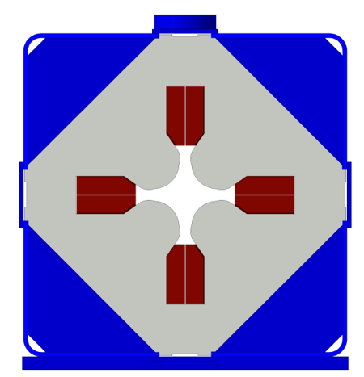
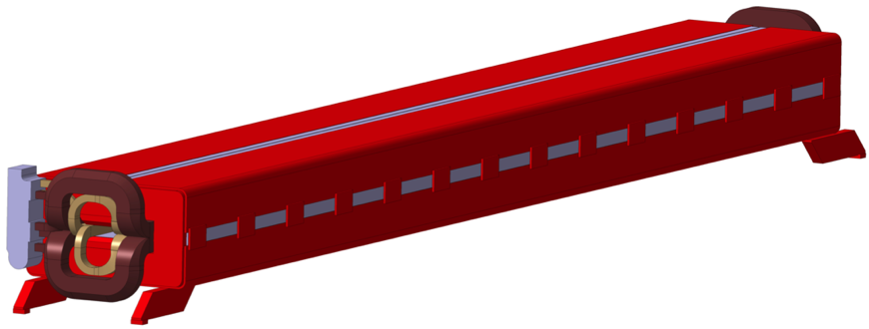
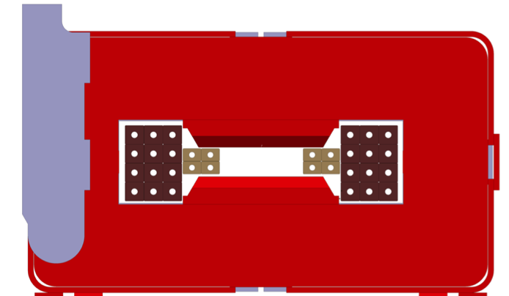
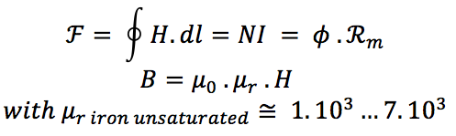
Resistive magnets (iron dominated)
Below saturation, the ferromagnetic yokes of the resistive magnets have a low reluctance. Such magnetic circuit can produce a high magnetic flux with limited ampere-turns.
Peak field of 1,5…. 1,8 Tesla with an excellent field quality.
The field quality is mostly driven by the geometry of the poles of the yoke and the accuracy of the yoke assembly.
Magnetic yokes laminated to minimize eddy currents during the current ramp up. These magnets tolerate short rise time (>1000 A/s) and can operate in pulsed mode (typically 0.1 … 1Hz)
Current density is limited to ~10 A/mm²
Illustration: CERN SPS Main Dipole (1974)
CERN SPS Main Quadrupole (1974)
Notes:
The magnetic field quality is achieved by the precision assembly (stacking) of the laminations of magnetic yoke. These laminations (thickness 1…1.5 mm) are produced by fineblanking of low carbon steel “blue steamed” (a oxide layer on each face of the steel sheet provides the electric insulation againts eddy currents). Yokes are generally welded in halves (dipoles) or in quadrants (quadrupoles), and later asssembled around the set of coils with appropriate shimming. The assembly is then all-welded under pres.
Nota: accelerators make use of other types of magnets for fast deflections, these kickers are based on completely different designs.(ferrite yokes,coil excitation by capacitive discharge for rise time of about 0.001 s)
Nota: Exist also the superferric magnets (often with room temperature yoke and SC coils), these magnets operate in the saturation domain of their yoke (field ~2T) but their field quality is still given by the shape of the iron poles.

Slide 5
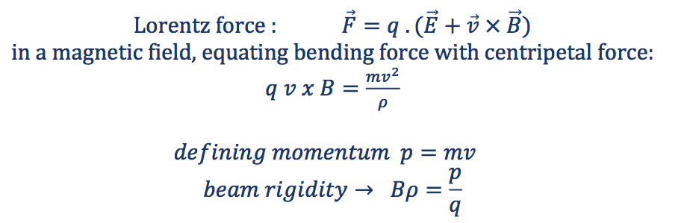
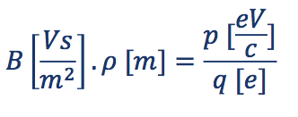
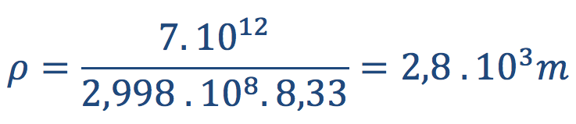
Quest to high field magnets
Bending Magnets (dipoles): Fighting centripetal force
LHC dipole: 8.33 T, proton momentum p = 7 TeV/c (charge q= -e)
←→ equivalent circumference 17.6 km
Deflecting a 7TeV/c proton beam on a closed orbit requires a constant dipole field of 8.33 T over 17.6 km. LHC: ~2/3 of the circumference of the LHC tunnel (26.7 km) is filled with 1232 15 m long dipole magnets generating the 8.33T field when powered at 11'850 Amps

Slide 6
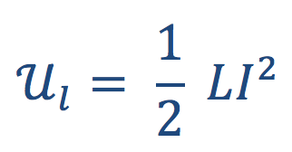
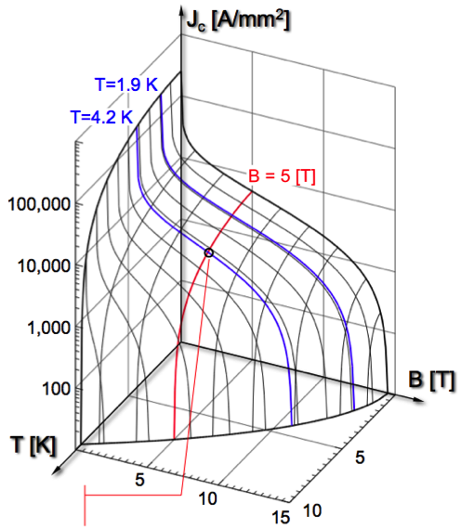
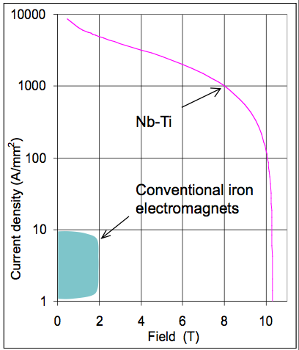
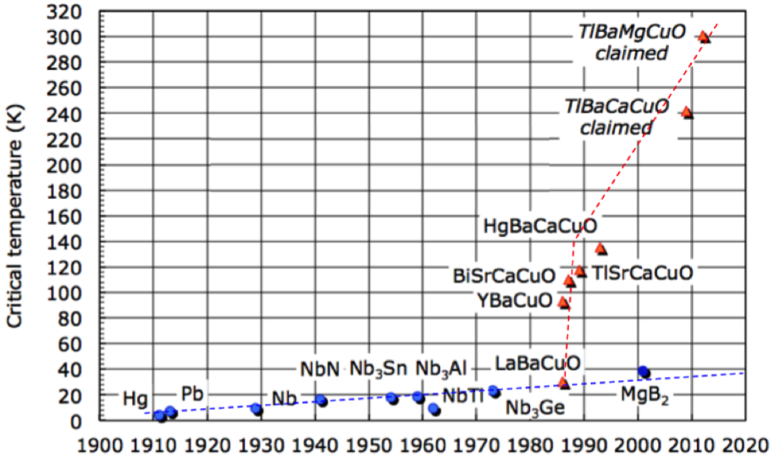
SC Magnets: “Cheap Ampere-Turns”
Above saturation, super-conductivity offers “cheap amp-turns”
Operational limits:
    Only few SC alloys usable for “good conductor” in large production (Nb-Ti, Nb₃Sn) ;
    Operate only below a “Critical surface”: Bc,Ic,Tc <-> requires margin (I/Ic ,T/Tc, B/Bc)
    Need to be cladded with a normal conductor (Cu:SC ratio) to stabilize the SC from disturbances and during a quench carry current and absorb heat
    Often requires quench detection and fast extraction of stored magnetic energy
Critical Surface of a
LHC Nb-Ti wire
J_{c} (5T, 4.2K)
~3000A/mm²
^{Graphics by courtesy} ^{of L. Bottura}
“Introduction to Accelerator Physics - Superconducting Magnets”
^{CERN Accelerator School 2012}

Slide 7
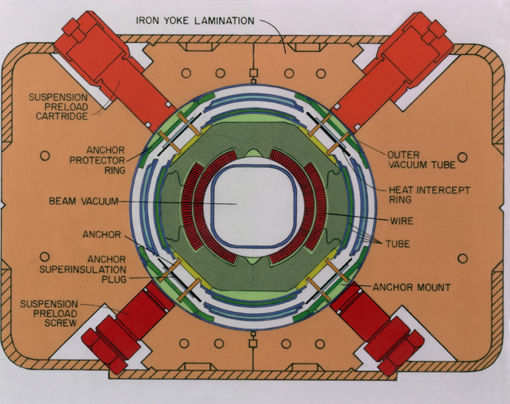
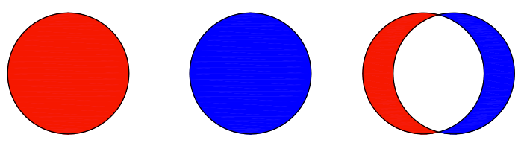
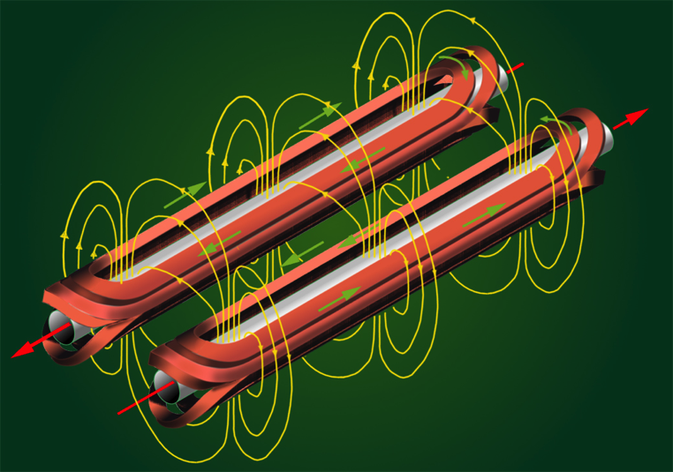
SC Magnets: Cos Theta Coils
With SC magnets the field quality is no longer driven by the geometry of the magnetic yoke but mostly by the current lines, in other terms by the position of the coil windings.
cosTheta Coils (sector coils)
I(θ)
θ
Tevatron Dipole (1979 Design)
Source: Fermilab National Laboratory
Pure multipole field (2n poles) can be produced intersecting 2n cylinders carrying a uniform current density, or if the current distribution is given by I(θ) = I₀.cosθ (ref.1, 2)
The I₀.cosθ current distribution can be well approximated by coils with current shells or sector blocks geometry.
Magnetic field induced by the LHC dipole's superconducting coils. CERN, 1996 design
Notes:
The yoke does not show any pole piece, its geometry has still to be optimized to reduce harmonics, but its geometry is mainly driven by other functionalities (supporting the coil, routing busbars, placing heat exchanger). Here a dipole cross-section from FERMIAL Tevatron , so called “energy saver” when designed in 1979 . Tevatron started operation in 1983 and ended in 2011

Slide 8
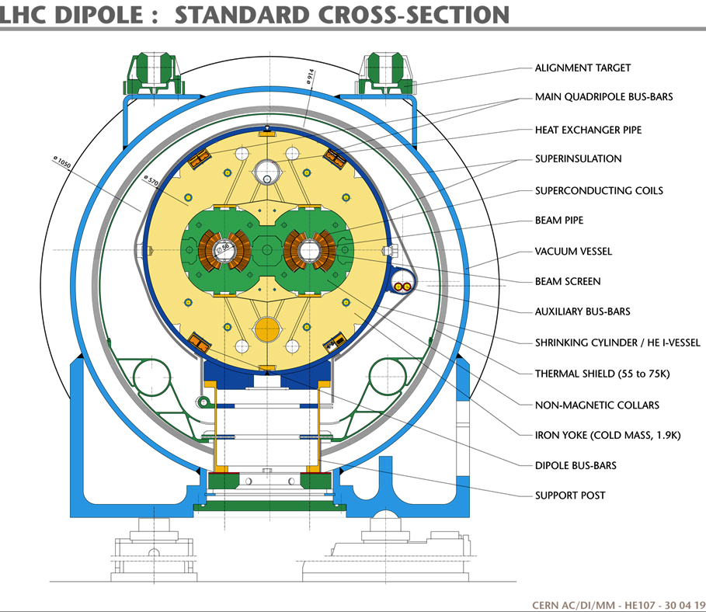
Superconducting Magnets: a few additional features
Cheap Amp/turns but…
Requires complex cryogenic systems (compressors, LHe + GHe distribution lines, heat exchangers, He bath, beam screen)
Good insulation system (1W heat loss in LHe =~245W electric power)
Complex warm-cold transitions for both power supply and vacuum
Superconducting bus-bar system;
Alignment issue
Components assembled at room temperature, operating at 4.5 K or 1.9 K subjected to important EM forces ;
Illustration: LHC Dipole (1996 Design) , CERN
Notes:
The magnetic circuit is somehow a relatively small part of the final cold mass-cryostat assembly.
One shall note the symmetry of the geometry in this design. This is to keep the uniformity of the field (busbar routing, heat exchange: all slots insid ethe yoke is symmetrically duplicated, even if it carries no functionality).

Slide 9
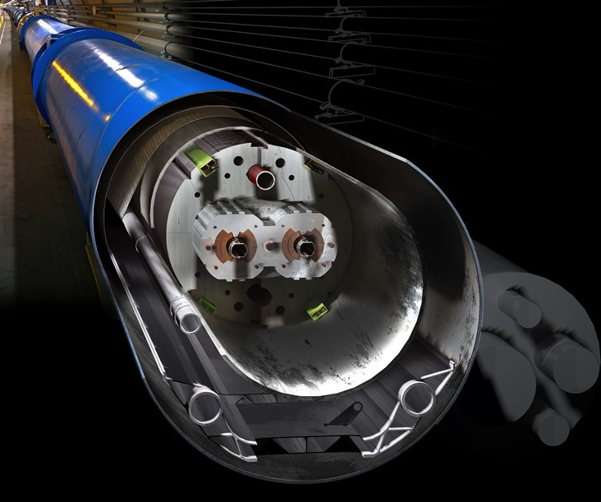
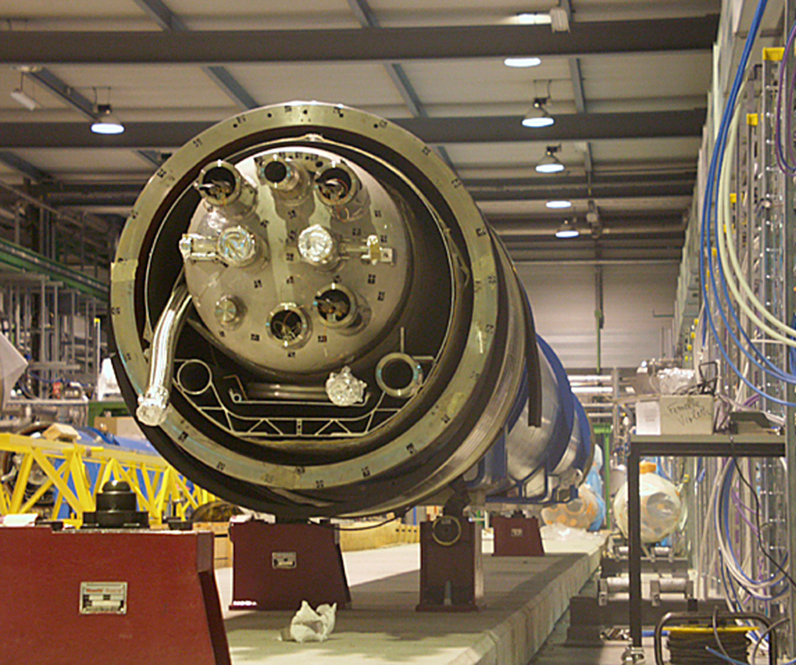
The LHC MB Dipole Magnet

Slide 10
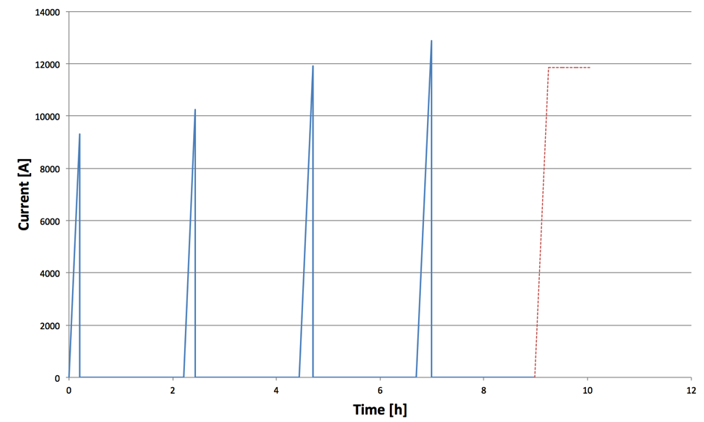
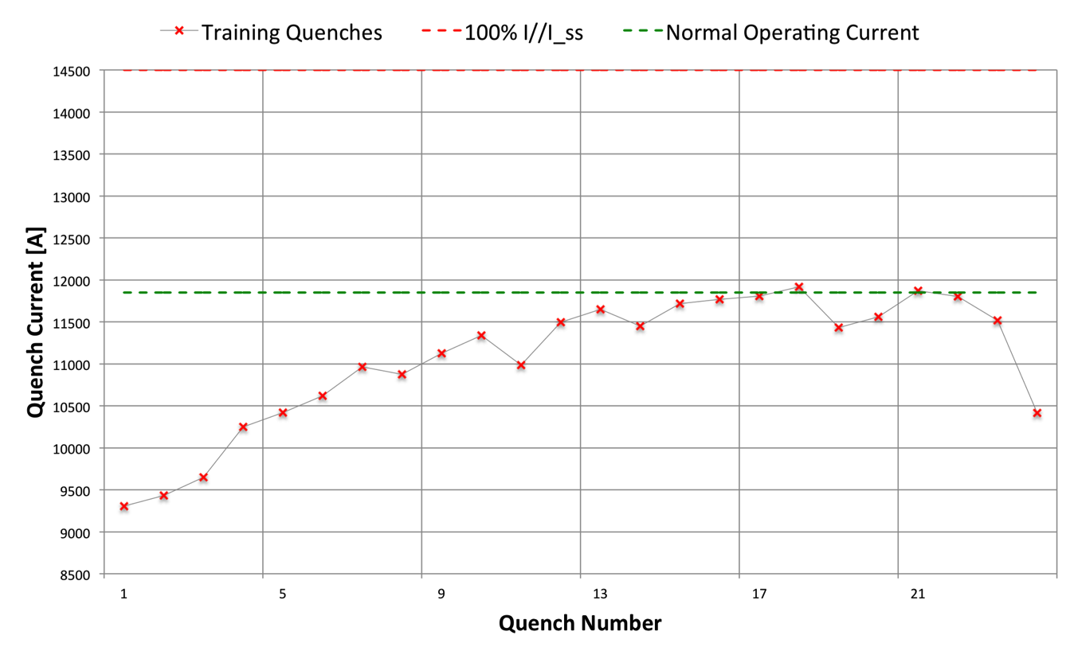
Quench, Training, Degradation
A quench is the transition from superconducting state to normal state
Minimum quench energy is ~10⁻⁶ … 10⁻³ J to heat up a sufficient volume to propagate quench (due to very low specific heat of conductor at 2K)
Training behavior during initial powering
During initial powering a SC magnet will quench at increasingly higher current, this is called training
SC magnet have a training “memory”; once trained a magnet should not quench below the maximum current reached during training
Not quite good enough yet !
Detraining
Bad !
Training Chart for 11T Dipole 2m first model

Slide 11
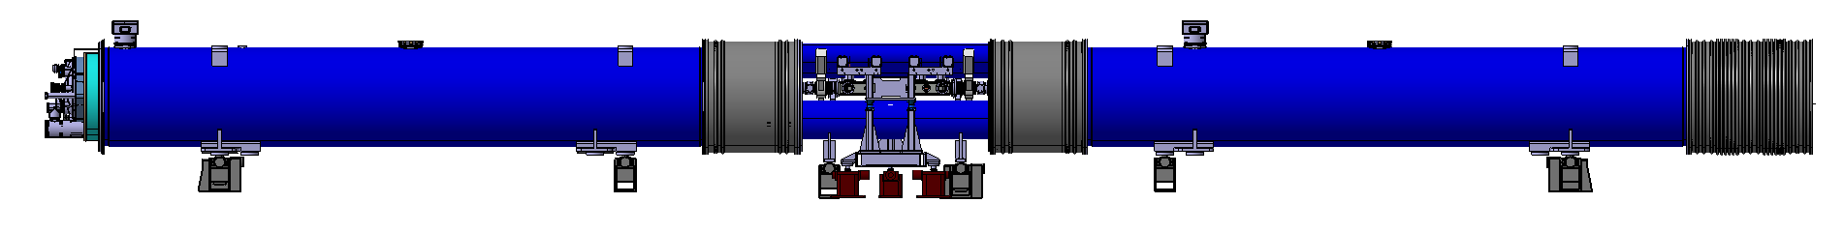
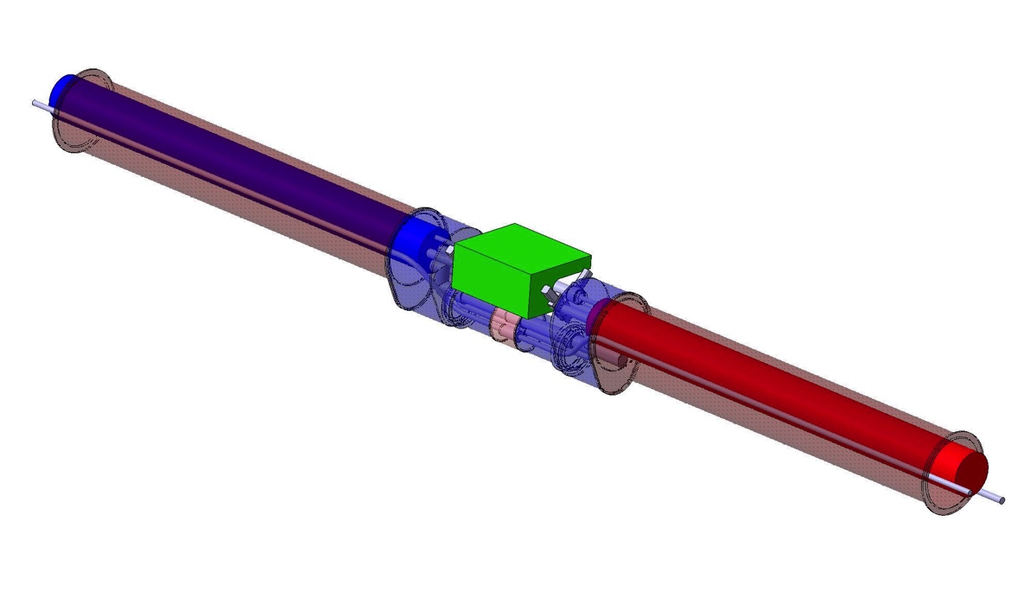
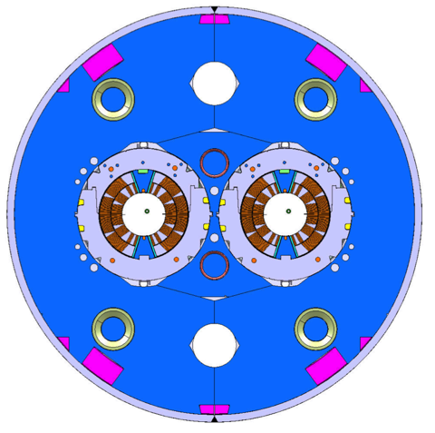
Case Study the 11T Dipole for the HL-LHC
In view of the LHC upgrade (High Luminosity LHC), 5.5 m long 11Tesla dipole magnets are currently being developed.
2 of these shorter/stronger magnets shall be used to replace one 15m long 8.33T LHC dipole to make room for a collimation system
The magnet design started in 2010 with a model program (2m long model magnets)
The prototype phase (5.5 m long prototype) has started
Pre-series magnets are foreseen in 2018

Slide 12
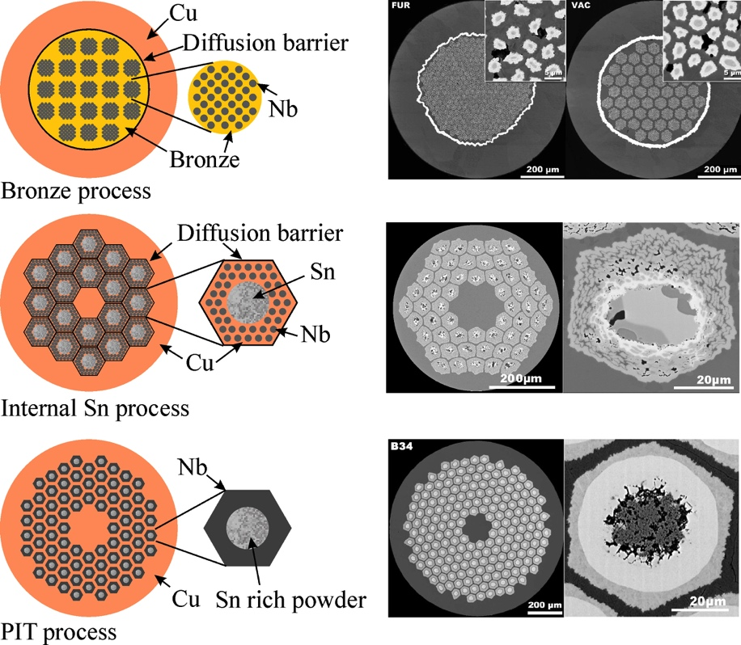
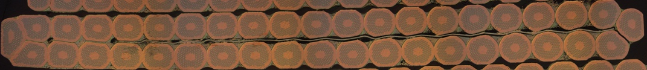
Conductor Development
High Field magnets require high current (>10kA)
SC conductor is often braided into a “Rutherford” cable, made of several strands to reach the required capacity
Specific High performance strand is often required for HEP magnets (Ic, RRR, # elements, filament size), requiring years of development
For less demanding applications: many commercial strands (Nb-Ti, Nb₃Sn, HTS) readily available
14.7
1.25
11T Dipole Nb₃Sn 40-strand cable
^{Graphics by courtesy} ^{of L. Bottura and} ^{B. Bordini}
^{CERN}
Notes:
Large magnets for HEP often require coils made from multi-wire cable in order to carry more current (the cable of the 11T dipole is made of 40 x 0.7 mm diameter round wires, with a current carrying capicity of x A at 12T and 1.9K). The rutherford cable is a braiding pattern minimizing the parasitic effects of permanent currents circulating in the loops created by the contact between each wires .
The development of a new conductor as in the case of the 11T dipole takes years to improve sufficiently the metallurgy of the strand (filament size, number of filaments, critical current, Cu:SC ratio, workability for mass production, …), as well as the development of the conductor itself (diameter of the starnd, number of strands, cable width, mid-thickness, key-stone angle, compaction with inherent filaments degradation, mechanical stability during winding).
Designing smaller SC magnets can in certain cases be much faster: having the possibility to wind coils directly from a single wire allows to use Nb-Ti conductors (and even Low grade Nb3Sn) that are standard production from manufacturers. These wires are affordable and readily available.

Slide 13
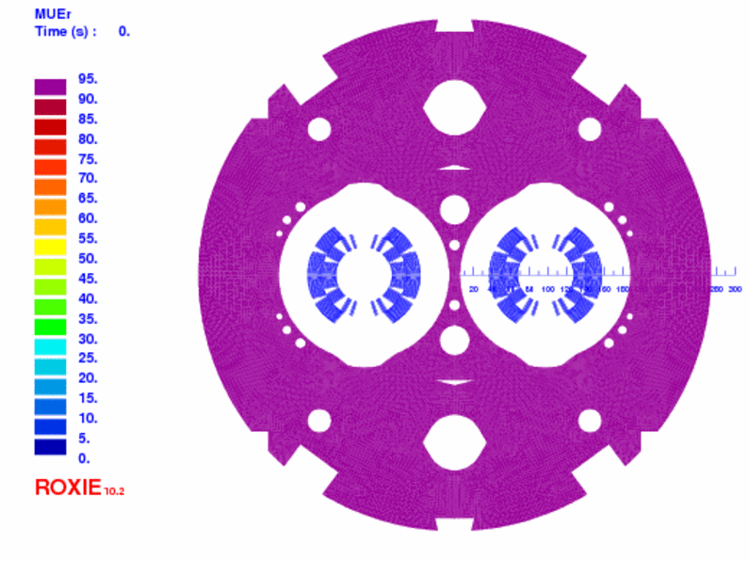
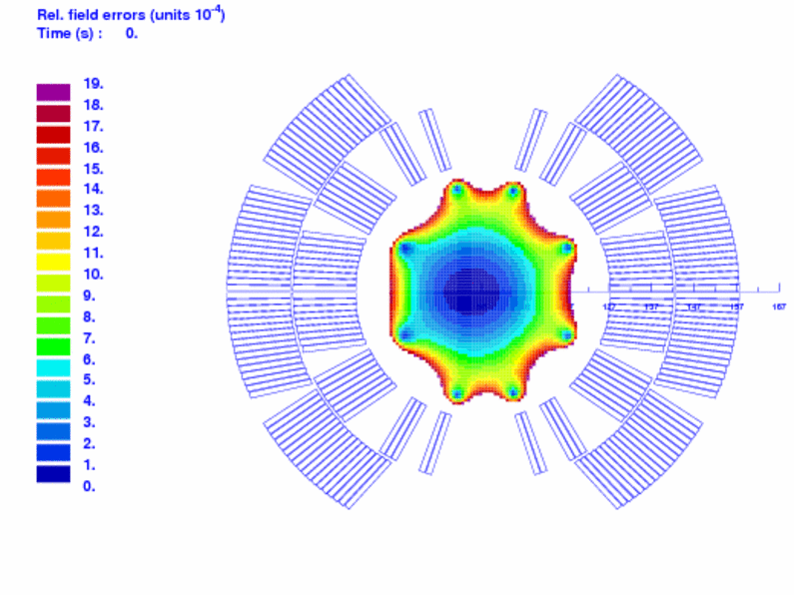
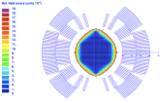


2D Magnetic Design
Beam optic/dynamic defines :
  Required aperture (bore)
  Required integrated field
  Field quality (normalized multipoles w.r.t main field, in units.10⁻⁴)
From field-> current density (NI)
  Definition of conductor
    current, # of turns, insulation thickness
  2D optimization of coil cross-section
    minimize harmonics (i.e. B1 will generate B3, B5, B7,…)
    Ensure margin B_{c},I_{c},T_{c}
  Yoke optimization
Twin apertures does not make things simpler… (cross-talks, beam inter-distance)
2D optimized (single coil inside optimized yoke)
2D field quality in twin-aperture configuration (cross-talk, assymetric yoke saturation, …)
Plots, courtesy of M. Karppinen, CERN , 11T Dipole Project
11T Dipole 2D Magnetic cross-section using ROXIE
Notes:
Several groups of iterations are required: starting with the development of the SC strand and of the conductor, the definition of the current and number of turns in the coil.
The design of the coil cross-section starts with optimizing the number of turns and number of blocks inside the coil (the yoke is not designed at this stage, only its effect on the main field enhancement). Objectives: minimizing harmonics, allowing sufficient margins, reaching the required strength (field)
Next step once coil is optimized: design of a realistic magnetic yoke and optimization of the yoke to minimize field harmonics in the bore.
Other aspects during 2D design: persistent current effects, coupling currents, … -> sharing information with beam optics to ensure that field errors are manageable by the corrector magnets in the machine
Nota: The insulation around the conductor is also a domain requiring extensive development. The definition of the insulation thickness around the cable plays a major role and needs to be defined in the early phase of the coil design, higher field can be reached if the insulation is minimum. This thickness must also be accurately respected for coil geometry requirements.
Material selection is also challenging: for the Nb-Ti alloy, relatively easy to insulate, a specific insulation based on polyimide wrapping, with B-stage adhesive tapes was developed to ensure that the insulation layers will remain very porous to superfluid helium. In the case of Nb3Sn technology, coils are epoxy impregnated with much less cooling capabilities, however the Nb3Sn conductor has a much larger temperature margin. The challenge for the insulation of Nb3Sn cable is to resist to the reaction heat cycle at 650 Celsius and still operate correctly later at 2K.

Slide 14
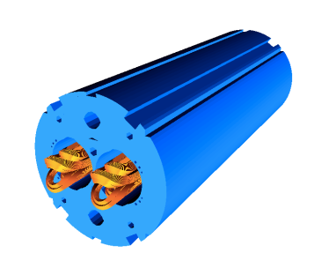
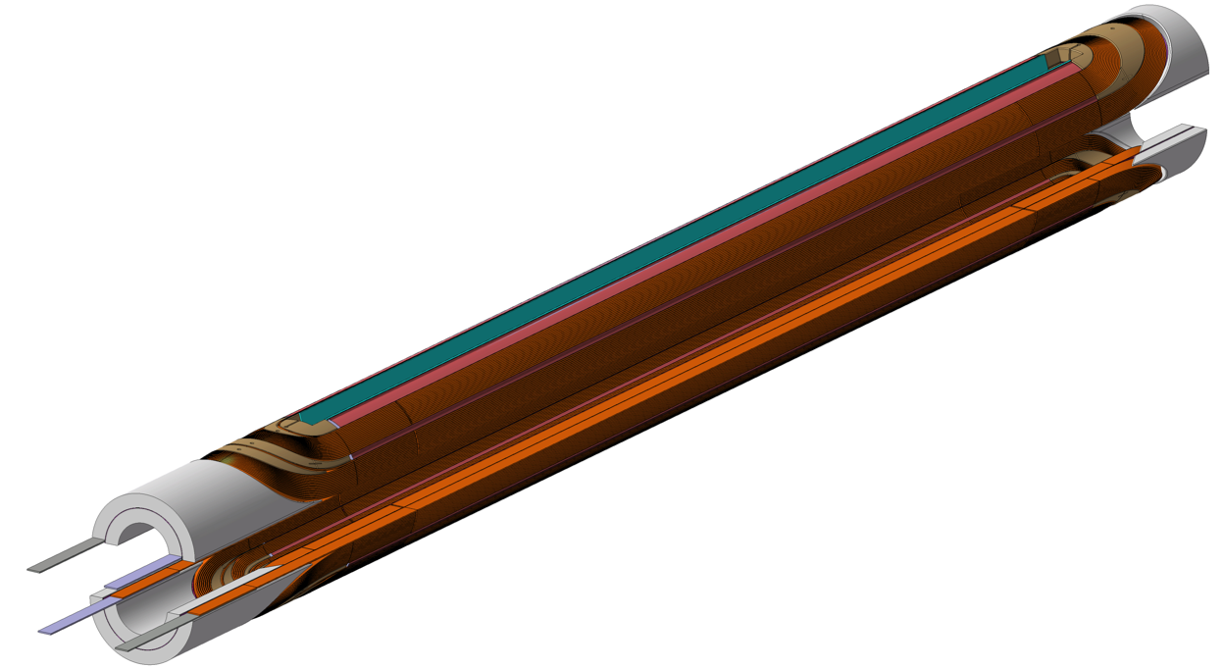
3D Magnetic Design
Coil Ends modeling
Match real mechanical behavior of the cable (hard-way bend, soft-way bend, torsion)
Minimizing harmonics
Design of the “end spacers”
Tuning coil length to required field integral
Effect of magnetic yoke (3D longitudinal effects, yoke cut-back to avoid peak field in the coil ends)
3D quench computation
CERN 11T Dipole 2m long model
3D magnetic design using ROXIE
CERN 11T Dipole 2m long model
Pair of Coils
Notes:
At this stage, the magnetic design has sufficiently progressed. The mechanical design of the components can start.

Slide 15
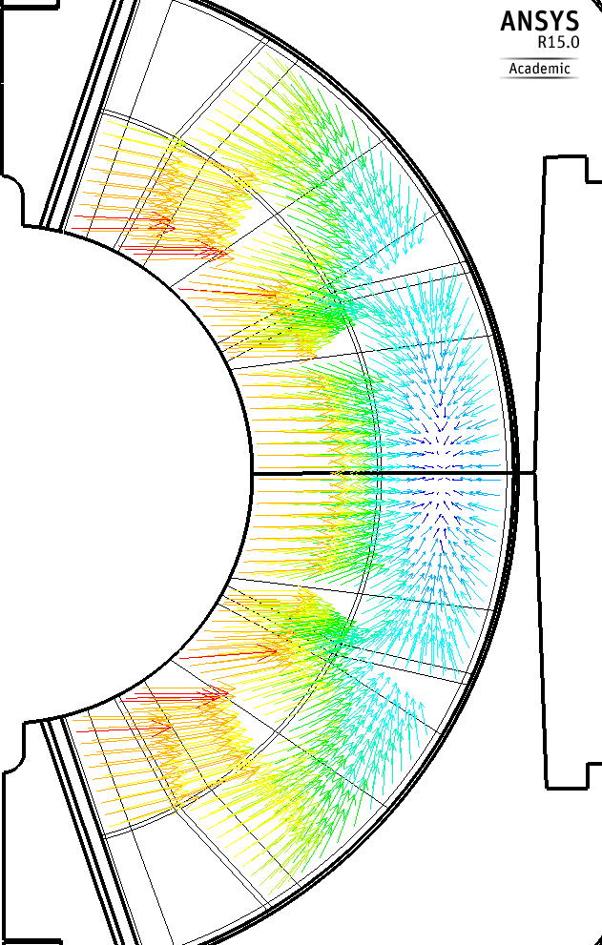
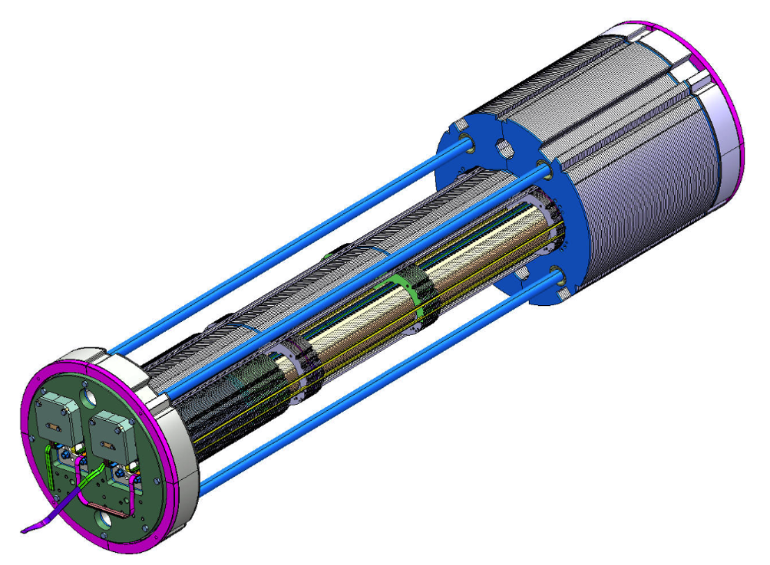
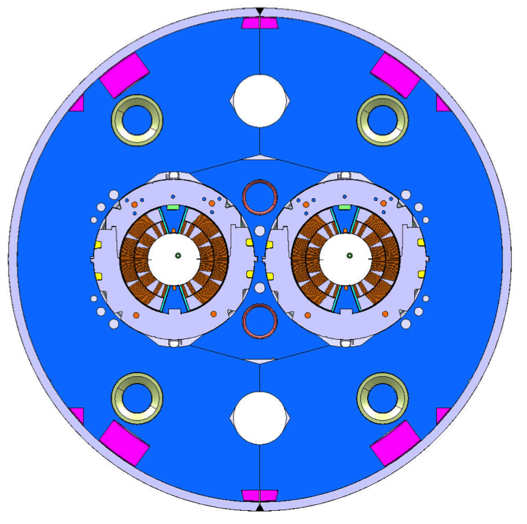
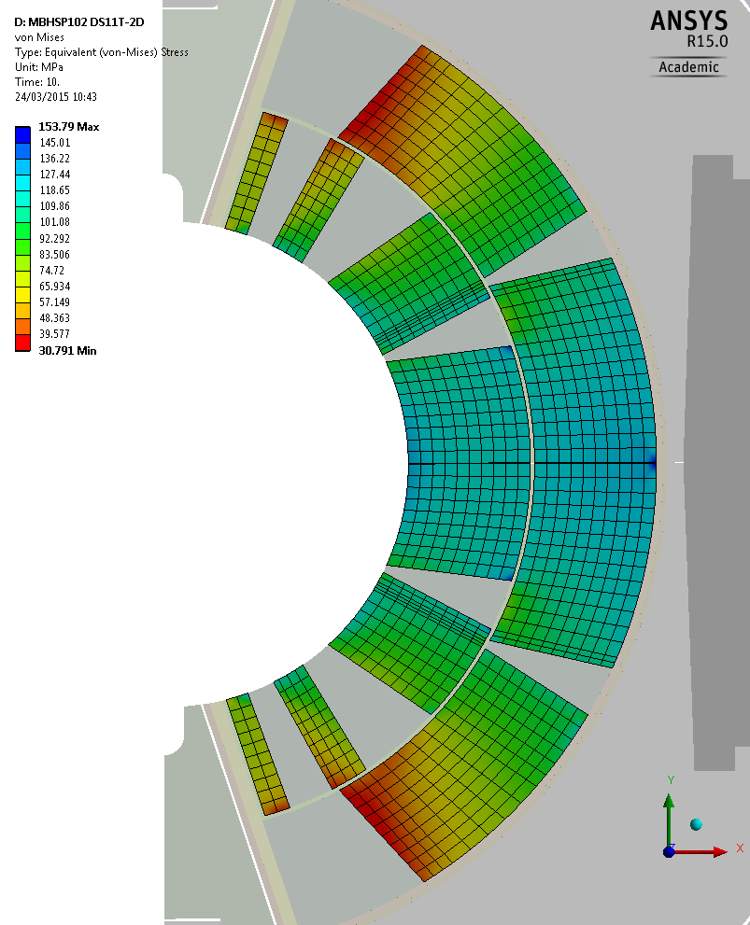
Mechanical Design
Mechanical design aims at containing electromagnetic forces by pre-loading coils at room temperature during assembly and maintaining the pre-compression in the coil at cold, up to maximum field
Illustration: 11T DS Dipole Model, CERN
Notes:
During the mechanical phase, the main focus is to manage the pre-stress of the coil which will impact training. (see hereafter the reasons)
The coil pre-stress must be maintained at all stage of powering, thus at cold, although assembly of the components is carried out at room temperature.
The components are designed such to match the thermo-contraction of the coils, and feature areas where material will bend or elongate in order to “store” stress to compensate for differential thermocontraction.

Slide 16
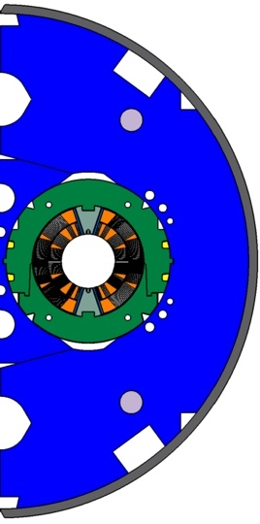
External Shell
Yoke
Collars
Wedges
Structure | Material | Therm.contr. (300-2 K) mm/m | E modulus Gpa @293K | E modulus Gpa @2K
Coil | Nb₃Sn Impreg. | 3.3/2.9 (rad./azi.) | 27 | 30
Wedges | ODS Cu | 3.3 | 130 | 130
Pole | Ti-6Al-4V | 1.7 | 115 | 125
Collars | Austenitic Steel YUS-130 | 2.9 | 195 | 215
Yoke | Low C Steel | 2.05 | 210 | 225
Shell | 316L | 2.9 | 195 | 215
Pole
Illustration: 11T DS Dipole Model, CERN
Notes:
The FEA is complex:
Coil modelling suffers from large uncertainties (E-modulus, thermocontraction not well know and anisotropic; final coil geometry varying during production)
Magnet assembly is carried out in several steps (collaring, yoking); each requiring high load press which have to be modeled too. External shell needs to be stretched by means of the press but also by the weld.
Effects of thermo-contraction is then computed, followed by computation of electromagnetic forces and effect on the mechanical structure is investigated.
Specific material selection is required to resist cryogenic operation, and exhibit non magnetic behaviour (i.e. austenitic steel may precipitate in high susceptibility martensite when cycled at cryogenic temperatures) . In many cases radiation resistance will also be a major aspect.

Slide 17
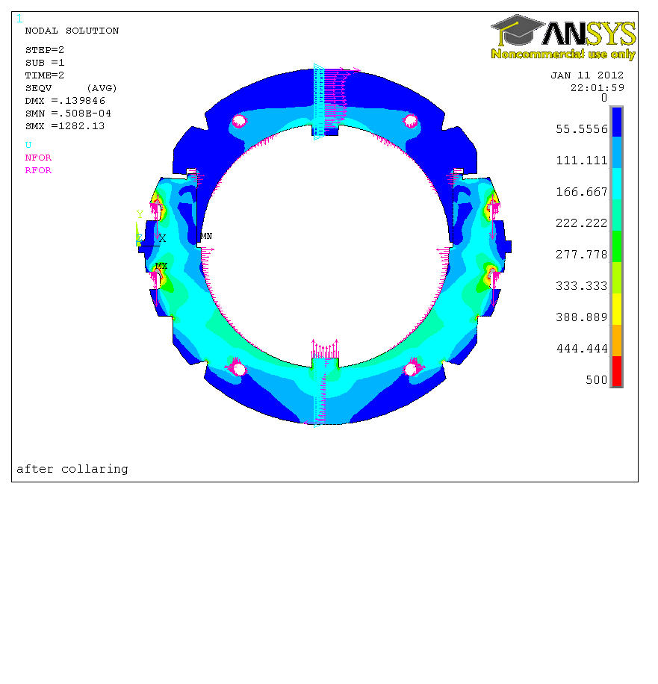
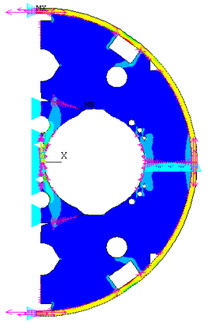
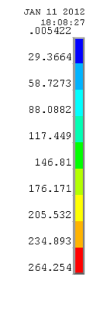
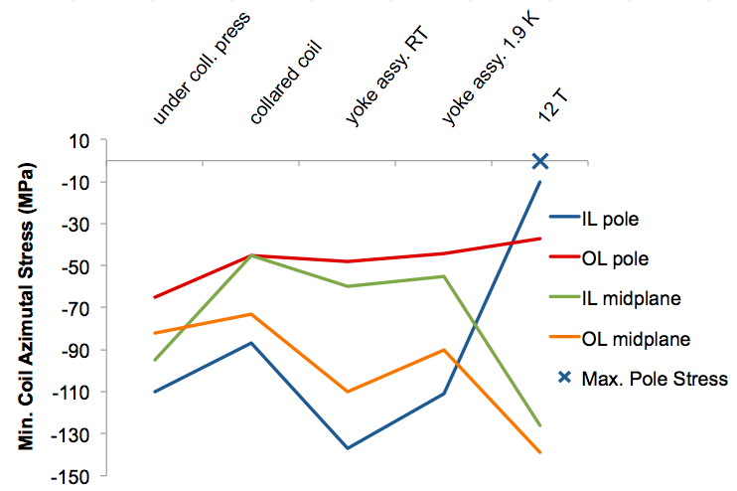
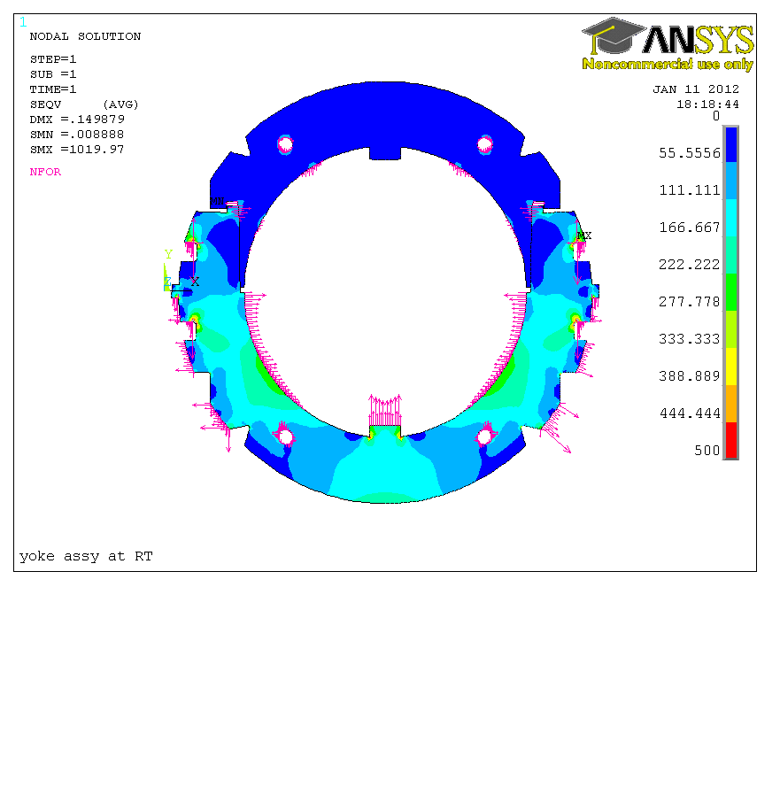
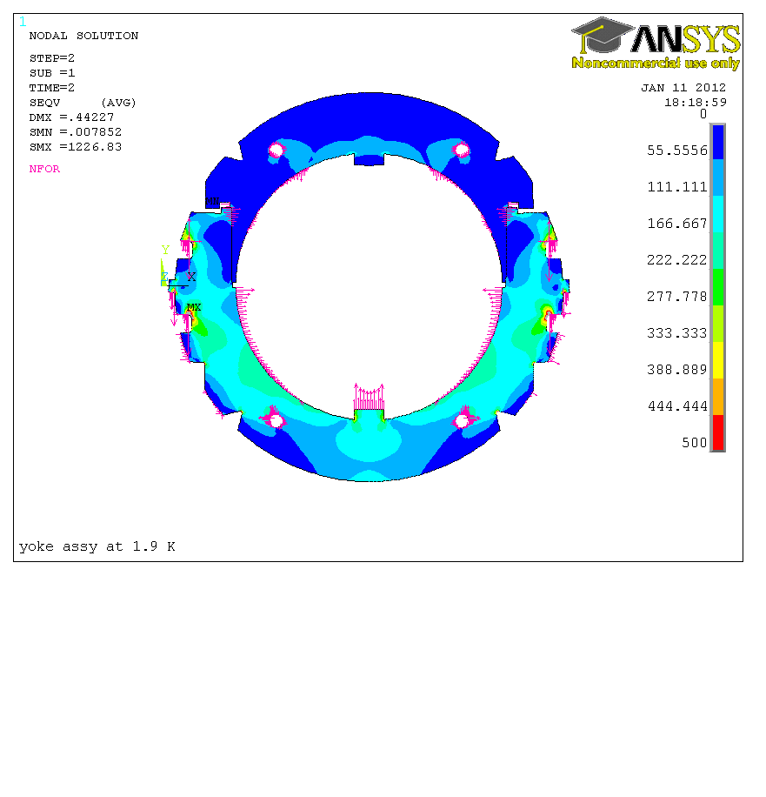
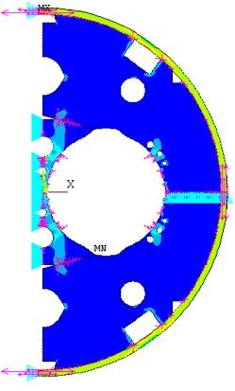
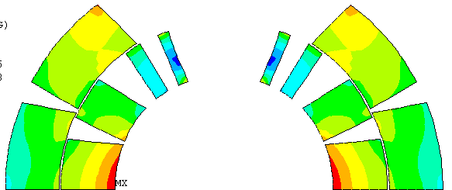
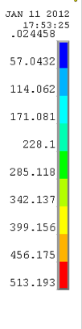

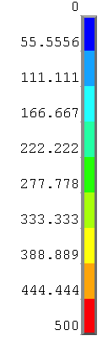
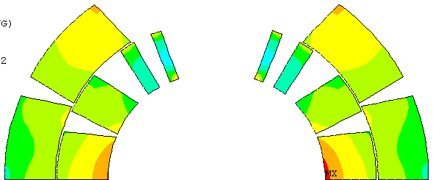
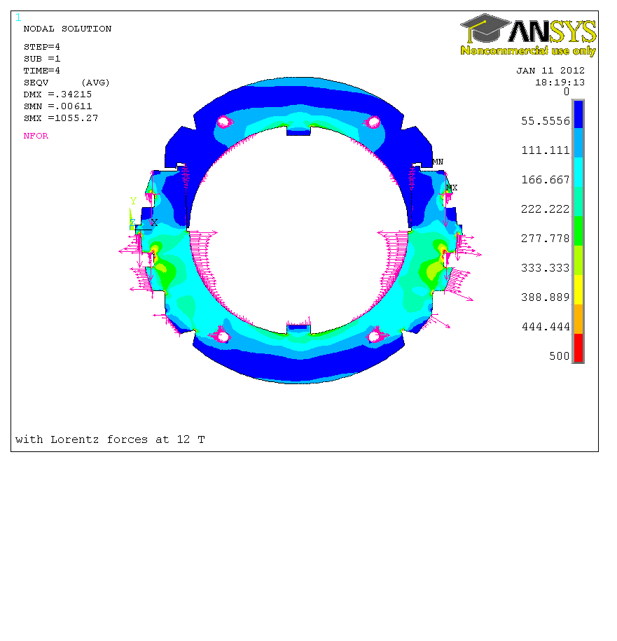

Yoke assy RT
FE- Analysis
Collared
Coil
Yoke assy
RT
@ 12 T
-150 MPa
Yoke assy
@ 293K
@1.9 K
@1.9 K
@ 12 T
@ 12 T
Illustration: 11T DS Dipole Model, CERN
Notes:
Because of the assembly at room temperature, elastic limits are rapidly reached. Strength of material gets better at cryogenic temperature.
The FEA will allow to tweak the assembly parameters and optimized the components such that it shall be possible to remain within elestic limits, repsect the mximum stress and strain on the superconductor and still guarantee that the coil remain under compression up to ultimate powering (here at 12 Tesla)
One shall note that the coil inner layer has a smaller azimuthal length and more hard wedges than the outer layer of the coil, with a larger azimuthal length and more turns of soft conductor. The coil modulus is not homogeneous. It is difficult to design the mechanical components such that the coil can be uniformly loaded. In the present case the pole (not depicted here) is design with a slot such that the pole tip bends and relieve some of the excessive stress form the coil inner layer.
Also, EM-forces are much too high for the collars. It is necessary to transfer the EM-forces from the coils to the outer shell through the laminations. As the laminations, made of soft steel, have a much lower thermocontraction factor than the coil and the austenitic steel, it is necessary to design to introduce a bending strain in the yoke, a high tension in the shell, as well as an interference between the yoke and both the shell and the collars, such that at cold the contact between collars and laminations is guaranteed to transfer the forces to the shell.

Slide 18

Coil Technology (Nb₃Sn conductor)
SLS End Spacers
with “springy legs”
Loading plate
2 mm 316LN
Braided 11-TEX S2-glass
on “open-C” Mica sleeve
ODS Cu-alloy
Wedges
Saddle-Splice Block: Single Piece G-11
Interlayer protection
heater R&D
Courtesy of D. Mitchell, FNAL

Slide 19






Coil Technology (Nb₃Sn conductor)
30
60.8
56 Turn Coil, 2 Layers
Beam Bore: 60 mm
Outer diameter: 121.6 mm
Nb3Sn Rutherford Cable,
40 strands 0.7 mm
Illustration: 11T DS Dipole Model, CERN
Photos: 11T DS Dipole Fermilab (fil, cable, section de bobine)

Slide 20



Collaring: A shrink-fitting cage
Rivet Location
A shrink fitting cage is built by a sequence of “long” collars alternatively placed top-bottom. Each long collar is attached to a short colla r(non structural) filling the gap. The short collar is riveted “loose” to the long.
A special grade of 316LN austenitic steel is required to guarantee the low permeability
Slots Collaring Keys (4x)
Short Collar
Long Collar
Illustration: 11T DS Dipole Model, CERN
Notes:
The term “shrink fitting”is here abusive: we’ll use it to illustrate that the functionality of the collars is to built-up coil compression. “Shrink fitting” is incorrect in the sense that the collars are not designed to interfere radially with the coil, as would a traditional shrink fit in mechanics.

Slide 21






Collaring: Azimuthal Pre-stress by loading at pole
Illustration: 11T DS Dipole Model, CERN
Notes:
Building up coil pre-stress by loading azimuthal the left/right branches of the coil by displacement of the pole wedge is very similar to the “roman arch”: The top keystone loads the arches.
If the azimuthal length and the young modulus of the coil is well known, adapting the size of the pole (by shimming) allows to tune the coil pre-

Slide 22





Collaring: advantages
2-parts assembly, mobile: allow for large displacement during collaring (low modulus coils)
Tunable azimuthal pre-stress by adapting pole shimming,
Usable over long coils (LHC dipoles: 15m)
Mass production easy (fineblanking from thin sheets)
Illustration: 11T DS Dipole Model, CERN
Notes:
This slide depicts in detail the locking mechanism by means of keys in between alternating long collars. Keys are locked in position by the springback of the coil after collaring.

Slide 23






Yoking – Shell welding
The outer shell (once completed with dished ends, becomes the helium tank (cryogenic pressure vessel)
For high field magnets the shell also play an important structural role backing up the collaring structure and supporting the longitudinal forces from the coil ends
11T Dipole Single Aperture Model
during shell welding under press
The magnet is (almost)
Completed…

Slide 24


The magnet is not yet finished…
Completing the cold mass:
  Electrical & vacuum interconnects,
  Heat exchanger, dished ends,…
Insertion in vacuum vessel (cryostat), alignment…

Slide 25



Collaring Variant: “key-hole”
Long Collar
Pole
Wedges
Nominal Position
Under Press
Insertion of the rod
After press release: rod locked by coil spring back
Conductors
Collaring Rod
Short Collar
Illustration: MCXB Corrector Dipole, Model,
LHC Dipole Collars
CERN

Slide 26



Collaring Variant: collars for quadrupole coils
Action 1: compression jack press the collars and open the key slots
Action 2: the 8 auxiliary jacks push the keys inside their slots
Pairs of quadrupoles collars rotated 90 degrees, 2 poles integrated + 2 floating poles
Requires specialized press (4 compression jacks + 8 keying jacks)
Vertical collaring, progressive collaring operation: by segments of ~200 mm
Illustration: MQXS Sqew Corrector Quadrupole, Model, CERN

Slide 27




Variant: eccentric laminations
Low carbon steel laminations, Lamination with a decentered outer diameter ./. Inner bore
Stacking lamination, each turned 90 degrees more than the previous
Shrink fitting of an outer aluminum shell by heating/cooling
CERN patent
4 MQTL coils,
potted and precision machined
Empilage laminations
MQTL Quadrupole Coil
Aluminum Shrink-fit cylinder
Decentered lamination
Illustration: Schematic of Trim Quadrupole MQTL, LHC, CERN

Slide 28





Shrink Fitting Eccentric Laminations
Photos: Coil-module Assy, Trim Quad MQTL, LHC, CERN

Slide 29



Eccentric Lams (Larger Variant)
Variant: Prototype MCBX “nested”
Coils fitted in aluminium cylinder
Avoids mismatch of thermo-contraction between shell/yoke/coils : scissor laminations allow to transfer stress to the outer shell
Illustration: Ansys FE Prototype Dipole MCBX, LHC, CERN
Photo: modèle mécanique MCBX, CERN-Danfysik

Slide 30







Epilogue
This concludes our glance at the magnetic and mechanical design leading to the genesis of SC magnets.
During the last decades, Nb-Ti conductors have vastly progressed and allowed to populate HEP accelerators (Tevatron, RHIC, HERA, LHC) with an impressive family of SC magnets.
Designers are already looking at magnets for a possible LHC successor, the FCC (future circular collider), a ~100 TeV machine, that will require magnets reaching very high fields (16 T – 20T), based on different superconductors (LTS and HTS) that have still to be mastered before considering mass production of magnets.
MQXF Quadrupole Model

Slide 31
References
Special thanks to the people who helped in providing material for this presentation:
B. Auchmann, B. Bordini, L. Bottura, M. Karppinen, Ch. Löffler, N. Peray, Ch. Kokkinos
The 11T Dipole Project is a joint collaboration between CERN and the Fermi National Laboratory (Batavia, USA). We thank here our collaborators from US for the constant support to improve the Nb3Sn magnet technology.
Bibliography:
  Ph. J. Bryant, K. Johnsen, 1993, “The principles of Circular Accelerators and Storage Rings”
  Wilson, M. N. 1987. “Superconducting Magnets”
  Mess K.-H. , Schmüser P., Wolff S. 1996. “Superconducting Accelerator Magnets”
  Russenschuck S., 2010. “Field Computation for Accelerator Magnets”
Links:
  accelerator physics and associated technologies for physicists, engineers, technicians and students: CERN Accelerator School (http://cas.web.cern.ch/cas/) ;
  Articles, reports and multimedia content in HEP: CERN Document Server (http://cds.cern.ch)

