Slide 1
PLL meeting
02/02

Slide 2
What is done?
VCO circuit + layout
  Verified in all corners with rcx
  187 – 190 dBc/Hz FOM
  3mW
Phase detector circuit + layout
  Verified in all corners with rcx
Divider circuit + layout
  Busy checking layouts
Decoupling capacitors (MOS + MOM)

Slide 3
What has to be done?
Charge pump layout
Loop filter layout
Startup circuit
Programming circuit
LDO

Slide 4
High speed divider
Standard cells are slow on ss corner at 85°C
220ps CQ delay (typical C extraction)
Divide by 2 does not work here at high speeds
  ~3.2GHz
Need high speed /2

Slide 5
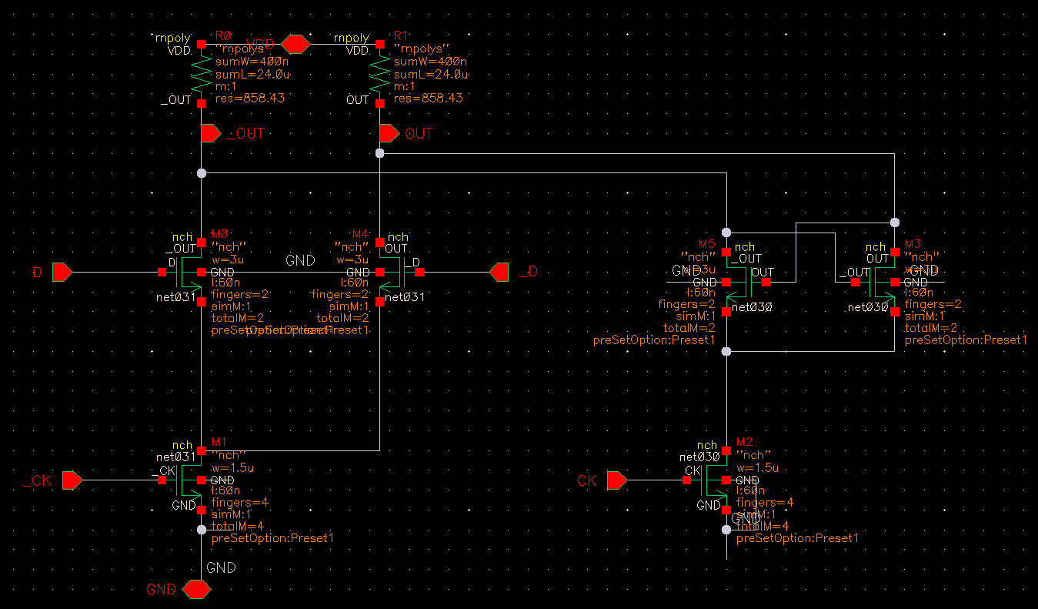
High speed divider
CML latch - master slave FF

Slide 6
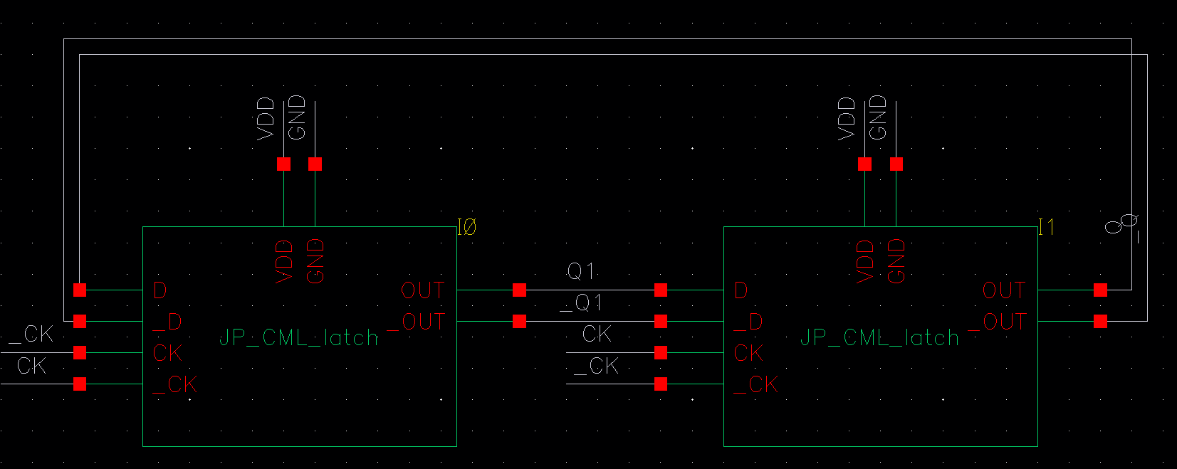
High speed divider

Slide 7
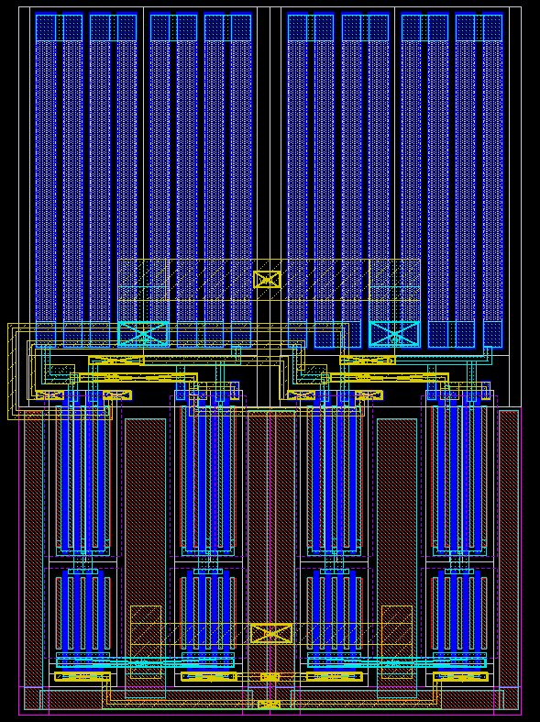

Slide 8
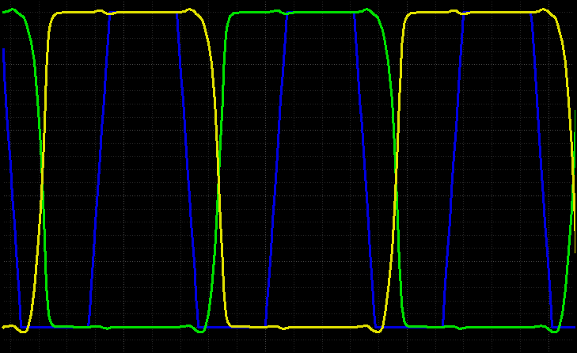

Slide 9
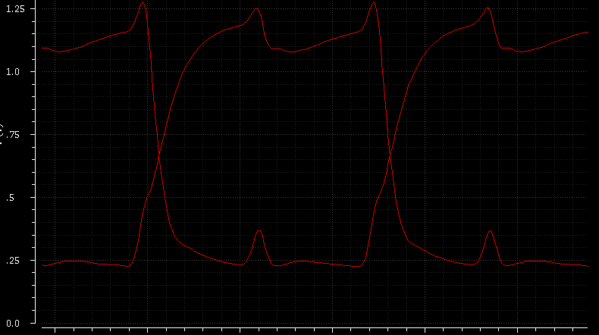

Slide 10
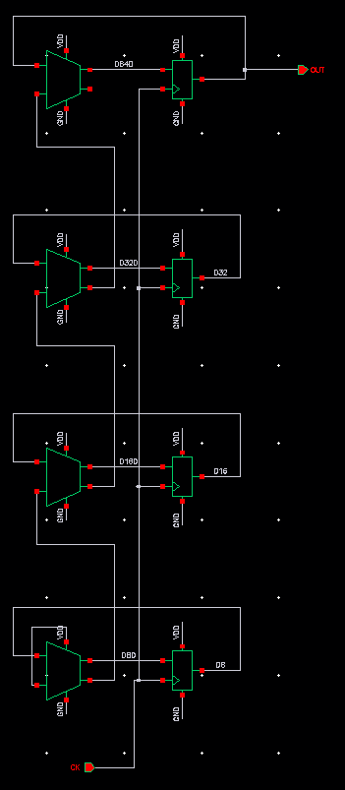
Low speed Divide by 16
Standard cells
Ripple carry adder.
Need other adder?

Slide 11
