Slide 1
PLL meeting
05/03

Slide 2
AFC
HDL triplicated
Feedback voters
Simulated with verilog-PLL model (accurate nonlinear VCO model)
Charge pump : 0.4V – 0.8V
11 bit asynchronous counters (not TMR)

Slide 3
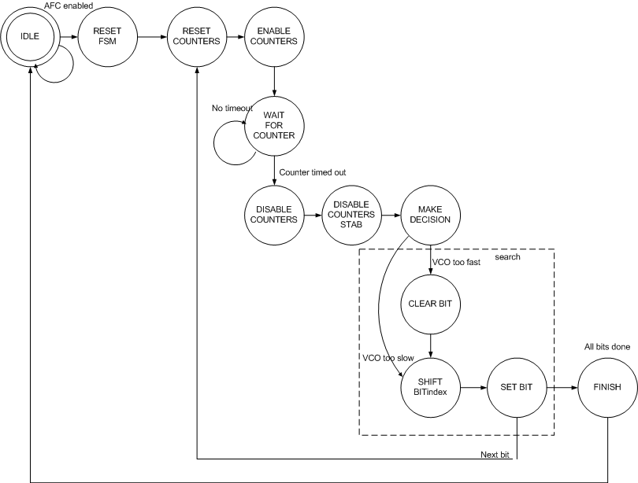

Slide 4
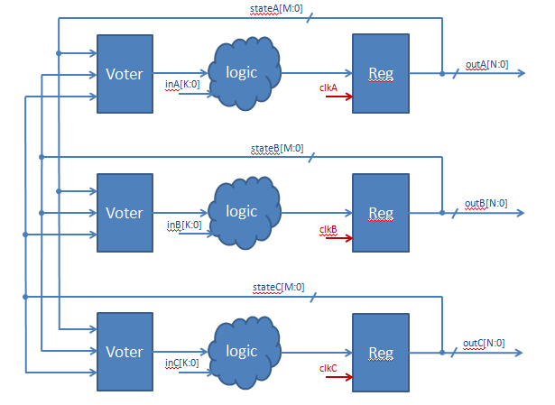

Slide 5
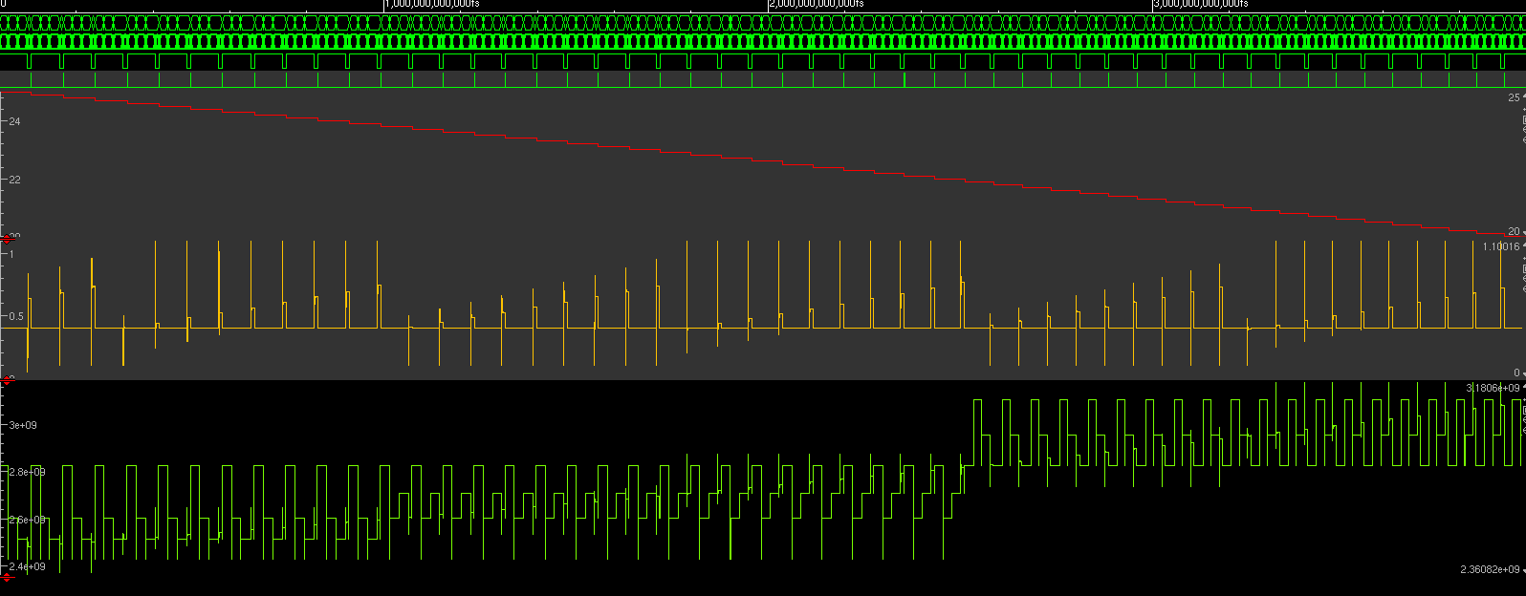
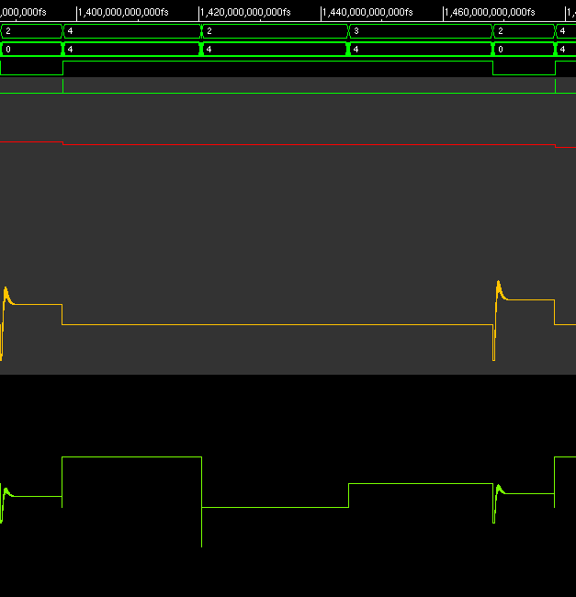

Slide 6
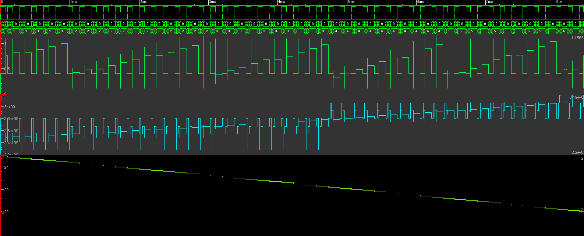
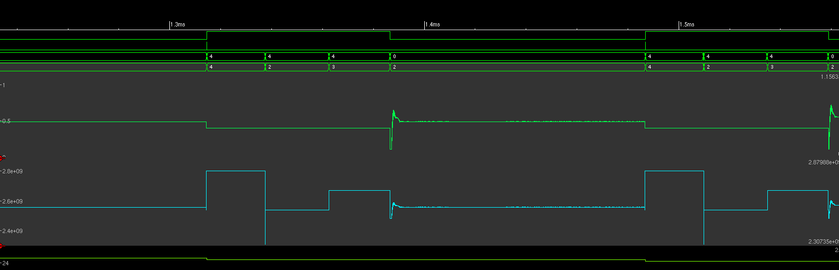

Slide 7
AFC
Verilog module synthesized
  No timing issues (40MHz)
PnR
  Can be done again, takes only 20 minutes

Slide 8
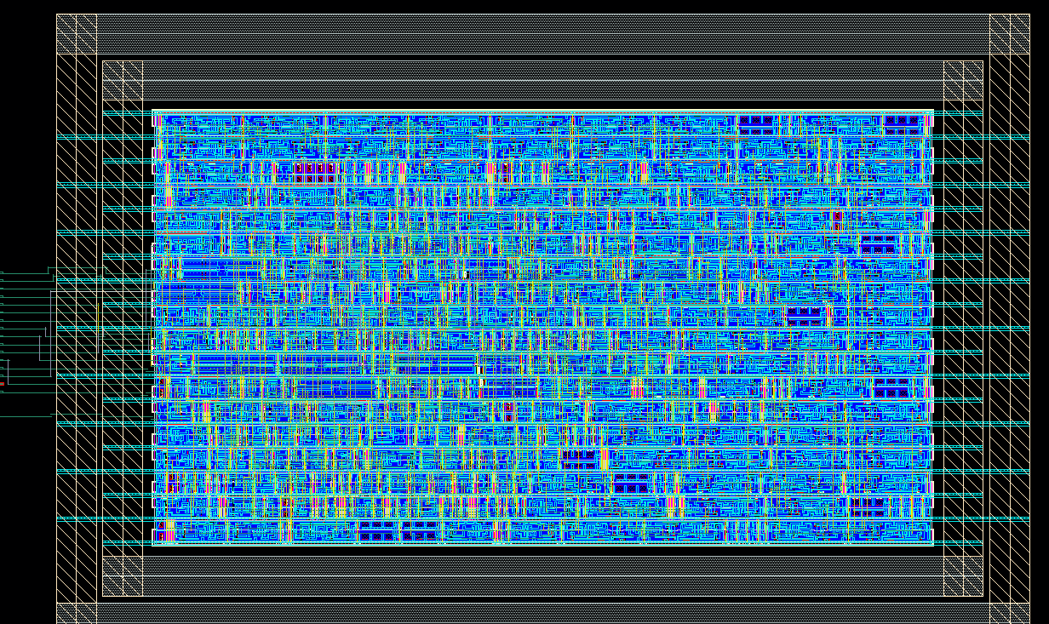

Slide 9
AFC
Part is finished
SET simulated
  stuck-at tests on registers
  Removing input signals
Some aditional features?
  Lock detect?
  Auto – enable

Slide 10
Programming register
Serial input shift register
Need reprogramming (readout) during SET tests
  Needs to be SEU hard
3x or 5x redundant shift register
Refreshing memory register

Slide 11
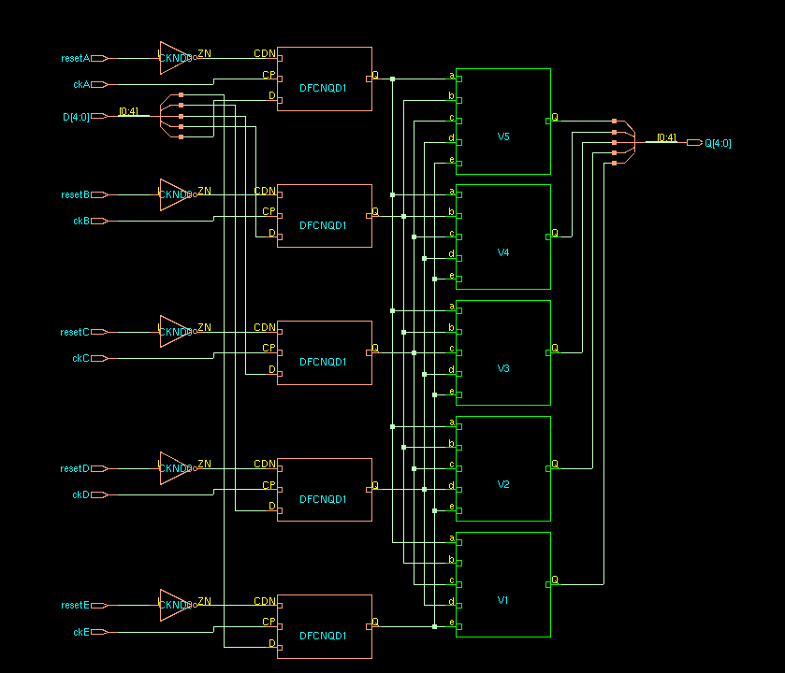
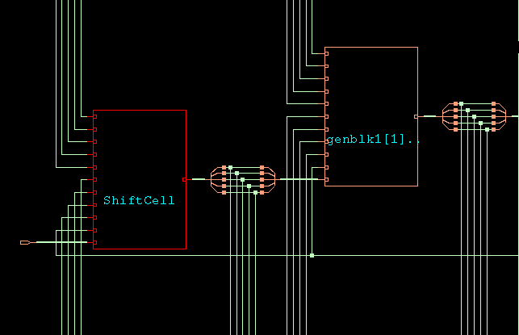
Shift register cell

Slide 12
Memory cell
If E=0
  Q (n)= voted Q(n-1)
If E=1
  Q(n) = D(n) (5 bits)

Slide 13
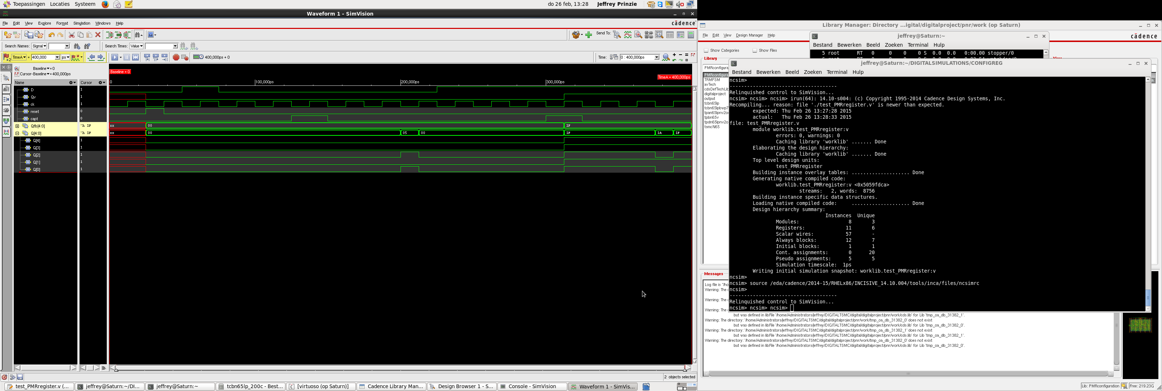
Memory cell 2xSEU

Slide 14
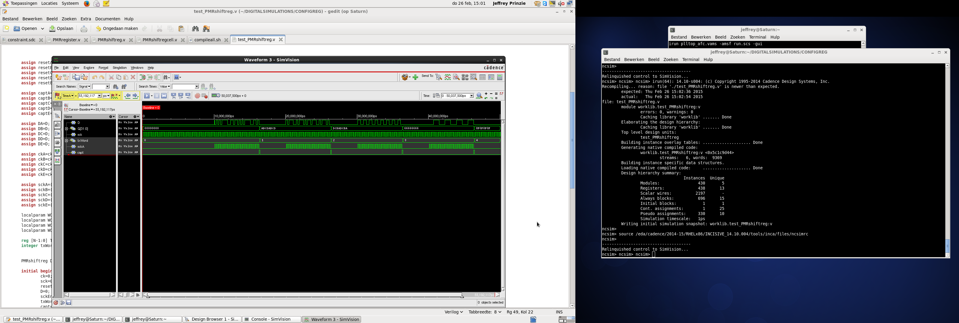
Total shift register
14142 bits test words applied
  ABCDABCD, DCBA DCBA, 66666666,0F0F0F0F
“SCK” an “D” are inputs
Memory cells capture shift register on “capt” (“capt”=enable)

