Slide 2
TDC Design Status
DLL, Finecode Drivers, 3/23/2015
Moritz Horstmann

Slide 3
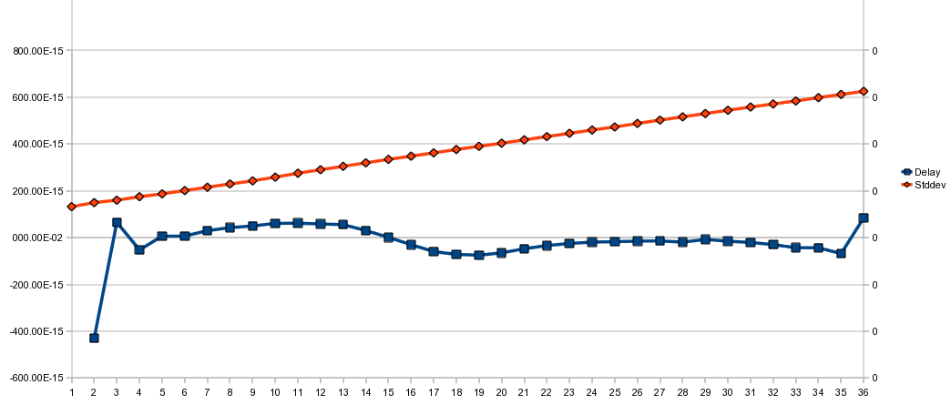
DLL Phase Noise and INL
Blue: Deviation from optimal delay per Cell
Red: RMS of Phase Noise

Slide 4
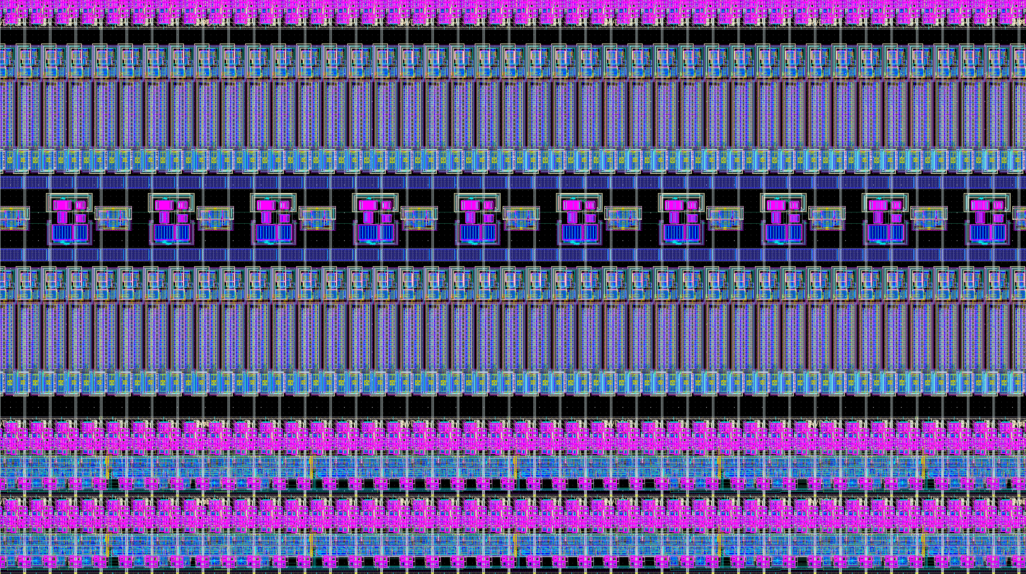
DLL and Finecode Distribution

