Slide 1
Parameter lists for the “new_CLIC” detector model
this version: 20 Nov. 2014
Outline:
-> will need, at some point, to define all the details of new_CLIC
-> have done so once, for the CDR
-> start with tables from the CDR and from supporting material (LCD notes)
“new_CLIC “ resembles CLIC_ILD in important aspects (“the longer detector”)
-> use CLIC_ILD tables from LCD-Note-2011-002
BUT use CLIC_SiD as starting point for the main tracker
Should take this opportunity to “clean up” !

Slide 2
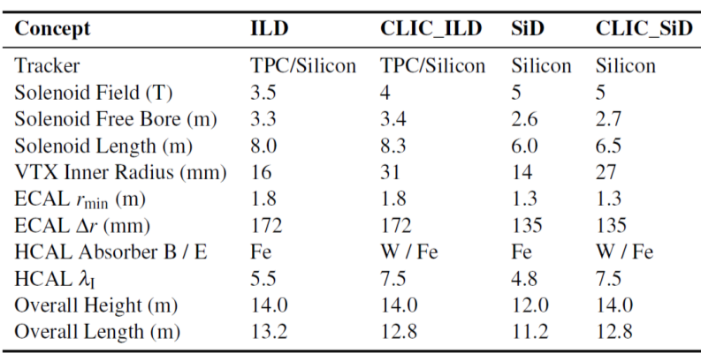
from CDR
new_CLIC
Silicon
4
3.4
8.3
31
1.5
159
Fe
7.5
14 (?)
13.2 (?)
L* (m) 4.4 4.335 3.5 3.5 4.4 (?)

Slide 3
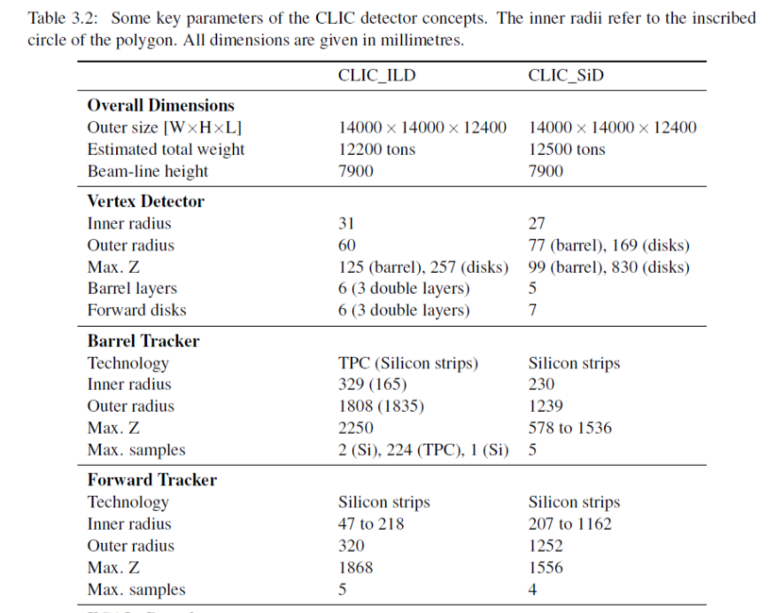
new_CLIC
from CDR
not very important
31
60 (?)
130(barrel),257(disks)(?)
6 3 double layers
6 3 double layers (spirals)
silicon (large pixels ?
pads? and strips )
< 1500 (tdb)
< 2350 (tbd)
7 (?)
silicon
(large pixels ?
pads? Strips ?)
(tbd)

Slide 4
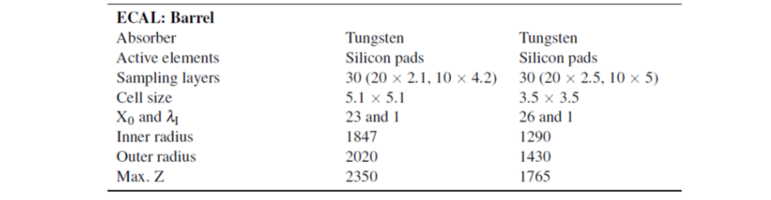
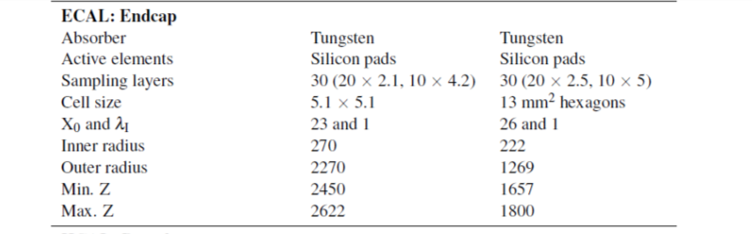
CLIC_ILD
CLIC_SiD
new_CLIC
Tungsten
Silicon pads
25 (17 x 2.4 , 8 x 4.8)
from CDR
5.1 x 5.1
23 and 1 (?)
1500
1659
2350
Tungsten
Silicon pads
25 (17 x 2.4 , 8 x 4.8)
5.1 x 5.1
23 and 1 (?)
270
2270
2450
2609

Slide 5
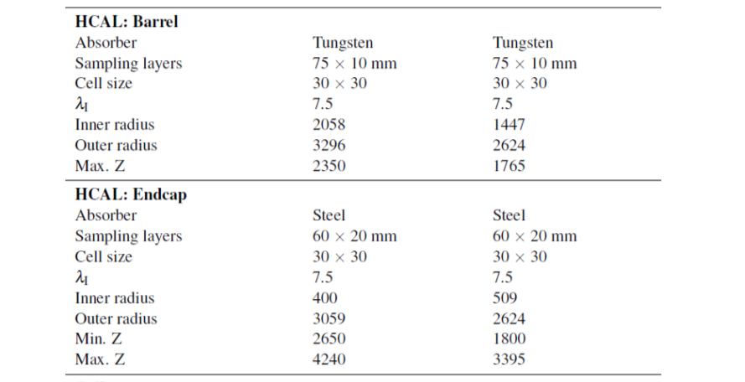
CLIC_ILD
CLIC_SiD
new_CLIC
from CDR
Steel
60 x 20
30 x 30
7.5
1697
3287
2350
Steel
60 x 20
30 x 30
7.5
400 (?)
3059 (?)
2637
4227

Slide 6
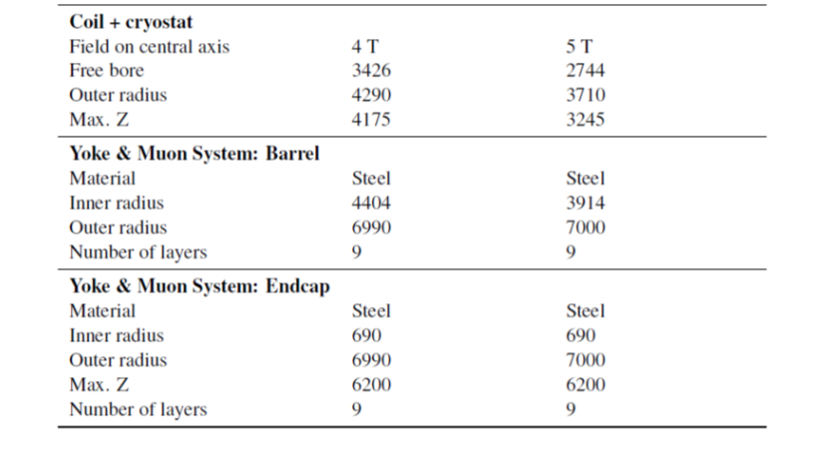
CLIC_ILD
CLIC_SiD
new_CLIC
from CDR
4 T
3417
4281
4175
Steel
4395
6981
9 (?)
Steel
690 (?)
6990 (?)
6000 with end-coils (?)
9 (?)

Slide 7
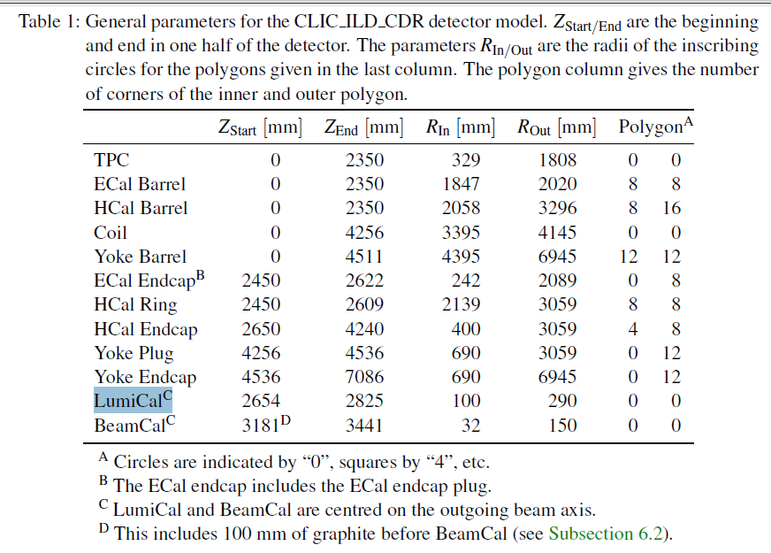
Overview -- from CLIC_ILD
------------------------------------------------------------------------------------------
-----1500
-----1659
-----1705
-----3287
?
?
√
-----2609
-----2637
-----4227

Slide 8
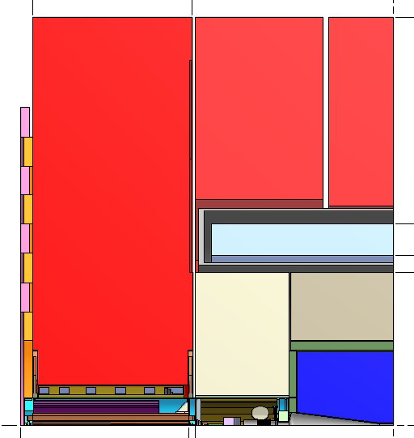
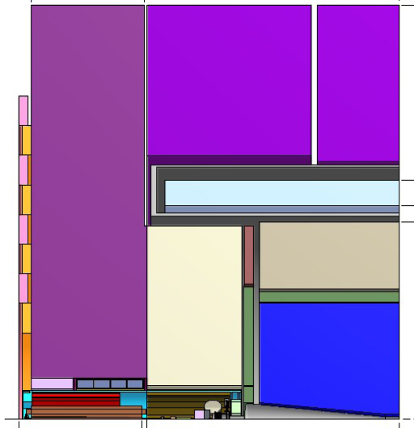
Engineering drawings -- CLIC_SiD and CLIC_ILD
HCAL plug
ECAL plug
ECAL plug

Slide 9
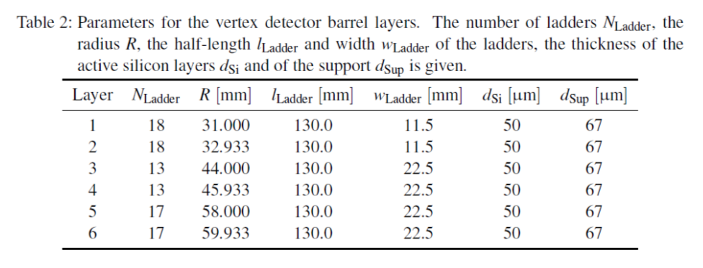
Vertex barrel -- from CLIC_ILD
apparently, no layout change is needed
(but we should change the thickness of the support material…
need to reach 0.4% X_{o} per double layer)
carbon ?
?

Slide 10
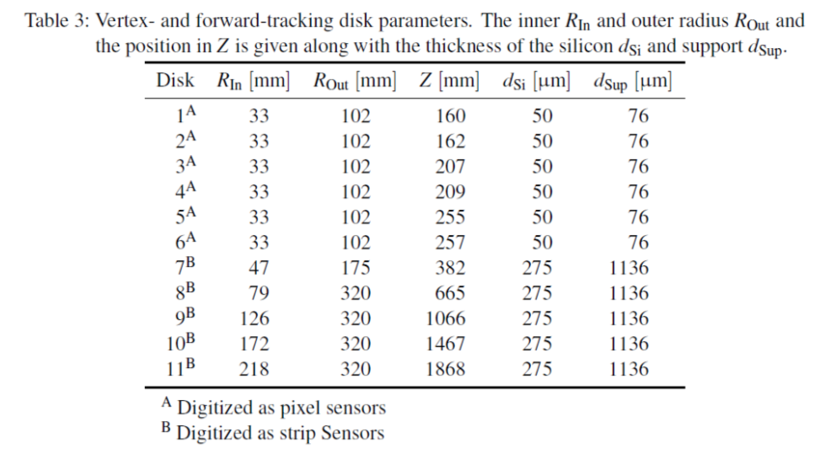
Vertex forward disks -- from CLIC_ILD
New “petals” geometry for VTX fwd disks – tracker see next pages

Slide 11
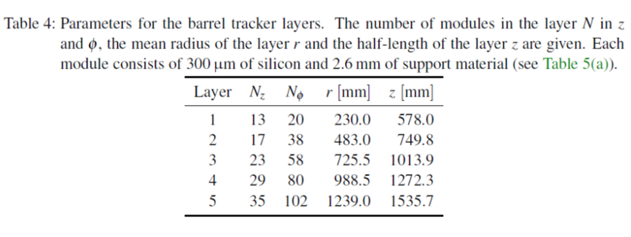
Main Tracker -- from CLIC_SiD
LCD-Note-2011-009

Slide 12
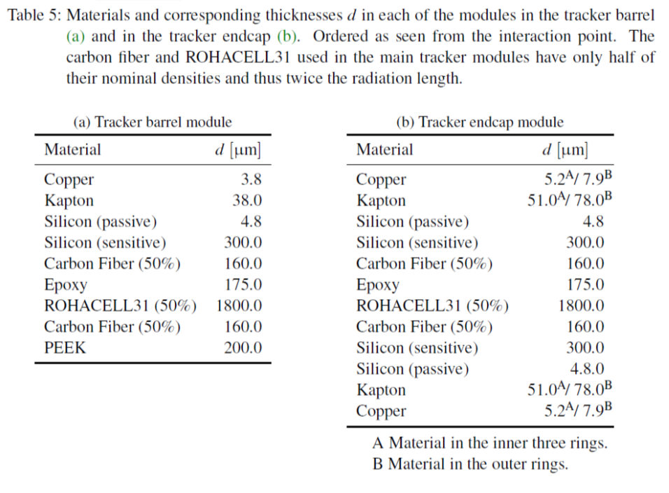
CLIC_SiD

Slide 13
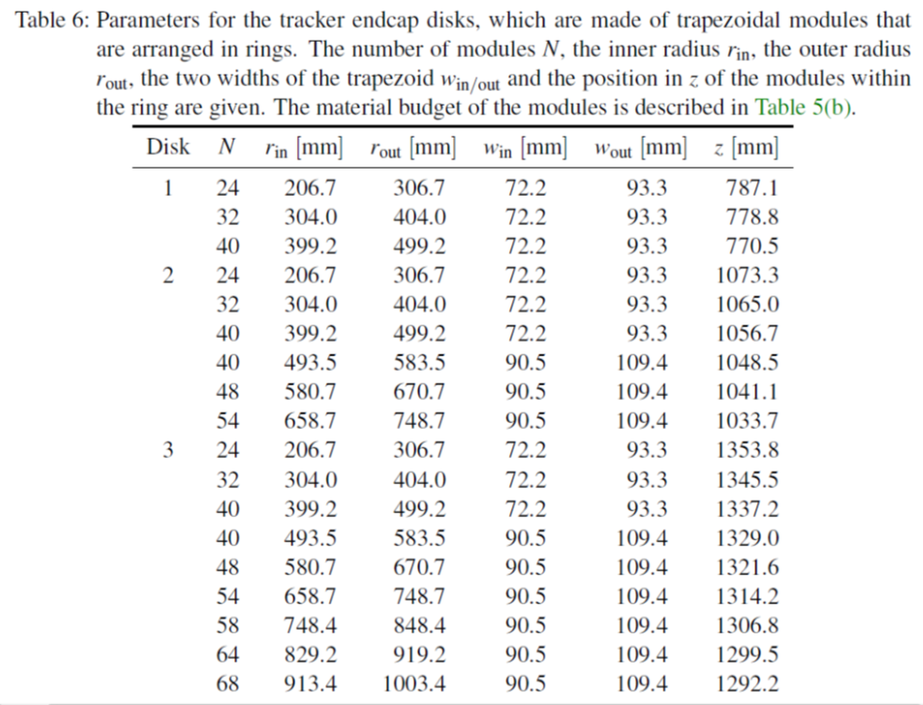
CLIC_SiD

Slide 14
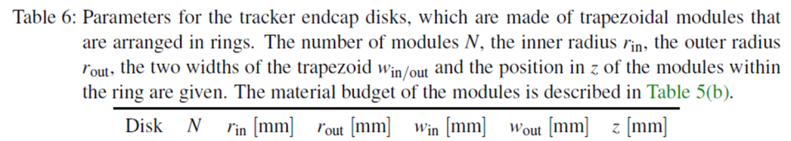
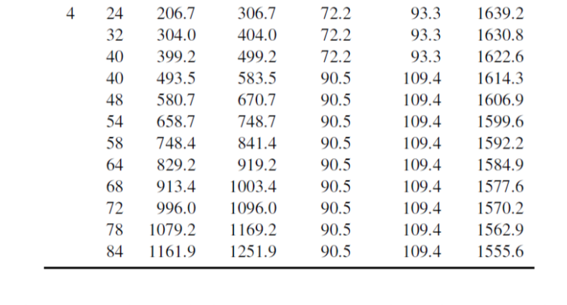
CLIC_SiD (cont. of Table 6)

Slide 15
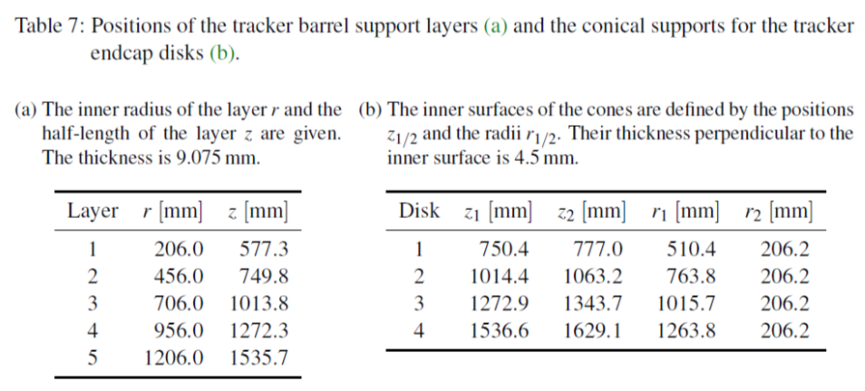
CLIC_SiD

Slide 16
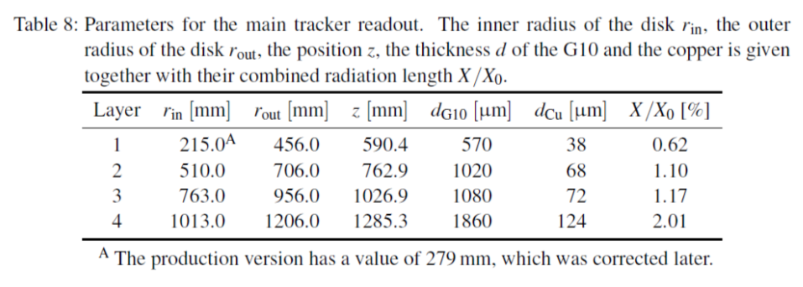
CLIC_SiD

Slide 17
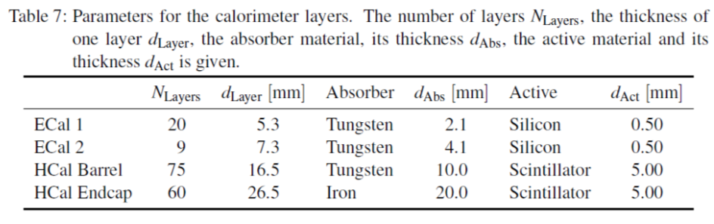
ECAL and HCAL -- from CLIC_ILD
--- 17
--- 5.6
--- 2.4
--- 4.8
--- 8
--- 7.9
4.2
60 26.5 Iron 19.0 + 1
----- 3.0
?
?
?
19.0 + 1
----- 3.0
?
26.5
?
Question: should ECAL and HCAL “end” with a metal layer
(presently the outermost element is a sensor layer)

Slide 18
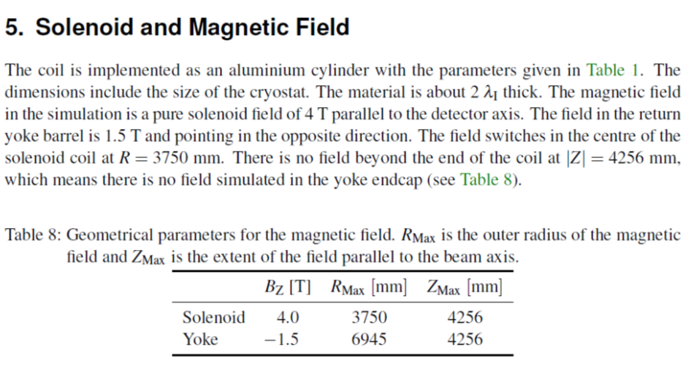
CLIC_ILD
?

Slide 19
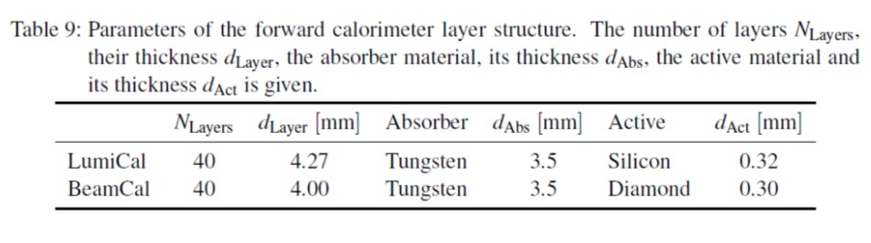
LumiCal and BeamCal -- CLIC_ILD
√

Slide 20
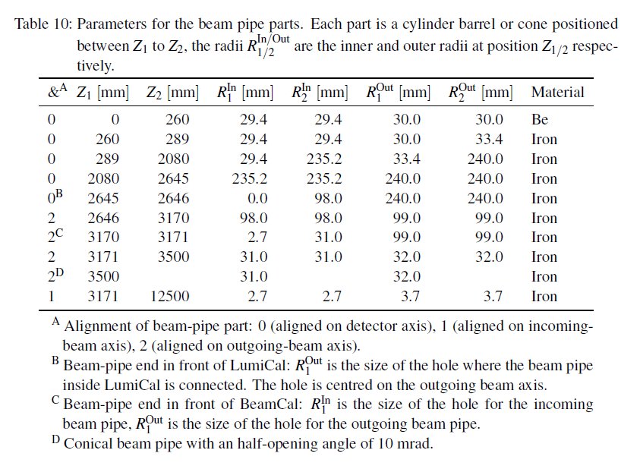
CLIC_ILD

Slide 21
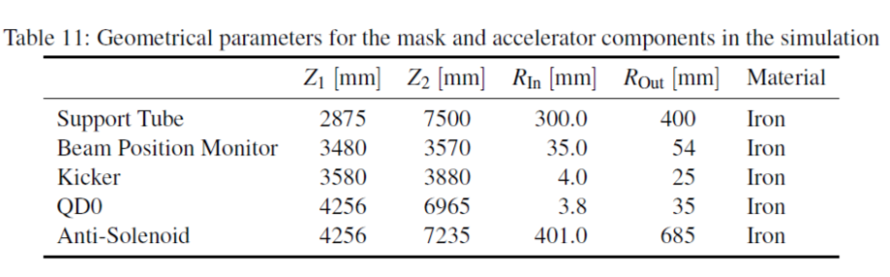
CLIC_ILD

