Slide 1
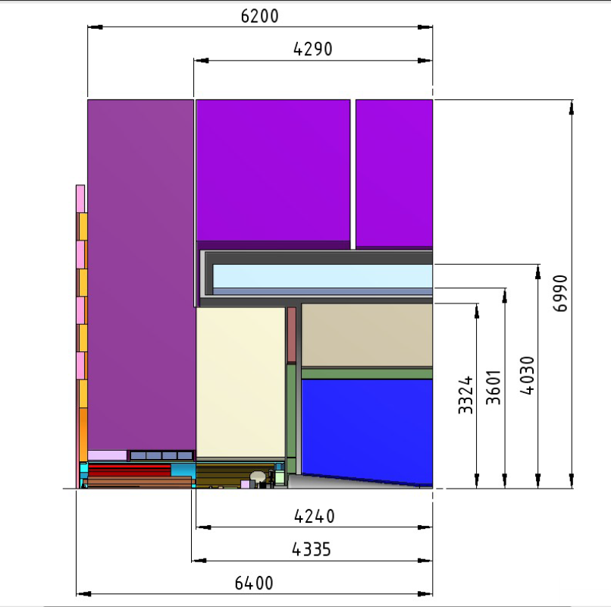
CLIC_ILD

Slide 2
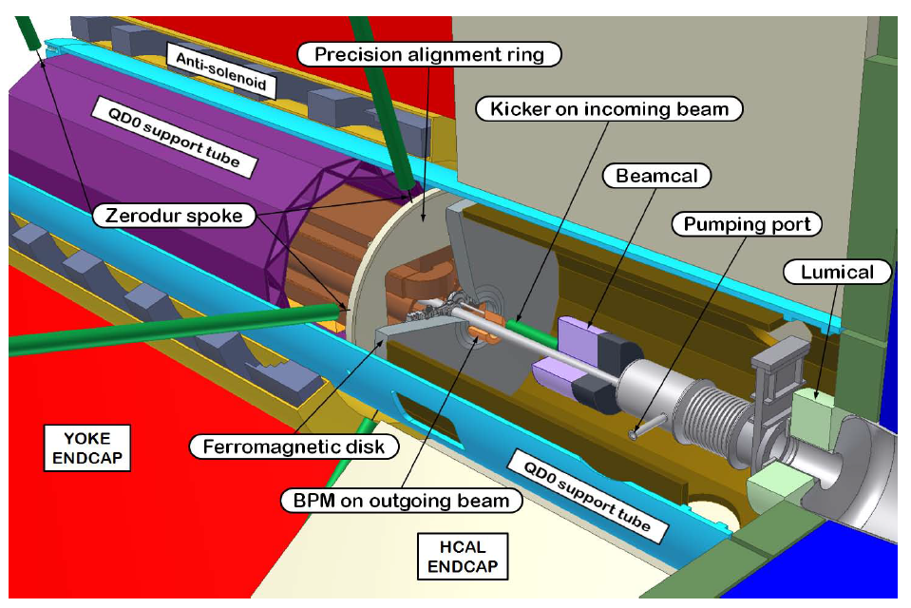
N.B. LumiCal (and BeamCal?) outer radii as shown here do not include readout electronics
(space needed is apparently less than 50 mm in radius)

Slide 3
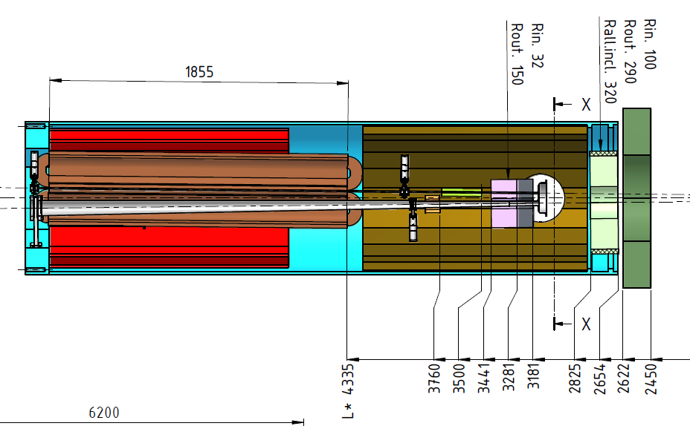
EMDS No. 1151918
(NB. Possibility to reduce LumiCal acceptance – from now outer angle 105 mrad to e.g. 80 mrad)

Slide 4
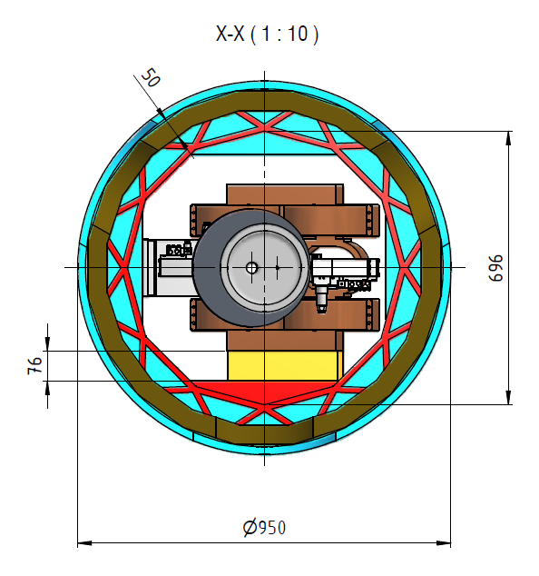
EMDS No. 1151918

Slide 5
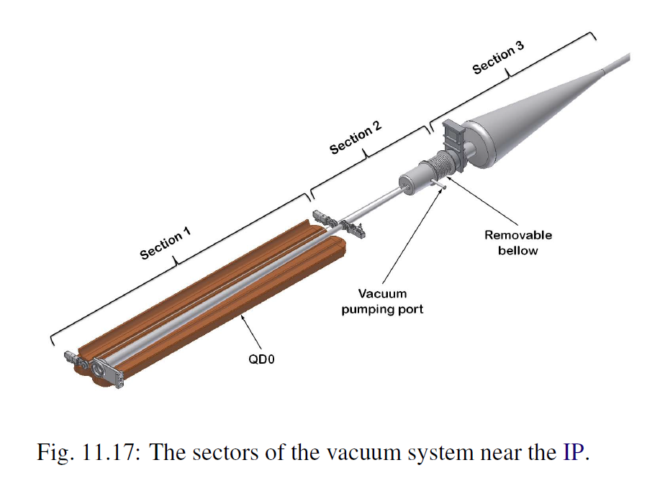
to be discussed (MDI meetings) – much of this layout/sectorisation was motivated by
the need for efficient push-pull operations

