Slide 1


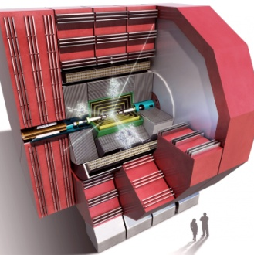
HCal Optimization: Update
Nikiforos Nikiforou
CERN/PH-LCD
CLICdp Optimization Meeting
CERN, 20th of November 2014

Slide 2
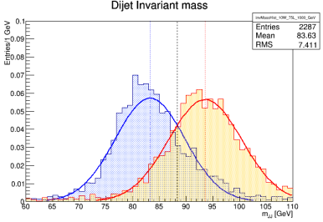
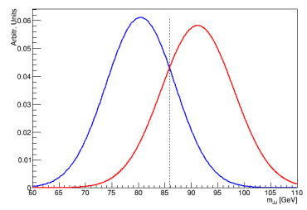
Reminders - Introduction
It was decided to move forward with a Steel HCal Barrel option
Today’s slides just include an update of the previous study with WW/ZZ events ( W/Z invariant mass separation)
Included a few points with Background overlay (60 BX)
Differences from study without background
  Used Tight Timing Cuts for selection of PFOs (before all were used)
  Used R=0.7 Jets (was 1.5)

Slide 3



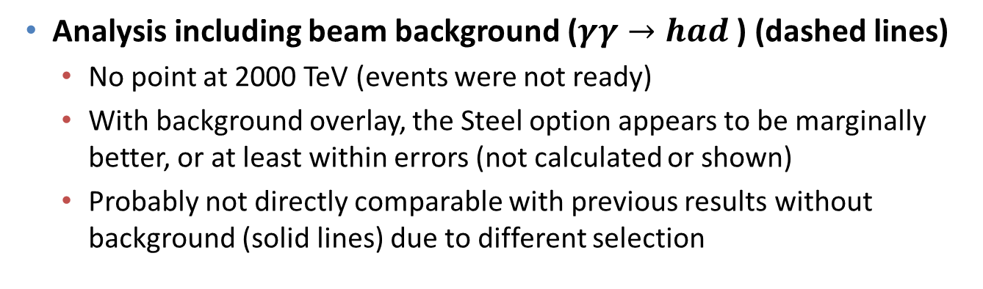
W/Z Separation Study – Updated
W models: 100 ns Barrel
Fe: model: 10 ns Barrel
Both: 10 ns Endcap
Overlap [%]
Separation [$N_{σ}$]
(equivalent separation for ideal gaussians with same σ)
$\sqrt{s}$ [GeV]
$\sqrt{s}$ [GeV]
Analysis including beam background ($γγ→had$) (dashed lines)
  No point at 2000 TeV (events were not ready)
  With background overlay, the Steel option appears to be marginally better, or at least within errors (not calculated or shown)
  Probably not directly comparable with previous results without background (solid lines) due to different selection

Slide 4
Conclusions – Next steps
With background overlay, the performance of the Steel and Tungsten HCal models considered is even more similar
Results appear favor our decision to go with a Steel HCal Barrel
Will attempt to add the missing points and perhaps increase the statistics
Intend to use the W/Z separation method to study the effects of increased HCal coverage
  Removed Beamcal, LumiCal, LHCal from IDL_o1_v06
  Extended HCal endcap to complete hermiticity (ideal case)
  Already generated and simulated events (K0L, WW, ZZ, …) for this model
  No results for today

Slide 5
Bonus material – OLDER PLOTS

Slide 6
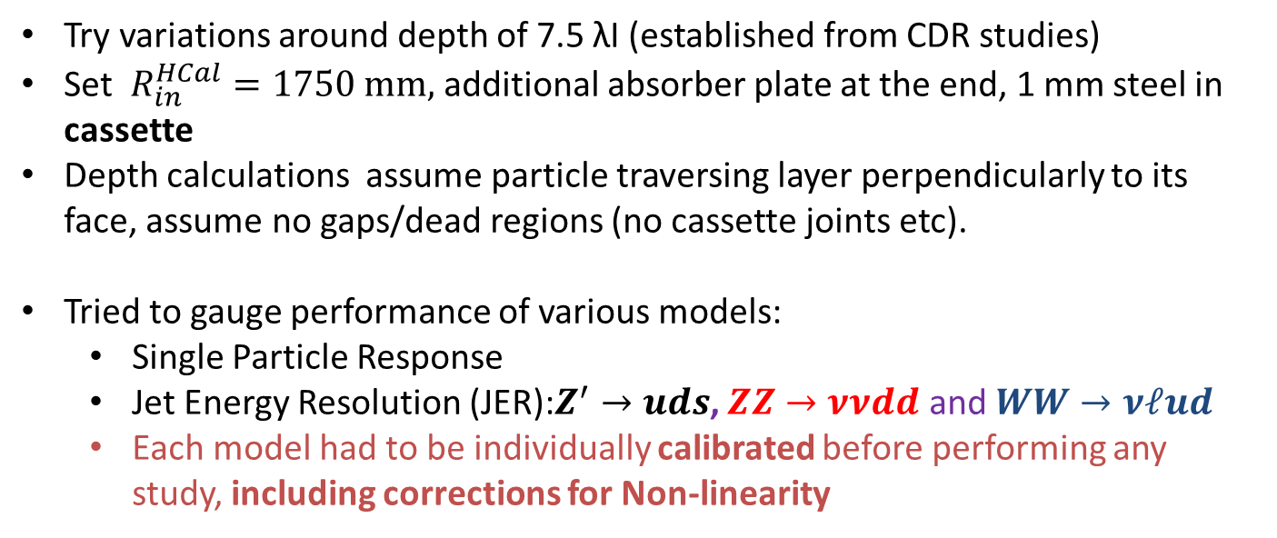
Various Model Options for the HCAL Barrel
Try variations around depth of 7.5 λΙ (established from CDR studies)
Set $R_{in}^{HCal}=1750 mm,$ additional absorber plate at the end, 1 mm steel in cassette
Depth calculations assume particle traversing layer perpendicularly to its face, assume no gaps/dead regions (no cassette joints etc).
Tried to gauge performance of various models:
  Single Particle Response
  Jet Energy Resolution (JER):$Z^{′}→uds$, $ZZ→ννdd$ and $WW→νℓud$
  Each model had to be individually calibrated before performing any study, including corrections for Non-linearity
Detector | # Layers | Abs Thick | Cass. Thick | Air | Total Depth | Total Thickness | Inner R | Outer Face Position | Outer Radius
 |  | mm | mm | mm | #λΙ | mm | mm | mm | mm
CLIC_ILD_CDR | 75 | 10 | 5* (*Scint) | 1.5 | 7.42 | 1237.5 | 2058 | 3295.5 | 3341.2
CLIC_SID_CDR |  |  |  |  |  | 1237.5 | 1447 | 2684.5 | 2721.7
W + cassette | 75 | 10 | 4.8 | 2.7 | 7.92 | 1322.5 | 1750 | 3072.5 | 3115.1
W + cassette | 70 | 10 | 4.8 | 2.7 | 7.40 | 1235 | 1750 | 2985 | 3026.4
Fe + cassette | 60 | 19 | 4.8 | 2.7 | 7.55 | 1609 | 1750 | 3359 | 3405.6
Fe + cassette | 70 | 16 | 4.8 | 2.7 | 7.93 | 1661 | 1750 | 3411 | 3458.3

Slide 7

JER Results For the Most Promising Options
$$\left|\cos{θ_{j}}\right|<0.7$$
Probably the performance for Tungsten shown here is close to its optimal
  Tungsten has been observed to be compensating
Steel on the contrary, may benefit from software compensation -> expect some improvement in JER
  May also explain observed gain from increased timing window (?)

Slide 8
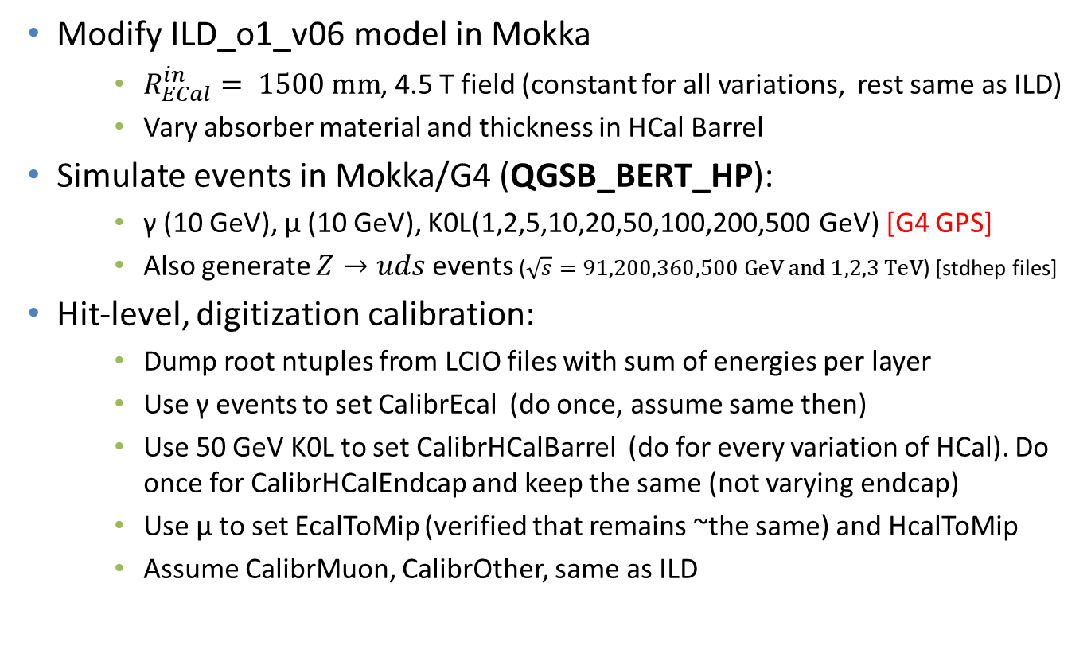
Outline of Calibration Procedure and JER study
Modify ILD_o1_v06 model in Mokka
    $R_{ECal}^{in}= 1500 mm$, 4.5 T field (constant for all variations, rest same as ILD)
    Vary absorber material and thickness in HCal Barrel
Simulate events in Mokka/G4 (QGSB_BERT_HP):
    γ (10 GeV), μ (10 GeV), K0L(1,2,5,10,20,50,100,200,500 GeV) [G4 GPS]
    Also generate $Z→uds$ events ($\sqrt{s}=91,200,360,500 GeV and 1,2,3 TeV$) [stdhep files]
Hit-level, digitization calibration:
    Dump root ntuples from LCIO files with sum of energies per layer
    Use γ events to set CalibrEcal (do once, assume same then)
    Use 50 GeV K0L to set CalibrHCalBarrel (do for every variation of HCal). Do once for CalibrHCalEndcap and keep the same (not varying endcap)
    Use μ to set EcalToMip (verified that remains ~the same) and HcalToMip
    Assume CalibrMuon, CalibrOther, same as ILD

Slide 9
Outline of Calibration Procedure - II
PandoraPFA calibration:
    Run PandoraPFA over the γ events to get ECALToEM , HCALToEM (actually set both to 1 for these studies)
    Run Calibration procedure over the Kaon events to obtain ECALToHAD, HCALToHAD at 50 GeV
    Obtain Non-Linearity Corrections (NLC) [Note Difference from Steve’s studies who does not use NLC]:
      Measure response for 1,2,5,10,20,50,100,200,500 GeV Kaons and calculate scaling factor (extrapolate in-between)
Recalibrate when changing Readout Window Timing Cut
Having these numbers, we can study the Jet Energy Resolution
Use AnalysePerformance (from PandoraAnalysis-v00-06)
Study the performance various models
  Also look at different Timing Cuts

Slide 10
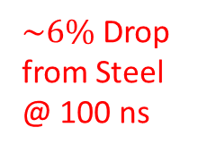


JER Results
$\sim 14\%$ Drop
$\sim 6\%$ Drop from Steel @ 100 ns

Slide 11

Single particle response (K0L)
No errors on plots
Fits to energy distributions from calibration procedure
After application of NLC
Some small discrepancies at low and high ends of the energies
However, taking all plots into consideration and comparing with JER plots, it seems unlikely this is driving the JER performance
I would say that nothing looks extremely suspicious here
Look at timing cut response in more detail (next two slides)

Slide 12
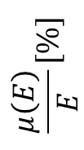
Tungsten and Steel Response to 50 GeV K0L for various Timing Cuts: Fraction of Reconstructed Energy
Tighter timing cut = Smaller Fraction of reconstructed energy
  Tungsten is more sensitive
  Calibration procedure adapts to correct for the lost energy
$$\frac{μ\left(E\right)}{E}[\%]$$
UPDATED NOV 3. SEE FOLLOWING SLIDES FOR OLD PLOT
Readout Window Timing Cut [ns]

Slide 13
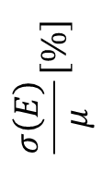
Tungsten and Steel Response to 50 GeV K0L for various Timing Cuts: Energy Resolution (normalized to fitted mean)
First attempt to reproduce previous studies by M. Thomson and J. Marshall (see backup)
Similar conclusion to JER study:
Tungsten@100 ns “outperforms” Steel at 10 ns and 100 ns
$$\frac{σ\left(E\right)}{μ}[\%]$$
UPDATED NOV 3. SEE FOLLOWING SLIDES FOR OLD PLOT
Readout Window Timing Cut [ns]

Slide 14
OLDER (WRONG) PLOTS FOR TIMING RESPONSE IN OVERLAY WITH THE PROPER ONES
There was an error in the configuration for the original dotted lines (response for fixed calibration). Basically the configuration between the two cases (fixed vs cut-dependent calibration) was incompatible
  The original solid lines (cut-dep. Calibration) had the HCAL endcap timing cut fixed to 10 ns both for the calibration and the reconstruction. This configuration is kept for the updated plots
  The original dotted lines (fixed calibration) used the same (varying) timing cut for HCAL endcap and barrel, contrary to the solid lines. Furthermore, the fixed calibration was performed at 1000000 ns vs 10000 ns
$$\frac{μ\left(E\right)}{E}[\%]$$
WAS 1000000 ns IN REALITY!
SEE PREVIOUS SLIDES FOR PROPER VERSION WITHOUT OLD PLOTS
Readout Window Timing Cut [ns]

Slide 15
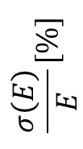
OLDER (WRONG) PLOTS FOR TIMING RESPONSE IN OVERLAY WITH THE PROPER ONES
Same comments as previous slide.
In addition, I replaced this plot (which uses a fixed normalization of 50 GeV) with a version that uses the fitted mean. See slide 10
$$\frac{σ\left(E\right)}{E}[\%]$$
WAS 1000000 ns IN REALITY!
SEE PREVIOUS SLIDES FOR PROPER VERSION WITHOUT OLD PLOTS
Readout Window Timing Cut [ns]

Slide 16
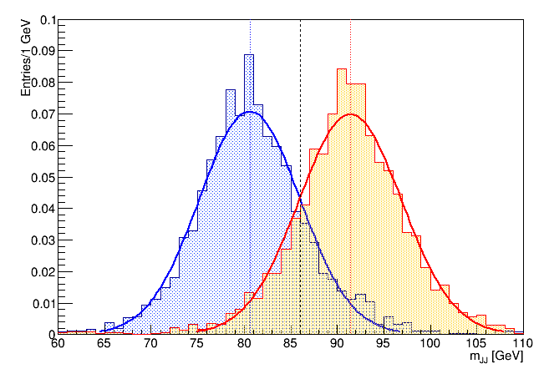
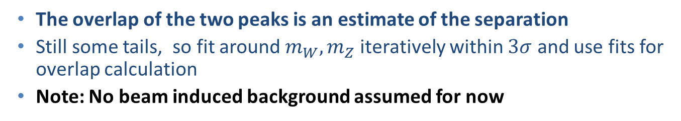

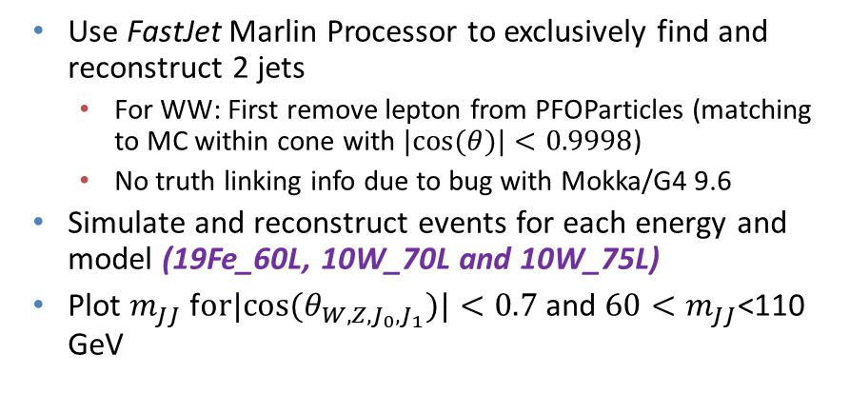
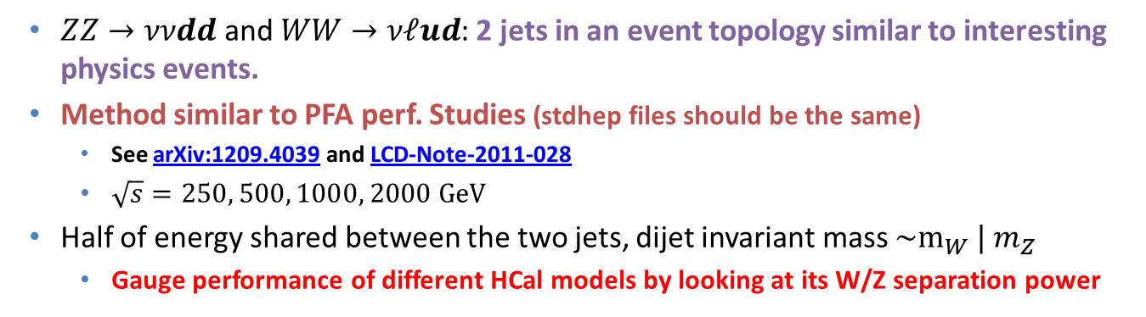
W/Z Separation Study
  $ZZ→ννdd$ and $WW→νℓud$: 2 jets in an event topology similar to interesting physics events.
  Method similar to PFA perf. Studies (stdhep files should be the same)
    See arXiv:1209.4039 and LCD-Note-2011-028
    $\sqrt{s}=250, 500, 1000, 2000 GeV$
  Half of energy shared between the two jets, dijet invariant mass $\sim m_{W} | m_{Z}$
    Gauge performance of different HCal models by looking at its W/Z separation power
Use FastJet Marlin Processor to exclusively find and reconstruct 2 jets
  For WW: First remove lepton from PFOParticles (matching to MC within cone with $|cos⁡(θ)|<0.9998$)
  No truth linking info due to bug with Mokka/G4 9.6
Simulate and reconstruct events for each energy and model (19Fe_60L, 10W_70L and 10W_75L)
Plot $m_{JJ}$ f$or|cos⁡(θ_{W,Z,J_{0},J_{1}})|<0.7$and $60<m_{JJ}$<110 GeV
Example for 19Fe_60L, $\sqrt{s}=1 TeV$
The overlap of the two peaks is an estimate of the separation
Still some tails, so fit around $m_{W},m_{Z}$ iteratively within $3σ$ and use fits for overlap calculation
Note: No beam induced background assumed for now

Slide 17
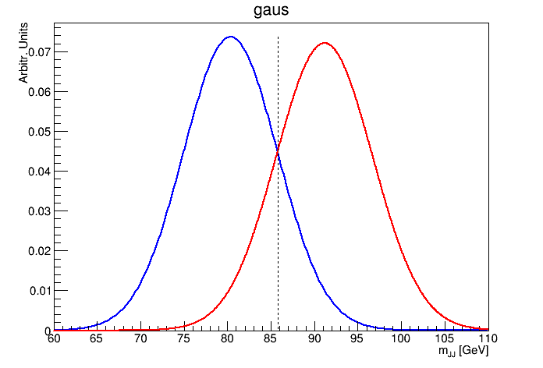
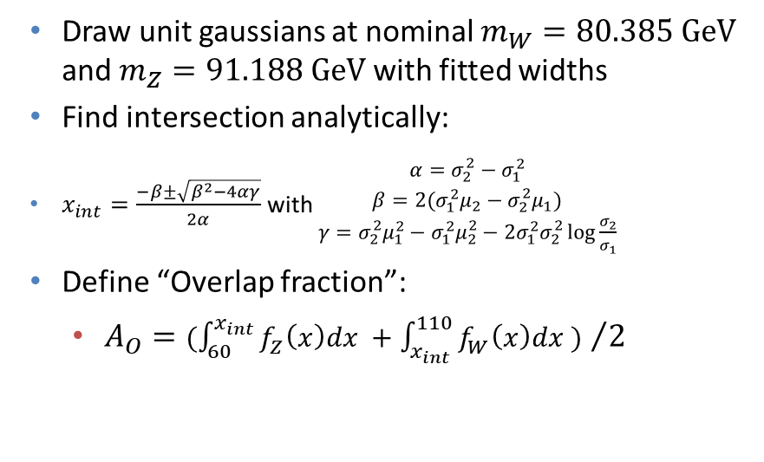
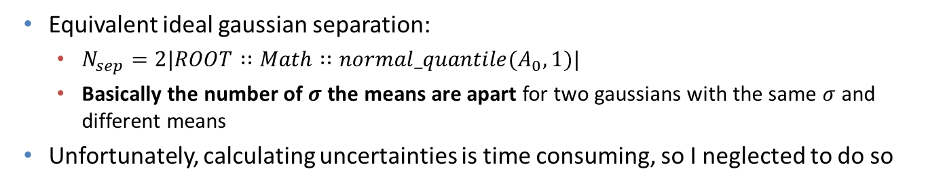
W/Z Separation Study – cont’d
Draw unit gaussians at nominal $m_{W}=80.385 GeV$ and $m_{Z}=91.188 GeV$ with fitted widths
Find intersection analytically:
$x_{int}=\frac{−β±\sqrt{β^{2}−4αγ}}{2α}$ with $\begin{matrix}α=σ_{2}^{2}−σ_{1}^{2} \\ β=2(σ_{1}^{2}μ_{2}−σ_{2}^{2}μ_{1}) \\ γ=σ_{2}^{2}μ_{1}^{2}−σ_{1}^{2}μ_{2}^{2}−2σ_{1}^{2}σ_{2}^{2}\log{\frac{σ_{2}}{σ_{1}}}\end{matrix}$
Define “Overlap fraction”:
  ${A_{O}=(\int_{60}^{x_{int}}{f_{Z}\left(x\right)dx }+\int_{x_{int}}^{110}{f_{W}\left(x\right)dx }) }/2$
Equivalent ideal gaussian separation:
  $N_{sep}=2|ROOT∷Math∷normal_quantile(A_{0},1)|$
  Basically the number of $σ$ the means are apart for two gaussians with the same $σ$ and different means
Unfortunately, calculating uncertainties is time consuming, so I neglected to do so
Energy | 19Fe_60L |  | 10W_70L |  | 10W_75L
[GeV] | Overlap [%] | Nsep [σ] | Overlap [%] | Nsep [σ] | Overlap [%] | Nsep [σ]
250 | 11.3 | 2.4 | 10.6 | 2.5 | 10.3 | 2.5
500 | 11.9 | 2.4 | 11.3 | 2.4 | 10.6 | 2.5
1000 | 16.2 | 2.0 | 14.9 | 2.1 | 14.2 | 2.1
2000 | 22.3 | 1.5 | 21.2 | 1.6 | 22.0 | 1.5

Slide 18
Residuals with Proper Calibration
Residual non-linearity to be investigated more
See next slides for single particle response

Slide 19
Residuals with Proper Calibration
Residual non-linearity to be investigated more
See next slides for single particle response

Slide 20
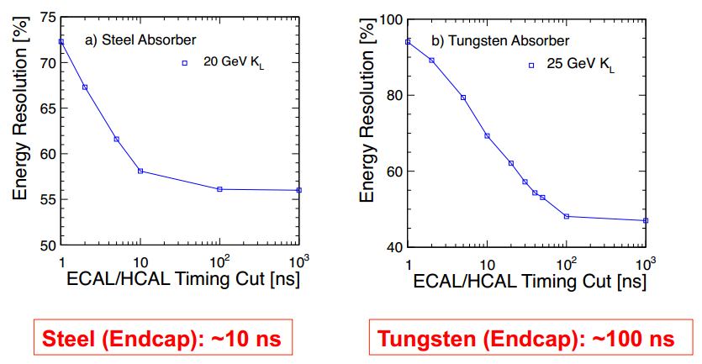
Reminder: Readout Windows
See talks by M. Thompson:
  http://indico.cern.ch/event/115459/contribution/14/material/slides/0.pdf (slides 3,4)
  https://agenda.linearcollider.org/getFile.py/access?contribId=13&sessionId=1&resId=0&materialId=slides&confId=5134 (slides 16,17…)
Further timing cuts (mainly for background/pileup suppression) are applied at the PFO level. NOT CONSIDERED IN THE STUDY PRESENTED TODAY
  We will apply cuts at the digitization level

Slide 21
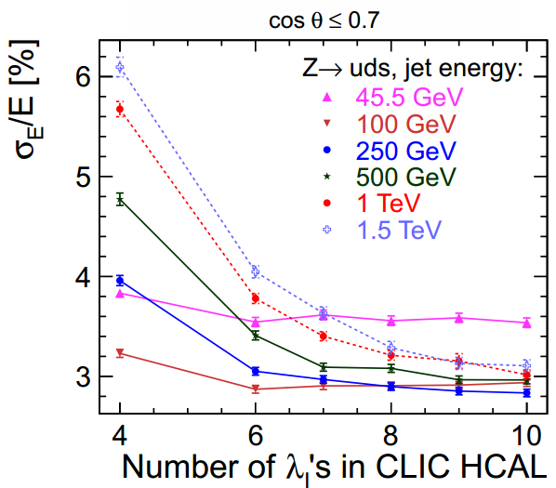
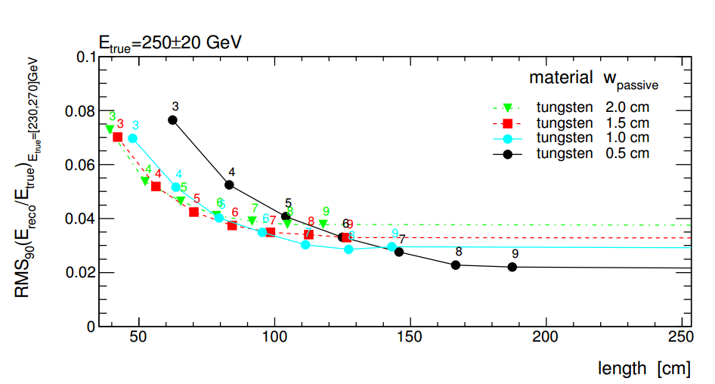
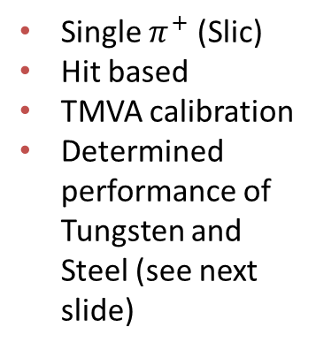
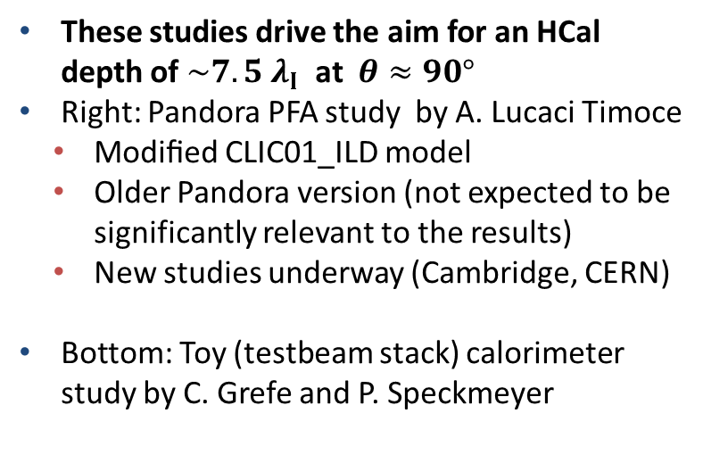

Plots from CDR
These studies drive the aim for an HCal depth of $\sim 7.5 λ_{Ι}$ at $θ≈90°$
Right: Pandora PFA study by A. Lucaci Timoce
  Modiﬁed CLIC01_ILD model
  Older Pandora version (not expected to be significantly relevant to the results)
  New studies underway (Cambridge, CERN)
Bottom: Toy (testbeam stack) calorimeter study by C. Grefe and P. Speckmeyer
CDR Fig. 6.2 and Refs. [3,4]
Single $π^{+}$ (Slic)
Hit based
TMVA calibration
Determined performance of Tungsten and Steel (see next slide)
Numbers indicate $\#λ_{Ι}$
CDR Fig. 6.1, see also Ref. [1]

Slide 22
Material Scan of W-HCAL (CLIC_SID_CDR)
Try to verify material budget in current detector geometry implementations
See whether we can squeeze some more the HCal outer radius
Scan using Slic/Geant4 (see backup)
Geometry Parameters:
(www.lcsim.org/detectors/clic_sid_cdr.html)
HCAL BARREL
Number Of Layers | 75
Number Of Sides | 12
Inner Radius | 1419 mm
Outer Radius | 2656.5 mm
Z Length | 3530 mm
Section Phi | 0.52 radians
Cell Size U | 30.0 mm
Cell Size V | 30.0 mm
Layers 0 - 74
10 mm | Tungsten
5 mm (sensor) | Polystyrene
1.5 mm | Air

Slide 23

CLIC_SID_CDR Material Scan in θ

Slide 24
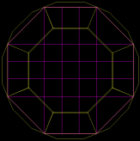
CLIC_ILD_CDR Material Scan in φ
Scan using Mokka/Geant4 (see backup)
Geometry Parameters:
(from CDR and http://www-flc.desy.de/ldcoptimization/tools/mokkamodels.php?model=CLIC_ILD_CDR)
HCAL BARREL | SHcalSc02
Number Of Layers | 75
Number Of Sides | (8) 16
Inner Radius | 2058 mm
Outer Radius | 3296 mm
Z Length | 4700 mm
Section Phi | 0.52 radians
Cell Size U | 30.0 mm
Cell Size V | 30.0 mm
Layers 0 - 74
10 mm | Tungsten
5 mm (sensor) | Polystyrene
1.5 mm | Air

Slide 25
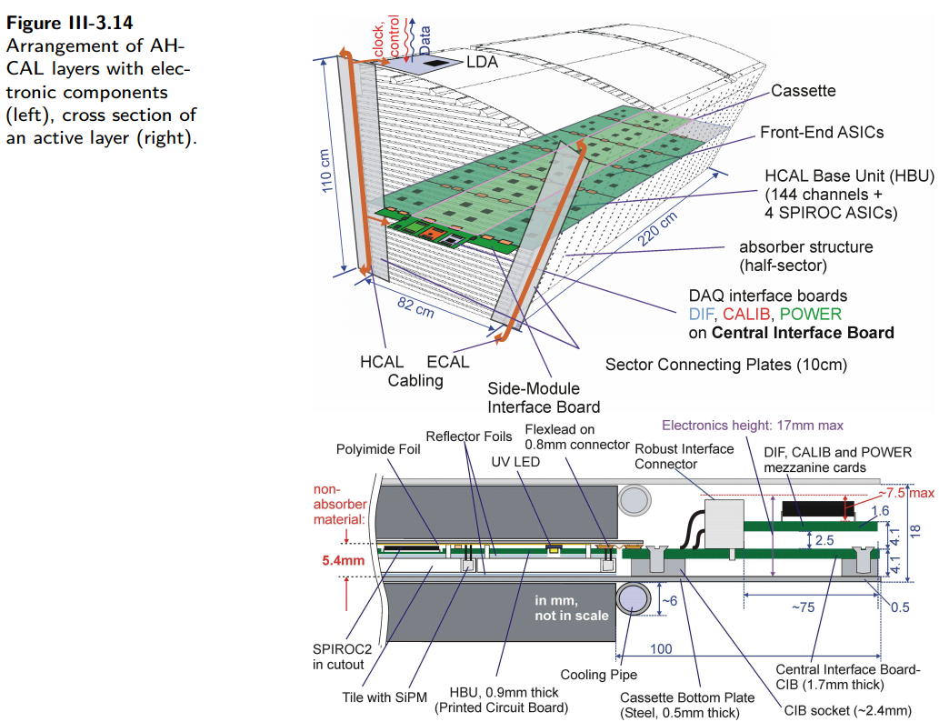
ILD AHCAL Assembly (from ILD TDR)
Active Element Cassette |  | ILD
Material | Thickness | Thickness
 | mm | mm
Steel | 2 | 0.5
PCB | 1.4 | 1
Cu (etching) | 0.1 | 0
Electronics (30%) | 1.5 | 1
Scintillator | 5 | 3
Sum (per layer) | 10 | 5.5
#λΙ (per layer) | 0.02 | 0.01
NB: ILD TDR also mentions “The active layers will contribute 4 mm of steel to each absorption layer”
Not shown in diagram?
16 mm (absorber layer) +
4 mm = 20 mm steel
+0.5 mm bottom plate?
Not clear what is done in code (comment says ignored)

