Slide 1

Future Detectors 1/3
Werner Riegler, CERN, werner.riegler@cern.ch
June 30th , 2015

Slide 2
Lecture 1
Past Detectors
A History of Instrumentation

Slide 3
History of Particle Physics
1895: X-rays, W.C. Röntgen
1896: Radioactivity, H. Becquerel
1899: Electron, J.J. Thomson
1911: Atomic Nucleus, E. Rutherford
1919: Atomic Transmutation, E. Rutherford
1920: Isotopes, E.W. Aston
1920-1930: Quantum Mechanics, Heisenberg, Schrödinger, Dirac
1932: Neutron, J. Chadwick
1932: Positron, C.D. Anderson
1937: Mesons, C.D. Anderson
1947: Muon, Pion, C. Powell
1947: Kaon, Rochester
1950: QED, Feynman, Schwinger, Tomonaga
1955: Antiproton, E. Segre
1956: Neutrino, Rheines
etc. etc. etc.

Slide 4
History of Instrumentation
1906: Geiger Counter, H. Geiger, E. Rutherford
1910: Cloud Chamber, C.T.R. Wilson
1912: Tip Counter, H. Geiger
1928: Geiger-Müller Counter, W. Müller
1929: Coincidence Method, W. Bothe
1930: Emulsion, M. Blau
1940-1950: Scintillator, Photomultiplier
1952: Bubble Chamber, D. Glaser
1962: Spark Chamber
1968: Multi Wire Proportional Chamber, C. Charpak
Etc. etc. etc.

Slide 5
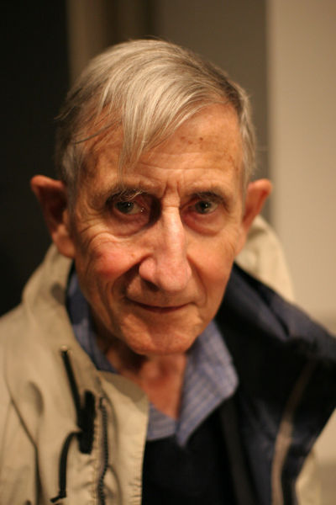
On Tools and Instrumentation
“New directions in science are launched by new tools much more often than by new concepts.
The effect of a concept-driven revolution is to explain old things in new ways.
The effect of a tool-driven revolution is to discover new things that have to be explained”
From Freeman Dyson ‘Imagined Worlds’

Slide 6
Physics Nobel Prices for Instrumentation
1927: C.T.R. Wilson, Cloud Chamber
1939: E. O. Lawrence, Cyclotron & Discoveries
1948: P.M.S. Blacket, Cloud Chamber & Discoveries
1950: C. Powell, Photographic Method & Discoveries
1954: Walter Bothe, Coincidence method & Discoveries
1960: Donald Glaser, Bubble Chamber
1968: L. Alvarez, Hydrogen Bubble Chamber & Discoveries
1992: Georges Charpak, Multi Wire Proportional Chamber
All Nobel Price Winners related to the Standard Model: 89 !
(biased personal statistics by W. Riegler
http://www.nobelprize.org/nobel_prizes/physics/)
31 for Standard Model Experiments
13 for Standard Model Instrumentation and Experiments
3 for ‘Standard Model Instrumentation’
23 for Standard Model Theory
9 for Quantum Mechanics Theory
9 for Quantum Mechanics Experiments
1 for Relativity
56 for Experiments and Instrumentation
33 for Theory

Slide 7
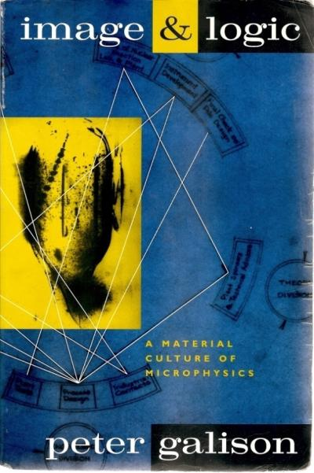
History of Instrumentation
History of ‘Particle Detection’
Image Tradition: Cloud Chamber
Emulsion
Bubble Chamber
Logic Tradition: Scintillator
Geiger Counter
Tip Counter
Spark Counter
Electronics Image: Wire Chambers
Silicon Detectors
…
Peter Galison, Image and Logic
A Material Culture of Microphysics

Slide 8
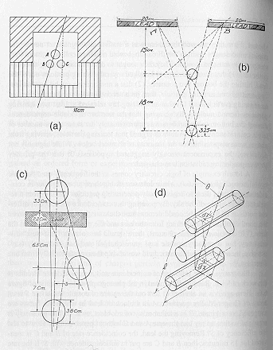
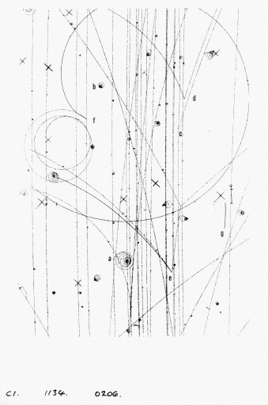
History of Instrumentation
Image Detectors
‘Logic (electronics) Detectors ’
Bubble chamber photograph
Early coincidence counting experiment

Slide 9
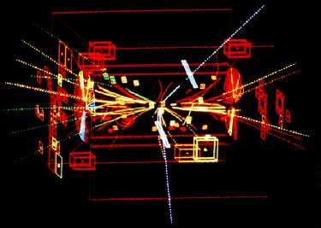
History of Instrumentation
Both traditions combine into the ‘Electronics Image’ during the 1970ies
Z-Event at UA1 / CERN

Slide 10
IMAGES

Slide 11
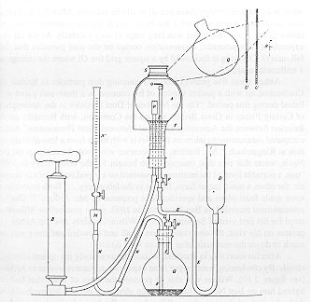
Cloud Chamber
John Aitken, *1839, Scotland:
Aitken was working on the meteorological question of
cloud formation. It became evident that cloud
droplets only form around condensation nuclei.
Aitken built the ‘Dust Chamber’ to do controlled
experiments on this topic. Saturated water vapor
is mixed with dust. Expansion of the volume leads to
super-saturation and condensation around the
dust particles, producing clouds.
From steam nozzles it was known and speculated that
also electricity has a connection to cloud formation.
Dust Chamber, Aitken 1888

Slide 12
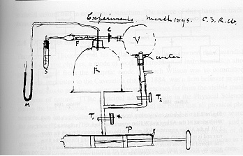
Cloud Chamber
Charles Thomson Rees Wilson, * 1869, Scotland:
Wilson was a meteorologist who was, among other things, interested in cloud formation initiated by electricity.
In 1895 he arrived at the Cavendish Laboratory where J.J. Thompson, one of the chief proponents of the corpuscular nature of electricity, had studied the discharge of electricity through gases since 1886.
Wilson used a ‘dust free’ chamber filled with saturated water vapor to study the cloud formation
caused by ions present in the chamber.
Cloud Chamber, Wilson 1895

Slide 13
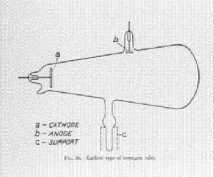
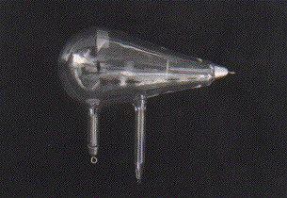
Cloud Chamber
Conrad Röntgen discovered X-Rays in 1895.
At the Cavendish Lab Thompson and Rutherford found that irradiating a gas with X-rays increased it’s conductivity suggesting that X-rays produced ions in the gas.
Wilson used an X-Ray tube to irradiate his Chamber and found ‘a very great increase in the number of the drops’, confirming the hypothesis that ions are cloud formation nuclei.
Radioactivity (‘Uranium Rays’) discovered by Becquerel in 1896. It produced the same effect in the cloud chamber.
1899 J.J. Thompson claimed that cathode rays are
fundamental particles → electron.
Soon afterwards it was found that rays from radioactivity consist of alpha, beta and gamma rays (Rutherford).
This tube is a glass bulb with positive and negative electrodes, evacuated of air, which displays a fluorescent glow when a high voltage current is passed though it. When he shielded the tube with heavy black cardboard, he found that a greenish fluorescent light could be seen from a platinobaium screen 9 feet away.

Slide 14
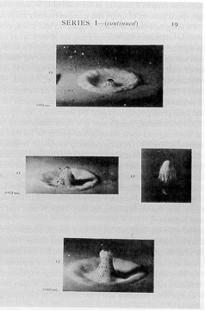
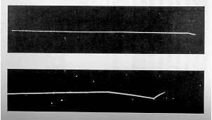
Cloud Chamber
Using the cloud chamber Wilson also did rain
experiments i.e. he studied the question on how
the small droplets forming around the condensation
nuclei are coalescing into rain drops.
In 1908 Worthington published a book on ‘A Study
of Splashes’ where he shows high speed photographs
that exploited the light of sparks enduring only a few
microseconds.
This high-speed method offered Wilson the technical
means to reveal the elementary processes of
condensation and coalescence.
With a bright lamp he started to see tracks even by eye !
By Spring 1911 Wilson had track photographs from
from alpha rays, X-Rays and gamma rays.
Worthington 1908
Early Alpha-Ray picture, Wilson 1912

Slide 15
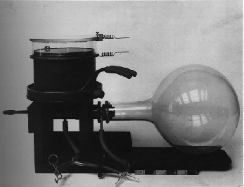
Cloud Chamber
Wilson Cloud Chamber 1911

Slide 16
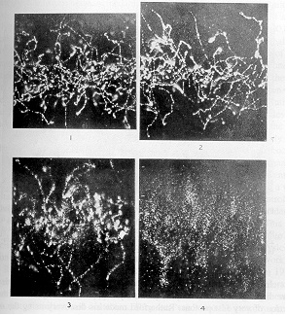
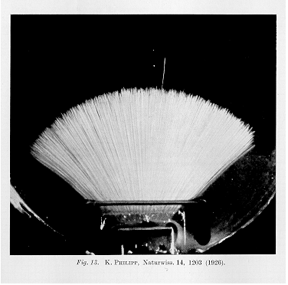
Cloud Chamber
X-rays, Wilson 1912
Alphas, Philipp 1926

Slide 17
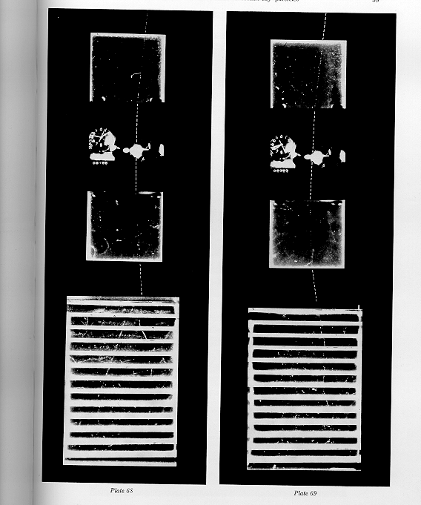
Cloud Chamber
1931 Blackett and Occhialini began
work on a counter controlled
cloud chamber for cosmic ray
physics to observe selected rare
events.
The coincidence of two Geiger
Müller tubes above and below the
Cloud Chamber triggers the
expansion of the volume and the
subsequent Illumination for
photography.

Slide 18
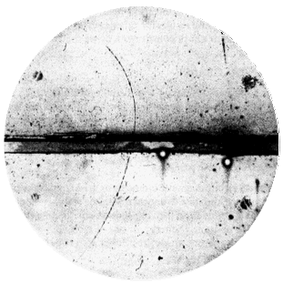
Cloud Chamber
Magnetic field 15000 Gauss,
chamber diameter 15cm. A 63 MeV
positron passes through a 6mm lead plate,
leaving the plate with energy 23MeV.
The ionization of the particle, and its
behaviour in passing through the foil are
the same as those of an electron.
Positron discovery,
Carl Andersen 1933

Slide 19
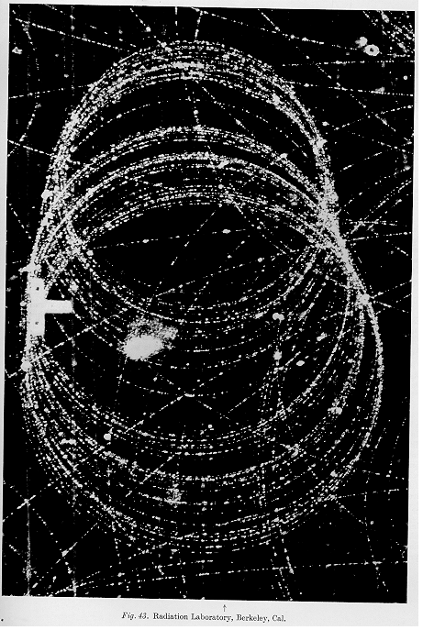
Cloud Chamber
The picture shows and electron with 16.9 MeV initial energy. It spirals about 36 times in the magnetic field.
At the end of the visible track the energy has decreased to 12.4 MeV. from the visible path length (1030cm) the energy loss by ionization is calculated to be 2.8MeV.
The observed energy loss (4.5MeV) must therefore be cause in part by
Bremsstrahlung. The curvature indeed shows sudden changes as can
Most clearly be seen at about the seventeenth circle.
Fast electron in a magnetic field at the Bevatron, 1940

Slide 20
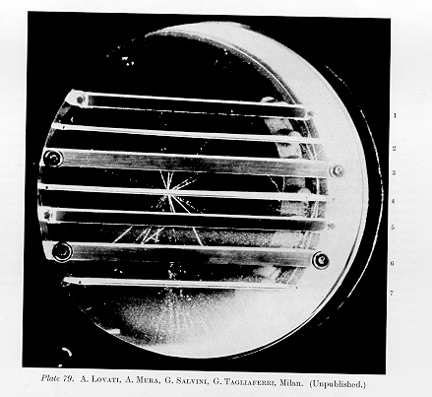
Cloud Chamber
Taken at 3500m altitude in
counter controlled cosmic ray
Interactions.
Nuclear disintegration, 1950

Slide 21
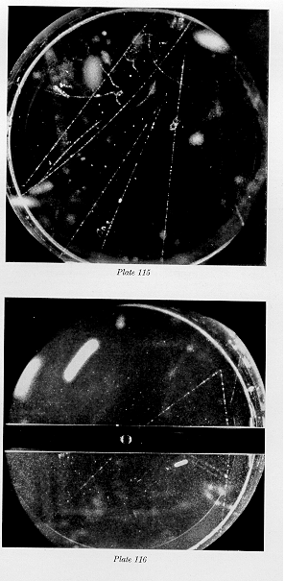
Cloud Chamber
Particle momenta are measured by the bending
in the magnetic field.
‘ … The V0 particle originates in a nuclear
Interaction outside the chamber and decays after
traversing about one third of the chamber.
The momenta of the secondary particles are
1.6+-0.3 BeV/c and the angle between them is 12 degrees … ‘
By looking at the specific ionization one can try to identify the particles and by assuming a two body decay on can find the mass of the V0.
‘… if the negative particle is a negative proton, the mass of the V0 particle is 2200 m, if it is a Pi or Mu
Meson the V0 particle mass becomes about 1000m
…’
Rochester and Wilson

Slide 22
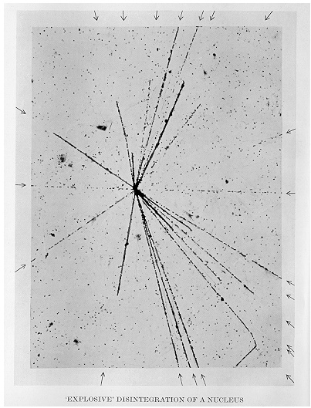
Nuclear Emulsion
Film played an important role in the
discovery of radioactivity but was first seen
as a means of studying radioactivity rather
than photographing individual particles.
Between 1923 and 1938 Marietta Blau
pioneered the nuclear emulsion technique.
E.g.
Emulsions were exposed to cosmic rays
at high altitude for a long time (months)
and then analyzed under the microscope.
In 1937, nuclear disintegrations from cosmic
rays were observed in emulsions.
The high density of film compared to the
cloud chamber ‘gas’ made it easier to see
energy loss and disintegrations.

Slide 23
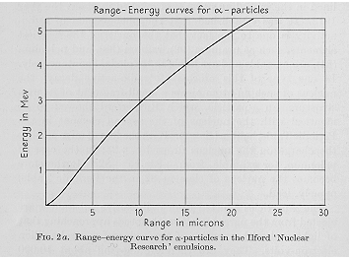
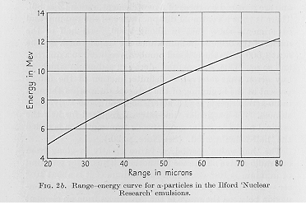
Nuclear Emulsion
In 1939 Cecil Powell called the emulsion
‘equivalent to a continuously sensitive
high-pressure expansion chamber’.
A result analog to the cloud chamber
can be obtained with a picture 1000x
smaller (emulsion density is about 1000x
larger than gas at 1 atm).
Due to the larger ‘stopping power’ of
the emulsion, particle decays could be
observed easier.
Stacks of emulsion were called
‘emulsion chamber’.

Slide 24
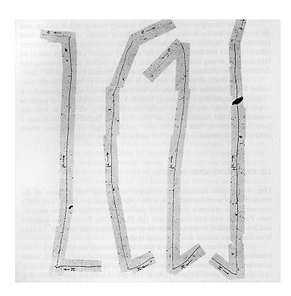
Nuclear Emulsion
Discovery of the Pion:
The muon was discovered in the 1930ies
and was first believed to be Yukawa’s meson
that mediates the strong force.
The long range of the muon was however
causing contradictions with this hypothesis.
In 1947, Powell et. al. discovered the
Pion in Nuclear emulsions exposed to
cosmic rays, and they showed that it decays
to a muon and an unseen partner.
The constant range of the decay muon indicated a
two body decay of the pion.
Discovery of muon and pion

Slide 25
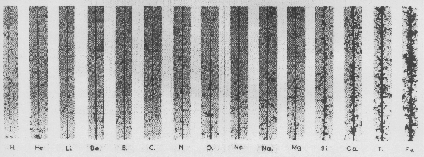
Nuclear Emulsion
Energy Loss is proportional to Z² of the particle
The cosmic ray composition was studied by putting detectors on balloons flying at high altitude.

Slide 26
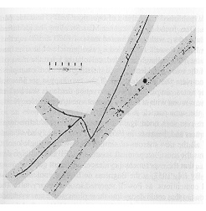
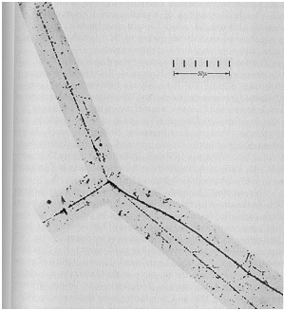
Nuclear Emulsion
First evidence of the decay of the Kaon into 3 Pions was found in 1949.
Pion
Kaon
Pion
Pion

Slide 27
Particles in the mid 50ies
By 1959: 20 particles
e⁻ : fluorescent screen
n : ionization chamber
7 Cloud Chamber: 6 Nuclear Emulsion:
e⁺ π⁺, π ⁻
μ⁺, μ⁻ anti-Λ⁰
K⁰ Σ⁺
Λ⁰ K⁺ ,K⁻
Ξ⁻
Σ⁻
2 Bubble Chamber: 3 with Electronic techniques:
Ξ⁰ anti-n
Σ⁰ anti-p
π ⁰

Slide 28

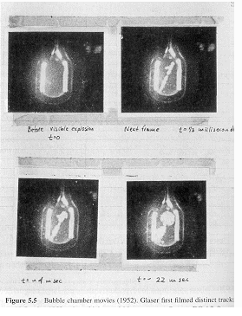
Bubble Chamber
In the early 1950ies Donald Glaser tried to build
on the cloud chamber analogy:
Instead of supersaturating a gas with a vapor
one would superheat a liquid. A particle
depositing energy along it’s path would
then make the liquid boil and form bubbles along
the track.
In 1952 Glaser photographed first Bubble chamber
tracks. Luis Alvarez was one of the main proponents
of the bubble chamber.
The size of the chambers grew quickly
1954: 2.5’’(6.4cm)
1954: 4’’ (10cm)
1956: 10’’ (25cm)
1959: 72’’ (183cm)
1963: 80’’ (203cm)
1973: 370cm

Slide 29
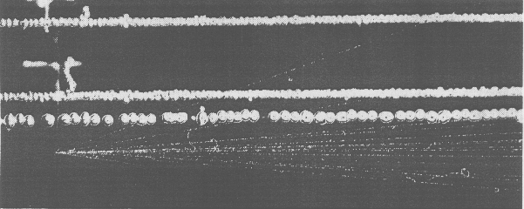
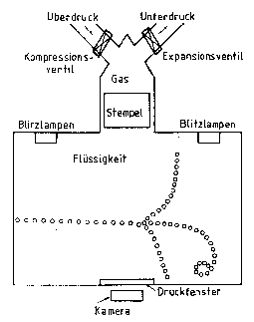
Bubble Chamber
‘old bubbles’
‘new bubbles’
Unlike the Cloud Chamber, the Bubble Chamber
could not be triggered, i.e. the bubble chamber
had to be already in the superheated state when
the particle was entering. It was therefore not
useful for Cosmic Ray Physics, but as in the 50ies
particle physics moved to accelerators it was
possible to synchronize the chamber compression
with the arrival of the beam.
For data analysis one had to look through millions
of pictures.

Slide 30
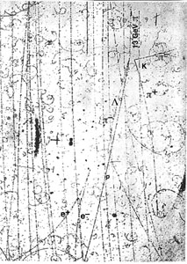
Bubble Chamber
In the bubble chamber, with a density about
1000 times larger that the cloud chamber, the
liquid acts as the target and the detecting
medium.
Figure:
A propane chamber with a magnet discovered the Σ° in 1956.
A 1300 MeV negative pion hits a proton to produce a neutral kaon and a Σ°, which decays into a Λ° and a photon.
The latter converts into an electron-positron pair.

Slide 31
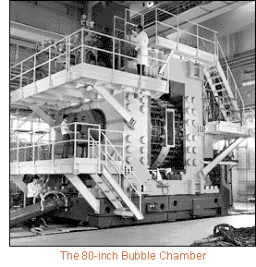
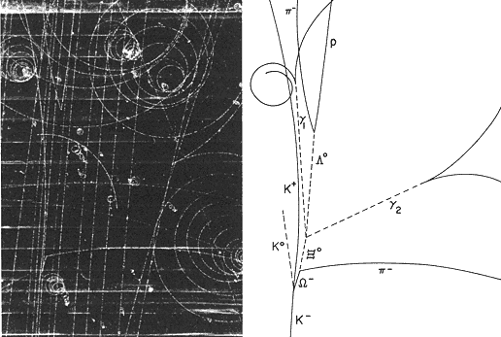
Bubble Chamber
BNL, First Pictures 1963, 0.03s cycle
Discovery of the Ω⁻ in 1964

Slide 32
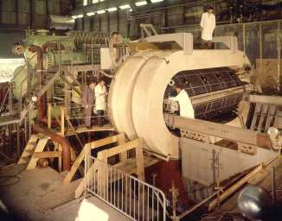
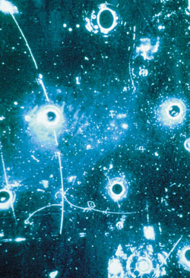
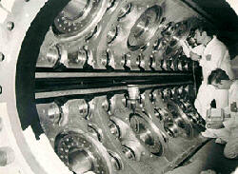
Bubble Chamber
Gargamelle, a very large heavy-liquid (freon) chamber constructed at Ecole Polytechnique in Paris, came to CERN in 1970.
It was 2 m in diameter, 4 m long and filled with Freon at 20 atm.
With a conventional magnet producing a field of almost 2 T, Gargamelle in 1973 was the tool that permitted the discovery of neutral currents.
Can be seen outside the Microcosm Exhibition

Slide 33
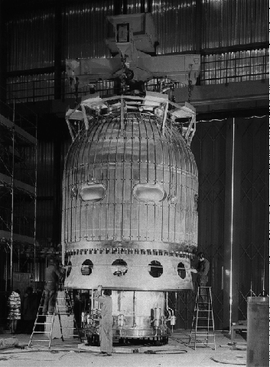
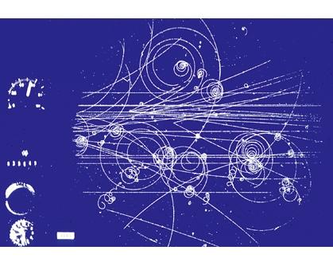
Bubble Chamber
3.7 meter hydrogen bubble chamber at CERN, equipped with the largest superconducting magnet in the world.
During its working life from 1973 to 1984, the "Big European Bubble Chamber" (BEBC) took over 6 million photographs.
Can be seen outside the Microcosm Exhibition

Slide 34
Bubble Chambers
The excellent position (5μm) resolution and the fact that target and detecting volume are the same (H chambers) makes the Bubble chamber almost unbeatable for reconstruction of complex decay modes.
The drawback of the bubble chamber is the low rate capability (a few tens/ second). E.g. LHC 10⁹ collisions/s.
The fact that it cannot be triggered selectively means that every interaction must be photographed.
Analyzing the millions of images by ‘operators’ was a quite laborious task.
That’s why electronics detectors took over in the 70ties.

Slide 35
Logic and Electronics

Slide 36
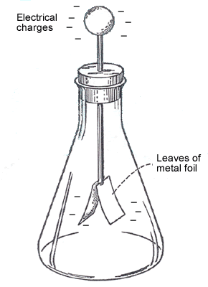
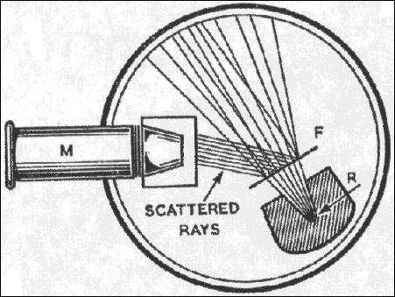
Early Days of ‘Logic Detectors’
Scintillating Screen:
Rutherford Experiment 1911, Zinc Sulfide screen was used as detector.
If an alpha particle hits the screen, a flash can be seen through the microscope.
Electroscope:
When the electroscope is given an electric charge the two ‘wings’ repel each other and stand apart.
Radiation can ionize some of the air in the electroscope and allow the charge to leak away, as shown by the wings slowly coming back together.
Victor Hess discovered the Cosmic Rays by taking an electroscope on a Balloon

Slide 37
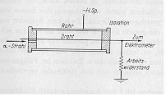
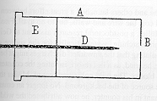
Geiger Rutherford
In 1908, Rutherford and Geiger
developed an electric device to
measure alpha particles.
The alpha particles ionize the gas, the
electrons drift to the wire in the electric
field and they multiply there, causing a
large discharge which can be measured
by an electroscope.
The ‘random discharges’ in absence of
alphas were interpreted as ‘instability’, so
the device wasn’t used much.
As an alternative, Geiger developed the
tip counter, that became standard for
radioactive experiments for a number
of years.
Rutherford and Geiger 1908
Tip counter, Geiger 1913

Slide 38
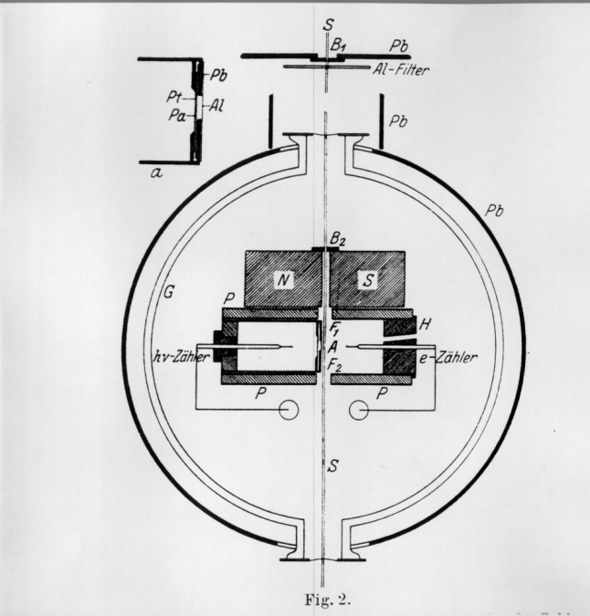
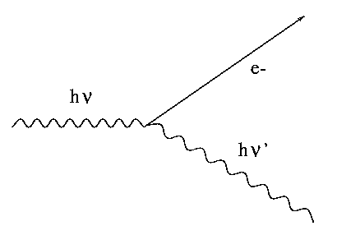
Detector + Electronics 1925
‘Über das Wesen des Compton Effekts’
W. Bothe, H. Geiger, April 1925
Bohr, Kramers, Slater Theory:
Energy is only conserved statistically
testing Compton effect
‘ Spitzenzähler ’

Slide 39
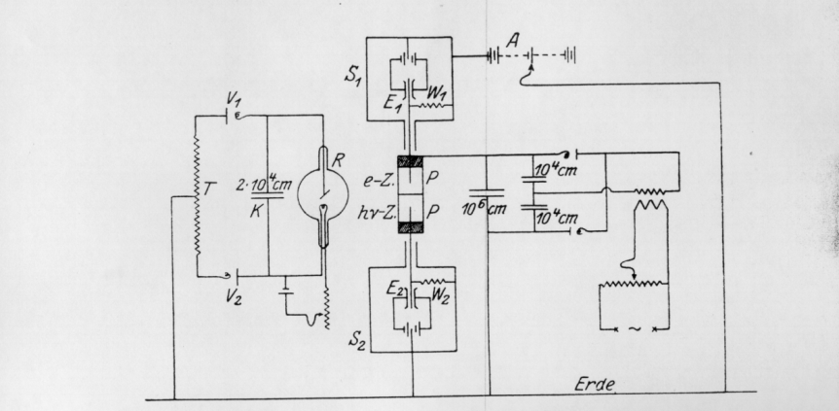
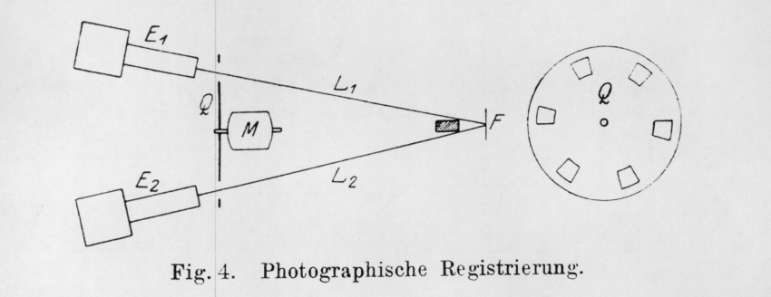
Detector + Electronics 1925
‘Über das Wesen des Compton Effekts’, W. Bothe, H. Geiger, April 1925
‘’Electronics’’:
  Cylinders ‘P’ are on HV.
  The needles of the counters are insulated and connected to electrometers.
Coincidence Photographs:
  A light source is projecting both electrometers on a moving film role.
  Discharges in the counters move the electrometers , which are recorded on the film.
  The coincidences are observed by looking through many meters of film.

Slide 40
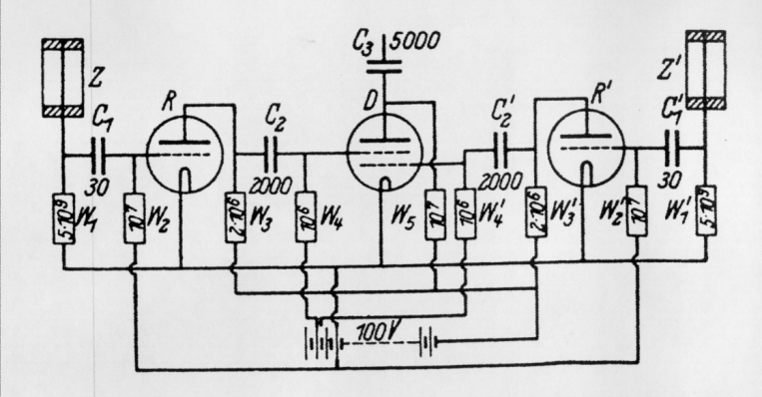
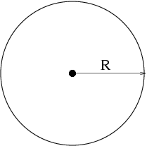
Detector + Electronics 1929
In 1928 Walther Müller started
to study the sponteneous
discharges systematically and
found that they were actually caused
by cosmic rays discovered by
Victor Hess in 1911.
By realizing that the wild discharges
were not a problem of the counter, but
were caused by cosmic rays, the
Geiger-Müller counter went, without
altering a single screw from a device with
‘fundametal limits’ to the most sensitive
intrument for cosmic rays physics.
‘Zur Vereinfachung von Koinzidenzzählungen’
W. Bothe, November 1929
Coincidence circuit for 2 tubes

Slide 41
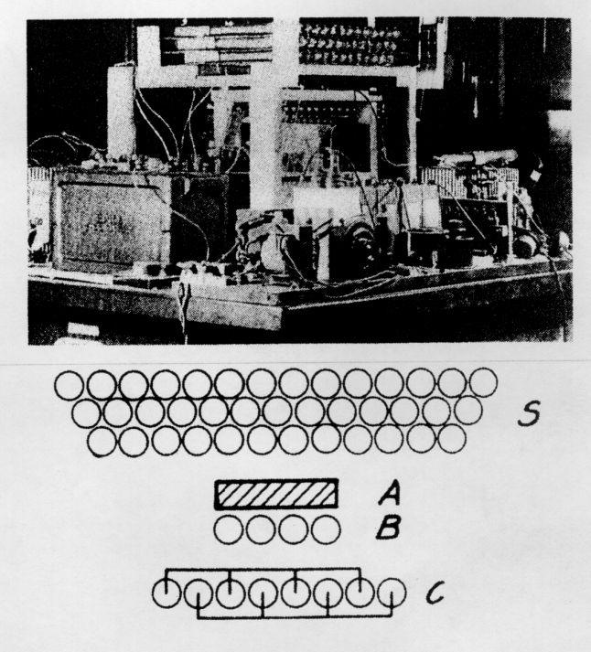
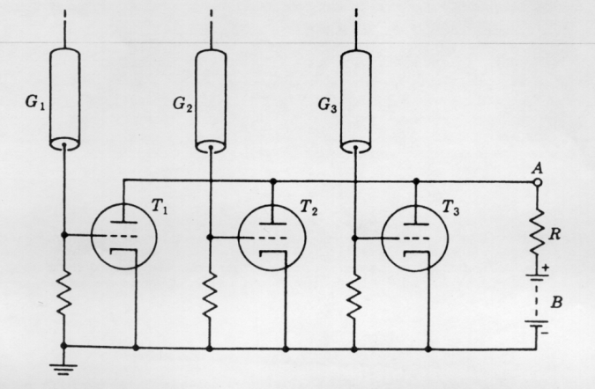
1930 - 1934
Cosmic ray telescope 1934
Rossi 1930: Coincidence circuit for n tubes

Slide 42
Geiger Counters
By performing coincidences of Geiger Müller tubes e.g. the angular distribution of cosmic ray particles could be measured.

Slide 43
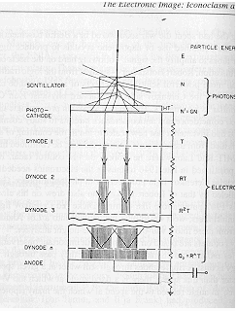

Scintillators, Cerenkov light, Photomultipliers
In the late 1940ies, scintillation counters and Cerenkov counters exploded into use.
Scintillation of materials on passage of particles was long known.
By mid 1930 the bluish glow that accompanied the passage of
radioactive particles through liquids was analyzed and largely explained
(Cerenkov Radiation).
Mainly the electronics revolution begun during the war initiated this development.
High-gain photomultiplier tubes, amplifiers, scalers, pulse-height analyzers.

Slide 44

Antiproton
One was looking for a negative particle with the mass of the proton. With a bending magnet, a certain particle momentum was selected (p=mvγ).
Since Cerenkov radiation is only emitted if v>c/n, two Cerenkov counters (C1, C2) were set up to measure a velocity comparable with the proton mass.
In addition the time of flight between S1 and S2 was required to be between 40 and 51ns, selecting the same mass.

Slide 45

Anti Neutrino Discovery 1959
Reines and Cowan experiment principle consisted in using a target made of around 400 liters of a mixture of water and cadmium chloride.
The anti-neutrino coming from the nuclear reactor interacts with a proton of the target matter, giving a positron and a neutron.
The positron annihilates with an electron of the surrounding material, giving two simultaneous photons and the neutron slows down until it is eventually captured by a cadmium nucleus, implying the emission of photons some 15 microseconds after those of the positron annihilation.
ν + p ➔ n + e⁺

Slide 46


Spark Counters
The Spark Chamber was developed in the early 60ies.
Schwartz, Steinberger and Lederman used it in
discovery of the muon neutrino
A charged particle traverses the detector and leaves an ionization trail.
The scintillators trigger an HV pulse between the metal plates and sparks form in the place where the ionization took place.

Slide 47


Multi Wire Proportional Chamber
Tube, Geiger- Müller, 1928
Multi Wire Geometry, in H. Friedmann 1949
G. Charpak 1968, Multi Wire Proportional Chamber,
readout of individual wires and proportional mode working point.

Slide 48
MWPC
Individual wire readout: A charged particle traversing the detector
leaves a trail of electrons and ions. The wires are on positive HV.
The electrons drift to the wires in the electric field and start to form an
avalanche in the high electric field close to the wire. This induces a signal on
the wire which can be read out by an amplifier.
Measuring this drift time, i.e. the time between passage of the particle and
the arrival time of the electrons at the wires, made this detector a precision
positioning device.

Slide 49
The Electronic Image
During the 1970ies, the Image and Logic devices merged into
‘Electronics Imaging Devices’

Slide 50
W, Z-Discovery 1983/84
UA1 used a very large
wire chamber.
Can now be seen in the CERN Microcosm Exhibition
This reconstruction shows the tracks of charged particles from the proton-antiproton collision. The two white tracks reveal the Z's decay. They are the tracks of a high-energy electron and positron.

Slide 51

LEP 1988-2000
All Gas Detectors

Slide 52

LEP 1988-2000
Aleph Higgs Candidate Event: e⁺ e⁻ → HZ → bb + jj

Slide 53



Increasing Multiplicities in Heavy Ion Collisions
e+ e- collision in the ALEPH Experiment/LEP.
Au+ Au+ collision in the STAR Experiment/RHIC
Up to 2000 tracks
Pb+ Pb+ collision in the ALICE Experiment/LHC
Up to 10 000 tracks/collision

Slide 54

ATLAS at LHC
Large Hadron Collider at CERN.
The ATLAS detector uses more than 100 million detector channels.

Slide 55





Slide 56

CMS Experiment at LHC

Slide 57


“CERN should undertake design studies for accelerator projects in a global context, with emphasis on proton-proton and electron- positron high-energy frontier machines.”
today
Project
Kick-off meeting: 11th Nov. 2013 (Daresbury)
FCC Study : p-p towards 100 TeV
Kick-off meeting: mid-February 2014
FCC: Frontier Circular Colliders

Slide 58

Future Circular Hadron Collider (FCC-hh)
LHC 14TeV 27km
FCC 100TeV 100km
→ Dipole Magnets from 8T to 16T

Slide 59





CMS & ATLAS
@ LHC
Future Circular Hadron Collider Detector Concepts
Twin Solenoid + Dipole, BL² scaled
Tracker r=2.5m p_{t} reso 15% at 10TeV
12 lambda ECAL+HCAL =1m+2.5m
Coil R=6m, 6T, Shielding Coil
Forward Dipole 10Tm
Tracker
Emcal
Hcal
Muon
Coil
TAS
Triplet
Toroid + Dipole, BL² scaled
Tracker r=2.5m p_{t} reso 15% at 10TeV
Thin Coil R= 2.5m, B= 4T
12 lambda ECAL+HCAL =1m+2.5m
Muon Toroid
Forward Dipole 10Tm
CMS+, resolution scaled
Tracker r=1.2m p_{t} reso 15% at 10TeV
12 lambda ECAL+HCAL =0.6m+2.2m
Coil R=4m
Iron Return Yoke
→ Extreme detector technology push
FCC 100TeV detectors

Slide 60

Future Circular Hadron Collider Detector Concepts
H. ten Kate et al.

Slide 61
Summary
Particle physics, ‘born’ with the discovery of radioactivity and the electron at the end of the 19th century, has become ‘Big Science’ during the last 100 years.
A large variety of instruments and techniques were developed for studying the world of particles.
Imaging devices like the cloud chamber, emulsion and the bubble chamber took photographs of the particle tracks.
Logic devices like the Geiger Müller counter, the scintillator or the Cerenkov detector were (and are) widely used.
Through the electronic revolution and the development of new detectors, both traditions merged into the ‘electronics image’ in the 1970ies.
Particle detectors with over 100 million readout channels are operating at this moment at the LHC.
Substantial activities to develop detector technologies for the HL-LHC Upgrade and for future collider detectors are under way.

