Slide 1
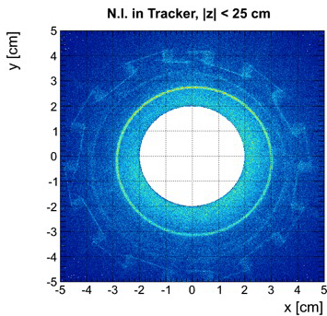
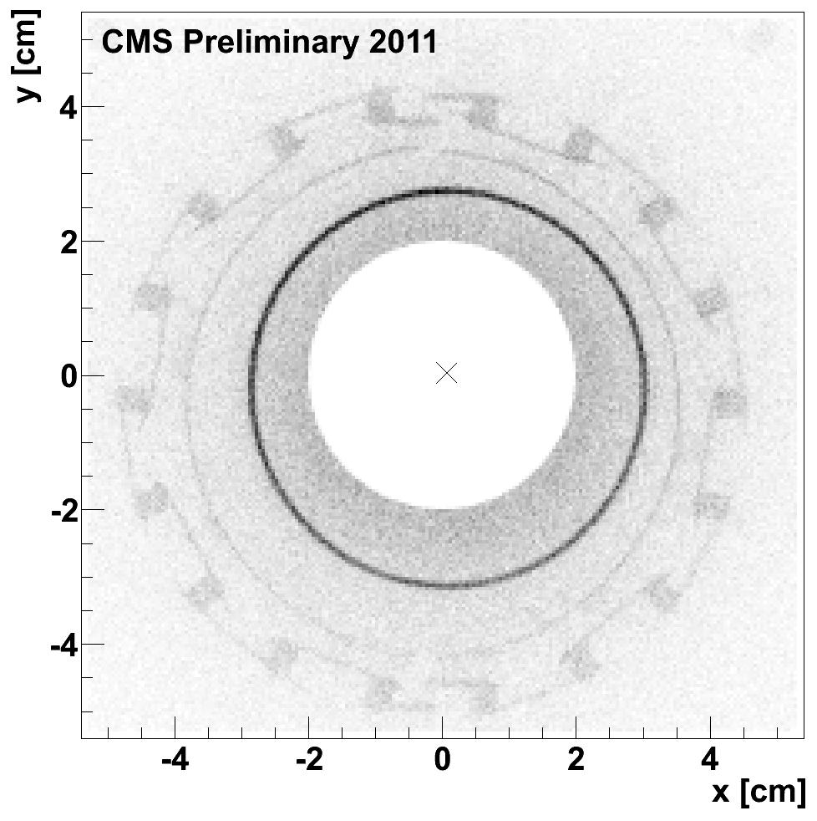
Position of the Central beam pipe of CMS
The CMS offline coordinate system coincides with the surveyer’s m.s.
Using nuclear interaction we measured the following displacement of the central beam pipe
|Z| < 25 cm
X = +0.9 ± 0.2 mm
Y = - 2.0 ± 0.2 mm
|Z| < 25 cm
X = +0.9 ± 0.2 mm
Y = - 2.0 ± 0.2 mm
2012
G.Sguazzoni
N.Pozzobon
https://indico.cern.ch/getFile.py/access?contribId=18&sessionId=13&resId=6&materialId=slides&confId=151886
https://indico.cern.ch/event/243949/session/2/contribution/6/material/slides/0.pdf

Slide 2
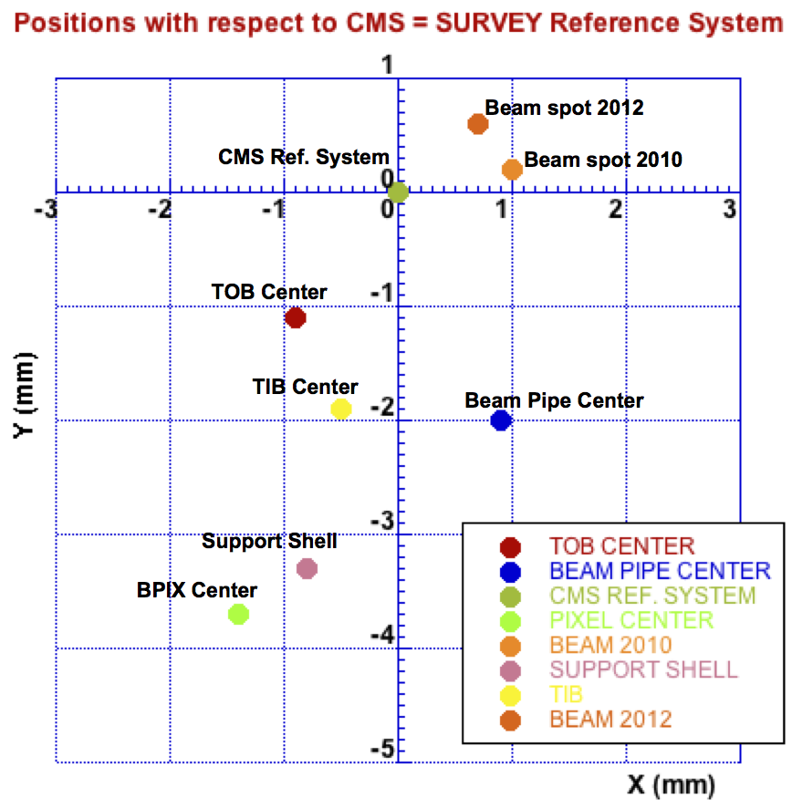
SUMMARY FROM OFFLINE MESUREMENTS
Old beam pipe position
BPIX will be shimmed up by 3mm
Pixel Support Tube

Slide 3
SUMMARY FROM SURVEY MESUREMENTS (2013)
The 2013 Y position of the pipe from survey measurements at the collars (±1.6m) seems to be consistent with nuclear interaction analysis results.
Also the X position seems consistent (taking the average of the survey results).
NB: The old beam pipe was “counter-sagging”
-2.0
-2.6
-2.1
Y
-3.8
-3.6
+0.9
2.1
1.3
X
0.6
0.5
NB: survey measurements taken after FPIX re-installation in 2009 differ from 2013 data but in principle nothing was done in between

Slide 4
NEW BEAM PIPE MEASUREMENTS (2014)
TARGET X=0
TARGET Y= +0.5
NB: At the 3.1m flange the position of the NEW beam pipe is 4.2mm higher than the OLD pipe

Slide 5
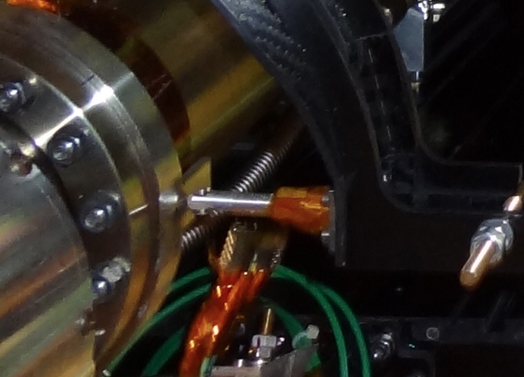
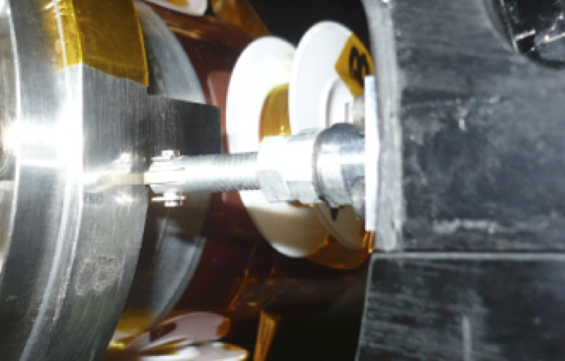
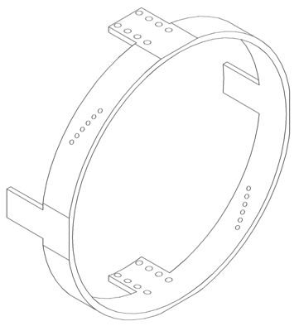
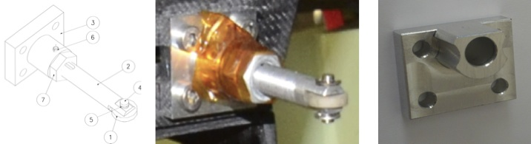
NEW BEAM PIPE MEASUREMENTS (2014)
OLD beam pipe with OLD horizontal support
NEW beam pipe with OLD horizontal support
Old support
New support
Width is 15mm
Up by 5mm

Slide 6
My Conclusions
The position of the new beam pipe is correct and the difference is due to a “wrong” position of the old pipe. This difference is 4.2 to 4.4 mm and is fully explained by the survey measurements.
Why was the old beam pipe left so low ? Perhaps academic, what is more relevant is WHY the carbon fiber support structure at 3.1-3.5 meters (fishing rods) seem also low ? Is this because the Pixel support tube is low by 3.3mm ?
The new horizontal support pieces will re-position the support in the middle of the flat piece of the collar.
Need to re-work one of the carbon fiber disk at 3.1m because it doesn’t fit well now (indicating that the fishing rods are now lower than they should be to be compatible with the (0,0) position of the pipe)
Do we want to re-measure the floor position ?

Slide 7
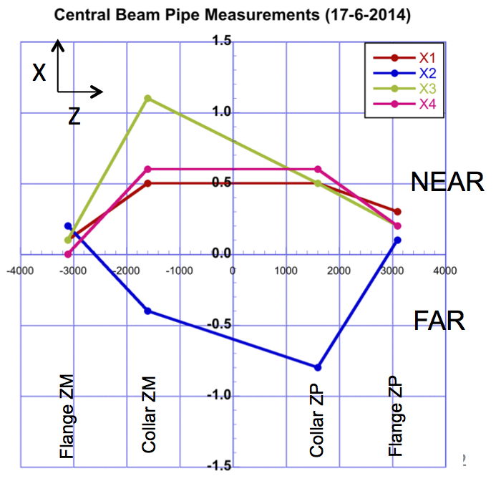
Previous Measurement
Nominal position. All horizontal wires attached. Measure each wire tension.
NEAR (+X) horizontal wires removed.
NEAR and FAR horizontal wires removed.
Back with ALL horizontal wires attached with the nominal tension.

Slide 8
Proposed Program for the measurement of the Central Beam Pipe
Measure/adjust the beam pipe at ±3.1m and ±1.6m at both ends. Target is X=0mm, Y=+0.5mm minimizing the horizontal wires tension and record these values .
Release the horizontal wires and put them back with the same tension and re-measure the beam pipe (both ends).
Release the horizontal wires and remove the carbon fiber disks (one at the time) at ±3.1m replacing them with the slim temporary brackets. This process should leave the flange in the same location. Measure the position of the ±3.1m flange.
NB: For the installation of the Phase I Pixel Upgrade detector the idea is to release the horizontal wires at both ends and replace the carbon fiber disks with the temporary brackets at both ends. Install BPIX, and both FPIXs then re-install the carbon fiber disks and horizontal wires (without the bottom part for PLT/BCM installation).

Slide 9
Proposed Program for the measurement of the Central Beam Pipe
Measure/adjust the beam pipe at ±3.1m and ±1.6m at both ends. Target is X=0mm, Y=+0.5mm minimizing the horizontal wires tension and record these values .
Release the horizontal wires and put them back with the same tension and re-measure the beam pipe (both ends).
Release the horizontal wires and remove the carbon fiber disks (one at the time) at ±3.1m replacing them with the slim temporary brackets. This process should leave the flange in the same location. Measure the position of the ±3.1m flange.
Insert the PSI measuring tool and confirm the position of the beam pipe with respect to the BPIX rail system (both sides of the –Z end).
Play with the adjustments and insert the BPIX mock-up in its final location from the –Z end (though no BPIX supply tube available). Survey its final position.
Remove the temporary brackets at -3.1m and place the carbon fiber ring and the horizontal wires as calibrated during step 2. Inspect any movement of the pipe (via a camera?).
Repeat step 6 this time removing the horizontal wires/carbon fiber disks at -3.1m and replace them with the temporary brackets.

Slide 10
Proposed Program for the measurement of the Central Beam Pipe
Steps 1 and 2 are needed in order to re-establish the correct position of the central beam pipe and the impact of the horizontal wires.
Step 3 may need to be repeated and it is aimed at testing the technique of replacing the horizontal wires/carbon fiber support disks at 3.1m without changing the position of the beam pipe at the flange.
Step 4 verifies that the beam pipe is in a good location also from the rails reference frame point of view, which is ultimately the one that counts for installation.
Step 5 is the rehearsal of the BPIX installation, adjusted in X and Y to take into account the measurements taken during step 4. Survey the final position of the BPIX mock-up.
Steps 6,7 are aimed at verifying that during the carbon fibers to temporary brackets (and vice-versa) transferring process (exercised during step 3) the clearance (only 2.5 mm) of the pipe to the inner bore of BPIX is not compromised. We could install a camera watching the pipe to BPIX clearance during the operations at the flange. Notice that we exist step 7 with the temporary brackets installed ready for the later installation of the present BPIX.

Slide 11
BACK UP

Slide 12
Pixel Support Tube
By nuclear interaction measurements the Pixel support tube was measured to be low by 3.4 mm
Pixel Support Tube
|Z| < 25 cm
X=-0.8mm; Y=-3.3mm
N.Pozzobon
https://indico.cern.ch/event/239872/contribution/3/material/slides/0.pdf

Slide 13
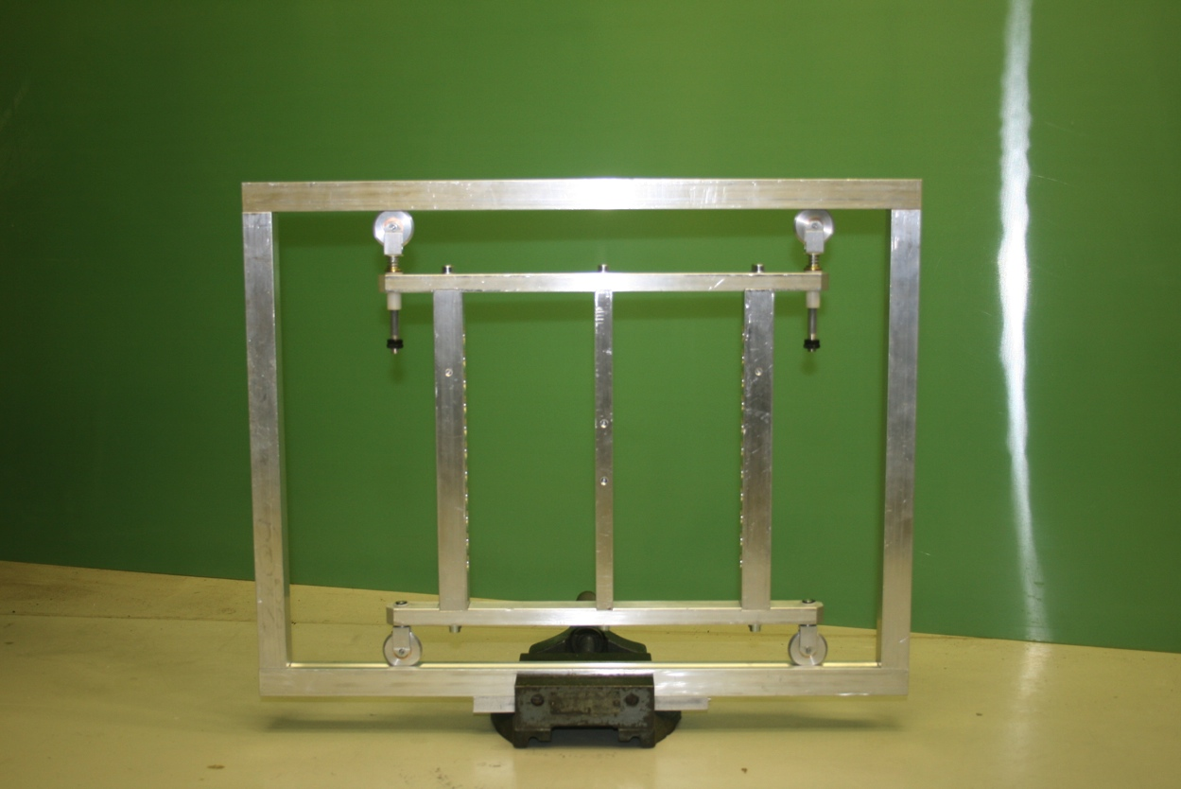
Pixel Support Tube
With the tool fabricated to survey the position of the rails inside the Pixel support tube, the rails were measured to be at Y = -3.4 mm, consistent with the nuclear interaction measurements (see next slides for details).

Slide 14
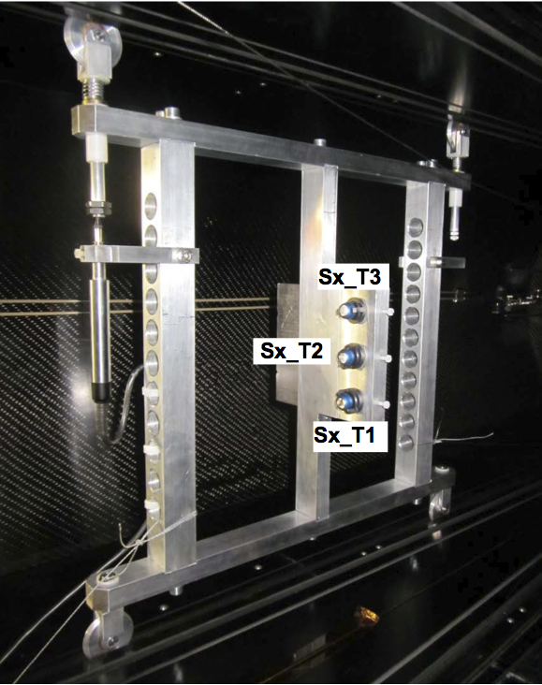
Pixel support tube position
Using a specially designed tool, measurement of the parallelism and absolute position of the BPIX rails were performed on May 30, 2013. A draft document was submitted in October 2013:
mailto:https://cms-docdb.cern.ch/cgi-bin/DocDB/RetrieveFile%3Fdocid=12177%26version=1%26filename=131030_Rail_Pix_Support_Tube_DRAFT.pdf
Within measurement accuracy rails are parallel to the beam line reference system (i.e. the center position T2 in Y, vertical coordinate stays within +/- 0.3 mm along the whole length on the pixel support tube)
The absolute value of the Y coordinate system of T2 is measured to be Y= -10.4 mm
The tool itself was then surveyed on December 4, 2013 and the report submitted on December 13, 2013:
mailto:https://edms.cern.ch/document/1336659/1
Pixel support tube measurement tool

Slide 15
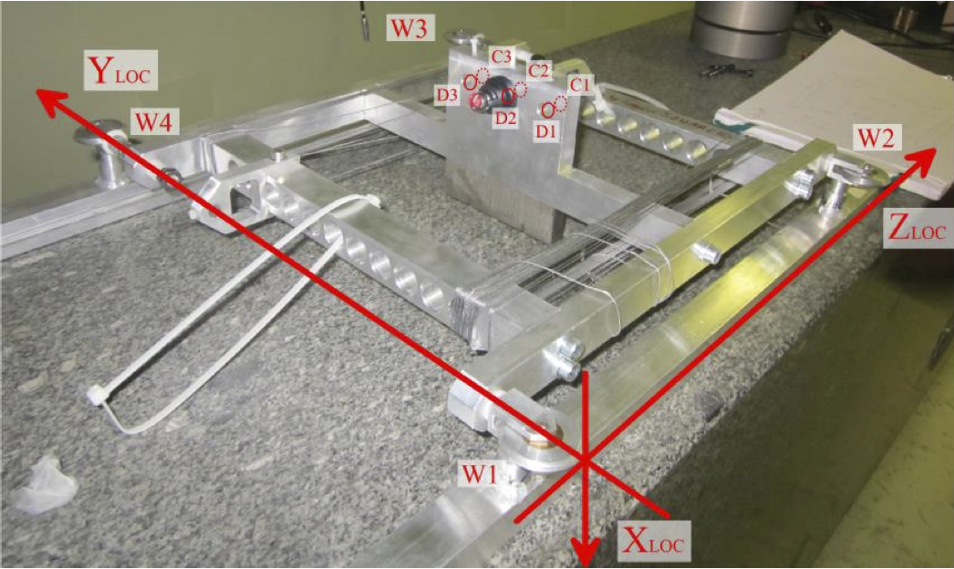
Pixel support tube position
The position of the middle target T2 (now called C2) was measured with respect to the edge of the bottom wheel in local coordinate system defined as in the picture below.
The Y (vertical) position of the middle target with respect to the edge of the bottom wheel is measured to be 197mm
The distance between the two flat planes of the Pixel support tube is 388 +/- 0.2 mm, hence its median lies at 194mm.
The groove the reference wheel travels in is 10mm deep.
If the median of the pixel support tube was to coincide with the beam line (ideal case) we should have measured:
194 – (197 – 10) = -7mm
Since instead we measured -10.4mm, it means that the pixel support tube is 3.4mm below the beam line.
Local coordinate system definition for the survey of the measurement tool used during the Pixel support tube survey of May 2013
FPIX
BPIX
7mm
10mm
Groove depths in the Pixel support tube

Slide 16
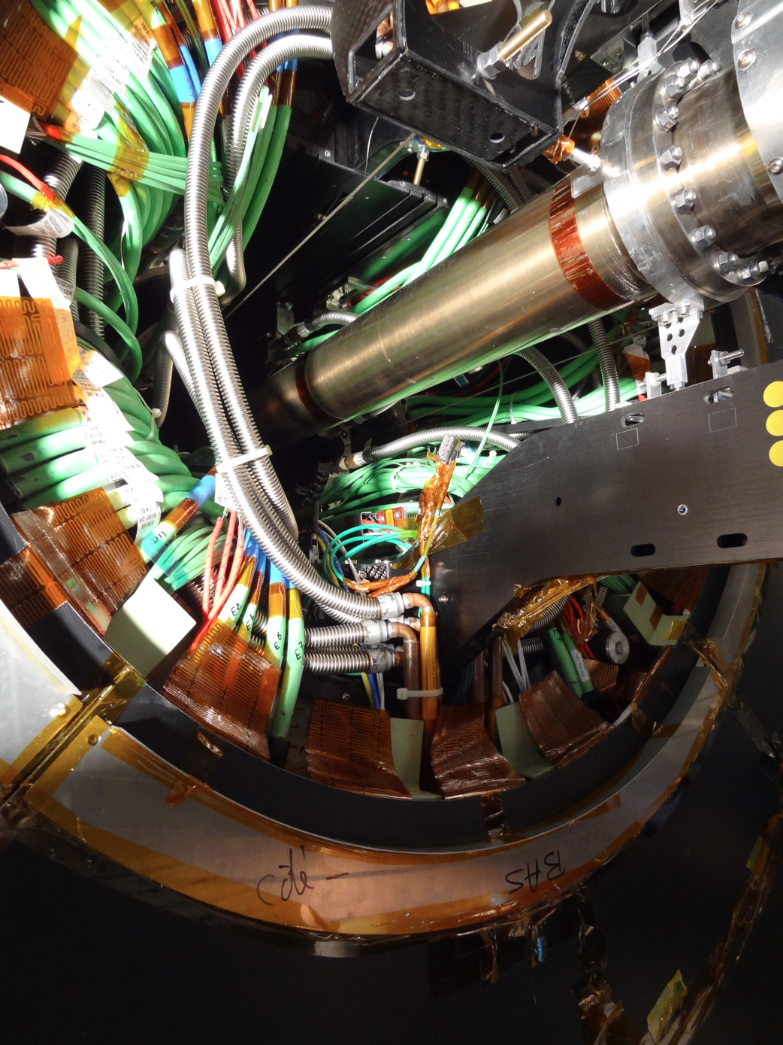
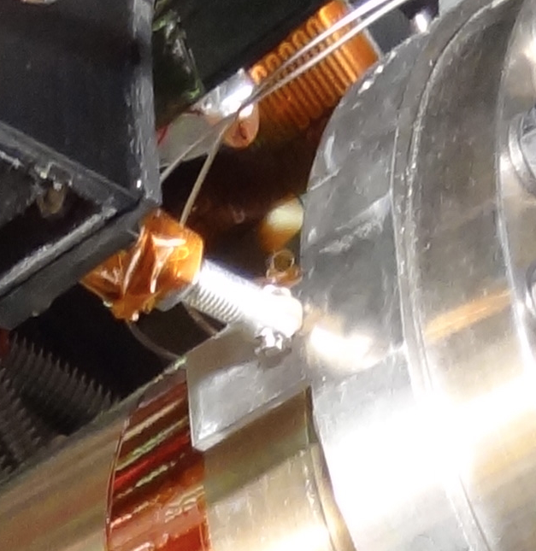
-Z end, May 3 2013. Before BCM extraction
-Z end NEAR

Slide 17
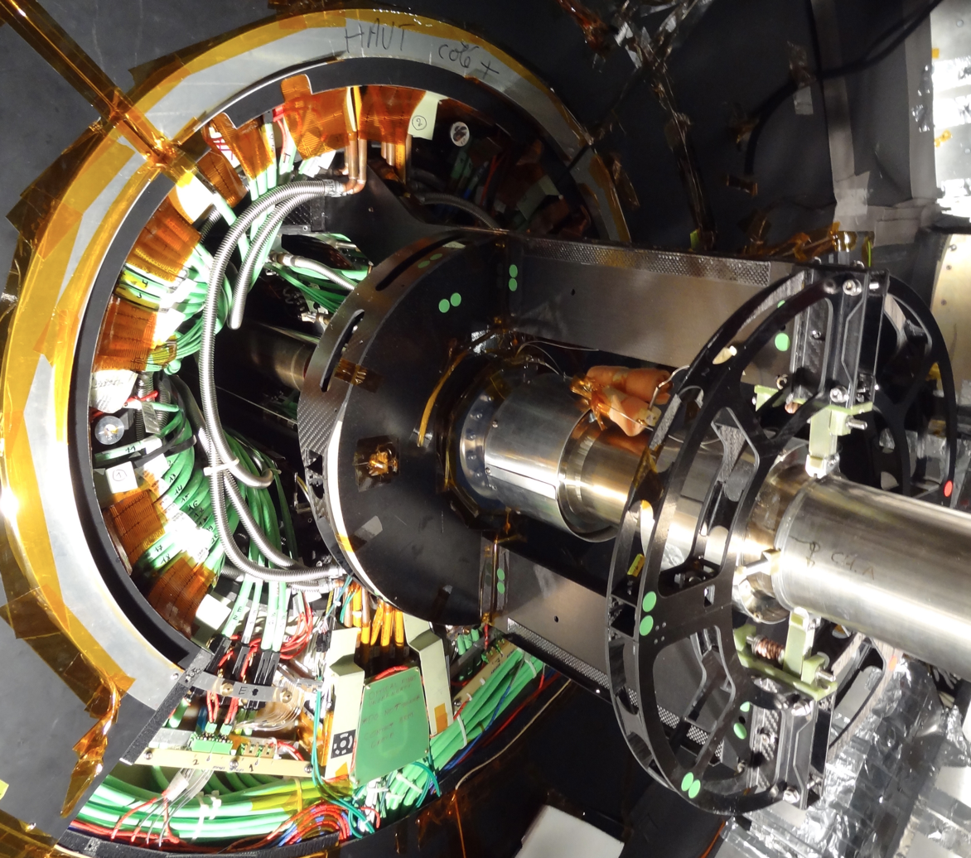
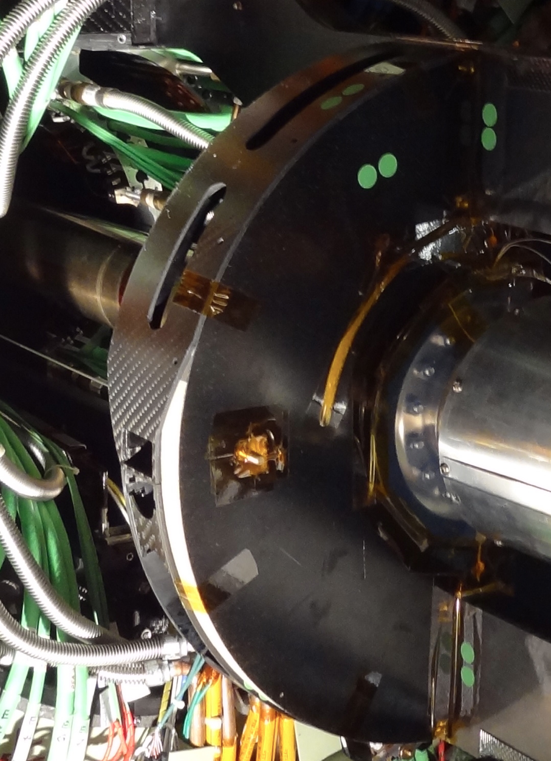
+Z end, May 3 2013. Before BCM extraction

Slide 18
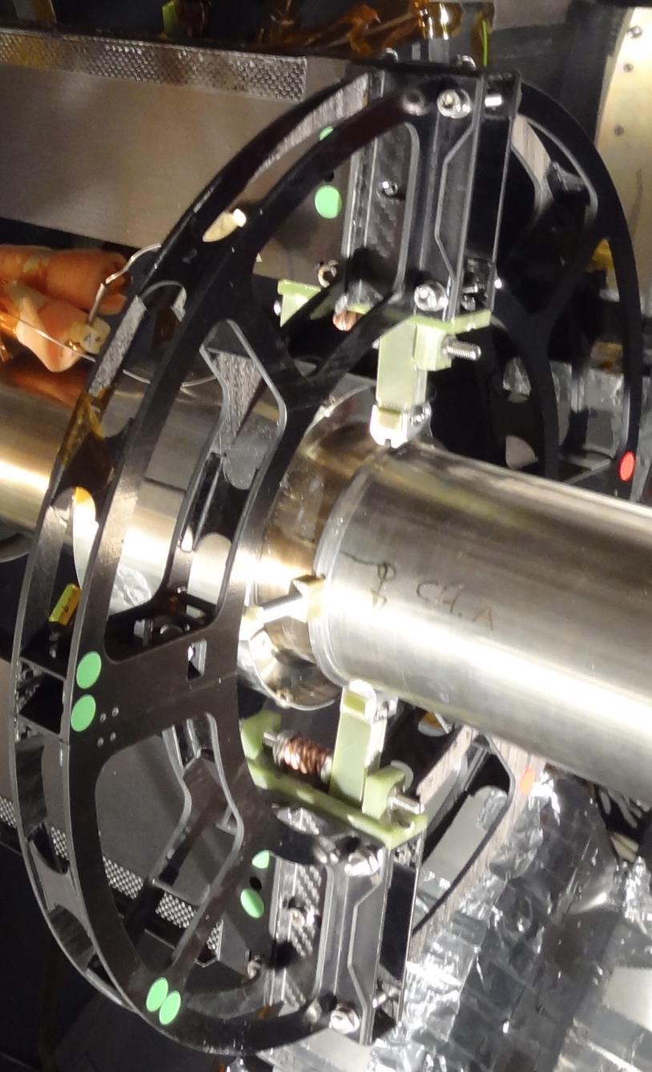
The 3.5m support seen from the +Z end

Slide 19
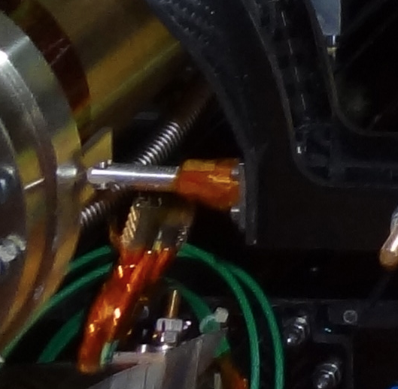
+Z NEAR
-Z end NEAR

